Slide 1
Module 01: Creating Azure App Service Web Apps

Slide 2
Topics
Azure App Service core concepts
Creating an Azure App Service Web App
Configuring and Monitoring App Service apps
Scaling App Service apps
Azure App Service staging environments
Notes:
These are the topics that will be covered in this module.

Slide 3
Lesson 01: Azure App Service core concepts

Slide 4
Azure shared responsibility model
You Manage
Cloud Provider Manages
On-Premises
( Private Cloud )
Infrastructure
( as a Service )
Platform
( as a Service )
Software
( as a Service )
Data & Access
Data & Access
Data & Access
Data & Access
Applications
Applications
Applications
Applications
Runtime
Runtime
Runtime
Runtime
Operating System
Operating System
Operating System
Operating System
Virtual Machine
Virtual Machine
Virtual Machine
Virtual Machine
Compute
Compute
Compute
Compute
Networking
Networking
Networking
Networking
Storage
Storage
Storage
Storage
Notes:
As you consider and evaluate public cloud services, it’s critical to understand the shared responsibility model and which security tasks are handled by the cloud provider and which tasks are handled by you. The workload responsibilities vary depending on whether the workload is hosted on Software as a Service (SaaS), Platform as a Service (PaaS), Infrastructure as a Service (IaaS), or in an on-premises datacenter. For all cloud deployment types, you own your data and identities. You are responsible for protecting the security of your data and identities, on-premises resources, and the cloud components you control (which varies by service type).
Regardless of the type of deployment, the following responsibilities are always retained by you:
Data
Endpoints
Account
Access management

Slide 5
App Service
Service for hosting web applications, REST APIs, and mobile backends can be developed in many of the following languages:
Applications can execute and scale in a fully managed, sandbox environment
.NET
Java
Ruby
Node.JS
PHP
Python
Notes:
Azure App Service not only adds the power of Microsoft Azure to your application, such as security, load balancing, autoscaling, and automated management. You can also take advantage of its DevOps capabilities, such as continuous deployment from VSTS, GitHub, Docker Hub, and other sources; and package management, staging environments, custom domain, and SSL certificates.
With App Service, you pay for the Azure compute resources that you use. The compute resources you use is determined by the App Service plan that you run your apps on.

Slide 6
Web Apps
Scalable hosting for web applications:
Provides a quick way to host your web application in the cloud
Allows you to scale your web app without being required to redesign for scalability
Integrates with Visual Studio
Provides an open platform for many different programming languages
Advantages:
Near instant deployment
SSL and Custom Domain Names available in some tiers
WebJobs provide background processing for independent scaling
Can scale to larger machines without redeploying applications
Notes:
Azure App Service Web Apps (or just Web Apps) is a service for hosting web applications, REST APIs, and mobile backends. You can develop in your favorite language, be it .NET, Java, Ruby, Node.js, PHP, or Python. Applications run and scale with ease on Windows-based environments.

Slide 7
Key features of App Service Web Apps
Multiple languages and frameworks:
First-class support for Microsoft ASP.NET, Java, Ruby, Node.js, PHP, or Python
DevOps optimization:
Continuous integration and deployment with Azure DevOps, GitHub, Bitbucket, Docker Hub, or Azure Container Registry
Global scale with high availability:
Scale up or out manually or automatically. Host anywhere in the Microsoft global datacenter infrastructure
Connections to SaaS platforms and on-premises data:
More than 50 connectors for enterprise systems (such as SAP), SaaS services (such as Salesforce), and internet services (such as Facebook)
Notes:
Multiple languages and frameworks
Web Apps has first-class support for ASP.NET, Java, Ruby, Node.js, PHP, or Python. You can also run PowerShell and other scripts or executables as background services.
DevOps optimization
Set up continuous integration and deployment with Visual Studio Team Services, GitHub, BitBucket, Docker Hub, or Azure Container Registry. Promote updates through test and staging environments. Manage your apps in Web Apps by using Azure PowerShell or the cross-platform command-line interface (CLI).
Global scale with high availability
Scale up or out manually or automatically. Host your apps anywhere in Microsoft's global datacenter infrastructure, and the App Service SLA promises high availability.
Connections to SaaS platforms and on-premises data
Choose from more than 50 connectors for enterprise systems (such as SAP), SaaS services (such as Salesforce), and internet services (such as Facebook). Access on-premises data using Hybrid Connections and Azure Virtual Networks.

Slide 8
Key features of App Service Web Apps (cont.)
Security and compliance:
App Service is ISO, SOC, and PCI compliant
Application templates:
Templates in the Azure Marketplace, such as WordPress, Joomla, and Drupal
Visual Studio integration:
Streamline the work of creating, deploying, and debugging
API and mobile features:
Turn-key Cross-Origin Resource Sharing (CORS) support for RESTful API scenarios, and enables authentication, offline data sync, push notifications, and more
Serverless code:
Run code on-demand without having to explicitly provision or manage infrastructure
Notes:
Security and compliance
App Service is ISO, SOC, and PCI compliant. Authenticate users with Azure Active Directory or with social login (Google, Facebook, Twitter, and Microsoft). Create IP address restrictions and manage service identities.
Application templates
Choose from an extensive list of application templates in the Azure Marketplace, such as WordPress, Joomla, and Drupal.
Visual Studio integration
Dedicated tools in Visual Studio streamline the work of creating, deploying, and debugging.
API and mobile features
Web Apps provides turnkey CORS support for RESTful API scenarios, and simplifies mobile app scenarios by enabling authentication, offline data sync, push notifications, and more.
Serverless code
Run a code snippet or script on-demand without having to explicitly provision or manage infrastructure, and pay only for the compute time your code actually uses.

Slide 9
App Service plans
App Service plans can logically group apps within a subscription:
Characteristics such as features, capacity, and tiers are shared among the website instance in the group
The App Service plan is the unit of billing in most cases
Multiple App Service plans can exist in a single Resource Group and multiple apps can exist in a single App Service plan
Notes:
In App Service, an app runs in an App Service plan. An App Service plan defines a set of compute resources for a web app to run. These compute resources are analogous to the server farm in conventional web hosting. One or more apps can be configured to run on the same computing resources (or in the same App Service plan).
When you create an App Service plan in a certain region (for example, West Europe), a set of compute resources is created for that plan in that region. Whatever apps you put into this App Service plan run on these compute resources as defined by your App Service plan.

Slide 10
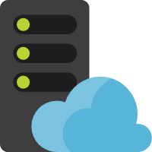

App Service plans (continued)
Web app
App Service plan
Web app
Web app
Notes:
Because you pay for the computing resources your App Service plan allocates, you can potentially save money by putting multiple apps into one App Service plan. You can continue to add apps to an existing plan as long as the plan has enough resources to handle the load. However, keep in mind that all the apps in an App Service plan share the same compute resources. To determine whether the new app has the necessary resources, you must understand the capacity of the existing App Service plan, and the expected load for the new app. Overloading an App Service plan can potentially cause downtime for your new and existing apps.

Slide 11
Authentication and authorization
Built-in authentication and authorization support:
No extra code required to make use of these features
User claims are made available to code:
If you wish to enhance the authentication support, you can use your existing code with popular identity frameworks:
ASP.NET Identity
PHP server variables
Built-in token store
Logging and tracing enabled for authentication events
Support for popular identity providers:
Azure Active Directory (Azure AD), Microsoft accounts, Facebook, Google, Twitter, more…
Notes:
Azure App Service provides built-in authentication and authorization support, so you can sign in users and access data by writing minimal or no code in your web app, API, and mobile backend, and also Azure Functions.
For all language frameworks, App Service makes the user's claims available to your code by injecting them into the request headers. For ASP.NET apps, App Service populates ClaimsPrincipal.Current with the authenticated user's claims, so you can follow the standard .NET pattern, including the [Authorize] attribute. Similarly, for PHP apps, App Service populates the _SERVER['REMOTE_USER'] variable.
App Service provides a built-in token store, which is a repository of tokens that are associated with the users of your web apps, APIs, or native mobile apps. When you enable authentication with any provider, this token store is immediately available to your app.
If you enable application logging, you will observe authentication and authorization traces directly in your log files. If you observe an authentication error that you didn’t expect, you can conveniently find all the details by examining your existing application logs. If you enable failed request tracing, you can review exactly what role the authentication and authorization module may have played in a failed request.
App Service uses federated identity, in which a third-party identity provider manages the user identities and authentication flow for you. Five identity providers are available by default:
Azure Active Directory /.auth/login/aad
Microsoft account /.auth/login/microsoftaccount
Facebook /.auth/login/facebook
Google /.auth/login/google
Twitter /.auth/login/twitter
When you enable authentication and authorization with one of these providers, its sign-in endpoint is available for user authentication and for validation of authentication tokens from the provider. You can provide your users with any number of these sign-in options with ease. You can also integrate another identity provider or your own custom identity solution.

Slide 12

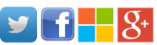


Authentication and authorization (Continued)
Configuration flows to the module via
Environment variables. Most of these settings Are read-only and some of them can be configured by the customer via App Settings.
App Service Web Worker VM(s)
All AuthN/AuthZ logic, including
Crypto for token validation and session management, executes in the worker sandbox and outside of the Web app code. Identity information Flows directly into the app code.
Sandbox
Web App Code
Environment
WEBSITE_AUTH_CLIENT_ID
WEBSITE_AUTH_OPENID_ISSUER
WEBSITE_AUTH_TRACE_LEVEL
WEBSITE_AUTH_TOKEN_STORE_ENABLED
WEBSITE_AUTH_DEFAULT_PROVIDER
HTTP_X_MS_CLIENT_PRINCIPL_NAME
HTTP_X_MS_CLIENT_PRINCIPAL_ID
Clients(s)
Browser
Native App
External Service
App Service
Front Ends
easyauth.dll
File Server
By default, state is managed centrally on the
Site’s storage volume. This includes the token
Store tokens, IIS logs and application traces.
It’s also possible to store these additional
artifacts in other places, such as Azure Storage.
Storage Volume
App
Content
IIS Logs
OAuth
Tokens
App
Logs
Notes:
The authentication and authorization module runs in the same sandbox as your application code. When it's enabled, every incoming HTTP request passes through it before being handled by your application code.
This module handles several things for your app:
Authenticates users with the specified provider
Validates, stores, and refreshes tokens
Manages the authenticated session
Injects identity information into request headers
The module runs separately from your application code and is configured by using app settings. No SDKs, specific languages, or changes to your application code are required.

Slide 13
Azure App Service Hybrid Connections
Enables access to resources in other networks:
Any operating system and any application
Hosted in other cloud networks, local networks, or even a specific machine
Correlates to a single TCP host and port combination
Service that is available in more than just App Service
Benefits:
Doesn’t require internet-facing endpoint
Web Apps can access on-premises systems securely
Does not require firewall changes in most scenarios
Framework and operating system agnostic
Notes:
Within App Service, Hybrid Connections can be used to access application resources in other networks. It provides access from your app to an application endpoint. It does not enable an alternate capability to access your application. As used in App Service, each Hybrid Connection correlates to a single TCP host and port combination. This means that the Hybrid Connection endpoint can be on any operating system and any application, provided you are accessing a TCP listening port. The Hybrid Connections feature does not know or care what the application protocol is, or what you are accessing. It is simply providing network access.
Hybrid Connections is both a service in Azure and a feature in Azure App Service. As a service, it has uses and capabilities beyond those that are used in App Service.
There are a number of benefits to the Hybrid Connections capability, including:
Apps can access on-premises systems and services securely.
The feature does not require an internet-accessible endpoint.
It is quick and easy to set up.
Each Hybrid Connection matches to a single host:port combination, which is helpful for security.
It normally does not require firewall holes. The connections are all outbound over standard web ports.
Because the feature is network level, it is agnostic to the language used by your app and the technology used by the endpoint.
It can be used to provide access in multiple networks from a single app.

Slide 14
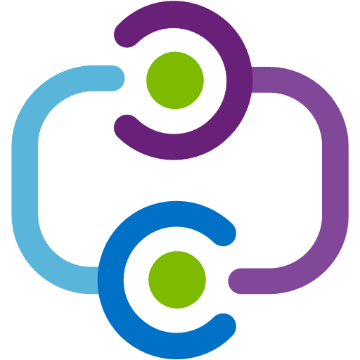


Azure App Service Hybrid Connections example
Web App
Relay hybrid
connection
Hybrid
Connection
Manager
Endpoint
Notes:
The Hybrid Connections feature consists of two outbound calls to Azure Service Bus Relay. There is a connection from a library on the host where your app is running in App Service. There is also a connection from the Hybrid Connection Manager (HCM) to Service Bus Relay. The HCM is a relay service that you deploy within the network hosting the resource that you are trying to access.
Through the two joined connections, your app has a TCP tunnel to a fixed host:port combination on the other side of the HCM. The connection uses TLS 1.2 for security and shared access signature (SAS) keys for authentication and authorization.
When your app makes a DNS request that matches a configured Hybrid Connection endpoint, the outbound TCP traffic will be redirected through the Hybrid Connection.

Slide 15
Controlling traffic by using Azure Traffic Manager
Routes requests from clients to apps in Azure
Keeps track of app status (running, stopped, deleted):
Will automatically route traffic away from an unavailable app
Configured by using profiles:
Stores the routing method for requests
Stores a list of endpoints (apps) to route requests to
Stores information about endpoint status
Notes:
You can use Azure Traffic Manager to control how requests from web clients are distributed to apps in Azure App Service. When App Service endpoints are added to an Azure Traffic Manager profile, Azure Traffic Manager keeps track of the status of your App Service apps (running, stopped, or deleted) so that it can decide which of those endpoints should receive traffic.
To configure the control of App Service app traffic, you create a profile in Azure Traffic Manager, and then add the endpoints (in this case, App Service) for which you want to control traffic to the profile. Your app status (running, stopped, or deleted) is regularly communicated to the profile so that Azure Traffic Manager can direct traffic accordingly.

Slide 16


Azure Traffic Manager and Web Apps
DNS
Azure Traffic Manager
Inbound IP
Notes:
You can use Azure Traffic Manager to control how requests from web clients are distributed to apps in Azure App Service.
Traffic Manager uses DNS to direct client requests to the most appropriate service endpoint based on a traffic-routing method and the health of the endpoints.

Slide 17
Azure Traffic Manager routing methods
Priority:
Distribute users to a specific app
In case of failure, route users to backup apps based on a priority scheme
Weighted:
Distribute traffic across apps according to weights that you define
Your weight definition could potentially distribute users evenly
Performance:
Route users to the “closest” app location based on latency
Geographic:
Route users to specific app locations based on their current location
Notes:
Priority
Use a primary app for all traffic, and provide backups in case the primary or the backup apps are unavailable.
Weighted
Distribute traffic across a set of apps, either evenly or according to weights, which you define.
Performance
When you have apps in different geographic locations, use the "closest" app in terms of the lowest network latency.
Geographic
Direct users to specific apps based on which geographic location their DNS query originates from.

Slide 18



Priority traffic-routing method
1
Recursive
DNS Service
User
Browser
DNS query
DNS response
2
4
3
Client connects directly
to selected endpoint,
not through Traffic Manager
Choose available endpoint
with highest priority
Traffic Manager
Endpoint | Priority | Status
Primary | 1 | Degraded
Failover A | 2 | Online
Failover B | 3 | Online
Health checks
Primary
Priority 1
Failover A
Priority 2
Failover B
Priority 3
Azure
Notes:
Often an organization wants to provide reliability for its services by deploying one or more backup services in case their primary service goes down. The priority traffic-routing method allows Azure customers to easily implement this failover pattern.
The Azure Traffic Manager profile contains a prioritized list of service endpoints. By default, Traffic Manager sends all traffic to the primary (highest-priority) endpoint. If the primary endpoint is not available, Traffic Manager routes the traffic to the second endpoint. If both the primary and secondary endpoints are not available, the traffic goes to the third, and so on. Availability of the endpoint is based on the configured status (enabled or disabled) and the ongoing endpoint monitoring.

Slide 19
Weighted traffic-routing method
1
Recursive
DNS Service
User
Browser
DNS query
DNS response
2
4
3
Client connects directly
to selected endpoint,
not through Traffic Manager
Choose available endpoint at
random, based on weights
Traffic Manager
Endpoint | Weight | Status
Primary | 50 | Degraded
Failover A | 5 | Online
Failover B | 50 | Online
Health checks
Primary
Weight 50
Failover A
Weight 5
Failover B
Weight 50
Azure
Notes:
The weighted traffic-routing method allows you to distribute traffic evenly or to use a pre-defined weighting. In the weighted traffic-routing method, you assign a weight to each endpoint in the Traffic Manager profile configuration. The weight is an integer from 1 to 1000. This parameter is optional. If omitted, Traffic Managers use a default weight of 1. The higher the weight, the higher the priority.
For each DNS query received, Traffic Manager randomly chooses an available endpoint. The probability of choosing an endpoint is based on the weights assigned to all available endpoints. Using the same weight across all endpoints results in an even traffic distribution. Using higher or lower weights on specific endpoints causes those endpoints to be returned frequently in the DNS responses.

Slide 20
Performance traffic-routing method
1
Recursive
DNS Service
User
Browser
DNS query
DNS response
2
Look up closest available endpoint in latency
table by using DNS query source IP address
4
3
IP Range | West US | North Europe | East Asia
… | … | … | …
89.17.0.0/16 | 75ms | 15ms | 150ms
… | … | … | …
Client connects directly
to selected endpoint,
not through Traffic Manager
Traffic Manager
Health checks
Endpoint 1
West US
Endpoint 2
North Europe
Endpoint 3
East Asia
Azure
Notes:
Deploying endpoints in two or more locations across the globe can improve the responsiveness of many applications by routing traffic to the location that is 'closest' to you. The performance traffic-routing method provides this capability.
The 'closest' endpoint is not necessarily closest as measured by geographic distance. Instead, the performance traffic-routing method determines the closest endpoint by measuring network latency. Traffic Manager maintains an internet latency table to track the round-trip time between IP address ranges and each Azure datacenter.
Traffic Manager looks up the source IP address of the incoming DNS request in the internet latency table. Traffic Manager then chooses an available endpoint in the Azure datacenter that has the lowest latency for that IP address range and returns that endpoint in the DNS response.

Slide 21
Geographic traffic-routing method
1
Recursive
DNS Service
User
Browser
DNS query
DNS response
Choose the endpoint that is designated to
serve the user’s geographic region, based on
the DNS query’s source IP address
4
Client connects directly
to selected endpoint,
not through Traffic Manager
3
2
Endpoint | Assigned Geo
Endpoint 1 | Germany
Nested Profile | Mexico, Asia
Endpoint 2 | World
Health Checks
Traffic Manager
Endpoint 1
[Germany]
Nested Profiles
[Mexico, Asia]
Endpoint 2
[World]
Endpoint A
Priority 1
Endpoint B
Priority 2
Azure
Notes:
You can configure Traffic Manager profiles to use the geographic routing method so that users are directed to specific endpoints (Azure, External, or Nested) based the geographic location from which their DNS query originates. When a profile is configured for geographic routing, each endpoint associated with that profile must have a set of geographic regions assigned to it.
A geographic region can be at following levels of granularity:
World, which means any region
Regional Grouping; for example, Africa, Middle East, or Australia/Pacific.
Country/Region; for example, Ireland, Peru, or Hong Kong SAR.
State/Province; for example, California in the USA, Queensland in Australia, or Alberta in Canada. Note that this granularity level is supported only for states or provinces in Australia, Canada, and the USA.
When you assign a region or a set of regions to an endpoint, any requests from those regions get routed only to that endpoint. Traffic Manager uses the source IP address of the DNS query to determine the region from which a user is querying. Usually, this is the IP address of the local DNS resolver doing the query on behalf of the user.

Slide 22
Azure App Service Local Cache
Provides a write-but-discard cache of your content
Created asynchronously when site is started
Automatically serves content once the cache is ready
Faster than reading content from Azure Storage directly on each client request
Notes:
Azure web app content is stored on Azure Storage and is surfaced up in a durable manner as a content share. This design is intended to work with a variety of apps and has the following attributes:
The content is shared across multiple virtual machine (VM) instances of the web app.
The content is durable and can be modified by running web apps.
Log files and diagnostic data files are available under the same shared content folder.
Publishing new content directly updates the content folder. You can immediately view the same content through the SCM website and the running web app (typically, some technologies such as ASP.NET do initiate a web app restart on some file changes to get the latest content).
While many web apps use one or all of these features, some web apps just need a high-performance, read-only content store that they can run from with high availability. These apps can benefit from a VM instance of a specific local cache.
The Azure App Service Local Cache feature provides a web role view of your content. This content is a write-but-discard cache of your storage content that is created asynchronously on-site startup. When the cache is ready, the site is switched to run against the cached content. Web Apps that run on Local Cache have the following benefits:
They are immune to latencies that occur when they access content on Azure Storage.
They are immune to the planned upgrades or unplanned downtimes and any other disruptions with Azure Storage that occur on servers that serve the content share.
They have fewer app restarts due to storage share changes.

Slide 23
App Service environments (ASEs)
App Service variant that provides a fully isolated and dedicated environment for securely running App Service apps at high scale
Ideal for application workloads that require:
Very high scale, higher than typical App Service capacity
Network isolation and secure network access
High memory utilization
Single or Multi-region
Deployed to a virtual network
An ASE is dedicated exclusively to a single subscription:
Max 100 instances
Notes:
The Azure App Service Environment is an Azure App Service feature that provides a fully isolated and dedicated environment for securely running App Service apps at high scale. App Service environments (ASEs) are appropriate for application workloads that require:
Very high scale
Isolation and secure network access
High memory utilization
Customers can create multiple ASEs within a single Azure region or across multiple Azure regions. This flexibility makes ASEs ideal for horizontally scaling stateless application tiers in support of high Remote PowerShell workloads.
ASEs are isolated to running only a single customer's applications and are always deployed into a virtual network. Customers have fine-grained control over inbound and outbound application network traffic. Applications can establish high-speed secure connections over virtual private networks (VPNs) to on-premises corporate resources.
An ASE is dedicated exclusively to a single subscription and can host 100 App Service plan instances. The range can span 100 instances in a single App Service plan to 100 single-instance App Service plans, and everything in between.
An ASE is composed of front ends and workers. Front ends are responsible for HTTP/HTTPS termination and automatic load balancing of app requests within an ASE. Front ends are automatically added as the App Service plans in the ASE are scaled out.

Slide 24
Lesson 02: Creating an Azure App Service Web App

Slide 25
Demonstration: Creating a web app by using the Azure portal

Slide 26
Creating a web app with Azure command-line interface (CLI) (continued)
# generate a unique name and store as a shell variable
webappname=mywebapp$RANDOM
# create a resource group
az group create --location westeurope --name myResourceGroup
# create an App Service plan
az appservice plan create --name $webappname --resource-group myResourceGroup --sku FREE
# create a Web App
az webapp create --name $webappname `
--resource-group myResourceGroup `
--plan $webappname
Notes:
Generate a random web app name.
Create a resource group.
Create a new App Service plan using the randomly generated web app name as the name of the plan and the FREE tier.
Create a new web app using the App Service plan created earlier and the randomly generated name.

Slide 27
Deploying a web app with Azure CLI
# store a repository url as a shell variable
gitrepo=https://github.com/Azure-Samples/php-docs-hello-world
# deploy code from a Git repository
az webapp deployment source config --name $webappname --resource-group myResourceGroup --repo-url $gitrepo --branch master --manual-integration
# print out the FQDN for the Web App
echo http://$webappname.azurewebsites.net
Notes:
Store a GitHub URL (URL for a publicly available Git repo).
Deploy code from the public URL by using the master branch to the web app created earlier.
Print out the fully qualified domain name (FQDN) by using string concatenation and the web app name variable.

Slide 28
Creating a Web App with Azure PowerShell
Command | Notes
New-AzResourceGroup | Creates a resource group in which all resources are stored
New-AzAppServicePlan | Creates an App Service plan
New-AzWebApp | Creates an Azure Web App
Set-AzResource | Modifies a resource in a resource group

Slide 29
Creating an App Service plan with Azure PowerShell
# Create variables for the repository URL, Web App name and location
$gitrepo="https://github.com/Azure-Samples/app-service-web-dotnet-get-started.git"
$webappname="mywebapp$(Get-Random)"
$location="West Europe"
# Create new resource group
New-AzResourceGroup -Name myResourceGroup -Location $location
# Create new App Service plan
New-AzAppServicePlan -Name $webappname -Location $location -ResourceGroupName myResourceGroup -Tier Free
Notes:
Generate a random web app name and variables for the location and repository URL.
Create a resource group.
Create a new App Service plan by using the randomly generated web app name as the name of the plan and the FREE tier.

Slide 30
Creating a Web App with Azure PowerShell
# Create new Web App
New-AzWebApp -Name $webappname -Location $location -AppServicePlan $webappname -ResourceGroupName myResourceGroup
# Create deployment resource manually using ARM
$PropertiesObject = @{
repoUrl = "$gitrepo";
branch = "master";
isManualIntegration = "true";
}
Set-AzResource -PropertyObject $PropertiesObject -ResourceGroupName myResourceGroup -ResourceType Microsoft.Web/sites/sourcecontrols -ResourceName $webappname/web -ApiVersion 2015-08-01 -Force
Notes:
Create a new Web App by using the App Service plan created earlier and the randomly generated name.
Deploy code from the public URL using the master branch to the Web App created earlier.

Slide 31
Demonstration: Creating a static HTML web app by using Azure Cloud Shell

Slide 32
App Service on Linux
Why Linux?
Many application stacks are optimized for Linux:
Ruby/Rails, PHP, Node, and others
Often, better tools are available on Linux for these stacks
New and upcoming frameworks are built for Linux first and then Windows
Portability of Docker containers
Linux is at the forefront of innovations in nano and microservice architecture
Notes:
App Service is a fully managed compute platform that is optimized for hosting websites and web applications.
App Service on Linux provides a highly scalable, self-patching web hosting service by using the Linux operating system.
Customers can use App Service on Linux to host web apps natively on Linux for supported application stacks.

Slide 33



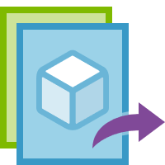
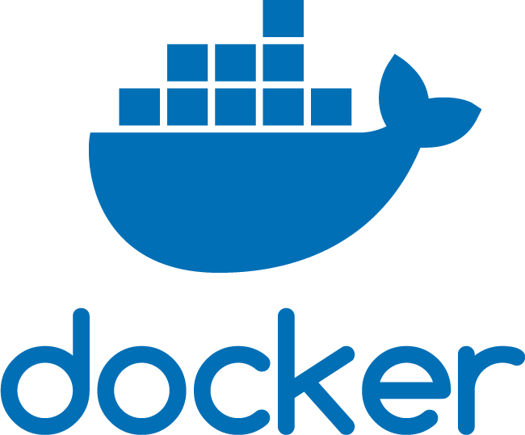
Docker in App Service on Linux
Testing/Staging on-premises
Production in Azure
Development on local machine
Container image
Notes:
App Service Linux provides predefined application stacks on Linux with support for languages such as .NET, PHP, Node.js, and others. These application stacks are defined by using Docker containers. You can also use a custom Docker image to run your web app on an application stack that is not already defined in Azure.
Using a Docker container for App Service can ensure that your applications remain portable and work in all your environments.

Slide 34
Web apps for Linux containers
Deploy applications and solutions that are containerized directly to App Service Web Apps:
Simplifies deployment
Matches the already popular container workflow using:
CI/CD with Docker Hub, Azure Container Registry, or GitHub
Compatible with existing App Service features:
Auto-scale, Deployment Slots, and others
Notes:
Web App for Containers provides built-in Docker images on Linux with support for specific versions, such as PHP 7.0 and Node.js 4.5.
Web App for Containers uses the Docker container technology to host both built-in images and custom images as a Platform as a Service (PaaS).

Slide 35
Web apps for Linux containers (continued)
Containers can be sourced from your existing registries:
Docker Hub:
Deploy images already shared on Docker Hub
Deploy the most popular official images
Private images are available on Docker Hub
Azure Container Registry:
Managed service for hosting Docker images
Can deploy to Docker Swarm, Kubernetes, or Web App for Containers
Notes:
Custom image development requires basic knowledge of the Docker development workflow.
Deployment of a custom image to a web app requires publication of your custom image to a repository host like Docker Hub.
If you are familiar with Docker and can add Docker tasks to your build workflow, or if you are already publishing your app as a Docker image, a custom image is almost certainly the best choice.

Slide 36
Demonstration: Creating Web Apps with a local Git deployment source

Slide 37
Lesson 03: Configuring and Monitoring App Service apps

Slide 38
App Service settings
Overrides settings in Web.config or appsettings.json
Hidden by default in Azure portal
You can configure:
Application settings
Connection strings
Default documents
Path mappings
Language stack (app runtime)
Custom containers
Notes:
For ASP.NET developers, configuring app settings in App Service is similar to configuring them in <appSettings> in Web.config or appsettings.json. The difference is that the values in App Service override the values in Web.config or appsettings.json. You can keep development settings in Web.config or appsettings.json (for example, local MySQL password), but keeping production secrets (such as Azure MySQL database password) in App Service is ideal. This is because the same code uses your development settings when you debug locally, and it uses your production secrets when deployed to Azure.

Slide 39
Default documents
Only available for Windows apps
List of documents to show when navigating to a directory on the web server:
First matching file is used
Alternative to building a custom module
Notes:
This setting is only available for Windows apps. The default document is the web page that displays at the root URL for a website. The first matching file in the list is used.
If the app uses modules that route based on URL instead of serving static content, there is no need for default documents.

Slide 40
Path mappings
Windows:
Custom IIS handler mappings
Virtual applications/directories
Containerized:
Custom-mounted storage
Notes:
For Windows apps, you can customize the Microsoft Internet Information Services (IIS) handler mappings, virtual applications, and directories.
You can use handler mappings to add custom script processors to handle requests for specific file extensions.
You can add custom storage for your containerized app. Containerized apps include all Linux apps and also the Windows and Linux custom containers running on App Service.

Slide 41
Updating app runtimes
az webapp config set --linux-fx-version "DOTNETCORE|3.1" --resource-group <groupname> --name <appname>
az webapp config set --php-version 7.0 --resource-group <groupname> --name <appname>
az webapp config set --python-version 3.4 --resource-group <groupname> --name <appname>
az webapp config set --resource-group <groupname> --name <appname> --java-version 1.8 --java-container Tomcat --java-container-version 9.0
Update .NET version
Update PHP version
Update Python version
Update Java version
Notes:
When adding a new version (major or minor), it installs side-by-side with existing versions. You can also manually upgrade your app to the new version. If you configured the runtime version in a configuration file (such as web.config and package.json), you need to upgrade by using the same method. If you used an App Service setting to configure your runtime version, you can change it in the Azure portal or by running an Azure CLI command in the Cloud Shell.
To update the application runtime, use the az webapp config set command with the appropriate parameter for your runtime.

Slide 42
Updating app runtimes (Node.js)
az webapp config appsettings set `
--resource-group <groupname> `
--name <appname> `
--settings WEBSITE_NODE_DEFAULT_VERSION=8.9.3
Notes:
Web Apps does not have a built-in mechanism to update Node.js runtimes. Instead, you can use the az webapp config appsettings set command to change the WEBSITE_NODE_DEFAULT_VERSION application setting to the version of Node.js that you wish to use.

Slide 43
Editing bulk settings
[
{
"name": "<key-1>",
"value": "<value-1>",
"slotSetting": false
},
{
"name": "<key-2>",
"value": "<value-2>",
"slotSetting": false
},
...
]
Notes:
To add or edit app settings in bulk, use the JSON format shown on this slide.

Slide 44


CORS
Mechanism for servers to indicate that they support cross-site requests
Servers can specify:
Allowed HTTP verbs
Allowed origins
Allowed headers
Directly supported by API Apps
1
Options
2
Access Control
3
Actual Request
Notes:
Browser security prevents a web page from making requests to a different domain than the one that served the web page. This restriction is called the same-origin policy. The same-origin policy prevents a malicious site from accessing sensitive data on another site.
Sometimes, you might want to allow other sites make cross-origin requests (CORS) to your app. CORS is a Worldwide Web Consortium (W3C) standard that allows a server to relax the same-origin policy.
In a standard CORS implementation, the JavaScript client will send a pre-flight request by using an OPTIONS verb to assess the server's willingness to accept a cross-site request. If allowed, the JavaScript client will then issue a cross-site HTTP request.

Slide 45
OS and runtime patching
OS and application stack are managed by Azure on your behalf
Monthly OS patching:
Physical servers
Guest virtual machines
Stable versions of application runtimes are periodically added to App Services:
Some are installed side by side, while others replace existing versions
You can manually migrate from one application runtime to another
Notes:
App Service is a platform as a service (PaaS), which means that the OS and application stack are managed for you by Azure; you only manage your application and its data.
Azure manages OS patching on two levels, the physical servers and the guest virtual machines (VMs) that run the App Service resources. Both are updated monthly. These updates are applied automatically, in a way that guarantees the high availability SLA of Azure services.
New stable versions of supported language runtimes (major, minor, or patch) are periodically added to App Service instances. Some updates overwrite the existing installation, while others are installed side by side with existing versions. An overwrite installation means that your app automatically runs on the updated runtime. A side-by-side installation means you must manually migrate your app to take advantage of a new runtime version.

Slide 46
Inbound and outbound IP addresses
Each app has a single inbound IP address:
Regardless of scale-out quantity
Inbound IP address can change:
Delete an app and re-create it in a new resource group
Delete the last app in a resource group + region combination and re-create it
Delete an existing SSL binding
You can opt to use a static inbound IP
Each app has a set number of outbound IP addresses:
The set and quantity changes as you scale your app between tiers
Notes:
Azure App Service is a multi-tenant service. Apps share network infrastructure with other apps. As a result, the inbound and outbound IP addresses of an app can be different, and can even change in certain situations.
Regardless of the number of scaled-out instances, each app has a single inbound IP address. The inbound IP address might change when you perform one of the following actions:
Delete an app and recreate it in a different resource group.
Delete the last app in a resource group and region combination and recreate it.
Delete an existing SSL binding, such as during certificate renewal.
Sometimes you might want a dedicated, static IP address for your app. To get a static inbound IP address, you need to configure an IP-based SSL binding. If you don't actually need SSL functionality to secure your app, you can even upload a self-signed certificate for this binding. In an IP-based SSL binding, the certificate is bound to the IP address itself, so App Service provisions a static IP address to make it happen.
Regardless of the number of scaled-out instances, each app has a set number of outbound IP addresses at any given time. Any outbound connection from the App Service app, such as to a back-end database, uses one of the outbound IP addresses as the origin IP address. You can't know beforehand which IP address a given app instance will use to make the outbound connection, so your back-end service must open its firewall to all the outbound IP addresses of your app.
The set of outbound IP addresses for your app changes when you scale your app between the lower tiers (Basic, Standard, and Premium) and the Premium V2 tier.

Slide 47
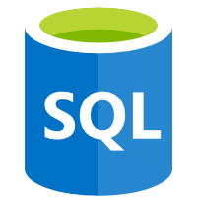

Outbound IP addresses
Web App instances
Inbound IP
Outbound IPs
Azure SQL Database
Azure Storage
Notes:
Regardless of the number of scaled-out instances, each app has a set number of outbound IP addresses at any given time. Any outbound connection from the App Service app, such as a connection to a back-end database, uses one of the outbound IP addresses as the origin IP address.
You can't know beforehand which IP address a given app instance will use to make the outbound connection. Therefore, your back-end service must open its firewall to all the outbound IP addresses of your app.

Slide 48
When IP addresses change
Inbound:
When you delete an app and recreate it
When you delete the last app in a resource group
When you delete an existing SSL binding
Outbound:
Why you scale from a lower tier (Basic, Standard, Premium) to the Premium V2 tier
Notes:
Regardless of the number of scaled-out instances, each app has a single inbound IP address.
The inbound IP address might change when you perform one of the following actions:
Delete an app and recreate it in a different resource group.
Delete the last app in a resource group and region combination and recreate it.
Delete an existing SSL binding, such as during certificate renewal
The set of outbound IP addresses for your app changes when you scale your app between the lower tiers (Basic, Standard, and Premium) and the Premium V2 tier.

Slide 49
Find outbound IP addresses
# find Outbound IP address
az webapp show --resource-group <group_name> --name <app_name> --query outboundIpAddresses --output tsv
# find all possible IP addresses (regardless of tier)
az webapp show --resource-group <group_name> --name <app_name> --query possibleOutboundIpAddresses --output tsv
Notes:
You can find the set of all possible outbound IP addresses your app can use, regardless of pricing tiers, by examining the possibleOutboundIPAddresses property.
You can find the same information by observing your app in the Azure portal. Select Properties in your app's left-hand navigation.

Slide 50
Lesson 04: Scaling App Service apps

Slide 51
Autoscale
A primary advantage of the cloud is elastic scaling (the ability to use as much capacity as you need):
Scaling out as load increases
Scaling in when the extra capacity is not needed
Many Microsoft Azure services provide the capability to scale both manually and automatically
Autoscale refers to the capability of many of these services to monitor the application instances and automatically scale appropriately to handle the current usage of the application:
Using autoscale, your cloud service can scale out and in to exactly match the amount of instances needed for your specific computing pattern
Notes:
Autoscale is a built-in feature of Azure Cloud Services, Mobile Services, Virtual Machines, and websites that helps applications perform their best when demand changes. Of course, performance means different things for different applications. Some apps are CPU bound, others memory bound. For example, you could have a web app that handles millions of requests during the day and none at night. Autoscale can scale your service by any of these—or by a custom metric you define.

Slide 52
Autoscale metrics
Metric | Metric identifier | Description
CPU | CpuPercentage | The average amount of CPU time used across all instances of the plan
Memory | MemoryPercentage | The average amount of memory used across all instances of the plan
Data in | BytesReceived | The average incoming bandwidth used across all instances of the plan
Data out | BytesSent | The average outgoing bandwidth used across all instances of the plan
HTTP queue | HttpQueueLength | The average number of HTTP requests that had to sit in the queue before being fulfilled. A high or increasing HTTP queue length is a symptom of a plan under a heavy load.
Disk queue | DiskQueueLength | The average number of both read and write requests that were queued on storage. A high disk queue length is an indication of an application that might be slowing down due to excessive disk I/O.
Notes:
Azure Monitor autoscaling allows you to scale the number of running instances up or down, based on telemetry data (metrics).
By default, Resource Manager-based virtual machines (VMs) and virtual machine scale sets (VMSSs) emit basic (host-level) metrics. In addition, when you configure diagnostics data collection for an Azure VM and VMSS, the Azure diagnostic extension also emits guest-OS performance counters (commonly known as guest-OS metrics). You use all these metrics in autoscale rules.
You can also perform autoscale based on common web server metrics such as the Http queue length. It's metric name is HttpQueueLength. This table lists available server farm (Web Apps) metrics.
You can scale by Storage queue length, which is the number of messages in the storage queue. Storage queue length is a special metric and the threshold is the number of messages per instance. For example, if there are two instances and if the threshold is set to 100, scaling occurs when the total number of messages in the queue is 200. That can be 100 messages per instance, 120 and 80, or any other combination that adds up to 200 or more.
You can scale by Service Bus queue length, which is the number of messages in the Service Bus queue. Service Bus queue length is a special metric and the threshold is the number of messages per instance. For example, if there are two instances and if the threshold is set to 100, scaling occurs when the total number of messages in the queue is 200. That can be 100 messages per instance, 120 and 80, or any other combination that adds up to 200 or more.

Slide 53
Autoscale patterns
Scale based on CPU
Scale differently on weekdays vs. weekends
Scale differently during holidays
Scale based on custom metric
Notes:
Azure Monitor Autoscale applies only to Virtual Machine Scale Sets, Cloud Services, App Service - Web Apps, and API Management services.

Slide 54
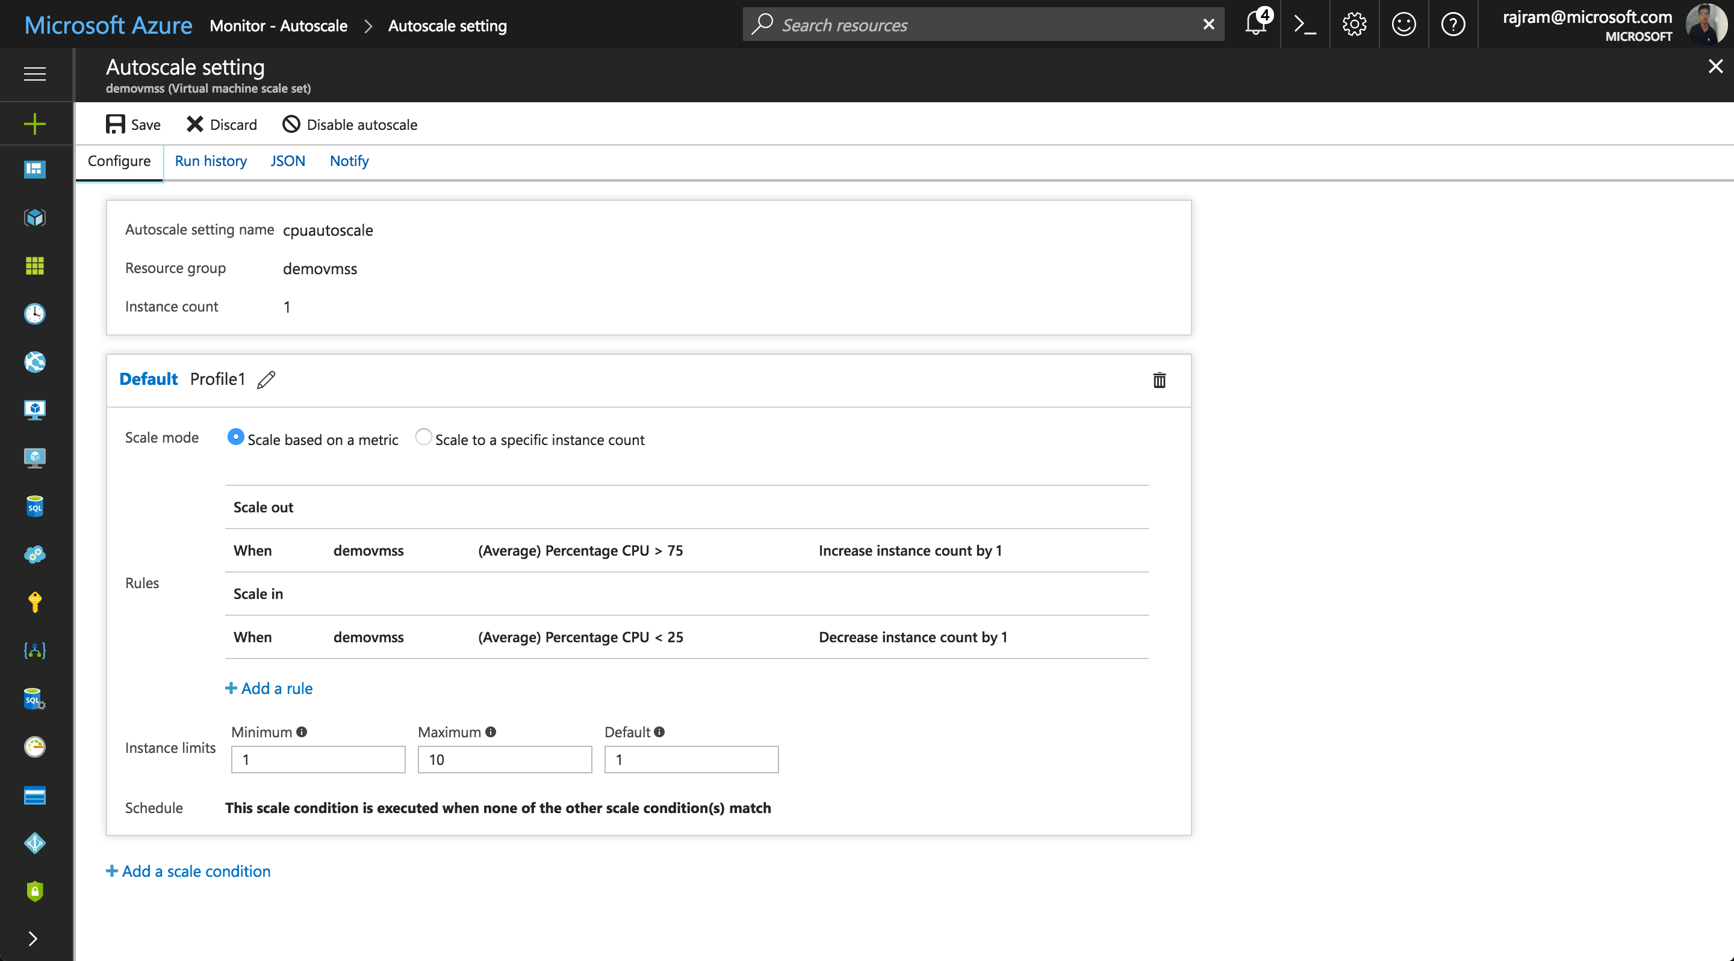
Scale based on CPU
Notes:
You have a web app (/VMSS/cloud service role) and:
You want to scale out/scale in based on CPU.
Additionally, you want to ensure there is a minimum number of instances.
Also, you want to ensure that you set a maximum limit to the number of instances you can scale to.

Slide 55
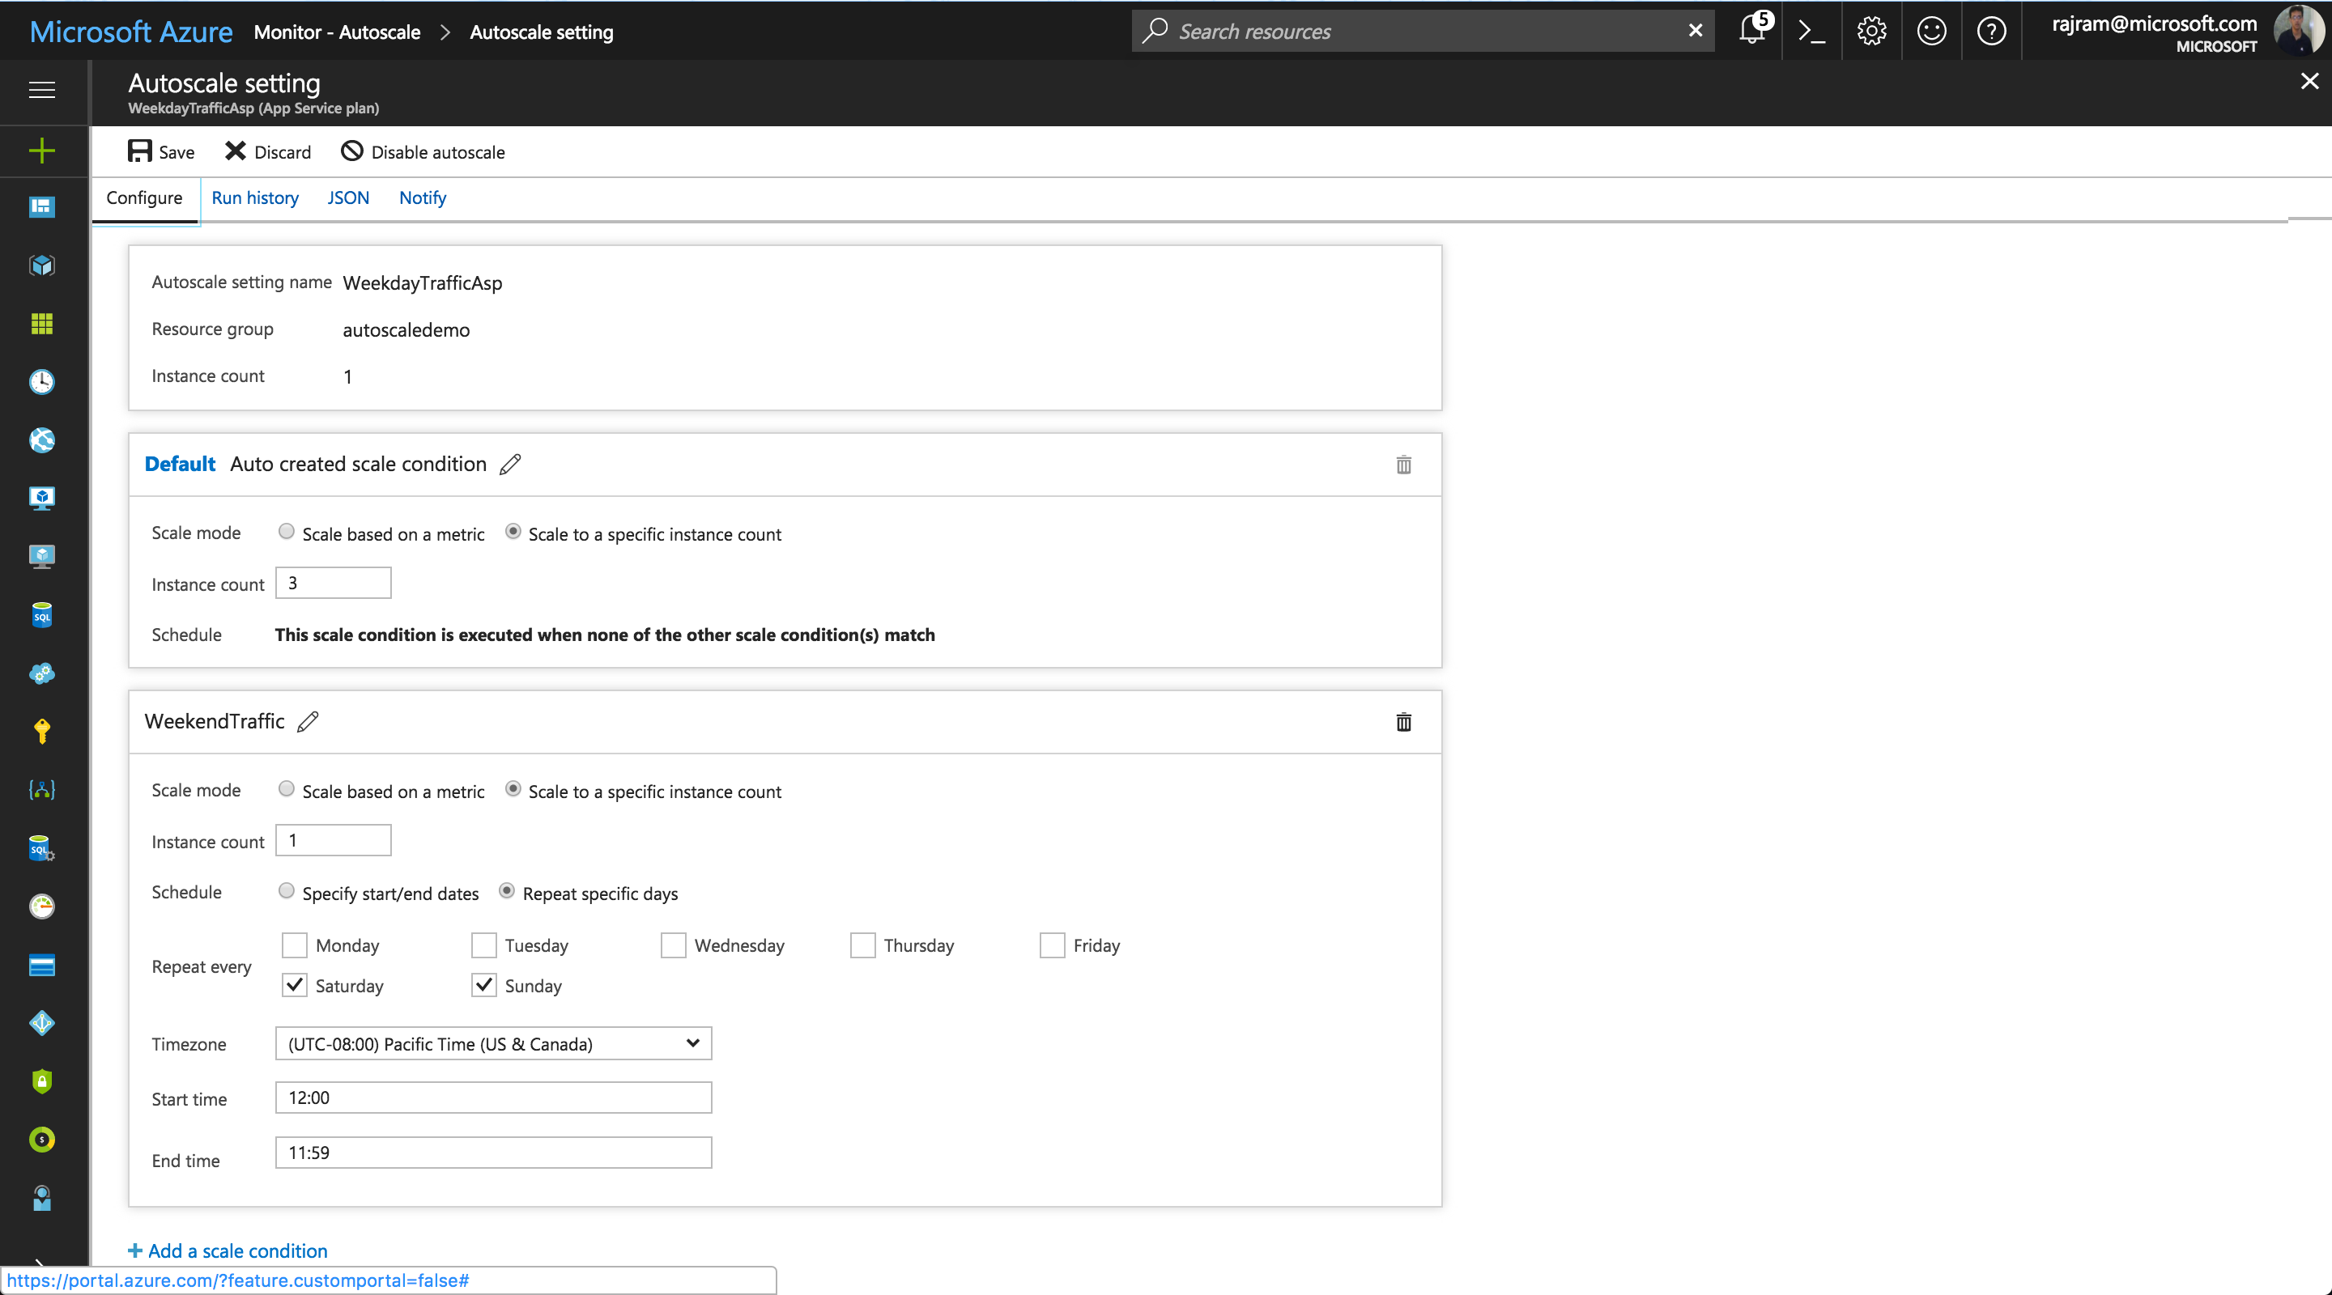
Scale differently on weekdays vs. weekends
Notes:
You have a web app (/VMSS/cloud service role) and:
You want three instances by default (on weekdays).
You don't expect traffic on weekends and therefore you want to scale down to 1 instance on weekends.

Slide 56
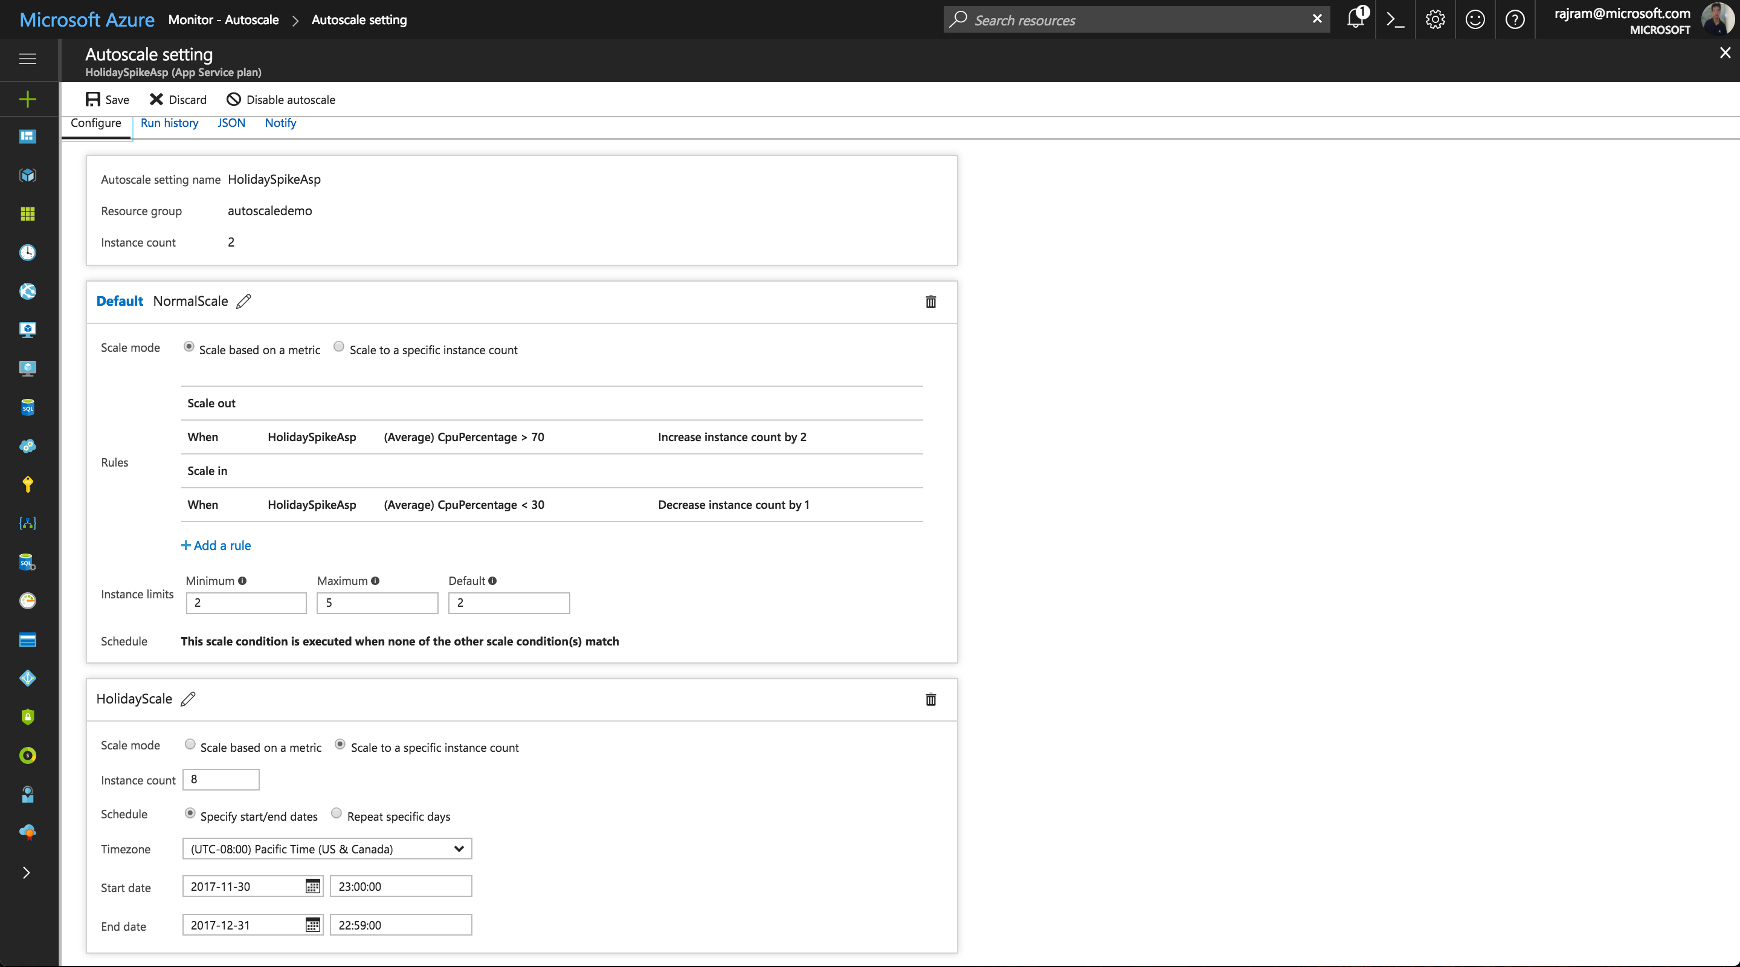
Scale differently during holidays
Notes:
You have a web app (/VMSS/cloud service role) and:
You want to scale up/down based on CPU usage by default.
However, during holiday season (or specific days that are important for your business) you want to override the defaults and have more capacity at your disposal.

Slide 57
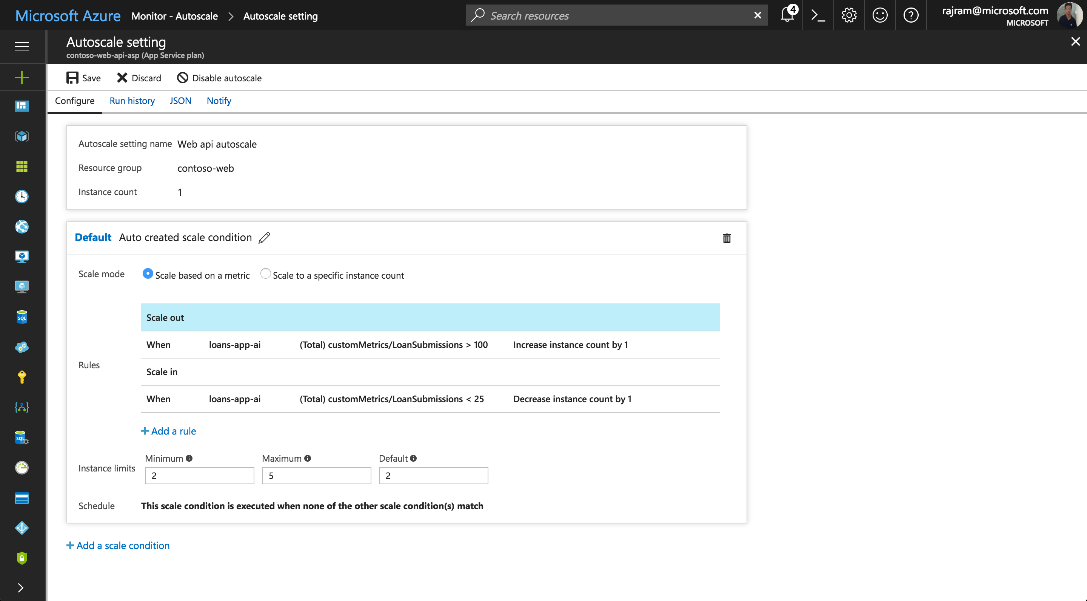
Scale based on custom metric

Slide 58
Autoscale setting schema
{
"id": "...", "name": "demoSetting", "type": "Microsoft.Insights/autoscaleSettings",
"location": "East US",
"properties": {
"enabled": true, "targetResourceUri": "...",
"profiles": [
{
"name": "mainProfile",
"capacity": {
"minimum": "1", "maximum": "4", "default": "1"
},
"rules": [ ... ]
}
]
}
}
Notes:
Autoscale settings help ensure that you have the right amount of resources running to handle the fluctuating load of your application. You can configure autoscale settings to be triggered based on metrics that indicate load or performance, or triggered at a scheduled date and time.
To illustrate the autoscale setting schema, this autoscale setting has:
One profile.
An array of profiles and an array of rules.

Slide 59
Autoscale setting schema – scale-out rule
{
"metricTrigger": {
"metricName": "Percentage CPU", "metricResourceUri": "...",
"timeGrain": "PT1M",
"statistic": "Average",
"timeWindow": "PT10M",
"timeAggregation": "Average",
"operator": "GreaterThan",
"threshold": 85
},
"scaleAction": {
"direction": "Increase", "type": "ChangeCount",
"value": "1",
"cooldown": "PT5M"
}
}
Notes:
To illustrate the autoscale setting schema, this autoscale setting has:
Two metric rules in this profile: one for scale out, and one for scale in.
The scale-out rule is triggered when the virtual machine scale set's average percentage CPU metric is greater than 85 percent for the past 10 minutes.

Slide 60
Autoscale setting schema – scale-in rule
{
"metricTrigger": {
"metricName": "Percentage CPU", "metricResourceUri": "...",
"timeGrain": "PT1M",
"statistic": "Average",
"timeWindow": "PT10M",
"timeAggregation": "Average",
"operator": "LessThan",
"threshold": 60
},
"scaleAction": {
"direction": "Decrease", "type": "ChangeCount",
"value": "1",
"cooldown": "PT5M"
}
}
Notes:
To illustrate the autoscale setting schema, this autoscale setting has:
Two metric rules in this profile: one for scale out, and one for scale in.
The scale-in rule is triggered when the virtual machine scale set's average is less than 60 percent for the past minute.

Slide 61
Autoscale setting schema – fixed date profile
"fixedDate": {
"timeZone": "Pacific Standard Time",
"start": "2020-12-26T00:00:00",
"end": "2020-12-26T23:59:00"
}
Notes:
This profile is for special cases. For example, let’s say you have an important event coming up on December 26, 2020 (PST). You want the minimum and maximum capacities of your resource to be different on that day, but still scale on the same metrics. In this case, you should add a fixed date profile to your setting’s list of profiles. The profile is configured to run only on the event’s day. For any other day, Autoscale uses the regular profile.

Slide 62
Autoscale setting schema – weekdays and weekends
"recurrence": {
"frequency": "Week",
"schedule": {
"timeZone": "Pacific Standard Time",
"days": [
"Saturday"
],
"hours": [
0
],
"minutes": [
0
]
}
}
Notes:
Let’s say that on weekends, you want your maximum capacity to be 4. On weekdays, because you expect more load, you want your maximum capacity to be 10. In this case, your setting would contain two recurrence profiles, one to run on weekends and the other on weekdays.
The JSON setting displayed here shows that each recurrence profile has a schedule. This schedule determines when the profile starts running. The profile stops when it’s time to run another profile.
For example, in the JSON setting displayed here, “weekdayProfile” is set to start on Monday at 12:00 AM. That means this profile starts running on Monday at 12:00 AM. It continues until Saturday at 12:00 AM, when “weekendProfile” is scheduled to start running.

Slide 63
Autoscale concepts
Each resource can have one autoscale setting:
Autoscale settings can have one-to-many profiles
Profiles can have one-to-many rules
Autoscale increases instances horizontally within bounds:
Bounds are set by using the minimum, maximum, and default values
Thresholds are calculated at an instance level
Autoscale successful actions and failures are logged to the Activity Log
Notes:
A resource can have only one autoscale setting.
An autoscale setting can have one or more profiles, and each profile can have one or more autoscale rules.
An autoscale setting scales instances horizontally, which is moved out by increasing the instances and in by decreasing the number of instances. An autoscale setting has a maximum, minimum, and default value of instances.
An autoscale job always reads the associated metric to scale by checking if it has crossed the configured threshold for scale-out or scale-in.
All thresholds are calculated at an instance level. For example, "scale out by one instance when average CPU > 80% when instance count is 2", means scale-out when the average CPU across all instances is greater than 80%.
All autoscale failures are logged to the Activity Log. You can then configure an activity log alert so that you can be notified via email, SMS, or webhooks whenever there is an autoscale failure.
Similarly, all successful scale actions are posted to the Activity Log. You can then configure an activity log alert so that you can be notified via email, SMS, or webhooks whenever there is a successful autoscale action. You can also configure email or webhook notifications to get notified for successful scale actions via the notifications tab on the autoscale setting.

Slide 64

Autoscale thresholds
Scale is constrained to a minimum and maximum:
Your current instance count must be between the minimum and maximum:
Minimum can help guarantee availability
Maximum can help control costs
Min = 2
+/- VMs as needed
Max = 5
VM
VM
VM
VM
VM
3 currently running
Notes:
With autoscale, you can add the right amount of resources to handle increased load on your application. It also helps you save money by removing idle resources.
You specify a minimum and maximum number of instances to run, and the system will automatically add or remove VMs based on a set of rules.
Having a minimum ensures that an application is always running, even under no load.
Having a maximum limits your total possible hourly cost.

Slide 65








Autoscale workflow
Azure Infrastructure
Autoscale
Resources
Metrics are measured for a resource
When conditions are met (threshold surpassed), autoscale triggers:
Perform scale actions
Send notifications (alerts)
Send messages to webhooks for external automation
Metrics
Rule
Criteria met
Actions
Time
+/- VMS
email
webhook
Automate
Automation
Runbook
Function
Logic Apps
3rd Party URL
(ex PagerDuty)
3
rd
Notes:
Resources emit metrics, and these metrics are later processed by rules. When autoscale rule conditions are met, one or more autoscale actions are triggered. You can add and remove VMs or perform other actions by using automation tools.

Slide 66
Autoscale hierarchy
Autoscale setting
min
profile 1
max
One autoscale setting
Settings have one or more profiles
Profiles have one or more rules:
Profiles can also have recurrences and capacity settings
Notifications can be directly associated with an autoscale setting
capacity
default
rule 1
trigger
rule (n)
scale action
recurrence
profile (m)
admin?
notification
coadmin?
Emails
custom 1-(n)
Webhooks
webhook 1
webhook (n)
Notes:
Autoscale uses the following terminology and structure:
The autoscale engine reads an autoscale setting to determine whether to scale up or down. It contains one or more profiles, information about the target resource, and notification settings:
An autoscale profile is a combination of a:
Capacity setting, which indicates the minimum, maximum, and default values for a number of instances.
Set of rules, each of which includes a trigger (time or metric) and a scale action (up or down).
Recurrence, which indicates when autoscale should put this profile into effect.
You can have multiple profiles, which enables you to take care of different overlapping requirements. For example, you can have different autoscale profiles for different times of the day or days of the week.
A notification setting defines what notifications should occur when an autoscale event occurs based on satisfying the criteria of one of the autoscale setting’s profiles. Autoscale can notify one or more email addresses or make calls to one or more webhooks.

Slide 67
Best practices
Ensure that the maximum and minimum values are different and have an adequate margin between them
Manual scaling is reset by autoscale min and max
Always use a scale-out and scale-in rule combination that performs an increase and decrease
Choose the appropriate statistic for your diagnostics metric
Choose the thresholds carefully for all metric types
Notes:
Ensure that the maximum and minimum values are different and have an adequate margin between them
If you have a setting that has minimum=2, maximum=2 and the current instance count is 2, no scale action can occur. Keep an adequate margin between the maximum and minimum instance counts, which are inclusive. Autoscale always scales between these limits.
Manual scaling is reset by autoscale min and max
If you manually update the instance count to a value above or below the maximum, the autoscale engine automatically scales back to the minimum (if below) or the maximum (if above). For example, you set the range between 3 and 6. If you have one running instance, the autoscale engine scales to three instances on its next run. Likewise, if you manually set the scale to eight instances, on the next run autoscale will scale it back to six instances. Manual scaling is temporary unless you also reset the autoscale rules.
Always use a scale-out and scale-in rule combination that performs an increase and decrease
If you use only one part of the combination, autoscale will only take action in a single direction (scale out, or in) until it reaches the maximum, or minimum instance counts defined in the profile. This is not optimal because ideally, you want your resource to scale up at times of high usage to ensure availability. Similarly, at times of low usage you want your resource to scale down, so you can realize cost savings.
Choose the appropriate statistic for your diagnostics metric
For diagnostics metrics, you can choose among Average, Minimum, Maximum and Total as a metric to scale by. The most common statistic is Average.
Choose the thresholds carefully for all metric types
We recommend carefully choosing different thresholds for scale-out and scale-in based on practical situations.
We do not recommend autoscale settings like the examples below with the same or very similar threshold values for out and in conditions:
Increase instances by 1 count when Thread Count <= 600
Decrease instances by 1 count when Thread Count >= 600
Estimation during a scale-in is intended to avoid "flapping" situations, where scale-in and scale-out actions continually go back and forth. Keep this behavior in mind when you choose the same thresholds for scale-out and -in.
Considerations for scaling threshold values for special metrics
For special metrics such as Storage or Service Bus Queue length metric, the threshold is the average number of messages available per current number of instances. Carefully choose the threshold value for this metric.

Slide 68
Lesson 05: Azure App Service staging environments

Slide 69

Deployment slots
Live apps with their own:
Host names
Content
Configuration
Can be swapped between each other. For example:
Staging ⬌ Production
Production ⬌ Staging
Dev ⬌ Test
Test ⬌ QA
QA ⬌ Staging
Production
swappable
Staging
QA
Test
Dev
Notes:
When you deploy your app to Azure App Service, you can use a separate deployment slot instead of the default production slot that you're running.

Slide 70

Modern deployment workflow
Staging
Production
GitHub
master branch
swap
Web
deploy
deploy
swap
API
merge
Dev
feature branch

Slide 71
Auto swap
Automatically swaps an application to the production slot:
Performed after the application is "warmed up"
Swaps the deployment target slot with the production slot
Deploy apps continuously while minimizing cold starts and downtime
Notes:
Auto swap streamlines Azure DevOps scenarios where you want to deploy your app continuously with zero cold starts and zero downtime for app customers.
When auto swap is enabled from a slot into production, every time you push your code changes to that slot App Service automatically swaps the app into production after it's warmed up in the source slot.

Slide 72

Route traffic between slots
All traffic is normally routed to production:
Production slot has 100% weighting
You can manually configure the weight of traffic between multiple slots
Production
75%
25%
New Feature
Notes:
By default, all client requests to the app's production URL are routed to the production slot. However, you can route a portion of the traffic to another slot. This feature is useful if you need user feedback for a new update, but you're not ready to release it to production.

Slide 73
Automate slot management - Azure PowerShell
New-AzWebAppSlot -ResourceGroupName "<groupname>" -Name "<appname>" -Slot "staging" -AppServicePlan "<appserviceplanname>"
$Params = @{targetSlot = "[slot name – e.g. "production"]"}
Invoke-AzResourceAction -ResourceGroupName "<groupname>" ` -ResourceType "Microsoft.Web/sites/slots" -ResourceName "<appname>/staging" ` -Action "slotsswap" -Parameters $Params -ApiVersion 2015-07-01
Create new slot
Target
Source
Swap slots
Notes:
Azure PowerShell contains a New-AzWebAppSlot cmdlet that you can use to create new deployment slots for an app.
To swap a slot, you can manually invoke an Azure Resource Manager (ARM) action by using the Invoke-AzResourceAction cmdlet.

Slide 74
Automate slot management - Azure CLI
az webapp deployment slot create --name <appname> --resource-group <groupname> --slot staging
az webapp deployment slot swap --resource-group <groupname> --name <appname> --slot staging --target-slot production
Create new slot
Swap slots
Source
Target
Notes:
You can use the az webapp deployment slot group in the Azure CLI to manage slots.
You can use the create command to create a new slot.
You can use the swap command to swap a slot from a source to a destination (or target).

Slide 75

Lab: Building a web application on Azure platform as a service offerings
Notes:
This lab is scheduled to take 45 minutes.

Slide 76

Lab sign-in information
Duration
Lab: Building a web application on Azure platform as a service offerings
AZ204-SEA-DEV
Username: Admin
Password: Pa55w.rd
Notes:
Students will also have access to the following scenario description in their lab guide:
You're the owner of a startup organization and have been building an image gallery application for people to share great images of food.
To get your product to market as quickly as possible, you decided to use Microsoft Azure App Service to host your web apps and APIs.
Recently, you realized that the images that are being uploaded to your application are simply too large.
Out of concern for storage and bandwidth costs, you decided to use Azure Functions to process images in the background and shrink them down to thumbnails that can load quickly.

