Slide 1
Module 08: Implement API Management

Slide 2
Topics
API Management overview
Working with APIs in APIM
Configure authentication for APIs

Slide 3
Lesson 01: API Management overview

Slide 4
API Management (APIM)
Streamlines the process of common tasks necessary for creating an API for external use
Tasks include:
Creating a successful and useful developer portal
Securing API endpoints from anonymous or unwanted access
Managing existing developer access through cache mechanisms, throttling, and other policies
Building a monitoring and analytics platform to diagnose issues and monitor adoption
Providing business users and developers with deep insights into how each API is specifically used
Notes:
API Management (APIM) helps organizations publish APIs to external, partner, and internal developers to unlock the potential of their data and services. Businesses everywhere are seeking to extend their operations as a digital platform, creating new channels, finding new customers, and driving deeper engagement with existing ones. API Management provides the core competencies to ensure a successful API program through developer engagement, business insights, analytics, security, and protection. You can use Azure API Management to take any backend and launch a full-fledged API program based on it.

Slide 5
Terminology
Backend API:
A HTTP service that you implement with your business logic
Frontend API:
A HTTP service façade hosted by API Management to obfuscate your back-end API
Product:
One or more APIs, along with a usage quota and terms of use
Operation:
A specific operation in the front-end API that correlates to a specific request/response from the backend API
Notes:
Backend API
An HTTP service that implements your API and its operations.
Frontend API/APIM API
An APIM API does not host APIs, it creates facades for your APIs to customize the facade according to your needs without touching the back-end API.
APIM product
A product contains one or more APIs as well as a usage quota and the terms of use. You can include several APIs and offer them to developers through the developer portal.
APIM API operation
Each APIM API represents a set of operations available to developers. Each APIM API contains a reference to the back-end service that implements the API, and its operations map to the operations implemented by the back-end service.

Slide 6
Terminology (continued)
Version:
A breaking change to the front-end API
Existing application will not be required to change its code as you update or change the front-end API
Revision:
A non-breaking change to a front-end API
Developer portal:
An interface that developers use to learn about your API and test operations
Notes:
Version
Sometimes you want to publish new or different API features to some users, while others want to remain with the API that currently works for them.
Revision
When your API is ready to go and starts to be used by developers, you usually need to take care in making changes to that API and at the same time not to disrupt callers of your API. It's also useful to let developers know about the changes you made.
Developer portal
Your customers (developers) should use the developer portal to access your APIs. The developer portal can be customized.

Slide 7
Products
Contains one or more APIs in a package
Products can be open or protected:
Open products are free to use without any subscription
Protected products must be subscribed to before use
When a product is ready for developers, it can be published for use
Notes:
Products are associations of one or more APIs. You can include a number of APIs and offer them to developers through the developer portal. You can add an existing API during the product creation. You can add an API to the product later, either from the Products Settings page or while creating an API.
Developers must first subscribe to a product to get access to the API. When they subscribe, they get a subscription key that is good for any API in that product. If you created the APIM instance, you are an administrator already, so you are subscribed to every product by default.

Slide 8
Products and APIs
Free products
Paid products
Enterprise API
Basic
Advanced API
Notes:
Each API can be added to one or more products. To use an API, developers subscribe to a product that contains that API, which will get them a key to access the API.
Products are the means by which developers access APIs. Products in API Management have one or more APIs. Developers configure the products with a title, description, and terms of use. Products can be Open or Protected. You must subscribe to protected products before you can use them. However, you can use open products without a subscription.

Slide 9

APIs and operations
API
Operation
Cognitive Services
Operation
Legacy API
Operation
Notes:
To use API Management, administrators create APIs. Each API consists of one or more operations. Each API represents a set of operations that are available to developers. To use an API, developers can call the API's operation.
Each API's operations map to the operations implemented by the back-end service. Operations in API Management are highly configurable, providing control over URL mapping, query and path parameters, request and response content, and operation response caching. You can also implement rate limit, quotas, and IP restriction policies at the API or individual operation level.

Slide 10



Back-end and front-end APIs
Front end
Back end
APIM
Modern API
API 1
Legacy API
API 2
Search
Cognitive Services
Notes:
APIs are the foundation of an API Management service instance. Each API contains a reference to the back-end service that implements the API.

Slide 11
Demonstration: Creating an APIM instance by using Azure CLI

Slide 12
Demonstration: Importing an API by using the Azure portal

Slide 13
Demonstration: Creating and publishing a product

Slide 14
Lesson 02: Working with APIs in APIM

Slide 15

API Management instance overview
Create and manage APIs
Each API contains one or more sets of operations
Operations are configurable, granting control over:
URL mapping
Query and path parameters
Request and response content
Operation response caching
Notes:
To use API Management, administrators create APIs. Each API consists of one or more operations, and each API can be added to one or more products. To use an API, developers subscribe to a product that contains that API, and then they can call the API's operation, subject to any usage policies that might be in effect.

Slide 16



Manage using Git
>_
git clone
git pull
https://{name}.scm.azure-api.net
https://{name}.management.azure-api.net
git pull
SAVE
git push
Configuration
database
Git repo
DEPLOY
Notes:
Each API Management service instance maintains a configuration database that contains information about the configuration and metadata for the service instance. You can make changes to the service instance by changing a setting in the Azure portal, by using a PowerShell cmdlet, or by making a REST API call. In addition to these methods, you can also manage your service instance configuration by using Git.
When you make changes to your service by using the Azure portal, PowerShell cmdlets, or the REST API, you are managing your service configuration database by using the https://{name}.management.azure-api.net endpoint. This is depicted in the diagram on the slide. The diagram also depicts how you can manage your service configuration by using Git and the Git repository for your service, which is located at https://{name}.scm.azure-api.net.

Slide 17
Service hierarchy
Create and manage APIs
Each API contains one or more sets of operations
Operations are configurable, granting control over:
URL mapping
Query and path parameters
Request and response content
Operation response caching
Operation (HTTP GET)
API
(Internal API)
Operation (HTTP POST)
Service (API Management)
API
(Third-party API)
Operation (HTTP GET)
Notes:
Each service instance has one or more APIs that contain one or more operations.

Slide 18
Policies
Collection of statements that are executed sequentially at the request or response of an API
Are a quick way to change the behavior of an API without code changes to the actual back-end API application
A comprehensive list of policy options can be found at API Management policies (https://aka.ms/AA4gbik)
Notes:
In Azure API Management (APIM), policies are a powerful capability of the system that allow the publisher to change the behavior of the API through configuration. Policies are a collection of Statements that are executed sequentially on the request or response of an API. Popular Statements include format conversion from XML to JSON and call rate limiting to restrict the amount of incoming calls from a developer. Many more policies are available out of the box.

Slide 19
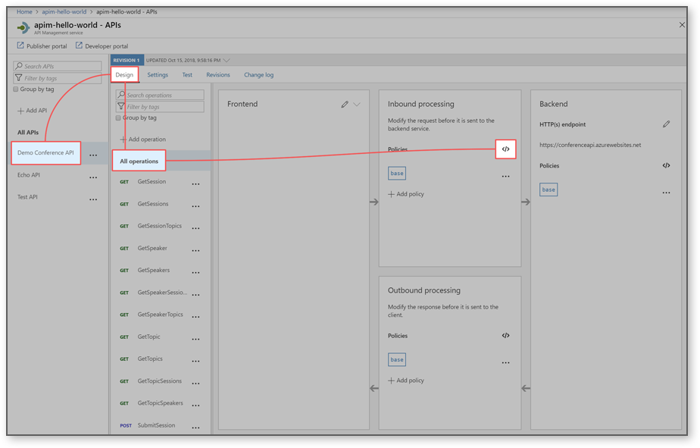
Editing policies
<policies>
<inbound>
<base />
</inbound>
<backend>
<base />
</backend>
<outbound>
<base />
</outbound>
<on-error>
<base />
</on-error>
</policies>
Notes:
The policy definition is an XML document that describes a sequence of inbound and outbound statements. The XML can be edited directly in the definition window. You can also select a predefined policy from the list that is provided to the right of the policy window. The statements applicable to the current scope are enabled and highlighted. Selecting an enabled statement adds the appropriate XML at the location of the cursor in the definition view.

Slide 20

Policy scopes
Global policies are invoked here.
<policies>
<inbound>
<cross-domain />
<base />
<find-and-replace from="xyz" to="abc" />
</inbound>
</policies>
Global policies
API
Policies
Notes:
If you have a policy at the global level and a policy configured for an API, then whenever that particular API is used both policies will be applied. API Management allows for deterministic ordering of combined policy statements using a special <base /> element.

Slide 21
Demonstration: Transforming an API by using policies

Slide 22
Advanced policy scenarios – control flow
<choose>
<when condition="Boolean expression | Boolean constant">
<!-- one or more policy statements to be applied if the above condition is true -->
</when>
<when condition="Boolean expression | Boolean constant">
<!-- one or more policy statements to be applied if the above condition is true -->
</when>
<otherwise>
<!-- one or more policy statements to be applied if none of the above conditions are true -->
</otherwise>
</choose>
Notes:
The choose policy applies enclosed policy statements based on the outcome of evaluation of Boolean expressions, similar to an if-then-else or a switch construct in a programming language.
The control flow policy must contain at least one <when/> element. The <otherwise/> element is optional. Conditions in <when/> elements are evaluated in order of their appearance within the policy. Policy statement(s) enclosed within the first <when/> element with condition attribute equals true will be applied. Policies enclosed within the <otherwise/> element, if present, will be applied if all of the <when/> element condition attributes are false.

Slide 23
Advanced policy scenarios – forward request
<forward-request timeout="time in seconds" follow-redirects="true | false"/>
Back-end service
Operation
Notes:
The forward-request policy forwards the incoming request to the back-end service specified in the request context. The back-end service URL is specified in the API settings and can be changed by using the set backend service policy.
Removing this policy results in the request not being forwarded to the back-end service and the policies in the outbound section are evaluated immediately upon the successful completion of the policies in the inbound section.

Slide 24
Advanced policy scenarios – limit concurrency
<limit-concurrency key="expression" max-count="number">
<!-- nested policy statements -->
</limit-concurrency>
Service
Operation
Notes:
The limit-concurrency policy prevents enclosed policies from executing by more than the specified number of requests at any time. Upon exceeding that number, new requests will fail immediately with a 429 Too Many Requests status code.

Slide 25

Advanced policy scenarios – log to Event Hub
<log-to-eventhub logger-id="id of the logger entity" partition-id="index of the partition where messages are sent" partition-key="value used for partition assignment">
<!-- Expression returning a string to be logged -->
</log-to-eventhub>
Event Hub instance
Operation
Notes:
The log-to-eventhub policy sends messages in the specified format to an Event Hub defined by a Logger entity. As its name implies, the policy is used for saving selected request or response context information for online or offline analysis.

Slide 26
Advanced policy scenarios – mock response
<mock-response status-code="code" content-type="media type"/>
Operation
Response
Notes:
The mock response policy, as the name implies, is used to mock APIs and operations. It aborts normal pipeline execution and returns a mocked response to the caller. The policy always tries to return responses of highest fidelity. It prefers response content examples, whenever available. It generates sample responses from schemas, when schemas are provided and examples are not. If neither examples or schemas are found, responses with no content are returned.

Slide 27
Advanced policy scenarios – retry
<retry
condition="boolean expression or literal"
interval="retry interval in seconds"
max-interval="maximum retry interval in seconds"
delta="retry interval delta in seconds"
count="number of retry attempts">
<!-- One or more child policies. No restrictions -->
</retry>
Service
Operation
Notes:
The retry policy executes its child policies once and then retries their execution until the retry condition becomes false or retry count is exhausted.

Slide 28
Advanced policy scenarios – return response
<return-response response-variable-name="existing context variable">
<set-header/><set-body/><set-status/>
</return-response>
Status
Response
Modified
Operation
Body
Notes:
The return response policy aborts pipeline execution and returns either a default or custom response to the caller. Default response is 200 OK with no body. Custom response can be specified via a context variable or policy statements. When both are provided, the response contained within the context variable is modified by the policy statements before being returned to the caller.

Slide 29
Application Gateway
Enables management of traffic to your web applications
Operates as a web traffic load balancer, which allows for more specific traffic routing than a traditional load balancer
Can handle additional scenarios such as:
Custom routing
Session affinity
SSL termination
Firewall management
Redirection
Notes:
Azure Application Gateway is a web traffic load balancer that enables you to manage traffic to your web applications by routing based on more criteria than a traditional load balancer (OSI layer 4). This type of routing is known as application layer (OSI layer 7) load balancing. Azure Application Gateway can do URL-based routing and more.

Slide 30




Application Gateway (continued)
ImageServerPool
Application
Gateway
/images/*
Contoso.com
WAF
VideoServerPool
/video/*
L7 LB
Notes:
Traditional load balancers operate at the transport layer (OSI layer 4 - TCP and UDP) and route traffic based on source IP address and port, to a destination IP address and port.
With the Application Gateway, you can be even more specific. For example, you can route traffic based on the incoming URL. So if /images is in the incoming URL, you can route traffic to a specific set of servers (known as a pool) configured for images. If /video is in the URL, that traffic is routed to another pool optimized for videos.

Slide 31
Lesson 03: Configure authentication for APIs

Slide 32
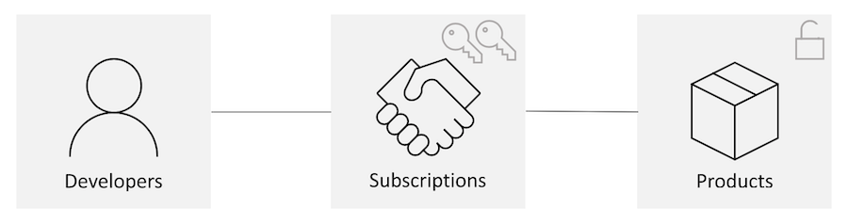
Subscriptions
Subscriptions tie Developers together with Products
A Developer will sign up for a subscription to get access to various products
The subscription will grant the Developer access to subscription keys
The subscription keys can be used to access specific products
Notes:
When you publish APIs through API Management, it's easy and common to secure access to those APIs by using subscription keys. Developers who need to consume the published APIs must include a valid subscription key in HTTP requests when they make calls to those APIs. Otherwise, the calls are rejected immediately by the API Management gateway. They aren't forwarded to the back-end services.
To get a subscription key for accessing APIs, a subscription is required. A subscription is essentially a named container for a pair of subscription keys. Developers who need to consume the published APIs can get subscriptions. And they don't need approval from API publishers. API publishers can also create subscriptions directly for API consumers.
Traditionally, subscriptions in API Management were always associated with a single API product scope. Developers found the list of products on the Developer portal. Then they'd submit subscription requests for the products they wanted to use. After a subscription request is approved, either automatically or by API publishers, the developer can use the keys in it to access all APIs in the product.

Slide 33
Client certificates
<!-- checking the expiration date -->
<choose>
<when condition="@(context.Request.Certificate == null || context.Request.Certificate.NotAfter < DateTime.Now)" >
<return-response><set-status code="403" reason="Invalid client certificate" /></return-response></when></choose>
<!-- checking the issuer and subject -->
<choose>
<when condition="@(context.Request.Certificate == null || context.Request.Certificate.Issuer != "trusted-issuer" || context.Request.Certificate.SubjectName != "expected-subject-name")" >
<return-response><set-status code="403" reason="Invalid client certificate" /></return-response></when></choose>
Notes:
API Management provides the capability to secure access to APIs (that is, client to API Management) by using client certificates. Currently, you can check the thumbprint of a client certificate against a desired value. You can also check the thumbprint against existing certificates uploaded to API Management.
Checking the expiration date
Policies can be configured to check if the certificate is expired.
Checking the issuer and subject
Policies can be configured to check the issuer and subject of a client certificate.

Slide 34
Client certificates (continued)
<!-- checking the thumbprint -->
<choose>
<when condition="@(context.Request.Certificate == null || context.Request.Certificate.Thumbprint != "desired-thumbprint")" >
<return-response><set-status code="403" reason="Invalid client certificate"
/></return-response></when></choose>
<!-- checking a thumbprint against certificates uploaded to API Management -->
<choose>
<when condition="@(context.Request.Certificate == null || !context.Deployment.Certificates.Any(c => c.Value.Thumbprint == context.Request.Certificate.Thumbprint))" >
<return-response><set-status code="403" reason="Invalid client certificate"
/></return-response></when></choose>
Notes:
API Management provides the capability to secure access to APIs (that is, client to API Management) by using client certificates. Currently, you can check the thumbprint of a client certificate against a desired value. You can also check the thumbprint against existing certificates uploaded to API Management.
Checking the thumbprint
Policies can be configured to check the thumbprint of a client certificate.
Checking a thumbprint against certificates uploaded to API Management
Policies can be configured to check the thumbprint of a client certificate against certificates uploaded to API Management.

Slide 35

Lab: Creating a multi-tier solution by using services in Azure
Notes:
This lab is scheduled to take 45 minutes.

Slide 36

Lab sign-in information
Duration
Lab: Creating a multi-tier solution by using services in Azure
AZ204-SEA-DEV
Username: Admin
Password: Pa55w.rd
Notes:
Students will also have access to the following scenario description in their lab guide:
The developers in your company have successfully adopted and used the https://httpbin.org/ website to test various clients that issue HTTP requests.
Your company would like to use one of the publicly available containers on Docker Hub to host the httpbin web application in an enterprise-managed environment with a few caveats.
First, developers who are issuing Representational State Transfer (REST) queries should receive standard headers that are used throughout the company's applications.
Second, developers should be able to get responses by using JavaScript Object Notation (JSON) even if the API that's used behind the scenes doesn't support the data format.
You're tasked with using Microsoft Azure API Management to create a proxy tier in front of the httpbin web application to implement your company's policies.

