Slide 1
Module 09: Develop App Service Logic Apps

Slide 2
Topics
Azure Logic Apps

Slide 3
Lesson 01: Azure Logic Apps

Slide 4
Azure Logic Apps
Automation workflow solution:
No-code designer for rapid creation of integration solutions
Prebuilt templates to simplify getting started
Out-of-box support for popular software as a service (SaaS) and on-premises integrations
BizTalk APIs available to advanced integration solutions
JSON-based workflow definition:
Can be deployed by using Azure Resource Manager templates
Notes:
logic apps helps you build solutions that integrate apps, data, systems, and services across enterprises or organizations by automating tasks and business processes as workflows. logic apps is cloud service in Azure that simplifies how you design and create scalable solutions for app integration, data integration, system integration, enterprise application integration (EAI), and B2B communication, whether in the cloud, on premises, or both.
For example, here are just a few workloads that you can automate with logic apps:
Process and route orders across on-premises systems and cloud services.
Move uploaded files from an SFTP or FTP server to Azure Storage.
Send email notifications with Office 365 when events happen in various systems, apps, and services.
Monitor tweets for a specific subject, analyze the sentiment, and create alerts or tasks for items that need review.

Slide 5
Components
Workflow
The business process described as a series of steps
Triggers
The step that invokes a new workflow instance
Actions
A individual step in a workflow, typically a Connector or custom API app
Connectors
A special case of an API app that is prebuilt and ready to integrate with a specific service or data source. For example:
Twitter and SQL Server Connectors
Notes:
Every logic apps workflow starts with a trigger, which fires when a specific event happens, or when new available data meets specific criteria. Many triggers include basic scheduling capabilities so that you can specify how regularly your workloads run. For more custom scheduling scenarios, start your workflows with the Schedule trigger. Learn more about how to build schedule-based workflows.
Each time that the trigger fires, the logic apps engine creates a logic app instance that runs the workflow's actions. These actions can also include data conversions and flow controls, such as conditional statements, switch statements, loops, and branching. For example, this logic app starts with a Dynamics 365 trigger with the built-in criteria "When a record is updated". If the trigger detects an event that matches this criteria, the trigger fires and runs the workflow's actions. Here, these actions include XML transformation, data updates, decision branching, and email notifications.
Azure logic apps can be used to build integration solutions with logic apps, choose from a growing gallery that has more than 200 connectors, including other Azure services such as Service Bus, Functions, and Storage; SQL, Office 365, Dynamics, BizTalk, Salesforce, SAP, Oracle DB, file shares, and many more. These connectors provide triggers, actions, or both for creating logic apps that securely access and process data in real time.

Slide 6

Workflow components
Workflow
Action
Action
Connector
Trigger
Action
Connector
Action
Notes:
Logic apps are composed of a workflow that consists of at-least one trigger followed by a series of actions or connectors to perform specific tasks.

Slide 7
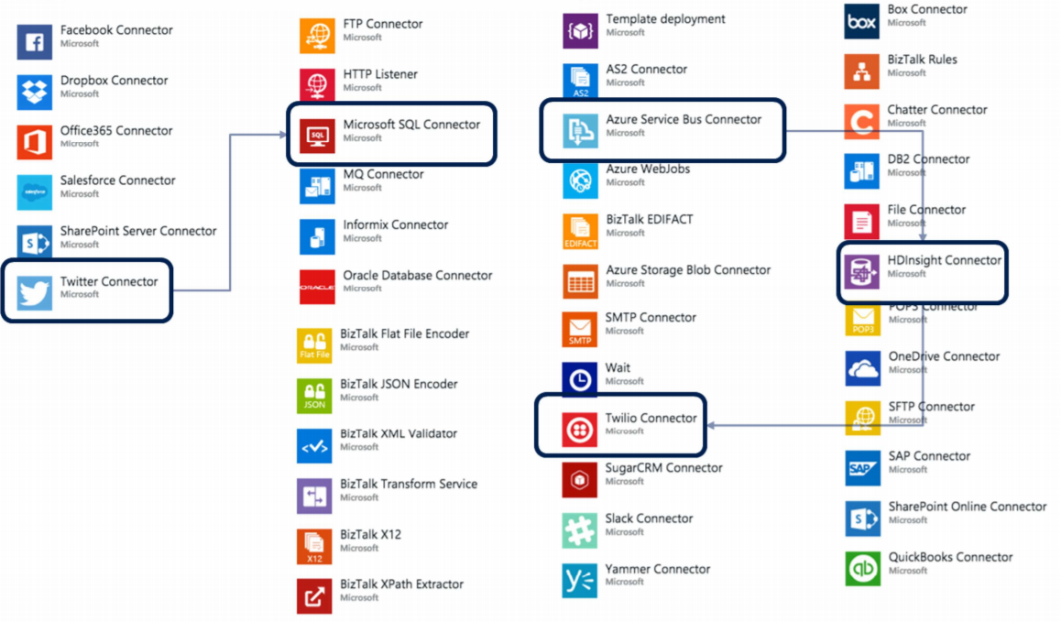
Connectors
Notes:
Connectors play an integral part when you create automated workflows with Azure logic apps. By using connectors in your logic apps, you expand the capabilities for your on-premises and cloud apps to perform tasks with the data that you create and already have. Connectors are available as either built-ins or managed connectors.
Built-ins: These built-in actions and triggers help you create logic apps that run on custom schedules, communicate with other endpoints, receive and respond to requests, and call Azure functions, Azure API Apps (Web Apps), your own APIs managed and published with Azure API Management, and nested logic apps that can receive requests. You can also use built-in actions that help you organize and control your logic app's workflow, and also work with data.
Managed connectors: These connectors provide triggers and actions for accessing other services and systems. Some connectors require that you first create connections that are managed by logic apps. Managed connectors are organized into these groups:
Managed API connectors
Create logic apps that use services such as Azure Blob storage, Office 365, Dynamics, Power BI, OneDrive, Salesforce, SharePoint Online, and many more.
On-premises connectors
After you install and set up the on-premises data gateway, these connectors help your logic apps access on-premises systems such as SQL Server, SharePoint Server, Oracle DB, file shares, and others.
Integration account connectors
Available when you create and pay for an integration account, these connectors transform and validate XML, encode and decode flat files, and process B2B messages with AS2, EDIFACT, and X12 protocols.
Enterprise connectors
Provide access to enterprise systems such as SAP and IBM MQ for an additional cost.

Slide 8
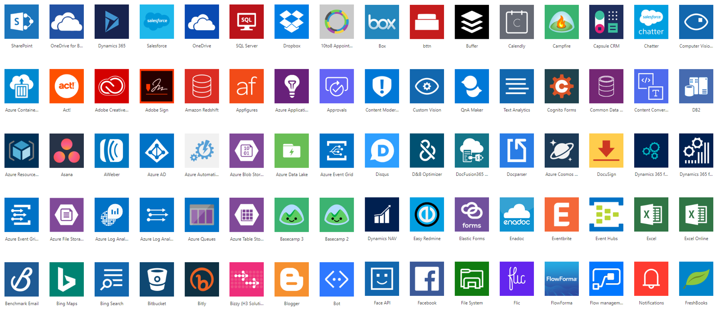
Connector ecosystem
Notes:
With logic apps, you have access to an entire ecosystem of connectors that you can use in your workflows.
This list of connectors on the slide form only a subset of all the connectors available in the logic apps ecosystem.
For your logic app workflows, you can provide your own connectors or use premium third-party connectors.

Slide 9
Connector components
Connectors are composed of
Actions
Changes directed by a user
Triggers
Notify your app when events occur
There are two types of Triggers
Polling triggers
Push triggers
Notes:
Each connector offers a set of operations classified as Actions and Triggers. After you connect to the underlying service, these operations can be easily leveraged within your apps and workflows.
Actions
Actions are changes directed by a user. For example, you would use an action to look up, write, update, or delete data in a SQL database. All actions directly map to operations defined in the Swagger.
Triggers
Several connectors provide triggers that can notify your app when specific events occur. For example, the FTP connector has the OnUpdatedFile trigger. You can build either a logic app or Flow that listens to this trigger and performs an action whenever the trigger fires.
There are two types of triggers.
Polling Triggers: These triggers call your service at a specified frequency to check for new data. When new data is available, the trigger causes a new run of your workflow instance with the data as input.
Push Triggers: These triggers listen for data on an endpoint, that is, they wait for an event to occur. The occurrence of this event causes a new run of your workflow instance.

Slide 10
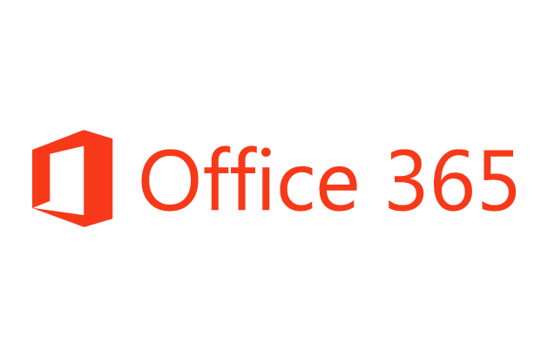



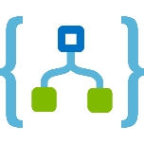
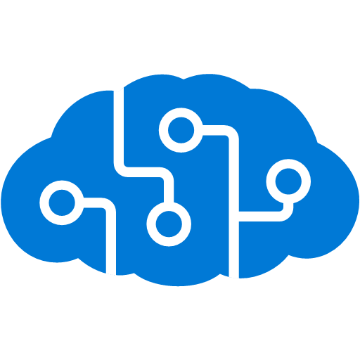
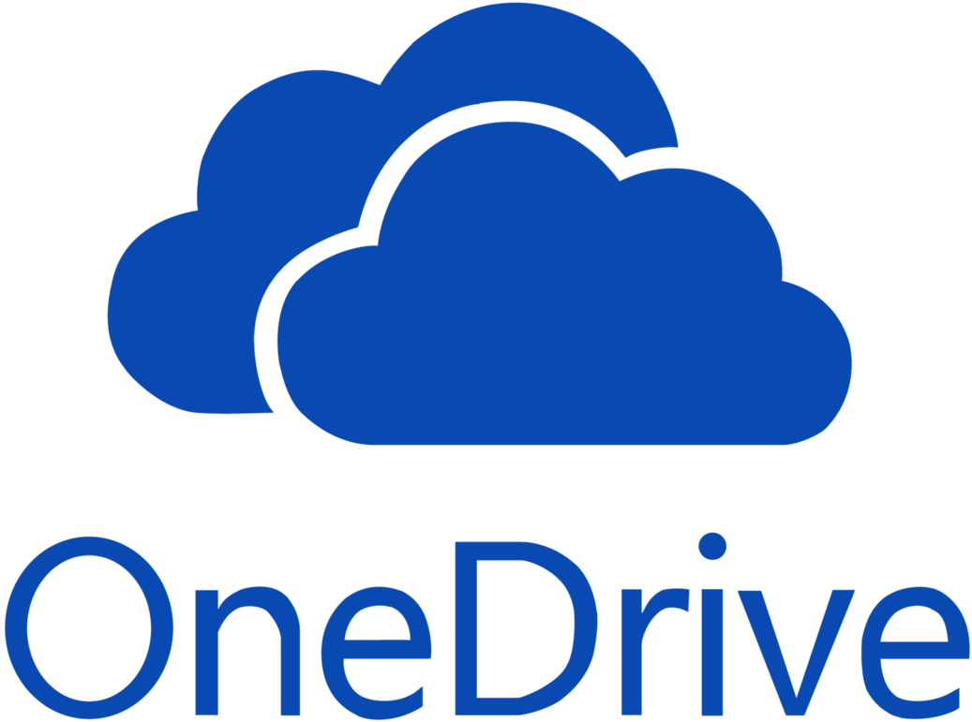
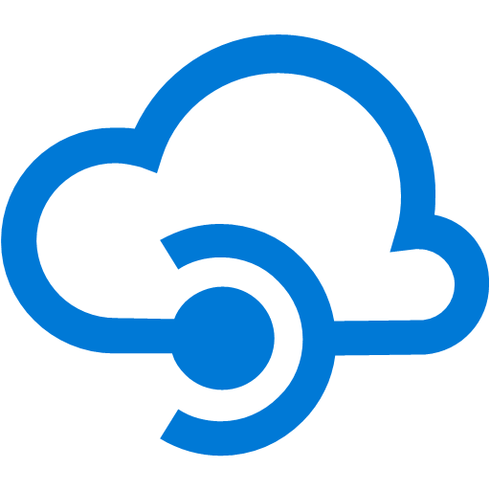

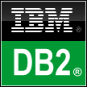


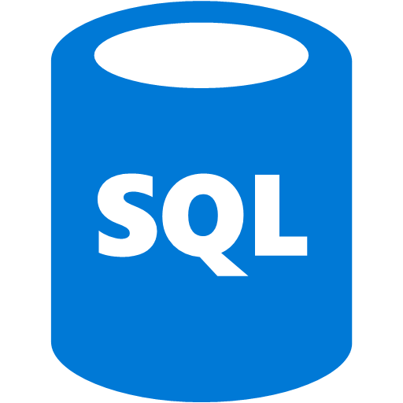
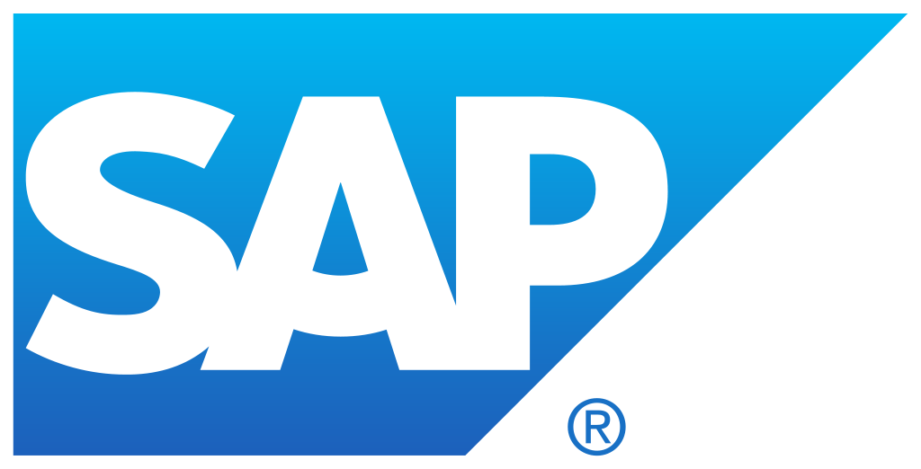
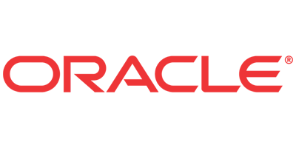
Hybrid connectivity
Connect on-premises, hybrid and cloud applications
Run mission-critical, complex integration scenarios
Machine Learning
Service Bus
Cognitive Services
Logic app
API Management
BB2B and electronic data interchange
On-premises data gateway
BizTalk Server
Notes:
You require an on-premises data gateway to connect your logic app to secure data that isn’t hosted on Azure. You can use the gateway to create a hybrid workflow that runs complex integration scenarios across data in the cloud and on-premises environments.

Slide 11
B2B scenarios and the Enterprise Integration Pack
A special pack that transforms different formats
Communicate seamlessly between organizations
Secure messages with encryption and digital signatures
Based on familiar BizTalk concepts
Why should you use Enterprise Integration?
With enterprise integration, you can store all your artifacts in one place—your integration account
You can build B2B workflows and integrate with third-party software as a service (SaaS) apps, on-premises apps, and custom apps by using the Azure logic apps engine and all its connectors
You can create custom code for your logic apps with Azure Functions
Notes:
For B2B workflows and seamless communication with Azure logic apps, you can enable enterprise integration scenarios with the Microsoft cloud-based solution called the Enterprise Integration Pack. Organizations can exchange messages electronically, even if they use different protocols and formats. The pack transforms different formats into a format that organizations' systems can interpret and process. Organizations can exchange messages through industry-standard protocols, including AS2, X12, and EDIFACT. You can also secure messages with both encryption and digital signatures.
If you are familiar with BizTalk Server or Microsoft Azure BizTalk Services, the Enterprise Integration features are easy to use because most concepts are similar. One major difference is that Enterprise Integration uses integration accounts to simplify the storage and management of artifacts used in B2B communications.
Architecturally, the Enterprise Integration Pack is based on "integration accounts." These accounts are cloud-based containers that store all your artifacts, like schemas, partners, certificates, maps, and agreements. You can use these artifacts to design, deploy, and maintain your B2B apps and also to build B2B workflows for logic apps. But before you can use these artifacts, you must first link your integration account to your logic app. After that, your logic app can access your integration account's artifacts.

Slide 12
Enterprise integration steps
Create an integration account in the Azure portal
Add partners, schemas, certificates, maps, and agreements to the integration account
Create a logic app
Link the logic app to the integration account
In your logic app, use the components stored in the integration account
Enterprise integration architecture
Create an integration account in the Azure portal
Add partners, schemas, certificates, maps and agreements to the integration account
Create a logic app
Link the logic app to the integration account
In your logic app, use the partners, schemas, certificates, and agreements stored in the integration account
Notes:
You can build and manage B2B apps with the Enterprise Integration Pack through the logic app Designer in the Azure portal. You can also manage your logic apps with PowerShell.
Displayed here are the high-level steps that you must take before you can create apps in the Azure portal.

Slide 13
Create logic apps by using Visual Studio
Save time and simplify complex processes with visual design tools
Build logic apps from start to finish by using the Logic Apps Designer
Through your browser in the Azure portal
Through Visual Studio
Start workflow with a trigger and actions directly in Visual Studio
View, edit, and revise templates quickly by using existing code-based tools
Notes:
With Azure logic apps and Visual Studio, you can create workflows for automating tasks and processes that integrate apps, data, systems, and services across enterprises and organizations. This lesson shows how you can design and build these workflows by creating logic apps in Visual Studio and deploying those apps to Azure in the cloud. And although you can perform these tasks in the Azure portal, Visual Studio lets you add logic apps to source control, publish different versions, and create Azure Resource Manager templates for different deployment environments.

Slide 14
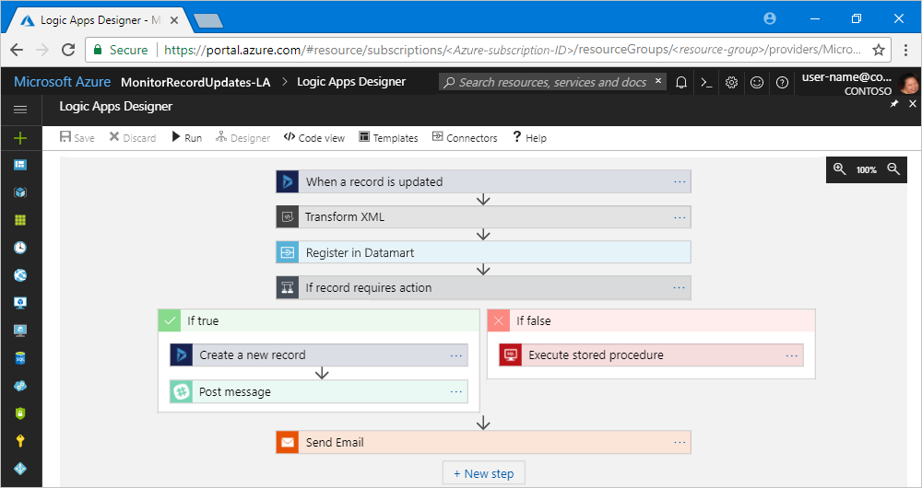
Logic Apps Designer
Notes:
You can build your logic apps visually with the logic apps Designer, available in the Azure portal through your browser and in Visual Studio. For more custom logic apps, you can create or edit logic app definitions in JavaScript Object Notation (JSON) by working in "code view" mode. You can also use Azure PowerShell commands and Azure Resource Manager templates for select tasks. Logic apps deploy and run in the cloud on Azure.

Slide 15
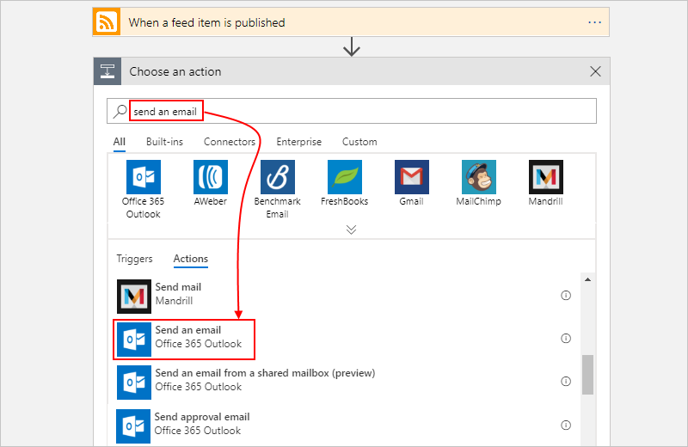
Logic Apps Designer – action search
Notes:
When you first decide to create an action, you must select an action from the list of available actions. A search bar makes it easier to find the specific action and connector you require.

Slide 16
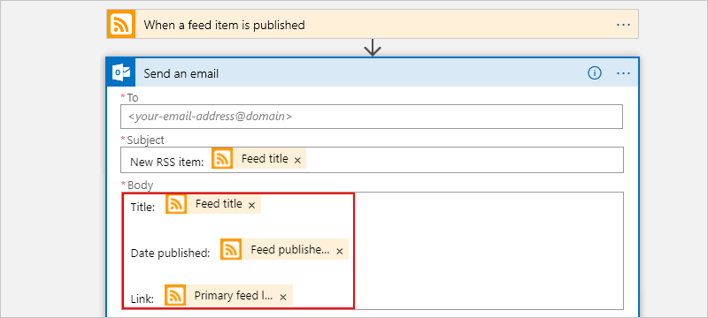
Logic Apps Designer – action configuration
Notes:
After an action is selected, you will use the designer to configure the action. The configuration screen will be unique to each action.

Slide 17
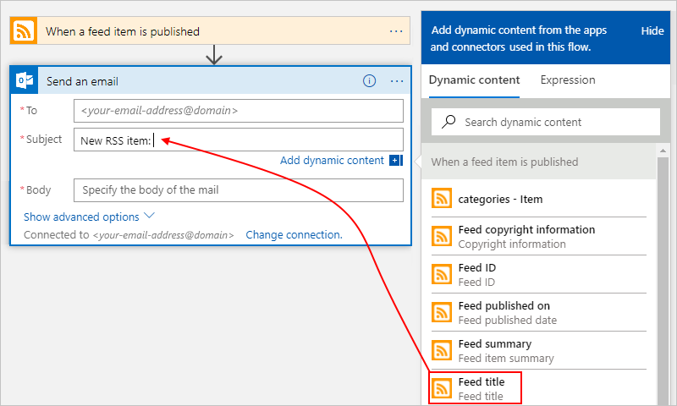
Logic Apps Designer – dynamic content
Notes:
A side panel makes it easier to add expressions that reference variables, input, and output from other locations in the workflow. In this example, an output of the previous trigger or action is used in the current action.

Slide 18

Schedule triggers
Workflow
Scheduled trigger
Notes:
You can start your logic app workflow by using a scheduled trigger, which isn’t associated with any specific service or system.
This type of trigger starts and runs your workflow based on the recurrence frequency and interval that you specify. You can also set the start date and time as well as the time zone. Each time a trigger fires, logic apps creates and runs a new workflow instance for your logic app.

Slide 19
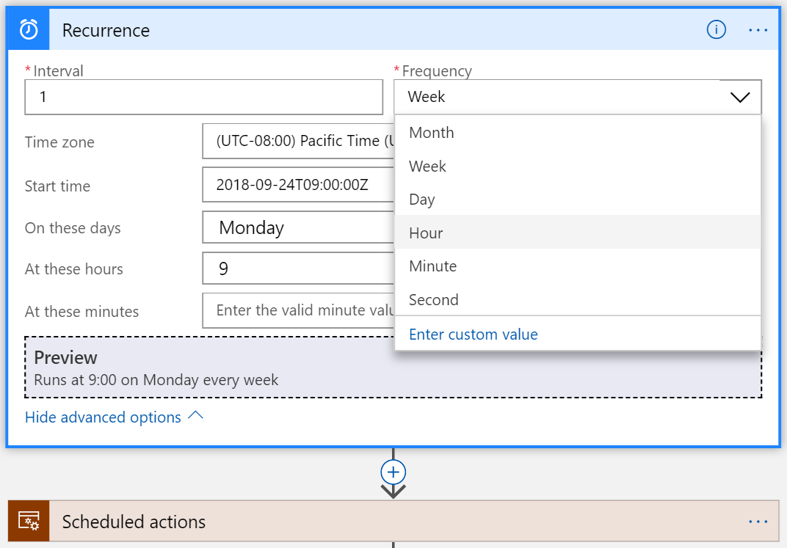
Scheduling recurrence
Simple recurrence:
Interval and frequency
Examples: every 30 seconds, 5 minutes, or 1 month
Start time:
Date and time for the first execution
Not earlier than the date and time for prescribed schedules
Complex schedules:
Specify minutes, hours, weekdays, or days of the month of the recurrence
Examples: every Sunday at noon or every 15 minutes during work hours
Notes:
The Recurrence trigger runs your workflow at regular time intervals based on your specified schedule.
If recurrences are missed, the Recurrence trigger doesn't process the missed recurrences but restarts recurrences with the next scheduled interval.
You can specify a start date and time as well as the time zone.
If you select Day, you can specify hours of the day and minutes of the hour; for example, every day at 2:30 PM. If you select Week, you can also select days of the week, such as Wednesday and Saturday.

Slide 20
Schedule trigger types
Recurrence
Sliding window
0
5
10
15
20
0
5
10
15
20
Notes:
The recurrence trigger runs your workflow at regular time intervals based on the schedule that you specify. The sliding window trigger runs your workflow at regular time intervals that handle data in continuous chunks.
If the interval is less than a day and can be measured in seconds, minutes, or hours, you can use both recurrence trigger and sliding window trigger. If the interval is more than a day and needs to be measured in days, weeks, or months, you can use only the recurrence trigger.

Slide 21
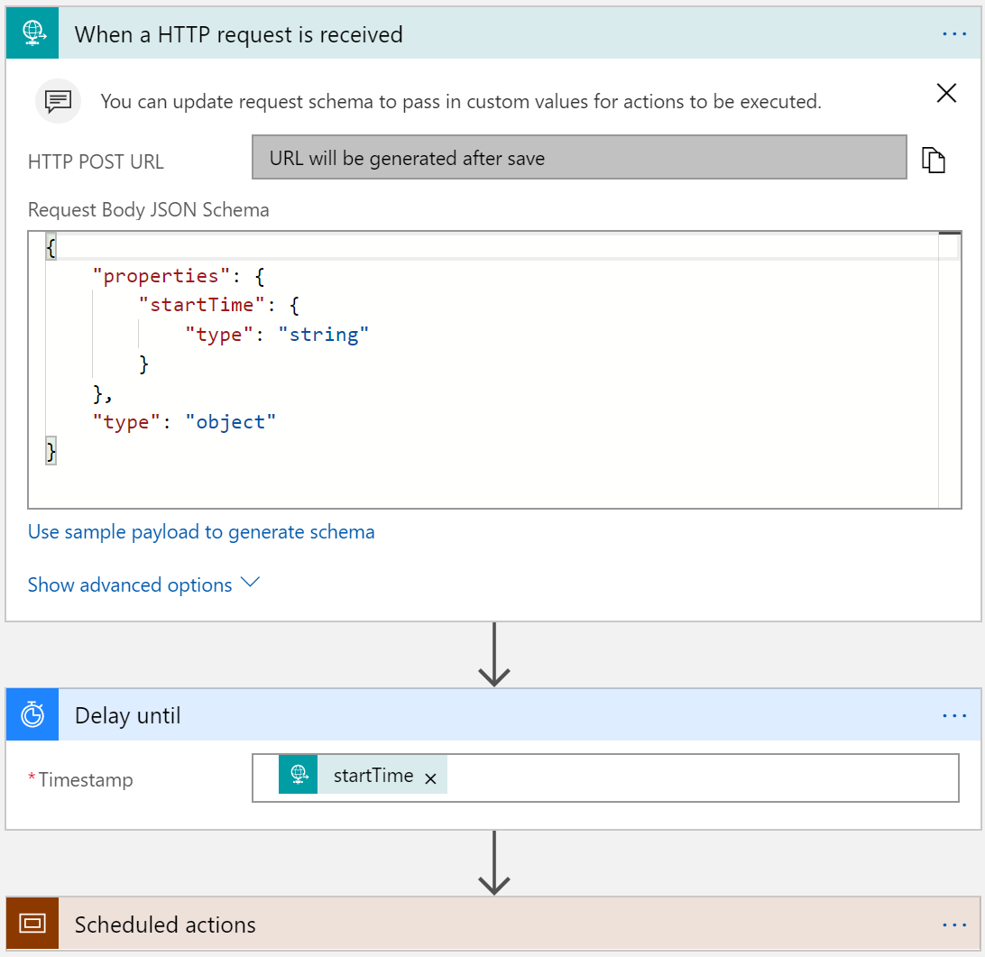
Single execution (run once)
Delay
Specify the wait duration
Delay until
Specify the startTime property
Execute actions
Notes:
If you want to run your logic app only at one time in the future, you can start your logic app with the When a HTTP request is received - Request trigger, and then pass the start time as a parameter for the trigger. For the first action, use the Delay until action, and provide the time for when the next action starts running.
After any action in your logic app workflow, you can use the Delay until action to make your workflow wait before the next action runs. The Delay until action will wait to run the next action until the specified date and time.

Slide 22
Demonstration: Creating a logic app by using the Azure portal

Slide 23


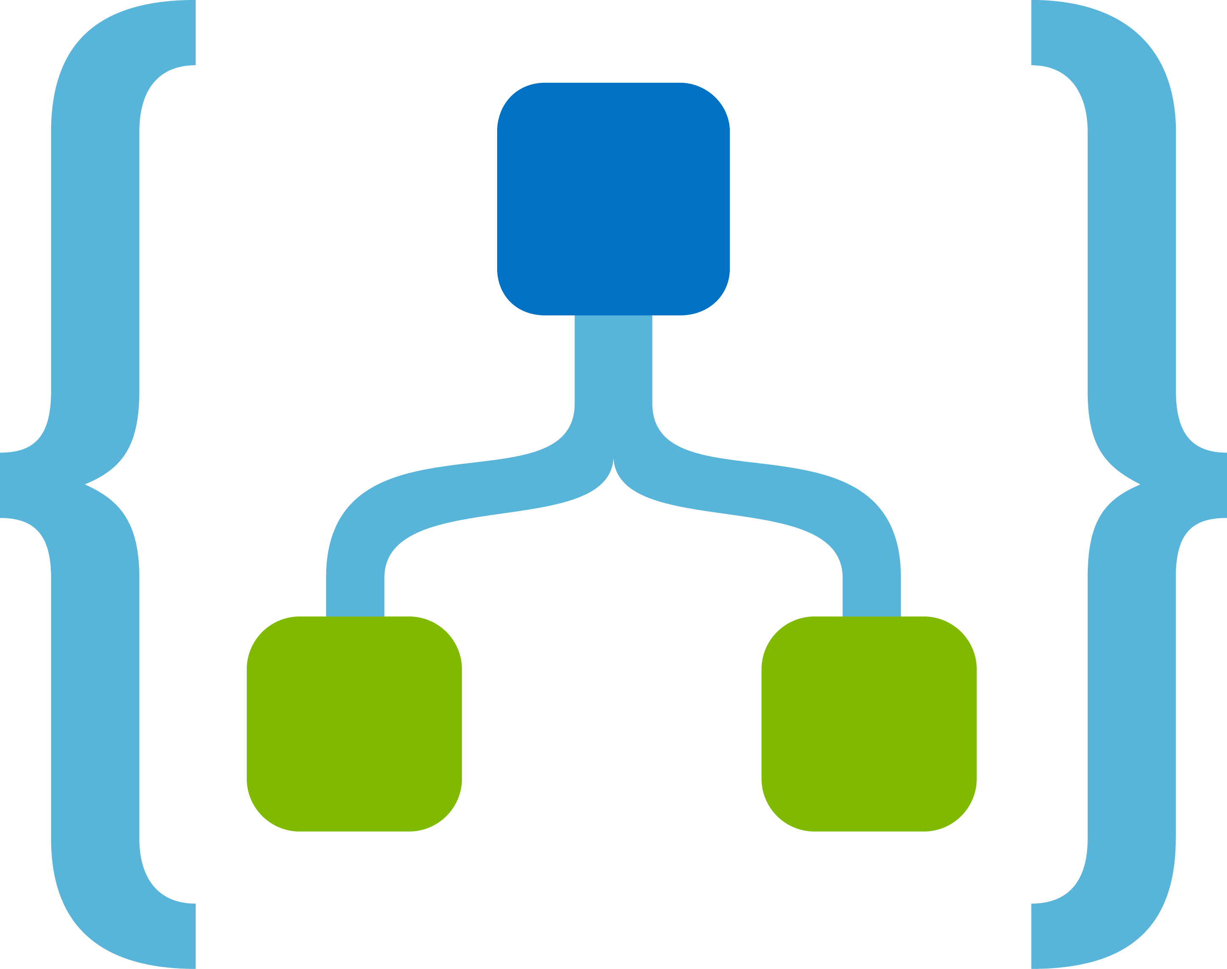
Custom connectors
Text Analytics API
Some APIs, services, and systems are available by using prebuilt connectors
Build custom connectors:
Function-based
Custom defined triggers and actions
Build and secure your API
Describe your API and define the connector
Use your connector
Share your connector (optional)
Certify your connector (optional)
Custom connectors
App or Flow
Logic App
Notes:
Without writing any code, you can build workflows and apps with Azure logic apps, Microsoft Flow, and PowerApps. To help you integrate your data and business processes, these services offer more than 180 connectors—for Microsoft services and products, and other services like GitHub, Salesforce, Twitter, and more.
Sometimes though, you might want to call APIs, services, and systems that aren't available as prebuilt connectors. To support more tailored scenarios, you can build custom connectors with their own triggers and actions. These connectors are function-based—data is returned based on calling specific functions in the underlying service.
The example diagram shows a custom connector for an API that detects sentiment in text.

Slide 24
Deployment templates
JSON template to build a logic app workflow
Three basic components of a logic app represented as JSON objects
Logic app resource
Workflow definition
Connections
Can be extracted from existing workflows
Templates can be deployed by using Azure Resource Manager templates
Notes:
After a logic app has been created, you might want to create it as an Azure Resource Manager template. This way, you can easily deploy the logic app to any environment or resource group where you might need it.
A logic app has three basic components:
logic app resource: Contains information about things like pricing plan, location, and the workflow definition.
Workflow definition: Describes your logic app's workflow steps and how the logic apps engine should execute the workflow. You can view this definition in your logic app's Code View window. In the logic app resource, you can find this definition in the definition property.
Connections: Refers to separate resources that securely store metadata about any connector connections, such as a connection string and an access token. In the logic app resource, your logic app references these resources in the parameters section.
You can view all these pieces of existing logic apps by using a tool like Azure Resource Explorer.
To make a template for a logic app to use with resource group deployments, you must define the resources and parameterize as needed. For example, if you're deploying to a development, test, and production environment, you likely want to use different connection strings to a SQL database in each environment. Or, you might want to deploy within different subscriptions or resource groups.

Slide 25
Template code
{
"$schema": "http://schema.management.azure.com/providers/Microsoft.Logic/schemas/2016-06-01/workflowdefinition.json#",
"contentVersion": "1.0.0.0",
"parameters": {
"testUri": {
"type": "string",
"defaultValue": "[parameters('testUri')]"
}
},
"triggers": {
"recurrence": {
"type": "recurrence",
"recurrence": {
"frequency": "Hour",
"interval": 1
}
}
},
Notes:
UPDATED SLIDE: In this code example, the parameters and triggers are shown for the workflow.
The parameters are the input values and the trigger is the event that starts the workflow. In this example, our workflow is triggered once every hour and starts off with a string parameter named testURI.

Slide 26
Template code (continued)
"actions": {
"http": {
"type": "Http",
"inputs": {
"method": "GET",
"uri": "@parameters('testUri')"
},
"runAfter": {}
}
},
"outputs": {}
}
Notes:
UPDATED SLIDE: In this code example, the actions and outputs are shown for the workflow.
The actions object contains a list of actions that will execute for the workflow. In this example, a HTTP GET request is issued against the URL stored in the testUri parameter.

Slide 27
Create a deployment template
Visual Studio tools for logic apps
Either generate from a visual workflow or author JSON directly
Using the Code tab in the Azure portal
Generate from existing visual workflow
Use a logic app template creator PowerShell module
Notes:
The easiest way to have a valid logic app deployment template is to use the Visual Studio tools for logic apps. The Visual Studio tools generate a valid deployment template that can be used across any subscription or location.
A few other tools can assist you as you create a logic app deployment template. You can author by hand, that is, by using the resources already discussed here to create parameters as needed. Another option is to use a logic app template creator PowerShell module. This open-source module first evaluates the logic app and any connections that it is using, and then generates template resources with the necessary parameters for deployment. For example, if you have a logic app that receives a message from an Azure Service Bus queue and adds data to an Azure SQL database, the tool preserves all the orchestration logic and parameterizes the SQL and Service Bus connection strings so that they can be set at deployment.

Slide 28
Create a deployment template – Azure PowerShell
Install-Module -Name LogicAppTemplate
armclient token $SubscriptionId | Get-LogicAppTemplate -LogicApp MyApp -ResourceGroup MyRG -SubscriptionId $SubscriptionId -Verbose | Out-File C:\template.json
Notes:
UPDATED SLIDE: The easiest way to install the module is via the PowerShell Gallery, by using the command Install-Module -Name LogicAppTemplate.
For the module to work with any tenant and subscription access token, we recommend that you use it with the ARMClient command-line tool.
After PowerShell is installed, you can generate a template by using the Get-LogicAppTemplate command.
$SubscriptionId is the Azure subscription ID. This line first gets an access token via ARMClient, then pipes it through to the PowerShell script, and then creates the template in a JSON file.

Slide 29
Template parameters – Function App example
"parameters": {
"functionName": { "type":"string", "minLength":1, "defaultValue":"<FunctionName>" }
},
...
"MyFunction": {
"type": "Function",
"inputs": {
"body":{},
"function":{
"id":"[resourceid('Microsoft.Web/sites/functions','functionApp', parameters('functionName'))]"
}
},
"runAfter":{}
}
Notes:
UPDATED SLIDE: After you create your logic app template, you can continue to add or modify parameters that you might need. For example, if your definition includes a resource ID to an Azure Function or nested workflow that you plan to deploy in a single deployment, you can add more resources to your template and parameterize IDs as needed. The same applies to any references to custom APIs or Swagger endpoints you expect to deploy with each resource group.
And you can use template functions such as parameters, variables, resourceId, concat, and others. For example, this code shows how you can replace the Azure Function resource ID.

Slide 30
Template parameters – Service Bus example
"Send_message": {
"type": "ApiConnection",
"inputs": {
"host": {
"connection": {
"name": "@parameters('$connections')['servicebus']['connectionId']"
}
},
"method": "post",
"path": "[concat('/@{encodeURIComponent(''', parameters('queueuname'), ''')}/messages')]",
"body": { "ContentData": "@{base64(triggerBody())}" },
"queries": { "systemProperties": "None" }
},
"runAfter": {}
}
Notes:
UPDATED SLIDE: As another example, you can parameterize the Service Bus send message operation.
Note: host.runtimeUrl is optional and can be removed from your template if it is present.

Slide 31

Lab: Automating business processes by using logic apps
Notes:
This lab is scheduled to take 45 minutes.

Slide 32

Lab sign-in information
Duration
Lab: Automating business processes by using logic apps
AZ204-SEA-DEV
Username: Admin
Password: Pa55w.rd
Notes:
Students will also have access to the following scenario description in their lab guide:
Your organization keeps a collection of JSON files that it uses to configure third-party products in a Server Message Block (SMB) file share in Microsoft Azure.
As part of a regular auditing practice, the operations team would like to call a simple HTTP endpoint and retrieve the current list of configuration files.
You have decided to implement this functionality using a no-code solution based on Azure API Management service and logic apps.

