Slide 1
Module 12: Instrument solutions to support monitoring and logging

Slide 2
Topics
Overview of monitoring in Azure
Configure instrumentation in an app or service
Analyzing and troubleshooting apps
Implement code that handles transient faults

Slide 3
Lesson 01: Overview of monitoring in Azure

Slide 4
Azure Monitor
Metrics
Logs
Common Store
Unified Monitoring
Data Driven Insights
Workflow Integrations
A common platform for all metrics, logs and other monitoring telemetry
Advanced diagnostics and analytics powered by machine learning capabilities
Rich ecosystem of popular DevOps, issue management, SIEM, and ITSM tools
Notes:
Azure Monitor maximizes the availability and performance of your applications by delivering a comprehensive solution for collecting, analyzing, and acting on telemetry from your cloud and on-premises environments. It helps you understand how your applications are performing and proactively identifies issues affecting them and the resources they depend on. You can consider Azure monitor a single "pane of glass" that was once handled by multiple separate services. Using the insights and metrics, you can them implement workflows to integrate with popular tooling in the market.

Slide 5

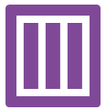
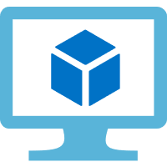
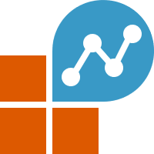
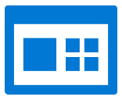
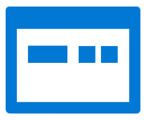



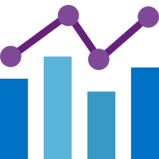




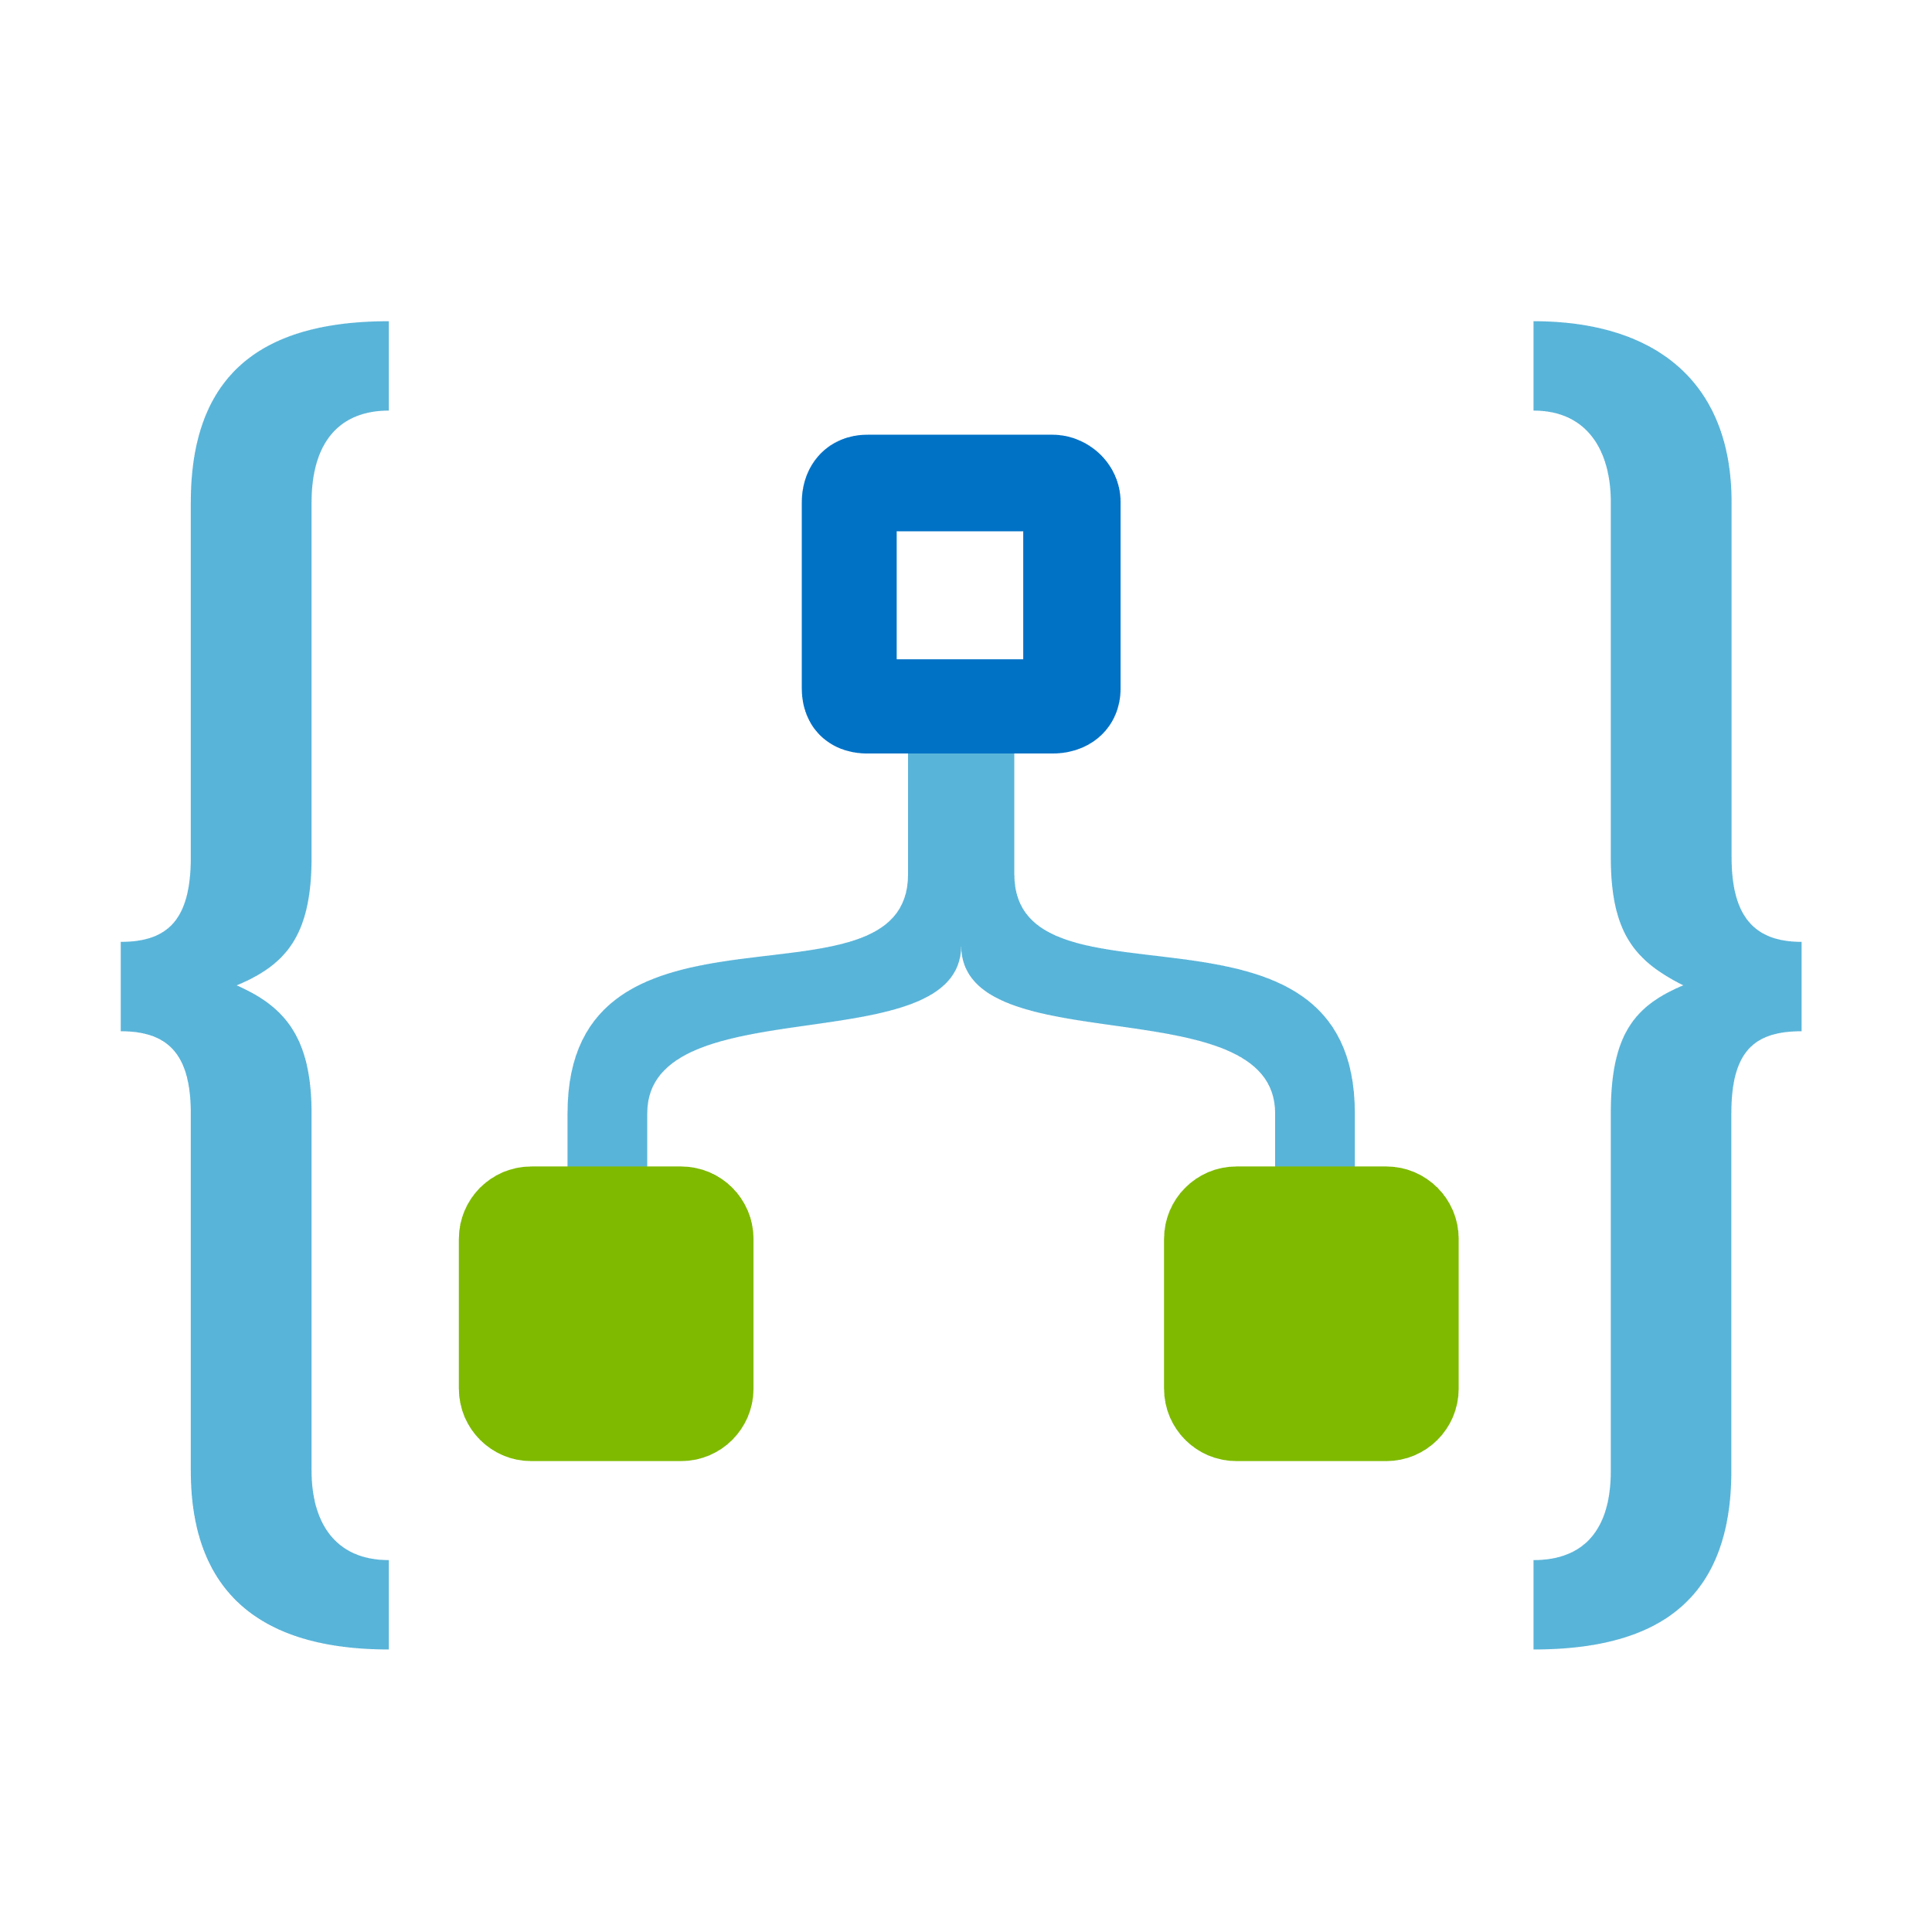
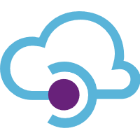
Azure Monitor overview
Azure Monitor
Insights
Application
Container
VM
Monitoring
solutions
Application
Operating system
Visualize
Azure resources
Dashboards
Views
Power BI
Workbooks
Azure subscription
Metrics
Analyze
Azure tenant
Metric Analytics
Log Analytics
Logs
Respond
Custom sources
Alerts
Autoscale
Integrate
Event Hubs
Logic Apps
Ingest and
export APIs
Notes:
The following diagram gives a high-level view of Azure Monitor. At the center of the diagram are the data stores for metrics and logs, which are the two fundamental types of data use by Azure Monitor. On the left are the sources of monitoring data that populate these data stores. On the right are the different functions that Azure Monitor performs with this collected data such as analysis, alerting, and streaming to external systems.

Slide 6
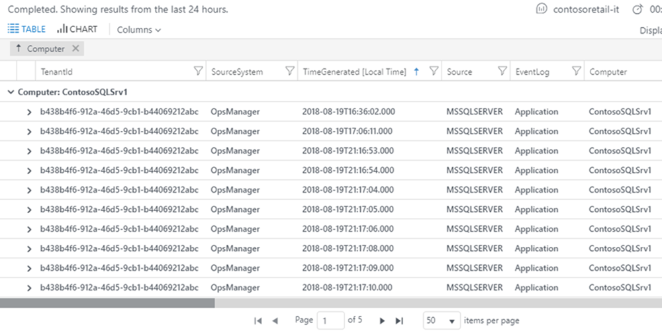
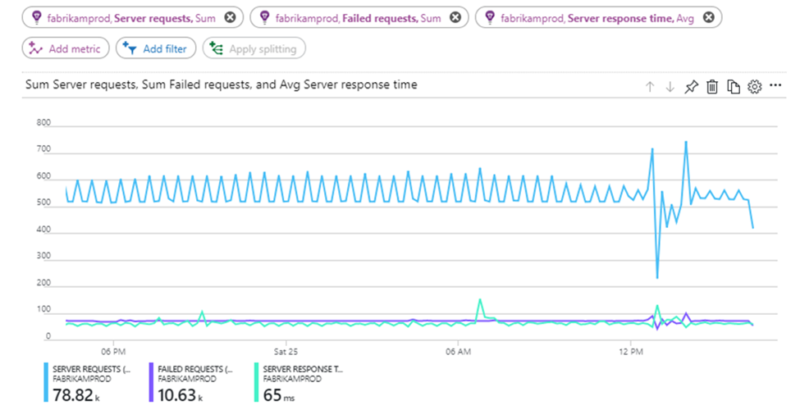

Monitoring data platform
Logs
Metrics
Log Analytics
Metrics Explorer
Notes:
All data collected by Azure Monitor fits into one of two fundamental types, metrics and logs. Metrics are numerical values that describe some aspect of a system at a particular point in time. They are lightweight and capable of supporting near real-time scenarios. Logs contain different kinds of data organized into records with different sets of properties for each type. Telemetry such as events and traces are stored as logs in addition to performance data so that it can all be combined for analysis.
Log data collected by Azure Monitor is stored in Log Analytics, which includes a rich query language to quickly retrieve, consolidate, and analyze collected data. You can create and test queries by using the Log Analytics page in the Azure portal and then either directly analyze the data by using these tools or save queries for use with visualizations or alert rules.

Slide 7
Alerts
Alert rule
Proactively notify you when conditions are met
Defined in alert rules
Now unified across multiple services
Application Insights
Log Analytics
Azure Monitor
Target resource
Signal
Criteria / Logic test
Action group
Monitor condition
Actions to do
Alert state
Notes:
Alerts proactively notify you when important conditions are found in your monitoring data. They allow you to identify and address issues before the users of your system notice them.
Note: The new unified alert experience in Azure Monitor now includes Log Analytics and Application Insights. The previous alert experience and alert types are called classic alerts.
Alert rule – The alert rule captures the target and criteria for alerting. The alert rule can be in an enabled or a disabled state. Alerts only fire when enabled.

Slide 8





Alerts workflow
Resource
OMS Alerts
Diagnostic Logs
Azure Monitor Alerts
Rule
Azure Infrastructure
Criteria met
Resource Metrics
Automation
Email
Automation Runbook
SMS
Activity Logs
Webhook
Function App
Logic Apps
3rd Party URL
Notes:
The key attributes of an alert rule are:
Target Resource – Defines the scope and signals available for alerting. A target can be any Azure resource. Example targets: a virtual machine, a storage account, a virtual machine scale set, a Log Analytics workspace, or an Application Insights resource. For certain resources (like virtual machines), you can specify multiple resources as the target of the alert rule.
Signal Signals are emitted by the target resource and can be of several types. Metric, Activity log, Application Insights, and Log.
Criteria – Criteria is the combination of Signal and Logic applied on a Target resource. Examples:
Percentage CPU > 70%
Server Response Time > 4 ms
Result count of a log query > 100
Alert Name – A specific name for the alert rule configured by the user.
Alert Description – A description for the alert rule configured by the user.
Severity – The severity of the alert once the criteria specified in the alert rule is met. Severity can range from 0 to 4.
Action – A specific action taken when the alert is fired.

Slide 9
Alert state
State | Description
New | The issue has just been detected and has not yet been reviewed.
Acknowledged | An administrator has reviewed the alert and started working on it.
Closed | The issue has been resolved. After an alert has been closed, you can reopen it by changing it to another state.
Notes:
You can set the state of an alert to specify where it is in the resolution process. When the criteria specified in the alert rule is met, an alert is created or fired, and it has a status of New. You can change the status when you acknowledge an alert and when you close it. All state changes are stored in the history of the alert.
Alert state is different and independent of the monitor condition. Alert state is set by the user. Monitor condition is set by the system. When an alert fires, the alert's monitor condition is set to fired. When the underlying condition that caused the alert to fire clears, the monitor condition is set to resolved. The alert state isn't changed until the user changes it.

Slide 10
Application Insights
Application performance management service:
Collects application telemetry
Processes telemetry by using Machine Learning technology
Detects and diagnoses problems automatically
Enables you to use queries to answer complex questions
Notes:
Application Insights, a feature of Azure Monitor, is an extensible Application Performance Management (APM) service for developers and DevOps professionals. You can use it to monitor live applications, as it's designed to help continuously improve performance and usability of live applications. Application insights will automatically detect performance anomalies. It includes powerful analytics tools to help diagnose issues and to understand what users actually do with an application.

Slide 11



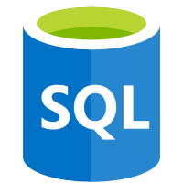
Application Insights architecture
Web Applications
Alerts
AI
Power BI
HTTP Requests
Application Insights
Server-Side Code
Visual Studio
AI
REST API
Dependency Calls
Continuous Export
External Services
Background Services
AI
Notes:
You install a small instrumentation package in your application, and set up an Application Insights resource in the Microsoft Azure portal. The instrumentation monitors your app and sends telemetry data to the portal. (The application can run anywhere—it doesn't have to be hosted in Azure.)
You can instrument not only the web service application but also any background components and the JavaScript in the webpages themselves.
In addition, you can pull in telemetry from the host environments such as performance counters, Azure diagnostics, or Docker logs. You can also set up web tests that periodically send synthetic requests to your web service.
All these telemetry streams are integrated in the Azure portal, where you can apply powerful analytic and search tools to the raw data.

Slide 12
Lesson 02: Configure instrumentation in an app or service

Slide 13
Application Insights for webpages
Monitor webpage or applications
Observe usage in near real-time
Gather performance metrics
Can use a script to capture front-end telemetry
Page load time
Asynchronous JavaScript and XML (AJAX) calls
Browser exceptions
AJAX failures
User information
Session counts
Segmented breakdowns
By users, page, client OS, browser version, geo-location, or other dimensions
Notes:
Use Application Insights for webpages to find out about the performance and usage of your webpage or app. If you add Application Insights to your page script, you get timings of page loads and AJAX calls, counts and details of browser exceptions and AJAX failures, and user and session counts. All these can be segmented by page, client OS and browser version, geo-location, and other dimensions. You can set alerts on failure counts or slow page loading. And by inserting trace calls in your JavaScript code, you can track how the different features of your webpage application are used.

Slide 14
Application Insights for webpages - code
<script type="text/javascript">
var appInsights=window.appInsights||function(a){
function b(a){c[a]=function(){var b=arguments;c.queue.push(function(){c[a].apply(c,b)})}}var c={config:a},d=document,e=window;setTimeout(function(){var b=d.createElement("script");b.src=a.url||"https://az416426.vo.msecnd.net/scripts/a/ai.0.js",d.getElementsByTagName("script")[0].parentNode.appendChild(b)});try{c.cookie=d.cookie}catch(a){}c.queue=[];for(var f=["Event","Exception","Metric","PageView","Trace","Dependency"];f.length;)b("track"+f.pop());if(b("setAuthenticatedUserContext"),b("clearAuthenticatedUserContext"),b("startTrackEvent"),b("stopTrackEvent"),b("startTrackPage"),b("stopTrackPage"),b("flush"),!a.disableExceptionTracking){f="onerror",b("_"+f);var g=e[f];e[f]=function(a,b,d,e,h){var i=g&&g(a,b,d,e,h);return!0!==i&&c["_"+f](a,b,d,e,h),i}}return c
}({ instrumentationKey:"<your instrumentation key>" });
window.appInsights=appInsights,appInsights.queue&&0===appInsights.queue.length&&appInsights.trackPageView();
</script>
Instrumentation Key goes here
Notes:
Application Insights can be used with any webpages—you just add a short piece of JavaScript. If your web service is Java or Microsoft ASP.NET, you can integrate telemetry from your server and clients.
Insert the script just before the </head> tag of every page that you want to track. If your website has a master page, you can put the script there. For example, in an ASP.NET MVC project, you'd put it in View\Shared\_Layout.cshtml.
The script contains the instrumentation key that directs the data to your Application Insights resource.

Slide 15
Application Insights for web pages - config
// Send telemetry immediately without batching.
// Remember to remove this when no longer required, as it can affect browser performance.
enableDebug: boolean,
// Don't log browser exceptions.
disableExceptionTracking: boolean,
// Don't log ajax calls.
disableAjaxTracking: boolean,
// Limit number of Ajax calls logged, to reduce traffic.
maxAjaxCallsPerView: 10, // default is 500
// Time page load up to execution of first trackPageView().
overridePageViewDuration: boolean,
// Set dynamically for an authenticated user.
accountId: string,
Notes:
There are several parameters that you can set, although in most cases, you shouldn't need to. For example, you can disable or limit the number of AJAX calls reported per page view (to reduce traffic). Or you can set debug mode to have telemetry move rapidly through the pipeline without being batched.
To set these parameters, add them after the instrumentationKey as properties of the same JSON object.

Slide 16
Application Insights for console applications
Install latest Microsoft.ApplicationInsights NuGet package
Install latest Microsoft.ApplicationInsights.DependencyCollector NuGet package
Set the instrumentation key
By using the static TelemetryConfiguration.Active.InstrumentationKey property
By using the APPINSIGHTS_INSTRUMENTATIONKEY environment variables
By using the ApplicationInsights.config file
Notes:
To get started:
In the Azure portal, create an Application Insights resource. For application type, choose General.
Take a copy of the Instrumentation Key. Find the key in the Essentials drop-down of the new resource you created.
Install latest Microsoft.ApplicationInsights package. Install latest version of Microsoft.ApplicationInsights.DependencyCollector package—it automatically tracks HTTP, SQL, or some other external dependency calls.
Set the instrumentation key in your code before tracking any telemetry (or set APPINSIGHTS_INSTRUMENTATIONKEY environment variable). After that, you should be able to manually track telemetry and view it on the Azure portal.

Slide 17
Application Insights for console applications - config
TelemetryConfiguration.Active.InstrumentationKey = " *your key* ";
var telemetryClient = new TelemetryClient();
telemetryClient.TrackTrace("Hello World!");
Notes:
Set the instrumentation key in your code before tracking any telemetry (or set APPINSIGHTS_INSTRUMENTATIONKEY environment variable). After that, you should be able to manually track telemetry and view it on the Azure portal.
You may initialize and configure Application Insights from the code or by using the ApplicationInsights.config file. Make sure that initialization happens as early as possible.
Note: Instructions referring to ApplicationInsights.config are only applicable to apps that are targeting the .NET Framework, and do not apply to .NET applications.

Slide 18
Application Insights for console applications - files
using System.IO;
// Reads ApplicationInsights.config file if present
TelemetryConfiguration config = TelemetryConfiguration.Active;
TelemetryConfiguration configuration = TelemetryConfiguration.CreateFromConfiguration(File.ReadAllText("C:\\ApplicationInsights.config"));
var telemetryClient = new TelemetryClient(configuration);
Notes:
By default, Application Insights SDK searches for ApplicationInsights.config file in the working directory when TelemetryConfiguration is being created.
You may also specify path to the config file.
You may get a full example of the config file by installing the latest version of the Microsoft.ApplicationInsights.WindowsServer package.

Slide 19
Application Insights for console applications - code
var module = new DependencyTrackingTelemetryModule();
// Prevent Correlation Id to be sent to certain endpoints.
module.ExcludeComponentCorrelationHttpHeadersOnDomains.Add("core.windows.net");
// enable known dependency module.IncludeDiagnosticSourceActivities.Add("Microsoft.Azure.EventHubs");
// initialize the module
module.Initialize(configuration);
Notes:
During application startup, create and configure a DependencyTrackingTelemetryModule instance—it must be singleton and must be preserved for application lifetime.
Add common telemetry initializers.
For .NET Framework Windows app, you may also install and initialize Performance Counter collector module.

Slide 20
Application Insights for desktop apps
Can be configured in a manner very similar to Application Insights for console apps
Install latest Microsoft.ApplicationInsights NuGet package
Install latest Microsoft.ApplicationInsights.DependencyCollector NuGet package
Set the instrumentation key
By using the static TelemetryConfiguration.Active.InstrumentationKey property
By using the ApplicationInsights.config file
Notes:
Applications hosted on-premises, in Azure, and in other clouds can all take advantage of Application Insights. The only limitation is the need to allow communication to the Application Insights service.

Slide 21
Application Insights for desktop apps - code
public partial class Form1 : Form
{
private TelemetryClient tc = new TelemetryClient();
private void Form1_Load(object sender, EventArgs e)
{
// Alternative to setting ikey in config file:
tc.InstrumentationKey = "key copied from portal";
// Set session data:
tc.Context.User.Id = Environment.UserName;
tc.Context.Session.Id = Guid.NewGuid().ToString();
tc.Context.Device.OperatingSystem = Environment.OSVersion.ToString();
// Log a page view:
tc.TrackPageView("Form1");
...
}
}
Notes:
Just as with any other platform, you can use the API to send telemetry to Application Insights.

Slide 22
Application Insights platforms
Official support – languages
.NET (C# & Microsoft Visual Basic)
Java
JavaScript
Node.js
Unofficial support – languages
F#
PHP
Python
Ruby
Official support –platforms/frameworks
ASP.NET (including ASP.NET)
Android
Angular
Azure (Azure App Service, Azure Cloud Services, Azure Functions)
Docker
Glimpse
iOS
Java 2 Platform Enterprise Edition (J2EE)
OS X
Spring
Universal Windows Platform (UWP)
Windows Communication Foundation (WCF)
Notes:
These items are implementations of Application Insights that we know about, including some by third parties.

Slide 23
Demonstration: Instrumenting an ASP.NET app for monitoring in Application Insights

Slide 24
Other monitoring tools
AppDynamics:
Application Performance Management (APM), which enables application owners to rapidly troubleshoot performance bottlenecks and optimize the performance of their applications running in an Azure environment.
Datadog:
A monitoring service that gathers monitoring data from your containers within your Azure Container Service cluster. Datadog has a Docker Integration Dashboard, where you can view specific metrics within your containers. Metrics gathered from your containers are organized by CPU, memory, network, and I/O.
Notes:
To view a comprehensive list of partners with direct integrations into Azure Monitor, refer to “Azure Monitor partner integrations” at https://aka.ms/AA4gj9s.

Slide 25
Other monitoring tools (continued)
The Elasticsearch, Logstash, and Kibana (ELK) stack
Combination of Elasticsearch, Logstash, and Kibana that provides an end-to-end stack that can be used to monitor and analyze logs in your cluster. The ELK stack is popular for monitoring container clusters, because the monitoring stack itself is open source and already containerized.
New Relic Application Performance Management
Popular APM add-in for .NET applications. New Relic Application Performance Management can be used similarly in the Azure platform and has first-class support in role-based access control scenarios.
Notes:
To view a comprehensive list of partners with direct integrations into Azure Monitor, refer to “Azure Monitor partner integrations” at https://aka.ms/AA4gj9s.

Slide 26
Lesson 03: Analyzing and troubleshooting apps

Slide 27
What data does Azure Monitor collect?
Azure Monitor can collect data from:
Application monitoring data
Guest OS monitoring data
Azure resource monitoring data
Azure subscription monitoring data
Azure tenant monitoring data
Notes:
Azure Monitor can collect data from a variety of sources. You can think of monitoring data for your applications in tiers ranging from your application, any operating system and services it relies on, down to the platform itself. Azure Monitor collects data from each of the following tiers:
Application monitoring data: Data about the performance and functionality of the code you have written, regardless of its platform.
Guest OS monitoring data: Data about the operating system on which your application is running. This could be running in Azure, another cloud, or on-premises.
Azure resource monitoring data: Data about the operation of an Azure resource.
Azure subscription monitoring data: Data about the operation and management of an Azure subscription, as well as data about the health and operation of Azure itself.
Azure tenant monitoring data: Data about the operation of tenant-level Azure services, such as Azure Active Directory.

Slide 28
Data sources
Custom sources
Data Collector API
Azure
Other clouds
On-premises
Application
Application Insights
Metrics
Guest operating system
Dependency agent Log Analytics agent,
Diagnostics extension
Azure services
Monitoring solutions
Diagnostic logs Metrics
Azure platform
Azure
Service health
Activity log
Logs
Azure tenant
Audit logs
Notes:
Monitoring data in Azure comes from a variety of sources that can be organized into tiers, the highest tiers being your application and any operating systems and the lower tiers being components of Azure platform.
Azure tenant: Telemetry related to your Azure tenant is collected from tenant-wide services such as Azure Active Directory.
Azure platform: Telemetry related to the health and operation of Azure itself includes data about the operation and management of your Azure subscription. It includes service-health data stored in the Azure Activity log and audit logs from Azure Active Directory.
Guest operating system: Compute resources in Azure, in other clouds, and on-premises have a guest operating system to monitor. With the installation of one or more agents, you can gather telemetry from the guest into the same monitoring tools as the Azure services themselves.
Applications: In addition to telemetry that your application may write to the guest operating system, detailed application monitoring is done with Application Insights. Application Insights can collect data from applications running on a variety of platforms. The application can be running in Azure, another cloud, or on-premises.
Custom sources: Azure Monitor can collect log data from any REST client using the Data Collector API. This allows you to create custom monitoring scenarios and extend monitoring to resources that don't expose telemetry through other sources.

Slide 29








Azure Monitor sources
Autoscale
Notifications Engine
Application Insights
Resource
Log Analytics
Metrics
Event Hubs
Azure Infrastructure
Azure Storage
Azure Portal
Azure PowerShell
Azure CLI
REST API
3rd Party Tools
Notes:
All data collected by Azure Monitor fits into one of two fundamental types, metrics and logs.
Metrics are numerical values that describe some aspect of a system at a particular point in time. They are lightweight and capable of supporting near real-time scenarios.
Logs contain different kinds of data organized into records with different sets of properties for each type. Telemetry such as events and traces are stored as logs in addition to performance data so that it can all be combined for analysis.

Slide 30
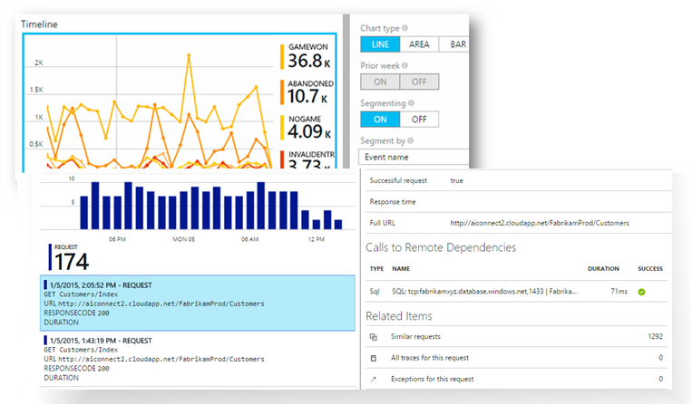
Application Insights overview
Extensible application performance monitoring service
Can be used to:
Monitor a live web application
Automatically detect performance anomalies
Diagnose issues by using analytical tools
Understand real-world user behavior by using custom queries and metric visualizations
Notes:
Application Insights is an extensible application performance management (APM) service for web developers on multiple platforms. Use it to monitor your live web application. It will automatically detect performance anomalies. It includes powerful analytics tools to help you diagnose issues and understand what users actually do with your app.

Slide 31
Monitored metrics
Request rates, response times, and failure rates
Find out which pages are most popular, what times of day are most popular, and where your users are. Observe which pages perform the best. If your response times and failure rates go high when there are more requests, you might have a resourcing problem.
Dependency rates, response times, and failure rates
Find out whether external services are slowing you down
Exceptions
Analyze the aggregated statistics, or pick specific instances and drill into the stack trace and related requests. Both server and browser exceptions are reported.
Page views and load performance
Directly reported by your users' browsers
User and session counts
Notes:
Application Insights is aimed at the development team, to help you understand how your app is performing and how it's being used. It monitors:
Request rates, response times, and failure rates – Find out which pages are most popular, at what times of day, and where your users are. Observe which pages perform best. If your response times and failure rates go high when there are more requests, you might have a resourcing problem.
Dependency rates, response times, and failure rates – Find out whether external services are slowing you down.
Exceptions - Analyze the aggregated statistics, or pick specific instances and drill into the stack trace and related requests. Both server and browser exceptions are reported.
Page views and load performance – Reported by your users' browsers.

Slide 32
Monitored metrics (continued)
Asynchronous JavaScript and XML (AJAX) calls
Rates, response times, and failure rates for these webpage-based calls
Performance counters
Measured from your Windows Server or Linux server machines, such as counters for CPU, memory, and network usage
Host diagnostics
Ingested from Docker or Azure
Diagnostic trace logs
Logs from your app so that you can correlate trace events with requests
Custom events and metrics
Custom metrics that you write yourself in the client or server code to track business events, such as the number of items sold or games won
Notes:
AJAX calls from webpages – rates, response times, and failure rates.
User and session counts.
Performance counters from your Windows or Linux server machines, such as CPU, memory, and network usage.
Host diagnostics from Docker or Azure.
Diagnostic trace logs from your app – so that you can correlate trace events with requests.
Custom events and metrics that you write yourself in the client or server code, to track business events such as items sold or games won.

Slide 33
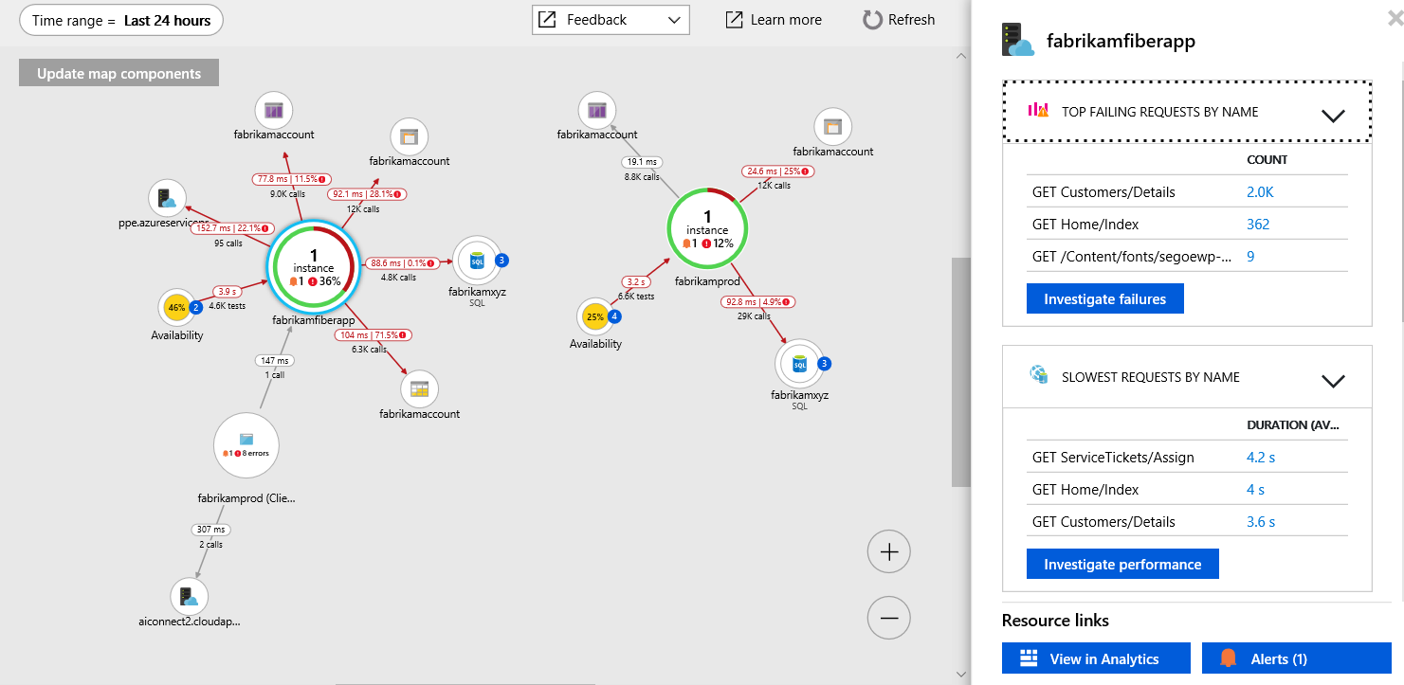
Application Map
Notes:
Application Map helps you spot performance bottlenecks or failure hotspots across all components of your distributed application. Each node on the map represents an application component or its dependencies; and has health KPI and alerts status. You can select through from any component to more detailed diagnostics, such as Application Insights events. If your app uses Azure services, you can also select through to Azure diagnostics, such as SQL Database Advisor recommendations.

Slide 34
Components
Components are independently deployable parts of your distributed/microservices application
Components are different from "observed" external dependencies
Components run on any number of server/role/container instances
Components can be separate Application Insights instrumentation keys, or different roles reporting to a single Application Insights instrumentation key
Notes:
Developers and operations teams have code-level visibility or access to telemetry generated by these application components.
Components are different from "observed" external dependencies such as SQL, EventHub, and others, which your team/organization might not have access to (code or telemetry).
The preview map experience shows the components regardless of how they are set up.
You can view the full application topology across multiple levels of related application components. Components could be different Application Insights resources, or different roles in a single resource. The app map finds components by following HTTP dependency calls made between servers with the Application Insights SDK installed.
This experience starts with progressive discovery of the components. When you first load the application map, a set of queries are triggered to discover the components related to this component. A button at the top-left corner will update with the number of components in your application as they are discovered.

Slide 35
Application Map - code
using Microsoft.ApplicationInsights.Channel;
using Microsoft.ApplicationInsights.Extensibility;
namespace CustomInitializer.Telemetry
{
public class MyTelemetryInitializer : ITelemetryInitializer
{
public void Initialize(ITelemetry telemetry)
{
if (string.IsNullOrEmpty(telemetry.Context.Cloud.RoleName))
{
//set custom role name here
telemetry.Context.Cloud.RoleName = "RoleName";
}
}
}
}
Notes:
Application Map uses the cloud_RoleName property to identify the components on the map. The Application Insights SDK automatically adds the cloud_RoleName property to the telemetry emitted by components. For example, the SDK will add a website name or service role name to the cloud_RoleName property. However, there are cases where you might want to override the default value.

Slide 36
Application Map - configuration
<ApplicationInsights>
<TelemetryInitializers>
<!-- Fully qualified type name, assembly name: -->
<Add Type="CustomInitializer.Telemetry.MyTelemetryInitializer, CustomInitializer"/>
...
</TelemetryInitializers>
</ApplicationInsights>
using Microsoft.ApplicationInsights.Extensibility;
using CustomInitializer.Telemetry;
protected void Application_Start()
{
...
TelemetryConfiguration.Active.TelemetryInitializers.Add(
new MyTelemetryInitializer()
);
}
Notes:
You can load your initializer in ApplicationInsights.config or in code (ex: Global.aspx.cs).

Slide 37
View activity logs to audit actions on resources
Through activity logs, you can determine:
What operations were taken on the resources in your subscription
Who initiated the operation (although operations initiated by a back-end service do not return a user as the caller)
When the operation occurred
The status of the operation
The values of other properties that might help you research the operation
Notes:
The activity log contains all write operations (PUT, POST, DELETE) performed on your resources. It does not include read operations (GET). You can use the audit logs to find an error when troubleshooting or to monitor how a user in your organization modified a resource.
Activity logs are retained for 90 days. You can query for any range of dates, as long as the starting date is not more than 90 days in the past.
You can retrieve information from the activity logs through the portal, PowerShell, Azure CLI, Insights REST API, or Insights .NET Library.

Slide 38
Auditing in Azure PowerShell
Get-AzLog -ResourceGroup ExampleGroup
Get-AzLog -ResourceGroup ExampleGroup -StartTime 2015-08-28T06:00 -EndTime 2015-09-10T06:00
Get-AzLog -ResourceGroup ExampleGroup -StartTime (Get-Date).AddDays(-14)
Get-AzLog -ResourceGroup ExampleGroup -StartTime (Get-Date).AddDays(-14) | Where-Object OperationName -eq Microsoft.Web/sites/stop/action
Get-AzLog -ResourceGroup deletedgroup -StartTime (Get-Date).AddDays(-14) -Caller someone@contoso.com
Get-AzLog -ResourceGroup ExampleGroup -Status Failed
Notes:
To retrieve log entries, run the Get-AzLog command. You provide additional parameters to filter the list of entries. If you do not specify a start and end time, entries for the last hour are returned.
The examples show how to:
Get all operations.
Get operations during a specific time.
Get operations over a time span.
Query operations.
Get operations for a specific user.
Filter for failed operations.

Slide 39
Auditing in Azure PowerShell – retrieve specific operation
((Get-AzLog -Status Failed -ResourceGroup ExampleGroup -DetailedOutput).Properties[1].Content["statusMessage"] | ConvertFrom-Json).error
code message
---- -------
DnsRecordInUse DNS record dns.westus.cloudapp.azure.com is already used by another public IP.
Notes:
You can focus on one error by observing the status message for that entry. That call will return the output shown here.

Slide 40
Monitor availability and responsiveness of a website
Use test to monitor availability and responsiveness
Tests send web requests to the application at regular intervals
Tests send requests from around the world
Tests can point to any HTTP or HTTPs endpoint
Even if it’s not hosted on Azure
Two types of availability tests
URL ping test
Simple test that you can create in the Azure portal
Multi-step web test
Created in Visual Studio Enterprise and uploaded to the portal
Notes:
After you've deployed your web app or website to any server, you can set up tests to monitor its availability and responsiveness. Azure Application Insights sends web requests to your application at regular intervals from points around the world. It alerts you if your application doesn't respond, or responds slowly.
You can set up availability tests for any HTTP or HTTPS endpoint that is accessible from the public internet. You don't have to add anything to the website you're testing. It doesn't even have to be your site: you could test a REST API service on which you depend.
There are two types of availability tests:
URL ping test: a simple test that you can create in the Azure portal.
Multi-step web test: which you create in Visual Studio Enterprise and upload to the portal.
You can create up to 100 availability tests per application resource.
If you have already configured Application Insights for your web app, open its Application Insights resource in the Azure portal.
Or, if you want to view your reports in a new resource, go to the Azure portal, and create an Application Insights resource.

Slide 41
Lesson 04: Implement code that handles transient faults

Slide 42
Transient errors
Transient faults are temporary faults
Could be caused by environmental issues
Loss of network connectivity
Busy hardware components
Temporary unavailability of a connected service
Server timeouts
Typically are self-correcting
Notes:
An application that communicates with elements running in the cloud has to be sensitive to the transient faults that can occur in this environment. Faults include the momentary loss of network connectivity to components and services, the temporary unavailability of a service, or timeouts that occur when a service is busy.
These faults are typically self-correcting, and if the action that triggered a fault is repeated after a suitable delay, it's likely to be successful. For example, a database service that's processing a large number of concurrent requests can implement a throttling strategy that temporarily rejects any further requests until its workload has eased. An application trying to access the database might fail to connect, but if it tries again after a delay, it might succeed.

Slide 43
Handling transient errors
If an application detects a failure when it tries to send a request to a remote service, it can handle the failure by using the following strategies:
Cancel
If the fault indicates that the failure isn't transient or is unlikely to be successful if repeated, the application should cancel the operation and report an exception. For example, an authentication failure caused by providing invalid credentials is not likely to succeed no matter how many times it's attempted.
Retry
If the specific fault reported is unusual or rare, it might have been caused by unusual circumstances, such as a network packet becoming corrupted while it was being transmitted. In this case, the application could retry the failing request again immediately, because the same failure is unlikely to be repeated and the request will probably be successful.
Retry after a delay
If the fault is caused by one of the more commonplace connectivity or busy failures, the network or service might need a short period of time while the connectivity issues are corrected or the backlog of work is cleared. The application should wait for a suitable amount of time before retrying the request.
Notes:
In the cloud, transient faults aren't uncommon, and an application should be designed to handle them elegantly and transparently. This minimizes the effects faults can have on the business tasks that the application is performing.
If an application detects a failure when it tries to send a request to a remote service, it can handle the failure by using the three strategies displayed here.
For the more common transient failures, the period between retries should be chosen to spread requests from multiple instances of the application as evenly as possible. This reduces the chance of a busy service continuing to be overloaded. If many instances of an application are continually overwhelming a service with retry requests, it'll take the service longer to recover.
If the request still fails, the application can wait and make another attempt. If necessary, this process can be repeated with increasing delays between retry attempts, until some maximum number of requests have been attempted. The delay can be increased incrementally or exponentially depending on the type of failure and the probability that it'll be corrected during this time.

Slide 44


Retrying after a transient error
The application invokes an operation on a hosted service. The request fails, and the service host responds with HTTP response code 500 (internal server error).
The application waits for a short interval and tries again. The request still fails with HTTP response code 500.
The application waits for a longer interval and tries again. The request succeeds with HTTP response code 200 (OK).
1
500
2
500
3
200
Notes:
The following diagram illustrates invoking an operation in a hosted service using the retry pattern described in this slide. If the request is unsuccessful after a predefined number of attempts, the application should treat the fault as an exception and handle it accordingly.
The application should wrap all attempts to access a remote service in code that implements a retry policy matching one of the strategies listed above. Requests sent to different services can be subject to different policies. Some vendors provide libraries that implement retry policies, where the application can specify the maximum number of retries, the amount of time between retry attempts, and other parameters.
An application should log the details of faults and failing operations. This information is useful to operators. If a service is frequently unavailable or busy, it's often because the service has exhausted its resources. You can reduce the frequency of these faults by scaling out the service. For example, if a database service is continually overloaded, it might be beneficial to partition the database and spread the load across multiple servers.

Slide 45
Handling transient errors in code
int retryCount = 3; readonly TimeSpan delay = TimeSpan.FromSeconds(5);
public async Task OperationWithBasicRetryAsync()
{
int currentRetry = 0;
for (;;)
{
try
{ await TransientOperationAsync(); break; }
catch (Exception ex)
{
Trace.TraceError("Operation Exception");
if (currentRetry++; > this.retryCount || !IsTransient(ex))
{ throw; }
}
await Task.Delay(delay);
}
}
Notes:
This example in C# illustrates an implementation of this pattern. The OperationWithBasicRetryAsync method, shown below, invokes an external service asynchronously through the TransientOperationAsync method. The details of the TransientOperationAsync method will be specific to the service and are omitted from the sample code.
The statement that invokes this method is contained in a try/catch block wrapped in a for loop. The for loop exits if the call to the TransientOperationAsync method succeeds without throwing an exception. If the TransientOperationAsync method fails, the catch block examines the reason for the failure. If it's believed to be a transient error, the code waits for a short delay before retrying the operation.
The for loop also tracks the number of times that the operation has been attempted, and if the code fails three times, the exception is assumed to be more long lasting. If the exception isn't transient or it's long lasting, the catch handler will throw an exception. This exception exists in the for loop and should be caught by the code that invokes the OperationWithBasicRetryAsync method.

Slide 46
Detecting if an error is transient
private bool IsTransient(Exception ex)
{
if (ex is OperationTransientException) return true;
var webException = ex as WebException;
if (webException != null)
{
return new[] {
WebExceptionStatus.ConnectionClosed,
WebExceptionStatus.Timeout,
WebExceptionStatus.RequestCanceled
}.Contains(webException.Status);
}
return false;
}
Notes:
The IsTransient method, shown here, checks for a specific set of exceptions that are relevant to the environment that the code is run in. The definition of a transient exception will vary according to the resources being accessed and the environment that the operation is being performed in.
For example, if the request is a web request, there are specific HTTP status codes that will indicate a transient error. A HTTP status code of 500 (Internal Server Error) indicates that something is broken so a retry may not occur. As an alternative, a HTTP status code of 503 (Service Unavailable) indicates that the error might be temporary and a retry is warranted.

Slide 47

Lab: Monitoring services that are deployed to Azure
Notes:
This lab is scheduled to take 45 minutes.

Slide 48

Lab sign-in information
Duration
Lab: Monitoring services that are deployed to Azure
AZ204-SEA-DEV
Username: Admin
Password: Pa55w.rd
Notes:
Students will also have access to the following scenario description in their lab guide:
You have created an application programing interface (API) for your next big startup venture.
Even though you want to get to market quickly, you have witnessed other ventures fail when they don’t plan for growth and have too few resources or too many users.
To plan for this, you have decided to take advantage of the scale-out features of Microsoft Azure App Service, the telemetry features of Application Insights, and the performance-testing features of Azure DevOps.

