Slide 1
MULTI MEDIA PROJECT
VAJRAVEL CM
RA1711003011200

Slide 2
MULTIMEDIA...

Slide 3
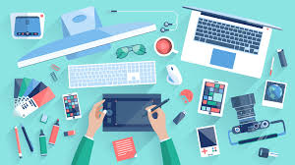
WHAT IS MULTIMEDIA?
Multimedia is content that uses a combination of different content forms such as text, audio, images, animations, video and interactive content. Multimedia contrasts with media that use only rudimentary computer displays such as text-only or traditional forms of printed or hand-produced material.

Slide 4
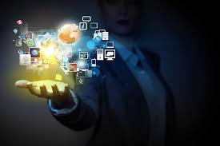
MULTIMEDIA APPLICATIONS:s:
Audio, video processing
Education and training
Multimedia analysis and Internet
Artificial Intelligence
Virtual reality and 3-D imaging
Wireless, Mobile Computing
Animation and Graphics
Visual Communication

Slide 5
VAJRAVEL CM
RA1711003011200
vm9012@srmist.edu.in
Contact:

