Slide 1
POST MERGER ANALYSIS OF CUSTOMER SATISFACTION AND LOYALTY – A STUDY ON RECENT MERGER OF ASSOCIATE BANKS OF SBI WITH ITSELF
-ADHITHYAN V (2016201002)

Slide 2
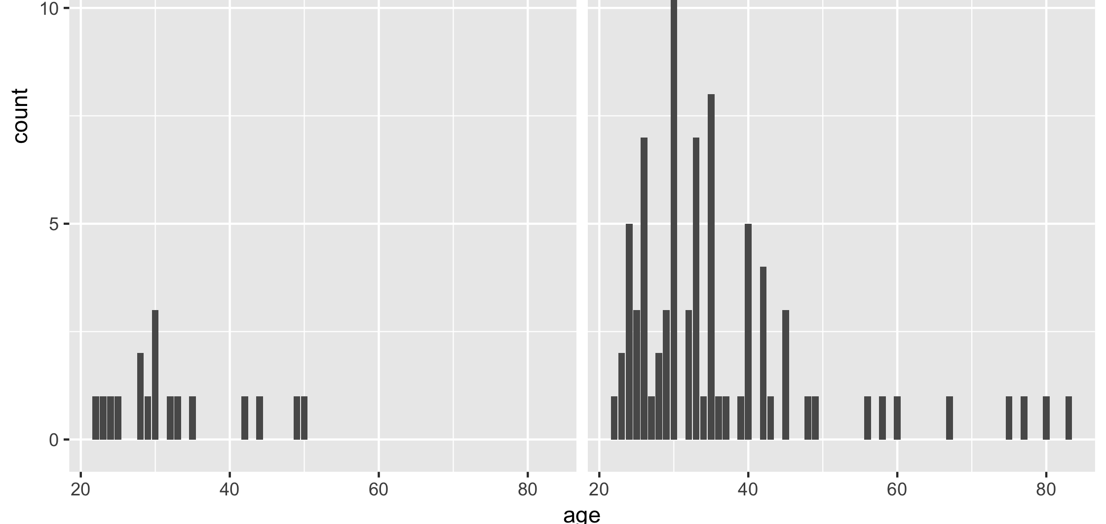
DATA COLLECTION
No of responses – 100
Male – 84 (83.2 %)
Female – 17 (16.8%)

Slide 3
CRONBACH’S ALPHA
Scale name | Cronbach’s alpha | No of items
PCV | 0.89 | 8
Service Performance | 0.712 | 10
Customer Satisfaction | 0.96 | 4
Customer Loyalty | 0.927 | 5

Slide 4
DESCRIPTIVE STATISTICS
Item | Mean | SD
PCV | 3.06 | 1.37
Customer Satisfaction | 2.968 | 0.98
Overall service | 2.80 | 1.49
Service Performance | 3.01 | 1.0428
Loyalty | 3.07 | 0.368

Slide 5
HYPOTHESIS
H1 - Psychological Contract Violation has negative influence on customer satisfaction.
H2 - Service performance is a determinant of Overall Service
H3 - Overall service has a positive impact on customer satisfaction
H4 - Customer satisfaction has positive influence on customer loyalty.

Slide 6
Service performance
Overall service
Psychological contract violation (PCV)
Customer satisfaction
Customer loyalty

Slide 7
PEARSON CORRELATION
 | Correlation Value
PCV vs Customer Satisfaction | -0.662
Service performance vs overall service | -0.830
Overall service vs customer satisfaction | 0.907
Customer satisfaction vs customer loyalty | 0.602

Slide 8
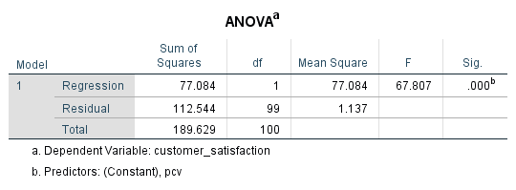
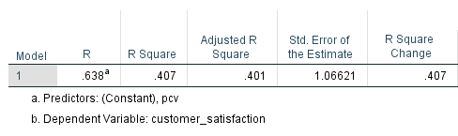
H1
Sd

Slide 9
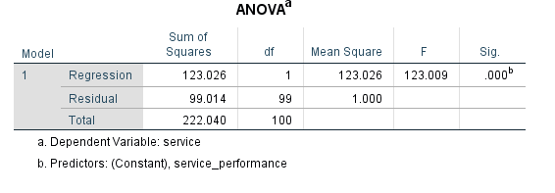
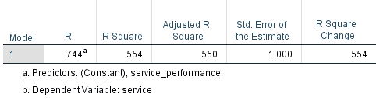
H2

Slide 10
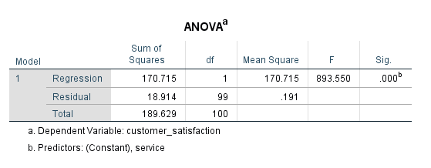
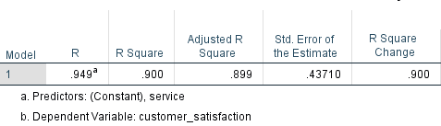
H3

Slide 11
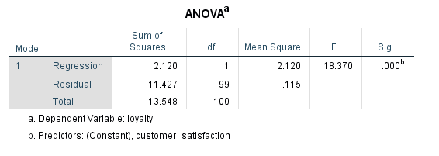
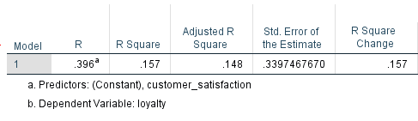
H4

Slide 12
INTERPRETATION
PCV and customer satisfaction are negatively correlated. (-0.662). This indicates as customer perceives more PCV, his satisfaction gets affected. SO H1 is accepted.
PCV influences 41% of variance in customer satisfaction.

Slide 13
CTD…
Service performance explains 55.4% of variance in overall service.
Service performance is negatively correlated with overall service. This indicates overall service doesn’t depend on service performance. H2 is rejected.

Slide 14
CTD
Overall service has a correlation with customer satisfaction. As overall service increases, customer satisfaction tends to increase. H3 is accepted.
Overall service explains 89.9% variance in customer satisfaction.

Slide 15
CTD
Customer satisfaction and loyalty are postively correlated. This indicates a satisfied customer will be more loyal to the bank and spreads word of mouth. H4 is accepted.
Customer satisfaction influences 14.8% of variance in loyalty.

Slide 16
CONCLUSION
Though merger is beneficial to management in terms of financial perspective and synergies, merger often brings a lot of pain to customer. In our case many branches were shut down, customers lost identities etc. So merger should be planned with customer in mind to ensure smooth functioning and service.

Slide 17
FUTURE RESEARCH DIRECTIONS
During response collection it was found that, many of the people preferred private banks over SBI/PSU banks. So a study can be conducted to know the areas in which private banks excel and it can be used to improve the service of PSU banks.

