Slide 1
POST MERGER ANALYSIS OF CUSTOMER SATISFACTION AND LOYALTY – A STUDY ON RECENT MERGER OF ASSOCIATE BANKS OF SBI WITH ITSELF
-ADHITHYAN V (2016201002)

Slide 2
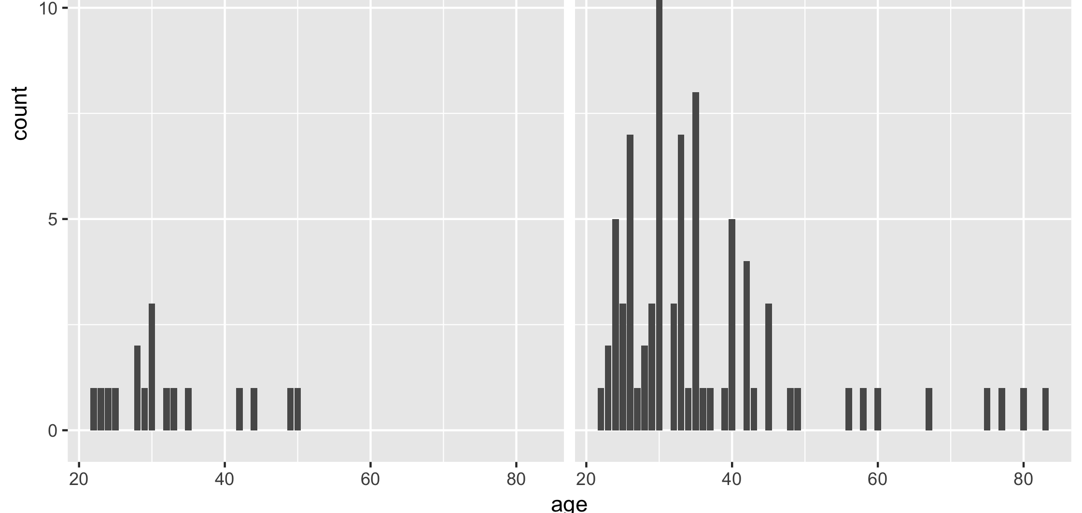
DATA COLLECTION
No of responses – 100
Male – 84 (83.2 %)
Female – 17 (16.8%)

Slide 3
CRONBACH’S ALPHA
Scale name | Cronbach’s alpha | No of items
PCV | 0.218 | 8
Service Performance | 0.712 | 10
Customer Satisfaction | 0.96 | 4
Customer Loyalty | 0.927 | 5

Slide 4
DESCRIPTIVE STATISTICS
Item | Mean | SD
PCV | 2.87 | 0.503
Customer Satisfaction | 2.78 | 1.33
Overall service | 2.8 | 1.49
Service Performance | 2.81 | 0.6437
Loyalty | 2.685 | 0.368

Slide 5
HYPOTHESIS
H0 - Psychological Contract Violation has negative influence on customer satisfaction.
H1 - Service performance is a determinant of Overall Service
H2 - Overall service has a positive impact on customer satisfaction
H3 - Customer satisfaction has positive influence on customer loyalty.

Slide 6
Service performance
Overall service
Psychological contract violation (PCV)
Customer satisfaction
Customer loyalty

Slide 7
PEARSON CORRELATION
 | Correlation Value
PCV vs Customer Satisfaction | -0.638
Service performance vs overall service | -0.744
Overall service vs customer satisfaction | 0.949
Customer satisfaction vs customer loyalty | 0.396

Slide 8
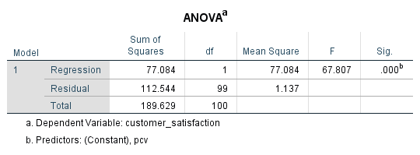
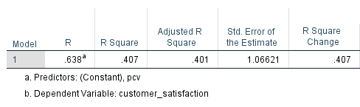
MODEL FIT – H0

Slide 9
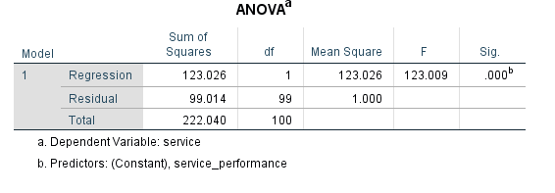
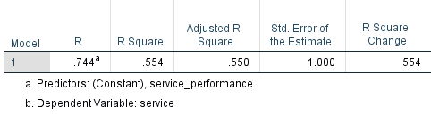
MODEL FIT – H1

Slide 10
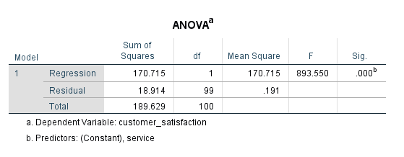
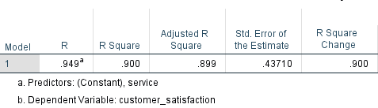
MODEL FIT – H2

Slide 11
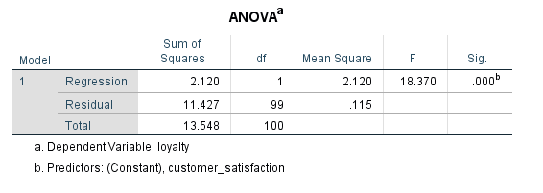
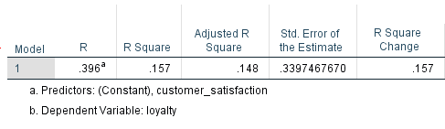
MODEL FIT – H3

Slide 12
INTERPRETATION
PCV and customer satisfaction are negatively correlated. This indicates as customer perceives more PCV, his satisfaction gets affected.
Service performance is negatively correlated with overall service. This indicates overall service doesn’t depend on service performance.
Overall service has a correlation with customer satisfaction. As overall service increases, customer satisfaction tends to increase.
Customer satisfaction and loyalty are postively correlated. This indicates a satisfied customer will be more loyal to the bank and spreads word of mouth

Slide 13
CTD…
R squared value for HO is 0.407 at 95% significance level.
R squared value for H1 is 0.554 at 95% significance level.
R squared value for H2 is 0.9 at 95% significance level
R squared value for H3 is 0.157 at 95% significance level

Slide 14
IMPLICATION

Slide 15
CONCLUSION

Slide 16
FUTURE RESEARCH DIRECTIONS

