Slide 1

RESPONSIVE DESIGN

Slide 2
There are many
ways
to make your
project responsive

Slide 3
RESPONSIVE IN HTML
With the viewport meta tag. Set width, scale and other display parameters to optimize user experience on different screens.

Slide 4
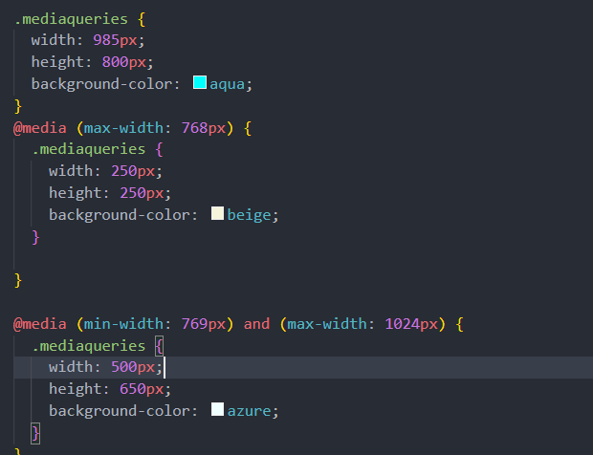
@MEDIA QUERIES
One of the first methods, and not the least important, is media queries.

Slide 5
We can use different parameters:
min/max-height
Orientation
Resolution
Device-width/height

Slide 6
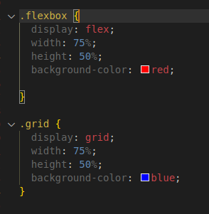
GRID & FLEX
There are also different displays to make your project more adaptable to different screens

Slide 7
Note that we use %
to define sizes.
This value makes it easy to adapt on the
screens.

Slide 8
Flex images
To prevent images from distorting or exceeding the limits of their container, we can use techniques such as the max-width attribute on images to ensure that they resize correctly.

Slide 9
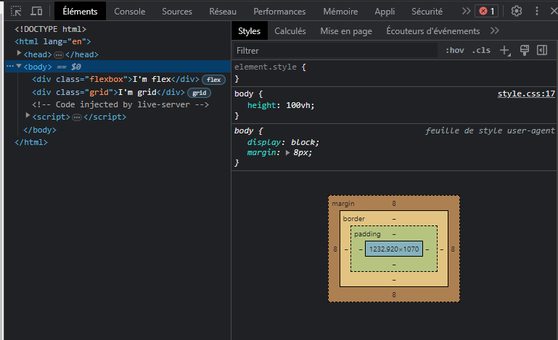

Slide 10
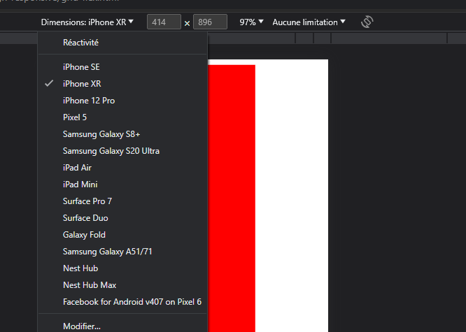

Slide 11
We can create our responsives projects in a variety of ways.
Mobile-First Design
Framework CSS Responsif

Slide 12




Frameworks responsive like

