Slide 1
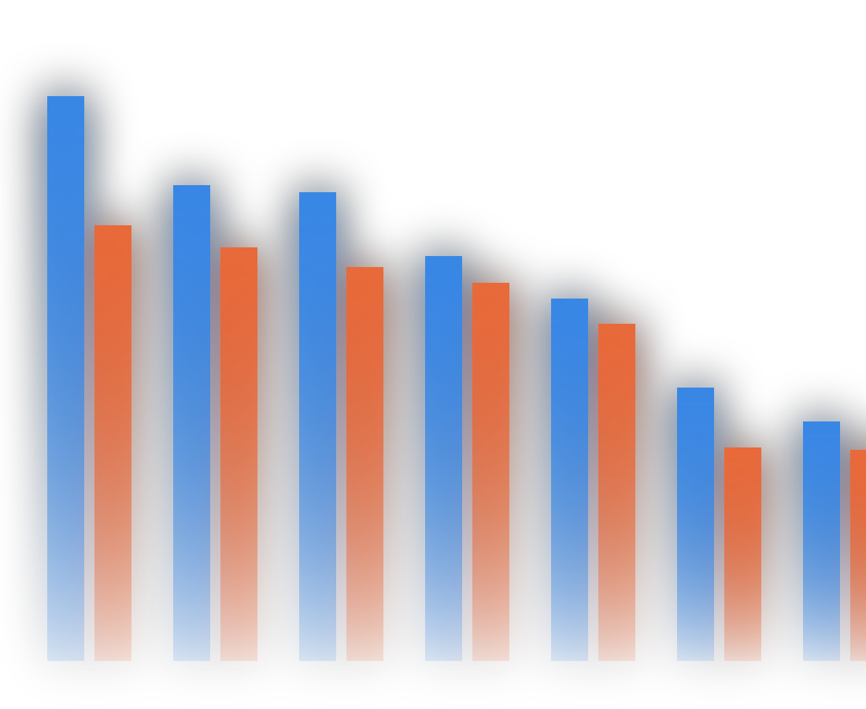
Developer Technology Trends:
Current Usage and Future Demand
IBM DATA ANALYST PROFESSIONAL CERTIFICATE · CAPSTONE
Vincenzo Ambrosino
October 6, 2026
Python
pandas
SQL / SQLite
Matplotlib
Seaborn
Looker Studio

Slide 2
From 65,437 raw survey responses to clear hiring signals
AT A GLANCE
65,437
18,845
161
survey responses after removing 10 duplicate rows
respondents in the dashboard long table
countries represented in the survey
3
978
64%
data sources: Job API, web scraping and the Stack Overflow Developer Survey
compensation outliers detected with the IQR method
missing compensation values, imputed with the median ($65,000)

Slide 3
What this deck covers
OUTLINE
Executive Summary
Discussion
Findings & Implications
1
5
Introduction
Conclusion
2
6
Methodology
Appendix
3
7
Results
Visualization – Charts · Dashboard
4

Slide 4





A stable core stack, with clear risers for next year
EXECUTIVE SUMMARY
Key findings from job postings, salary data and 18,845 developer survey responses
Jobs & pay
Washington DC (5,316), Detroit (3,945) and Seattle (3,375) lead job postings; Swift ($130.8K) and Python ($114.4K) top the salary ranking
Languages
JavaScript, SQL and TypeScript are both the most used and the most desired languages. Rust and Go enter the desired top 10, while PHP and PowerShell drop out
Databases
PostgreSQL is the leading database today (11,514) and its lead grows next year (12,193); Redis rises to 2nd place
Platforms
AWS, Microsoft Azure and Google Cloud dominate cloud platforms; React and Node.js dominate web frameworks
Respondents
Most respondents are 25-44 years old (68.6%) and hold a bachelor's or master's degree (72.3%)

Slide 5


Which skills are in demand today, and which come next?
INTRODUCTION
Purpose of the report, target audience & value of the analysis
Purpose
Target audience
Value
Identify which technology skills are in demand today and which ones developers want to adopt next
Hiring managers, HR and training teams, and job seekers planning their skills
Data-driven guidance on which languages, databases, platforms and frameworks to learn or invest in
Scope of the analysis
Job postings by US city and salaries by programming language
Developer survey: current vs. desired technologies and respondent demographics

Slide 6





From three raw sources to one clean, analysis-ready dataset
METHODOLOGY
Data sources, data collection & data wrangling steps
STEP 1
STEP 2
STEP 3
STEP 4
Data sources
Data wrangling in Python (pandas)
Exploratory analysis
Dashboard
Job postings via a Job API (job-postings.xlsx)
Salaries by language via web scraping (popular-languages.csv)
Stack Overflow Developer Survey
Removed 10 duplicate rows (65,447 to 65,437 responses)
Imputed missing categorical values with the mode: RemoteWork (10,631 rows, "Hybrid") and EdLevel (4,653 rows, "Bachelor's degree")
Imputed missing ConvertedCompYearly (64%) with the median ($65,000), then normalized it with Min-Max and Z-score scaling
Detected 978 compensation outliers with the IQR method (above $220,861)
Distributions, outliers and correlations (pandas, Matplotlib, Seaborn, SQL on SQLite)
Multi-select answers split into a long table (18,845 respondents), null values excluded, built in Google Looker Studio

Slide 7
Where the jobs are, what pays, and what developers use
01
RESULTS
Job postings, salaries by language, and programming language and database trends

Slide 8
Washington DC leads job postings, ahead of Detroit and Seattle
JOB POSTINGS
Number of job postings by city
5,316
postings in Washington DC
Key takeaways
Washington DC has the most postings (5,316), ahead of Detroit (3,945) and Seattle (3,375)
New York follows closely (3,226)
Los Angeles, San Francisco and Austin have far fewer postings (434-640)

Slide 9
Swift is the best-paid language; SQL and PHP pay the least
POPULAR LANGUAGES
Average annual salary by programming language
$130,801
average salary for Swift
Key takeaways
Swift is the best-paid language ($130,801)
Python, C++ and JavaScript all exceed $110,000
SQL and PHP are at the bottom (~$84,700-$84,800), although SQL is one of the most used languages

Slide 10
Rust and Go enter next year's top 10; PHP and PowerShell drop out
PROGRAMMING LANGUAGE TRENDS
JavaScript, SQL and TypeScript lead both years; Rust and Go replace PHP and PowerShell in next year's top 10.
Current year: languages used
Next year: languages desired
Drops out of next year's top 10
New in next year's top 10

Slide 11
Web and data skills stay core; Rust and Go are the ones to watch
PROGRAMMING LANGUAGE TRENDS · FINDINGS & IMPLICATIONS
FINDINGS
IMPLICATIONS
JavaScript is #1 in both years (14,943 used, 11,541 desired)
TypeScript moves up from 4th to 3rd place, overtaking HTML/CSS
Rust (5,597) and Go (5,661) enter the desired top 10; PHP and PowerShell leave it
Python stays 5th in both years
Web skills (JavaScript/TypeScript) remain a safe core investment
SQL stays essential for any data-related role
Training in Rust and Go can anticipate growing demand for systems and cloud development
Legacy languages (PHP, PowerShell) are losing interest

Slide 12
PostgreSQL widens its lead while Redis jumps to 2nd place
DATABASE TRENDS
PostgreSQL leads both years with a growing gap; Redis jumps to 2nd place and Supabase enters next year's top 10.
Current year: databases used
Next year: databases desired

Slide 13
PostgreSQL is the database skill to prioritize
DATABASE TRENDS · FINDINGS & IMPLICATIONS
FINDINGS
IMPLICATIONS
PostgreSQL is #1 in both years and grows from 11,514 to 12,193
Redis rises from 6th to 2nd place (6,384)
MySQL drops from 2nd to 4th (8,556 to 6,204)
Supabase enters the top 10; Oracle leaves it
PostgreSQL is the database skill to prioritize
Caching and in-memory stores (Redis) are becoming more relevant
Teams relying on MySQL or Oracle may need migration plans
Managed, developer-friendly services (Supabase) are gaining interest

Slide 14
The interactive view: today, tomorrow and who answered
02
DASHBOARD
Google Looker Studio dashboard: Current Technology Usage, Future Technology Trends and Demographics

Slide 15
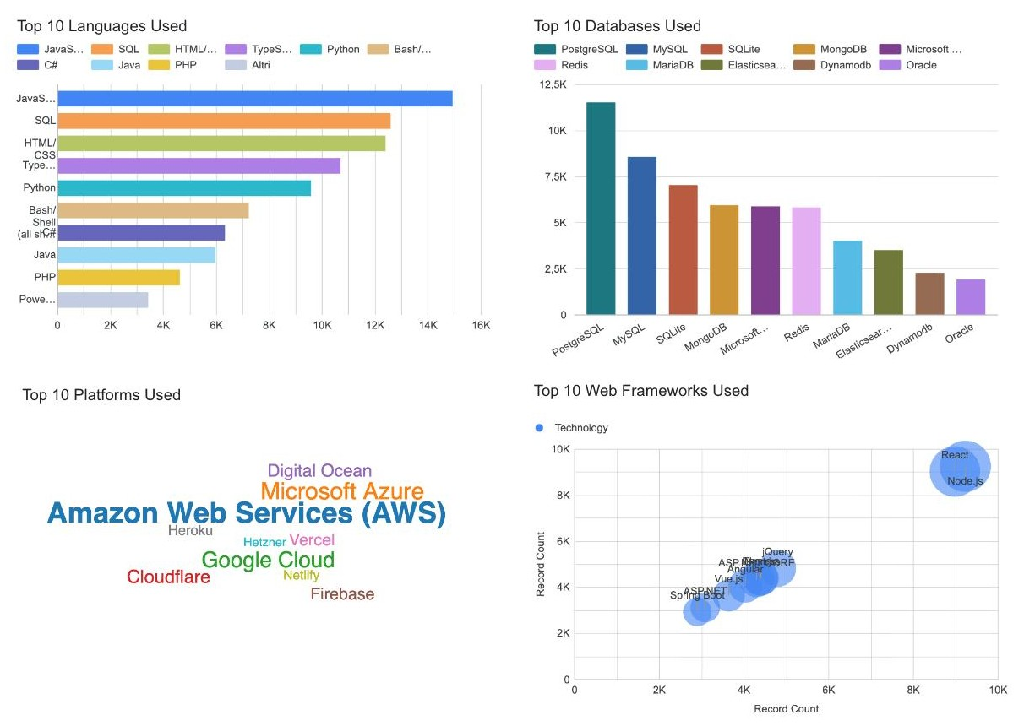
Today's stack: JavaScript, PostgreSQL, AWS and Node.js/React lead
DASHBOARD · TAB 1: CURRENT TECHNOLOGY USAGE
Key insights
JavaScript is the most used language (14,943), followed by SQL, HTML/CSS, TypeScript and Python
PostgreSQL leads the databases (11,514), ahead of MySQL and SQLite
AWS is the dominant cloud platform (10,871); Microsoft Azure and Google Cloud follow
Node.js (9,230) and React (8,999) far outpace every other web framework

Slide 16
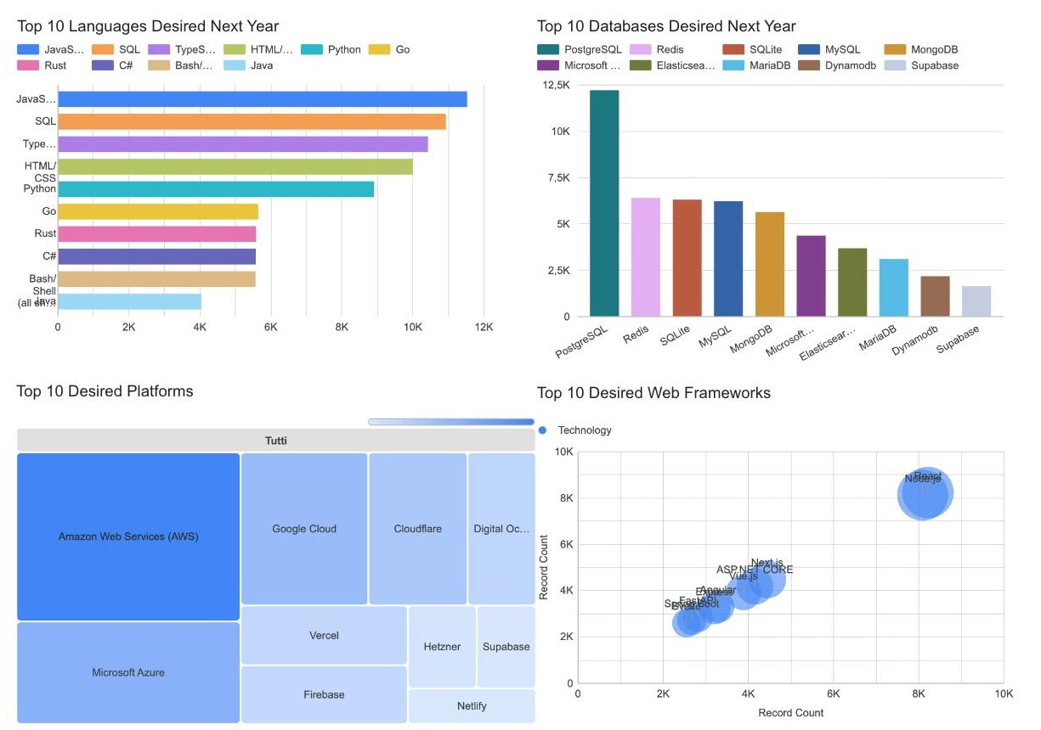
Tomorrow's stack: TypeScript, Rust, Go and Redis gain ground
DASHBOARD · TAB 2: FUTURE TECHNOLOGY TRENDS
Future trends
JavaScript, SQL and TypeScript stay on top; TypeScript overtakes HTML/CSS
Rust and Go enter the top 10, while PHP and PowerShell drop out
PostgreSQL widens its lead; Redis rises to 2nd place and Supabase appears
Cloudflare gains interest; Supabase replaces Heroku among platforms
React and Node.js remain the most wanted; jQuery leaves the top 10, FastAPI and Svelte enter

Slide 17
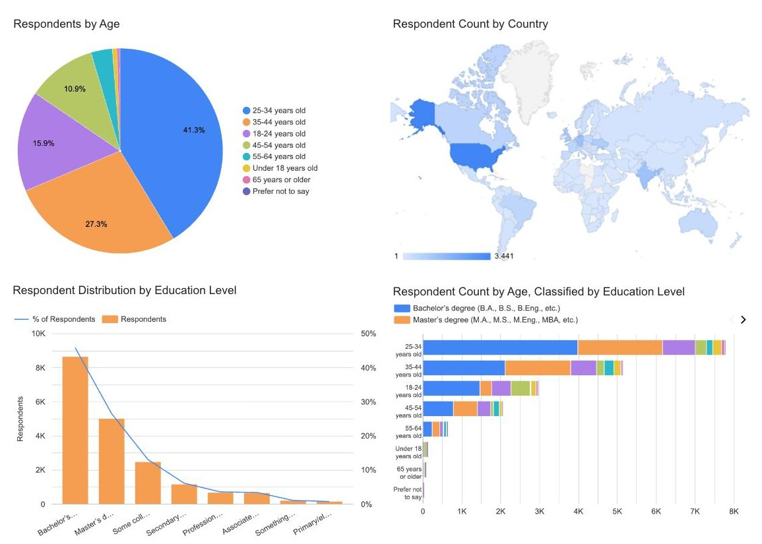
Respondents are young, highly educated and mostly from the US
DASHBOARD · TAB 3: DEMOGRAPHICS
Demographic insights
Respondents are young: 25-34 year olds are 41.3%, and 85% are under 45
The United States has the most respondents (3,441), followed by Germany (1,339) and India (1,316)
Bachelor's degree is the most common education level (45.8%), then Master's (26.5%)
Bachelor's degrees lead in every adult age group; Master's degrees weigh more from age 35 (about 30%)

Slide 18
What it means for job seekers, companies and recruiters
03
DISCUSSION & CONCLUSION
Overall insights, findings & implications, and conclusion

Slide 19




The top of the stack is stable; change happens in the middle
DISCUSSION
Overall insights derived from the dashboards
Stable core
Risers
The technology stack is stable at the top: JavaScript, SQL, PostgreSQL, AWS and React/Node.js lead in both current usage and future interest
Change happens in the middle of the rankings: Rust, Go, Redis, Supabase, FastAPI and Svelte are gaining ground
Fading
Caveat
Older technologies (PHP, PowerShell, Oracle, jQuery, Heroku) are losing interest
The survey mainly reflects young, highly educated developers, mostly from the US and Europe, so results may not represent every market

Slide 20

Combine a solid core with one emerging skill
OVERALL FINDINGS & IMPLICATIONS
FINDINGS
IMPLICATIONS
Core skills are stable: JavaScript, SQL, Python, PostgreSQL and AWS stay at the top
Job seekers should combine a solid core (SQL, JavaScript/Python) with one emerging skill
Modern alternatives grow: TypeScript, Rust, Go, Redis and Next.js gain ground
Companies should plan training on TypeScript, Rust/Go and cloud platforms
Demand is concentrated geographically (Washington DC, Detroit, Seattle, New York)
Recruiting efforts can focus on the cities with the most postings
Salary does not follow popularity: Swift pays the most, SQL and PHP the least
Niche skills such as Swift can command a salary premium

Slide 21

Learn the stable core, watch the risers, follow the market
CONCLUSION
01
02
JavaScript, SQL and PostgreSQL are the most widely used technologies and remain the most desired
Rust, Go, TypeScript and Redis are the main growing technologies for next year
03
04
AWS, Azure and Google Cloud dominate cloud platforms; React and Node.js dominate web frameworks
Job opportunities and salaries vary strongly by location and language: monitoring them helps target skills and recruiting

Slide 22
Respondents come from 161 countries, led by the United States
APPENDIX
Top 10 countries by number of survey respondents (161 countries in total)
3,441
respondents from the United States, more than Germany (1,339) and India (1,316) together

Slide 23
Median pay rises with age, peaking at about $110K at 55-64
APPENDIX
Median yearly compensation (USD) by age group · Python (pandas), notebooks 16-17
~$25K → ~$110K
Median pay rises steadily with age, from about $25K (18-24) to a peak of about $110K (55-64)

Slide 24
US developers earn 8.5x the median pay of developers in India
APPENDIX
Median yearly compensation (USD) in the top 10 countries by respondents
$65,000
$69,814
Overall median yearly compensation (respondents reporting pay)
Median yearly compensation of full-time employees
r = 0.41
8.5x
Correlation between compensation and work experience (outliers removed)
Gap between US and India median compensation
Source: Stack Overflow Developer Survey, ConvertedCompYearly (respondents who reported compensation); exploratory analysis in Python (pandas, Seaborn)

Slide 25

Thank you
for reading
Vincenzo Ambrosino
Notebooks, code and data sources are on GitHub:
github.com/v-ambrosino/ibm-data-analyst-capstone

