Slide 1
PAPERS I GONE THROUGH

Slide 2
PAPER NO : 1
PAPER TITLE :Learning with Missing Data
Published in: 2020 IEEE International Conference on Big Data (Big Data)
Date of Conference: 10-13 December 2020
Date Added to IEEE Xplore: 19 March 2021
DOI: 10.1109/BigData50022.2020.9377785
Carlos A. Escobar
General Motors,Global Research & Development,Warren,MI,USA
Jorge Arinez
General Motors,Global Research & Development,Warren,MI,USA
Daniela Macias
Tecnologico de Monterrey,Escuela de Ingenieria y Ciencias,Monterrey,NL,Mexico
Ruben Morales-Menendez
Tecnologico de Monterrey,Escuela de Ingenieria y Ciencias,Monterrey,NL,Mexico
Greedy-like algorithm is proposed to maximize the number of records.
Imputation done with less bias
INFORMATION OPTIMIZATION ALGORITHM

Slide 3
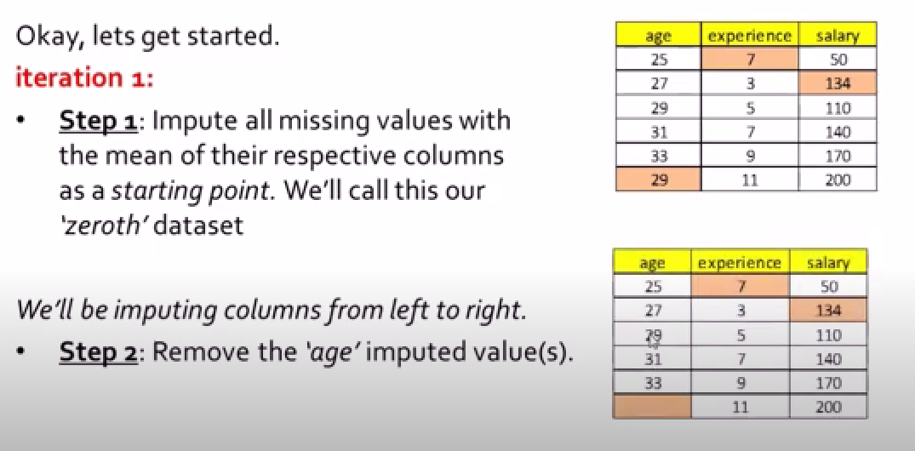
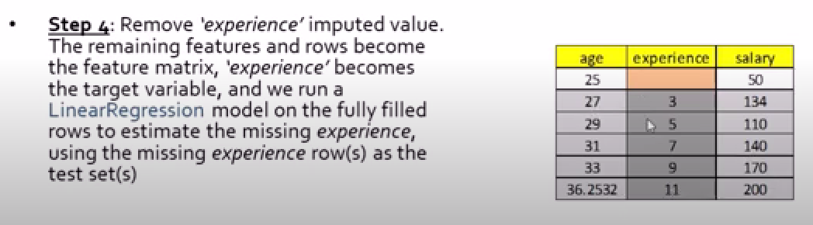
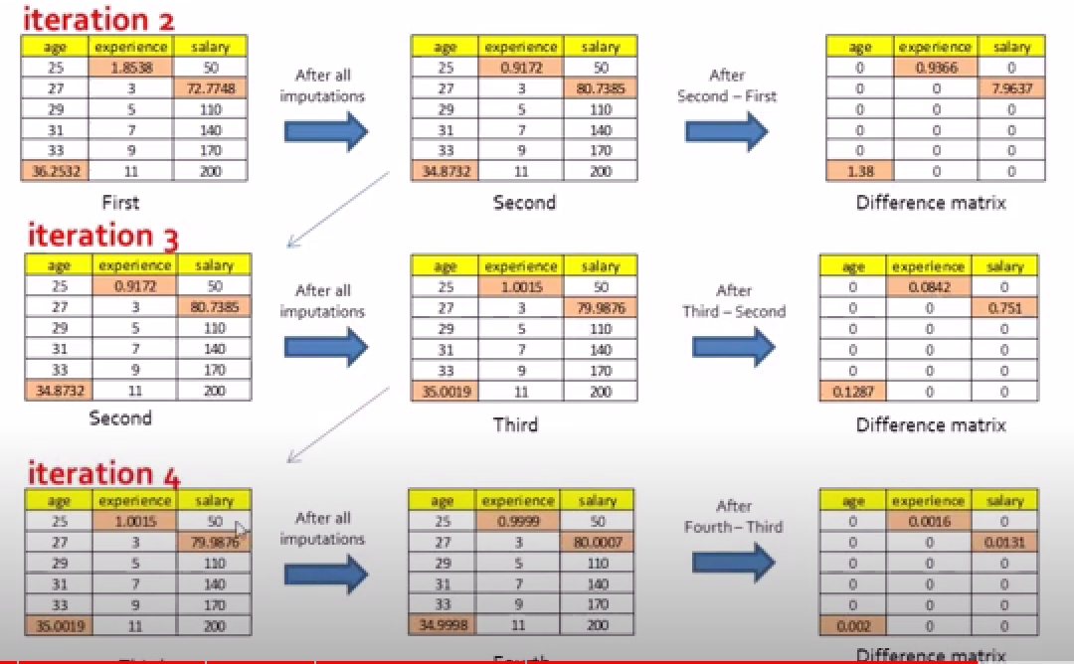
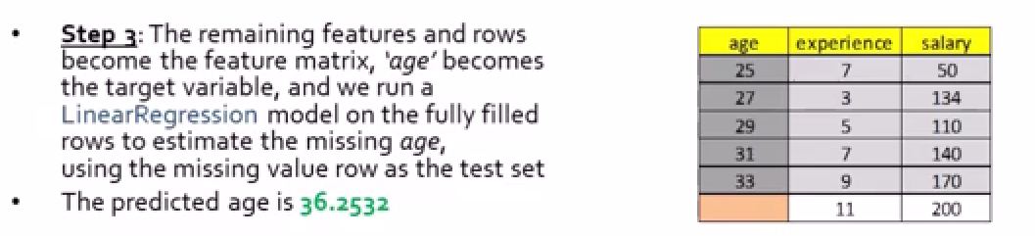
PAPER NO : 1
PAPER TITLE : Multiple Imputation by Chained Equations for Missing Data in UK Bioban
Published in: 2022 6th Annual International Conference on Data Science and Business Analytics (ICDSBA)
Date of Conference: 14-18 October 2022
Date Added to IEEE Xplore: 23 May 2023
DOI: 10.1109/ICDSBA57203.2022.00026
Liyuan Xu
School of Computer Engineering and Science, Shanghai University, Shanghai, China
Anqi Qiu
Department of Biomedical Engineering, National University of Singapore, Singapore, Singapore
MICE is assuming like data is missing at random

Slide 4
POINTS THAT I CAN ADD IN MY FINAL REPORT OR DURING FINAL PRESENTATIONS

Slide 5
XNA value are also present instead of null and NaN values
Develop a basic understanding of risk analytics in banking and financial services and understand how data is used to minimise the risk of losing money while lending to customers.
When the company receives a loan application, the company has to decide for loan approval based on the applicant’s profile. Two types of risks are associated with the bank’s decision:
If the applicant is likely to repay the loan, then not approving the loan results in a loss of business to the company
If the applicant is not likely to repay the loan, i.e. he/she is likely to default, then approving the loan may lead to a financial loss for the company.
In other words, the company wants to understand the driving factors (or driver variables) behind loan default, i.e. the variables which are strong indicators of default. The company can utilise this knowledge for its portfolio and risk assessment.
Data Understanding
This dataset has 3 files as explained below:
'application_data.csv' contains all the information of the client at the time of application. The data is about whether a client has payment difficulties.
'previous_application.csv' contains information about the client’s previous loan data. It contains the data whether the previous application had been Approved, Cancelled, Refused or Unused offer.
'columns_description.csv' is data dictionary which describes the meaning of the variables.

Slide 6
FEATURE ENGINEERING

Slide 7
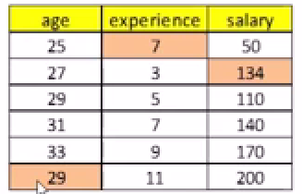
Many real-world data sets contain missing values, therefore, learning with incomplete data sets is a common challenge faced by datascientists.
Handling them in an intelligent way is important to develop robust data models, since there is no perfect approach to compensate for the missing values.
Deleting the rows with empty cells is a commonly used approach, this naivemethod may lead to estimates with larger standarderrors due to reduced sample size.
Univariate imputation techniques like mean, median, mode imputation causes “ brute force effect” [PAPER - 2]
here age 25 and 7 year experience does not feel right
On the otherhand, imputing the missing records is a better approach, but it should be used with great caution, as it relies on often unrealistic specific assumptions which can potentially bias results.
In this paper, a new greedy-like algorithm is proposed to maximize the number of records.
Type of Missing values
NaN (Not a Number) | Unknown or Not Available
Null or None | Dummy Values:
Blank or Empty String
Placeholder Values

Slide 8
Concepts of
MCAR – Missing completely at random
We cant predict the missing values based on other features in the dataset
MAR – Missing at random
You can get the values from other columns
MNAR – Missing not at random
There was a particular reason why the missing happened
eg an obese person is not at all interested in sharing details about his weight
This method is not advised unless the proportion of eliminated records is very small<5% [1].
Although imputation can be applied to preserve all samples, it relies on often unrealistic specific assumptions, which can potentially bias results.
Hot deck imputation has also shown inadequate results due to a high error probability caused by multiple missing values in the same row.
A review of imputation methods can be found in[1]–[3].

