Slide 1


BENGALURU CAMPUS
PROJECT TITLE :
CREDIT WORTHINESS EVALUATION
PROJECT BY
JANANE M
JAYESH SURENDRA KUMBHAR
MUNIR SHETH
SRUTHI BHANDARE
VASUDEV R NAIR
DETAILS
PGPDSC-FT-B-AUGUST 2023
Group 07
FINANCE DOMAIN
GUIDED BY
SAI SOURABH REDDY
Unlocking Financial Confidence: Your Trustworthy Partner in Credit Worthiness Evaluation.

Slide 2



PROBLEM DEFINITION
The objective is to develop a predictive model that assesses an individual's ability to repay a loan. The binary target variable is defined as follows: 1 indicates "Unable to pay the loan," and 0 signifies "Able to pay the loan." The dataset encompasses diverse features such as gender, salary, details about the individual's residence, familial information, marital status, and more. Through a careful analysis of these attributes, the model aims to distinguish patterns indicative of financial stability or risk, assisting financial institutions in making informed decisions on loan approvals based on an individual's creditworthiness.
VALUE ADDITIONS ADDED
Explainability and Transparency
Continuous Learning
Fairness and Bias Mitigation
User-Friendly Interface
Security Measures
Education and Communication
Benchmarking and Model Comparison
IMPORTANCE OF THE PROBLEM
Enhance decision-making, reduce the likelihood of defaults, and ensure fair and efficient allocation of resources, contributing to the overall stability and sustainability of the financial system.
TECHNOLOGY PROBLEM RESOLVED
Feature Selection and Engineering, Model Training and Evaluation,
Data Quality and Preprocessing, Interpretability, Scalability and Performance.
BUSINESS PROBLEM RESOLVED
Risk Mitigation, Customer Segmentation, Regulatory Compliance, Operational Efficiency, Customer Trust

Slide 3


SUGGESTED SOLUTION
CONSIDERED DATASET
DATASET SELECTION
File name :
application_data.csv
From :
Dimension :
EXPL DATA ANALYSIS
307511 x 122
1
2
The dataset aims to predict an individual's ability to repay a loan, with the target variable being whether they are "ABLE" or "UNABLE" to repay. Features include gender, age, loan amount, annual income, property information, car ownership status and many more. The dataset is designed for assessing creditworthiness and making informed lending decisions.
3
CHECKING ASSUMPTIONS
FEATURE ENGINEERING
4
5
MODELS DEVELOPMENT
MODEL EVALUATION
6
7
RISK USERS
MODEL IMPROVEMENT
UI DEVELOPMENT
8

Slide 5
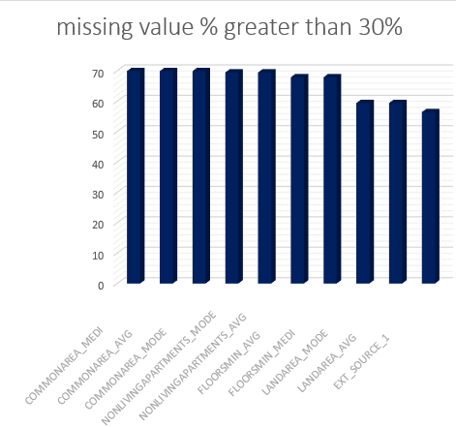
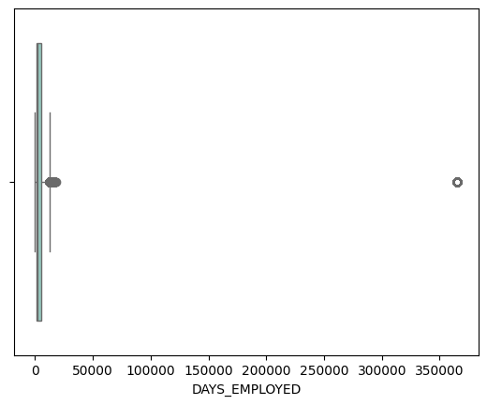
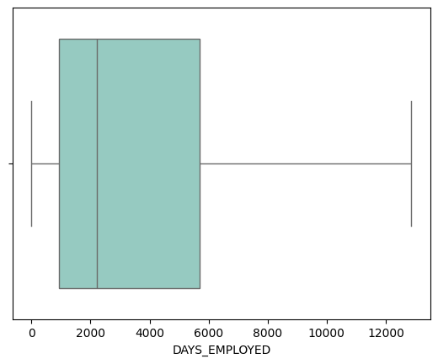
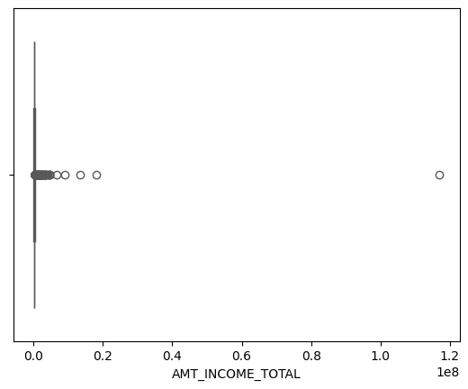
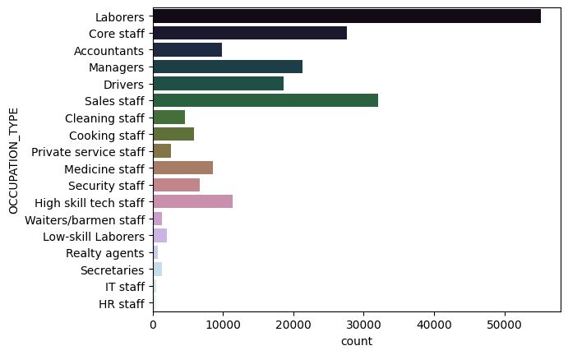
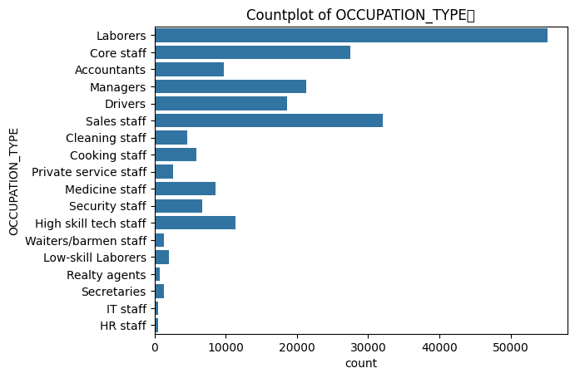
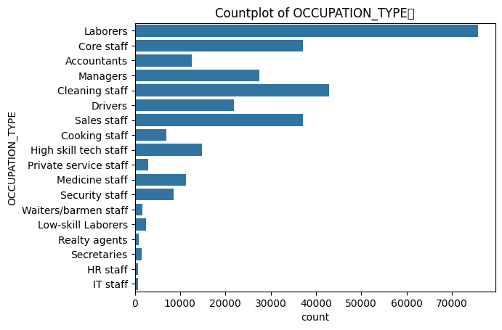
DATA PREPROCESSING
HANDLING NULL VALUES
2. OWN_CAR_AGE
RELATIONSHIP BETWEEN "FLAG_OWN_CAR" and "OWN_CAR_AGE"
There were 5 missing values for customers who owned car
Logically collected related columns
FLAG_OWN_CAR
OWN_CAR_AGE
CODE_GENDER
DAYS_BIRTH
DAYS_EMPLOYED
OCCUPATION_TYPE
CNT_FAM_MEMBERS
Predicted these 5 columns using regression imputation
1. OCCUPATION_TYPE
AMT_INCOME_TOTAL 0.000000
OCCUPATION_TYPE 31.345545
ORGANIZATION_TYPE 0.000000
NAME_INCOME_TYPE 0.000000
NAME_EDUCATION_TYPE 0.000000
DAYS_EMPLOYED 0.000000
AMT_REQ_CREDIT_BUREAU
DATA IS MISSING COMPLETELY AT RANDOM
Multiple Imputation by Chained Equations (MICE): Pros: Captures relationships between variables, provides multiple imputations for uncertainty estimation. Cons: Computationally intensive
"AMT_REQ_CREDIT_BUREAU_HOUR" ,"AMT_REQ_CREDIT_BUREAU_DAY", "AMT_REQ_CREDIT_BUREAU_WEEK", "AMT_REQ_CREDIT_BUREAU_MON", "AMT_REQ_CREDIT_BUREAU_QRT", "AMT_REQ_CREDIT_BUREAU_YEAR"
50 columns had more than 30% or more missing values
Base Model removed columns with null value % more than 35 %
Imputed these values with mean mode median
Final model- went with some unorthodox methods as well as standard methods
Filling missing values with random forest classifier

Slide 6
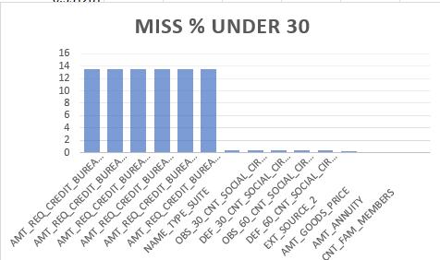
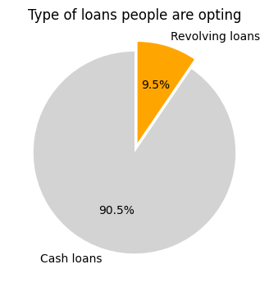
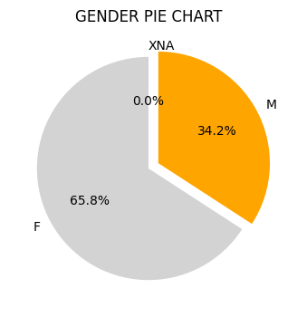
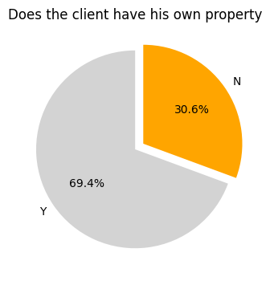
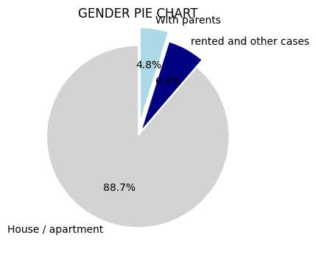

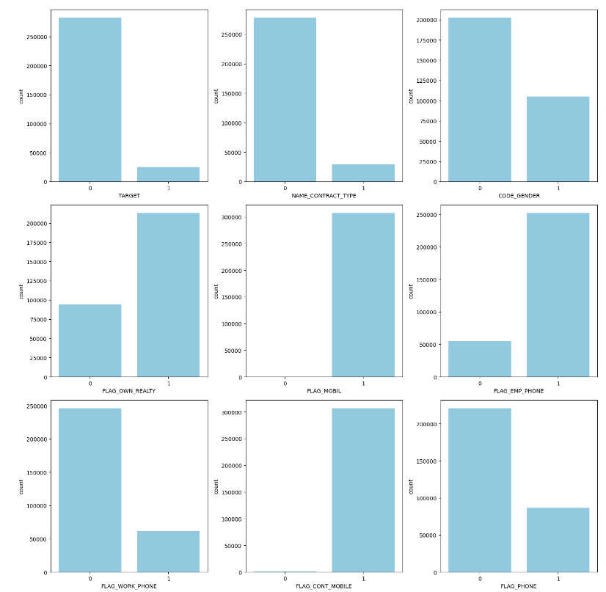
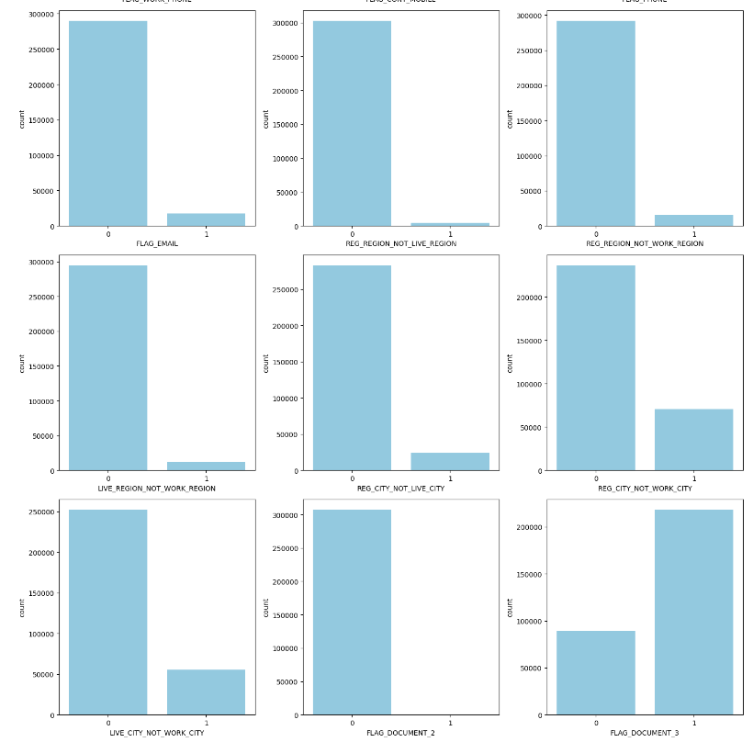
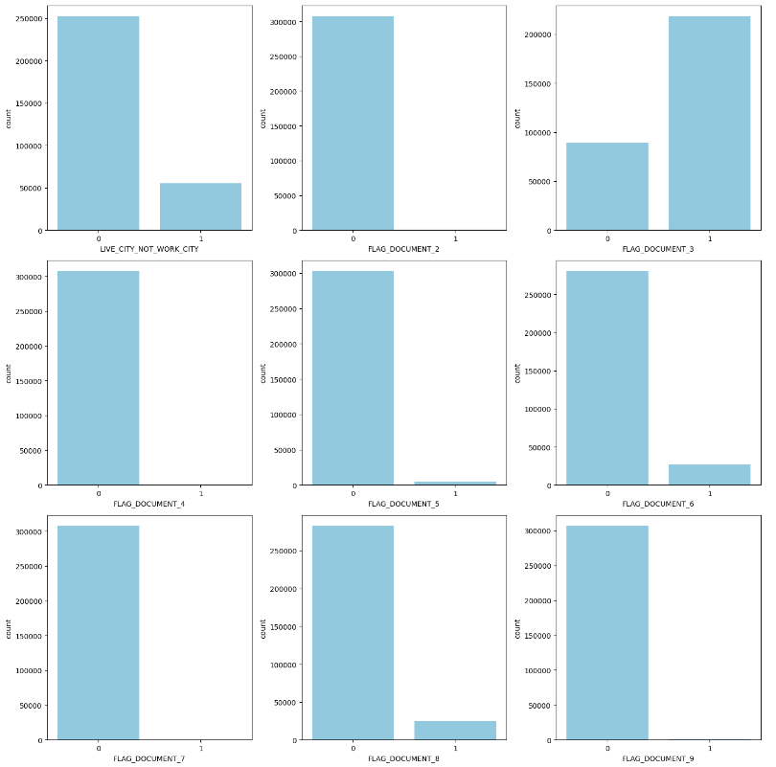
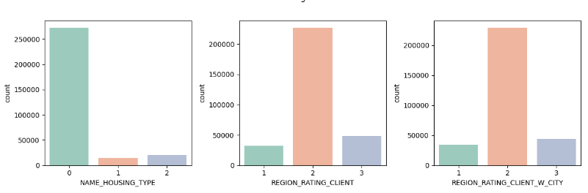
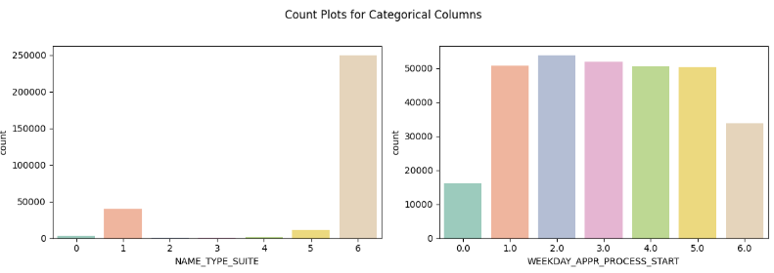
HANDLING OUTLIERS
NAME_TYPE_SUITE
NAME_TYPE_SUITE","CNT_FAM_MEMBERS","CNT_CHILDREN", "NAME_FAMILY_STATUS", "AMT_INCOME_TOTAL", "NAME_EDUCATION_TYPE", "DAYS_EMPLOYED", "DAYS_BIRTH", "OCCUPATION_TYPE", "ORGANIZATION_TYPE“
Decision tree imputation
VALUES LESS THAN 5%
Columns with missing values less than 10%:
'AMT_ANNUITY’
'AMT_GOODS_PRICE’
'CNT_FAM_MEMBERS’
DROPPED "FLAG_MOBIL“ since all the values were 1
COLUMNS related to house were having very high null values
"FLAG_OWN_REALTY" checks whether Does the client has a property or not
"NAME_HOUSING_TYPE": What is the housing situation of the client (renting, living with parents, ...)
Conclusions
Surprisingly people who are having the required conditions have missing info regarding the houses
This may be because these info might not be required when apply for different types of loans
Such a kind of information are available in case of people who are applying for housing loans
Here I am dropping these columns
binary columns which were having individual values only were dropped
More than 3 which was showing irregular shapes were clubbed together
All the categorical columns were then encoded

Slide 7
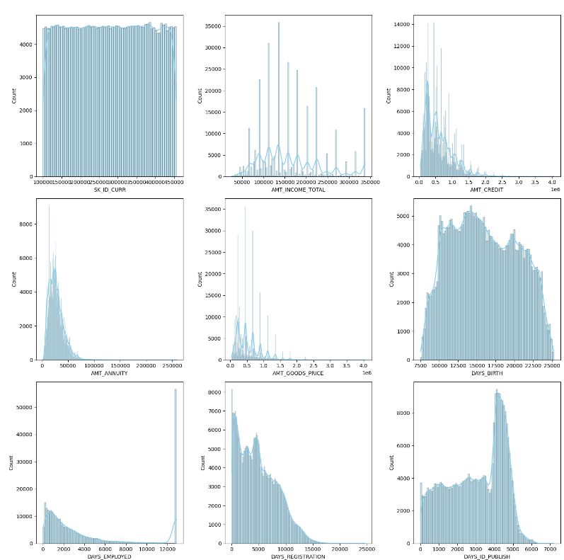
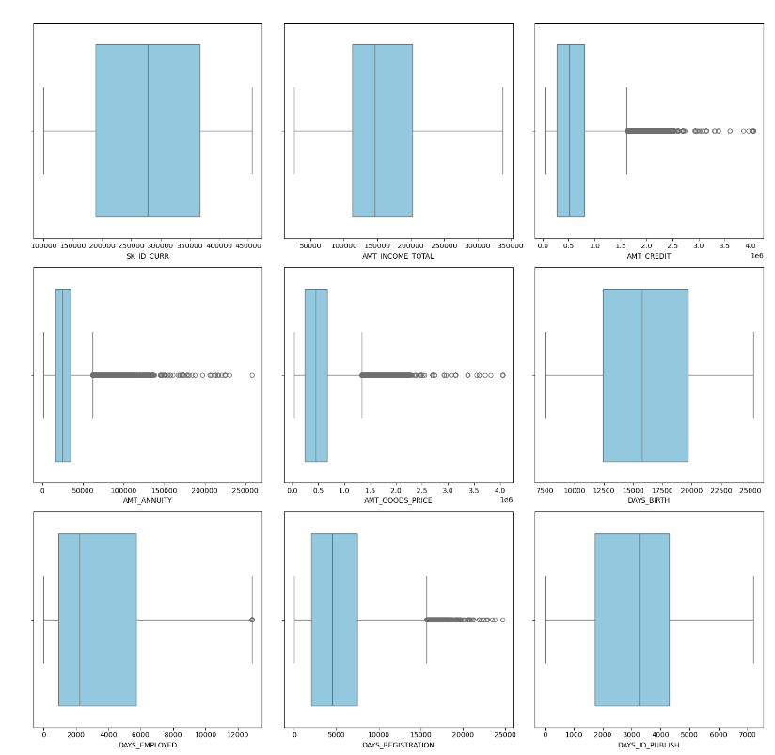
HANDLING OUTLIERS
1. Numerical Input, Numerical Output
This is a regression predictive modeling problem with numerical input variables.
The most common techniques are to use a correlation coefficient, such as Pearson’s for a linear correlation, or rank-based methods for a nonlinear correlation.
• Pearson’s correlation coefficient (linear).
• Spearman’s rank coefficient (nonlinear)
2. Numerical Input, Categorical Output
This is a classification predictive modeling problem with numerical input variables. This might be the most common example of a classification problem. Again, the most common techniques are correlation based, although in this case, they must take the categorical target into account.
• ANOVA correlation coefficient (linear).
• Kendall’s rank coefficient (nonlinear).
3. Categorical Input, Numerical Output
This is a regression predictive modeling problem with categorical input variables. This is a strange example of a regression problem (e.g. you would not encounter it often). Nevertheless, you can use the same “Numerical Input, Categorical Output” methods (described above), but in reverse.
4. Categorical Input, Categorical Output
This is a classification predictive modeling problem with categorical input variables. The most common correlation measure for categorical data is the chi-squared test. You can also use mutual information (information gain) from the field of information theory.
Chi-Squared test (contingency tables).
Mutual Information.
In fact, mutual information is a powerful method that may prove useful for both categorical and numerical data, e.g. it is agnostic to the data types.

Slide 8
ARE YOU WORTHY ....?

