Slide 1

AGENDA FOR DISCUSSION
1. GENE EMBEDDINGS & INSILICO PERTURBATION
2. VCC AND PERTURBATION
3. GENEFORMER’s PERTURBATION IN VCC
4. RESULTS

Slide 2

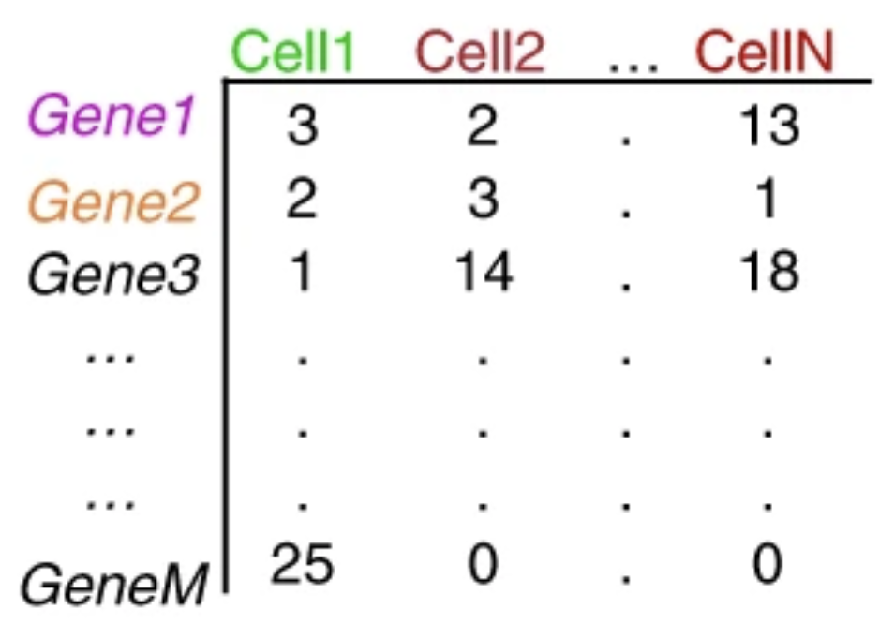
GENE EMBEDDINGS USING GENEFORMER
Geneformer the foundation model
Rank value encodings
HVGs
What are gene embeddings
KEYS
GENEFORMER Encoder
TP53
EGFR
BRCA1
MYC
KRAS
CDK1
…
BCL2
PTEN
ATM
MAPK1
4096 HVGs
Cell X Gene matrix
TP53:
[ 0.12, -0.45, 1.03, ..., -0.18, 0.77 ] ← 768 dim
EGFR:
[-0.34, 0.91, 0.22, ..., 1.02, -0.44 ]
BRCA1
[ 0.88, 0.14, -0.67, ..., -0.09, 0.51 ]
Rank value Encodings
Cell Embedding
[-0.34, 0.91, 0.22, ..., -0.89, 1.14 ] - 768 dim

Slide 3

INSILICO PERTURBATION USING GENEFORMER
Geneformer the foundation model
Rank value encodings
HVGs
What are gene embeddings
KEYS
KRAS perturbed cell’s embedding
GENEFORMER Encoder
TP53
EGFR
BRCA1
MYC
KRAS
CDK1
…
BCL2
PTEN
ATM
MAPK1
4096 HVGs
Cell X Gene matrix
TP53
EGFR
BRCA1
MYC
CDK1
…
BCL2
PTEN
ATM
MAPK1
4096 HVGs
TP53:
[ 0.12, -0.45, 1.03, ..., -0.18, 0.77 ] ← 768 dim
EGFR:
[-0.34, 0.91, 0.22, ..., 1.02, -0.44 ]
BRCA1
[ 0.88, 0.14, -0.67, ..., -0.09, 0.51 ]
Rank value Encodings
Cell Embedding
[-0.34, 0.91, 0.22, ..., -0.89, 1.14 ] - 768 dim

Slide 4
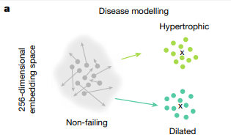
INSILICO PERTURBATION AT CELL EMBEDDING – REPRESENTATION
Clustering nature of cell embeddings
knock out not only a single gene but also multiple genes at a time.
Cosine Shift concept
KEYS

Slide 5

VCC AND PERTURBATION
TRAINING
List of genes to be perturbed
g1,
g2,
g3,
..
..
..
..
g150
Ground truth provided by VCC
Perturbed gene | No of cells
g1 | 4000
g2 | 3800
g3 | 3750
g150 | 15
Unperturbed cells
+
38 k cells
VALIDATION
g1,
g2,
g3,
..
..
g50
+
Predict expression
TEST
g1,
g2,
g3,
..
..
g100
+
Predict expression

Slide 6
3. GENEFORMER FOR VCC
3. 1. Limitations of using Geneformer Decoder
Cell x gene
GENEFORMER Encoder
GENEFORMER
Decoder
TP53
EGFR
BRCA1
MYC
KRAS
CDK1
…
BCL2
PTEN
ATM
MAPK1
TP53
EGFR
BRCA1
MYC
KRAS
CDK1
…
BCL2
PTEN
ATM
MAPK1
18080 genes per cell
4096 genes per cell
4096 genes per cell
Cell X Gene
Rank value Encodings
Rank value Encodings

Slide 7
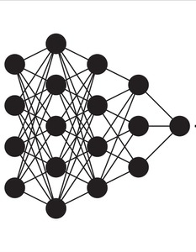
3. GENEFORMER FOR VCC
3. 1. Limitations of using Geneformer Decoder
Cell x gene
GENEFORMER Encoder
TP53
EGFR
BRCA1
MYC
KRAS
CDK1
…
BCL2
PTEN
ATM
MAPK1
18080 genes per cell
4096 genes per cell
Cell X Gene
Rank value Encodings

Slide 8
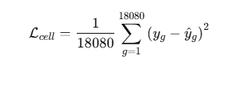
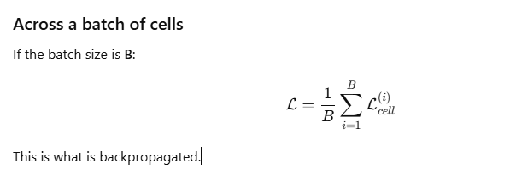
3. 2. Design for the Model
MSE LOSS PER CELL
Cell input vector (4096)
↓
Dense + LayerNorm + GELU
↓
1024
↓
Dense + LayerNorm + GELU
↓
2048
↓
Dense + LayerNorm + GELU
↓
4096
↓
Dense + LayerNorm + GELU
↓
8192
↓
Output Layer
↓
18,080 gene expression values
MSE LOSS FOR THE ENTIRE BATCH

