Slide 1
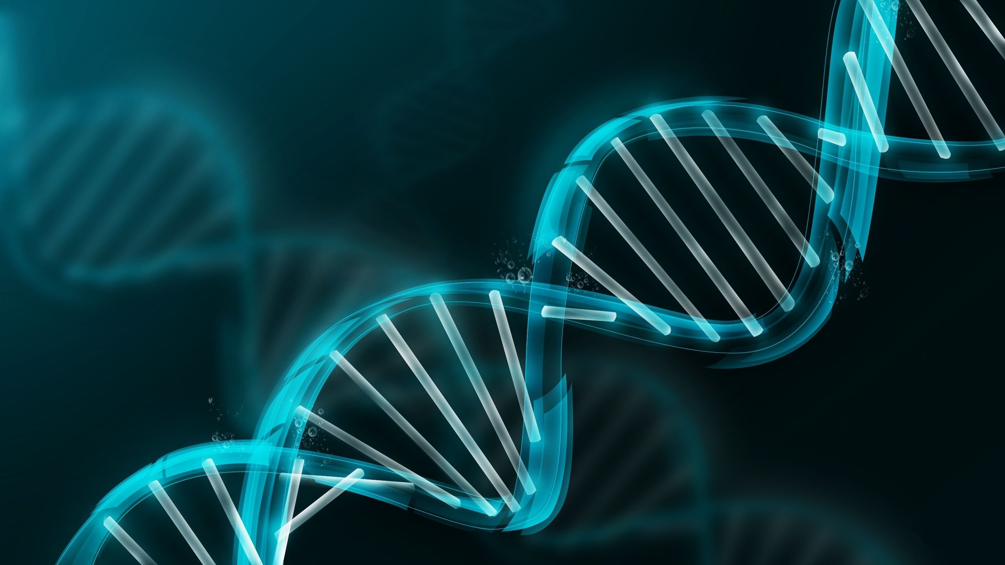
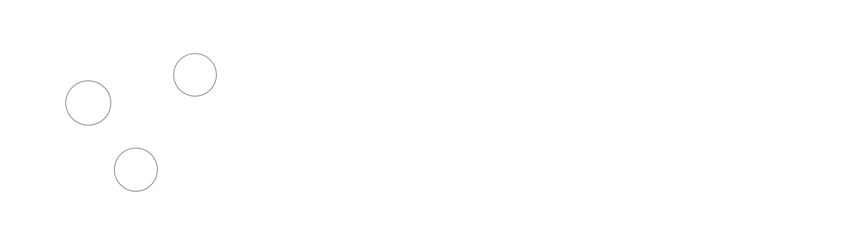
GeneFormer

Slide 2
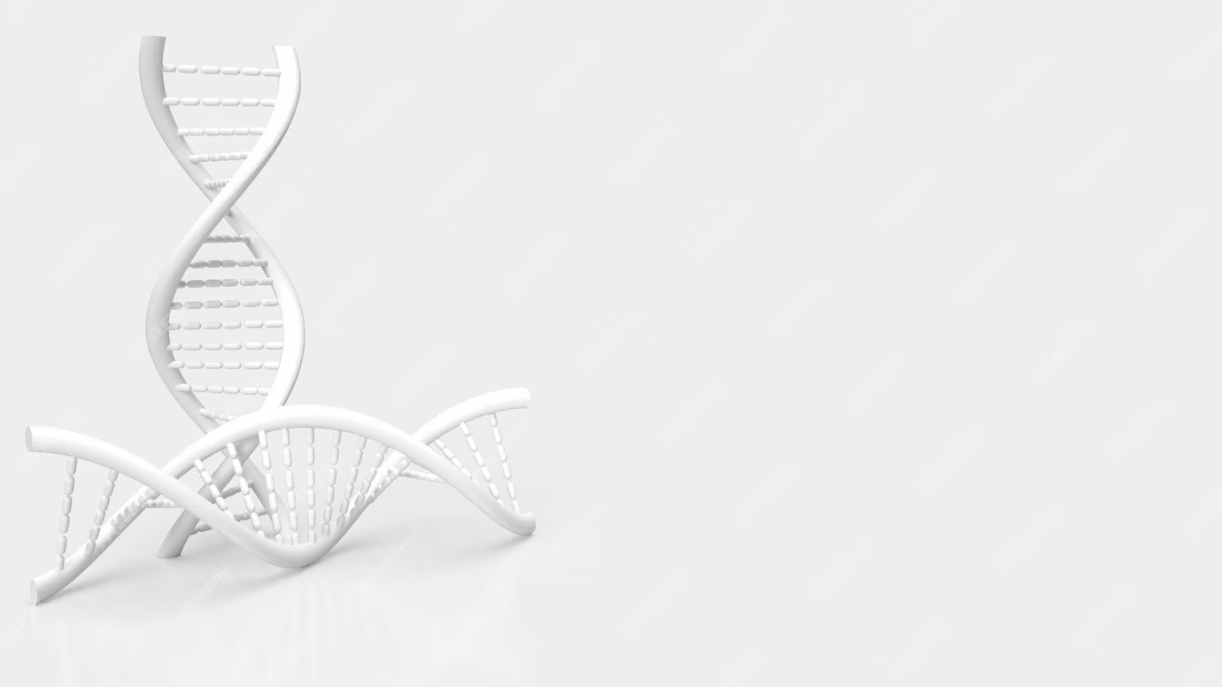

GeneFormer

Slide 3
AGNEDA
1. INTRODUCTION
2. ABOUT GENEFORMER
3. GENEFORMER ARCHITECTURE AND PRETRAINING
4. DOWNSTREAM TASKS USING GENEFORMER

Slide 4
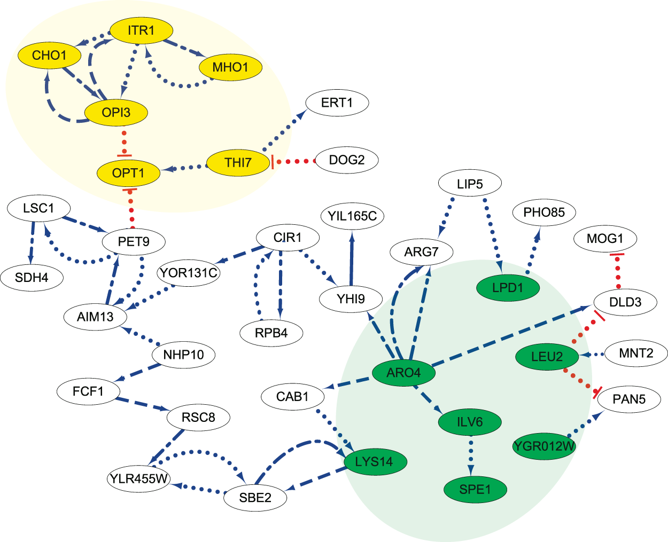
INTRODUCTION
Mapping Gene Regulatory networks – for diseases
To target core regulatory elements
Rather than targeting peripheral downstream effectors
Mapping requires large amount of Transcriptomic data
Limited in case of rare diseases
Disease affecting clinically inaccessible tissues
How to make a GRN in case for Rare Diseases
Limited Data
Precise and specific
GeneFormer
Trained on Genecorpus 30 M – Potentially providing more precise data for mapping GRN
Attention mechanism with Transfer-learning creates GRN to handle precision, specificity and also the problem of limited data

Slide 5
ABOUT GENEFORMER
Geneformer is analogous to Transformer
Context-aware, attention-based deep learning model as (network dynamics may vary across cell types, developmental timepoints or disease states.)
pretrained on large-scale transcriptomic data to enable predictions in network biology.
Advent of self-attention ( from BERT paper and AIAYN paper)
Attention over the large input space of genes – from transcriptomic data of single cell – to identify which genes are important to focus – to optimize predictive accuracy – given learning objective.
What’s preprocessing technique in Transformer

Slide 6
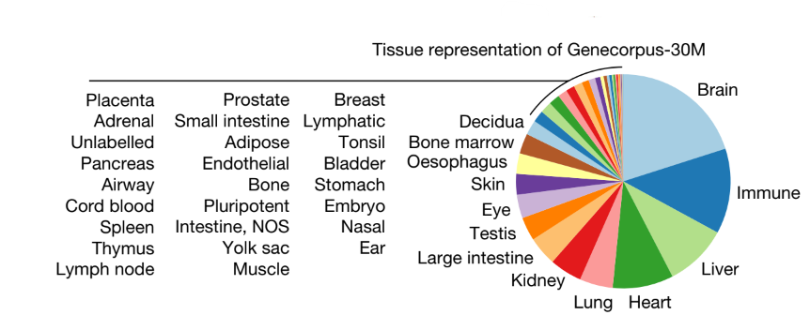
GENEFORMER ARCHITECTURE AND PRETRAINING
OUTLINE
Gene Corpus 30 M
29.9 million human single-cell transcriptomes from a broad range of tissues from publicly available data
Excluded cells with high mutational burdens
E.g. malignant cells and immortalized cell lines
Rank Value Encoding
Non Parametric representation for each single cell
Low Rank - Genes with low cell state distinguishing power but are highly expressed
High Rank - Genes with high cell state distinguishing power but are lowly expressed
How Rank is calculated
the non-zero median value of expression of each detected gene across all cells
Aggregated the transcript count distribution for each gene in a memory-efficient manner
Normalizing the gene transcript counts in each cell by the total transcript count of that cell
then normalized the genes in each single-cell transcriptome by the non-zero median value of expression of that gene across Genecorpus-30M.
ordered the genes by the rank of their normalized expression in that specific cell.
Excluded possible doublets and/or damaged cells
could lead to substantial network rewiring without companion genome sequencing to facilitate interpretation.
Rank Value Encoding
where genes are ranked by their expression in that cell normalized by their expression across the entire Genecorpus-30M

Slide 7
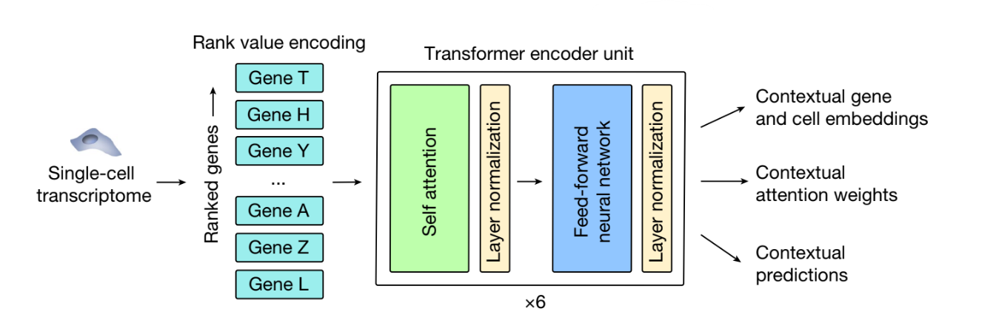
GENEFORMER ARCHITECTURE AND PRETRAINING
Rank Value Encoding
where genes are ranked by their expression in that cell normalized by their expression across the entire Genecorpus-30M
PRETRAINING PROCESS
15% of the genes are masked and the model is trained to predict these masked genes in a self supervised manner
Gene Embeddings
Each single-cell transcriptome presented
Geneformer embeds each gene into a 256-dimensional space that encodes the characteristics of the gene specific to the context of that cell.
Gene embeddings last layer – more specific to the target objective
Gene embeddings second to last layer – generalizable representation (and considered for study).
Cell Embeddings
generated by averaging the embeddings of each gene detected in that cell
Resulting in a 256-dimensional embedding.
Attention weights
Each GeneFormer had 4 attention weights
Unsupervised manner to pay attention to distinct classes of genes to jointly improve predictions without previous knowledge of the biological function of any gene.
GENEFORMER’s ENCODER
each composed of a self-attention layer + feed forward neural network layer network layer
GENE EMBEDDINGS
CELL EMBEDDINGS

Slide 8
GeneFormer DownStream Tasks
What are downstream tasks in Machine Learning ?
Transferring knowledge from a trained model to a specific task
Retrain the model with task specific data
Model will be able to give priority to only certain parameters
GeneFormer
Gene Dosage sensitivity prediction
Chromatin dynamics prediction
Network dynamics prediction
Pretraining Encoded Network Hierarchy
Insilico Gene Network Analysis
Insilico Treatment Analysis

Slide 9
Gene Dosage sensitivity prediction

Slide 10
Chromatin dynamics prediction

Slide 11
Network dynamics prediction

Slide 12
Pretraining Encoded Network Hierarchy

Slide 13
Insilico Gene Network Analysis

Slide 14
Insilico Treatment Analysis

