Slide 1

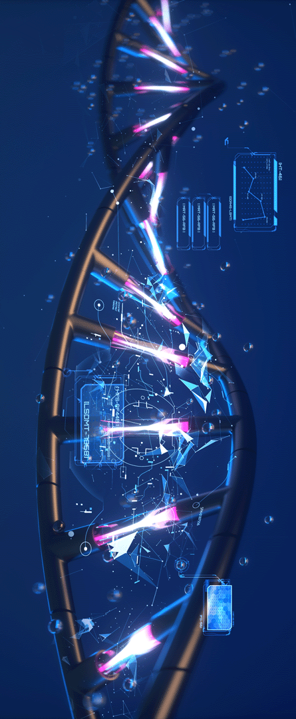

Discussion session
November – 1 - 2024
TRANSFORMER INTUITION : A prerequisite for LLMs and Biomedical Foundational Models
Vasudev R
Empid – 10073
Software Developer Trainee In Machine Learning
Machine Learning Department
Feathersoft Info IT Solutions Kochi

Slide 2

Agenda For Discussion
01 Sequence to Sequence Learning
02 Why Attention Mechanism
03 Mathematical Intuition Of Attention Mechanism
04 Transformer Architecture

Slide 3
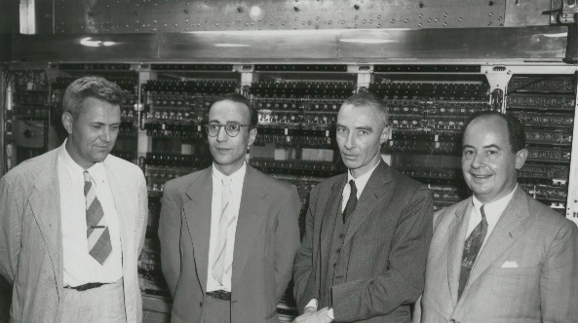
History of Seq2Seq Models
Cryptography Technique
What is Seq2seq ?
Input : a sequence (like sentence)
Output : a sequence
Applications include
Machine Translation
Text Summarization
Conversational Models
High level Architecture – Encoder Decoder Model
Decoder
Cipher Text
Plain Text
Non Readable
Format
Readable
Format
Encoder
Plain Text
Readable
Format
Warren Weaver, Letter to Norbert Wiener, March 4, 1947
“ One naturally wonders if the problem of translation could conceivably be treated as a problem in cryptography. ”
Two process is involved – Encryption and Decryption
Key Features
Confidentiality
Integrity
Authentication

Slide 4
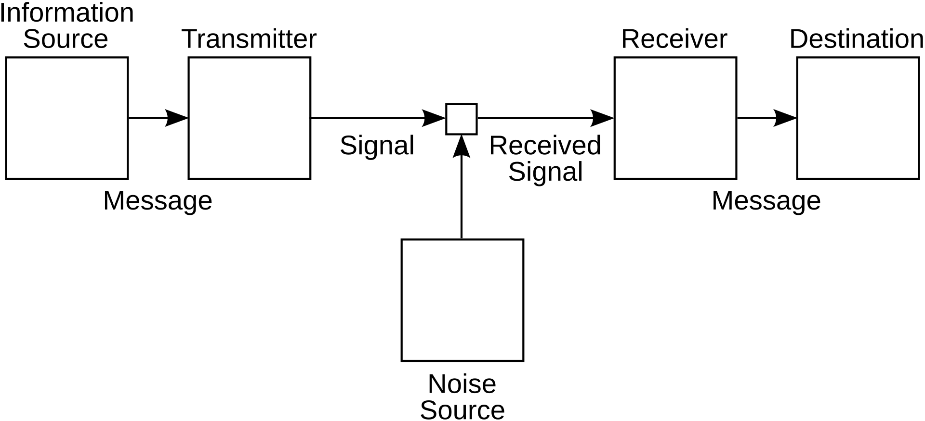
Sequential to Sequential Models
Signal Transduction Process
Sequential to Sequential Model in Natural Lang Processing
Input : Sequential data (sequence of words or sentences)
Output: Sequential data
Before Seq2seq
Statistical Methods
Phrase Based Methods
Unable to handle long term dependencies
Seq2Seq Model
Use RNN based Networks for input processing and as well as Output generation
Sequential
output
Hidden
State (context vector)
Decoder
Encoder
Sequential
Input
Encoder
Process the input sequence
convert into a fixed size hidden representation
Decoder
use hidden state representation
produce target sequence
Context vector – semantic information and other important information
Advanced version - Transformer

Slide 5
Agenda For Discussion
01 Sequence to Sequence Learning
02 Why Attention Mechanism
03 Mathematical Intuition Of Attention Mechanism
04 Transformer Architecture

Slide 6
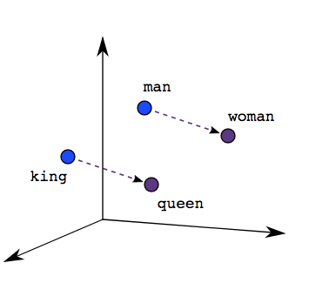
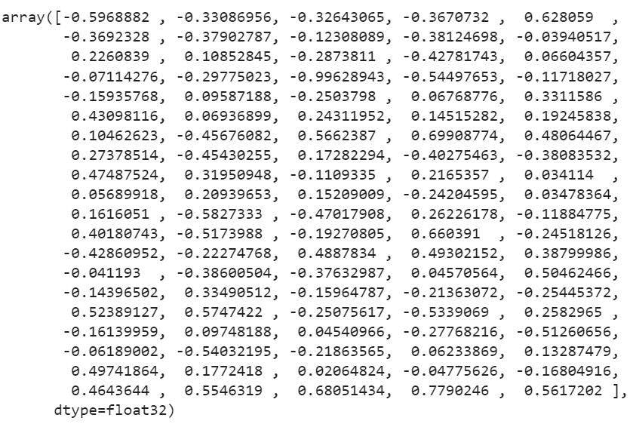
Pre-requisite : Embeddings
Bridge between humans and computers
Text to numbers
Better the embedding better the model prediction will be
Why Attention Mechanism ?
Limitations with the Word Embeddings
Where will you keep the word Cell ?
Prison
Jailer
Warden
Prisoner
Tissues
Organs
Blood vessels
College
Students
Faculty
Department

Slide 7
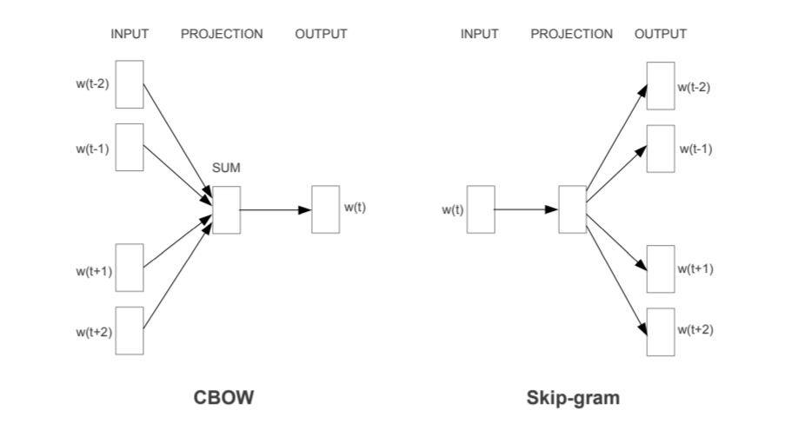
What Attention does ?
Uses the context of the whole sentence to know what we are talking about by adjusting the embeddings values
"The cell houses essential components like the nucleus, mitochondria, and cytoplasm...“
Each department formed a cell to drive innovation and quick solutions
The prisoner sat alone in his small cell.
Prison
Jailer
Warden
Prisoner
sentence 3
Cell
sentence 1
sentence 2
Tissues
Organs
Blood vessels
College
Students
Faculty
Department

Slide 8
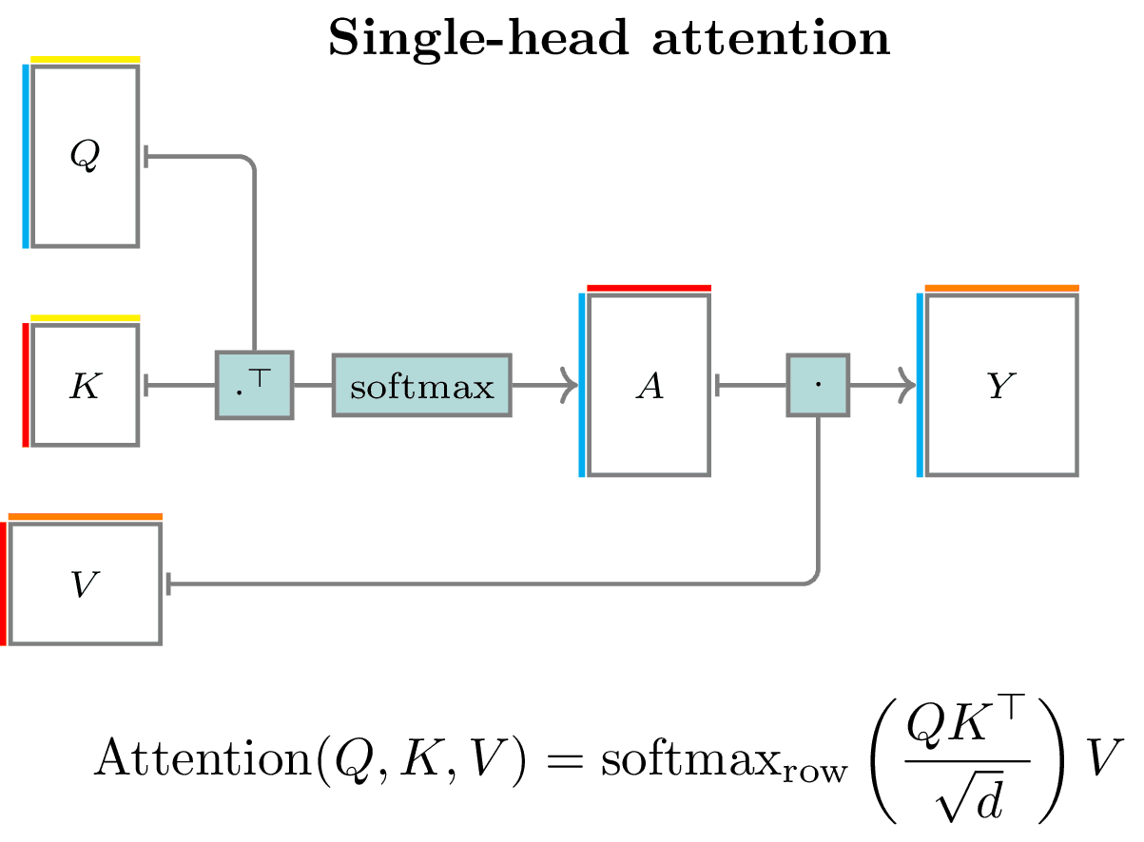
What about other words ?
The prisoner sat alone in his small cell.
The
alone
his
cell
in
prisoner
sat

Slide 9
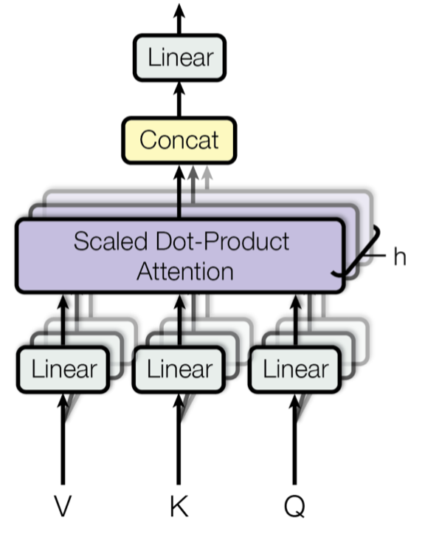
Is Single Head Attention Enough ?
No its not, You need multiple attention aka multihead Attention
More specifically multiple embeddings are created
Among the multiple embeddings we select the embeddings with the best separation of cluster
Select the best clusters from a set of clusters for clustering
One embedding is created – Apply linear transformations on it
Shear
Stretch
Rotate
Combination of all

Slide 10
Agenda For Discussion
01 Sequence to Sequence Learning
02 Why Attention Mechanism
03 Mathematical Intuition Of Attention Mechanism
04 Transformer Architecture

Slide 11
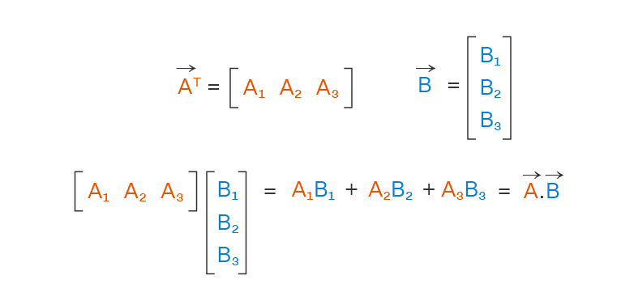
Mathematical Intuition Of Attention Mechanism
Two Process is involved
Similarity capturing between every words
Normalization and Exponential
Similarity measures in Euclidian space
Dot product
Cosine Similarity
Scaled Dot Product
Eg. The prisoner sat in his cell.
 | The | Prisoner | Sat | In | His | Cell | Tissue | College
The | 1 | 0.2 | 0 | 0 | 0 | 0 | 0 | 0
Prisoner | 0.2 | 1 | 0 | 0 | 0 | 0.75 | 0 | 0
Sat | 0 | 0 | 1 | 0 | 0 | 0 | 0 | 0
In | 0 | 0 | 0 | 1 | 0 | 0 | 0 | 0
The | 0 | 0 | 0 | 0 | 1 | 0 | 0 | 0
Cell | 0 | 0.75 | 0 | 0 | 0 | 1 | 0 | 0
Tissue | 0 | 0 | 0 | 0 | 0 | 0.8 | 1 | 0
College | 0 | 0 | 0 | 0 | 0 | 0.8 | 0 | 1
The =
Prisoner = 1 * Prisoner + 0.75 * Cell
Sat =
in =
his =
Cell = 0.75 * Prisoner + 1 * Cell

Slide 12
Normalization and exponentiation
Eg. The prisoner sat in his cell.
 | The | Prisoner | Sat | In | His | Cell | Tissue | College
The | 1 | 0.2 | 0 | 0 | 0 | 0 | 0 | 0
Prisoner | 0.2 | 1 | 0 | 0 | 0 | 0.75 | 0 | 0
Sat | 0 | 0 | 1 | 0 | 0 | 0 | 0 | 0
In | 0 | 0 | 0 | 1 | 0 | 0 | 0 | 0
The | 0 | 0 | 0 | 0 | 1 | 0 | 0 | 0
Cell | 0 | 0.75 | 0 | 0 | 0 | 1 | 0 | 0
Tissue | 0 | 0 | 0 | 0 | 0 | 0.8 | 1 | 0
College | 0 | 0 | 0 | 0 | 0 | 0.8 | 0 | 1
The =
Prisoner = 1 * Prisoner + 0.75 * Cell
Sat =
in =
his =
Cell = 0.75 * Prisoner + 1 * Cell
Prisoner = 1 * Prisoner + 0.75 * Cell = 0.58 Prisoner + 0.42 Cell
1+ 0.75
Prisoner = (𝑒 ^ 1) * Prisoner + (𝑒 ^ 0.75) * Cell = 0.58 Prisoner + 0.42 Cell
𝑒 ^ (1+ 0.75)

Slide 13
Eg. The prisoner sat in his cell.
The
Cell = 0.58 Prisoner + 0.42 Cell
alone
Prisoner = 0.42 Prisoner + 0.58 Cell
his
cell
The
in
alone
prisoner
his
prisoner
in
cell

Slide 14
Agenda For Discussion
01 Sequence to Sequence Learning
02 Why Attention Mechanism
03 Mathematical Intuition Of Attention Mechanism
04 Transformer Architecture

Slide 15
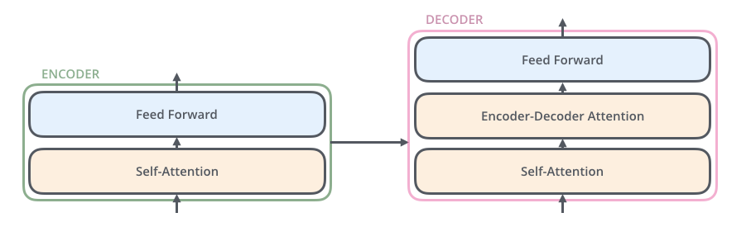
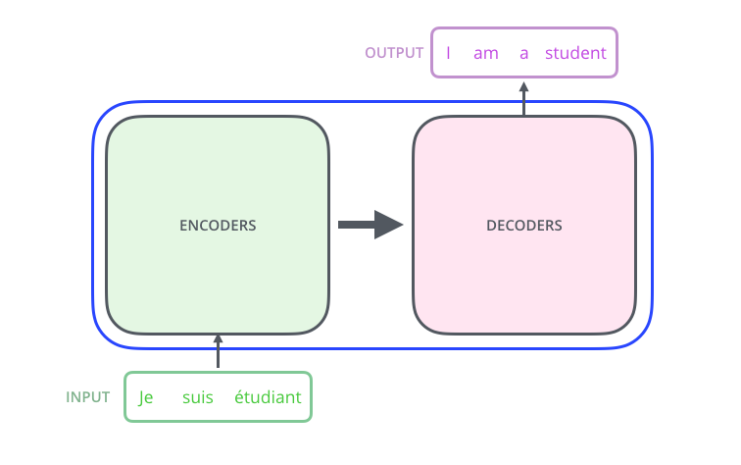
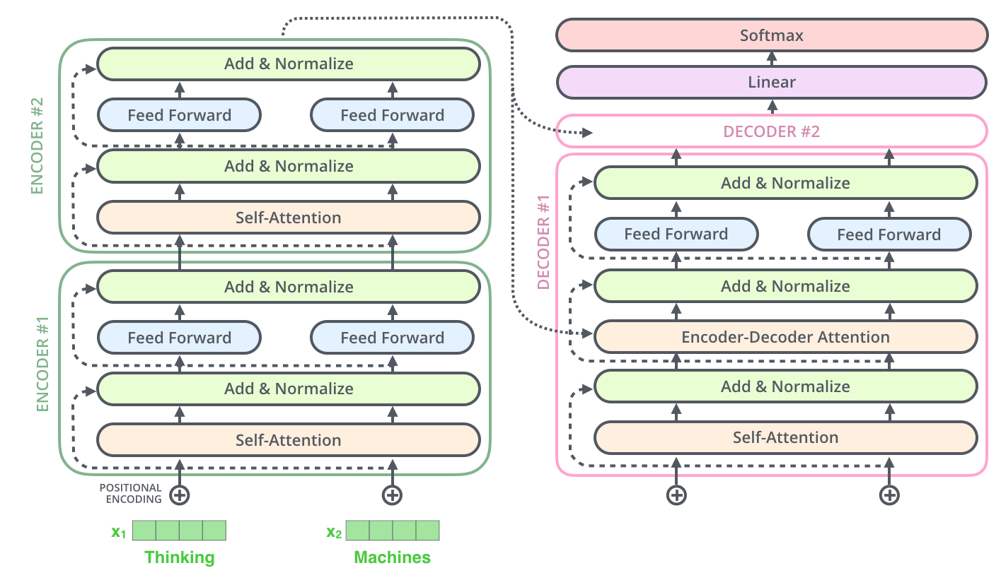
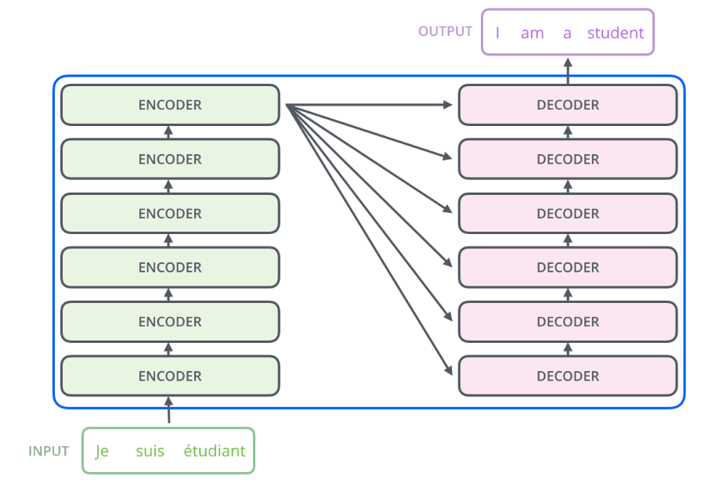
High level Architecture
Whats inside Encoder and Decoder ?

Slide 16
The Transformer Timeline
Word Embeddings
Hinton proposed the idea of “learning distributed representation of words”
Representing semantics of a word by mapping it into a higher dimension space.
Such that words that are together have similar meaning.
1986
Word2vec
This was a breakthrough in NLP
Embeddings generated were called Neural Embeddings
These embedding were of lower dimensions also.
2013
Transformer ( Attention )
Update the embedding values
Updated values will be able to capture wrt to context of the sentence.
2017

Slide 17
Thank You For your Valuable Time.

