Slide 2
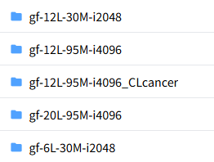
GENEFORMER DEMO ON DATABRICKS
5 VARIANTS
CURRENT RESOURCES
REQUIRED IMPLEMENTATION
TERMINOLOGIES
Cell Embeddings
IPSC State
Insilico Perturbation – {"delete", "overexpress", "inhibit", "activate"}
Classification generate embeddings perturbation
Cosine Similarity
Synthetic lethality Pairs
DEMO AGENDA
Geneformer 30-series classification implementation

Slide 3
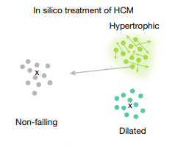
GENEFORMER PROJECT
Situation
Perturbation visual
Perform perturbation analysis on various cancer – to identify gene pairs whose inhibition that can shift from the
Tomour → Senescence.
Classification generate embeddings perturbation
What we have.
Queries
How we can model for various cancer studies?
Progress
Challenge
Presentations on Gene2vec, Transformers, Geneformer
Performed Insilico Perturbation analysis on Heart disease.
Article on Geneformer
Constructed dataset for all the avaible models.
Performed Finetuning- classification on colorectal cancer of 6 Belgian patients – discarded
Currently working on Korean patients datasets.
Sample dataset for latest model were not available
Learning curve
Solution
Use these dataset for heart disease as reference study and construct similar one for colorectal cancer and Finetune it for classification task

Slide 4
What we have ?
We have a geneformer model which applied this perturbation analysis on a heart disease

Slide 6


GeneFormer

Slide 7
AGNEDA
1. INTRODUCTION
2. ABOUT GENEFORMER
3. GENEFORMER ARCHITECTURE AND PRETRAINING
4. DOWNSTREAM TASKS USING GENEFORMER

Slide 8
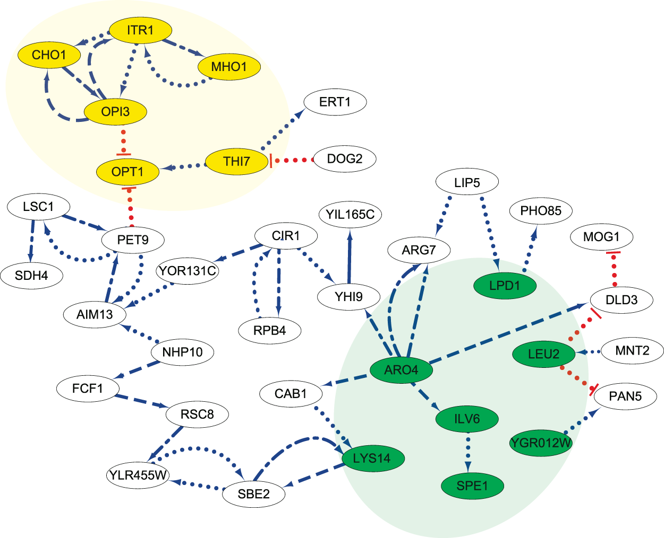
INTRODUCTION
Mapping Gene Regulatory networks – for diseases
To target core regulatory elements
Rather than targeting peripheral downstream effectors
Mapping requires large amount of Transcriptomic data
Limited in case of rare diseases
Disease affecting clinically inaccessible tissues
How to make a GRN in case for Rare Diseases
Limited Data
Precise and specific
GeneFormer
Trained on Genecorpus 30 M – Potentially providing more precise data for mapping GRN
Attention mechanism with Transfer-learning creates GRN to handle precision, specificity and also the problem of limited data

Slide 9
ABOUT GENEFORMER
Geneformer is analogous to Transformer
Context-aware, attention-based deep learning model as (network dynamics may vary across cell types, developmental timepoints or disease states.)
pretrained on large-scale transcriptomic data to enable predictions in network biology.
Advent of self-attention ( from BERT paper and AIAYN paper)
Attention over the large input space of genes – from transcriptomic data of single cell – to identify which genes are important to focus – to optimize predictive accuracy – given learning objective.
Pre-training technique in Transformer
Involves training a transformer model on a large, diverse dataset
This process typically uses unsupervised learning
Model learns to predict parts of the input data without explicit labels
Common techniques
Masked Language Modeling (MLM): some words in a sentence are masked, and the model learns to predict them based on the context.
Next Sentence Prediction (NSP): model learns to predict if one sentence follows another.
Causal Language Modeling (CLM): model predicts the next word in a sequence .
Advantages
Knowledge Transfer: Pretraining allows the model to learn general language patterns and structures from a large corpus of text. This knowledge can then be transferred to specific tasks, improving performance.
Efficiency: It reduces the amount of labeled data needed for training on specific tasks, as the model already has a strong understanding of language.
Pretraining
Mutihead Attention
Knowledge transfer
Constructing GRN for disease
Knowledge transfer

Slide 10
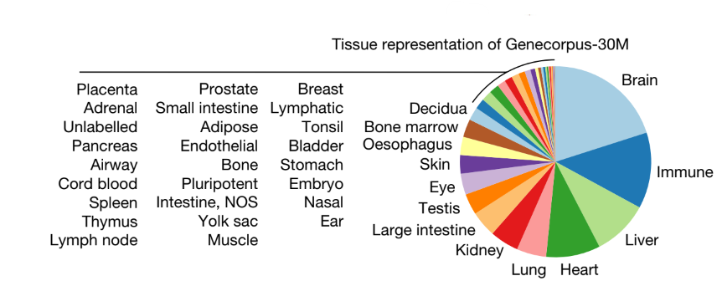
GENEFORMER ARCHITECTURE AND PRETRAINING
OUTLINE
Gene Corpus 30 M
29.9 million human single-cell transcriptomes from a broad range of tissues from publicly available data
Excluded cells with high mutational burdens
E.g. malignant cells and immortalized cell lines
Rank Value Encoding
Non Parametric representation for each single cell
High Rank - Genes with high cell state distinguishing power but are lowly expressed
Low Rank - Genes with low cell state distinguishing power but are highly expressed
How Rank is calculated
the non-zero median value of expression of each detected gene across all cells
Aggregated the transcript count distribution for each gene in a memory-efficient manner
Normalizing the gene transcript counts in each cell by the total transcript count of that cell
then normalized the genes in each single-cell transcriptome by the non-zero median value of expression of that gene across Genecorpus-30M.
ordered the genes by the rank of their normalized expression in that specific cell.
Excluded possible doublets and/or damaged cells
could lead to substantial network rewiring without companion genome sequencing to facilitate interpretation.
Rank Value Encoding
where genes are ranked by their expression in that cell normalized by their expression across the entire Genecorpus-30M

Slide 11
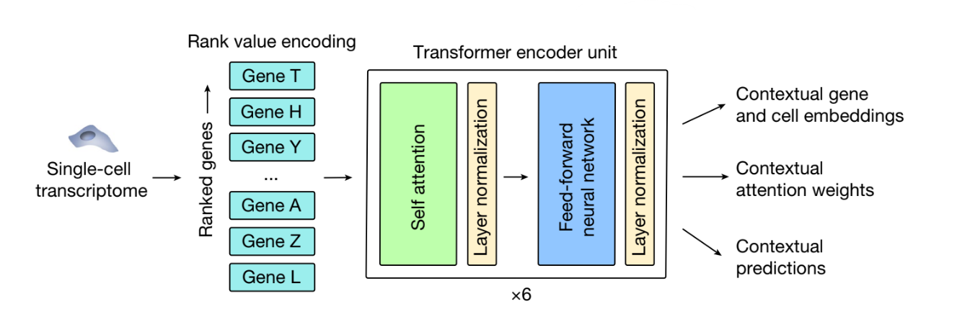
GENEFORMER ARCHITECTURE AND PRETRAINING
Rank Value Encoding
where genes are ranked by their expression in that cell normalized by their expression across the entire Genecorpus-30M
PRETRAINING PROCESS
15% of the genes are masked and the model is trained to predict these masked genes in a self supervised manner
Gene Embeddings
Each single-cell transcriptome presented
Geneformer embeds each gene into a 256-dimensional space that encodes the characteristics of the gene specific to the context of that cell.
Gene embeddings last layer – more specific to the target objective
Gene embeddings second to last layer – generalizable representation (and considered for study).
Cell Embeddings
generated by averaging the embeddings of each gene detected in that cell
Resulting in a 256-dimensional embedding.
.
GENEFORMER’s ENCODER
each composed of a self-attention layer + feed forward neural network layer network layer, 4 -attention heads
GENE EMBEDDINGS
CELL EMBEDDINGS

Slide 12
In silico perturbation
Perturbation the rank value encodings
Effects are measured at cell and gene embedding level
Study how Perturbation affects cell state and regulation of downstream tasks
In Silico deletion can be done removing single genes or multiple genes
In Silico activation can be done shifting the rank of the genes up and down in the rank value encodings
Quantifying the similarity between original and perturbed
1. Cell embeddings : prediction of deleterious effect of genes
2. Gene embeddings : embeddings of remaining genes in a single cell transcriptome to find out sensitivity wrt to current gene
In Silico Perturbation
In Silico Deletion
In Silico Activation

Slide 13


Transfer Learning
Balance
Steering
Road
Signals etc
Advantages of Transfer Learning
Training Time is Significantly Cut down
Improved Performance
Data Efficiency
Cost Effectiveness

Slide 14
GeneFormer DownStream Tasks
What are downstream tasks in Machine Learning ?
Transferring knowledge from a trained model to a specific task
Retrain the model with task specific data
Model will be able to give priority to only certain parameters
GeneFormer
In slico perbutration
In slico perbutration
In slico perbutration
Gene Dosage sensitivity prediction
Chromatin dynamics prediction
Network dynamics prediction
Pretraining Encoded Network Hierarchy
Insilico Gene Network Analysis
Insilico Treatment Analysis

Slide 15
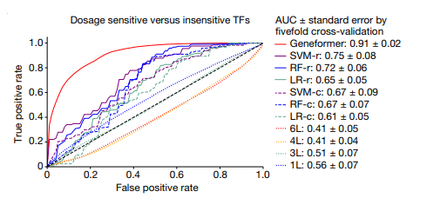
D.TASK - 1: Gene Dosage sensitivity prediction
Genome
Copy number variants (CNVs)
Genetic diagnosis
Gene Dosage sensitive vs Gene Dosage insensitive
Mapping Gene Regulatory networks – for diseases
To target core regulatory elements
Rather than targeting peripheral downstream effectors
situation
observations
Interpreting the CNVs
Drawbacks of Conservation and allele methods
Features captured may not vary accross cell states
Do not capture transcriptional dynamics
challenge
How to interpret the CNVs ?
To identify whether gene is Dosage sensitive or Dosage insensitive?
Which tissues are affected by dosage change?
Improving the pretraining dataset with more and diverse datset
improved predictive power with same specific limited data for finetuning
Queries
Applications
Transfer Learning with GeneFormer for DSen vs DinSen previously reported datasets
Fine Tuned using 10,000 single cell transcriptomes
Captured Dsen vs DinSen Factors
Solutions
Nuero devlopemnetal disease
Silico deletion approach in cardiomyopathy

Slide 16
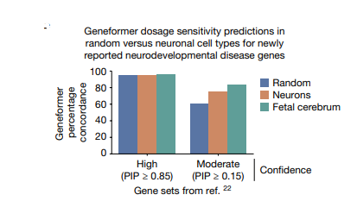
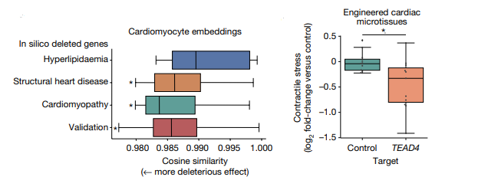
Nuero developmental disease
Silico deletion approach in cardiomyocytes
Training labels
Without furthur Finetuning
Genes whose deletion - primarly associated – high or moderate confidence
Observations
Concordance
Fetal cerebral cells (High conf) - 96% concordance with original study
Other celss (High Conf) – 95% confidence with original study
Fetal cerebral cells (Mod conf) - 84% concordance with original study
Context specificity
Moderate – confidence genes were more
Count Fetal cerebral cells > Neurons
Consistent wrt phenotype (across any adult or developemental timepoint)
In – slico deletion approach in cardiomyocytes
Identify if gene has deleterios effect on cell context
Removed genes from rank value encoding
Observations
Genes known for cardiomyopathy and heart diseases had more effect than control set of hyperlipidemia genes
Study was enriched for human phenotypes (including cardiomyopathy and abnormal myocardial morphology)
TOP 25 genes included
Transcription factors known to regulate myocardial development (eg FOXM1)
New dosage sensitivity gene candidates (TEAD4)
Experiment with TEAD4
CRISPR mediated knockout of TEAD4 (ipsc state) – affected generate contractile stress

Slide 17
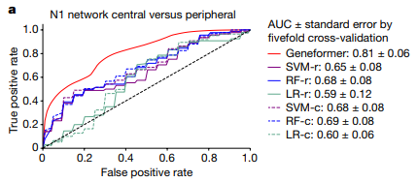
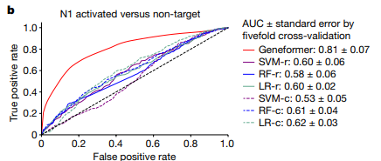
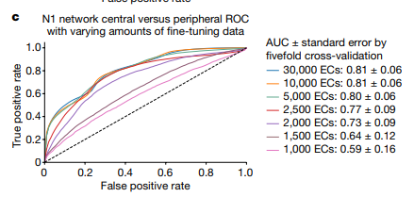
D.TASK – 3 :Network dynamics prediction
GRN – Top level, Middle level and lower level Regulators
Determining therapies targetting core regulatory elements
situation
observations
Mapping GRN requires large amount of Transcriptomic data
Patient specific cells with isogenic controls
For learning connection between genes
challenge
How to handle the problem of limited data ?
Queries
Geneformer Finetuning
Training data : NOTCH1 (N1)-dependent gene network governing cardiac valve disease
30,000 normal endothelial cells (ECs)
Distinguish between Central vs Peripheral factors within training data
Investigated to find minimum data threshold for optimal fine tuning
Solutions

Slide 18
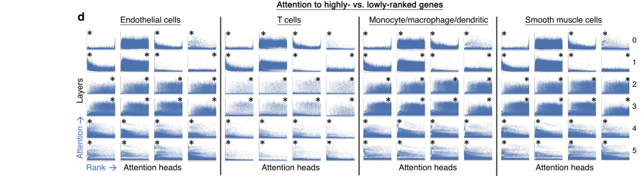
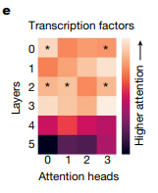
D.TASK – 4 : Pretraining Encoded Network Hierarchy
Investigating how the model was learning network dynamics during the pre-training stage ?
Queries
Trained attention weights
Each six layers had 4 attention heads – to pay attention to distinct classes of genes
situation
Layers description
Earliest layers : Most diverse in terms of the ranks they have attended
Middle layers : Broad interms of Ranks they have attended
Final layers : foccused on highest ranked genes that uniquely define cell state
Fine-Tuned with Aortic ECs
Examined attention weights in Aortic Ecs
20 % attended transcription factor than other genes
Transcription factors
Relative importance in distinguishing cell states
Certain attention heads – attended Central RN than peripheral nodes
Attended highest ranked genes
Solutions and obes

Slide 19
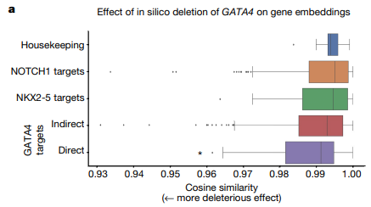
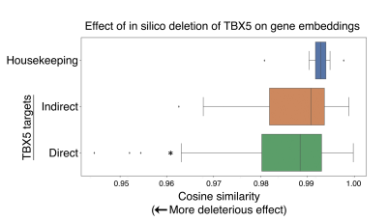
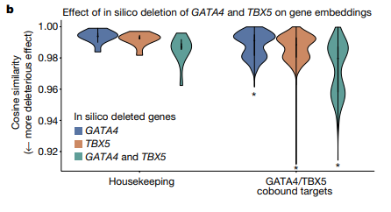
D.TASK – 5 : Insilico Gene Network Analysis
Transcription Factors and their targets
Gene Embeddings generated by GeneFormer
situation
Does the pre-trained Geneformer encoded network connection between transcriptome factors and their targets
Queries
Analyzed for Gene embeddings in Fetal cardiomyocytes
in silico deletion of GATA4 (congental heart disease)
Insilico deletion of TBX5 (another congenital heart disease)
in silico deletion of the combination of GATA4 and TBX5
Solutions and obes

Slide 20
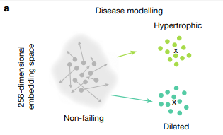
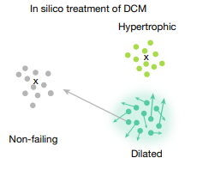
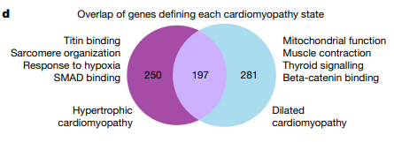
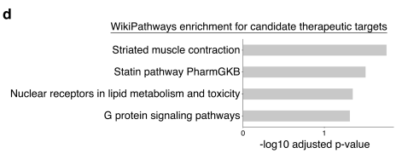
D.TASK – 6 :Insilico Treatment Analysis
Cardiomyopathy
States – Hypertrophic, dilated , Non- Falling
situation
Can one use Insilco perturbation strategy to model human diseases and reveal their candidate therapeutic targets
Queries
In silico inhibition in Cardiomyopathy
In Silico deletion in Non- Failing Hearts
Studied their effects and Pathway analysis was done
Classification model to distinguish
Dialated , Hypertrophic vs Non Failing Hearts
Out of sample accuracy : 90 %
Solutions

Slide 21
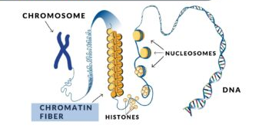
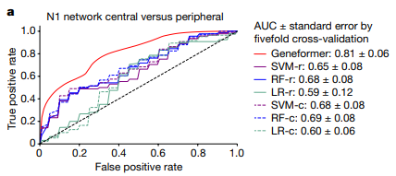
D.TASK - 2: Chromatin dynamics prediction
Chromatin structure
Bivalent Chromatin structure :
H3K4me3
H3K27me3
Promoters are in poised state
Bivalent promoters
Solely by H3k4me3
Unmethyled promoters
Fine Tuning single cell transcriptomes of 15,000 ESCs
distinguish
Bivalently marked genes from those whose
Promoters were unmethylated or marked solely by H3K4me3

Slide 22
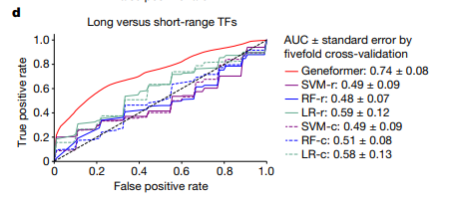
Transcription Factors
Regulatory variants
Transcription Factors
Regulatory variants
Determining the genomic distances over which transcription factor binding influences downstream expression is valuable for
interpreting regulatory variants and inferring target genes from
transcription factor genome occupancy data.
GeneFormer was finetuned to distinguish long range vs Short range Tfs.
Single cell transcriptomic data
34,000 cells undergoing iPSC to cardiomyo_x0002_cyte differentiation with no associated ChIP–seq or genomic distance data

