Slide 1
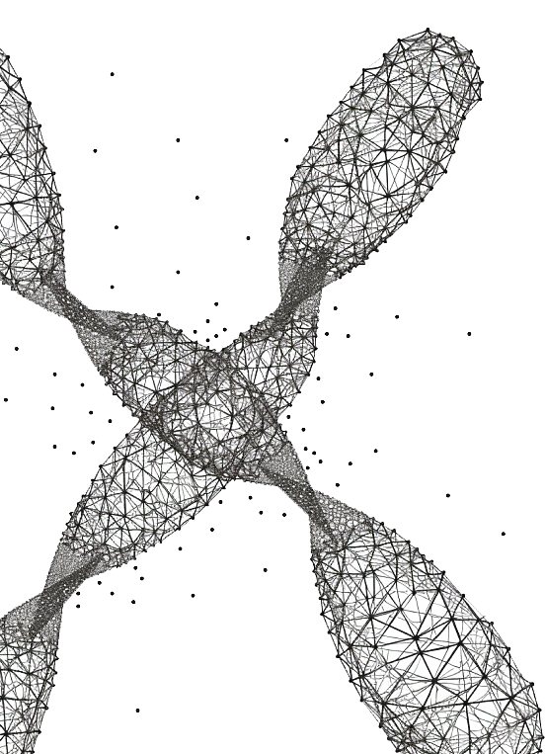

thinkbio.ai
Gene2vec : distributed representation of genes based on co-expression
Vasudev R
Empid – 10073
Software developer trainee in machine learning
Machine learning department
Feathersoft Info IT Solutions Kochi

Slide 2

Agenda for discussion
Word Embeddings
Word2vec – Skipgrams and Bag of Words
Gene2Vec
Introduction
About the Training data
Mathematical intuition behind Skipgram model
Additional steps to improve training
Applications of Gene2vec
Capturing the functional relationship - Performance evaluation
Gene to Gene Interaction – Performance Evaluation
Drawbacks of the model

Slide 3
Word Embeddings
Encoding – categorical data into numerical format
Word Embeddings

Slide 4
3.1. Introduction
Word Embeddings
Hinton proposed the idea of “learning distributed representation of words”
Representing semantics of a word by mapping it into a higher dimension space.
Such that words that are together have similar meaning.
1986
Word2vec
This was a breakthrough in NLP
Embeddings generated were called Neural Embeddings
These embedding were of lower dimensions also.
2013
Gene2vec
Inspired by word2vec
Representing Genes into a higher dimension
Applications include
Capture the functional relationship between the genes
Gene to gene interaction prediction
2019

Slide 5
3.2. Data Sources
Data Sources
Gene Expression
Gene types
Gene-gene interaction dataset
Tissue specific genes
Functional set genes

Slide 6
Train Test Input For the Model
Word2vec : input was a corpus (paragraph)
Gene2vec : input is gene pairs that are highly co-expressed
Data Source ?
Gene Expression Omnibus (GEO)
Keywords – “expression and human”
GPL570
Human Genome U133 array
Gene Pair selection
Number of samples >= 30
Log transformed and Quantile normalized
There were genes with multiple probe sets – largest variance once were used
Gene Co-expression measured using PCC
Selected PCC >=0.9
Labelling Process
1.
Gene Expression

