Slide 2
What Is Database Management System?
A database management system (or DBMS) is essentially nothing more than a computerized data-keeping system. Users of the system are given facilities to perform several kinds of operations on such a system for either manipulation of the data in the database or the management of the database structure itself. Database Management Systems (DBMSs) are categorized according to their data structures or types.

Slide 3
Why we are using DBMS?
A DataBase Management System is a system software for easy, efficient and reliable data processing and management. It can be used for:
Creation of a database.
Retrieval of information from the database.
Updating the database.
Managing a database.
It provides us with the many functionalities and is more advantageous than the traditional file system in many ways

Slide 4

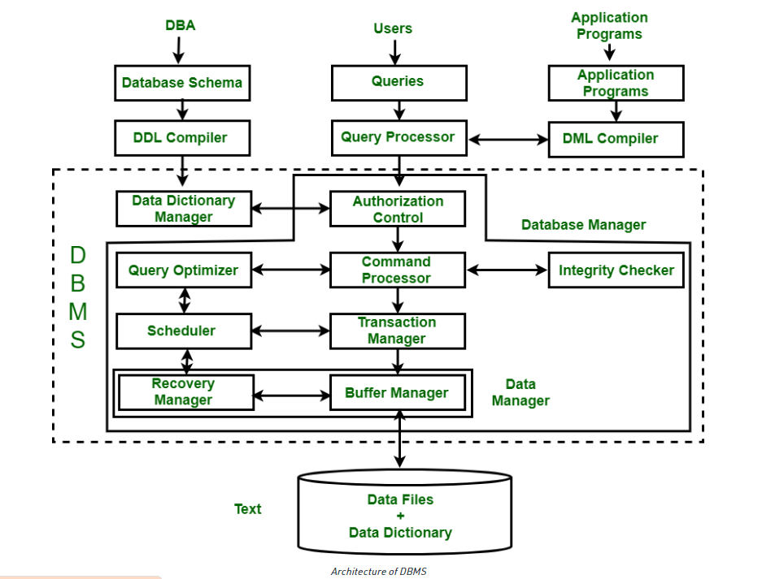
Architecture of DBMS:

Slide 5
What is MySQL?
MySQL is one of the most recognizable technologies in the modern big data ecosystem. Often called the most popular database and currently enjoying widespread, effective use regardless of industry, it’s clear that anyone involved with enterprise data or general IT should at least aim for a basic familiarity of MySQL.
MySQL is a relational database management system(RDBMS) developed by Oracle that is based on structured query language(SQL).

Slide 6
STRUCTURE OF THE DATABASE
Initially, we create a database of name central that contains three tables namely:Central_Hostel, Central_Student, Central_Employee.
Central_Hostel table contains Hostel number, Name, No. of Residents with int, varchar,int type where primary key is Hostel number.
Central_Student table contains Enrollment number, Name, Course, Subject, Year, Hostel_No, Address, Phone_No with varchar, varchar, varchar, varchar, int , int where primary key is Hostel number.
*Then we create database of each hostel namely:hostel1, hostel2,hostel3,...........,hostel16.

Slide 9

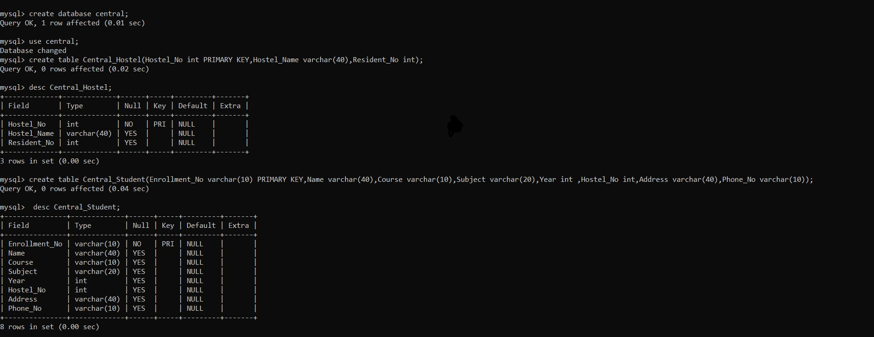
MYSQL CODE

Slide 10
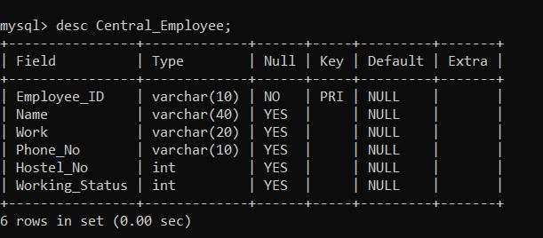

Slide 11
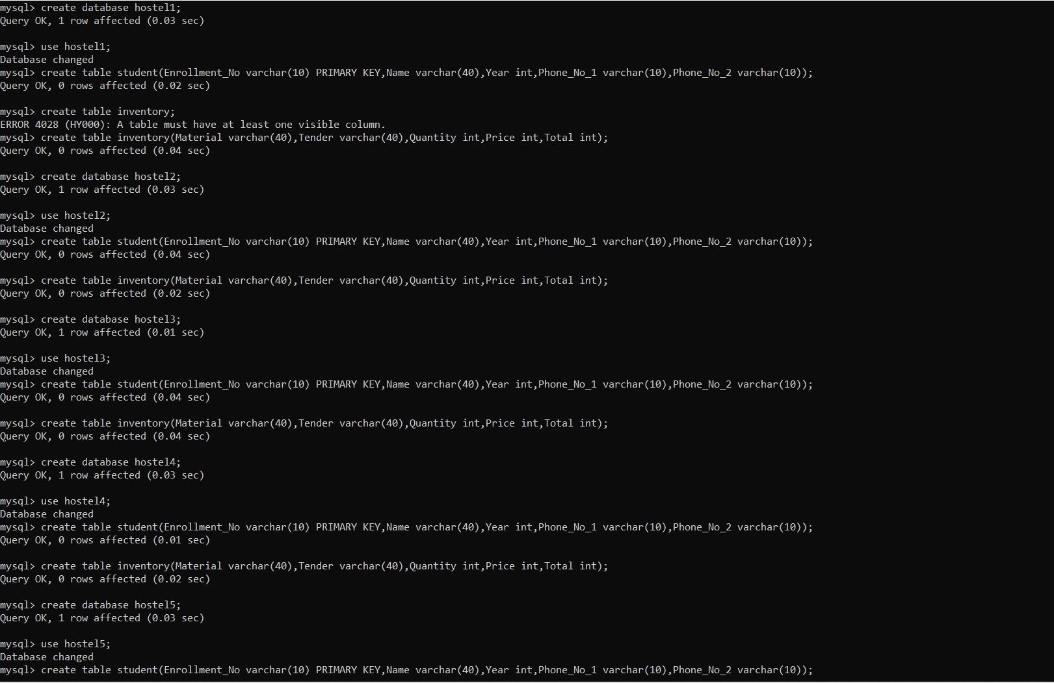

Slide 12
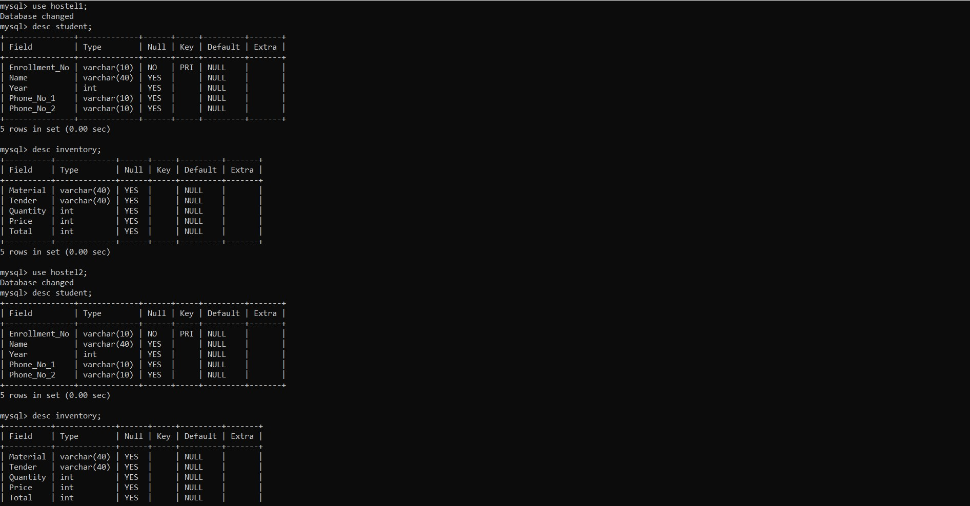

Slide 13
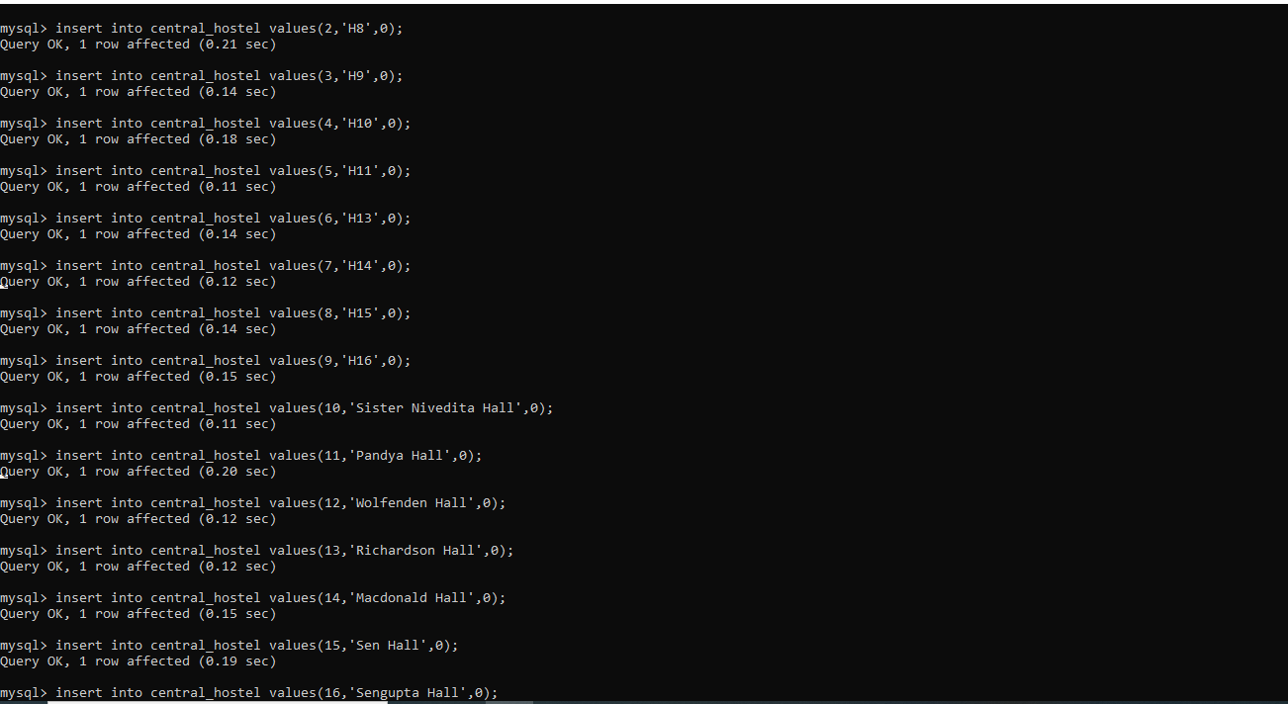

Slide 21
HOSTEL MANAGEMENT SYSTEM

