Slide 1
Commercial Vehicle Reliability & Failure Pattern Analysis
Industry: Commercial Vehicle / Automotive / Transportation & Logistics
Python-based Data Analysis and EDA | UK DVSA MOT Dataset 2024
Student: Shri Venkat Subramani M
Student ID: AF05320059
Course: AIML
Batch Code: ANP – D7444
Notes:
Good morning. I am Shri Venkat Subramani. My project is Commercial Vehicle Reliability and Failure Pattern Analysis, done in Python using the UK DVSA MOT dataset for 2024.

Slide 2
Industry Overview
The Industry
Why Reliability Matters
Commercial vehicles, automotive, transport and logistics
Fleets depend on vehicles being roadworthy and available
Unplanned unavailability delays deliveries
Raises repair and operating costs
Reduces fleet efficiency
Why Data Analysis Helps
MOT records show observed test failure patterns at large scale
Helps maintenance teams decide where to look first
Source: UK DVSA anonymised MOT test results, 2024 | 2 / 12
Notes:
Commercial vehicles keep goods moving. When a vehicle is unavailable, deliveries get delayed and costs go up. MOT data gives a large, real record of vehicle test outcomes, so analysis can show where failure patterns appear.

Slide 3
Problem Statement
Failure risk may depend on the combination of vehicle age, kilometres travelled, vehicle type, previous test history and previous defects, not on one factor alone.
Why one variable is not enough
Important distinction
Age alone ignores usage
Mileage alone ignores vehicle type
Combined view may reveal more
Who is affected: fleet operators, maintenance teams, logistics companies, vehicle owners
MOT failure = failed a periodic roadworthiness test
Breakdown = unplanned failure on the road
This project does NOT claim MOT failure rates equal breakdown probability
Source: UK DVSA anonymised MOT test results, 2024 | 3 / 12
Notes:
Most analysis looks at one factor only. My idea is that failure risk depends on a combination of factors. Important: an MOT failure is a test result, not a roadside breakdown.

Slide 4
Project Objectives
# | Objective | Status
1 | Understand structure and quality of the 2024 MOT dataset | Completed: full-year file inspected; schema and outputs documented
2 | Assess missing values and duplicate records | In progress: raw missing values counted; duplicate reconciliation open
3 | Explore MOT outcomes and observed failure rates | Preliminary outputs calculated; denominator conflict must be reconciled
4 | Investigate failure patterns by age, mileage and vehicle characteristics | Completed in notebook: age, mileage, make/model and combined age–mileage summaries
5 | Develop insights to support maintenance planning | Initial findings prepared; validate counts before final submission
Source: UK DVSA anonymised MOT test results, 2024 | 4 / 12
Notes:
These are my objectives. Completed and in-progress status must match your notebook; please update the status column before presenting.

Slide 5
Proposed Solution & Analysis Questions
Tools
Analysis Questions
Python: workflow
Pandas: clean, transform, group
NumPy: numeric operations
Matplotlib: visualisation
Share of valid MOT tests that failed?
How does failure rate vary by vehicle age?
How does it vary across mileage groups?
Which makes and models have higher observed rates?
How does it vary by vehicle characteristics?
Where history exists, how do previous failures relate to later outcomes?
Source: UK DVSA anonymised MOT test results, 2024 | 5 / 12
Notes:
We use Python with Pandas for cleaning and grouping, NumPy for numeric work, and Matplotlib for charts. These are the six questions the analysis answers. Numerical answers appear only where verified.

Slide 6
Dataset Information
Overview
Important Fields
Name: UK DVSA anonymised MOT test results, 2024
Source: Driver and Vehicle Standards Agency (DVSA)
Format: CSV
Raw full-year rows: 66,857,535
Source columns: 15
Notebook cleaned output: 43,441,151 rows (reported)
Expected after reported duplicate removal: 43,442,376
Unresolved difference: 1,225 rows
Scope: full-year 2024 MOT tests; not a single delivery fleet
test_id, vehicle_id, test_date
test_class_id, test_type, test_result
test_mileage, postcode_area
make, model, colour, fuel_type
cylinder_capacity, first_use_date
completed_date
Derived fields in notebook: vehicle_age, vehicle_age_group, mileage_group
Class 7 is examined as a commercial-goods-vehicle subset; overall charts use the broader MOT dataset.
Source: UK DVSA anonymised MOT test results, 2024 | 6 / 12
Notes:
This is the DVSA anonymised MOT dataset for 2024 in CSV format. The final row and column counts are still being verified, so I have marked them as to be verified.

Slide 7
Data Collection and Understanding
Source: DVSA anonymised MOT test-result CSVs for January–December 2024, assembled into a full-year file.
Pandas checks: column structure, test-result categories, missing values, duplicate records, age and mileage distributions.
Raw file: 66,857,535 rows; 15 source columns. Repeated header rows and CSV parsing/quoting issues were investigated.
SCHEMA
RAW QUALITY
DUPLICATES
VALID OUTCOMES
15 source columns
66.86M rows
23.42M reported
66.45M records
test_id • vehicle_id • test_date
test_result • test_mileage • make/model
Missing mileage: 537,738
Missing engine capacity: 834,190
35.02% of raw rows flagged as exact duplicates
P + F + PRS; raw-file rate 17.26% (preliminary)
Source: UK DVSA anonymised MOT test results, 2024 | 7 / 12
Notes:
Explain only what you actually did: how you got the files and how you inspected them. Then show your four screenshots. Do not add outputs you have not run.

Slide 8
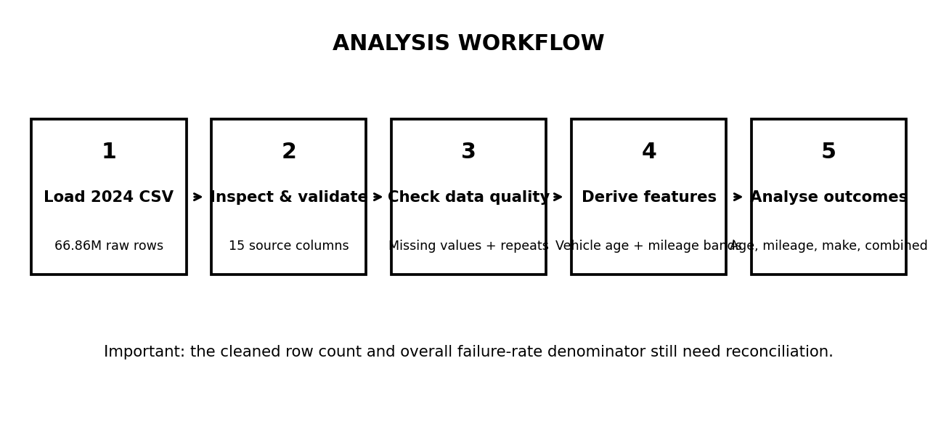
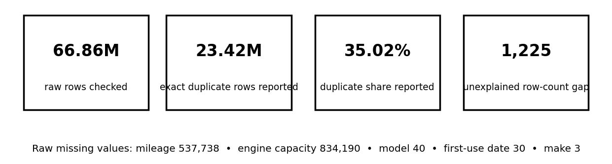
Data Cleaning and Transformation
CLEANING / ANALYSIS PIPELINE
CLEANING STEPS RECORDED IN NOTEBOOK
1. Inspect the 2024 CSV schema and columns.
2. Investigate repeated headers and malformed CSV rows.
3. Check exact duplicates across the full file using duplicate buckets.
4. Convert test dates and numeric fields; derive vehicle age and age/mileage groups.
5. Count missing values and calculate group-level failure rates.
VALIDATION STILL OPEN
• Duplicate-removal expectation: 43,442,376 rows.
• Existing cleaned output: 43,441,151 rows (gap: 1,225).
• Chunk-wise duplicate check alone does not prove global uniqueness.
• Do not claim all missing values were imputed or that only commercial vehicles were retained.
DATA QUALITY: VERIFIED NOTEBOOK OUTPUTS
Source: UK DVSA anonymised MOT test results, 2024 | 8 / 12
Notes:
Tick only the steps your notebook really performs and delete the rest. Do not say global duplicate removal or commercial-vehicle filtering is done unless the code confirms it.

Slide 9
Exploratory Data Analysis
Analysis | Method | Notebook result | Interpretation / caveat
Overall failure rate | F ÷ (P + F + PRS) | Raw: 17.26% Cleaned output: 18.87% | Conflicting denominators; reconcile before quoting one final rate.
Vehicle age | Failures ÷ valid tests per age band | 7.62% (0–3y) → 24.27% (12+y) | Observed rate rises across older age bands.
Mileage | Failures ÷ valid tests per mileage band | 6.44% (0–25k) → 25.28% (150k+) | Observed rate generally rises with mileage.
Age + mileage | Cross-tabulation of both groups | Highest shown: 27.18% (12+y, 150k+) | Combined pattern supports prioritising older, high-mileage groups for review.
Make / model | Minimum sample threshold applied | Make: DAEWOO 31.68%; TALBOT 31.49% (≥1,000 tests) | Observed group rates are not causal and may reflect fleet mix.
Data quality: raw missing values — mileage 537,738; engine capacity 834,190; model 40; first-use date 30; make 3. Duplicate-removal row count and overall-rate denominator still need reconciliation.
Source: UK DVSA anonymised MOT test results, 2024 | 9 / 12
Notes:
Only the overall failure rate has been previously reported. Everything else is pending until you run it. Replace each pending result with your verified output.

Slide 10
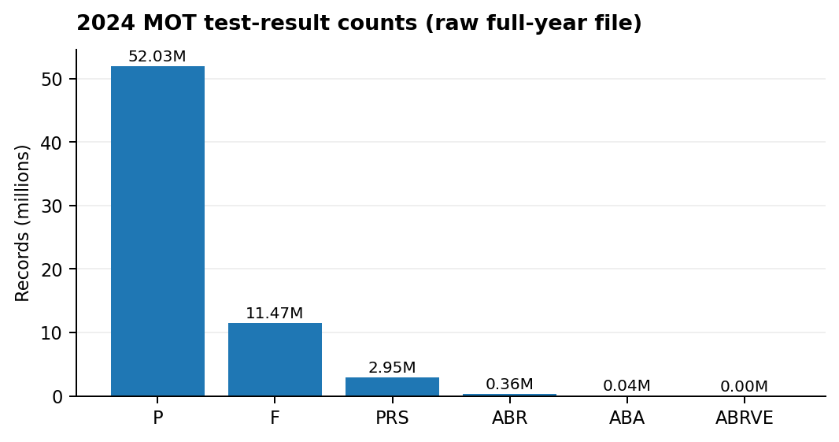
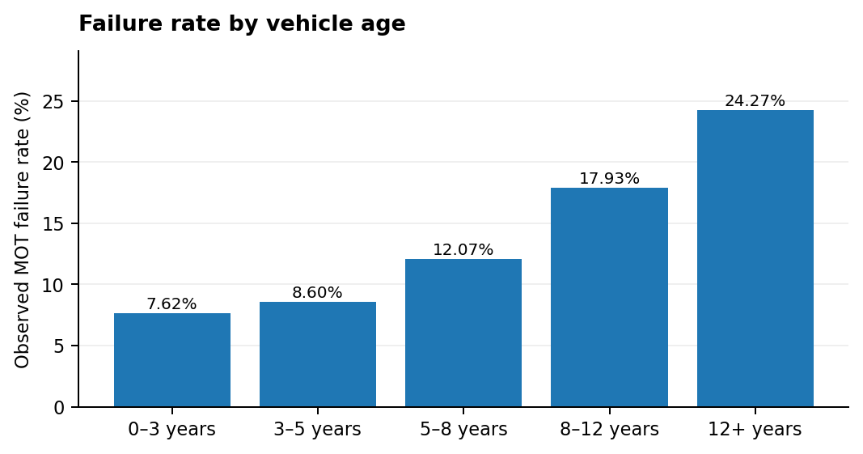
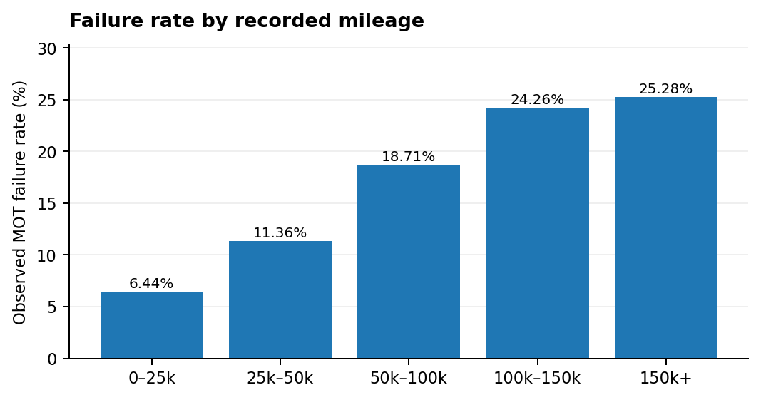
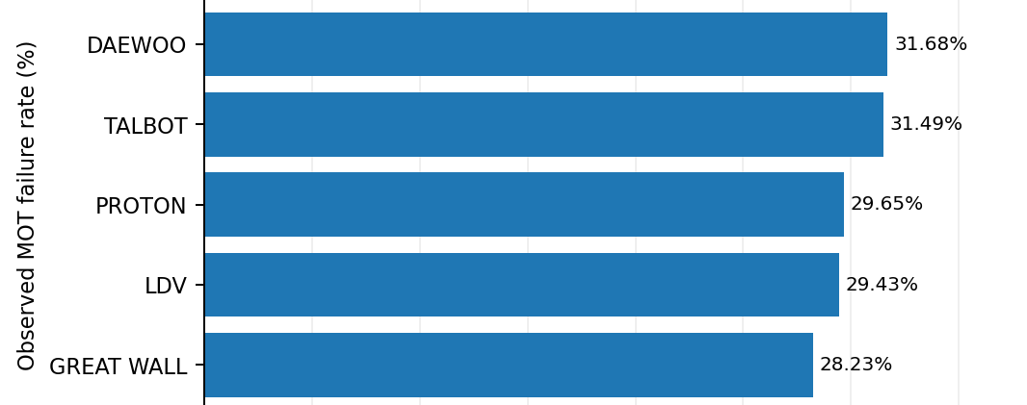
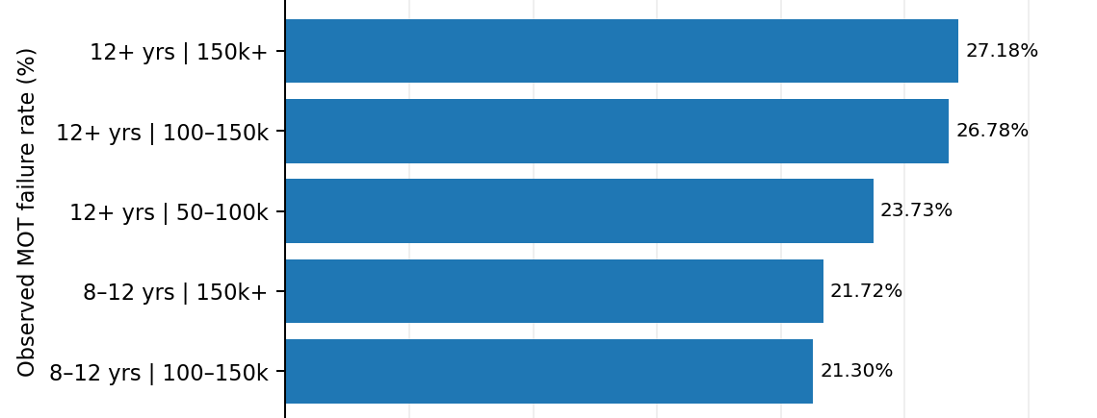
Data Visualization
Raw outcome counts: P dominates; valid-rate denominator uses P + F + PRS.
Age: 7.62% (0–3y) to 24.27% (12+y).
Mileage: 6.44% (0–25k) to 25.28% (150k+).
Make rates shown only for groups with ≥1,000 valid tests.
Highest shown combination: 12+ years and 150k+ mileage = 27.18%.
Source: UK DVSA anonymised MOT test results, 2024 | 10 / 12
Notes:
These are the planned Matplotlib charts. No chart has been created yet, so each shows a placeholder. Insert real charts after running the calculations.

Slide 11
Key Insights and Recommendations
A. Key Insights (verified only)
B. Recommendations (general, qualified)
• Age trend: observed failure rate rises from 7.62% (0–3 years) to 24.27% (12+ years).
• Mileage trend: rises from 6.44% (0–25k) to 25.28% (150k+).
• Combined: 12+ years / 150k+ group shows 27.18%.
• Make rates (≥1,000 tests): DAEWOO 31.68%; TALBOT 31.49%.
• Overall rate conflict: raw 17.26% vs cleaned-output 18.87%; resolve before final reporting.
• Prioritise inspection review for older, high-mileage vehicles; use these rates as screening signals, not a prediction.
• Set a minimum sample size before comparing makes/models.
• Investigate repeated defects using MOT failure-item records.
• Validate against fleet maintenance and roadside breakdown logs before operational use.
• Track missing mileage/engine-capacity data and finish duplicate reconciliation.
Source: UK DVSA anonymised MOT test results, 2024 | 11 / 12
Notes:
Insights come only from verified outputs, so this side is mostly pending. Recommendations are general good practice and are not findings from this dataset.

Slide 12
Conclusion and Future Scope
Conclusion
Future Scope
• Analysed UK DVSA 2024 MOT test outcomes using Python, Pandas, NumPy and Matplotlib.
• Notebook results show observed failure rates increase with vehicle age and mileage.
• The highest shown combined group is 12+ years and 150k+ mileage (27.18%).
• These are associations in MOT tests, not roadside-breakdown probabilities.
• Final limitation: overall rate and duplicate-removal row counts require reconciliation.
• Join multi-year MOT history with maintenance work orders, defect items, repair cost and breakdown records.
• Validate the cleaned dataset and resolve the 1,225-row difference.
• Extend analysis to a clearly defined commercial-vehicle subset (e.g., Class 7) before fleet-specific conclusions.
• After data validation, test a machine-learning risk model with time-based validation.
• Build a dashboard for maintenance prioritisation.
Source: UK DVSA anonymised MOT test results, 2024 | 12 / 12
Notes:
To conclude: this project builds a clean, honest EDA of MOT failure patterns. Final findings depend on verification. Future work adds maintenance and breakdown data, and only then models.

