Slide 1
AIML | PYTHON DATA ANALYSIS / EDA PROJECT
Commercial Vehicle Reliability & Failure Pattern Analysis
STUDENT NAME
Shri Venkat Subramani
STUDENT ID
AF05320059
COURSE
AIML
INDUSTRY
Automotive / Commercial Vehicle & Fleet Maintenance
ORGANIZATION
Anudip Foundation
6
1
4
0
8
0
3
BATCH CODE
,
,
ANP - D7444
rows in the initial MOT dataset

Slide 2




Industry Overview
INDUSTRY OVERVIEW
0
2
Fleet Operations
Reliability & Availability
Maintenance Planning
Data Analysis
Commercial fleets rely on vehicles being available and fit for use day to day.
Reliable vehicles stay available; failures can reduce fleet availability.
Planned maintenance helps fleets prepare for the kinds of failures that occur.
Test records can be analysed to identify recurring vehicle failure patterns.
THIS PROJECT
Analysing MOT test records to identify observed failure patterns that can support maintenance planning.

Slide 3



Problem Statement
PROBLEM STATEMENT
0
3
THE PROBLEM
Why it is important
Vehicle failures can affect fleet reliability and maintenance planning.
Vehicle failures can affect fleet reliability and maintenance planning. Analysing failures using only a single factor such as vehicle age, mileage, or failure type may not provide a complete view of failure patterns.
This project analyses multiple vehicle and test-related factors together to understand patterns associated with MOT test failures.
Who can be affected
Fleet operators, maintenance planners, and vehicle users.
How it supports planning
Failure-pattern analysis can help prioritise vehicles and defects for maintenance planning.

Slide 4





Project Objectives
PROJECT OBJECTIVES
0
4
1
Analyse MOT test result patterns.
2
Examine how vehicle mileage is associated with failure rates.
3
Examine how vehicle age is associated with failure rates.
4
Compare failure rates across vehicle characteristics such as make, fuel type, vehicle class, test type, and engine capacity.
5
Analyse recorded failure items and examine the combined relationship between vehicle age, mileage, and failure rates.

Slide 5
Proposed Solution & Questions
PROPOSED SOLUTION & ANALYSIS QUESTIONS
0
5
ANALYSIS QUESTIONS
PROPOSED SOLUTION
Use Python-based data cleaning, transformation, exploratory data analysis, and visualization to identify vehicle failure patterns from MOT test data.
Q1
How does vehicle mileage relate to MOT failure rates?
Q2
How does vehicle age relate to MOT failure rates?
Q3
How do failure rates vary across different vehicle makes?
Q4
How do fuel type, vehicle class, test type, and engine capacity relate to failure rates?
1
Data Cleaning
2
Transformation
3
Exploratory Data Analysis
Q5
What are the most frequently recorded vehicle defects?
Q6
How do vehicle age and mileage together relate to failure rates?
4
Visualization

Slide 6
Dataset Information
DATASET INFORMATION
0
6
INITIAL JANUARY 2024 TEST-RESULT DATA
CLEANED JANUARY 2024 TEST-RESULT DATA
FAILURE-ITEM DATASET
6,140,803
3,848,518
10,451,564
rows × 15 columns
rows × 15 columns
records × 6 columns
DATASET NAME
IMPORTANT FEATURES
UK DVSA Anonymised MOT Results
test_id
vehicle_id
test_date
DATASET SOURCE
test_class_id
test_type
test_result
UK Driver and Vehicle Standards Agency (DVSA) open data resource
test_mileage
make
model
FILE FORMAT
colour
fuel_type
cylinder_capacity
CSV
first_use_date
completed_date

Slide 7
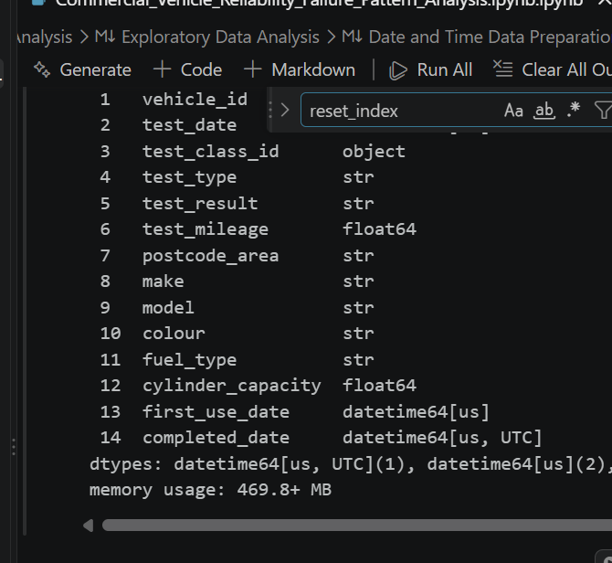
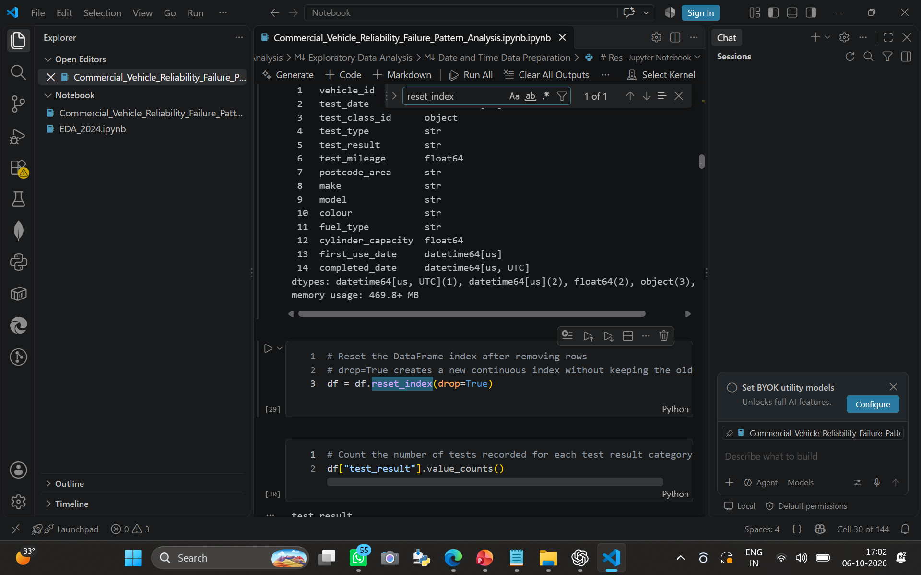
Data Collection & Understanding
DATA COLLECTION & UNDERSTANDING
0
7
1
MOT data obtained from the UK DVSA open data resource
Jupyter Notebook
2
Dataset shape examined
3
Column names and data types examined
4
Test-result distribution analysed
5
Mileage information examined
6
Vehicle characteristics examined
7
Date fields examined
8
Failure-related information analysed
9
Duplicate and invalid/header-like records identified

Slide 8
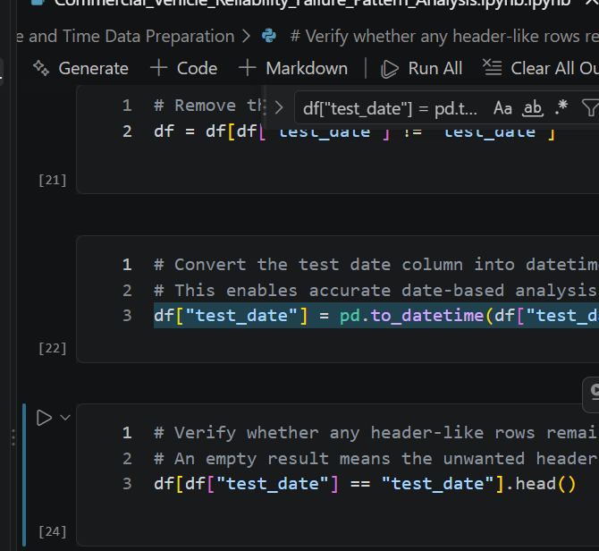
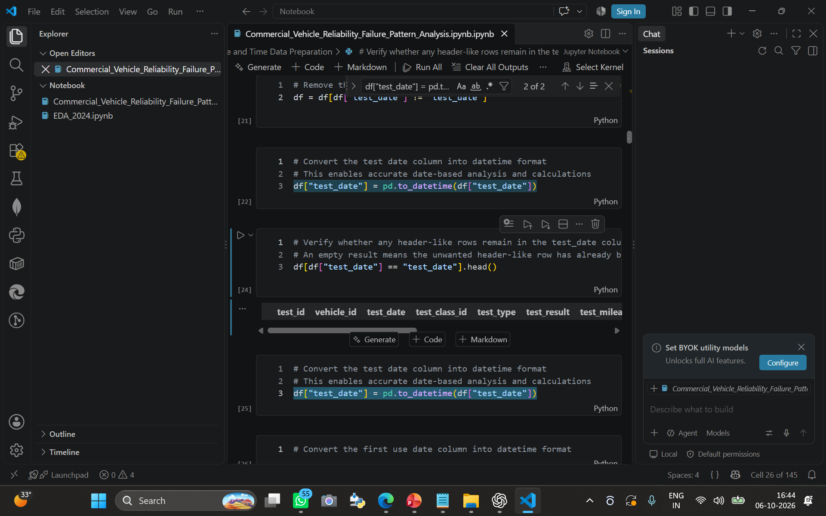
Data Cleaning & Transformation
DATA CLEANING & TRANSFORMATION
0
8
Jupyter Notebook
Clean
Convert
Create
1
Removed invalid/header-like records
2
Converted test_date into datetime format
3
Converted first_use_date into datetime format
4
Converted completed_date into datetime format
5
Converted test_mileage into numeric format
6
Converted cylinder_capacity into numeric format
7
Removed duplicate records
8
Reset the dataframe index
9
Created vehicle age
10
Created vehicle age groups
11
Created mileage groups

Slide 9
Exploratory Data Analysis
EXPLORATORY DATA ANALYSIS
0
9
Outcome
Age & mileage
Vehicle & test characteristics
Recorded failure items
Combined view
Test Result Distribution
Mileage vs Failure Rate
Vehicle Age vs Failure Rate
Make-wise Failure Rate
01
02
03
04
Fuel Type Analysis
Vehicle Class Analysis
Test Type Analysis
Engine Capacity Analysis
05
06
07
08
Vehicle Colour Analysis
Failure Item Type Analysis
Dangerous Mark Analysis
Defect Location Analysis
09
10
11
12
Top Vehicle Defects
Dangerous Failure by Failure Type
Defect Category Analysis
Combined Age + Mileage Failure Analysis
13
14
15
16

Slide 10
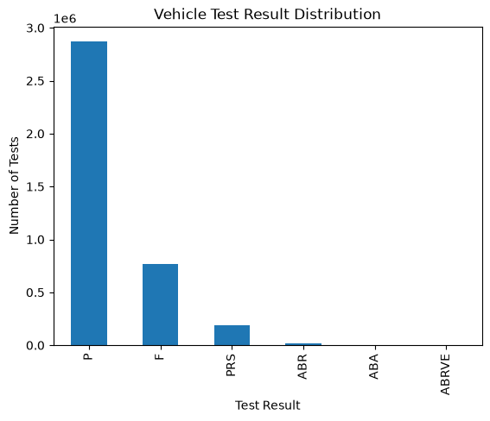
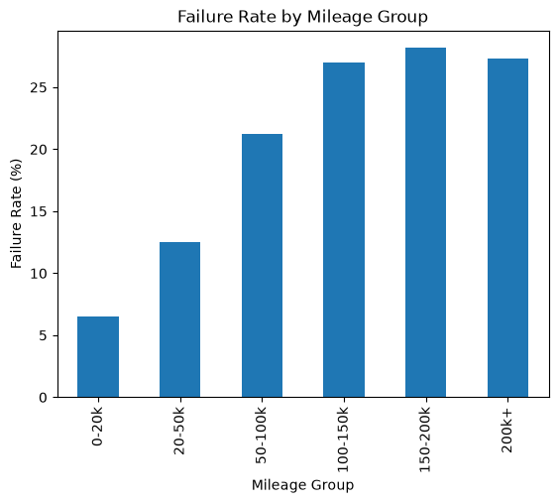
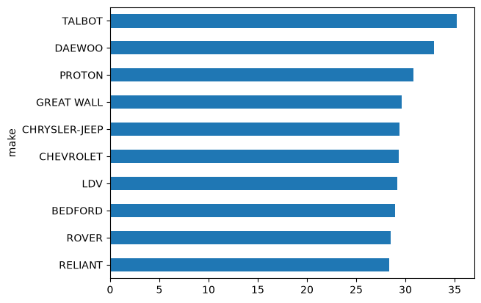
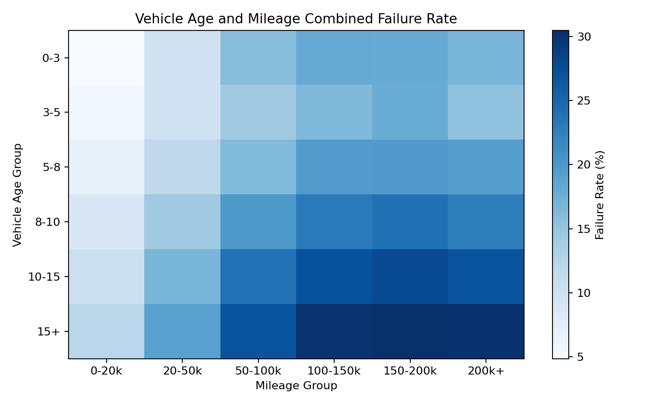
Data Visualization
DATA VISUALIZATION
1
0
Test Result Distribution
Failure Rate by Mileage
Understand the distribution of MOT test outcomes.
Examine failure rates across mileage groups.
Failure rates generally increase with mileage, with the highest observed rate in the 150–200k group.
Make-wise Failure Rate
Vehicle Age and Mileage Combined Failure Rate
Compare observed failure rates across vehicle makes.
Examine failure rates across combinations of vehicle age and mileage.
Older vehicles combined with higher mileage generally show higher observed failure rates.

Slide 11

Key Insights & Recommendations
KEY INSIGHTS & RECOMMENDATIONS
1
1
Failure rates generally increase as vehicle mileage increases.
RECOMMENDATIONS
Failure rates generally increase with vehicle age.
1
Give greater maintenance attention to older and higher-mileage vehicles.
Failure rates vary across vehicle makes.
2
Monitor frequently occurring defect categories.
Failure rates vary across fuel types and vehicle classes.
Vehicle Class 7 showed a higher observed failure rate than the other analysed vehicle classes.
3
Consider higher-age and higher-mileage vehicles for closer inspection.
Different engine-capacity groups showed different observed failure rates.
4
Monitor failure patterns across vehicle classes, makes, and fuel types.
Tyre, wear, corrosion, and structural/component-related defects were among the frequently recorded failure items.
5
Use historical MOT failure patterns as a supporting source for maintenance planning.
Older vehicles combined with higher mileage generally showed higher observed failure rates.
These findings represent associations and observed patterns in the dataset and do not establish direct causation.

Slide 12
CONCLUSION & FUTURE SCOPE
Conclusion & Future Scope
1
2
CONCLUSION
FUTURE SCOPE
The project analysed anonymised MOT test data using Python.
Data was cleaned and transformed before analysis.
EDA was performed across vehicle age, mileage, make, fuel type, vehicle class, test type, engine capacity, and recorded defects.
The analysis identified important observed failure patterns.
Combined age and mileage analysis provided a broader view of failure patterns.
The findings can support more informed vehicle reliability and maintenance planning.
Develop a vehicle failure-risk prediction model.
1
Use historical test records for predictive maintenance analysis.
2
Build a fleet-level maintenance prioritization system.
3
Include more historical data for deeper trend analysis.
4
Thank you

