Slide 1

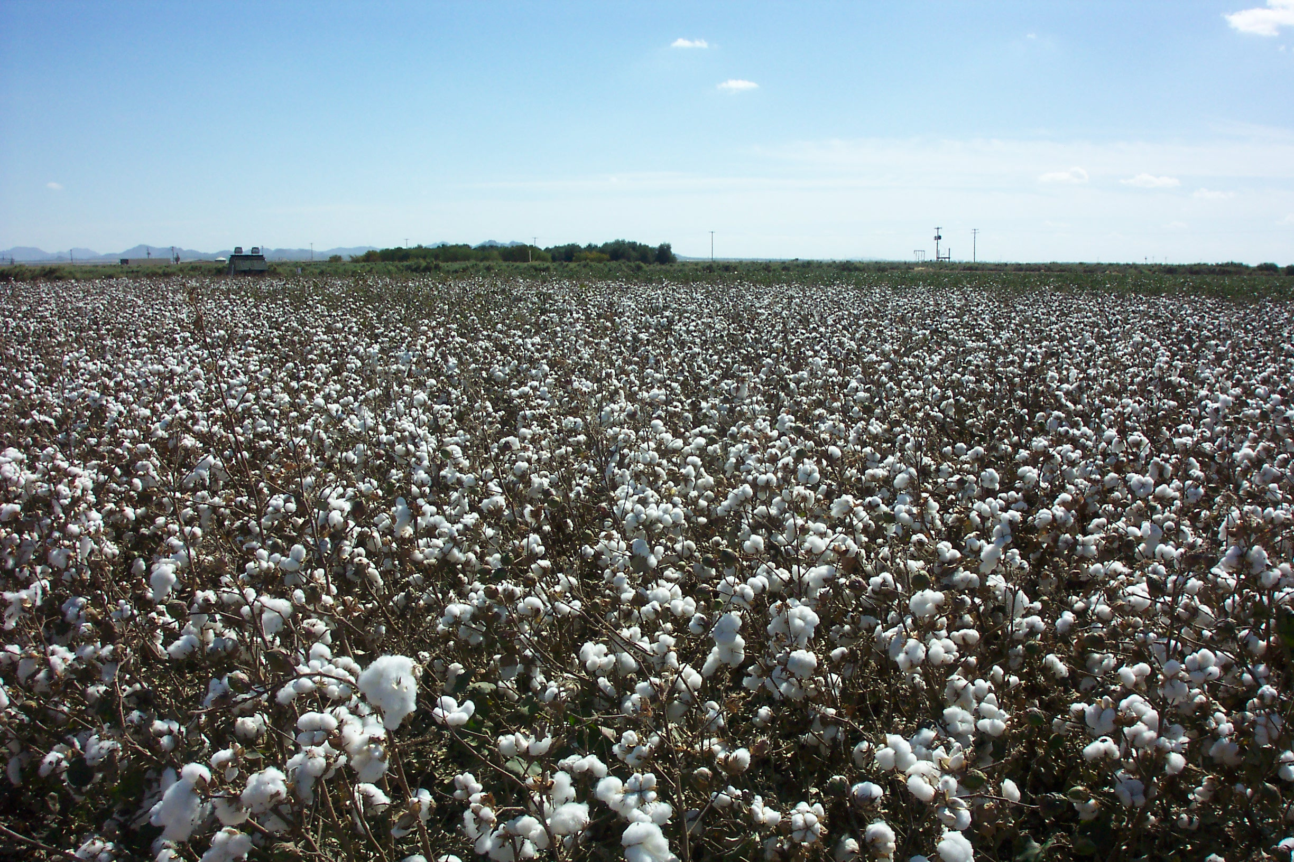

Slide 2
ACGA Seed Development
Committee
Started in 2001
Crossing nursery in 2001, 2002, & 2003
Evaluation nursery in 2005, & 2006
10 lines in ACGA advanced trials with
  U of A since 2003 in 3 locations. Yuma, Maricopa, and Safford. 10 new lines advanced each Year
37 -38 new lines tested in ACGA preliminary
  strains trial with the U of A at Yuma, and Maricopa
  each year since 2004. Including Safford in 2007.

Slide 3
Advanced Strains vs Preliminary Strains Trials
Advanced strains in trials with other seed company’s yet to be released materials, ie D&PL, CPCSD, FiberMax, Phytogen, Salcot, Stoneville & Dyna-Gro.
Preliminary strains trials, 37 to 38 selections that are tested in 2 locations with 4 replications at each location against 2 to 3 commercial variety’s. These are strains that are taken from the previous years nursery, after visual evaluations and HVI data is taken.

Slide 4
Importance of the Nursery
Provide strains from previous breeding efforts and plant selections that provide better quality and yield.
Individual plant selections are then taken from plants, then grown out until deemed stable to advance into the ACGA preliminary testing program.
These selections can be further evaluated in 3 locations, Yuma, Maricopa, and Safford, for quality and yield information.
Continue to advance materials that have superior quality and yield characteristics.

Slide 5
Table 2. Lint yield and fiber quality results for the ACGA preliminary strain trial in Yuma, AZ, 2006.
Strain | Lint Yield | Percent | HVI | Staple | Strength | Uniformity
 | lbs/acre | Lint | Color | 32nds | g/tex | g/tex
0122-2033-307 | 1890.0 | 41.7 | 11 | 36.6 | 30.1 | 80.8 | 4.25
DP432R | 1779.1 | 42.5 | 11 | 36.0 | 31.2 | 82.7 | 4.65
0122-2033-303 | 1777.6 | 42.3 | 21 | 36.3 | 31.7 | 82.2 | 4.05
0144-2086-4B | 1757.0 | 41.4 | 11 | 36.7 | 32.1 | 81.9 | 4.23
0122-2039-303 | 1746.6 | 40.1 | 11 | 36.3 | 31.8 | 82.7 | 4.13
0112-2067-302 | 1734.7 | 40.5 | 11 | 35.5 | 30.1 | 82.0 | 4.25
0112-2033-309 | 1723.2 | 39.5 | 11 | 36.3 | 30.3 | 80.9 | 4.33
0101-2141-301 | 1710.1 | 40.0 | 11 | 36.2 | 27.1 | 79.0 | 4.15
0144-2036-303 | 1702.0 | 41.7 | 11 | 36.7 | 32.5 | 81.7 | 4.08
0122-2014-305 | 1680.8 | 39.5 | 21 | 37.0 | 30.8 | 82.0 | 4.08
0112-2086-303 | 1666.0 | 40.0 | 11 | 35.2 | 28.2 | 80.2 | 4.40
0101-2165-303 | 1650.7 | 41.1 | 11 | 36.6 | 30.2 | 81.0 | 3.48
0157-303-B | 1645.8 | 41.7 | 11 | 37.7 | 30.8 | 82.4 | 4.18
0145-2008-301 | 1614.9 | 41.4 | 11 | 36.5 | 31.8 | 81.1 | 3.78
0122-2053-308 | 1577.5 | 41.0 | 11 | 36.9 | 30.1 | 81.7 | 4.33
0101-2100-302 | 1573.6 | 40.1 | 11 | 37.8 | 27.7 | 79.4 | 3.68

Slide 6
0112-2086-302 | 1563.9 | 38.0 | 11 | 35.8 | 29.0 | 81.4 | 4.15
0106-3004-B | 1555.8 | 42.3 | 11 | 36.9 | 31.3 | 81.0 | 4.05
0101-2100-307 | 1549.5 | 40.8 | 11 | 37.6 | 28.2 | 80.7 | 4.03
0139-2001-302 | 1549.2 | 39.9 | 11 | 36.0 | 31.3 | 81.4 | 3.90
0122-2004-303 | 1527.7 | 40.8 | 11 | 35.8 | 29.9 | 81.2 | 4.13
0116-2012-307 | 1527.1 | 39.8 | 12 | 36.5 | 30.6 | 81.4 | 4.88
0106-2022-2B | 1493.1 | 38.2 | 11 | 37.8 | 31.3 | 81.0 | 3.90
0115-2B-304 | 1490.8 | 40.3 | 11 | 37.4 | 31.3 | 82.3 | 3.93
0101-2100-301 | 1462.9 | 38.7 | 11 | 37.2 | 29.1 | 80.7 | 3.80
0116-2B-308 | 1439.8 | 36.6 | 11 | 37.4 | 31.4 | 82.0 | 3.88
0116-2B-301 | 1408.4 | 38.0 | 11 | 37.6 | 32.0 | 83.0 | 4.48
0112-2016-303 | 1383.9 | 37.5 | 11 | 37.4 | 30.5 | 81.0 | 3.70
0116-2011-308 | 1383.6 | 36.0 | 11 | 39.5 | 32.8 | 82.4 | 3.70
DP449BR | 1347.6 | 39.6 | 11 | 36.7 | 31.5 | 82.0 | 3.99
DP164B2F | 1346.3 | 39.2 | 11 | 38.2 | 30.1 | 82.2 | 3.73
0144-2036-304 | 1196.0 | 34.8 | 21 | 38.2 | 32.9 | 81.5 | 3.63
0116-2B-326 | 1139.4 | 38.4 | 21 | 35.8 | 33.0 | 82.1 | 4.05
0116-2018-307 | 1137.9 | 37.7 | 22 | 36.0 | 31.4 | 82.0 | 4.35
0116-2016-301 | 1111.1 | 37.1 | 11 | 37.8 | 32.0 | 82.9 | 3.78

Slide 7
Table 3. Lint yield and fiber quality results for the ACGA preliminary strain trial in Maricopa, AZ, 2006.
Strain | Lint Yield | Percent | HVI | Staple | Strength | Uniformity | Micronaire
 | lbs/acre | Lint | Color | 32nds | g/tex | g/tex
0122-2033-303 | 2118.3 | 40.8 | 21 | 36.0 | 32.2 | 82.4 | 4.55
0144-2036-304 | 2104.3 | 36.3 | 21 | 38.5 | 34.3 | 83.3 | 4.78
DP449BR | 2097.6 | 38.8 | 21 | 36.8 | 33.3 | 82.4 | 4.50
0101-2165-303 | 2053.4 | 38.7 | 31 | 37.3 | 31.4 | 81.1 | 3.70
0122-2033-307 | 2044.4 | 40.0 | 21 | 36.5 | 31.6 | 82.6 | 4.63
0116-2B-326 | 2023.0 | 41.0 | 21 | 36.3 | 34.4 | 83.3 | 4.60
0116-2016-301 | 1989.8 | 38.1 | 31 | 37.5 | 33.7 | 82.9 | 4.80
0116-2011-308 | 1969.2 | 35.5 | 31 | 39.8 | 32.6 | 83.0 | 4.20
0157-303-B | 1955.0 | 40.1 | 31 | 37.0 | 31.3 | 83.1 | 4.43
DP164B2F | 1937.5 | 39.1 | 21 | 37.3 | 30.5 | 81.4 | 4.10
0106-3004-B | 1876.4 | 40.2 | 31 | 36.8 | 31.8 | 81.3 | 4.25
0101-2100-307 | 1859.6 | 38.6 | 21 | 37.0 | 28.8 | 80.6 | 4.35
0122-2039-303 | 1853.9 | 38.0 | 21 | 36.8 | 32.9 | 83.3 | 4.38
0122-2004-303 | 1850.2 | 38.6 | 21 | 36.3 | 31.7 | 81.7 | 4.53
0116-2B-308 | 1846.6 | 37.3 | 21 | 37.0 | 31.9 | 82.0 | 4.50
0106-2022-2B | 1803.7 | 38.6 | 31 | 38.3 | 31.9 | 81.6 | 4.05

Slide 8
0144-2086-4B | 1803.1 | 39.1 | 31 | 36.3 | 33.4 | 82.6 | 4.68
0116-2B-301 | 1801.7 | 37.7 | 21 | 38.3 | 33.0 | 82.8 | 4.35
0145-2008-301 | 1800.0 | 39.9 | 21 | 36.3 | 33.1 | 82.0 | 4.53
0115-2B-304 | 1787.2 | 39.6 | 21 | 37.0 | 30.2 | 82.0 | 4.20
0122-2053-308 | 1778.8 | 40.1 | 21 | 37.0 | 31.4 | 82.5 | 4.53
DP432R | 1773.1 | 40.7 | 31 | 36.5 | 31.0 | 83.1 | 4.68
0144-2036-303 | 1768.4 | 38.9 | 31 | 36.8 | 33.2 | 82.7 | 4.68
0122-2014-305 | 1751.5 | 36.3 | 21 | 37.8 | 32.4 | 82.6 | 4.43
0112-2067-302 | 1737.1 | 38.8 | 21 | 35.5 | 31.5 | 80.8 | 4.38
0112-2016-303 | 1735.7 | 35.9 | 21 | 36.5 | 32.0 | 81.2 | 4.08
0101-2100-302 | 1730.6 | 36.9 | 21 | 37.5 | 28.1 | 79.1 | 4.05
0112-2033-309 | 1684.7 | 35.4 | 21 | 36.3 | 32.2 | 81.5 | 4.28
0139-2001-302 | 1676.1 | 38.3 | 21 | 36.0 | 33.0 | 82.3 | 4.33
0116-2012-307 | 1664.1 | 40.2 | 21 | 35.5 | 31.9 | 81.7 | 5.00
0101-2100-301 | 1641.3 | 36.3 | 21 | 36.3 | 29.8 | 80.0 | 4.18
0112-2086-303 | 1596.0 | 36.7 | 21 | 36.0 | 30.7 | 81.3 | 4.38
0116-2018-307 | 1569.8 | 38.4 | 31 | 36.3 | 32.7 | 82.0 | 4.78
0101-2141-301 | 1544.9 | 37.4 | 21 | 37.0 | 30.2 | 80.8 | 4.05
0112-2086-302 | 1440.6 | 34.5 | 21 | 36.3 | 30.4 | 80.6 | 4.30

Slide 9
Table 2. Lint yield and fiber quality results for the advanced strain trial conducted in Yuma, AZ, 2006.
Seed | Strain | Lint Yield | Lint | HVI | Staple | Strength | Uniformity | Micronaire
Company |  |  | Turnout | Color
 |  | lbs/acre | Percent |  | 32nds | g/tex | Percent
Dyna-Gro | DG2100B2RF | 1704.2 | 40.8 | 11 | 35.3 | 28.5 | 81.6 | 3.93
CPCSD | CS44 | 1688.7 | 41.6 | 11 | 36.5 | 30.0 | 80.5 | 4.15
Dyna-Gro | DG2520B2RF | 1675.5 | 40.7 | 11 | 36.3 | 27.0 | 81.4 | 4.03
Dyna-Gro | DG2215B2RF | 1588.9 | 38.7 | 11 | 35.5 | 27.8 | 81.3 | 3.55
Delta and Pine | DPLX06W660F | 1566.9 | 43.7 | 11 | 36.3 | 29.2 | 81.4 | 4.48
CPCSD | CS48 | 1561.0 | 40.6 | 11 | 37.8 | 30.2 | 81.1 | 4.38
AZ Cotton Growers | 0101-2165-305 | 1497.5 | 39.4 | 11 | 36.0 | 30.6 | 82.6 | 3.73
CPCSD | CS49 | 1475.7 | 40.2 | 11 | 35.8 | 28.2 | 81.3 | 4.13
Dyna-Gro | DG2242B2RF | 1473.4 | 40.1 | 11 | 36.3 | 28.4 | 81.4 | 4.18
AZ Cotton Growers | 0101-2161-304 | 1461.3 | 39.2 | 11 | 37.3 | 32.2 | 82.3 | 4.10
CPCSD | CS37 | 1458.9 | 38.5 | 11 | 37.3 | 32.5 | 81.2 | 3.90
CPCSD | CS46 | 1403.4 | 40.0 | 21 | 36.5 | 32.2 | 82.1 | 4.28
Control | DP432R | 1383.7 | 41.3 | 22 | 36.8 | 31.0 | 82.1 | 4.35
CPCSD | CS45 | 1379.7 | 38.7 | 21 | 37.5 | 32.4 | 81.7 | 3.93
Delta and Pine | DPLX06W650F | 1379.5 | 41.5 | 11 | 36.0 | 29.8 | 81.5 | 4.20
AZ Cotton Growers | 0122-2015-305 | 1360.4 | 38.4 | 11 | 36.5 | 31.4 | 81.6 | 3.75

Slide 10
AZ Cotton Growers | 0122-2030-303 | 1309.5 | 39.6 | 21 | 36.3 | 32.5 | 82.4 | 3.90
Control | DP164B2F | 1299.6 | 39.0 | 21 | 37.8 | 30.7 | 82.4 | 3.70
Delta and Pine | DPLX04T153F | 1244.6 | 41.7 | 21 | 37.5 | 30.3 | 81.0 | 3.43
FiberMax | FM965LLB2 | 1177.9 | 36.9 | 11 | 36.5 | 31.2 | 81.7 | 3.85
AZ Cotton Growers | 0122-2053-301 | 1153.9 | 38.5 | 11 | 36.8 | 30.9 | 82.4 | 4.20
Delta and Pine | DPLX04Z530F | 1137.7 | 38.3 | 41 | 38.0 | 34.7 | 83.4 | 4.03
Delta and Pine | DPLX06X058F | 1133.7 | 43.6 | 31 | 37.3 | 29.3 | 81.5 | 4.03
Delta and Pine | DPLX04T105DF | 1133.4 | 40.0 | 21 | 38.8 | 30.1 | 82.3 | 3.60
AZ Cotton Growers | 0116-2011-309 | 1132.1 | 35.7 | 11 | 38.3 | 32.2 | 81.4 | 3.53
FiberMax | FM989B2R | 1123.8 | 36.7 | 11 | 37.3 | 32.5 | 82.3 | 3.78
AZ Cotton Growers | 0116-2012-306 | 1117.3 | 36.6 | 22 | 36.8 | 30.9 | 82.0 | 4.25
CPCSD | CS47 | 1101.0 | 39.4 | 11 | 37.0 | 30.7 | 81.2 | 3.78
FiberMax | FM9060F | 1096.7 | 39.2 | 21 | 37.5 | 30.1 | 80.9 | 3.55
Delta and Pine | DPLX04X429DF | 1073.0 | 38.9 | 11 | 37.3 | 31.0 | 81.4 | 3.58
AZ Cotton Growers | 0116-2009-307 | 1056.3 | 36.4 | 21 | 38.8 | 32.3 | 82.0 | 3.60
AZ Cotton Growers | 0112-2006-302 | 1031.6 | 40.6 | 21 | 37.0 | 31.2 | 80.6 | 3.60
AZ Cotton Growers | 0112-2006-307 | 997.7 | 39.6 | 11 | 37.0 | 28.1 | 79.3 | 3.65
FiberMax | FM960B2R | 990.5 | 38.0 | 11 | 36.8 | 31.3 | 81.0 | 3.95
CPCSD | CS50 | 947.8 | 40.4 | 22 | 36.8 | 31.0 | 81.3 | 4.08
FiberMax | FM955LLB2 | 942.6 | 36.8 | 21 | 38.0 | 30.1 | 82.0 | 3.88
FiberMax | FM988LLB2 | 811.8 | 36.9 | 11 | 37.5 | 32.5 | 81.1 | 3.68

Slide 11
Table 3. Lint yield and fiber quality results for the advanced strain trial conducted in Maricopa, AZ, 2006.
Seed | Strain | Lint Yield | Lint | HVI | Staple | Strength | Uniformity | Micronaire
Company |  |  | Turnout | Color
 |  | lbs/acre | Percent |  | 32nds | g/tex | Percent
Delta and Pine Land | DPLX06W660F | 2114.0 | 41.9 | 21 | 36.8 | 29.8 | 81.8 | 4.53
Control | DP164B2F | 2099.7 | 39.2 | 31 | 38.5 | 30.1 | 82.3 | 4.35
Phytogen | P02X3003 | 2098.8 | 41.1 | 31 | 35.0 | 28.4 | 80.9 | 4.25
AZ Cotton Growers | 0116-2009-307 | 2056.0 | 38.0 | 31 | 38.0 | 30.5 | 82.4 | 5.05
CPCSD | CS37 | 2045.6 | 40.0 | 31 | 37.5 | 31.5 | 81.5 | 4.63
FiberMax | FM988LLB2 | 2034.3 | 39.1 | 31 | 37.5 | 31.2 | 82.7 | 4.55
Phytogen | P02X5068 | 2029.2 | 41.6 | 31 | 37.8 | 33.6 | 83.8 | 4.98
CPCSD | CS45 | 1979.1 | 40.4 | 31 | 37.3 | 31.9 | 82.5 | 4.68
Stoneville | STX0504B2RF | 1972.2 | 39.6 | 31 | 37.8 | 29.6 | 82.9 | 4.35
Salcot | SCX 246 | 1968.2 | 39.7 | 31 | 37.5 | 32.3 | 82.5 | 4.90
Phytogen | P03X4094 | 1960.9 | 40.2 | 31 | 37.3 | 30.0 | 82.7 | 4.33
AZ Cotton Growers | 0112-2006-302 | 1958.6 | 40.7 | 31 | 38.3 | 32.6 | 82.1 | 4.30
Phytogen | P03X4088 | 1955.0 | 40.9 | 31 | 36.5 | 29.1 | 82.6 | 4.38
Control | DP449BR | 1945.2 | 38.9 | 31 | 37.3 | 31.6 | 82.1 | 4.60
AZ Cotton Growers | 0116-2011-309 | 1925.2 | 36.6 | 31 | 37.8 | 30.4 | 81.7 | 4.88
CPCSD | CS49 | 1918.0 | 40.9 | 21 | 36.3 | 29.6 | 81.6 | 4.30
Salcot | SCX 17 | 1915.9 | 38.3 | 31 | 36.8 | 28.7 | 80.9 | 4.30
CPCSD | CS46 | 1899.8 | 38.6 | 31 | 37.0 | 31.8 | 82.7 | 4.45
Phytogen | P03X5077 | 1898.9 | 43.6 | 31 | 37.0 | 29.8 | 82.1 | 4.53
CPCSD | CS44 | 1884.5 | 39.4 | 31 | 36.3 | 29.2 | 79.5 | 4.40
Control | DP432R | 1874.3 | 40.3 | 31 | 36.8 | 29.8 | 83.4 | 5.00
AZ Cotton Growers | 0122-2015-305 | 1873.1 | 38.2 | 31 | 37.0 | 32.0 | 82.6 | 4.63

Slide 12
Delta and Pine Land | DPLX06W650F | 1862.0 | 38.8 | 31 | 37.3 | 29.5 | 81.9 | 4.13
CPCSD | CS47 | 1853.0 | 39.2 | 31 | 37.5 | 29.7 | 81.7 | 4.33
Phytogen | P03X3043 | 1830.5 | 39.7 | 31 | 36.3 | 30.2 | 82.6 | 4.85
CPCSD | CS48 | 1817.8 | 40.4 | 31 | 39.5 | 30.6 | 82.5 | 4.15
FiberMax | FM989B2R | 1814.1 | 37.3 | 31 | 37.5 | 33.4 | 83.5 | 4.55
AZ Cotton Growers | 0122-2030-303 | 1812.9 | 37.7 | 31 | 37.0 | 33.8 | 83.5 | 4.45
AZ Cotton Growers | 0112-2006-307 | 1811.6 | 37.6 | 31 | 38.0 | 29.7 | 79.9 | 4.08
FiberMax | FM9060F | 1805.9 | 40.1 | 31 | 38.5 | 29.5 | 82.0 | 3.98
Dyna-Gro | DG2520B2RF | 1797.8 | 38.9 | 31 | 38.3 | 27.8 | 80.5 | 3.93
FiberMax | FM9058F | 1793.3 | 40.5 | 31 | 39.0 | 30.2 | 82.1 | 3.93
Salcot | SCX 16 | 1784.9 | 37.5 | 31 | 37.8 | 31.7 | 82.3 | 4.65
Dyna-Gro | DG2100B2RF | 1783.4 | 39.0 | 31 | 36.5 | 27.3 | 81.8 | 3.80
Dyna-Gro | DG2242B2RF | 1764.9 | 38.8 | 31 | 37.3 | 28.5 | 81.7 | 4.18
AZ Cotton Growers | 0101-2165-305 | 1748.9 | 38.4 | 31 | 37.0 | 31.3 | 82.0 | 4.05
CPCSD | CS51 | 1728.7 | 38.6 | 31 | 37.8 | 31.3 | 82.1 | 4.13
AZ Cotton Growers | 0122-2053-301 | 1720.3 | 37.6 | 31 | 36.5 | 30.7 | 81.9 | 4.70
Phytogen | P03X4107 | 1715.9 | 38.7 | 21 | 36.5 | 29.0 | 81.2 | 4.53
FiberMax | FM960B2R | 1691.8 | 39.7 | 31 | 38.0 | 31.8 | 82.3 | 4.05
AZ Cotton Growers | 0101-2161-304 | 1689.4 | 39.3 | 21 | 37.3 | 30.9 | 83.0 | 4.75
Dyna-Gro | DG2215B2RF | 1671.7 | 37.9 | 31 | 37.0 | 27.5 | 81.5 | 3.83
FiberMax | FM955LLB2 | 1656.9 | 38.1 | 21 | 39.8 | 30.0 | 83.7 | 4.63
AZ Cotton Growers | 0116-2012-306 | 1647.7 | 37.4 | 31 | 35.3 | 29.1 | 80.8 | 5.25
Phytogen | P03X3026 | 1640.1 | 39.5 | 31 | 37.5 | 29.7 | 82.3 | 4.33
CPCSD | CS50 | 1636.6 | 41.5 | 31 | 35.8 | 30.0 | 81.4 | 4.70
FiberMax | FM9068F | 1572.0 | 38.8 | 31 | 38.5 | 31.4 | 82.3 | 4.30
FiberMax | FM9063B2R | 1568.6 | 38.4 | 31 | 39.8 | 31.3 | 81.4 | 3.90
FiberMax | FM965LLB2 | 1547.5 | 37.2 | 31 | 38.0 | 31.8 | 83.0 | 4.05

Slide 13
Table 4. Lint yield and fiber quality results for the advanced strain trial conducted in Safford, AZ, 2006.
Seed | Strain | Lint Yield | Lint | HVI | Staple | Strength | Uniformity | Micronaire
Company |  |  | Turnout | Color
 |  | lbs/acre | Percent |  | 32nds | g/tex | Percent
FiberMax | FM960B2R | 1978.2 | 37.3 | 21 | 38.8 | 30.4 | 82.0 | 3.95
FiberMax | FM988LLB2 | 1974.8 | 36.7 | 21 | 37.3 | 28.1 | 81.5 | 3.85
CPCSD | CS47 | 1911.6 | 37.7 | 21 | 37.0 | 27.9 | 81.5 | 3.83
Phytogen | P03X4107 | 1900.3 | 36.5 | 21 | 37.8 | 26.2 | 81.4 | 3.83
Phytogen | P02X5068 | 1891.2 | 38.9 | 21 | 37.8 | 29.1 | 82.8 | 4.10
Phytogen | P03X5077 | 1873.4 | 39.6 | 21 | 36.8 | 27.7 | 82.4 | 4.08
FiberMax | FM989B2R | 1872.3 | 37.3 | 21 | 38.0 | 29.2 | 82.1 | 3.90
Phytogen | P03X7040 | 1816.8 | 43.9 | 31 | 38.8 | 31.8 | 83.8 | 3.93
Phytogen | P03X4094 | 1785.5 | 36.7 | 21 | 37.3 | 27.3 | 82.7 | 3.85
CPCSD | CS45 | 1768.2 | 37.0 | 21 | 37.3 | 28.5 | 81.6 | 3.80
Salcot | SCX 246 | 1765.5 | 36.1 | 21 | 37.8 | 29.9 | 82.4 | 3.93
Phytogen | P03X3043 | 1764.8 | 35.7 | 31 | 36.8 | 26.8 | 82.5 | 4.10
Control | DP164B2F | 1734.0 | 35.8 | 21 | 38.5 | 29.2 | 82.2 | 3.68
Dyna-Gro | DG2242B2RF | 1727.0 | 35.7 | 31 | 36.8 | 25.2 | 81.1 | 4.13
Dyna-Gro | DG2215B2RF | 1723.2 | 35.6 | 31 | 37.0 | 26.2 | 81.4 | 3.68
Phytogen | P02X3003 | 1722.9 | 37.3 | 31 | 36.5 | 26.7 | 82.3 | 3.83
Salcot | SCX 15 | 1720.1 | 36.9 | 21 | 36.8 | 27.1 | 80.3 | 3.58
Phytogen | P03X7082 | 1717.9 | 35.7 | 21 | 40.3 | 30.6 | 83.7 | 4.05
AZ Cotton Growers | 0122-2015-305 | 1715.9 | 36.0 | 21 | 37.3 | 29.8 | 83.1 | 3.85
Control | DP432R | 1687.9 | 36.7 | 31 | 36.3 | 27.0 | 82.6 | 4.18
Delta and Pine Land | DPLX06W650F | 1677.3 | 36.5 | 31 | 36.8 | 27.9 | 82.6 | 3.58
CPCSD | CS44 | 1656.8 | 36.9 | 21 | 37.3 | 27.8 | 80.3 | 4.18
CPCSD | CS51 | 1626.7 | 34.4 | 21 | 37.0 | 29.9 | 81.5 | 3.53

Slide 14
Salcot | SCX 18 | 1624.8 | 36.1 | 21 | 37.8 | 28.1 | 80.9 | 3.68
CPCSD | CS37 | 1615.7 | 36.6 | 21 | 37.0 | 29.0 | 81.5 | 3.65
Delta and Pine Land | DPLX06W660F | 1615.2 | 38.2 | 21 | 36.8 | 28.2 | 82.3 | 4.18
Stoneville | STX0505B2RF | 1613.4 | 38.1 | 31 | 37.0 | 29.5 | 83.0 | 3.83
Phytogen | P03X3026 | 1608.9 | 36.4 | 21 | 38.3 | 26.8 | 82.1 | 3.68
CPCSD | CS38 | 1604.3 | 35.4 | 31 | 38.3 | 29.2 | 82.3 | 3.60
CPCSD | CS48 | 1592.0 | 36.9 | 31 | 39.3 | 28.1 | 81.6 | 3.90
Dyna-Gro | DG2520B2RF | 1578.0 | 35.5 | 31 | 38.3 | 25.4 | 81.0 | 3.58
Phytogen | P03X4088 | 1577.1 | 38.0 | 31 | 35.5 | 27.5 | 81.4 | 3.75
Control | DP449BR | 1560.8 | 37.2 | 21 | 36.5 | 28.7 | 81.7 | 3.88
AZ Cotton Growers | 0112-2006-302 | 1559.1 | 36.2 | 21 | 38.8 | 30.1 | 81.1 | 3.70
Dyna-Gro | DG2100B2RF | 1557.4 | 36.5 | 21 | 36.3 | 25.5 | 81.6 | 3.75
CPCSD | CS50 | 1539.1 | 37.9 | 31 | 37.8 | 27.2 | 82.0 | 3.88
CPCSD | CS49 | 1535.6 | 36.2 | 21 | 36.0 | 27.6 | 81.5 | 3.93
AZ Cotton Growers | 0116-2009-307 | 1508.1 | 33.6 | 21 | 38.8 | 28.9 | 81.4 | 3.58
FiberMax | FM9063B2R | 1497.1 | 35.0 | 21 | 39.8 | 31.0 | 82.0 | 3.85
FiberMax | FM965LLB2 | 1492.3 | 34.3 | 21 | 37.5 | 29.9 | 81.3 | 3.83
AZ Cotton Growers | 0116-2011-309 | 1490.5 | 33.8 | 21 | 39.5 | 29.6 | 81.8 | 3.55
CPCSD | CS46 | 1484.1 | 36.7 | 31 | 36.8 | 29.7 | 82.2 | 3.93
Stoneville | STX0503RF | 1479.7 | 37.8 | 31 | 37.3 | 28.7 | 82.5 | 3.55
Stoneville | STX0504RF | 1478.3 | 34.7 | 31 | 37.3 | 27.8 | 82.1 | 3.70
AZ Cotton Growers | 0112-2006-307 | 1467.6 | 34.7 | 21 | 37.8 | 26.9 | 79.4 | 3.75
FiberMax | FM955LLB2 | 1464.2 | 34.1 | 21 | 38.5 | 27.8 | 81.9 | 3.95
AZ Cotton Growers | 0101-2165-305 | 1399.1 | 34.0 | 21 | 36.8 | 28.1 | 81.9 | 3.18
AZ Cotton Growers | 0122-2053-301 | 1386.9 | 35.8 | 31 | 37.0 | 28.3 | 82.4 | 3.90
AZ Cotton Growers | 0116-2012-306 | 1275.1 | 34.2 | 21 | 36.5 | 29.2 | 81.6 | 3.95
AZ Cotton Growers | 0101-2161-304 | 1275.0 | 35.9 | 31 | 37.0 | 28.3 | 81.7 | 3.68
AZ Cotton Growers | 0122-2030-303 | 1255.5 | 35.0 | 31 | 36.5 | 30.3 | 83.1 | 3.55

Slide 15
2007 Advanced and Preliminary Strains testing
Financed thru Cotton Inc. Arizona State support dollars.
Research done by Dr. Randy Norton.
Trails at 3 locations this year Yuma, MAC, and Safford.
Over 50 lines tested in these 3 locations in 2007 in Preliminary strains testing, and 10 line in Advanced strains testing.

Slide 16
2007 Nursery
Approximately 130 F5 plants planted in 2 row plots.
Over 800 F4 single rows for individual plant selection.
Seed increase from last years nursery on 16 different lines based on previous years yield and quality data.

Slide 17
Conclusion
In the process of getting an evaluation of what this program is worth.
Try to decide what to do, sell, to who and what about rights to bag seed for growers of Arizona.
We understand the need for Herbicide gene technology.

Slide 18
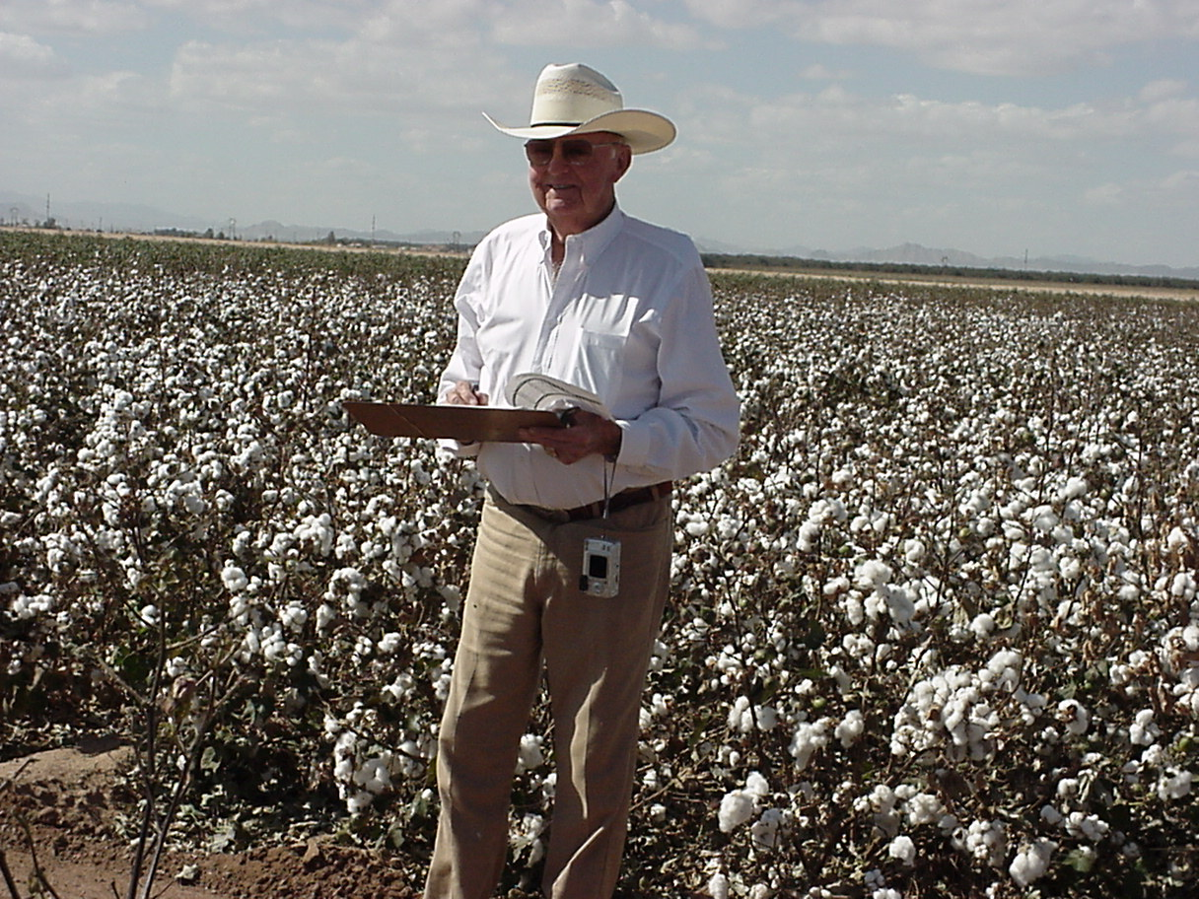
Thanks for your support

