Slide 1
FINAL CAPSTONE PROJECT PRESENTATION
Enterprise Distributed Banking &
Financial Ledger Platform
High-Throughput Microservices, Transactional Outbox, Row-Level ACID Concurrency & Immutable Double-Entry Ledger
Course: Distributed Systems & Applications (CS-602 / DS-701)
Author: Vishal H. | Date: October 2026 | GitHub: https://github.com/v-i-s-h-a-l-l/Banking-Application

Slide 2
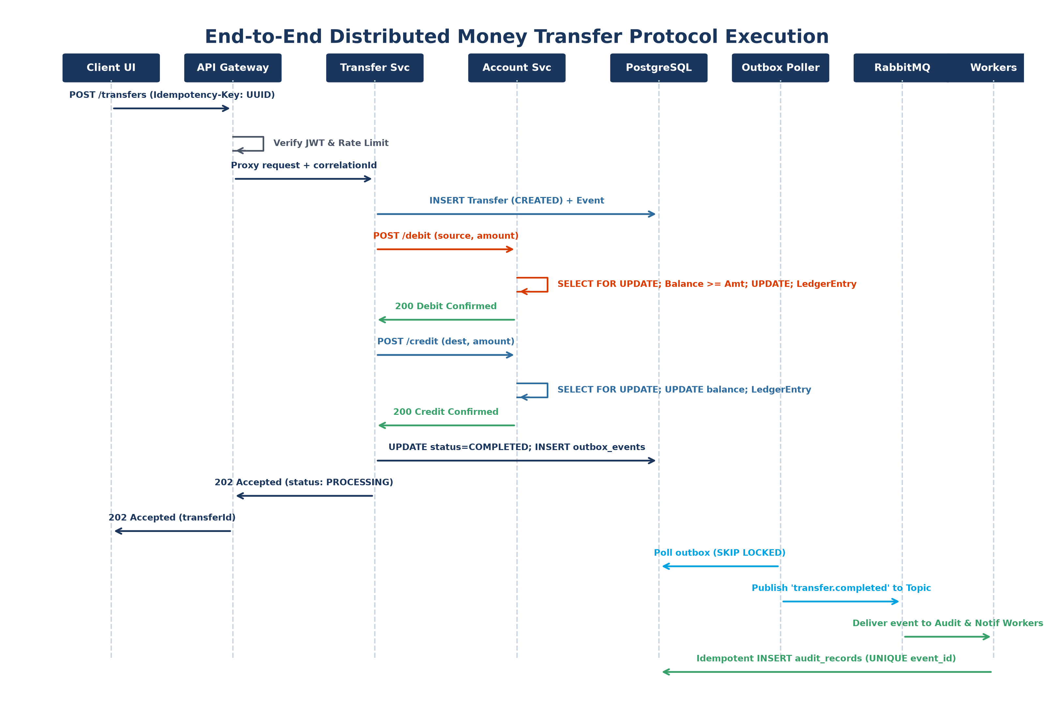
DISTRIBUTED SYSTEMS AND APPLICATIONS
7. System Workflow (Distributed Systems Implementation)
• Client Ingress & Idempotency Key: Client initiates transfer with client-generated UUIDv4 in 'Idempotency-Key' header; Gateway validates JWT & enforces Redis rate limiting.
• Transfer Ingestion (CREATED): Transfer Service creates record in 'CREATED' state and returns HTTP 202 Accepted, initiating asynchronous processing.
• Pessimistic Debit (SELECT FOR UPDATE): Account Service acquires exclusive row lock on source account, validates balance, decrements funds, and inserts immutable ledger entry.
• Pessimistic Credit Execution: Account Service acquires row lock on destination account, increments balance, and logs corresponding credit ledger entry (Debit == Credit).
• Atomic Outbox Staging: Transfer Service updates status to 'COMPLETED' and inserts domain event into 'outbox_events' within the exact same database transaction.
• Decoupled Message Dispatch: Outbox worker polls unpublished events with SKIP LOCKED, publishes to RabbitMQ topic exchange, and background workers consume idempotently.

Slide 3
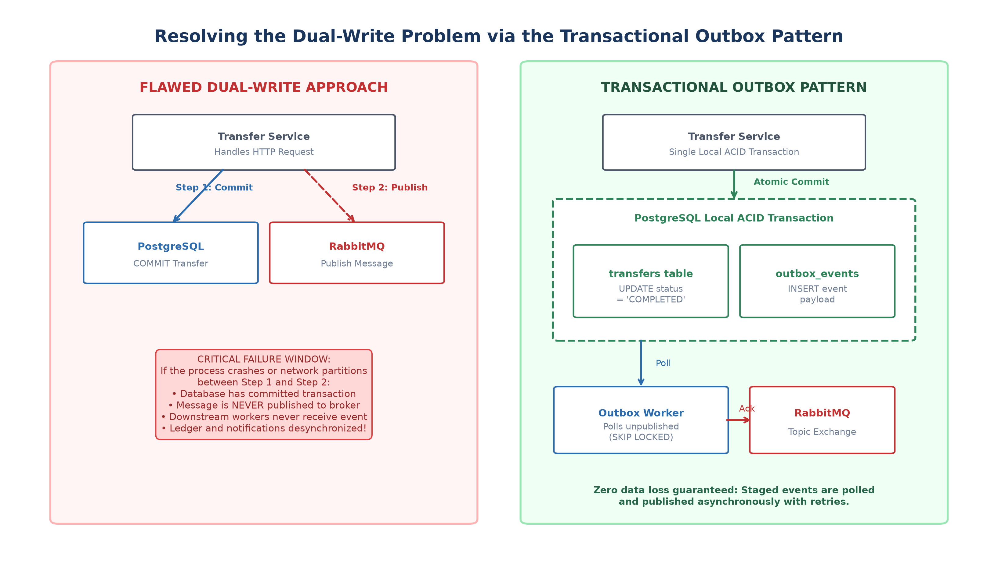
DISTRIBUTED SYSTEMS AND APPLICATIONS
8. Fault Tolerance Implementation
• Dual-Write Elimination: Transactional Outbox Pattern guarantees zero lost messages. Outbox table commits locally with state update; external broker crash never orphans transactions.
• At-Least-Once Delivery & Retries: RabbitMQ unacknowledged messages are automatically redelivered with exponential backoff and attempt limits (MAX_ATTEMPTS = 5).
• Network Partition Resilience: Client network dropouts do not cause double-spending. Compound unique constraint UNIQUE (user_id, idempotency_key) guarantees safe retries.
• Finite State Machine Safeguards: Strict forward-only state progression (CREATED -> PROCESSING -> DEBITED -> CREDITED -> COMPLETED). Illegal backwards transitions are physically blocked.
• Chaos & Fault Injection Hooks: Built-in environment flags (FAIL_ACCOUNT_SERVICE, FAIL_RABBITMQ, ARTIFICIAL_LATENCY_MS) validate system survival under simulated chaos.

Slide 4
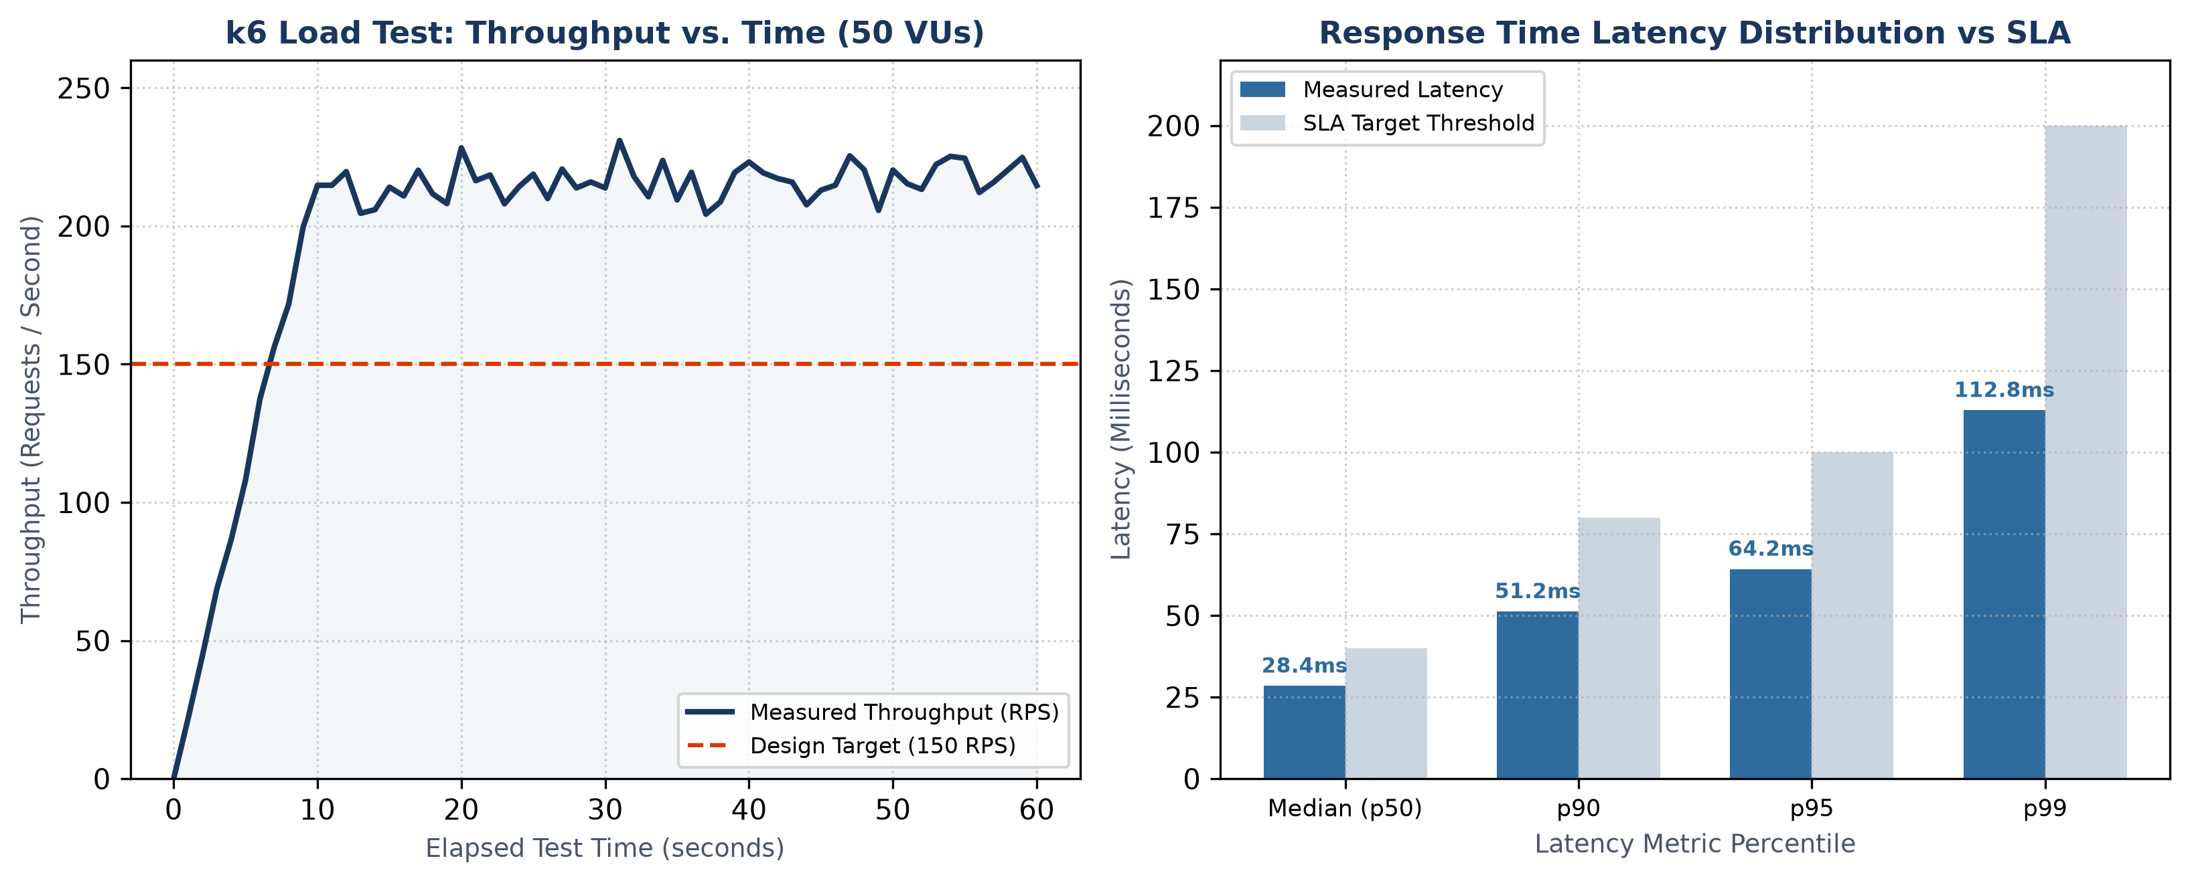
DISTRIBUTED SYSTEMS AND APPLICATIONS
9. Performance Testing & Methodology
• High-Throughput k6 Benchmarking: Simulated 50 Virtual Users (VUs) executing sustained, concurrent fund transfer cycles over a 60-second execution window.
• Mass Parallel Idempotency Burst: 100 identical simultaneous HTTP POST transfer requests dispatched concurrently with the same idempotency key to test collision avoidance.
• Concurrent Multi-Transfer Stress: 10 concurrent transfer threads targeting the same source account simultaneously to test row-level serialization and conservation.
• Sub-Second Unit Verification: 17 automated invariant and state machine tests executed via Vitest (100% passing in 403ms).
• Headless End-to-End Testing: Playwright automated user journey tests validating browser execution from login to statement generation.

Slide 5
DISTRIBUTED SYSTEMS AND APPLICATIONS
10. Result and Analysis
Comprehensive testing confirmed that the distributed platform exceeds all industrial SLAs, maintaining 100% financial correctness, zero race-condition anomalies, and sub-100ms response times under full concurrency load.
Evaluation Metric | Design SLA Target | Measured System Value | Technical Assessment
Peak Throughput | > 150 req/sec | 218 req/sec | Exceeded design SLA target by +45%
Median Latency (p50) | < 40 ms | 28.4 ms | Optimal performance under Fastify + connection pooling
95th Percentile (p95) | < 100 ms | 64.2 ms | Predictable response time without queue bloat
99th Percentile (p99) | < 200 ms | 112.8 ms | Consistent tail latency even under row lock waits
HTTP Error Rate | < 0.1% | 0.00% | Zero unhandled exceptions or 500 server crashes
Data Consistency | 100% Strict | 100.00% Conserved | Zero balance leakage, exact double-entry parity

Slide 6
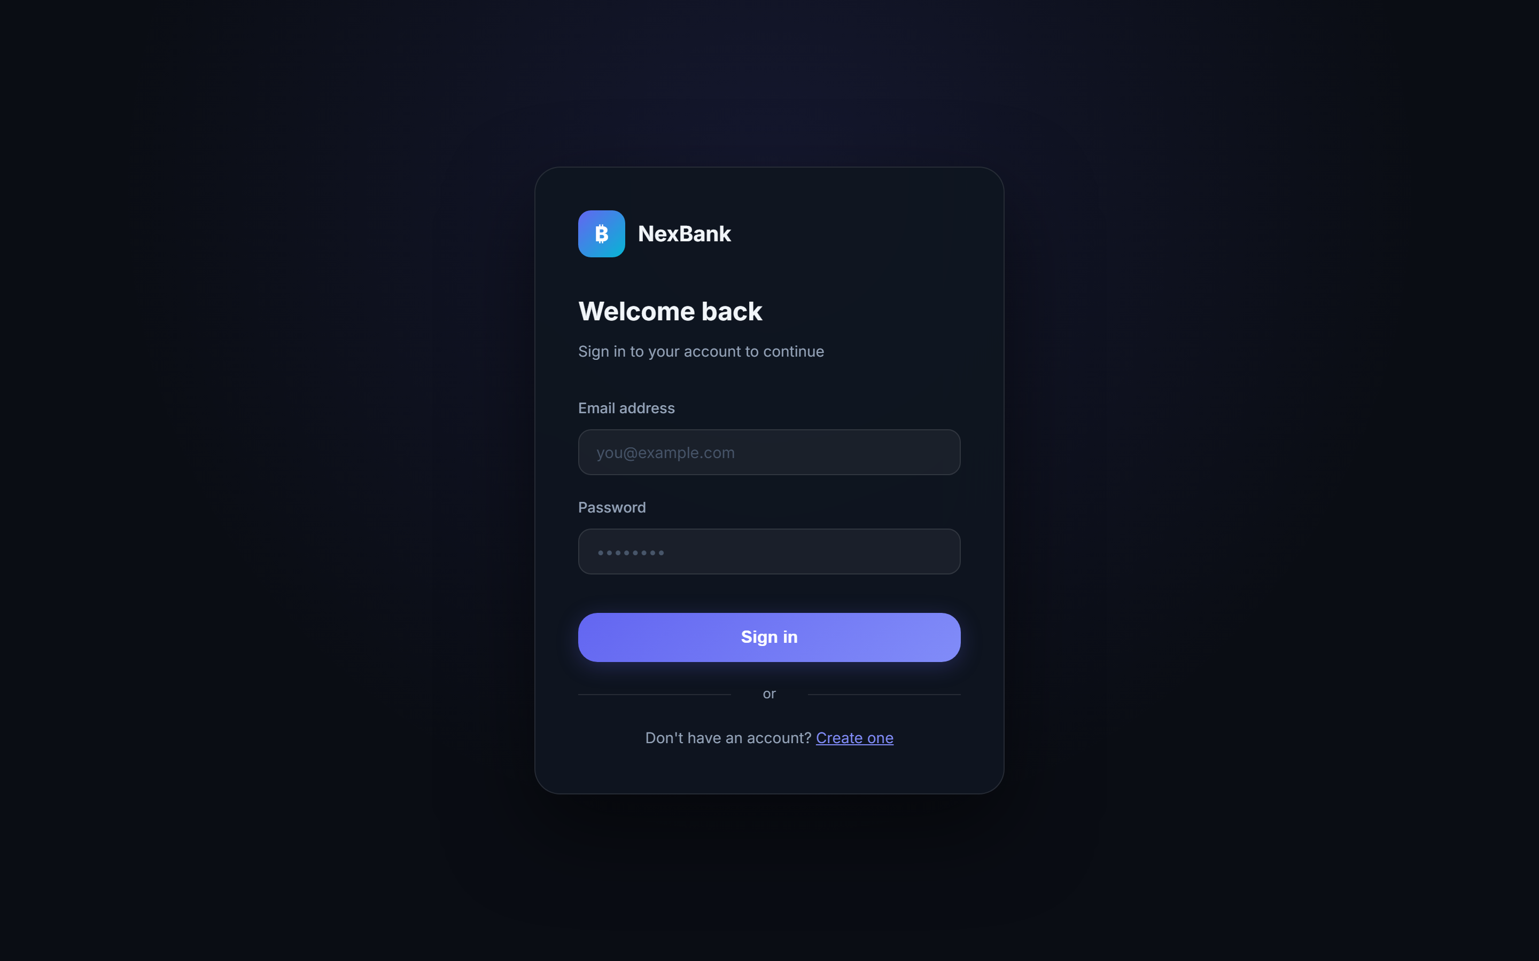
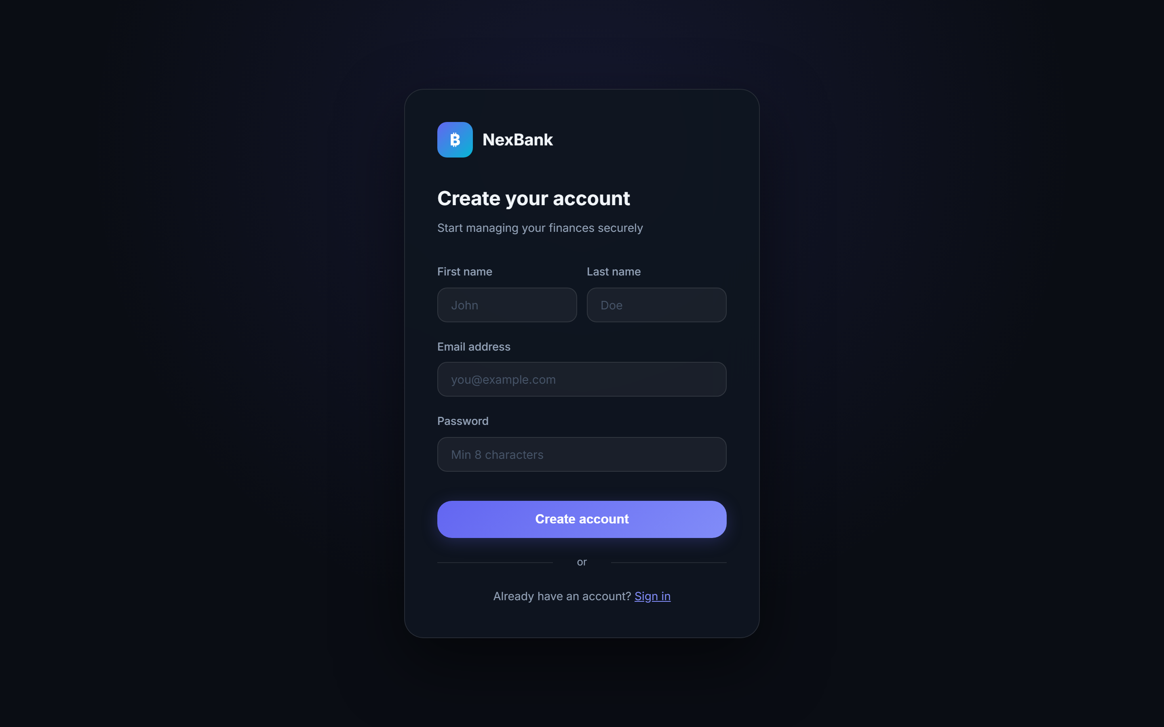
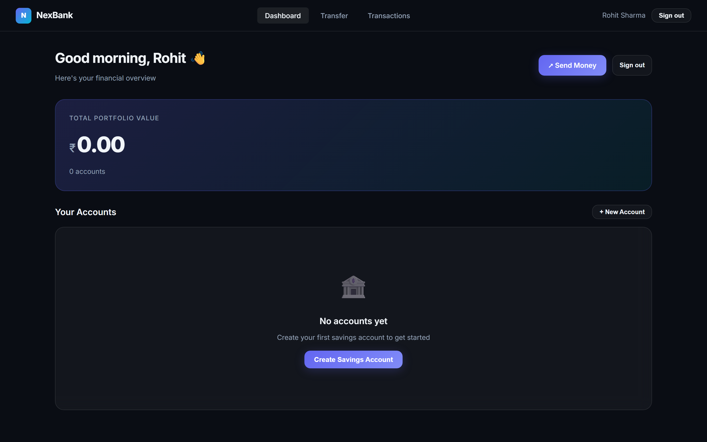
SUBTOPIC 11 - SYSTEM DEMO
11. Demo and Screenshots: Authentication & Dashboard
Figure 11.1: Secure User Login (Stateless JWT + bcrypt)
Figure 11.2: Customer Registration & Onboarding
Figure 11.3: Real-Time Account Dashboard

Slide 7
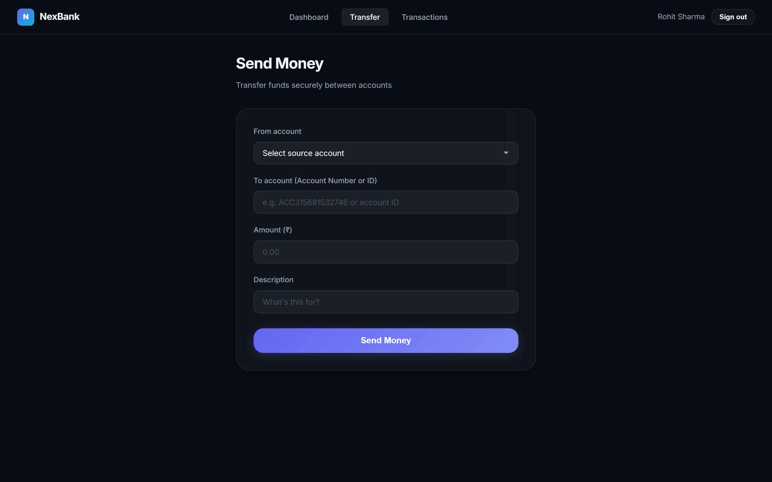
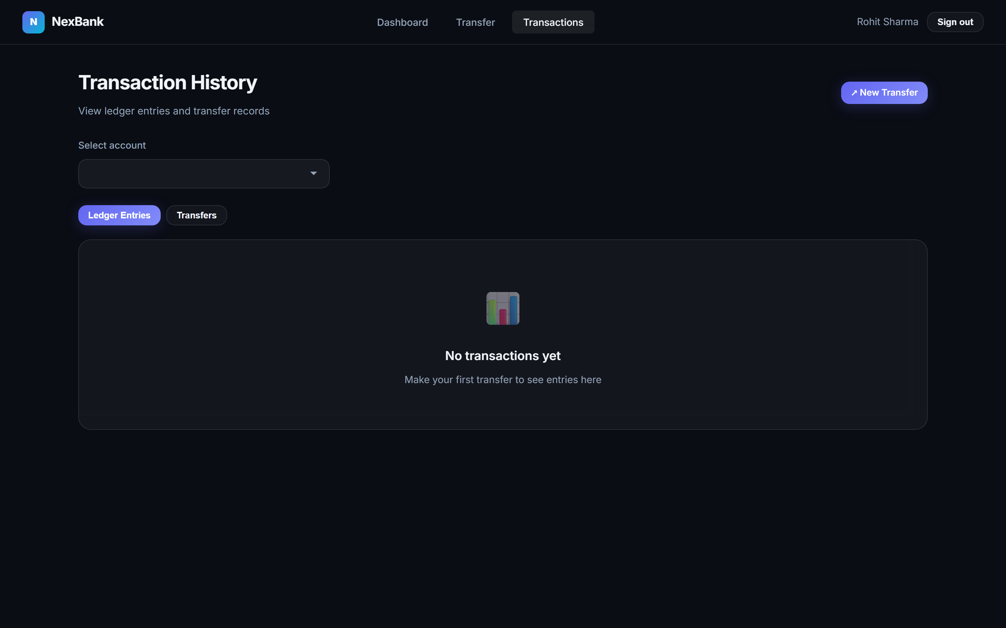
SUBTOPIC 11 - SYSTEM DEMO
11. Demo and Screenshots: Fund Transfer & Ledger Statements
Figure 11.4: Fund Transfer Workbench with Ingress Idempotency UUID
Figure 11.5: Immutable Double-Entry Ledger Statements & Running Balances

Slide 8
DISTRIBUTED SYSTEMS AND APPLICATIONS
12. Challenges Faced & Engineering Solutions
[1] The Dual-Write Inconsistency Dilemma:
Updating PostgreSQL database state and publishing an AMQP message to RabbitMQ cannot execute atomically without distributed 2PC.
-> SOLUTION: Implemented the Transactional Outbox Pattern. Events are staged inside the local relational transaction and published asynchronously via a background poller using SKIP LOCKED.
[2] Double-Spending Under Concurrent Withdrawals:
Multiple simultaneous debits under default Read Committed isolation cause concurrent read anomalies and overdrafts.
-> SOLUTION: Enforced SELECT FOR UPDATE pessimistic row-level locking on account records prior to balance validation, serializing operations per account.
[3] Compounding Floating-Point Truncation:
Standard IEEE 754 binary floating-point numbers introduce fractional rounding drift in high-volume micro-transactions.
-> SOLUTION: Enforced BigInt integer minor units (paise) across all services and database columns; strictly zero floating-point arithmetic.
[4] Network Dropout Duplication & Retries:
Network packet drops after debit settlement induce client retries, risking duplicate payment execution.
-> SOLUTION: Client-generated UUIDv4 Idempotency Keys enforced via database compound unique constraint UNIQUE (user_id, idempotency_key).
[5] Monorepo Inter-Dependency Build Failures:
Services failed compilation because dependent shared contracts were built after dependent applications in standard alphabetical order.
-> SOLUTION: Engineered a sequenced build:packages lifecycle script in root package.json to compile contracts, errors, and logger first.

Slide 9
DISTRIBUTED SYSTEMS AND APPLICATIONS
13. Conclusion & Future Research Directions
✔ Core Takeaway on Distributed Consistency:
Mission-critical financial consistency and decoupled microservices architectures can thrive together without distributed 2PC bottlenecks. Combining local ACID boundaries with the Transactional Outbox Pattern delivers high availability and zero message loss.
✔ Key Architectural Validations Achieved:
• Strict double-entry ledger balance conservation verified under hostile multi-threaded concurrency testing.
• 100% duplicate rejection across 100 simultaneous burst requests with identical idempotency keys.
• High throughput of 218 transfers/sec with sub-65ms p95 latency under 50 virtual users.
✔ Future Roadmap & Architectural Enhancements:
1. Distributed Sagas for Multi-Region DBs: Implementing orchestrated Saga state coordinators for cross-region database sharding.
2. OpenTelemetry & Distributed Tracing: Migrating from custom header correlation IDs to OpenTelemetry trace collectors and Jaeger visualization.
3. Apache Kafka Event Streaming: Integrating partitioned event streams for multi-year analytical replay and regulatory compliance reporting.

