Slide 1

Logistics Optimization & Delivery Performance Analytics
SQL-Based Analysis for FedEx
Project Summary
By - Vikas Sharma

Slide 2
Project Overview
FedEx, one of the world’s largest logistics and courier service providers, operates an extensive transportation network.
Rising e-commerce volumes increase logistics pressure
Delays impact customer satisfaction and operational costs
Data-driven insights improve route and shipment efficiency

Slide 3
Project Objectives
Analyze shipment delays patterns and operational inefficiencies
Optimize route efficiency for improved transit time
Evaluate warehouse and agent performance
Generate insights to improve on-time delivery

Slide 4
Dataset Overview
Orders
Routes
Warehouses
Delivery Agents
Shipments

Slide 5
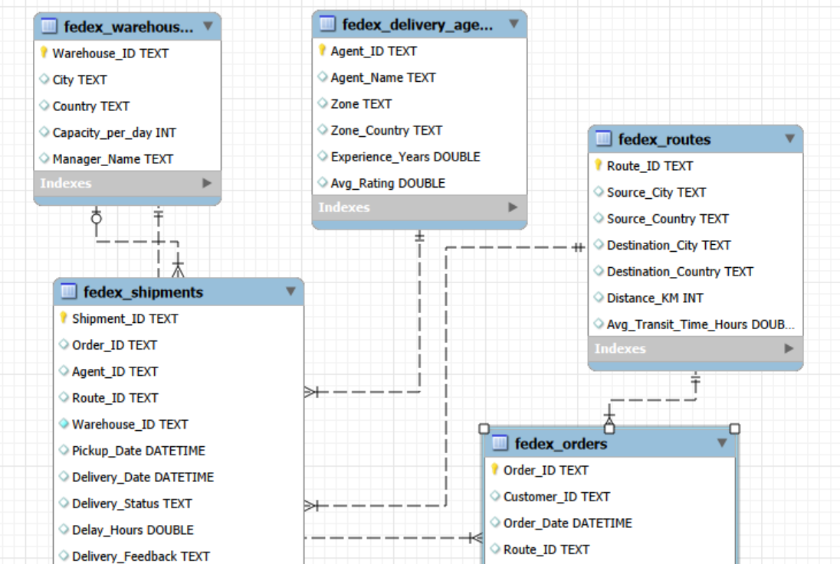
Database Schema

Slide 6
Data Cleaning & Preparation
Identified duplicate records
select Order_ID, count(*) as duplicate_count from fedex_ordersgroup by Order_ID having COUNT(*) > 1;
No dulplicates were found in Orders and Shipments table
Replaced missing Delay Hours values
select * from fedex_shipments where Delay_Hours is null;
No missing values found
Standardized datetime formats
Alter table fedex_orders modify column Order_Date datetime;
Alter table fedex_shipments modify column Pickup_Date datetime;
Alter table fedex_shipments modify column Delivery_Date datetime;

Slide 7
Data Cleaning & Preparation
No Delivery_Date occurs before Pickup_Date
select Shipment_ID, Pickup_Date, Delivery_Date,'Invalid Delivery Timeline' as Issue FROM fedex_shipments WHERE Delivery_Date < Pickup_Date;
No records found where Delivery Date occurs before Pickup Date
Validated referential integrity
#Invalid Route_ID in Orders : select o.* from fedex_orders o left join fedex_routes ron o.Route_ID = r.Route_ID where r.Route_ID is null;
#Invalid Warehouse_ID in Orders : select o.* from fedex_orders o left join fedex_warehouses won o.Warehouse_ID = w.Warehouse_ID where w.Warehouse_ID is null;
#Invalid Order_ID in Shipments : select s.* from fedex_shipments s left join fedex_orders oon s.Order_ID = o.Order_ID where o.Order_ID is null;

Slide 8
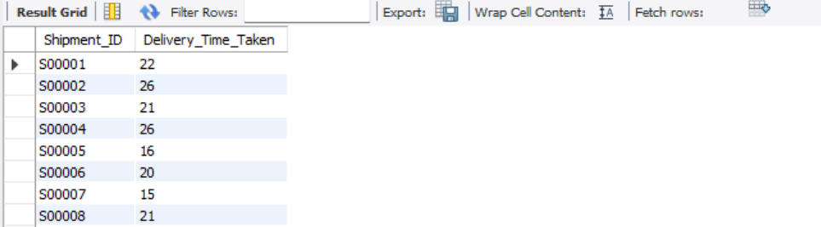
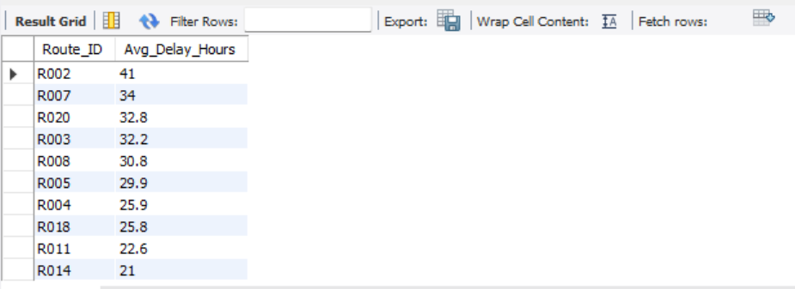
Delivery Delay Analysis
Difference of pickup and delivery date in hours
select Shipment_ID, Timestampdiff(hour, Pickup_Date, Delivery_Date) as Delivery_Time_Taken from fedex_shipments;
Top 10 delayed routes based on average delay hours
select Route_ID, round(avg(delay_hours),1) as Avg_Delay_Hours from fedex_shipmentsgroup by Route_ID order by Avg_Delay_Hours desc limit 10;

Slide 9
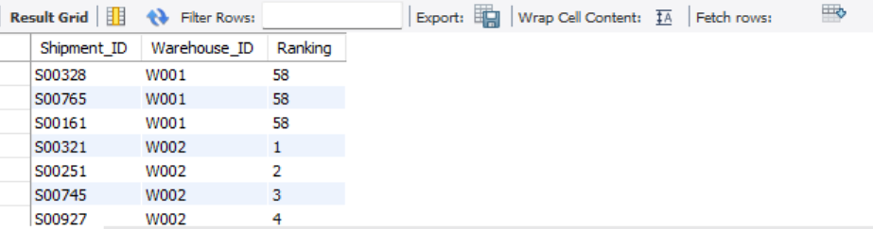
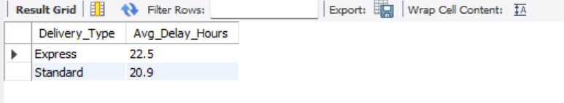
Delivery Delay Analysis
Ranking shipments by delay within each Warehouse_ID
select Shipment_ID, Warehouse_ID, dense_rank() over(partition by Warehouse_ID order by delay_hours desc) as Rankingfrom fedex_shipments;
Average delay per Delivery_Type
select o.Delivery_Type, round(avg(s.delay_hours),1) as Avg_Delay_Hours from fedex_orders o left join fedex_shipments s on o.Order_ID = s.Order_IDgroup by o.Delivery_Type order by Avg_Delay_Hours desc;

Slide 10
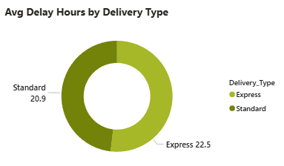
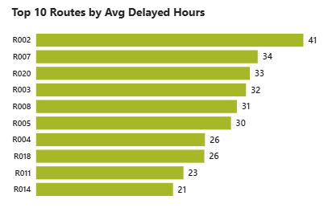
Delivery Delay Analysis Visuals

Slide 11
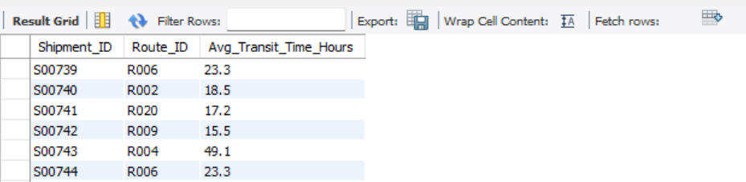
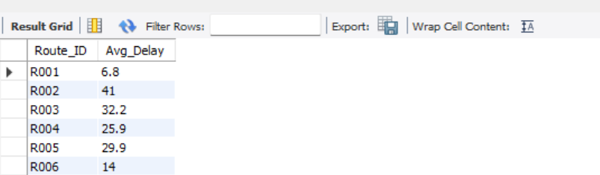
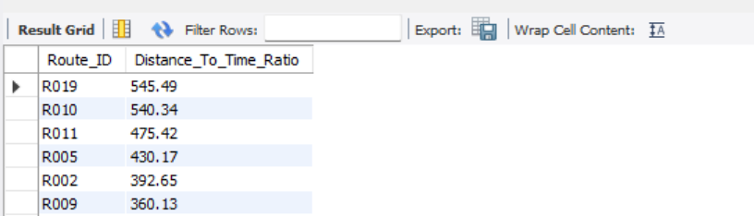
Route Optimization Insights
For each Route - Average transit time across all shipments
select s.Shipment_ID, r.Route_ID, r.Avg_Transit_Time_Hours from fedex_shipments s left join fedex_routes r on s.Route_ID = r.Route_ID;
Average delay per route
select r.Route_ID, round(avg(s.Delay_Hours),1) as Avg_Delay from fedex_routes r left join fedex_shipments s on s.Route_ID = r.Route_IDgroup by r.Route_ID order by Avg_Delay desc;
Distance-to-time efficiency ratio
select Route_ID, round(Distance_KM/Avg_Transit_Time_Hours,2) as Distance_To_Time_Ratiofrom fedex_routes order by Distance_To_Time_Ratio desc;
`

Slide 12
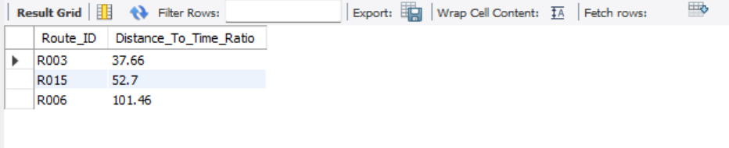
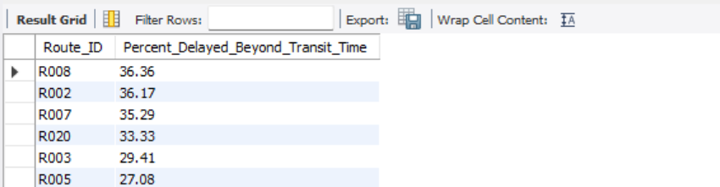
Route Optimization Insights
Worst 3 routes with the lowest efficiency ratio
select Route_ID, round(Distance_KM/Avg_Transit_Time_Hours,2) as Distance_To_Time_Ratiofrom fedex_routes order by Distance_To_Time_Ratio asc limit 3;
Routes with >20% of shipments delayed beyond expected transit time
With cte as (select s.Shipment_ID, s.Route_ID, r.Avg_Transit_Time_Hours, s.Delay_Hoursfrom fedex_shipments s join fedex_routes r on s.Route_ID = r.Route_ID)
select Route_ID, round(count(case when Delay_Hours>Avg_Transit_Time_Hours then 1 end)*100/count(*),2) as Percent_Delayed_Beyond_Transit_Time from cte group by Route_ID having Percent_Delayed_Beyond_Transit_Time > 20order by Percent_Delayed_Beyond_Transit_Time desc;
`

Slide 13
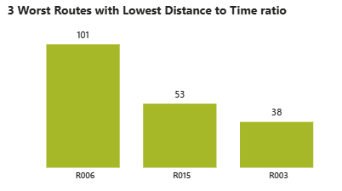
Route Optimization Visuals

Slide 14
Route Optimization Insights
Insights :
Average Delay hours of Route 2 and 7 are very high (41 and 34). These routes need proper optimizations. In terms of Distance to time efficiency Route 3, 15, 6 are the worst of all. Routes 8, 2, 7 have the highest percentage of delayed shipments close to 36%.
Recommendation for potential routes for optimization:
For these routes - we must investigate recurring bottlenecks such as customs clearance, congestion, or warehouse overload.
Introduce alternate routing during peak shipment periods and optimize route planning to reduce unnecessary idle time.
Prioritize delay alerts for these routes and deploy experienced delivery agents in high-risk zones.

Slide 15
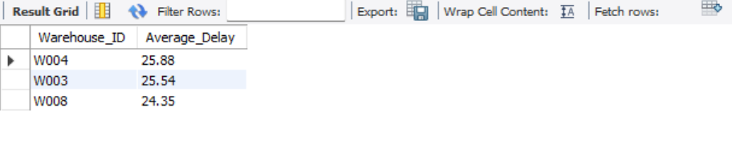
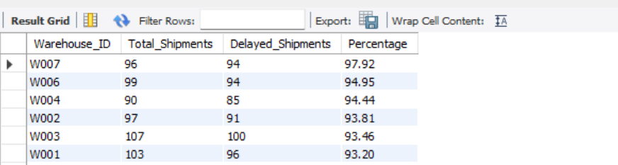
Warehouse Performance
Top 3 warehouses with the highest average delay in shipments dispatched
select Warehouse_ID, round(avg(Delay_Hours),2) as Average_Delay from fedex_shipments group by Warehouse_IDorder by Average_Delay desc limit 3;
Total shipments vs Delayed shipments for each warehouse
select Warehouse_ID, count(*) as Total_Shipments, count(case when Delay_Hours>0 then 1 end) as Delayed_Shipments,round(count(case when Delay_Hours>0 then 1 end)*100/count(*),2) as Percentagefrom fedex_shipments group by Warehouse_IDorder by Percentage desc;
`

Slide 16
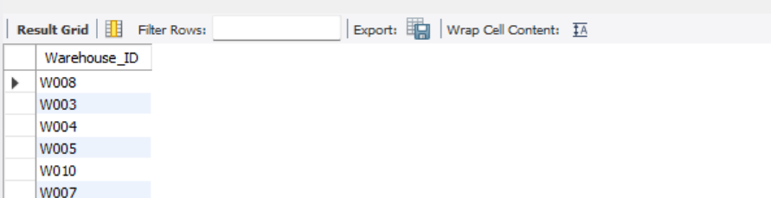
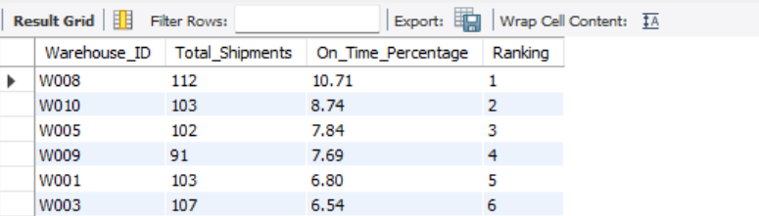
Warehouse Performance
Warehouses where average delay exceeds the global average delay
with cte as (select avg(delay_hours) as Global_Avg_Delay from fedex_shipments)
select Warehouse_ID from fedex_shipmentsgroup by Warehouse_ID having avg(delay_hours) > (select Global_Avg_Delay from cte);
Ranking all warehouses based on on-time delivery percentage
with cte as (select Warehouse_ID, count(*) as Total_Shipments, round((1-(count(case when Delay_Hours>0 then 1 end)/count(*)))*100,2) as On_Time_Percentage from fedex_shipments group by Warehouse_ID )
select *, dense_rank() over(order by On_Time_Percentage desc) as Ranking from cte;
`

Slide 17
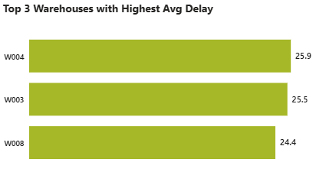
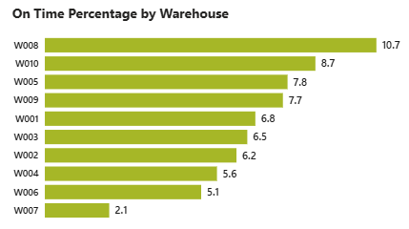
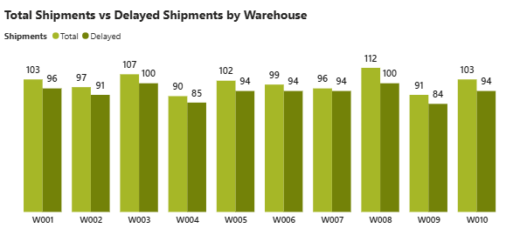
Warehouse Performance Visuals

Slide 18
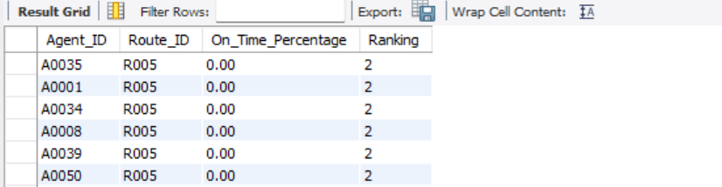
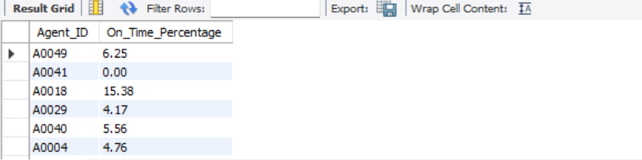
Delivery Agent Performance
Ranking delivery agents (per route) by on-time delivery percentage
with cte as (select Agent_ID, Route_ID,round((count(case when Delay_Hours=0 then 1 end)/count(*))*100,2) as On_Time_Percentage from fedex_shipments group by Route_ID, Agent_ID )
select *, dense_rank() over(partition by Route_ID order by On_Time_Percentage desc) as Ranking from cte;
Agents who's on-time % is below 85%
select Agent_ID,round((count(case when Delay_Hours=0 then 1 end)/count(*))*100,2) as On_Time_Percentage from fedex_shipments group by Agent_ID having On_Time_Percentage < 85.00;
`

Slide 19
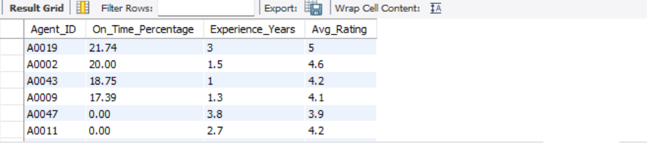
Delivery Agent Performance
The average rating and experience (in years) of the top 5 vs bottom 5 agents
(select a.Agent_ID,round((count(case when s.Delay_Hours=0 then 1 end)/count(*))*100,2) as On_Time_Percentage,a.Experience_Years, a.Avg_Ratingfrom fedex_delivery_agents a left join fedex_shipments s on a.Agent_ID = s.Agent_IDgroup by a.Agent_ID, a.Experience_Years, a.Avg_Rating order by On_Time_Percentage desc limit 5)
Union
(select a.Agent_ID,round((count(case when s.Delay_Hours=0 then 1 end)/count(*))*100,2) as On_Time_Percentage,a.Experience_Years, a.Avg_Ratingfrom fedex_delivery_agents a left join fedex_shipments s on a.Agent_ID = s.Agent_IDgroup by a.Agent_ID, a.Experience_Years, a.Avg_Rating order by On_Time_Percentage, a.Avg_Rating, a.Experience_Years limit 5);
`

Slide 20
Delivery Agent Performance
Recommendations for low performing agents :
Targeted Training Programs on: Time management, Customer handling and communication
Route Familiarization: Reassign low-performing agents temporarily to less complex delivery zones.
Give weekly targets for On-time delivery %, Customer feedback ratings
Workload Balancing Strategies : Reduce excessive shipment allocation for these agents and pair them with experienced staff.

Slide 21
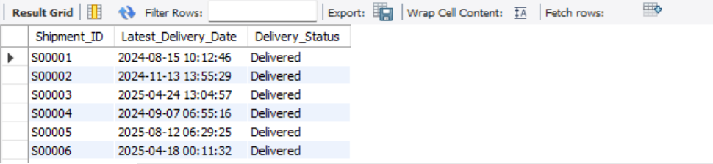
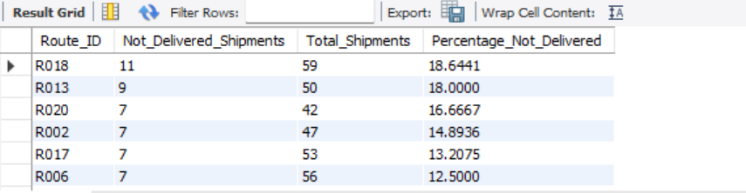
Shipment Tracking Analytics
For each shipment: The latest status along with the latest Delivery_Date
select Shipment_ID, Delivery_Date as Latest_Delivery_Date, Delivery_Statusfrom fedex_shipments where (Shipment_ID, Delivery_date) in (select Shipment_ID, Max(Delivery_Date) as Latest_Delivery_Date from fedex_shipments group by Shipment_ID);
Routes where the majority of shipments are still “In Transit” or “Returned”
select Route_ID, count(case when delivery_status = "In Transit" or delivery_status = "Returned" then 1 end) as Not_Delivered_Shipments,count(*) as Total_Shipments, count(case when delivery_status = "In Transit" or delivery_status = "Returned" then 1 end)*100/count(*) as Percentage_Not_Deliveredfrom fedex_shipments group by Route_ID order by Percentage_Not_Delivered desc;
`

Slide 22
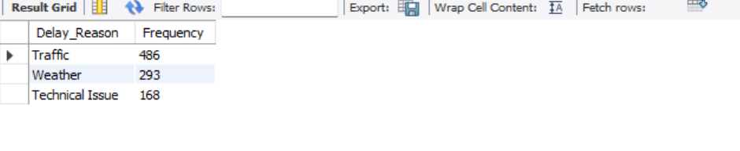
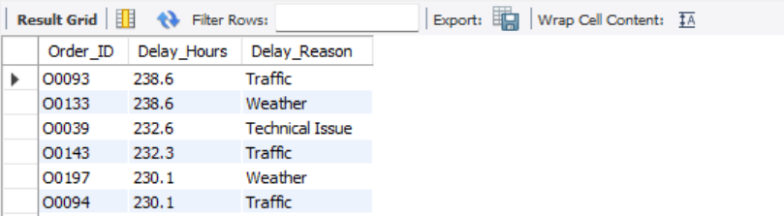
Shipment Tracking Analytics
The most frequent delay reasons
select Delay_Reason, count(Shipment_ID) as Frequency from fedex_shipmentsgroup by Delay_Reason order by Frequency desc limit 3;
Orders with exceptionally high delay (>120 hours)
select Order_ID, Delay_Hours, Delay_Reasonfrom fedex_shipments where Delay_Hours > 120 order by Delay_Hours desc;

Slide 23
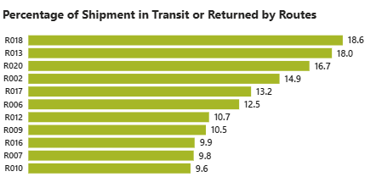
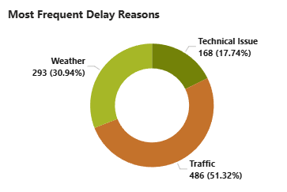
Shipment Tracking Analytics Visuals

Slide 24
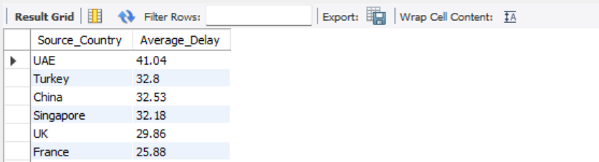
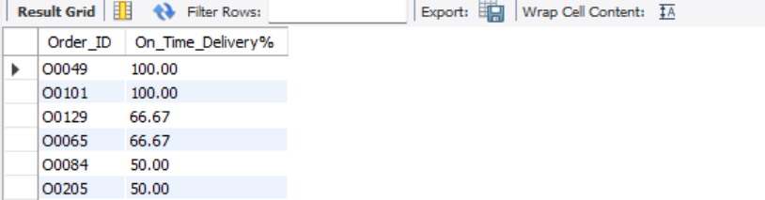
Advanced KPI Reporting
Average Delivery Delay per Source_Country
select Source_Country, round(avg(Delay_Hours),2) as Average_Delayfrom fedex_routes r left join fedex_shipments s on r.Route_ID = s.Route_ID group by Source_Countryorder by Average_Delay desc;
Orders On-Time Delivery %
select Order_ID,round((count(case when Delay_Hours=0 then 1 end)/count(*))*100,2) as `On_Time_Delivery%`from fedex_shipments group by Order_ID order by `On_Time_Delivery%` desc;
`

Slide 25
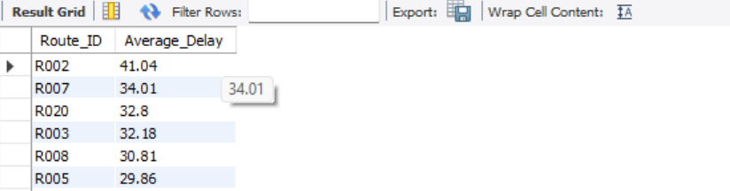
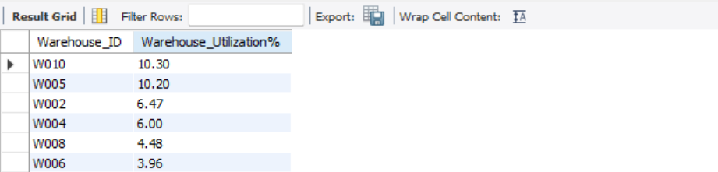
Advanced KPI Reporting
Average Delay (in hours) per Route_ID
select Route_ID, round(avg(Delay_Hours),2) as Average_Delay from fedex_shipments group by Route_ID order by Average_Delay desc;
Warehouse Utilization %
with cte as (Select Warehouse_ID, count(*) as Shipment_Handled from fedex_shipments group by Warehouse_ID)
select w.Warehouse_ID, round(cte.Shipment_Handled/w.Capacity_per_day * 100,2) as `Warehouse_Utilization%`from fedex_warehouses w left join cte on w.Warehouse_ID = cte.Warehouse_ID order by `Warehouse_Utilization%` desc;
`

Slide 26
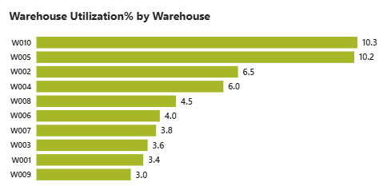
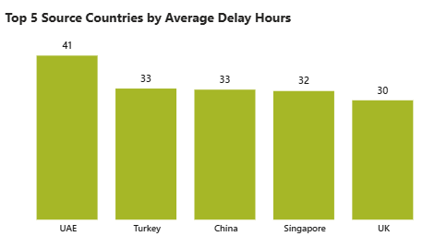
Advanced KPI Visuals

Slide 27

Key Business Insights
1. Route-Level Delays Are the Primary Operational Bottleneck
Routes R002, R007, and R020 consistently show the highest average delay hours.
Routes R002, R007, and R008 also have the highest proportion of delayed shipments.
2. Significant Route Inefficiencies Exist
Routes R006, R015, and R003 exhibit the poorest Distance-to-Time efficiency ratios.
Indicates possible congestion, excessive customs delays, or scheduling inefficiencies.
3. Traffic Is the Leading Cause of Shipment Delays
More than half of all recorded delays are attributed to traffic-related disruptions.
Weather-related disruptions are the second-largest contributor.
4. Warehouse Performance Varies Considerably
Warehouses W004, W003, and W008 generate the highest average delay hours.
Despite large shipment volumes, some warehouses demonstrate better service than others.

Slide 28

Key Business Insights
5. Capacity Utilization Is Uneven Across Warehouses
W010 and W005 show the highest utilization levels.
Several warehouses operate significantly below capacity.
6. International Routes Face Greater Delay Risks
Shipments originating from UAE, Turkey, China, and Singapore experience the highest average delays.
7. Delivery Type Does Not Significantly Impact Delays
Express and Standard deliveries show relatively similar average delay durations.
Operational bottlenecks appear to be network / routes rather than service-type driven.
8. High In-Transit and Returned Shipment Rates Require Attention
Routes R018, R013, and R020 show elevated percentages of shipments remaining in transit or being returned.
Indicates potential service reliability issues and increased operational costs.

Slide 29
Business Recommendations
Route Optimization
Prioritize R002, R007, R008, R006, R015, and R003 for route redesign and performance monitoring.
Implement dynamic route planning using real-time traffic data.
Warehouse Optimization
Reduce pressure on high-delay warehouses through load balancing.
Replicate best practices from better-performing facilities.
Delay Reduction Strategy
Introduce predictive delay alerts for high-risk routes.
Strengthen plans for traffic and weather disruptions. .
Service Reliability Improvement
Establish route-specific KPIs and performance dashboards.
Monitor delayed shipment percentages, transit efficiency, and warehouse performance continuously.

Slide 30

Conclusion
The analysis reveals that delivery delays are primarily driven by route inefficiencies, traffic-related disruptions, and inconsistent warehouse performance. By optimizing high-risk routes, balancing warehouse workloads, and implementing proactive delay-management strategies, FedEx can improve on-time delivery performance, enhance customer satisfaction, and reduce operational costs across its global logistics network.
Video Link : https://drive.google.com/drive/folders/1BxI8QAotJSqSuy_h-ZX2xX4d8hL-mcug?usp=sharing

