Slide 1
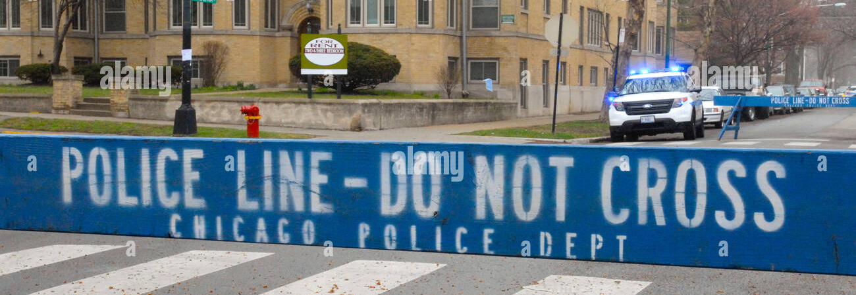
CHICAGO CRIME ANALYSIS
Vamsi Kasukurthi
IA50215
Prof: Dr. Chaojie (Jay) Wang

Slide 2
PROJECT MOTIVATION
To allocate resources of stakeholders and law enforcement efficiently by analysing the peak periods and high-risk areas and enhance public safety.
To understand the patterns within the crime data and develop targeted interventions and prevention strategies, fostering a safe urban environment based on evidence-driven insights.

Slide 3
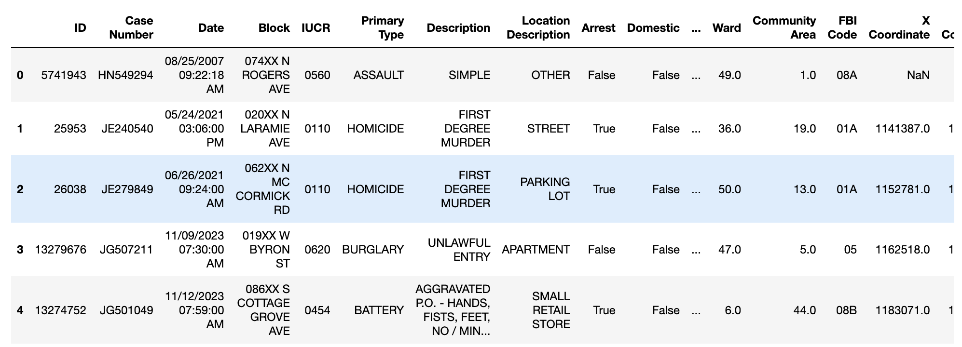
DATASET
The data is sourced from the Chicago public safety database. link
Originally, the dataset contains over 8 million records and 22 columns, but for ease of analysis, a sample of 100,000 records was used.

Slide 4
Variables we plan to use throughout analysis
Date - Date on which crime occured.
Primary Type - Primary type of crime.
IUCR – Four-digit Illinois Uniform Crime Reporting (IUCR) codes.
Description - Short description of the type of crime.
Location description - Description of where crime occured.
District - District code where crime occured.
Community - Community area code where crime occured.
Longitude & Latitude - Exact coordinates of crime occurrence.
FBI Code - numeric code indicating FBI crime categorization.
Year - Year of crime.
Arrest - Indicates whether arrest was made or not

Slide 5

Exploratory Data Analysis(EDA)

Slide 6
Overview
Each visualization helps us with unveiling patterns, trends, and insights within Chicago's crime data landscape. By analyzing Chicago crime data according to months in a year, stakeholders can identify seasonal patterns and allocate resources effectively to address peak periods of criminal activity. Additionally, targeted interventions and prevention strategies can be implemented to mitigate crime during specific months when rates are typically higher.

Slide 7
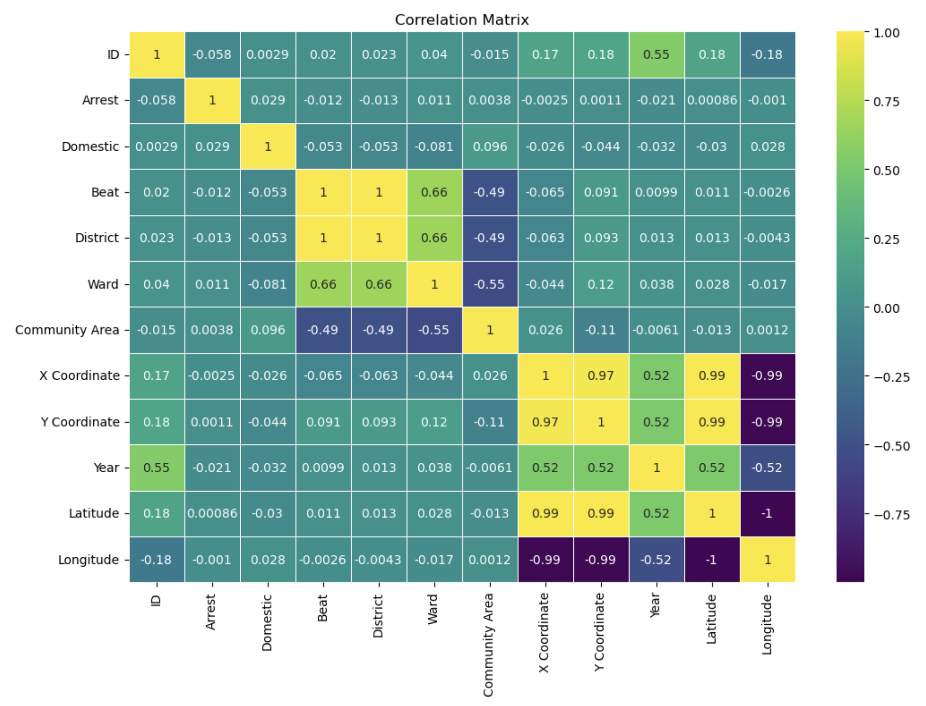
CORRELATION MATRIX

Slide 8
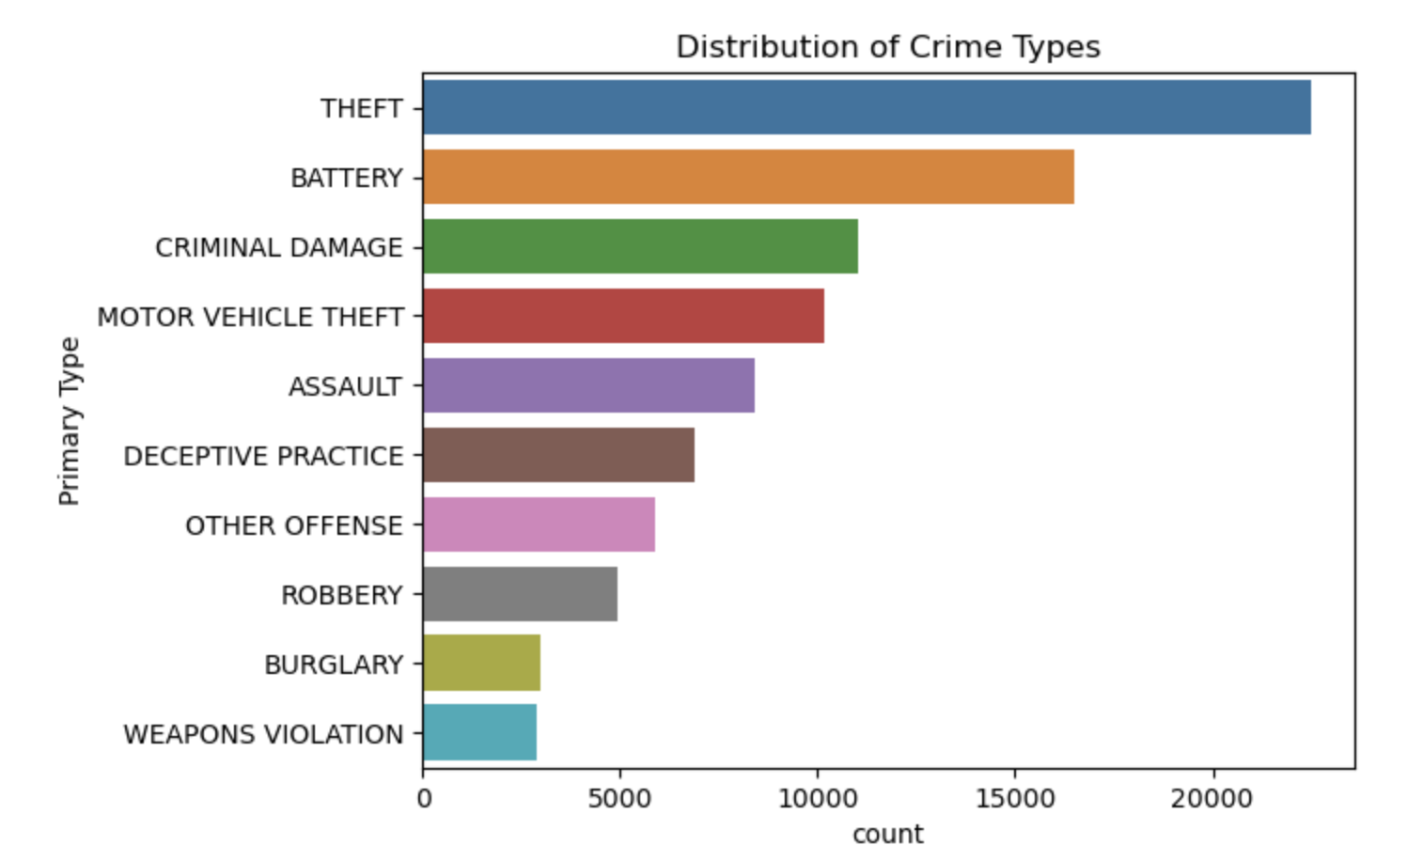
Top 10 Distribution of Crime Types

Slide 9
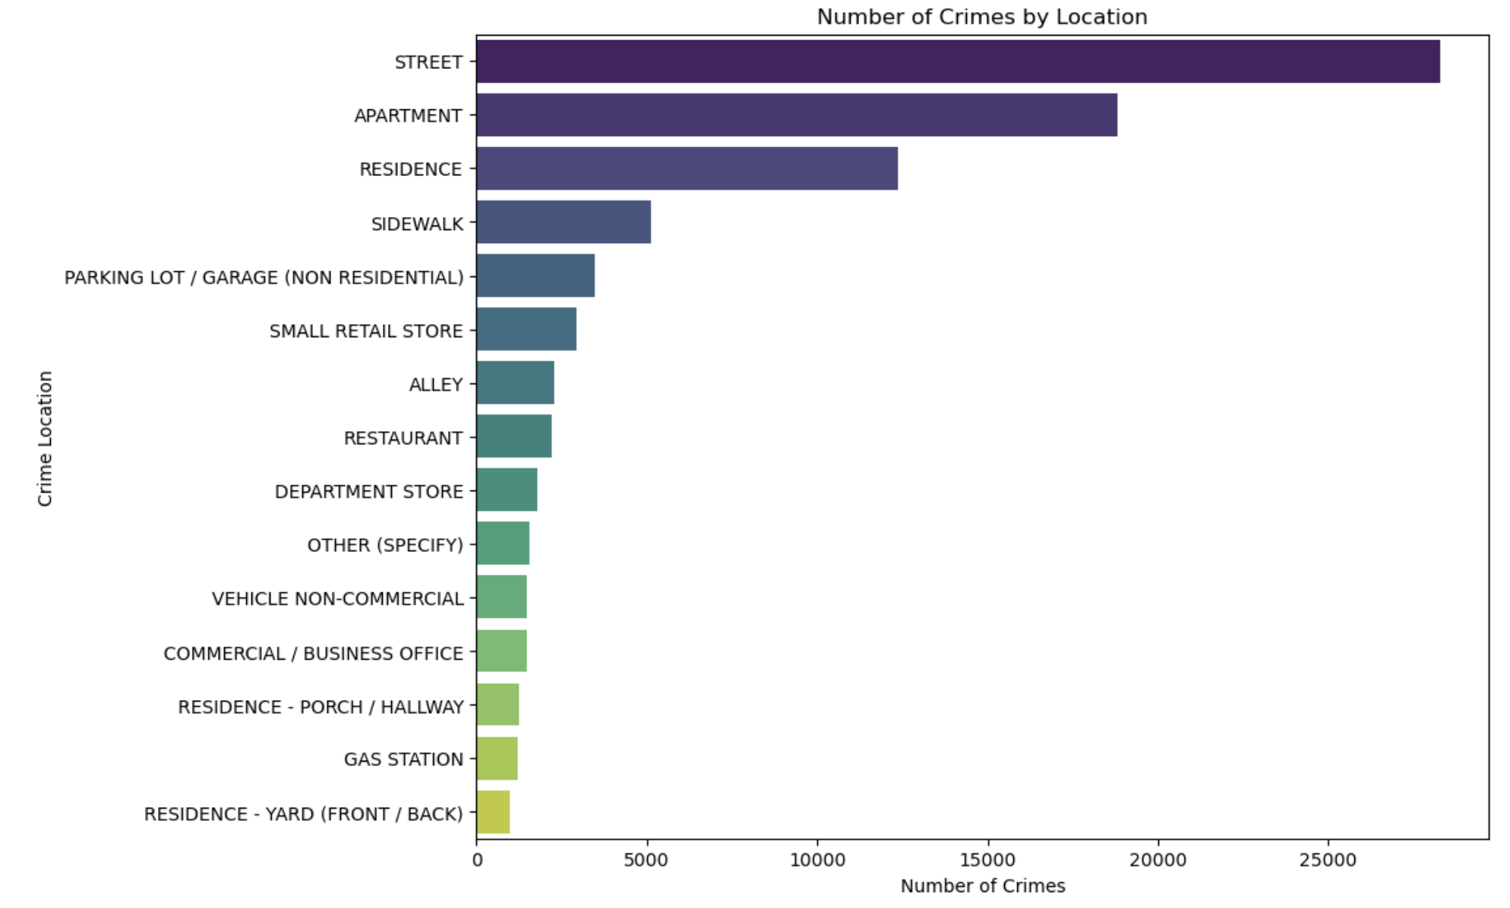
Top 15 Locations by Number of Crimes

Slide 10
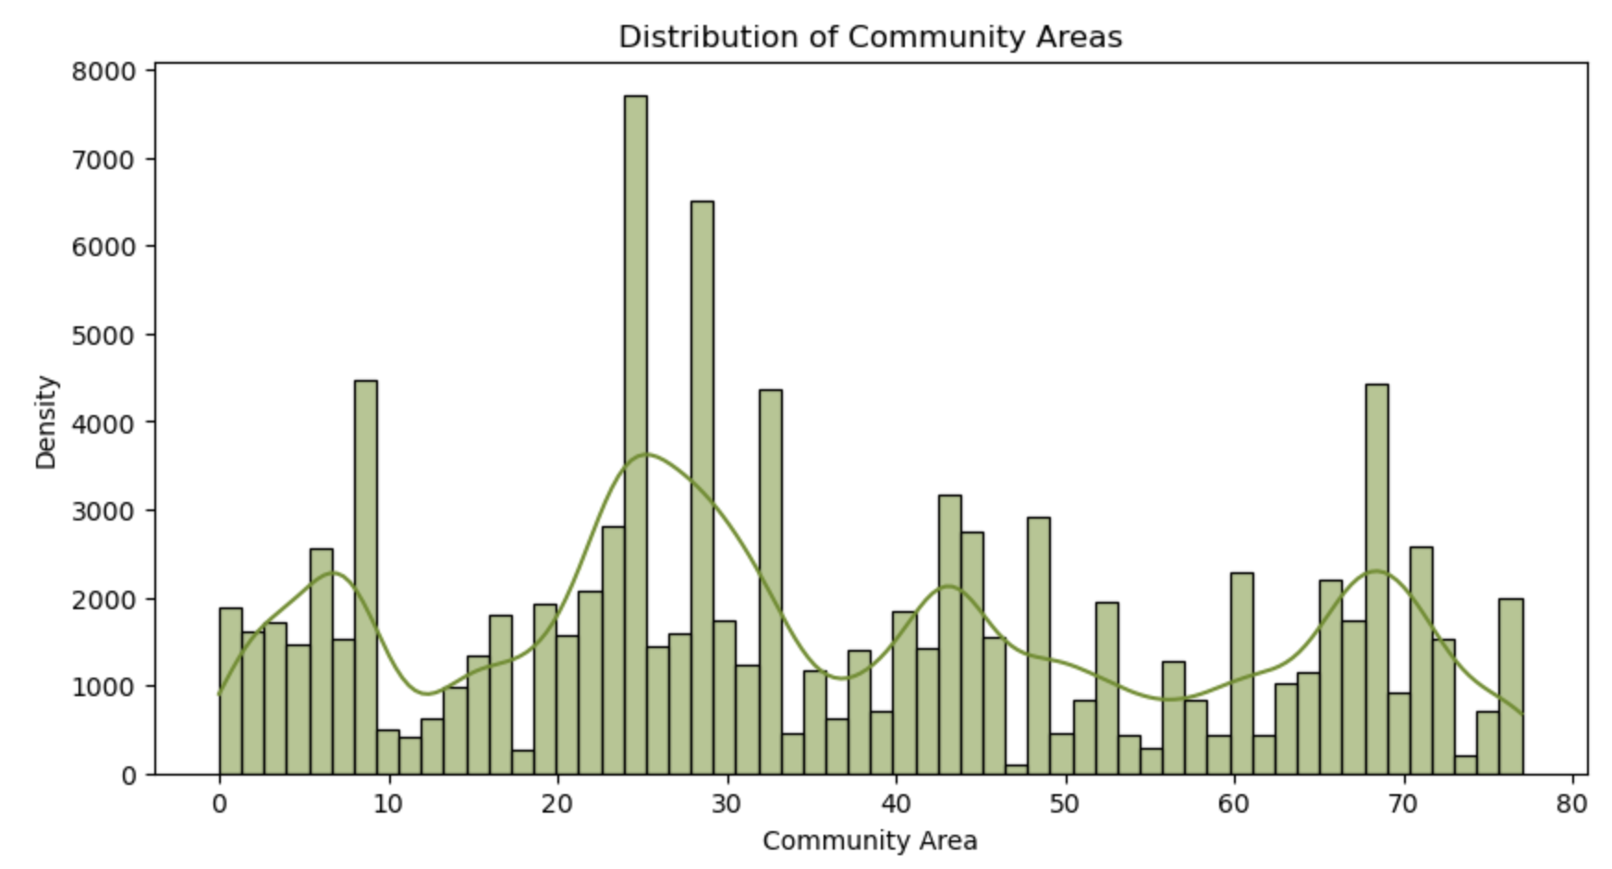
Distribution of Community Areas

Slide 11
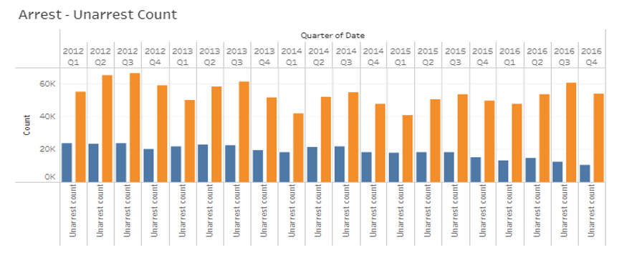
Quarterly comparisons highlight the significant disparity between arrest and unarrest counts. Through this we can clearly say that arrest count very less when compared to crime occurrences.

Slide 12
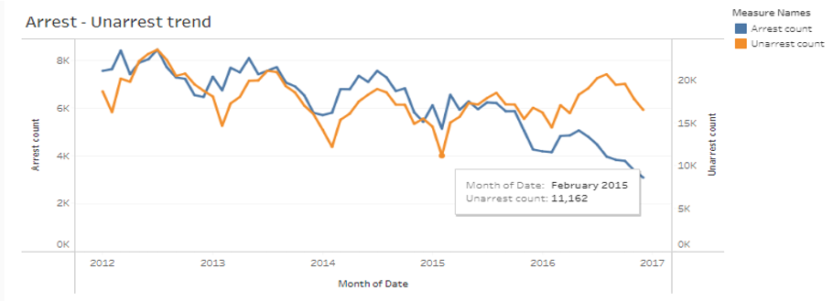
Our attention then shifts to trend analysis, focusing on arrest and unarrest counts over the years. Through categorized measures, we witness a gradual decrease in arrest rates.

Slide 13
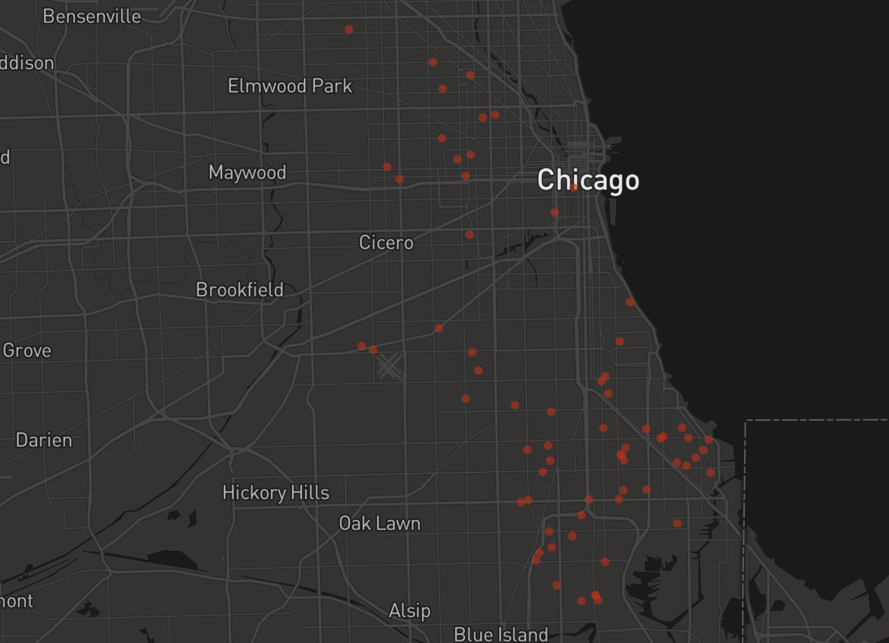
We can look at the dynamic display of crime instances across Chicago's districts. Each colored dot represents a specific crime type occurring in a district. As we filter the data by date, the visualization adapts, showcasing the crime distribution based on the filtered hour.

Slide 14

Models and Results

Slide 15
Models for Prediction
Logistic Regression Classifier
Logistic Regression is the model that usually works on any data frame and the scores given by the logistic regression are accurate depending upon the data set.
Decision-Tree-Classifier
We have chosen this because as we have more categorical data. It is useful to derive as it has feature of capturing the descriptive decision-making skills.
KNN- Model
We have chosen this as it is a simple supervised algorithm where we can assign the class to new data point, and it is non- parametric model.

Slide 16
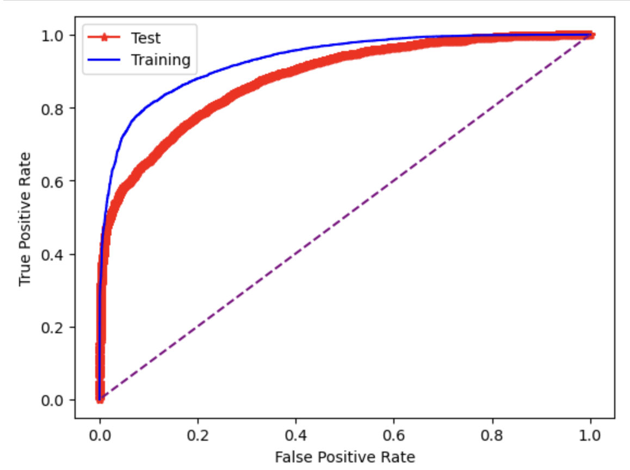
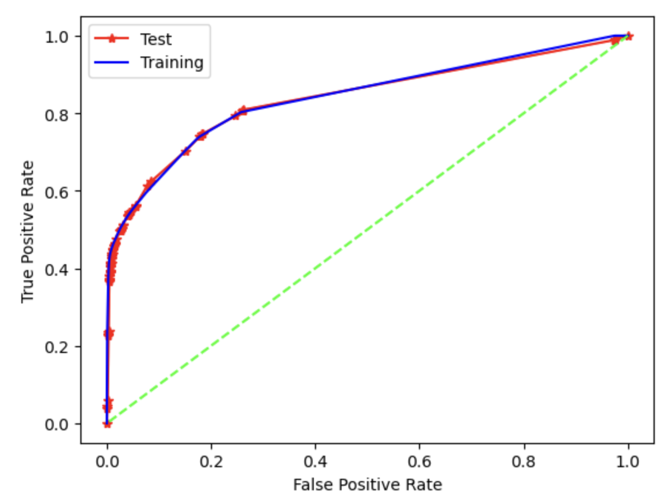
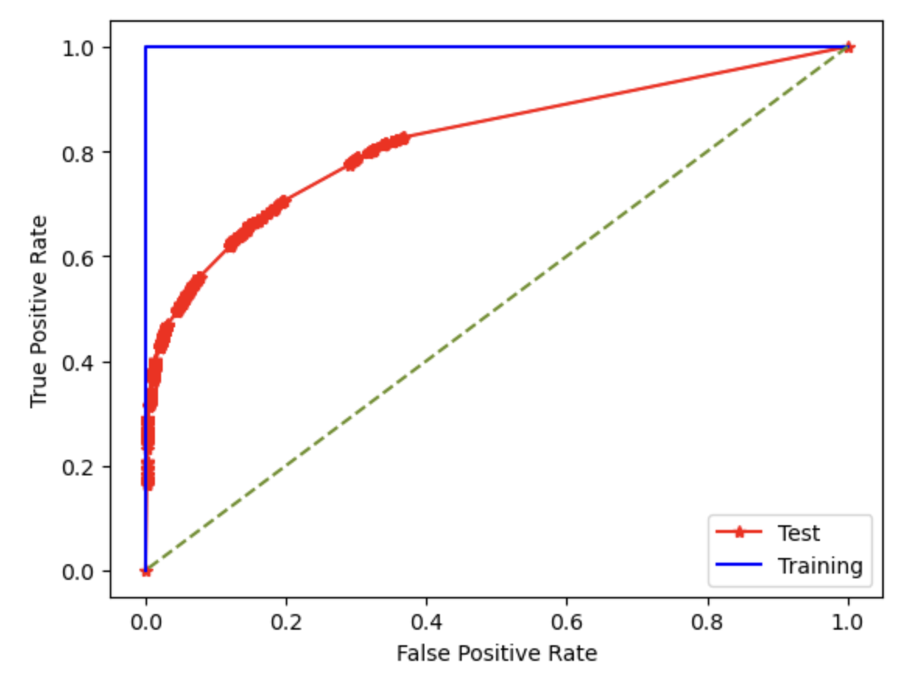
ROC Curve For Three Models
Logistic Regression
Decision Tree Classifier
KNN

Slide 17
Scores
Logistic Regression Classifier:
ROC-Accuracy Score: 88.03%
Logistic Regression score: 92.22%
F-1 Score: 56.79%
Decision-Tree Classifier:
ROC-Accuracy Score: 83.77%
Decision Tree score: 92.17%
F-1 Score: 57.92%
KNN-Model Classifier:
ROC-Accuracy Score: 82.10%
KNN- model score: 91.55%
F-1 Score: 53.25%

Slide 18
Comparing Models
Logistic Regression performed well among the three models including Decision tree and KNN model.
The ROC accuracy score is higher for the logistic regression as it maintains 88.03%.
And comparing the F1 score among the models, here also the logistic regression is best with 57.92%

Slide 19
Conclusion
In summary, analyzing Chicago's crime data from 2001 to the present reveals a complex interplay of factors influencing fluctuations in crime rates.
From the introduction of data-driven policing strategies like COMPSTAT to socioeconomic conditions, gang activity, and shifts in law enforcement priorities post-9/11, various elements have impacted crime trends.
Community policing initiatives, technology adoption, violence reduction programs, and changes in criminal justice policies further shape the landscape of crime in the city. Economic conditions, including both booms and crises, also play a significant role.
Ultimately, understanding Chicago's crime dynamics requires a multifaceted approach encompassing historical data, community dynamics, law enforcement strategies, and socioeconomic factors.

Slide 20

Thank you.

