Slide 1
CITY NAVIGATION SYSTEM
Presented by :
Shubhashish Shukla, Soumya kumar,
Vaishnavi Rai

Slide 2
Introduction
What is the City Navigation System?
A database system designed to help users navigate a city efficiently.
Stores and manages information about users, zones, utilities, and key personnel.
Helps in identifying key locations and their responsible authorities.
Can be used for city planning, emergency response, and urban development.

Slide 3
Purpose & Importance
Provides structured information about city zones and utilities.
Enables seamless communication between users and service providers.
Enhances urban navigation and management.
Aids in better city governance and planning.

Slide 4
Entity-Relationship (ER) Model Overview
The ER model defines the structure of the database and the relationships between entities.
Key entities include:
User (Registers and accesses system)
City (Divided into multiple zones)
Zones (Contains various utilities)
Utilities (Managed by different authorities)
Admins, Principals, Managers, Shop Owners, Doctors (Managing different services)

Slide 5
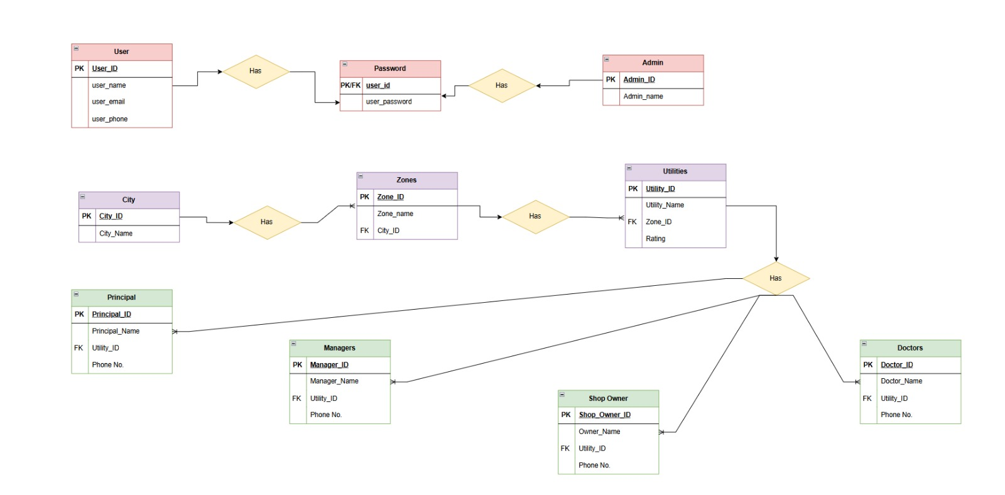

Slide 6
Explanation of Key Entities
1. User Table
Stores user details.
Attributes: User_ID (PK), Name, Email, Phone.
2. City Table
Represents different cities in the system.
Attributes: City_ID (PK), City_Name.
3. Zones Table
Defines various zones within a city.
Attributes: Zone_ID (PK), Zone_Name, City_ID (FK).
4. Utilities Table
Represents services available in different zones.
Attributes: Utility_ID (PK), Utility_Name, Zone_ID (FK), Rating.

Slide 7
Explanation of Personnel Tables
1. Principal Table
Manages key institutions in a zone.
Attributes: Principal_ID (PK), Name, Utility_ID (FK), Phone.
2. Managers Table
Manages different utilities.
Attributes: Manager_ID (PK), Name, Utility_ID (FK), Phone.
3. Shop Owner Table
Represents business owners in the system.
Attributes: Shop_Owner_ID (PK), Name, Utility_ID (FK), Phone.
4. Doctors Table
Represents medical professionals in the system.
Attributes: Doctor_ID (PK), Name, Utility_ID (FK), Phone.

Slide 8
Entity Relationships Explained
A City has multiple Zones.
Each Zone contains multiple Utilities.
Each Utility is managed by a Principal, Manager, Shop Owner, or Doctor.
Users access the system to find utility-related information.

Slide 9
Example Scenario
Use Case: Finding a Nearby Hospital
Step-by-Step Process:
A user logs into the system and selects their city.
The system lists all zones within the selected city.
The user selects a zone and filters utilities to show only hospitals.
The system displays details of hospitals, including the doctor’s contact details.
The user contacts the hospital for assistance.
Example:
City: New York
Zone: Manhattan
Utility: Hospitals
Hospital Name: XYZ Medical Center
Doctor 1: Dr. Mia K, +1 234 567 890, Specialist in Cardiology
Doctor 2: Dr. Jonny S, +1 987 654 321, Specialist in Gynecologist
Rating: 4.8/5
The user can quickly find hospitals in Manhattan, select a specific hospital,
check doctor availability, and get contact details instantly.

Slide 10
Benefits of the System
Quick access to city services and utilities.
Efficient management of urban information.
Enhances user experience and decision-making.
Scalable for different city-wide applications.

