Slide 1
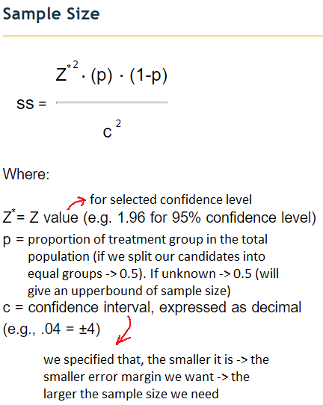
For estimating the required
# participants (sampled from
population) in experiment
to detect a possession of a
particular property (e.g. own
a car, speak second language)
“how much do we allow our
estimate to deviate from the
true population statistic?”
margin of error: ±5% -> 0.05

Slide 2
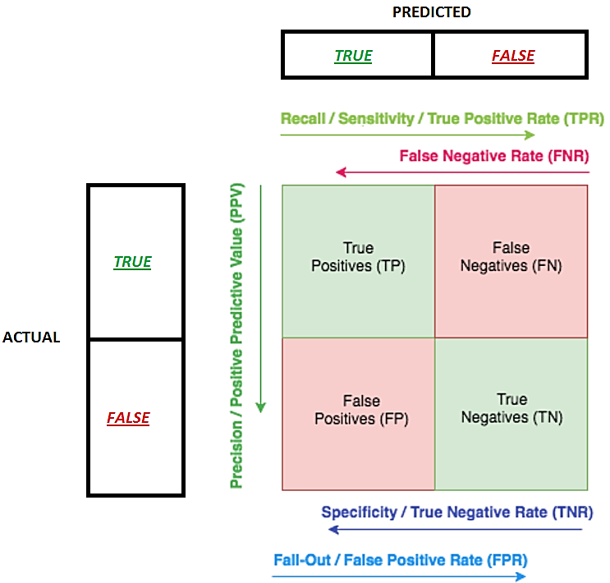
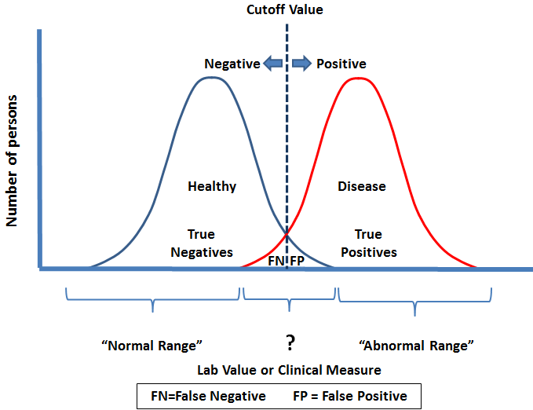
(1)
(0)
(1)
(0)
Group A
(H₀)
Group B
(H₁)

Slide 3
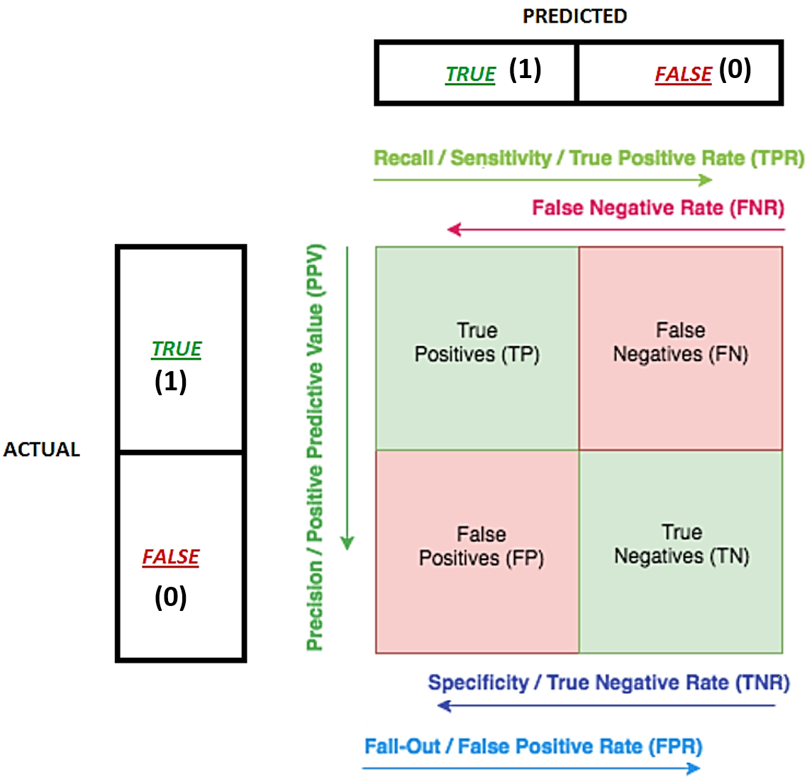
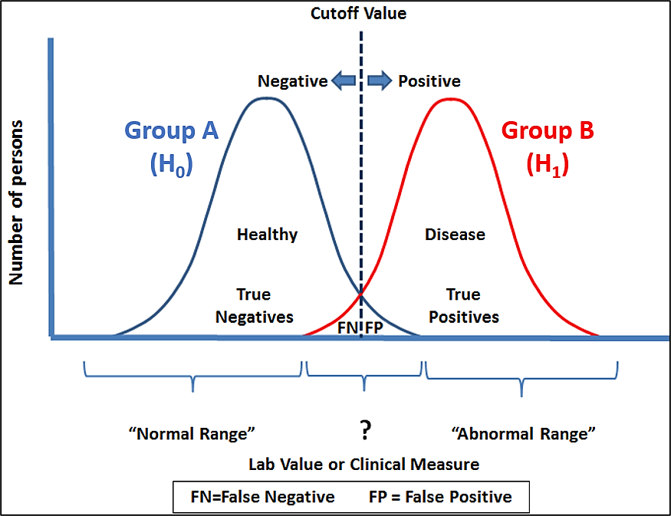
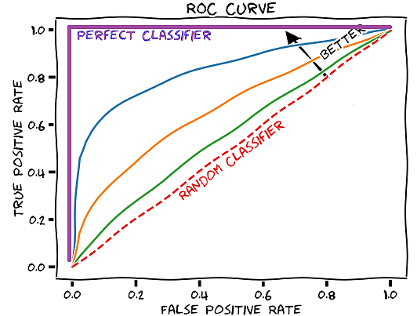




Start point of each ray -> the numerator of the metric.
The span of the ray -> summation in denominator
$$Recall=TPR=\frac{TP}{P}=\frac{TP}{TP+FN}$$
Type II Error
$$Fall_Out=FPR=\frac{FP}{N}=\frac{FP}{FP+TN}$$
Type I Error
$$Precision=\frac{TP}{P′}=\frac{TP}{TP+FP}$$
$$F−Score=(1+β^{2})\frac{precision∙recall}{β^{2}∙precision+recall}$$
Note, that ROC only considers TPR (which depends only on values from class 1)
and FPR (which depends only on values from class 0).
Thus, ROC AUC is not suitable for imbalanced datasets.
F-Score, on the other hand, is affected by class imbalance.

Slide 4
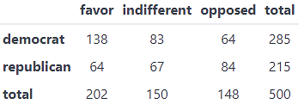
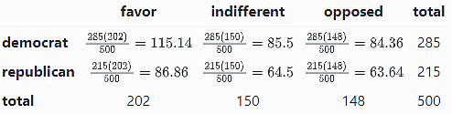

Chi-square goodness of fit test assesses whether the observed data fit a specified distribution.
Chi-square test of independence assesses the independence of two categorical variables
Example: Survey analyzed the regularity of sport exercises among students
and found out, that 60% of students do NOT exercise regularly,
25% exercise sporadically and 15% exercised regularly.
Next Year university launched a health promotion campaign. After that, the
survey was repeated and the following data was gathered. Based on the data,
is there evidence of a shift in the distribution of responses to the exercise question
following the implementation of the health promotion campaign on campus?
Example: Party Affiliation and Opinion on Tax Reform
Observed Table:
Observed Table:
No Regular Exercise | Sporadic Exercise | Regular Exercise | Total
255 | 125 | 90 | 470
H₀: In the population, the two categorical variables are independent.
H₁: In the population, the two categorical variables are dependent.
H₀: Distribution of responses has NOT changed
H₁: Distribution of responses has changed
Expected Table:
We need to calculate the table of expected counts for all of the cells. This table displays what the counts would be for our sample
data if there were no association between the variables.
Expected Table:
Based on the expected distribution, we can calculate the number of students we would have expected to see in each exercise category.
No Regular Exercise | Sporadic Exercise | Regular Exercise | Total
282=470*0.6 | 117.5=470*0.25 | 70.5=470*0.15 | 470
Degrees of Freedom: df = n-1 = 3-1 = 2
Degrees of Freedom: df = (nrows-1)* (ncols-1) = 1 * 2 = 2
Note: When testing for continuous distribution, data binning is required
If χ² > χ²_{crit}(df, α) -> reject H₀
Assumptions:
Expected frequencies for each cell are at least 1.
Expected frequencies should be at least 5 for the majority (80%) of the cells.

