Slide 1
SELECT … FROM table_name1 …
Specifying output columns
Filtering output rows

Slide 2
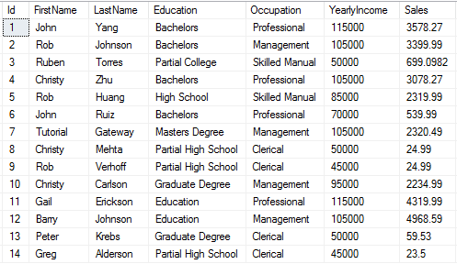
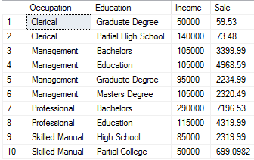
CTE (Common Table Expressions)
CTE allows you to grab a subset of data and store that data with a name, which you can then select from and perform more operations on.
A CTE allows you to define a temporary named result set that available temporarily in the execution scope of a statement such as SELECT, INSERT, UPDATE, DELETE, or MERGE.
Syntax
WITH expression_name[(column_name [,...])]
AS
(CTE_definition)
SQL_statement;
First, specify the expression name (expression_name) to which you can refer later in a query.
Next, specify a list of comma-separated columns after the expression_name. The number of columns must be the same as the number of columns defined in the CTE_definition.
Then, use the AS keyword after the expression name or column list if the column list is specified.
After, define a SELECT statement whose result set populates the common table expression.
Finally, refer to the common table expression in a query (SQL_statement) such as SELECT, INSERT, UPDATE, DELETE, or MERGE
Let’s say you’ve been asked to calculate the average time between transactions by a particular user. You have a table called transactions that contains a username and the time of the transaction. When you get a difficult question like the one above, take a minute and ask yourself what the ideal table would have to look like to allow you to answer your question with one SELECT statement.
In the above example, the ideal table was one that included one record for each transaction, and a column that gave the time of the next transaction.
Example
WITH Total_Sale_CTE AS (
SELECT Occupation,
Education,
SUM(YearlyIncome) AS Income,
SUM(Sales) AS Sale
FROM employee_table
GROUP BY Education, Occupation)
SELECT * FROM Total_Sale_CTE

Slide 3
Filter, Aggregate, Join
Generally, you want to follow these steps with your string of CTEs: filter, aggregate, join. Filter using WHERE, aggregate using GROUP BY, and join using JOIN.
By filtering and aggregating your data before joining, you write the most efficient SQL. Joins are expensive to process so you want the fewest possible rows before joining two tables together. Sometimes aggregating first won’t be possible, but usually you’ll be able to limit the size of the tables you’re joining with at least a WHERE clause or two.
It’s important to note that if you have a JOIN and a WHERE clause in the same CTE, SQL processes the JOIN first. In other words, the following (to the left) is very inefficient, because the entirety of your tables would be joined together and only then filtered to data after 8/1/2017:
--efficient
WITH a AS ( SELECT * FROM table_a WHERE day >= '2017-08-01’) b AS (
SELECT *
FROM table_b
WHERE day >= '2017-08-01’) SELECT * FROM a INNER JOIN b ON a.username=b.username;
--inefficient
SELECT * FROM table_a a INNER JOIN table_b b ON a.username = b.username WHERE a.day >= '2017-08-01'

Slide 4
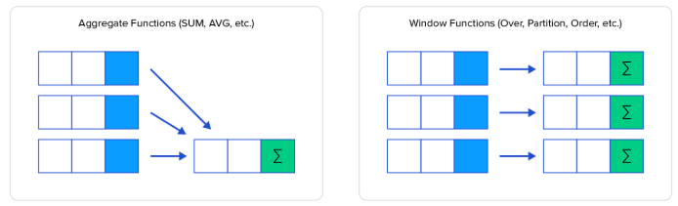
Window Functions
Like a GROUP BY clause, window functions separate your table into several chunks and operates on each chunk individually. But unlike GROUP BY, the rows are not combined. Window functions operate on a set of rows and return a single value for each row from the underlying query.
AGG_FUNC() should be some aggregation function like SUM, COUNT, AVG, RANK , LAG, FIRST_VALUE, etc. (Note, some functions might have additional parameters)
scalar_expression is an expression evaluated against the value of the first row of the ordered partition of a result set. The scalar_expression can be a column, subquery, or expression that evaluates to a single value. It cannot be a window function. For some AGG_FUNC() it is not required.
OVER() specifies the window for which the aggregation is performed. If no argument is provided, the aggregation is calculated on all the rows.
The PARTITION BY clause distributes rows of the result set into partitions to which the AGG_FUNC() function is applied. If you skip the PARTITION BY clause, the AGG_FUNC() function will treat the whole result set as a single partition.
Some of the functions require ORDER BY, and it’s not supported by the others. When the order of the rows is important when applying the calculation, the ORDER BY is required.
Syntax
AGG_FUNC ( scalar_expression )
OVER (
[PARTITION BY partition_expression, ... ]
ORDER BY sort_expression [ASC | DESC], ...
)
RANK, LAG, FIRST_VALUE, etc.
SUM, COUNT, AVG, etc.

Slide 5
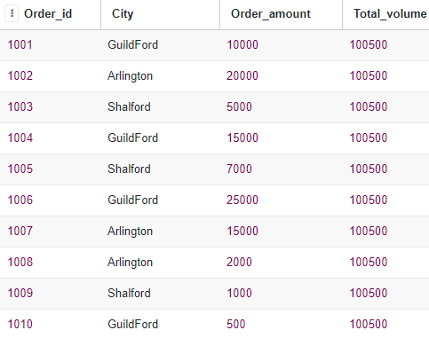
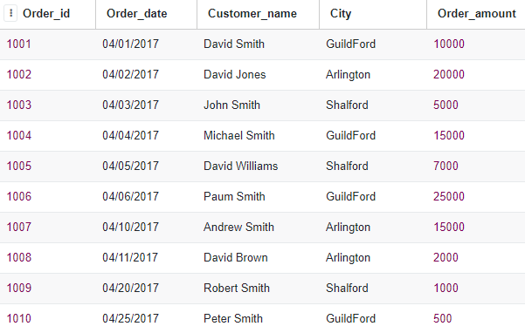
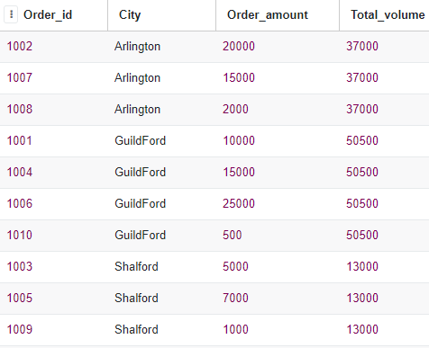
Window Functions, Examples
SELECT order_id,
city,
order_amount,
SUM(order_amount) OVER()
AS total_volume
FROM some_table
some_table
SELECT order_id,
city,
order_amount,
SUM(order_amount) OVER(
PARTITION BY city
) AS total_volume
FROM some_table

Slide 6
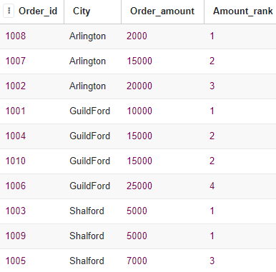
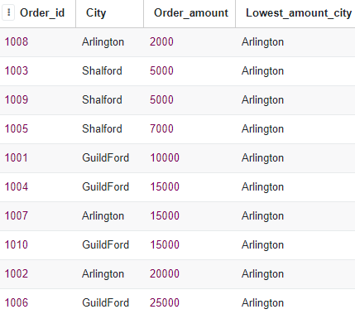
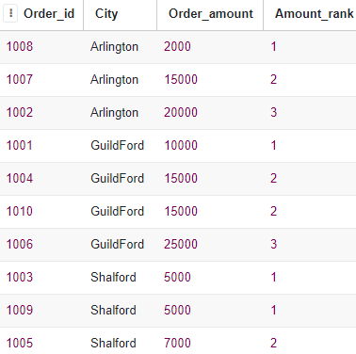
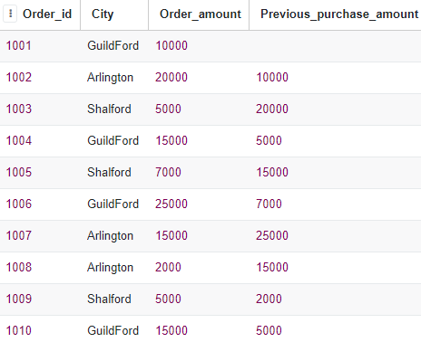
Window Functions, Examples, p.2
RANK()
FIRST_VALUE()
SELECT order_id,
city,
order_amount,
RANK() OVER(
PARTITION BY city
ORDER BY order_amount
) AS amount_rank
FROM some_table
SELECT order_id,
city,
order_amount,
FIRST_VALUE(city) OVER(
ORDER BY order_amount
) AS lowest_amount_city
FROM some_table
DENSE_RANK()
LAG()
SELECT order_id,
city,
order_amount,
DENSE_RANK() OVER(
PARTITION BY city
ORDER BY order_amount
) AS amount_rank
FROM some_table
SELECT order_id,
city,
order_amount,
LAG(order_amount, 1, NULL) OVER(
ORDER BY order_date
) AS previous_purchase_amount FROM some_table

Slide 7
Union
UNIONs are just the vertical version of JOINs: whereas JOINs combine tables or CTEs horizontally using a join key, a UNION just stacks the tables on top of each other to form one table containing all the rows from the two original tables. The requirement for this is that the two tables that are being UNION-ed have the same exact columns — otherwise there would be no way to logically combine them.
An example of when a UNION might be useful is when you have separate tables for two types of transactions, but want a single query to tell you how many of each type of transaction you have.
WITH sales AS ( SELECT 'sale’ AS type
FROM sale_transactions
WHERE day >= '2017-09-01’),
buys AS (
SELECT 'buy’ AS type
FROM buy_transactions
WHERE day >= '2017-09-01’),
unioned AS (
SELECT type
FROM buys
UNION ALL
SELECT type
FROM sales)
SELECT type, count(1) AS num_transactions
FROM unioned
GROUP BY type;
Syntax
query_1
UNION
query_2
The number and the order of the columns must be the same in both queries.
The data types of the corresponding columns must be the same or compatible.
UNION allows you to combine results of two SELECT statements into a single result set which includes all the rows that belongs to the SELECT statements in the union.

Slide 8
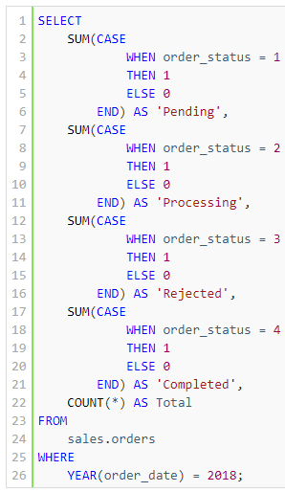
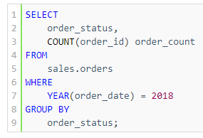

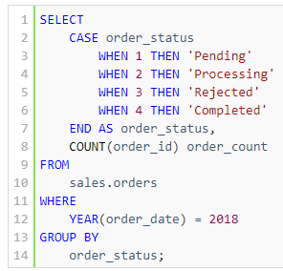


CASE
CASE statements are exactly the same as the ifelse() functions in environments like R and Excel. They’re useful for mapping from one set of predefined values to another.
Syntax
CASE input WHEN e1 THEN r1 WHEN e2 THEN r2 ... WHEN en THEN rn [ ELSE re ] END
The simple CASE expression compares the input expression (input) to an expression (ei) in each WHEN clause for equality. If the input expression equals an expression (ei) in the WHEN clause, the result (ri) in the corresponding THEN clause is returned. If the input expression does not equal to any expression and the ELSE clause is available, the CASE expression will return the result in the ELSE clause (re). In case the ELSE clause is omitted and the input expression does not equal to any expression in the WHEN clause, the CASE expression will return NULL.

Slide 9
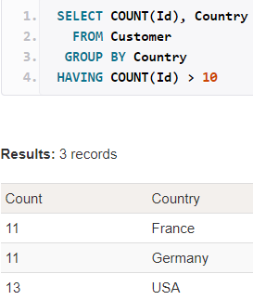
HAVING
HAVING filters records that work on summarized GROUP BY results.
HAVING applies to summarized group records, whereas WHERE applies to individual records.
Only the groups that meet the HAVING criteria will be returned.
HAVING requires that a GROUP BY clause is present.
WHERE and HAVING can be in the same query.
Problem: List the number of customers in each country. Only include countries with more than 10 customers.

Slide 10
CROSS JOIN vs INNER JOIN … ON … != …
SELECT t1.col AS col_1, t2.col AS col_2 FROM tabl t1 CROSS JOIN tabl t2
col_1 | col_2
A | A
A | B
A | C
B | A
B | B
B | C
C | A
C | B
C | C
SELECT t1.col AS col_1, t2.col AS col_2 FROM tabl t1 INNER JOIN tabl t2 ON t1.col != t2.col
col_1 | col_2
A | B
A | C
B | A
B | C
C | A
C | B
tabl
col
A
B
C

Slide 11
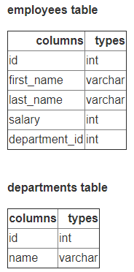
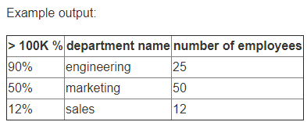
EXAMPLES
Given the tables above, select the top 3 departments by the highest percentage of employees making over 100K in salary and have at least 10 employees.
SELECT d.name, CAST(SUM(CASE WHEN salary > 100000 THEN 1 ELSE 0 END) AS DECIMAL) / COUNT(*) AS percent_employees_over_100K FROM departments AS d LEFT JOIN employees AS e ON d.id = e.department_id GROUP BY 1 HAVING COUNT(*) >= 10 ORDER BY 2 DESC LIMIT 3

Slide 12
EXAMPLES
Let’s say due to an ETL error, the employee table instead of updating the salaries every year when doing compensation adjustments, did an insert instead. The head of HR still needs the current salary of each employee. Write a query to get the current salary for each employee.
Assume no duplicate combination of first and last names. (I.E. No two John Smiths)
SELECT e.first_name, e.last_name, e.salary FROM employees AS e INNER JOIN ( SELECT first_name, last_name, MAX(id) AS max_id FROM employees GROUP BY 1,2 ) AS m ON e.id = m.max_id
The first step would be to remove duplicates. Given we know there aren't any duplicate first and last name combinations, we can remove duplicates from the employees table by just grouping by first and last name and getting the maximum id from the table which would be the last entry and the most up to date salary.

Slide 13
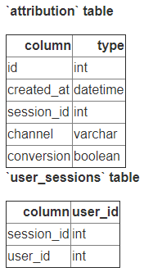
EXAMPLES
WITH conv_users AS ( SELECT b.user_id, a.channel, RANK() OVER ( PARTITION BY b.user_id ORDER BY created_at ) AS rank FROM attribution a INNER JOIN user_session b ON a.session_id = b.session_id WHERE a.conversion = true )
SELECT user_id, channel FROM conv_users WHERE rank = 1
The attribution table logs each user visit where a user comes onto their site to go shopping. If conversion = 1, then on that session visit the user converted and bought an item. The channel column represents which advertising platform the user got to the shopping site on that session. The `user_sessions` table maps each session visit back to the user.
First touch attribution is defined as the channel to which the converted user was associated with when they first discovered the website. Calculate the first touch attribution for each user_id that converted.

Slide 14
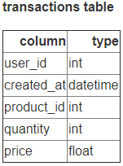
EXAMPLES
WITH unique_user_date_pairs AS ( SELECT user_id, DATE(created_at) FROM transactions GROUP BY 1,2 ) SELECT COUNT(*) FROM ( SELECT user_id FROM unique_user_date_pairs GROUP BY 1 HAVING COUNT(*) > 1 )
Given a transaction table of product purchases, write a query to get the number of customers that were upsold by purchasing additional products.
Note that if the customer purchased two things on the same day that does not count as an upsell. Each row in the transactions table also represents an individual user product purchase.
Opt. 1
SELECT COUNT(t.user_id) FROM (
SELECT user_id , RANK() OVER (
PARTITION BY user_id ORDER BY DATE(created_at::TIMESTAMP) ) AS rnk_purchases FROM transactions ) WHERE rnk_purchases > 1
SELECT COUNT(user_id) FROM (
SELECT user_id, COUNT(DISTINCT(DATE(created_at))) AS ct FROM transactions GROUP BY user_id
) WHERE ct > 1
Opt. 3
Opt. 2

Slide 15
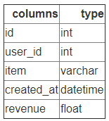
EXAMPLES
SELECT user_id, item FROM ( SELECT
user_id, item, ROW_NUMBER() OVER ( PARTITION BY user_id, ORDER BY created_at ASC ) AS row_num FROM transactions ) WHERE row_num = 3
Given the revenue transaction table above that contains a user_id, created_at timestamp, and transaction revenue, write a query that finds the third purchase of every user.

Slide 16
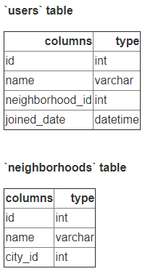
EXAMPLES
Given a users table with information about a user on which neighborhood they live in and a corresponding neighborhoods of all the neighborhoods in the U.S., write a query that returns all of the neighborhoods that have 0 users.
SELECT n.name FROM neighborhoods AS n LEFT JOIN users AS u ON n.id = u.neighborhood_id WHERE u.id IS NULL
Whenever the question asks about finding values with zero users, employees, posts, etc. immediately think LEFT JOIN

Slide 17
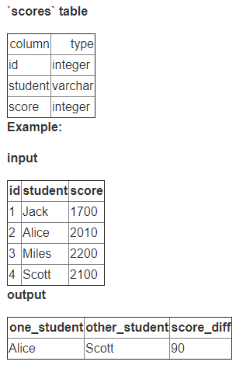
EXAMPLES
SELECT s1.student AS one_student, s2.student AS other_student, ABS(s1.score - s2.score) AS score_diff FROM scores AS s1 INNER JOIN scores AS s2 ON s1.id != s2.id ORDER BY 3 ASC LIMIT 1
Given a table of students and their SAT test scores, write a query to return the two students with the closest test scores with the score difference.
Assume a random pick if there are multiple students with the same score difference.

Slide 18
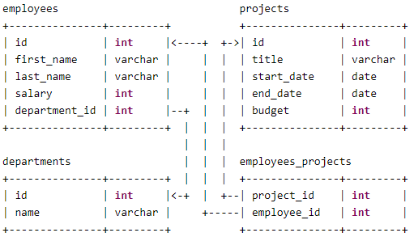
EXAMPLES
SELECT title, CASE WHEN CAST(project_days AS DECIMAL)/365 * total_salary > budget THEN 'overbudget’
ELSE 'within budget' END AS project_forecast FROM ( SELECT title, DATEDIFF(end_date, start_date) AS project_days, budget, SUM(COALESCE(salary,0)) AS total_salary, FROM projects AS p LEFT JOIN employees_projects AS ep ON p.id = ep.project_id LEFT JOIN employees AS e ON e.id = ep.employee_id GROUP BY 1,2,3 )
Over budget on a project is defined when the salaries, prorated to the day, exceed the budget of the project.
For example, if Alice and Bob both combined income make 200K and work on a project of a budget of 50K that takes half a year, then the project is over budget given 0.5 * 200K = 100K > 50K.
Write a query to select all projects that are over budget. Assume that employees only work on one project at a time.
Notice how we're left joining `projects` to both `employee_projects` and `employees`. This is due to the effect that if there exists no employees on a project, we still need to define it as overbudget and setting the salaries as 0.
We're also grouping by title, project_days, and budget, so that we can get the total sum. Given that each of title, project_days, and budget are distinct for each project, we can do the group by without a fear of duplication in our SUM.

Slide 19
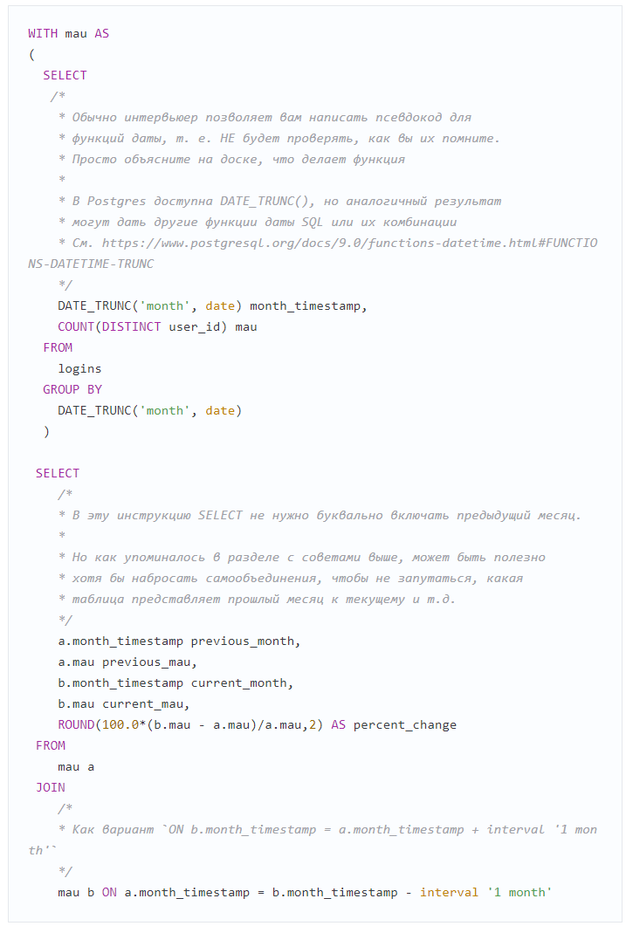
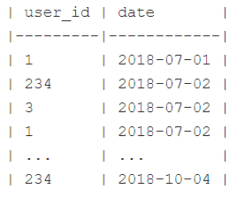
EXAMPLES
Контекст: часто полезно знать, как изменяется ключевая метрика, например, месячная аудитория активных пользователей, от месяца к месяцу. Допустим у нас есть таблица logins в таком виде:
Задача: найти ежемесячное процентное изменение месячной аудитории активных пользователей (MAU).

Slide 20
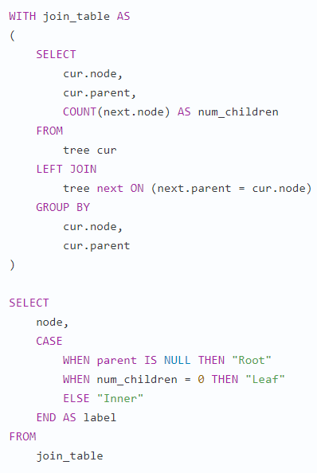
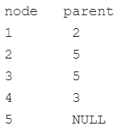
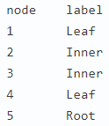
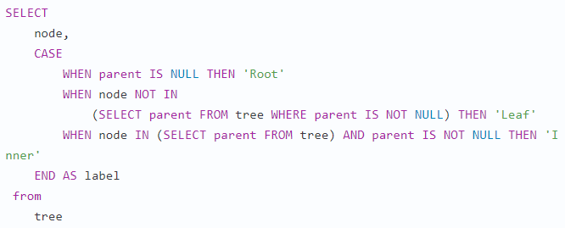
EXAMPLES
Решение 1
next.node
becomes
cur.child
Контекст: предположим, у вас есть таблица tree с двумя столбцами: в первом указаны узлы, а во втором — родительские узлы.
cur
next
Задача: написать SQL таким образом, чтобы мы обозначили каждый узел как внутренний (inner), корневой (root) или конечный узел/лист (leaf), так что для вышеперечисленных значений получится следующее:
Решение 2

