Slide 1
Digital Blockchain Will
Akaron Davis, Vishal Puppala, Bethel Kameni, Marvin Lee

Slide 2
Executive Summary
Goal: design and deploy a Smart Contract designed to tokenize a party’s assets when someone dies to then distribute in accordance with their final wishes laid out in a will and to avoid probate
The assets are distributed anonymously, such that beneficiaries can only view their own assets given the token identification given to each party
Two Smart Contracts were developed for this project to represent those assets and their attributes:
Real Estate: Name, Social Security Number (SSN), Date of Birth (DOB), Asset Name, Asset Value
Stock: Company, Ticker, Shares, Brokerage
For this demo, the Real Estate Smart Contract will be used

Slide 3
Presenter order
Vishal Puppala: <Smart Contracts and segue into UI>
Bethel Kameni: <Frontend>
Marvin Lee: Conclusion/Product areas for improvement

Slide 4
Smart Contract Purpose (Ron & Marvin)
Allowed for the tokenization of ‘real estate’ assets and ‘financial assets’ such as stocks/bonds
Key Points
Solidity 0.5.0
Import ERC721Full
Define a Data Structure for a piece of real estate
Define a Mapping to Associate a Token ID with a piece of real estate
Define an Event that records data
Define a Function that Registers the piece of real estate

Slide 5
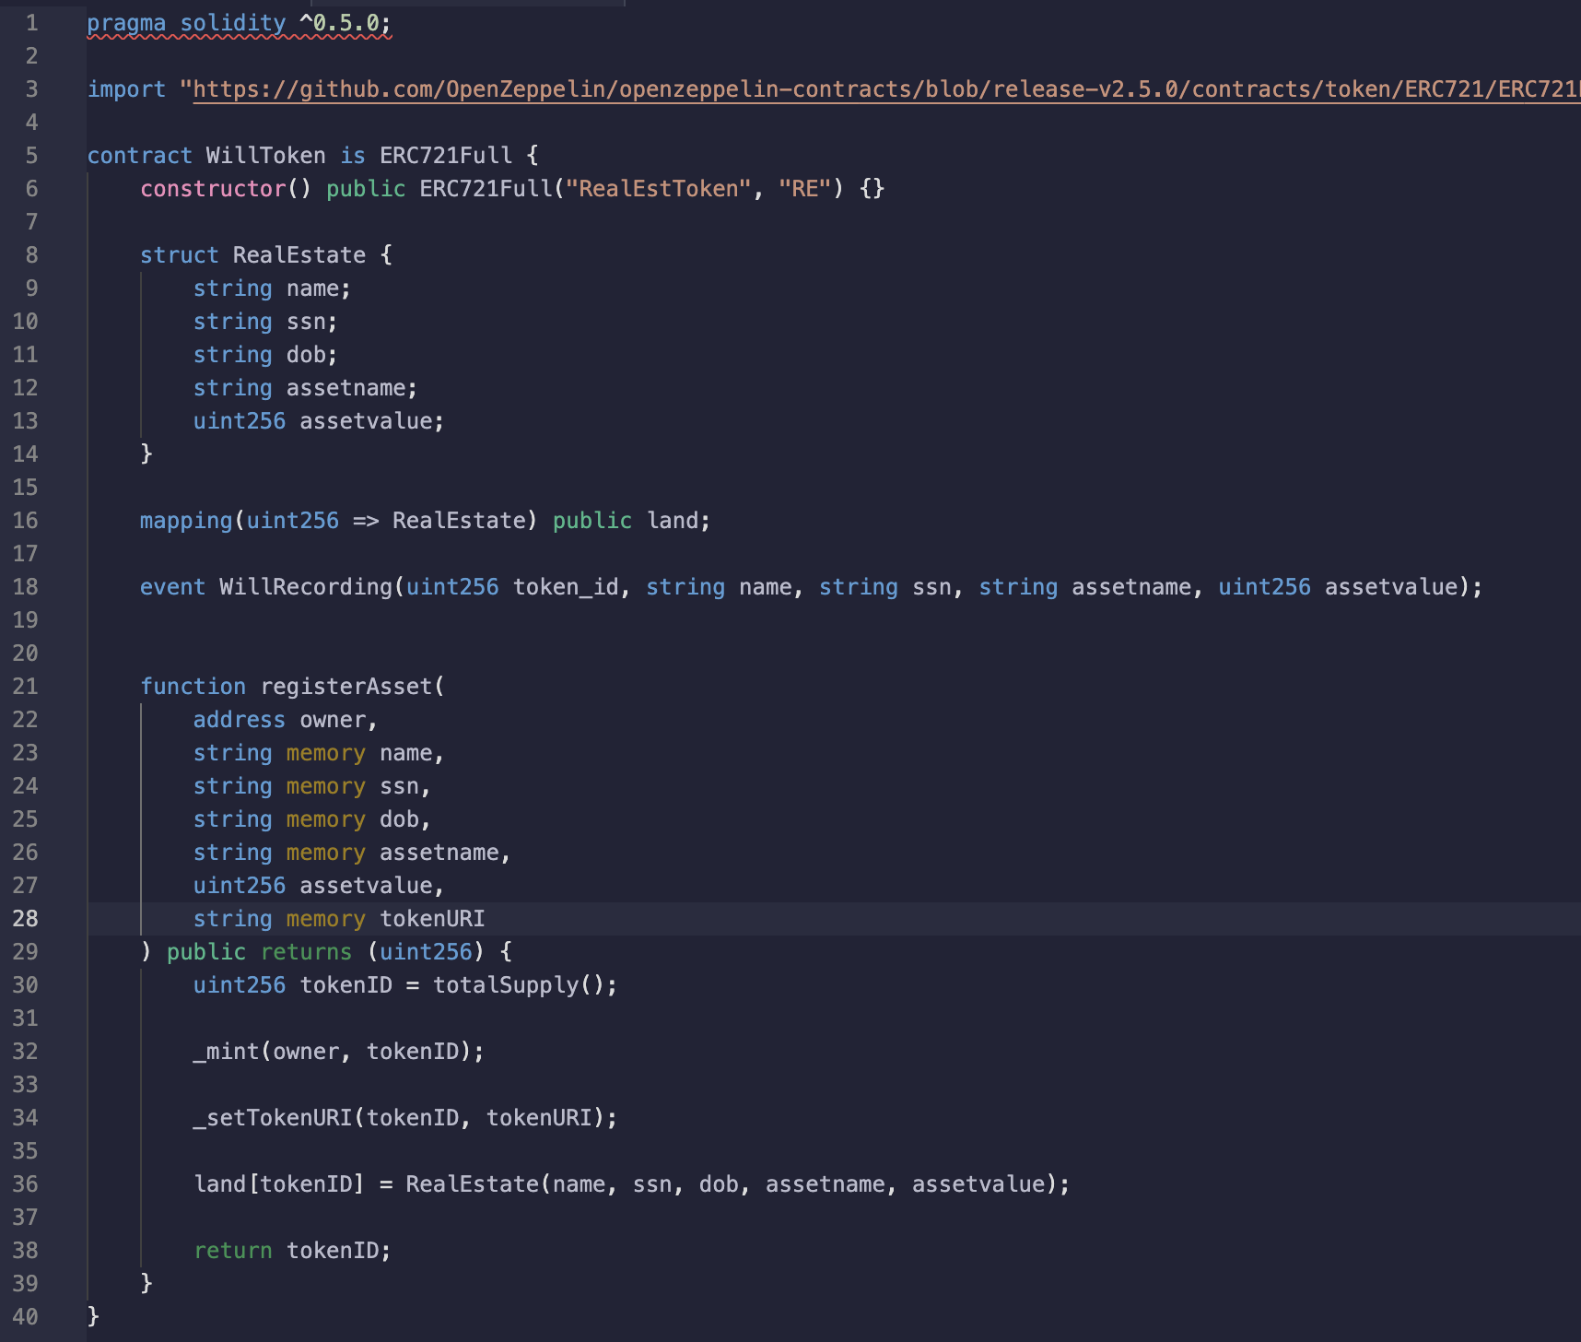
Real Estate Token

Slide 6
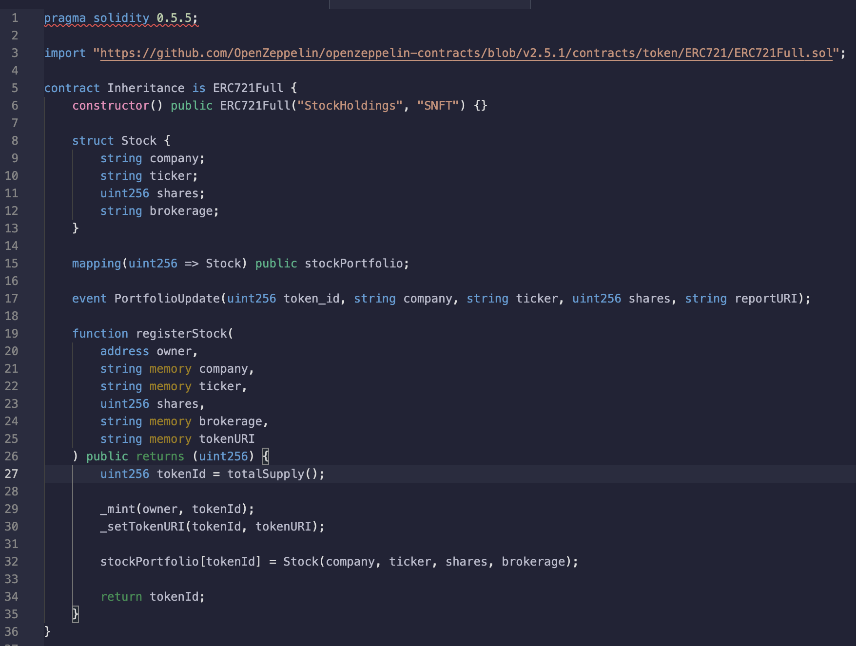
Stock Market Token (“SNFT”)

Slide 7
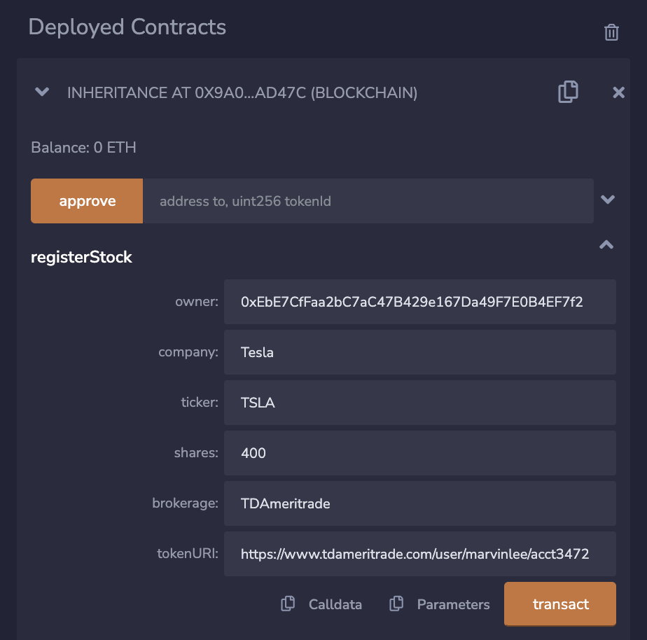
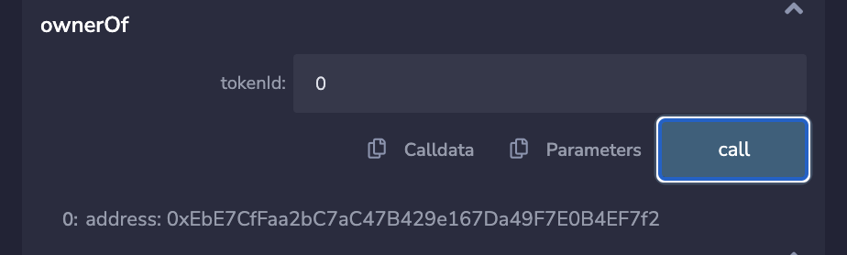
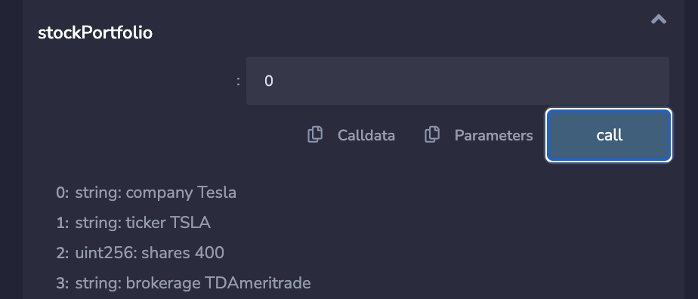
Screenshots of “SNFT”

Slide 8
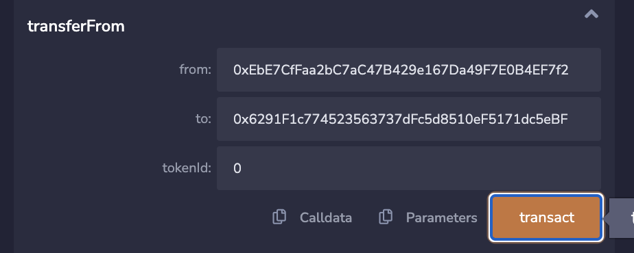
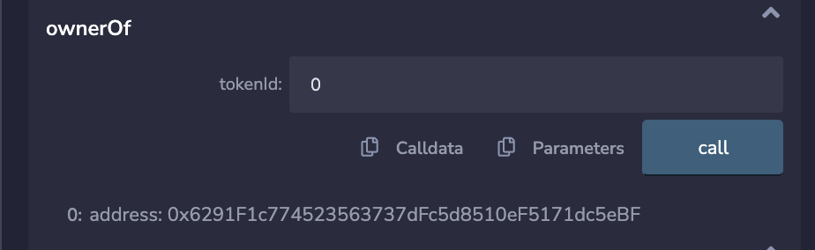

Slide 9
Frontend
Will Owner Frontend
User input that is needed to register one’s assets on the blockchain is collected and represents token attributes
Once information is entered, and SSN formatting is deemed correct, user can select any of the available Ganache accounts and complete the transaction
Unique Hash receipt is then printed, signifying proof of completion
Beneficiary Frontend
Input fields include login information emailed to beneficiaries at moment of smart contract execution in response to death

Slide 10
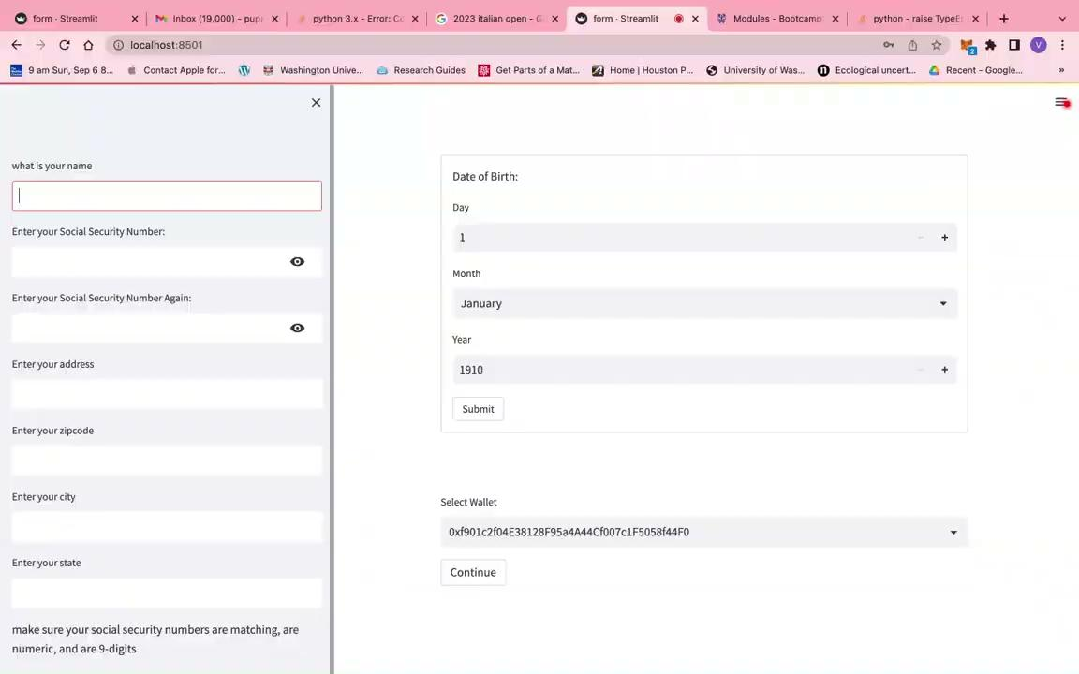

Slide 11
Potential Next Steps
Ensure this will is LEGALLY enforceable in every jurisdiction
Different states have different laws
Many states are behind on laws regarding cryptocurrency or blockchain technology (legal gray area)
In NY state, there needs to be 2 witnesses over the age of 18 at the ‘signing’ of the will
Exploring ways of creating a smart contract that allows witnesses to be added/removed
Preferable that witnesses be a ‘disinterested’ party
Example: Do NOT have your kids witness you ‘sign’ your will
Notary may be required
The testator of the will may also need to prove that they have of ‘sound mind’
Perhaps, they get a doctor to declare that they are mentally capable of creating/updating a will
Possible need for an ‘Executor’ or ’Administrator’
Smart contracts created that deal with the transfer of real estate and financial assets (stocks/bonds/crypto)
Need a way to facilitate transfer of other items such as (physical art, jewelry)
Example: An 82-year-old man in NY dies wearing a Rolex Yacht-master 126622 and he wants his son in Texas to inherit it.
Someone needs to be there to manage the transfer of other assets

Slide 12
Pricing
Development Team:
A team of backend developers (3-4) to improve and maintain the blockchain infrastructure by doing such tasks as maintaining nodes and gas transaction fees. Substantive Database integration would also be necessary as the company scales up, acquiring more customers.
1-2 front end developers to develop a more user-friendly and sleeker interface running on the world wide web
Server Access
AWS/Cloud Access for web visibility
Marketing and Outreach
Privacy and Security Enhancements
3rd party verification services to audit provided user information

Slide 13
Potential Next Steps … (Extra Time)
Looked into integrating various APIs from sites such as Zillow (real estate), and TDAmeritrade (stocks/bonds) to demonstrate how our ‘tokens’ can be directly connected to specific assets
Looked into integrating KYC-Chain or Civic Pass for identify verification
The testator, the witnesses, the beneficiaries would all get ID’ed
Potentially require them all to upload a picture holding their passport or something

