Slide 1
V
-
R
e
s
e
r
c
h
v
Research & Development for Cybersecurity Engineering
Francesco Beltramini, Marco Rocchetto
francesco@v-research.it marco@v-research.it
Dissemination level: Public
Confidentiality level: unencrypted
ECCN: NSR

Slide 2

Agenda
Business Development
Who we are
V-Research
Business Model
Cybersecurity Research
Purple Grand Challenge Description
Problem Statement – The current state of Cybersecurity
Our Objective – Cybersecurity Scientific Theory
Our Approach – ABF Theory
Next Steps

Slide 3

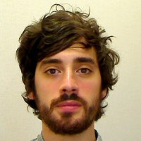
Who and History
Co-founder of V-Research
[Research & Development]
Co-founder of V-Research
[Business Development]
Head of SecOps Engineering - Inmarsat
Founded in 2020, Verona – IT
A private R&D center that bridges foundational challenges and engineering needs
Our mission is to develop a
  scientific theory of cybersecurity and
  a tool-chain for the secure engineering of cyber-physical systems
Combined 20+ years of experience in:
  formal methods for verification and testing
  system engineering for complex cyber (and cyber-physical) systems
  multi-year programs: both EU-funded (SPaCIoS, GOVSATCOM) and privately-funded (Global eXpress)
Notes:
We founded V-Research in February this year.
Our objective is to establish a private research center that bridges foundational challenges and engineering needs.
Our technical background is mainly on cybersecurity and ranges from formal methods for verification and testing to complex cyber-physical systems engineering
MR – technical role
Bachelor, Master and PhD in computer science – with B and M focusing on cybersecurity – and PhD
on the application of formal methods (logic-based approaches for the verification of security protocols).
Engineering state qualifying exam
Started as postdoc researcher University of Luxembourg, SUTD, Univr-ETHZ (with SIEMENS)
Researcher for the AVANTSSAR and SpaCIoS EU-funded projects (SAP, ETH, TUM, SIEMENS etc)
3 years as Senior Engineer in UTRC with leading role in several projects, two of them are:
– the Engineering of secure wireless elevator system (3 patents – Otis [elevator]) – up to tech transfer to Otis Engineers testing in Test tower
– Formal Risk Assessment (Otis [elevator], Rockwell Collins [aerospace])
Quit my position and opened V-Research
FB+

Slide 4
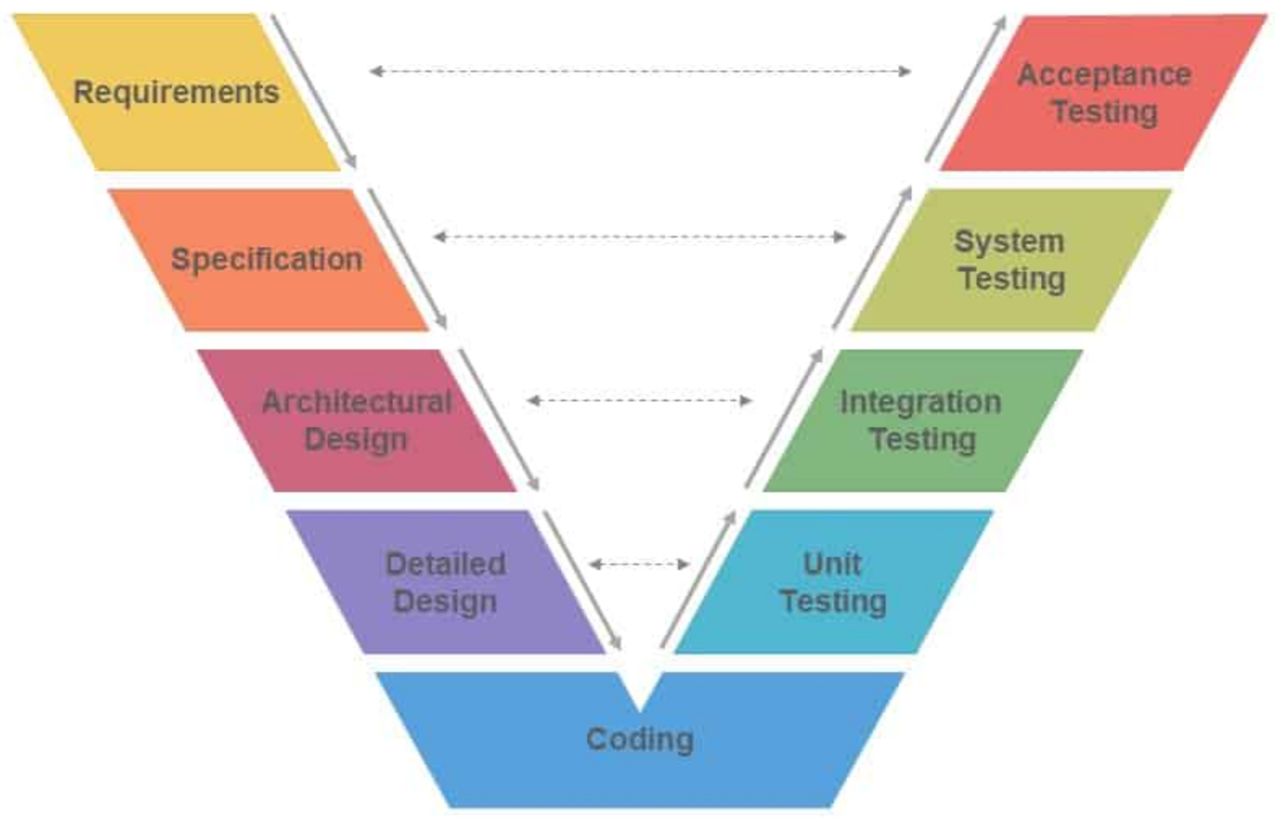
Current V-Research Offering
Systems Security Engineering
Requirements and Architecture properties
System Design and Formal Verification
Implementation and Testing
Complement customers internal resources
Standard & Regulation Analysis
TRL maturation plan
Commercial Expertise
Platform Evaluation and Selection
RFP / Tender consultancy
Partnership and Security Assurance
Conformance / Compliance Testing
Systems Security Research
Problem Statement Formulation
Analysis of state-of-the-art techniques
Gap Analysis
Solution Theoretical Formulation
Solution Prototype Implementation

Slide 5




Business Model
“Purple Challenge”
Engineering a 100% Secure Cyber-Physical System
grand
challenges
C
O
N
S
U
L
T
A
N
C
Y
P
R
O
D
U
C
T
S
Research
Openness & Collaboration
Open-source prototypes and products
Open-access research reports
No patents
System Engineering
Quality & Customer Focus
Private
Leverage research products
Leverage research ideas
challenges
tools
$
$
Private
funding

Slide 6
Agenda
Business Development
Who we are
V-Research
Business Model
Cybersecurity Research
Purple Grand Challenge
Problem Statement – The current state of Cybersecurity
Our Objective – Cybersecurity Scientific Theory
Our Approach – ABF Theory
Next Steps

Slide 7
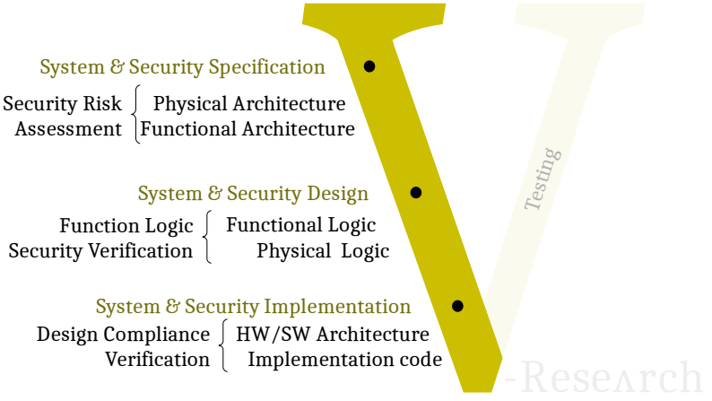
Purple Grand Challenge
Engineering a 100% Secure
Cyber-Physical System
System Specification
(functional & physical requirements)
Architecture Design
Security Risk Assessment
Security Requirement Extraction
Design Refinement & Security Requirement Extension
(functional architecture & communication logic)
Verification of Security Requirements
(data flow, behaviors, & protocol logic)
Software Prototype Implementation/Synthesis
Automated Security Testing
(abstract test-suite generation & concretization)
Hardware Prototype Implementation
Automated Security Testing
Penetration Testing
(potential falsification)

Slide 8







Problem Statement (Cybersecurity Pseudo-science)
517
The less attack a system have
The more secure it is
839
500+
Security is the absence of attacks in a system
136312
144329

Slide 9
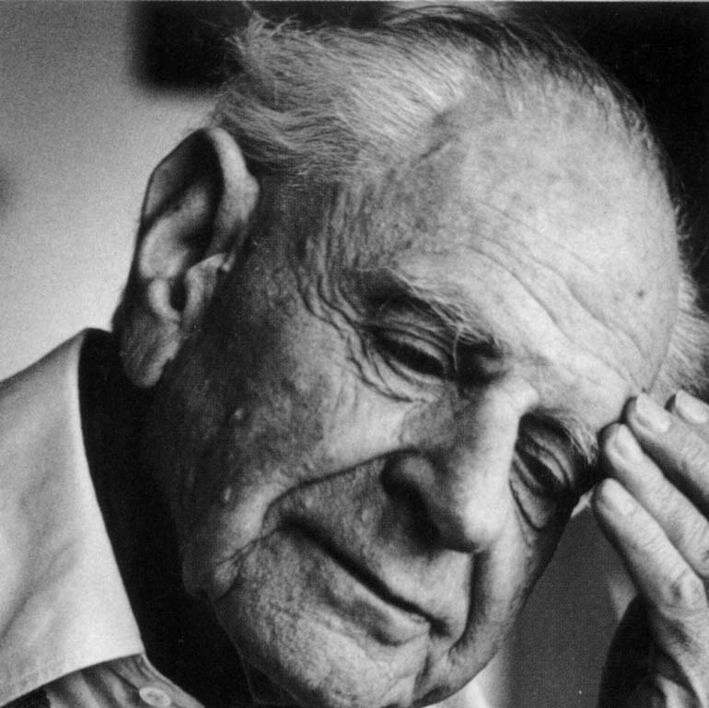
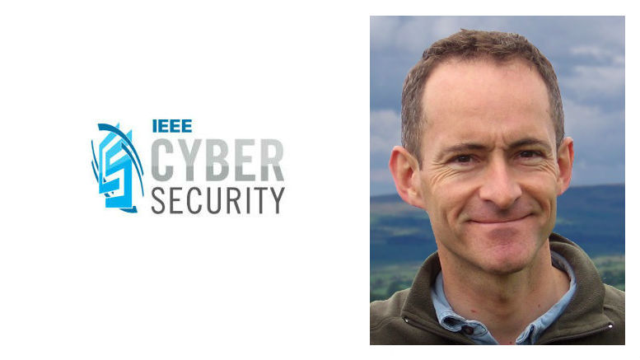
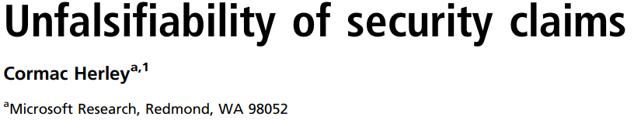
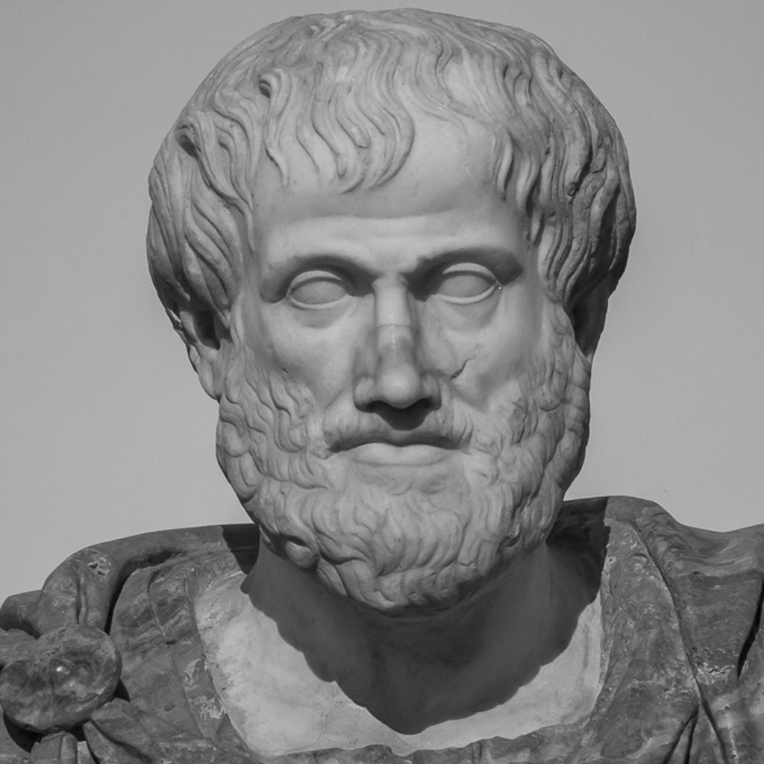
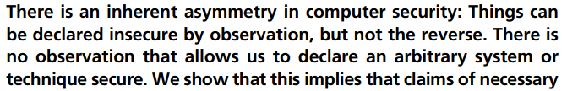
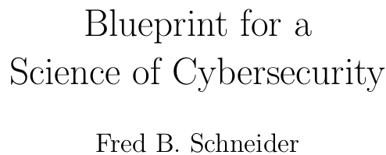
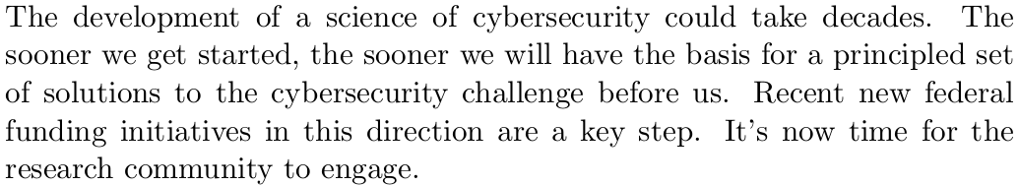
Problem Statement (Cybersecurity Pseudo-science)
517
X
The less attack a system have
The more secure it is
839
500+
Security is the absence of attacks in a system
136312
144329
Cybersecurity implies the absence of CWE/CVE
(not the opposite)
This is not a scientific approach!
False sense of security
Overspending

Slide 10
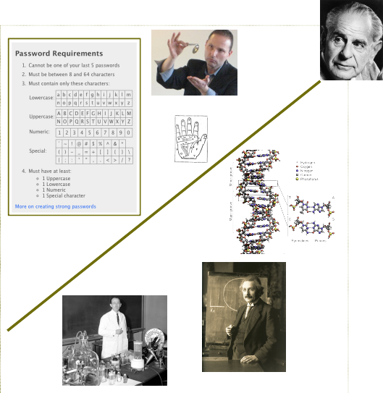
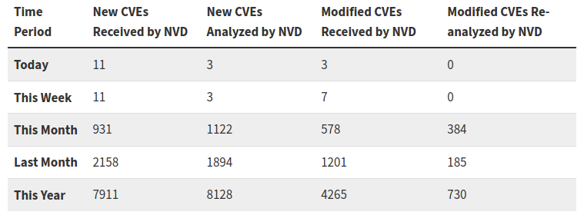
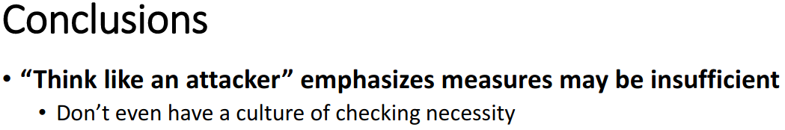
What is cybersecurity?
RESEARCH
A theory which is not refutable by any conceivable event is non-scientific. Irrefutability is not a virtue of a theory
(as people often think) but a vice.
K. Popper, Conjectures and Refutations
NVD - May 2020
Current Hypothesis
Scientific Theory
experiment
not( NVD_set ) => security
not( NVD_set )
Theory => prediction
not( prediction )
security
Theory falsified
Security Facts
If security is the absence of a set of attacks, we have 1000+ falsifications (by experiment) per month
Cybersecurity implies the absence of CWE/CVE (not the opposite)
X=>Y doesn’t mean not(X)=>not(Y)
Defend against attack X => safe from attack X
Do not defend against attack X !=> succumb to attack X
Notes:
Cybersecurity is not related to the maliciousness of the attacker
What if we assume that attacks just exist;
And due to the high number of attempts, attackers manage to find them and hack into a system
What if creativity was not so important? Would it change how we look at cybersecurity?

Slide 11
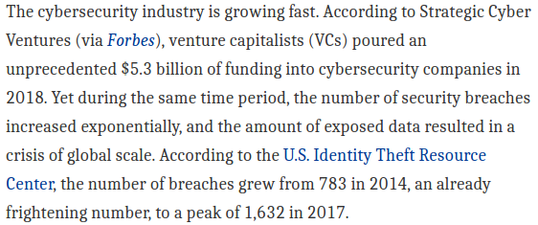

Current Status (Impact)
“We don’t have a test for security and
we don’t have a metric for security”
Necessary security conditions?
DO-326A – “Airworthiness Security Process Specification” requires a cybersecurity risk assessment of the design and is the “the only Acceptable Means of Compliance by FAA & EASA for aviation cybersecurity airworthiness certification, as of 2019” [SAE]
[ISO 62443] [IEC 61508] [SAE J3061] [NIST 800-82]
Jacob Nielsen (usability expert)
Usability suffers if users only get a row of bullets when they type their password.
Password Masking doesn’t even increase security but cost you business due to login failures
Bruce Schneier (security expert)
[June 26, 2009] “I agree with this”
Epic flame-war
[July 3, 2009] “So was I wrong? Maybe. Okay, probably”
systems engineering requires security standards
Overspending
standards mandates
risk assessments
risk assessments requires a metric for security

Slide 12
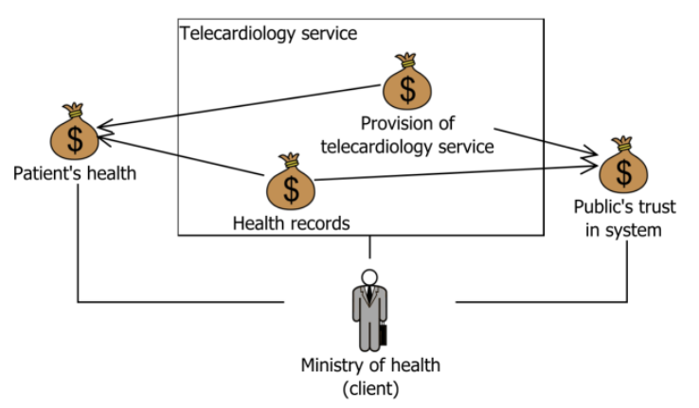
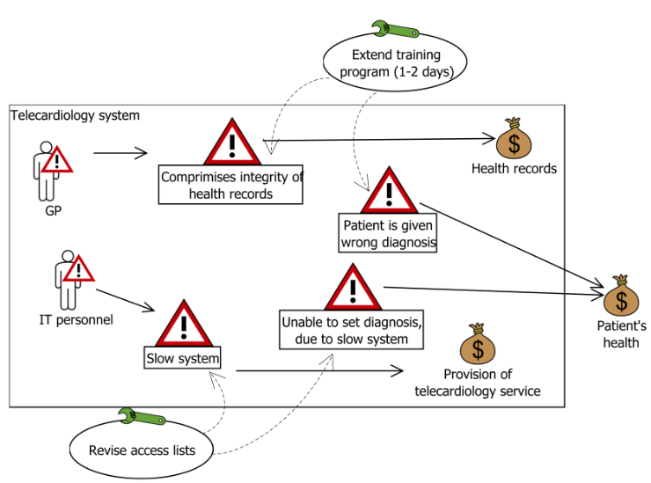
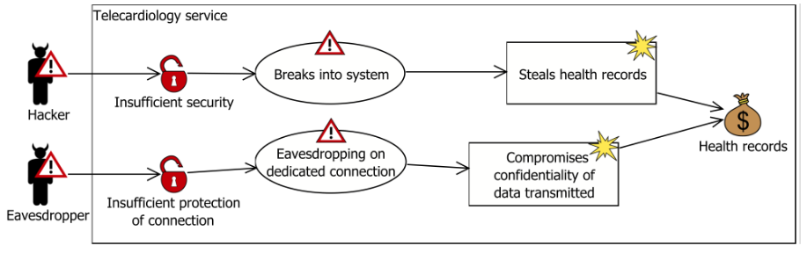
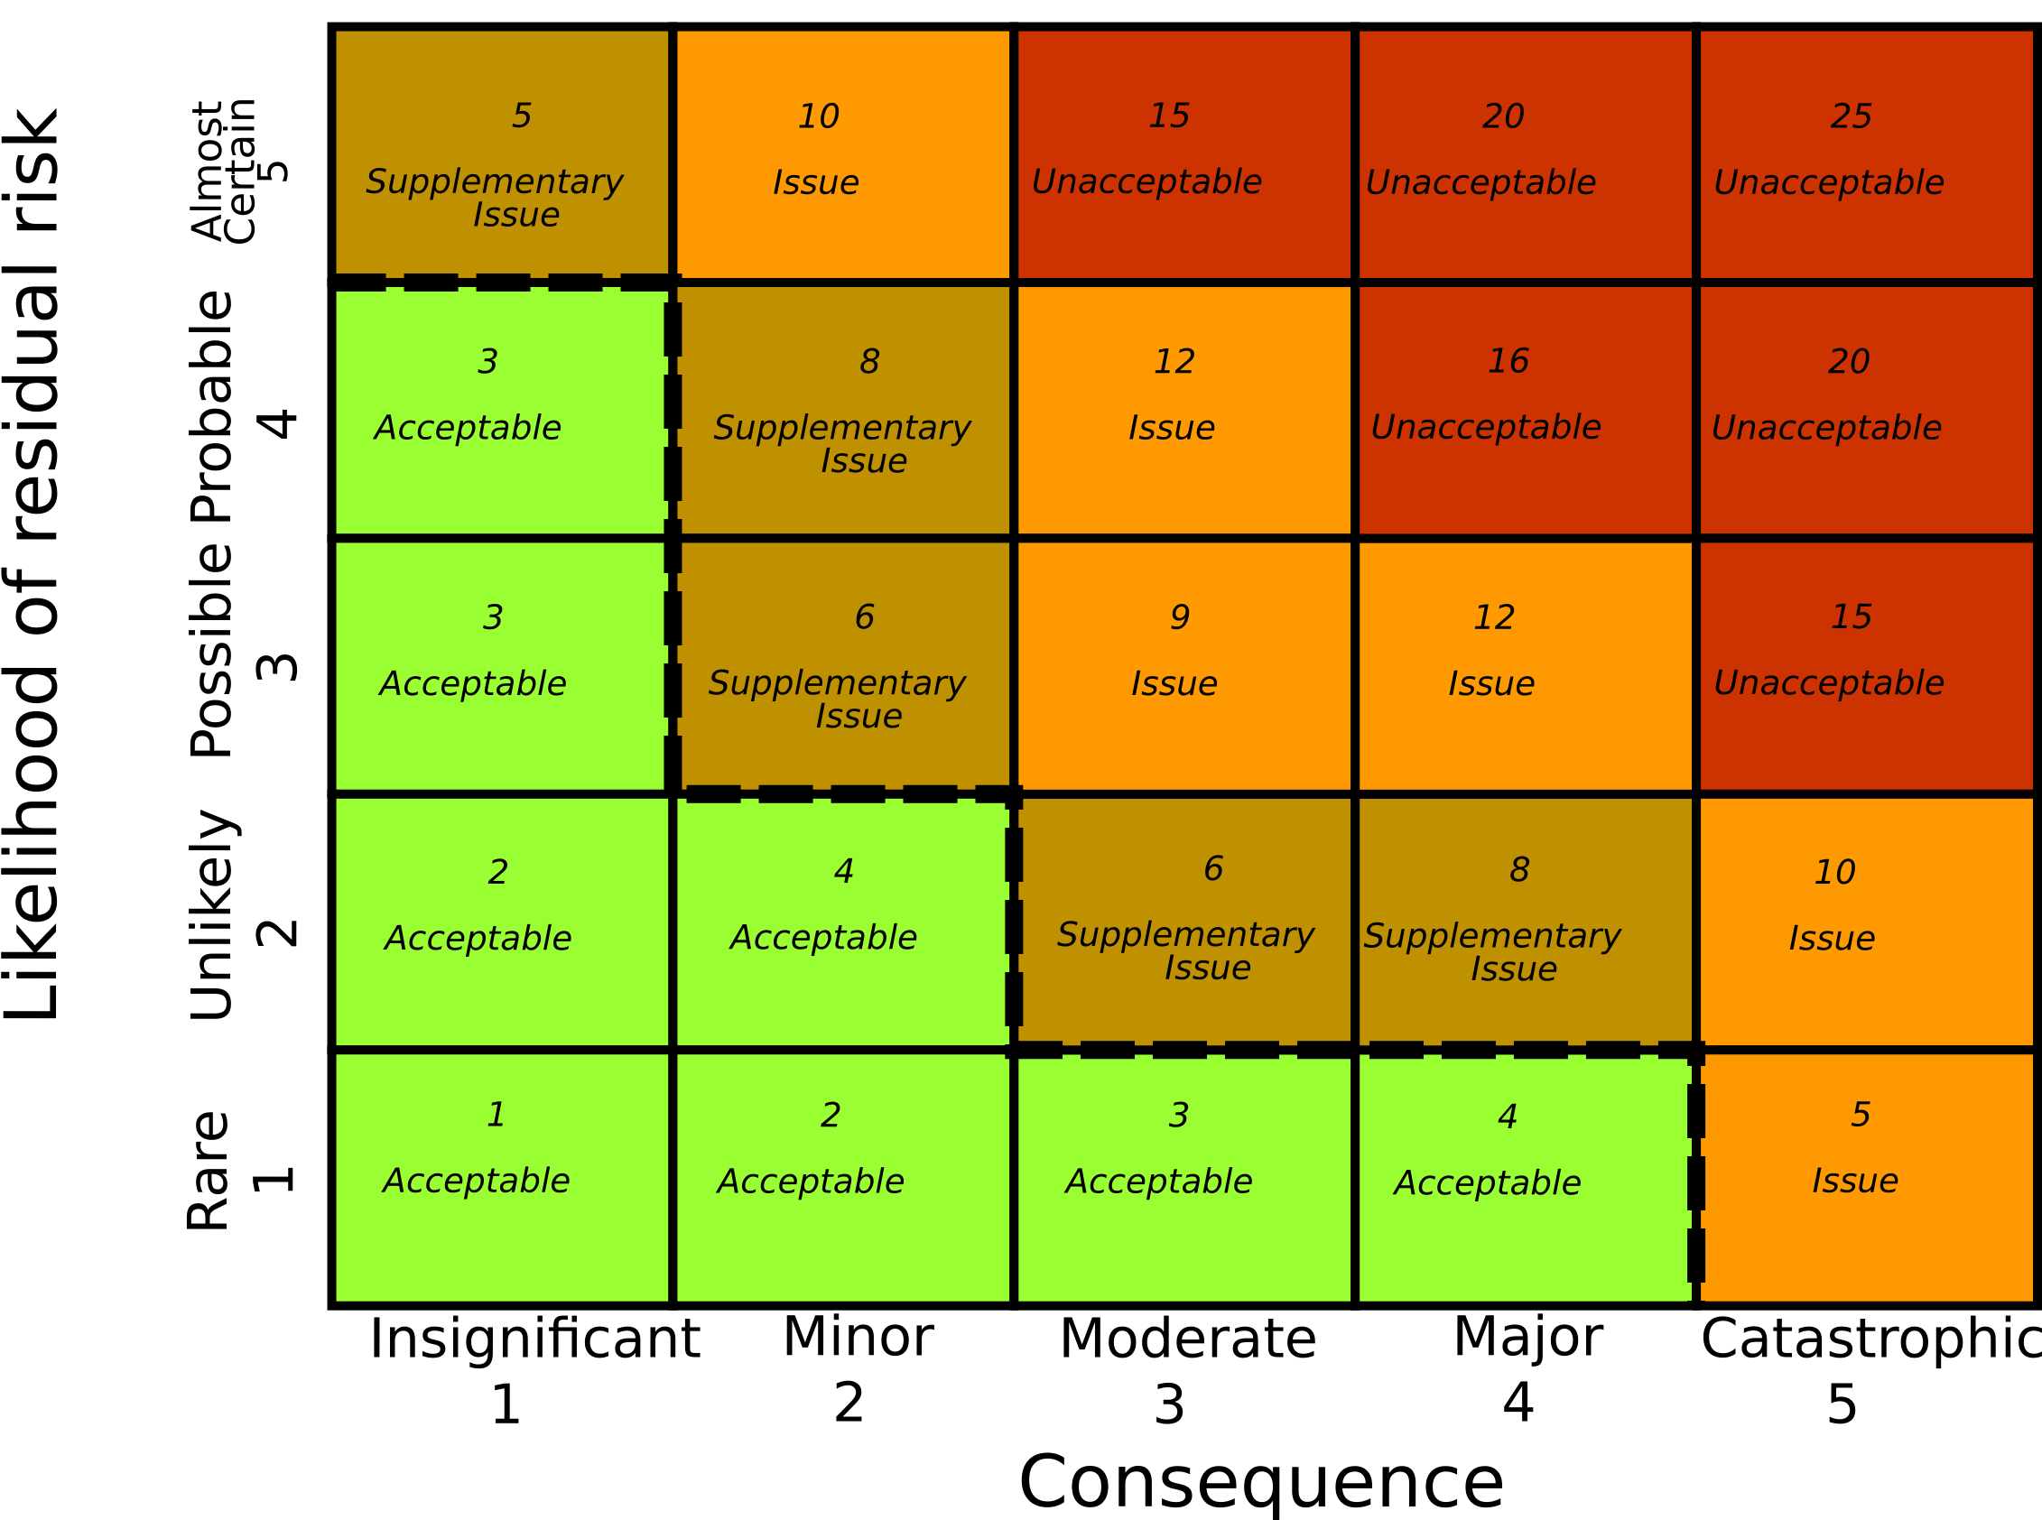
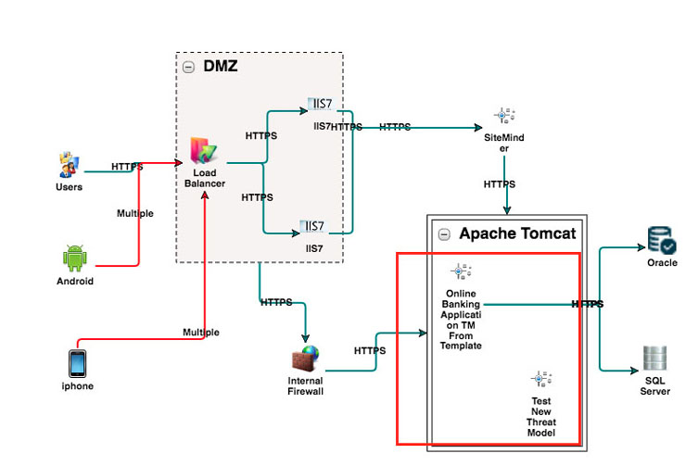
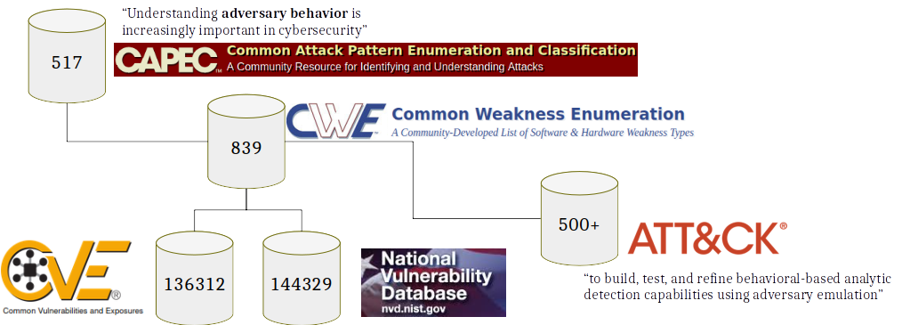
State of the Art (Security as a matter of expertise)
1. Asset Diagram
2. Threat Diagram
3. Risk Matrix
4. Treatments
CORAS
Methodology
ThreatModeler
The quality of the Risk Assessment
seems to be entirely based on
the expertise of the engineer
and NOT thanks to the tools
Tools do not predict but are based on always-incomplete repositories of weaknesses or vulnerabilities

Slide 13
V-Research Vision
With a Scientific theory on cybersecurity we would be able to predict insecurity
By falsifying prediction we would know that the theory is wrong
Errors [CWE???]
Fact: insecurity starts with a (human?) error
Hyp: a theory on system errors should predict insecurity
Challenge: how can we define a theory of errors?
Weak System [CWE]
Causality
Vulnerable System [CVE]
Once we predict errors in design
We predict weaknesses, vulnerabilities, and attacks
System under attack [CAPEC]
Hypothesis Summary
If security is the absence of attacks, we have some 1000+ falsifications (by experiment) per month
Cybersecurity implies the absence of CWE/CVE (not the opposite)
Cybersecurity attacks only if system error is present

Slide 14
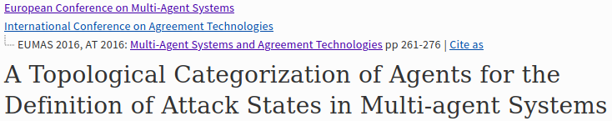

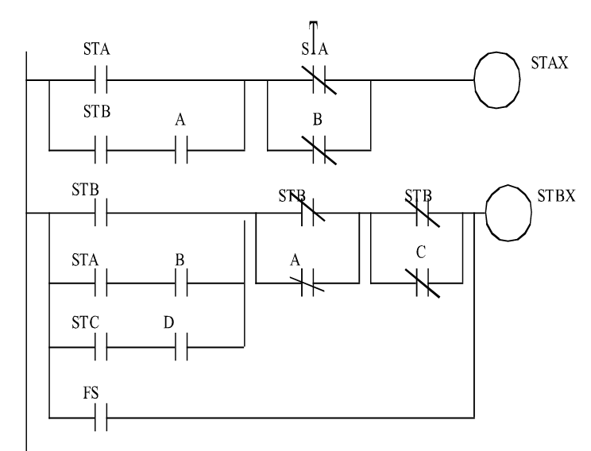
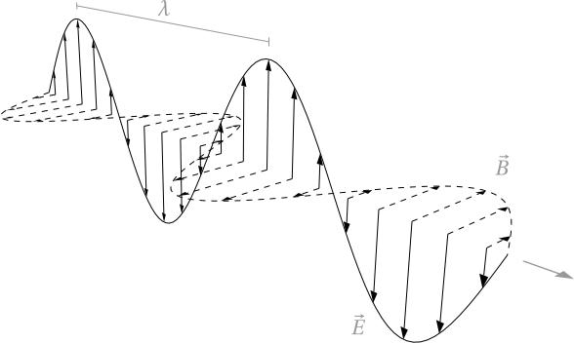
V-Research Cybersecurity Theory (ABF)
RESEARCH
We developed our theory from Jaakko Hintikka’s works,
mapping epistemological concepts to system engineering
1. Epistemology
3. MAS to CPS
4. Formal Reasoning
Reasoning
over Beliefs
Functional Architecture
 | RCC Calculus | R1 | R2
nominal | EQ | x | x
replace | DR | x | y
insert | PP | x | x·y
delete | PPi | x | x’ x
inject | PO | x | x’·y, x’ x
Port
Device
Information
translation
Information
transfer
Channel
Universe of Truths
(Knowledge)
Universe of Truths
(Requirements)
U
U
2. ABF MAS
Beliefs
Assertions
Fun. Arch.
Channels
Selective drop
Selective drop+insert
Facts
Requirements

Slide 15
A
A
A
Channel
Channel
F
B
A
B
Port
Fun. Arch.
Behavior &
Communication
Logic
Static analysis
&
Channel Noise
 | Quantity: Data Flow Channel(A,A); Port(B,A); Fun(B,B) | Quality: Requirements (Facts) Channel(A,F); Behavior(B,F)
EQ | Expected Nominal | Expected Nominal
DR | drops all the inputs and inserts new malicious data | the component never performs/carries the expected behavior/information
PP | selectively drops inputs | part of the expected outputs are not generated in response to the correct inputs
PPi | forwards all the inputs but crafts and inserts new malicious data | the components correctly performs/carries the expected behavior/information when the correct inputs are provided but is subject to input injections
PO | selectively drops inputs and inserts new data | Byzantine behavior - occasionally outputs the expected output given the correct inputs. Not all the inputs are handled properly, nor all the expected outputs are always generated when correct inputs are given
availability
integrity

Slide 16
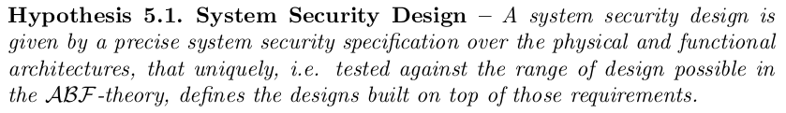
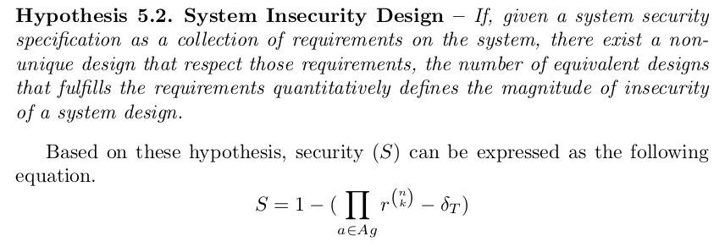
Cybersecurity Theory
Review
text
This allows us to precisely measure security risks

Slide 17

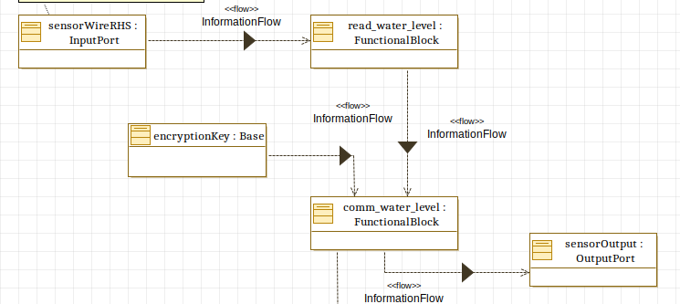
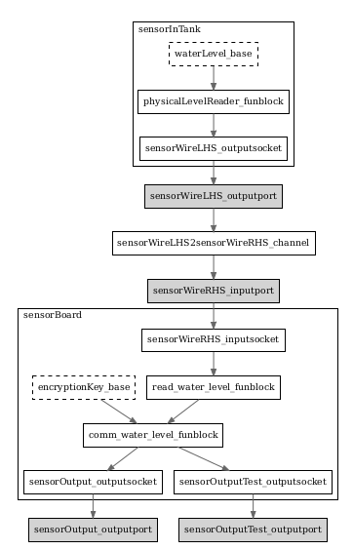
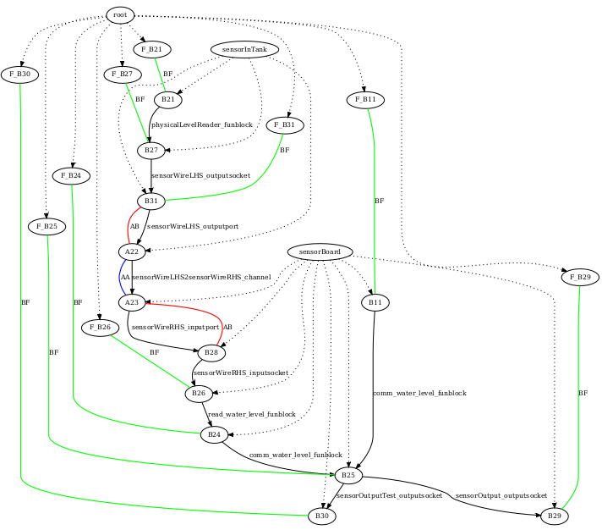

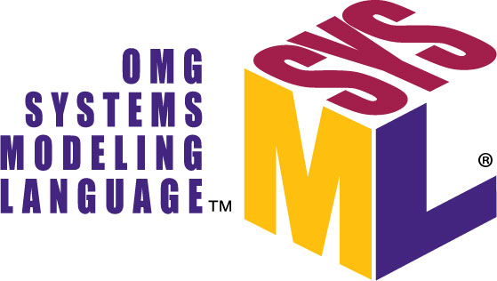
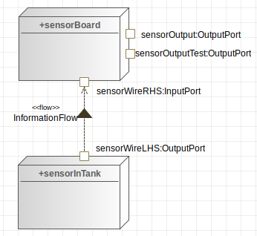





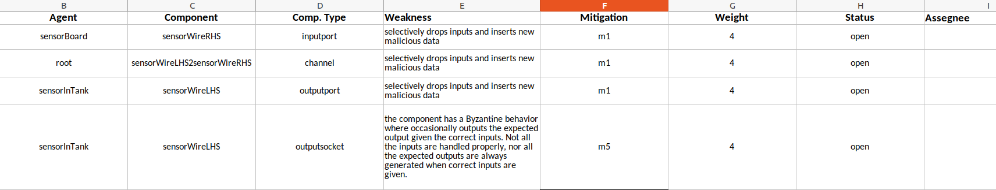
Automated Cybersecurity Risk Assessment
2. Automated Threat Scenario
Generation & Reasoning
1. System Engineering
Review
output
3. Automated Risk Estimation &
Mitigation Suggestions
4. on-the-fly Risk Reduction
Based on Mitigation

Slide 18
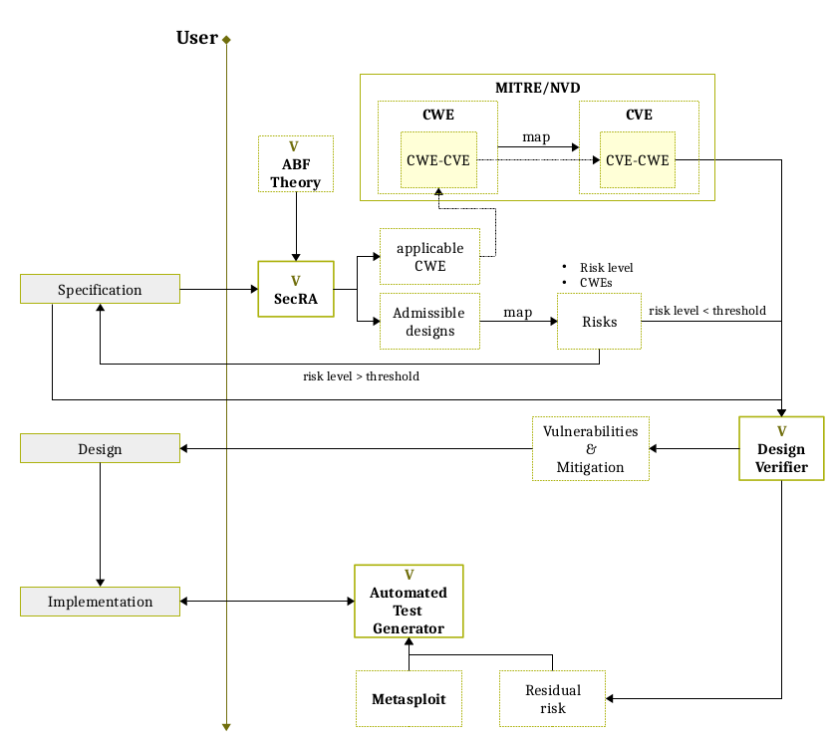
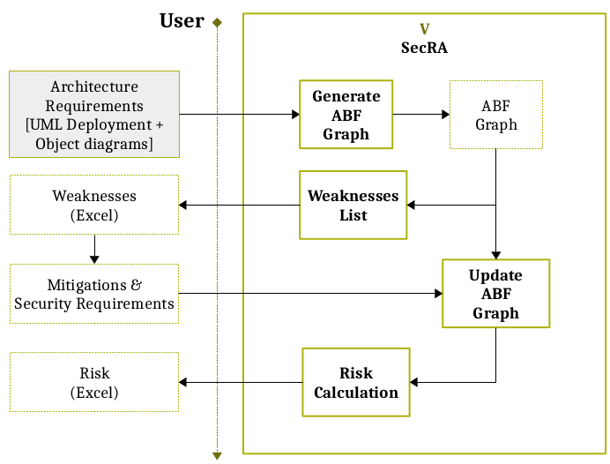
Conclusion
We defined a framework where the constituents of a system are
Generic enough to model any CPS (and MAS)
Allows the quantitative evaluation of Design Weaknesses
We defined a Cybersecurity Hypothesis that can be tested
predict all possible Weaknesses (Insecurity)
We proposed the Purple Grand Challenge to
Openly Collaborate
Define a process to test security theories
Having the first concept of a fully secure system
Roadmap
Propose a scientific security theory
Build a security risk assessment (tool-assisted) process
Build a protocol (logic) design verifier
Build a security test-case generator

Slide 19
BACKUP SLIDES

Slide 20
Cybersecurity – Current Beliefs
A system is secure if NO attack/exploit/vulnerability/weakness is present
Initial Theory
Today’s refinement
not( attack_1 ) => security
not( attack_1 )
not( NVD_set ) => security
not( NVD_set )
deduction
deduction
security
security
NVD - May 2020
X=>Y doesn’t mean not(X)=>not(Y)
Defend against attack X => safe from attack X
Do not defend against attack X !=> succumb to attack X
We should notice we are spending ineffectively on cybersecurity

Slide 21
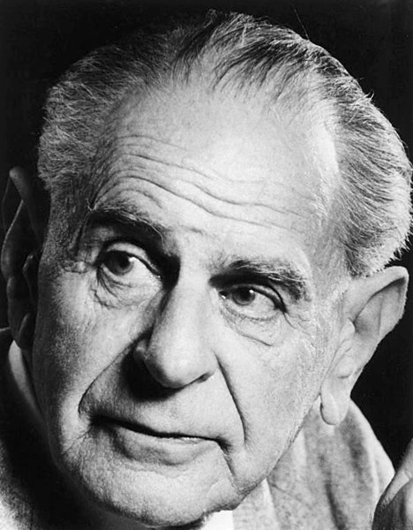
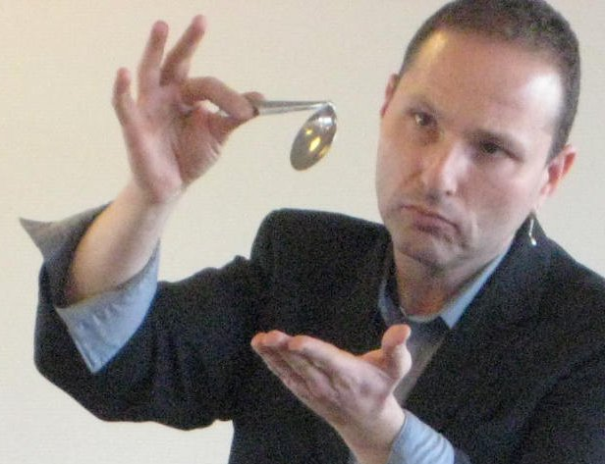
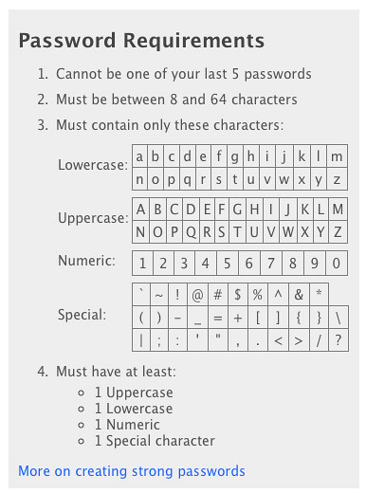
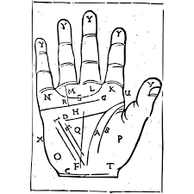
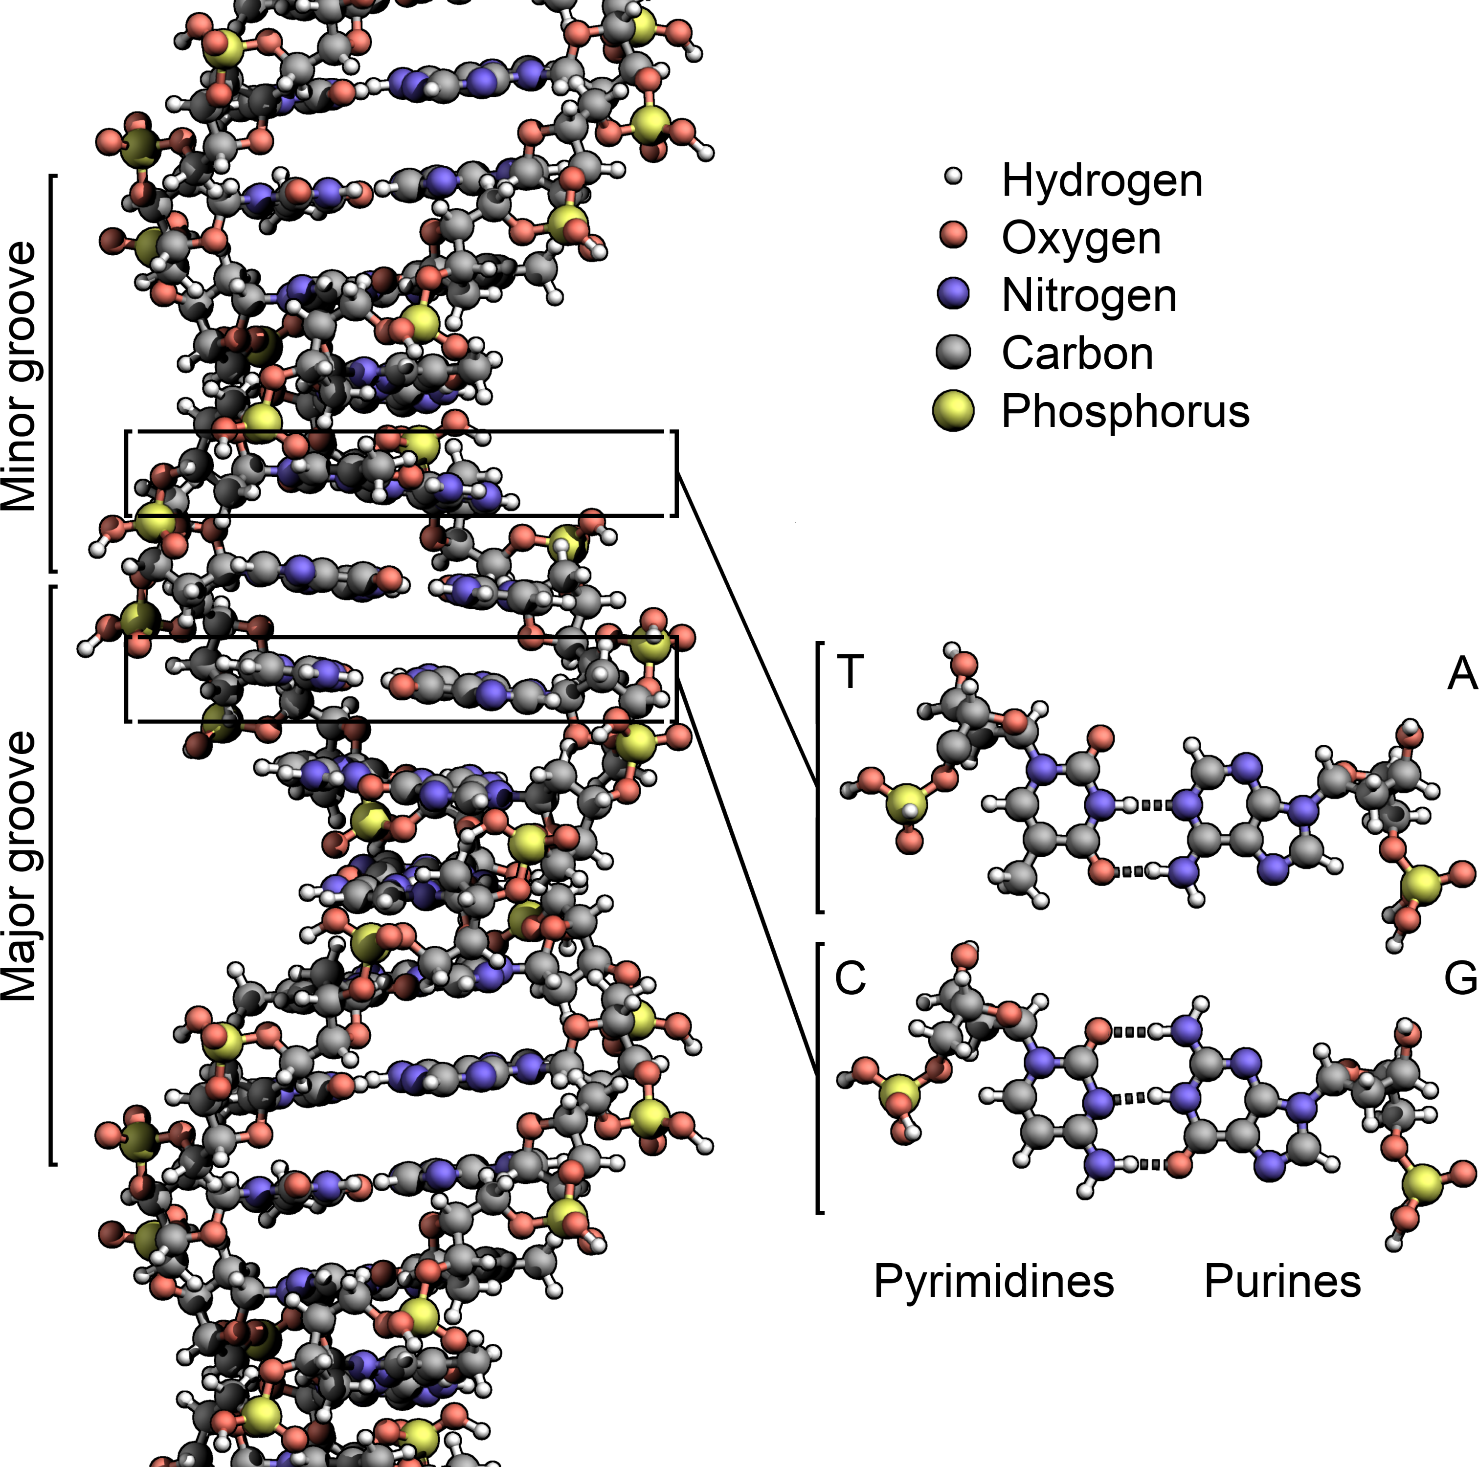
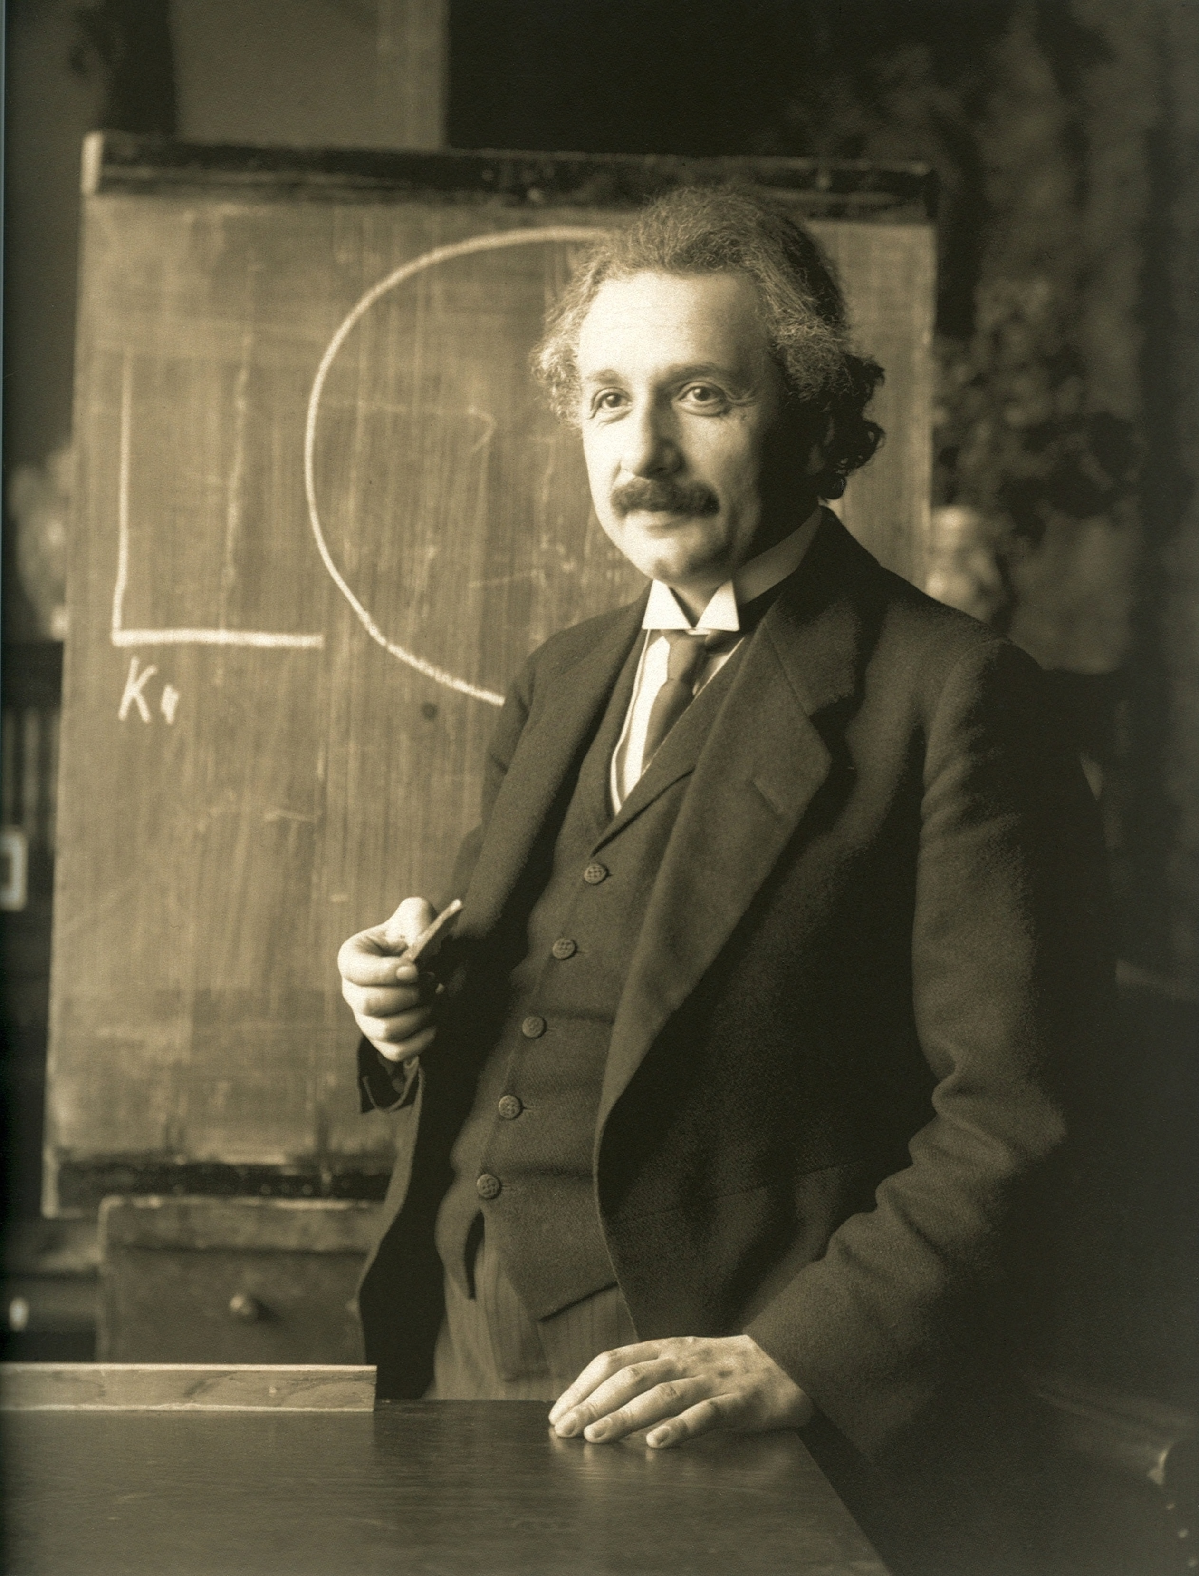
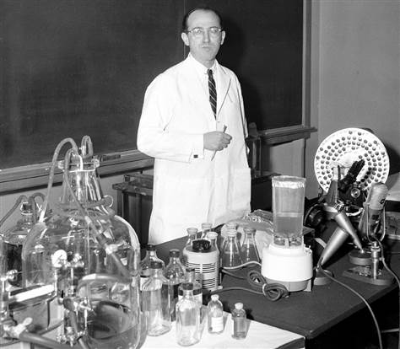
Science & Pseudo-science
A theory which is not refutable by any conceivable event is non-scientific. Irrefutability is not a virtue of a theory
(as people often think) but a vice.
K. Popper, Conjectures and Refutations
not( NVD_set ) => security
not( attack_1 )
security
“We don’t have a test for security and
we don’t have a metric for security”
Notes:
There is no example in which the current security “theory” is wrong.
There is no example that can falsify it.

Slide 22


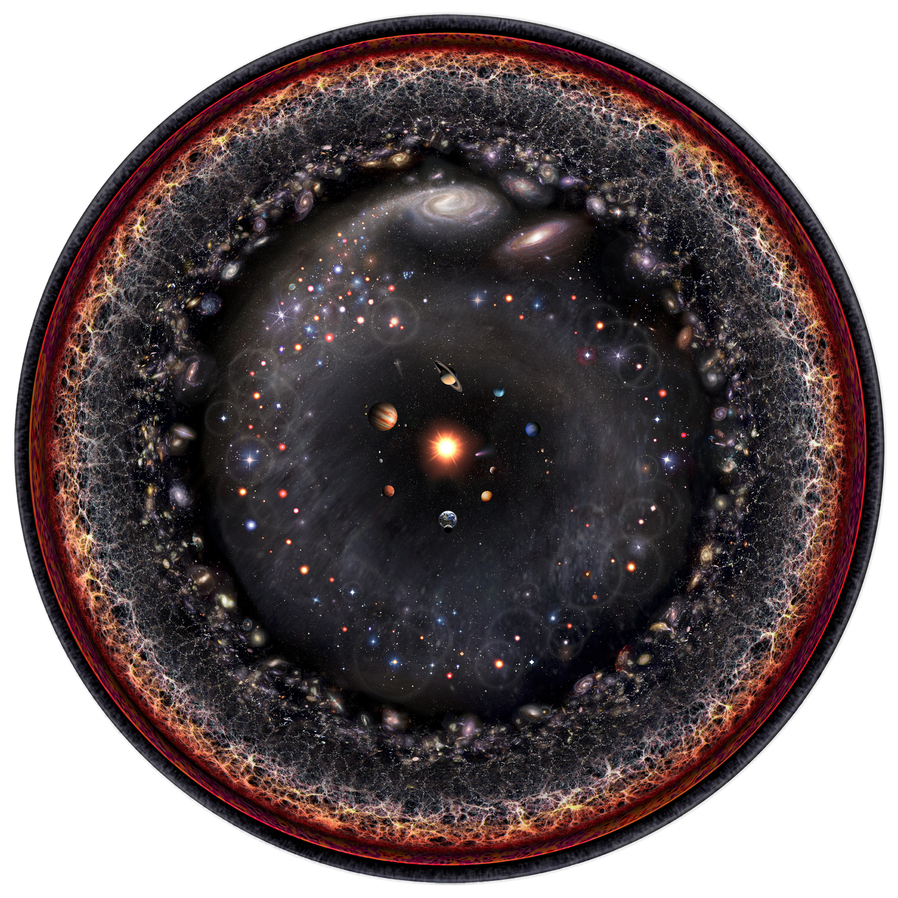
If not the absence of attacks, what is cybersecurity?
malicious
intent
cyber
attack
causality
safety
hazard
cause
effect
Causality
System
designs
Mankind
Nature
Exploitation
process
Process
abstract system
application
Weakness
Exploit
system
implementation
Vulnerability
Defect
realization
Failure
Black-hat
Hacking
process
Attack
malicious
intents
Incident
Accident
non-malicious
intents
Hazard
Asset
impacts
Threat
impacts
Asset
“Software weaknesses are errors that can lead to software vulnerabilities.
A software vulnerability [...] is a mistake in software that can be directly used by a hacker to gain access to a system or network” (MITRE)
Notes:
We analyzed in depth the state of the art trying to understand what is the role of attacker’s intents in cybersecurity.
It turns out that the whole process that leads an attacker to attack a system, starts from an error which creates a weakness and in turn a vulnerability which may lead to an attack.
So, cybersecurity is tightly related to errors.

Slide 23

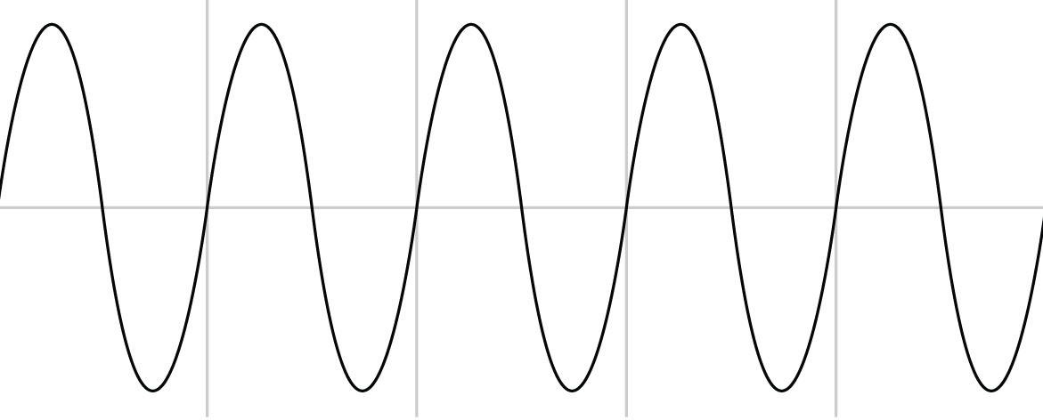

V-Research Cybersecurity Theory
We developed our theory from Jaakko Hintikka’s works,
mapping epistemological concepts to system engineering
Epistemology
Multi-Agent Systems
Set of Truths – Knowledge
Poorly Justified Statements – Beliefs
Transfer of Beliefs – Information
Facts – Ground Truths/Environment
Behaviors – Agent’s thoughts
Assertions – Agent’s communication
Error?
uncertainty
[Beliefs]
Acquisition, Generation
& Reasoning
[Knowledge]
Apple
[Information]
EM wave
B
F
B/F
B
F
B
F
F
B
Equal
Disjoint
Partial Overlap
Proper Part
Given a calculus (RCC5) over a topology
B/F errors in behaviors
A/F errors in assertions
A/B errors in translations
[Information]
Sound wave

