Slide 1
V
-
R
e
s
e
r
c
h
v
R&D for Systems and Security Engineering
Tool Demo
Marco Rocchetto
Dissemination level: L-0
Confidentiality level: confidential
ECCN: NSR

Slide 2
Agents
Everything is an Agent
or a part of it
There exist
2 types
of agents
Humans
Gods/Nature
Human’s template
God’s template
Assertions
Beliefs
Assertions
Knowledge

Slide 3
Interpretation
Everything is an Agent
or a part of it
There exist
2 types
of agents
Humans
Gods/Nature
Human’s template
God’s template
Assertions
Beliefs
Assertions
Knowledge
Information
Transformation

Slide 4

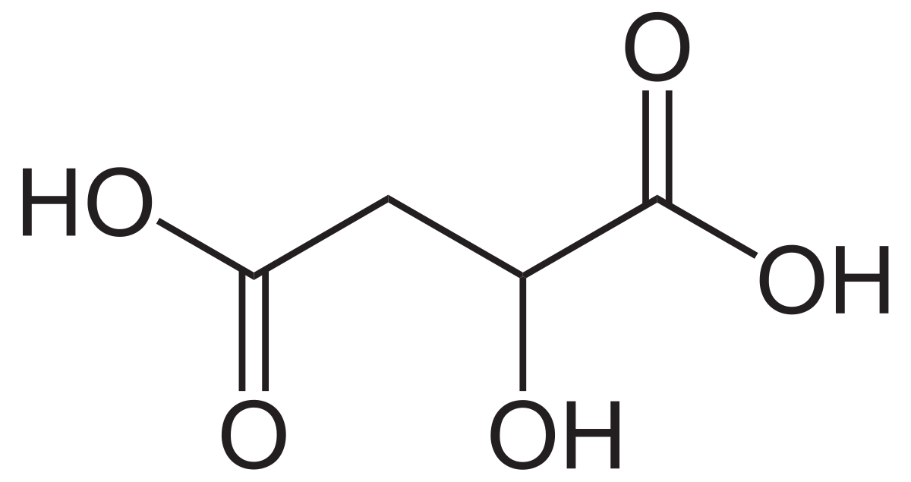
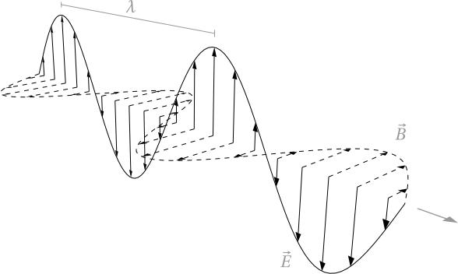
Example
Everything is an Agent
or a part of it
There exist
2 types
of agents
Humans
Gods/Nature
Human’s template
God’s template
Assertions
Beliefs
Assertions
Knowledge
Information
Transformation

Slide 5

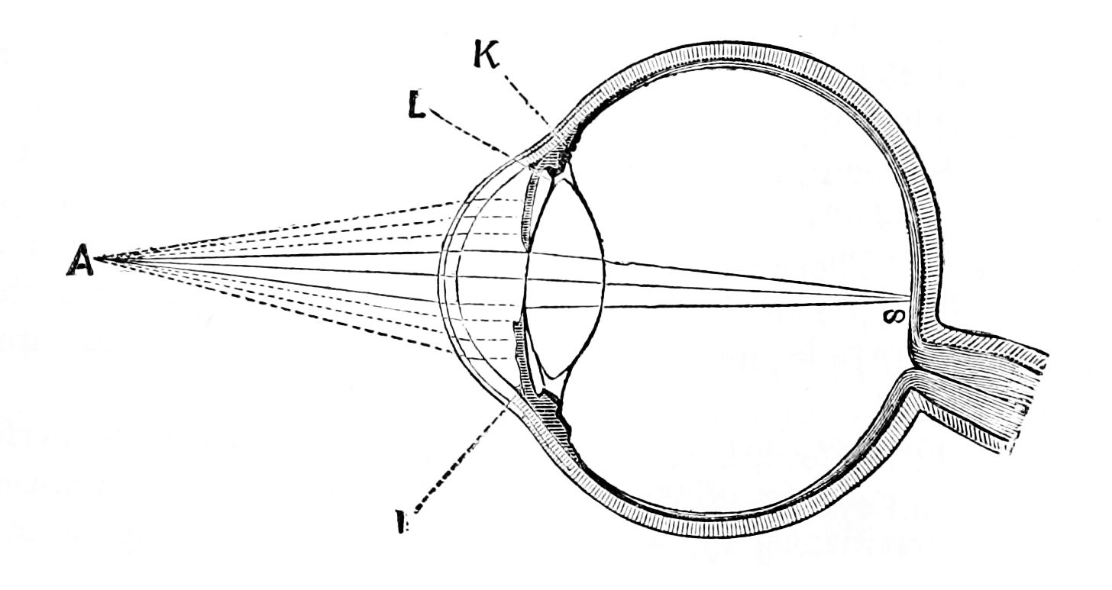
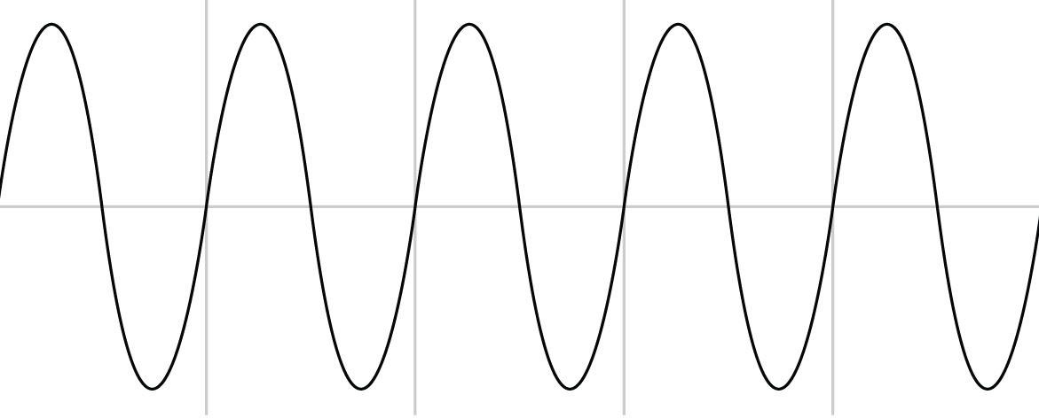

You design like a God
System (Agent)
Apple
EM wave
Sound wave

Slide 6
We test like a Human
Human-made system (Agent)
Nature (Agent)
Apple_k
Apple_b4
Apple_b3
Apple_b1
Apple_a1
EM wave
Apple_a2
Apple_b2
Apple_b6
Apple_a5
Sound wave
Apple_a5
Apple_b5

Slide 7
WHY
Nature (Agent)
Nature (Agent)
This may not be
apprehensible
This is what the spec mandates
Apple_k
waterLevel_k
This transformation
may (not) be an equality
Apple_b1
waterLevel_b1
10m
This is obviously apprehensible
This is what we desing & implement
Philosophy
Engineering

Slide 8
WHY
Nature (Agent)
Nature (Agent)
This may not be
apprehensible
This is what the spec mandates
Apple_k
waterLevel_k
This transformation
may (not) be an equality
Apple_b1
waterLevel_b1
10m
This is obviously apprehensible
This is what we desing & implement
Apple_a1
Philosophy
Engineering

Slide 9
Nothing else matters
System
sub-System
Components
InfoFlows
Human’s template
God’s template
Assertions
Beliefs
Assertions
Knowledge
There exist
2 types
of agents
Everything is an Agent
or a part of it

Slide 10
Nothing else matters
System
sub-System
test
Components
InfoFlows
We implement like a Human
You design like a God
Human’s template
God’s template
Assertions
Beliefs
Assertions
Knowledge
There exist
2 types
of agents
Everything is an Agent
or a part of it

Slide 11
V
-
R
e
s
e
r
c
h
v
R&D for Systems and Security Engineering
Tool Demo
Marco Rocchetto
Dissemination level: L-0
Confidentiality level: confidential
ECCN: NSR

Slide 12
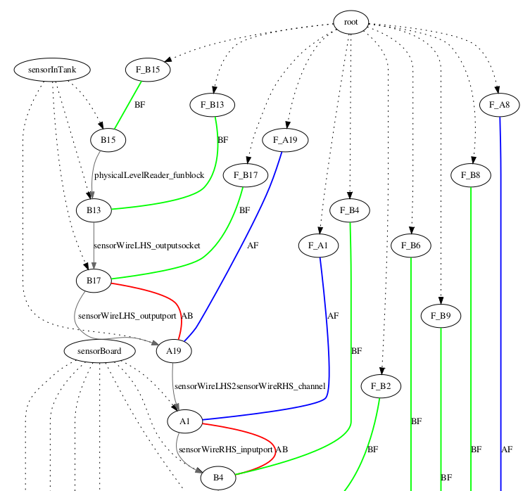

Slide 13
Granularity
Region/collection
101011
100001
Base/bit
b
a
fun arch
out-port
channel
t_0
t_1
t_2
t_3
t_4
time
B1,…,Bn
B1,…,Bn,A1,…,An
quantity of Info in time
This is our abstraction of the design of CPS
3 Atoms connected by 2 types of Flows (a,b) creates
2 symmetric Molecules (-> and <-) to make an Agent which
aggregated creates a System

Slide 14
Granularity
Region/collection
101011
100001
Base/bit
b
a
fun arch
out-port
channel
t_0
t_1
t_2
t_3
t_4
time
B1,…,Bn
B1,…,Bn,A1,…,An
quantity of Info in time
We believe that security is adherance to specification/requirements
Ambiguity (or non-adherence) of design to spec implies insecurity (weaknesses) of the design
Weaknesses in the desing brings vulnerabilities in the implementation
Exploitation of vulnerabilities (Exploits) can be avoided by a secure-by-design approach
So, what do we need to consider to properly reason on security?
Which are the properties that guarantee security?

Slide 15
The difference between specification and design
Everything is an Agent
or a part of it
There exist
2 types
of agents
Humans
Gods/Nature/Spec
Human’s template
Spec’s template
Assertions
Beliefs
Assertions
Knowledge
Information
Transformation

Slide 16
So, from this
Granularity
Region/collection
101011
100001
Base/bit
b
a
fun arch
out-port
channel
t_0
t_1
t_2
t_3
t_4
time
B1,…,Bn
B1,…,Bn,A1,…,An
quantity of Info in time
We believe that security is adherance to specification/requirements
Ambiguity (or non-adherence) of design to spec implies insecurity (weaknesses) of the design
Weaknesses in the desing brings vulnerabilities in the implementation
Exploitation of vulnerabilities (Exploits) can be avoided by a secure-by-design approach
So, what do we need to consider to properly reason on security?
Which are the properties that guarantee security?

Slide 17
Note: In a perfect world ~ is bijective
to this
Specification
Granularity
f
BF
AF
Region/collection
101011
100001
Base/bit
b
AB
a
fun arch
port
channel
t_0
t_1
t_2
t_3
t_4
time
B1,…,Bn
B1,…,Bn,A1,…,An
quantity of Info in time
What is a relation between A, B, and F? (see slide 4)
B
A
~
Oth. A
port would
change the
semantics of the
Information.
We defined a
port like this
to avoid
infinite regress
Given a scenario there exist a finite
domain of common knowledge F (common between agents)
F
AB
~
and a finite codomain of Beliefs and Assertions AB
b
out-port
a
spec
design
~
~
and an equivalence
relation between elements
atoms

Slide 18
information
Specification
Specification
Granularity
f
f_i
f_o
BF
AF
BF
AF
Region/collection
digital
analog
xxxxxx
yyyyy
b
a
b_i
BB
b_o
Base/bit
AB
fun arch
out-port
channel
But one can
Generalize with fun-blocks
t_0
t_1
t_2
t_3
t_4
time
B1,…,Bn
B1,…,Bn,A1,…,An
quantity of Info in time
What is a relation between A, B, and F? (see slide 4)
B
A
~
Oth. A
port would
change the
semantics of the
Information.
We defined a
port like this
to avoid
infinite regress
Given a scenario there exist a finite
domain of common knowledge F (common between agents)
F
AB
~
and a finite codomain of Beliefs and Assertions AB
b
out-port
a
spec
design
~
~
and an equivalence
relation between elements
atoms

Slide 19
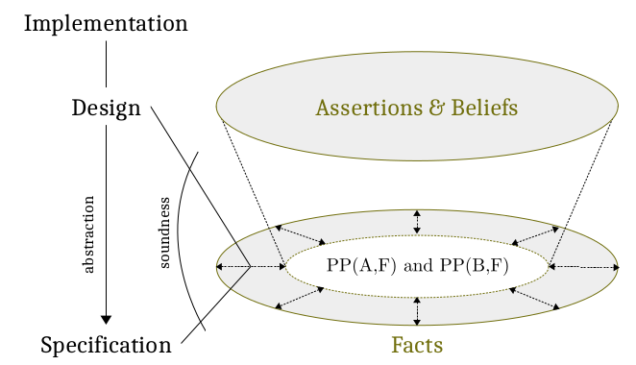
information
Granularity
f
BF
AF
Region/collection
digital
analog
Base/bit
b
AB
a
fun arch
out-port
channel
t_0
t_1
t_2
t_3
t_4
time
B1,…,Bn
B1,…,Bn,A1,…,An
quantity of Info in time
What does it mean to be EQ?
if B is EQ to F,
if all the elements of B are in F
- EQ(A,B) all the ports are ok
- EQ(B,F) all the blocks are ok
- EQ(A,F) all the channels are ok
EQ
DR
B
F
B
F
~
~
~
B
ONE
F
B
ONE
F
~
...
~
~

Slide 20
information
Granularity
f
BF
AF
Region/collection
digital
analog
Base/bit
b
AB
a
fun arch
out-port
channel
t_0
t_1
t_2
t_3
t_4
time
B1,…,Bn
B1,…,Bn,A1,…,An
quantity of Info in time
Base step
2^4 combinations
~/= by spec
trans by design
1 run
Due to Base/Bit
b
o-port
a
f_b
f_a
t_1
t_3
(B,F) EQ or DR
Base/bit
1
1
0
0
=
<
>
=
1 forward
0 drop
1 insertion
0 no comm
(A,F) EQ or DR
r
r
(A,B) EQ or DR
b
r
a
Rel type: RCC+poset

Slide 21
Rcc5:5
1) [f_1]/b -> [port] -> a
EQ(f,b)/\EQ(b,a)/\EQ(a,f_1) → secure (by def)
DR,DR,DR
DR,DR,EQ
DR,EQ,EQ
EQ,EQ,EQ
EQ,DR,EQ
…
2) a ->[chan] -> a_o
EQ(a,a_o) -> secure (by def)
DR(a,a_o) - unsec
EQ(a,a_o) – sec
3) b_i -> [funblock] -> b_o/f_2
EQ(b_o,f_2)
0
10
F
Rcc5:5
I
O
base
base
F
chan
F_0
floor
input
A
A
F_1
B
F<F_1±0.001m
F=bello(F_1)
f
fun
F
Rcc5:5
+10
I
O
B_1
F_1
Rcc5:5
A
i-port
B
o-port
I
O
+10
o-port
B
fun
B
Rcc5:5
A
I
O
chan
B
o-port
A
+10
i-port
+10
goto
F_2
10

Slide 22
Specification
Specification
Granularity
F_B
F_A
BF
AF
Region/collection
101011
100001
Base/bit
B
AB
A
component
out-port
channel
t_0
t_1
t_2
t_3
t_4
time
B1,…,Bn
B1,…,Bn,A1,…,An
quantity of Info in time
Base step
We assumed components (funblocks, sockets), ports (out/in-port), and channels to be atomic otherwise infinite regress.
Therefore, no Information is generated at time t_0, t_2, t_4
1 run
t_1
t_3
Base/bit
Quality: RCC

Slide 23
Specification
Specification
Granularity
F_B
F_A
BF
AF
Region/collection
101011
100001
Base/bit
B
AB
A
component
out-port
channel
t_0
t_1
t_2
t_3
t_4
time
B1,…,Bn
B1,…,Bn,A1,…,An
quantity of Info over time
Base step
Mixed sys with different granularities?
1 run
Case A) N runs of “component” with granularity:bit produces/obtains a collection of bits over N instants of time
Given the generality of “component” and that “produces”=outputs, “obtains”=inputs,
Any proof for case A holds for case B and vice versa
t_1
t_3
Base/bit
Case B) 1 run of “component” with granularity:region produces/obtains a collection of bits in an instant of time
Quality: RCC

Slide 24
Specification
Specification
Granularity
F_B
F_A
BF
AF
Region/collection
101011
100001
Base/bit
B
AB
A
component
out-port
channel
t_0
t_1
t_2
t_3
t_4
time
B1,…,Bn
B1,…,Bn,A1,…,An
quantity of Info over time
Base step
B
o-port
A
2^4 combinations
N run
EQ (forward)
PP (insertion)
PPi (partial/selective drop)
PO (partial/selective DR)
DR (drop+[insertion] or [injection])
Due to Base/Bit
t_1
t_3
1
1
0
0
=
<
>
=
1 forward
0 drop
1 insertion
0 no comm
(B,F) EQ or DR
Base/bit
(A,F) EQ or DR
Quality: RCC
(A,B) EQ or DR

Slide 25
{'block': {'dr': {'mitigation': 'm9',
'weakness': 'the component never performs the expected '
'behavior (e.g. physical damage)'},
'po': {'mitigation': 'm6',
'weakness': 'the component has a Byzantine behavior where '
'occasionally outputs the expected output given '
'the correct inputs. However, not all the inputs '
'are handled properly, nor all the expected '
'outputs are generated when correct inputs are '
'given.'},
'pp': {'mitigation': 'm7',
'weakness': 'part of the expected outputs are not generated '
'in response to the correct inputs'},
'ppi': {'mitigation': 'm8',
'weakness': 'the components correctly performs the expected '
'behavior when the correct inputs are provided '
'but is vulnerable to input injections'}},
'channel': {'dr': {'mitigation': 'm4',
'weakness': 'drops all the inputs and inserts new '
'malicious data'},
'po': {'mitigation': 'm1',
'weakness': 'selectively drops inputs and inserts new '
'malicious data'},
'pp': {'mitigation': 'm2',
'weakness': 'forwards all the inputs but crafts and '
'inserts new malicious data'},
'ppb0': {'mitigation': 'm5',
'weakness': "generates new outputs even when there's no "
'incoming data from the socket'},
'ppi': {'mitigation': 'm3',
'weakness': 'selectively drops inputs'},
'ppia0': {'mitigation': 'm5',
'weakness': 'drops all the incoming data'}},
'port': {'dr': {'mitigation': 'm4',
'weakness': 'drops all the inputs and inserts new malicious '
'data'},
'po': {'mitigation': 'm1',
'weakness': 'selectively drops inputs and inserts new '
'malicious data'},
'pp': {'mitigation': 'm2',
'weakness': 'forwards all the inputs but crafts and inserts '
'new malicious data'},
'ppb0': {'mitigation': 'm5',
'weakness': "generates new outputs even when there's no "
'incoming data from the socket'},
'ppi': {'mitigation': 'm3', 'weakness': 'selectively drops inputs'},
'ppia0': {'mitigation': 'm5',
'weakness': 'drops all the incoming data'}}}
I
port
O
O
EQ forward
PP
PPi
PO
DR
I
forwards all the inputs but crafts and inserts new malicious data

