Slide 1
V
-
R
e
s
e
r
c
h
v
Research & Development for Cybersecurity Engineering
Francesco Beltramini, Marco Rocchetto
francesco@v-research.it marco@v-research.it
Dissemination level: Public
Confidentiality level: unencrypted
ECCN: NSR

Slide 2

Agenda
Who we are, V-Research, Business Model
V-Research Cybersecurity Challenge
State-of-the-art Solutions and Competitors
Cybersecurity Research – A Scientific Quest!
V-Research Prototype - Security Risk Assessment Demo
Summary & Vision

Slide 3

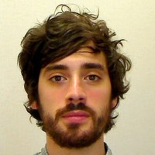
Who and History
Co-founder of V-Research
[Research & Development]
Co-founder of V-Research
[Business Development]
Head of SecOps Engineering - Inmarsat
Founded in 2020, Verona – IT
A private R&D center that bridges foundational challenges and engineering needs
Our mission is to develop a
  scientific theory of cybersecurity and
  a tool-chain for the secure engineering of cyber-physical systems
Combined 20+ years of experience in:
  formal methods for verification and testing
  system engineering for complex cyber (and cyber-physical) systems
  multi-year programs: both EU-funded (SPaCIoS, GOVSATCOM) and privately-funded (Global eXpress)
Notes:
We founded V-Research in February this year.
Our objective is to establish a private research center that bridges foundational challenges and engineering needs.
Our technical background is mainly on cybersecurity and ranges from formal methods for verification and testing to complex cyber-physical systems engineering
MR – technical role
Bachelor, Master and PhD in computer science – with B and M focusing on cybersecurity – and PhD
on the application of formal methods (logic-based approaches for the verification of security protocols).
Engineering state qualifying exam
Started as postdoc researcher University of Luxembourg, SUTD, Univr-ETHZ (with SIEMENS)
Researcher for the AVANTSSAR and SpaCIoS EU-funded projects (SAP, ETH, TUM, SIEMENS etc)
3 years as Senior Engineer in UTRC with leading role in several projects, two of them are:
– the Engineering of secure wireless elevator system (3 patents – Otis [elevator]) – up to tech transfer to Otis Engineers testing in Test tower
– Formal Risk Assessment (Otis [elevator], Rockwell Collins [aerospace])
Quit my position and opened V-Research
FB+

Slide 4
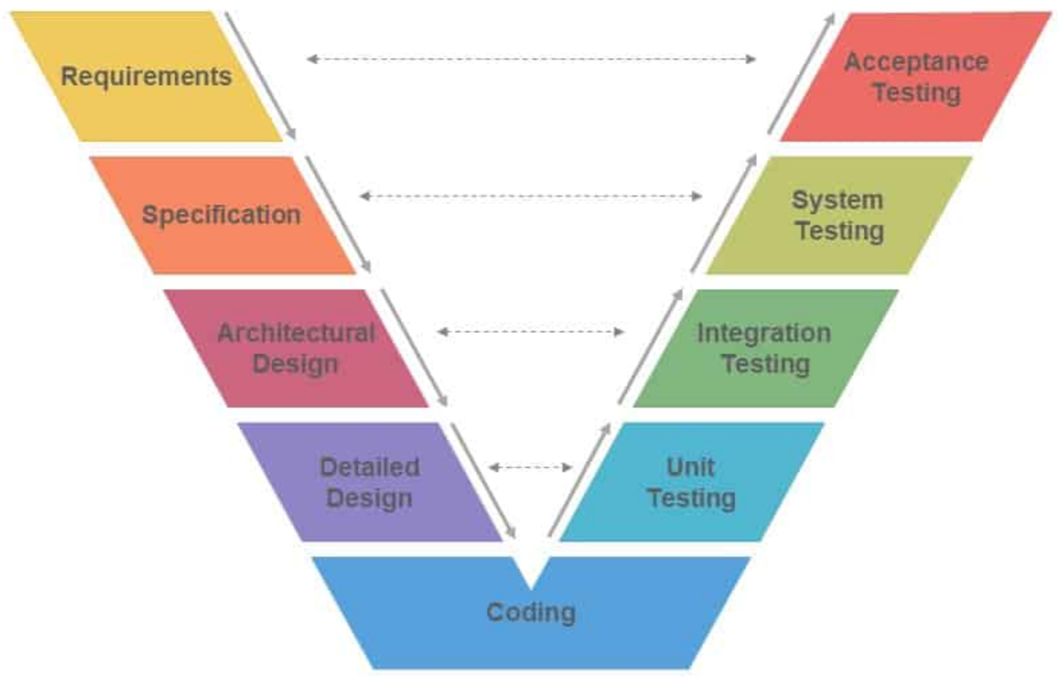
Current V-Research Offering
Systems Security Engineering
Requirements and Architecture properties
System Design and Formal Verification
Implementation and Testing
Complement customers internal resources
Standard & Regulation Analysis
TRL maturation plan
Commercial Expertise
Platform Evaluation and Selection
RFP / Tender consultancy
Partnership and Security Assurance
Conformance / Compliance Testing
Systems Security Research
Problem Statement Formulation
(no commercial solution)
Analysis of state-of-the-art techniques
Gap Analysis
Solution Theoretical Formulation
Solution Prototype Implementation

Slide 5
Business model
Openness (boost research)
  Open-source products (free ad, double licensing)
  Open-access research (no patents)
Product for consultancy (customer needs = company needs)
Consultancy
Research2business and back
  Search funding for secra
  Use funding to pay agency to bootstrap consultancy
  Invest money from consultancy to research

Slide 6
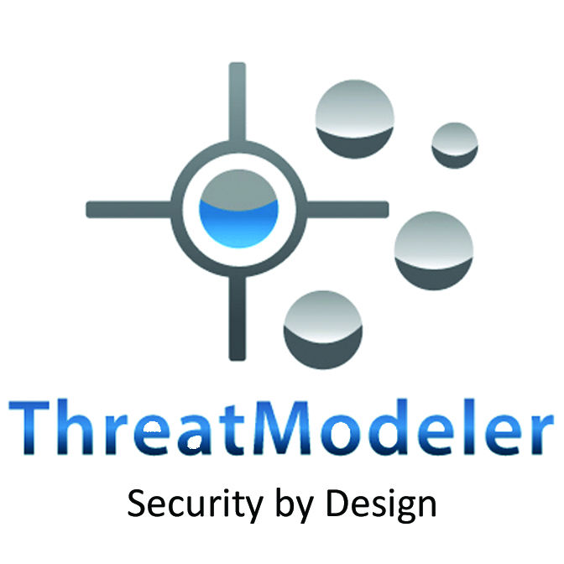

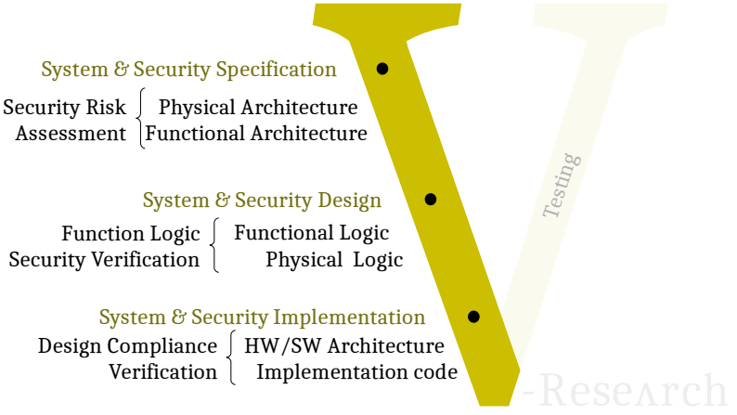
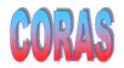
Current V-Research Research
Security Challenges
Identify a scientific security theory
Build a security risk assessment (tool-assisted) process
Build a protocol (logic) design verifier
Build a security test-case generator
Again?
Yet another
security tool
MSAT
SecRAM
Another
Methodology?

Slide 7
Agenda
Who we are, V-Research, Business Model
V-Research Cybersecurity Challenge
State-of-the-art Solutions and Competitors
Cybersecurity – A scientific Quest!
V-Research Prototype - Security Risk Assessment Demo
Summary & Vision

Slide 8
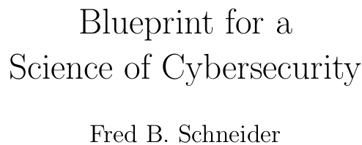
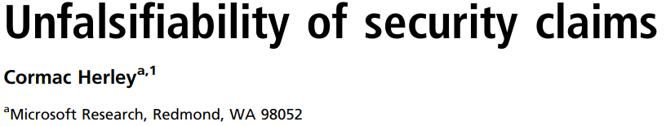
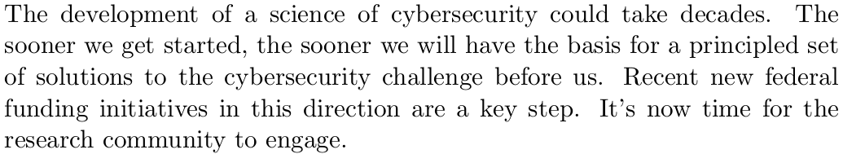
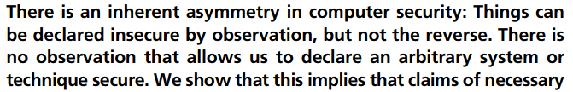
Motivation
“We don’t have a test for security and
we don’t have a metric for security”
A theory which is not refutable by any conceivable event is non-scientific. Irrefutability is not a virtue of a theory (as people often think) but a vice.​ ​
K. Popper, Conjectures and Refutations​
https://www.usenix.org/conference/usenixsecurity16/technical-sessions/presentation/herley

Slide 9







Cybersecurity – What’s going on?
517
“Understanding adversary behavior is increasingly important in cybersecurity”
839
500+
136312
144329
“to build, test, and refine behavioral-based analytic detection capabilities using adversary emulation”
Notes:
We (mostly the US state) have a network of databases where we collect attacks or related concepts such as weaknesses, vulnerability, exploit, attacker’s behaviors.
Why? Because we believe that by testing and excluding those attacks our system can be declared secure.

Slide 10
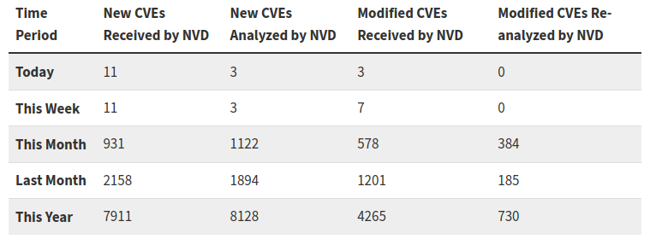
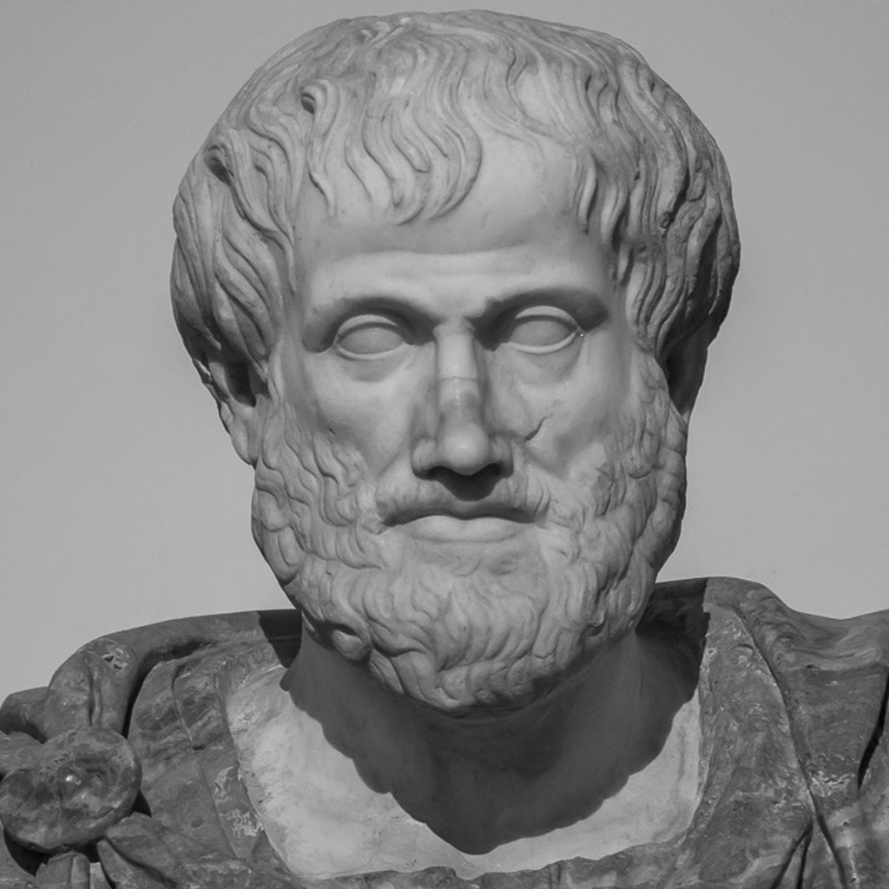
Cybersecurity – Current Beliefs
A system is secure if NO attack/exploit/vulnerability/weakness is present
Initial Theory
Today’s refinement
not( attack_1 ) => security
not( attack_1 )
not( NVD_set ) => security
not( NVD_set )
deduction
deduction
security
security
NVD - May 2020
X=>Y doesn’t mean not(X)=>not(Y)
Defend against attack X => safe from attack X
Do not defend against attack X !=> succumb to attack X
We should notice we are spending ineffectively on cybersecurity

Slide 11
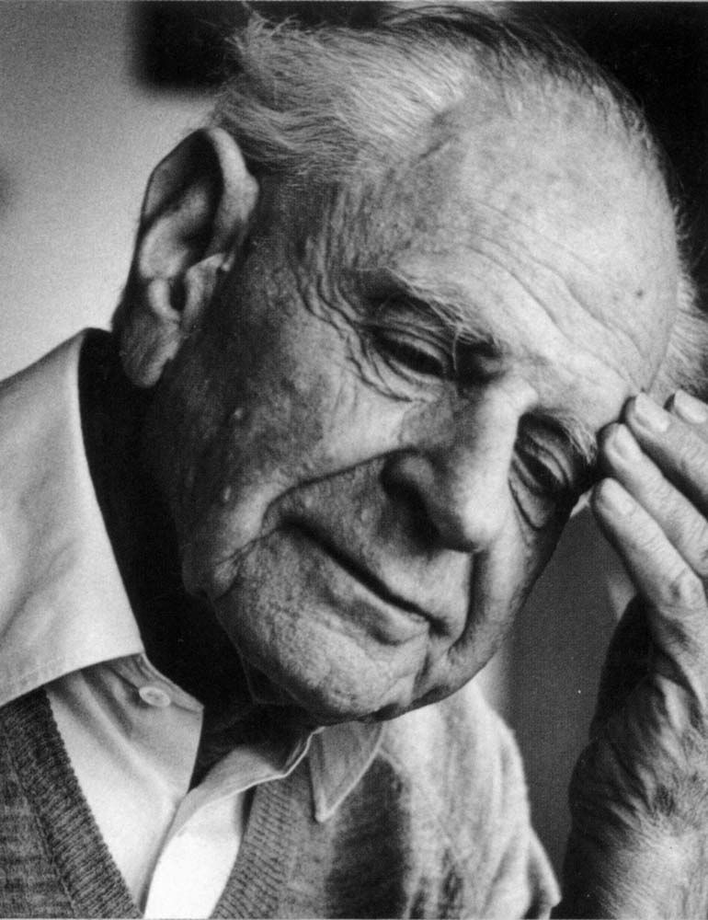
Cybersecurity – Current Beliefs
Should we reason
like this?
A system is secure if NO attack/exploit/vulnerability/weakness is present
Initial Theory
Today’s refinement
not( attack_1 ) => security
not( attack_1 )
not( NVD_set ) => security
not( attack_1 )
deduction
deduction
security
security
NVD - May 2020
X=>Y doesn’t mean not(X)=>not(Y)
Defend against attack X => safe from attack X
Do not defend against attack X !=> succumb to attack X
We should notice we are spending ineffectively on cybersecurity

Slide 12
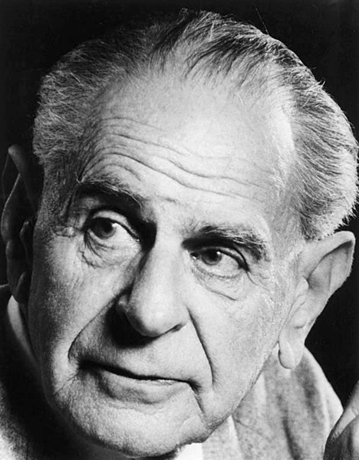
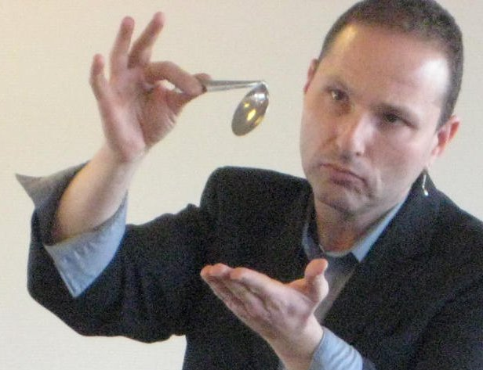
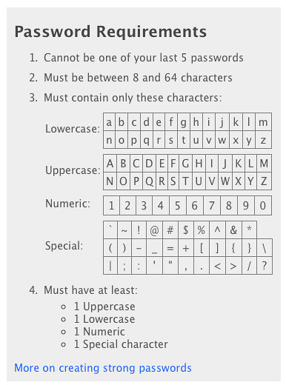
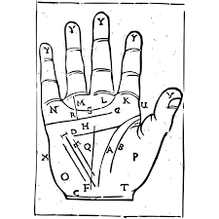
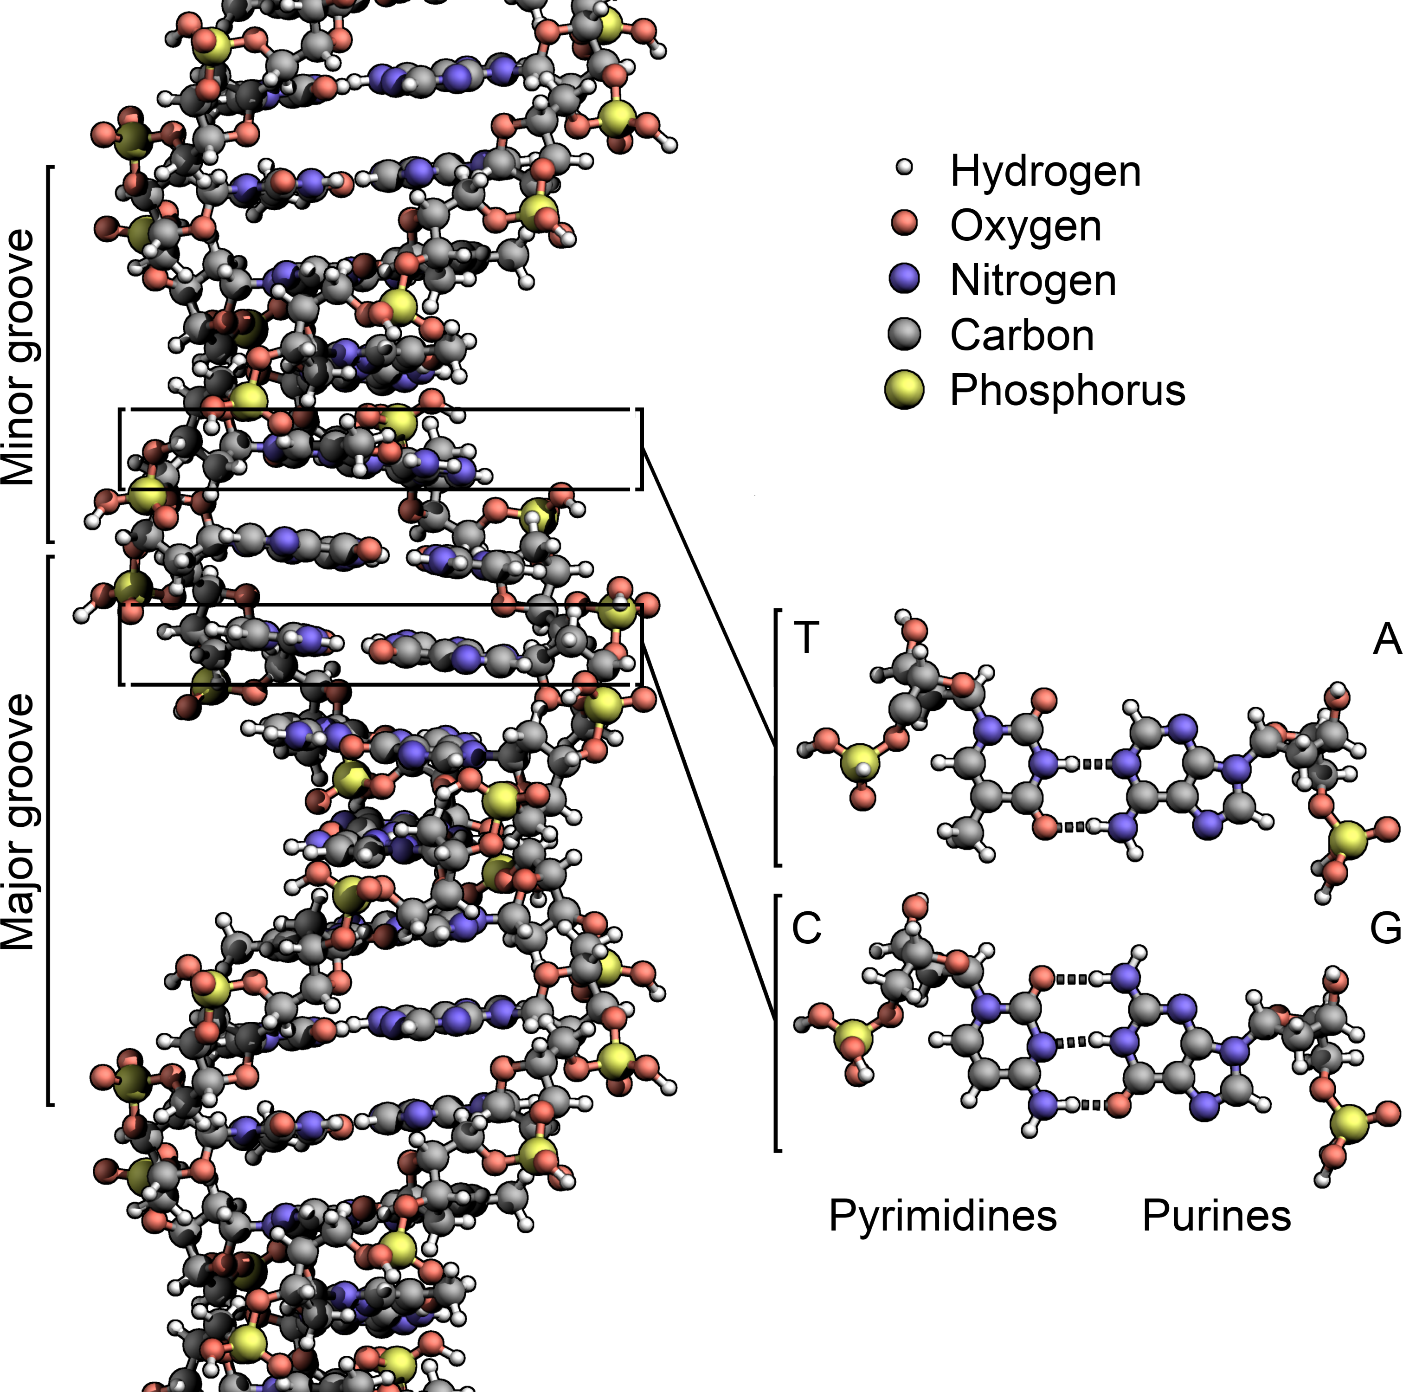
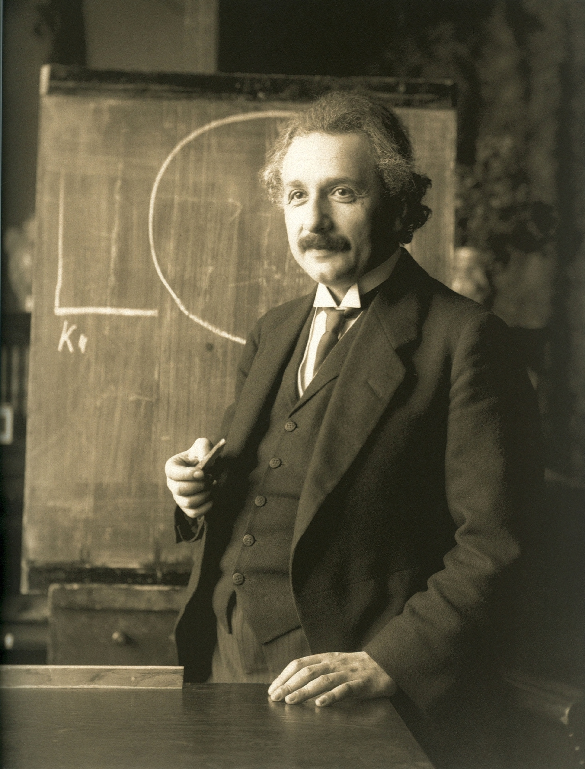
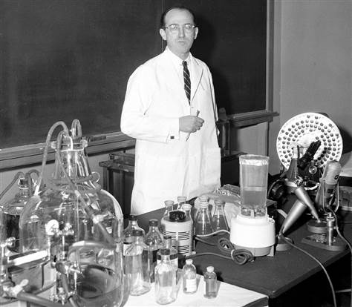
Science & Pseudo-science
A theory which is not refutable by any conceivable event is non-scientific. Irrefutability is not a virtue of a theory
(as people often think) but a vice.
K. Popper, Conjectures and Refutations
not( NVD_set ) => security
not( attack_1 )
security
“We don’t have a test for security and
we don’t have a metric for security”
Notes:
There is no example in which the current security “theory” is wrong.
There is no example that can falsify it.

Slide 13
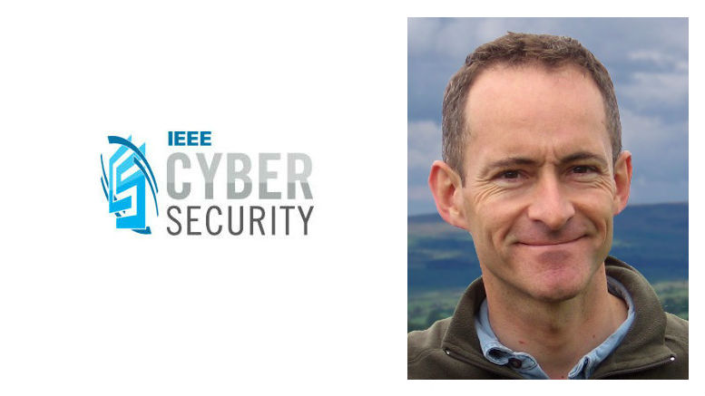
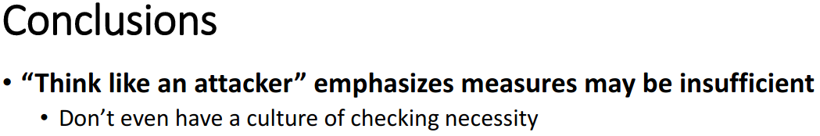
Science & Pseudo-science
A theory which is not refutable by any conceivable event is non-scientific. Irrefutability is not a virtue of a theory
(as people often think) but a vice.
K. Popper, Conjectures and Refutations
not( NVD_set ) => security
not( attack_1 )
security
“We don’t have a test for security and
we don’t have a metric for security”
Notes:
There is no example in which the current security “theory” is wrong.
There is no example that can falsify it.

Slide 14
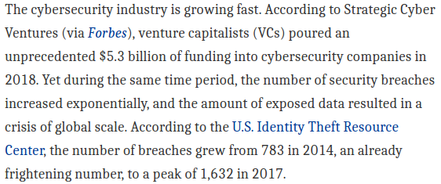

Science & Economy – Impact of Cybersecurity pseudo-science
OT
We don’t know what are the
necessary or sufficient
conditions nor we know how to distinguish between them
Jacob Nielsen (usability expert)
Usability suffers if users only get a row of bullets when they type their password.
Password Masking doesn’t even increase security but cost you business due to login failures
Bruce Schneier (security expert)
[June 26, 2009] “I agree with this”
Epic flame-war
[July 3, 2009] “So was I wrong? Maybe. Okay, probably”

Slide 15
Engineering – Impact of Cybersecurity pseudo-science
OT
“We don’t have a test for security and
we don’t have a metric for security”
systems engineering requires security standards
standards mandates
risk assessments
risk assessments requires a metric for security
DO-326A – “Airworthiness Security Process Specification” requires a cybersecurity risk assessment of the design and is the “the only Acceptable Means of Compliance by FAA & EASA for aviation cybersecurity airworthiness certification, as of 2019” [SAE]
[ISO 62443] [IEC 61508] [SAE J3061] [NIST 800-82] [etc]

Slide 16
Engineering – Impact of Cybersecurity pseudo-science
OT
“We don’t have a test for security and
we don’t have a metric for security”
systems engineering requires security standards
standards mandates
risk assessments
risk assessments requires a metric for security
If there really is no metric nor test for security
How come that companies sell risk assessment tools?
DO-326A – “Airworthiness Security Process Specification” requires a cybersecurity risk assessment of the design and is the “the only Acceptable Means of Compliance by FAA & EASA for aviation cybersecurity airworthiness certification, as of 2019” [SAE]
[ISO 62443] [IEC 61508] [SAE J3061] [NIST 800-82] [etc]

Slide 17
Agenda
Who we are, V-Research, Business Model
V-Research Cybersecurity Challenge
State-of-the-art Solutions and Competitors
Cybersecurity – A scientific Quest!
V-Research Prototype - Security Risk Assessment Demo
Summary & Vision

Slide 18
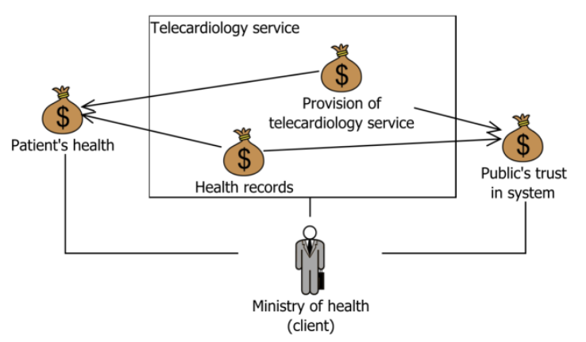
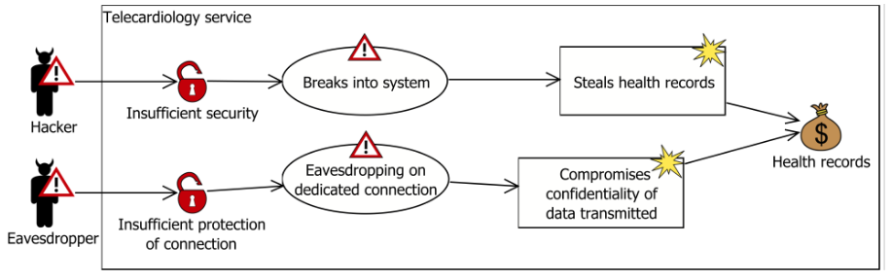
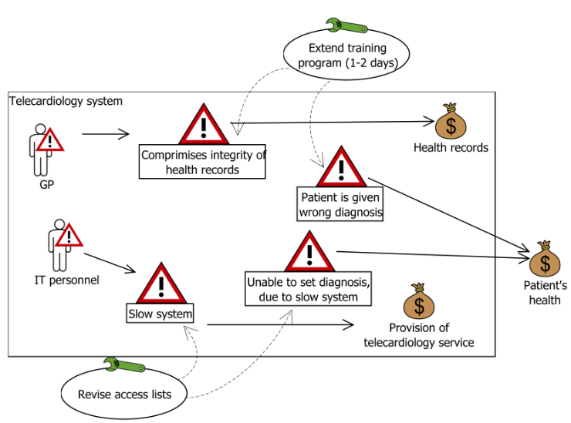
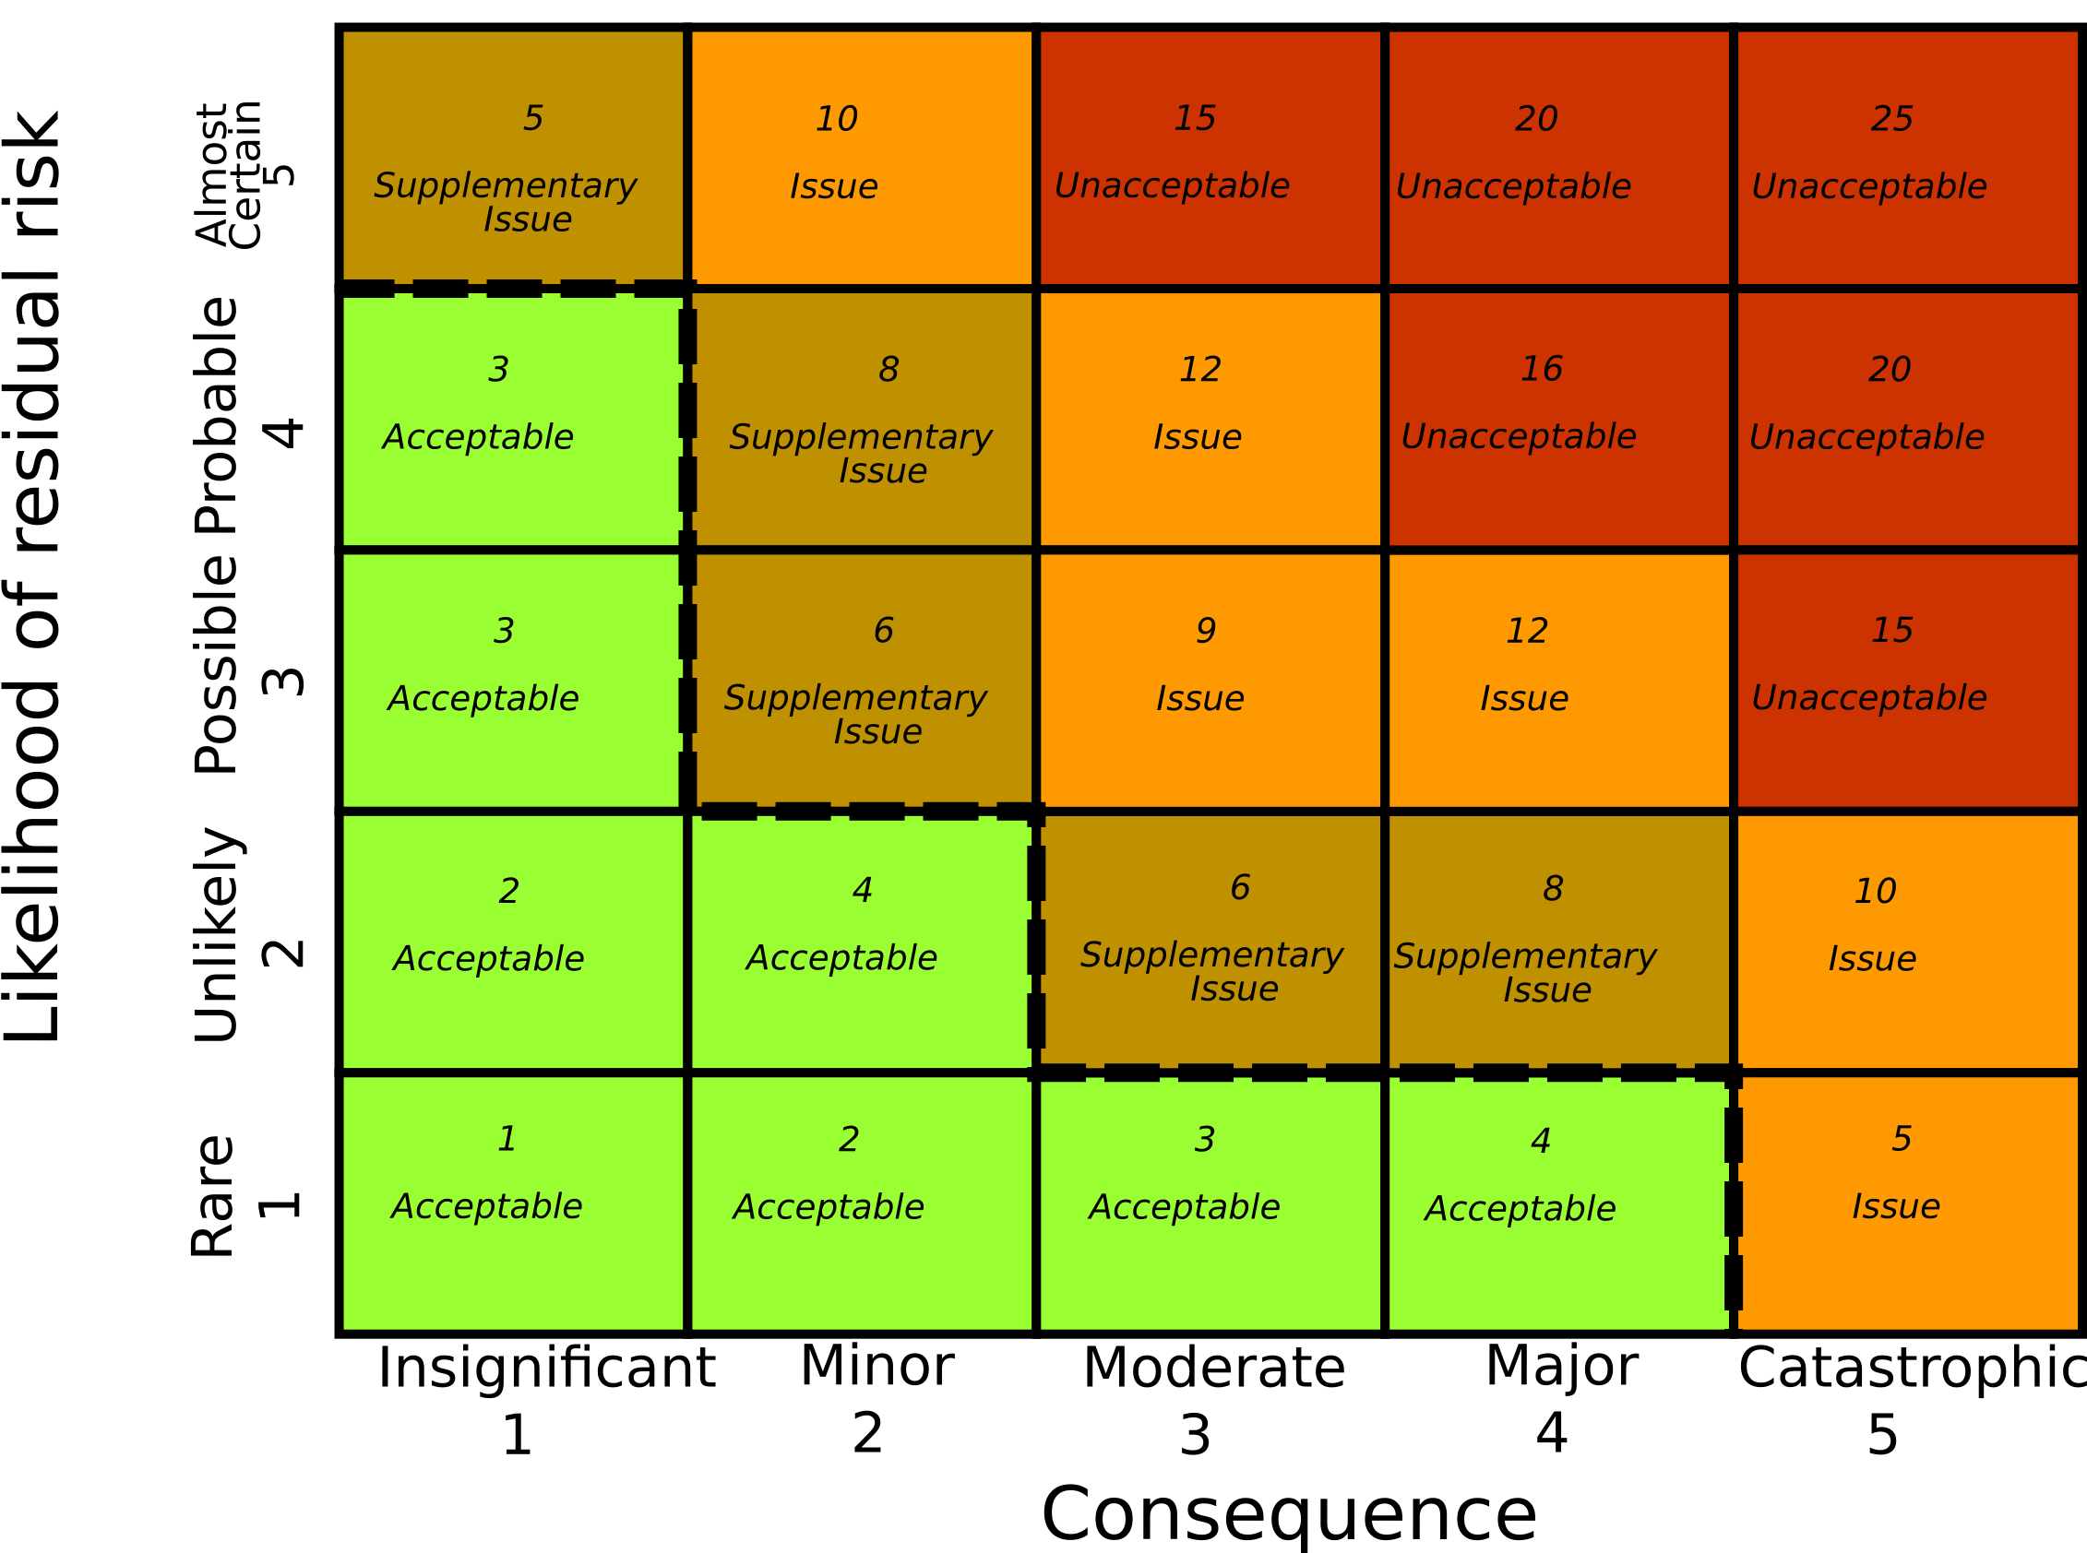
CORAS Methodology (as an example)
1. Asset Diagram
2. Threat Diagram
3. Risk Matrix
4. Treatments

Slide 19
CORAS Methodology (as an example)
1. Asset Diagram
2. Threat Diagram
The quality of the Risk Assessment
seems to be entirely based on
the expertise of the engineer
and NOT thanks to the CORAS tool
3. Risk Matrix
4. Treatments

Slide 20
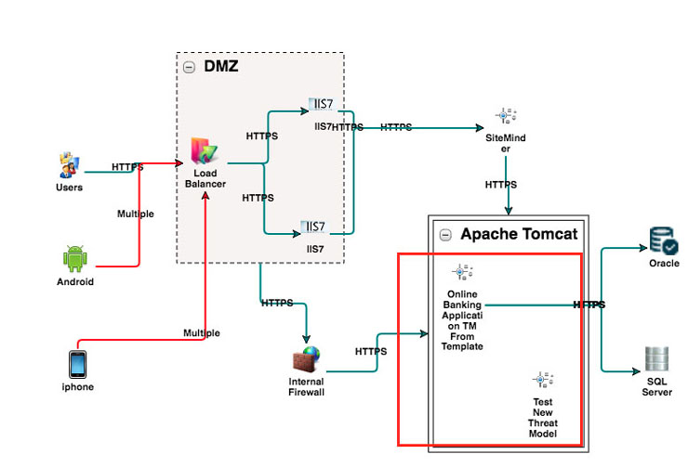
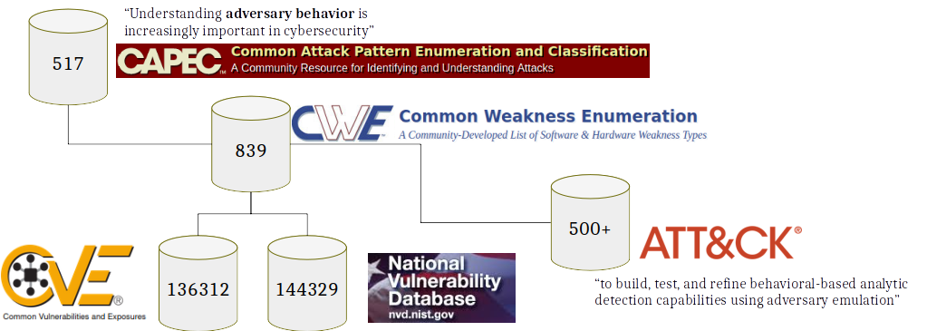
ThreatModeler (as an example)
Market analysis

Slide 21
ThreatModeler (as an example)
Can we compete?
What if we develop a theory that predicts all those insecurities
and develop a risk assessment tool free & open-source?
Nobody supports threat scenarios identification, we do!

Slide 22
Summarizing
There’s no scientific theory on system-cybersecurity
  Unclear sufficient conditions (overstating security, increasing costs)
  Unclear necessary conditions (false sense of security)
  Risk cannot be properly calculated
System Engineering Risks - Cybersecurity Requirements

Slide 23
Agenda
Who we are, V-Research, Business Model
V-Research Cybersecurity Challenge
State-of-the-art Solutions and Competitors
Cybersecurity – A scientific Quest!
V-Research Prototype - Security Risk Assessment Demo
Summary & Vision

Slide 24
What is cybersecurity?
Current Hypothesis
Scientific Theory
experiment
not( NVD_set ) => security
not( NVD_set )
Theory => prediction
not( prediction )
security
Theory falsified
Security Facts
If security is the absence of a set of attacks, we have 1000+ falsifications (by experiment) per month
Cybersecurity implies the absence of CWE/CVE (not the opposite)
Is cybersecurity related to the maliciousness of attacker?
“security is like safety in a malicious environment”
Notes:
Cybersecurity is not related to the maliciousness of the attacker
What if we assume that attacks just exist;
And due to the high number of attempts, attackers manage to find them and hack into a system
What if creativity was not so important? Would it change how we look at cybersecurity?

Slide 25
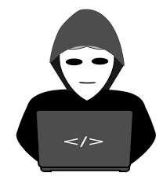

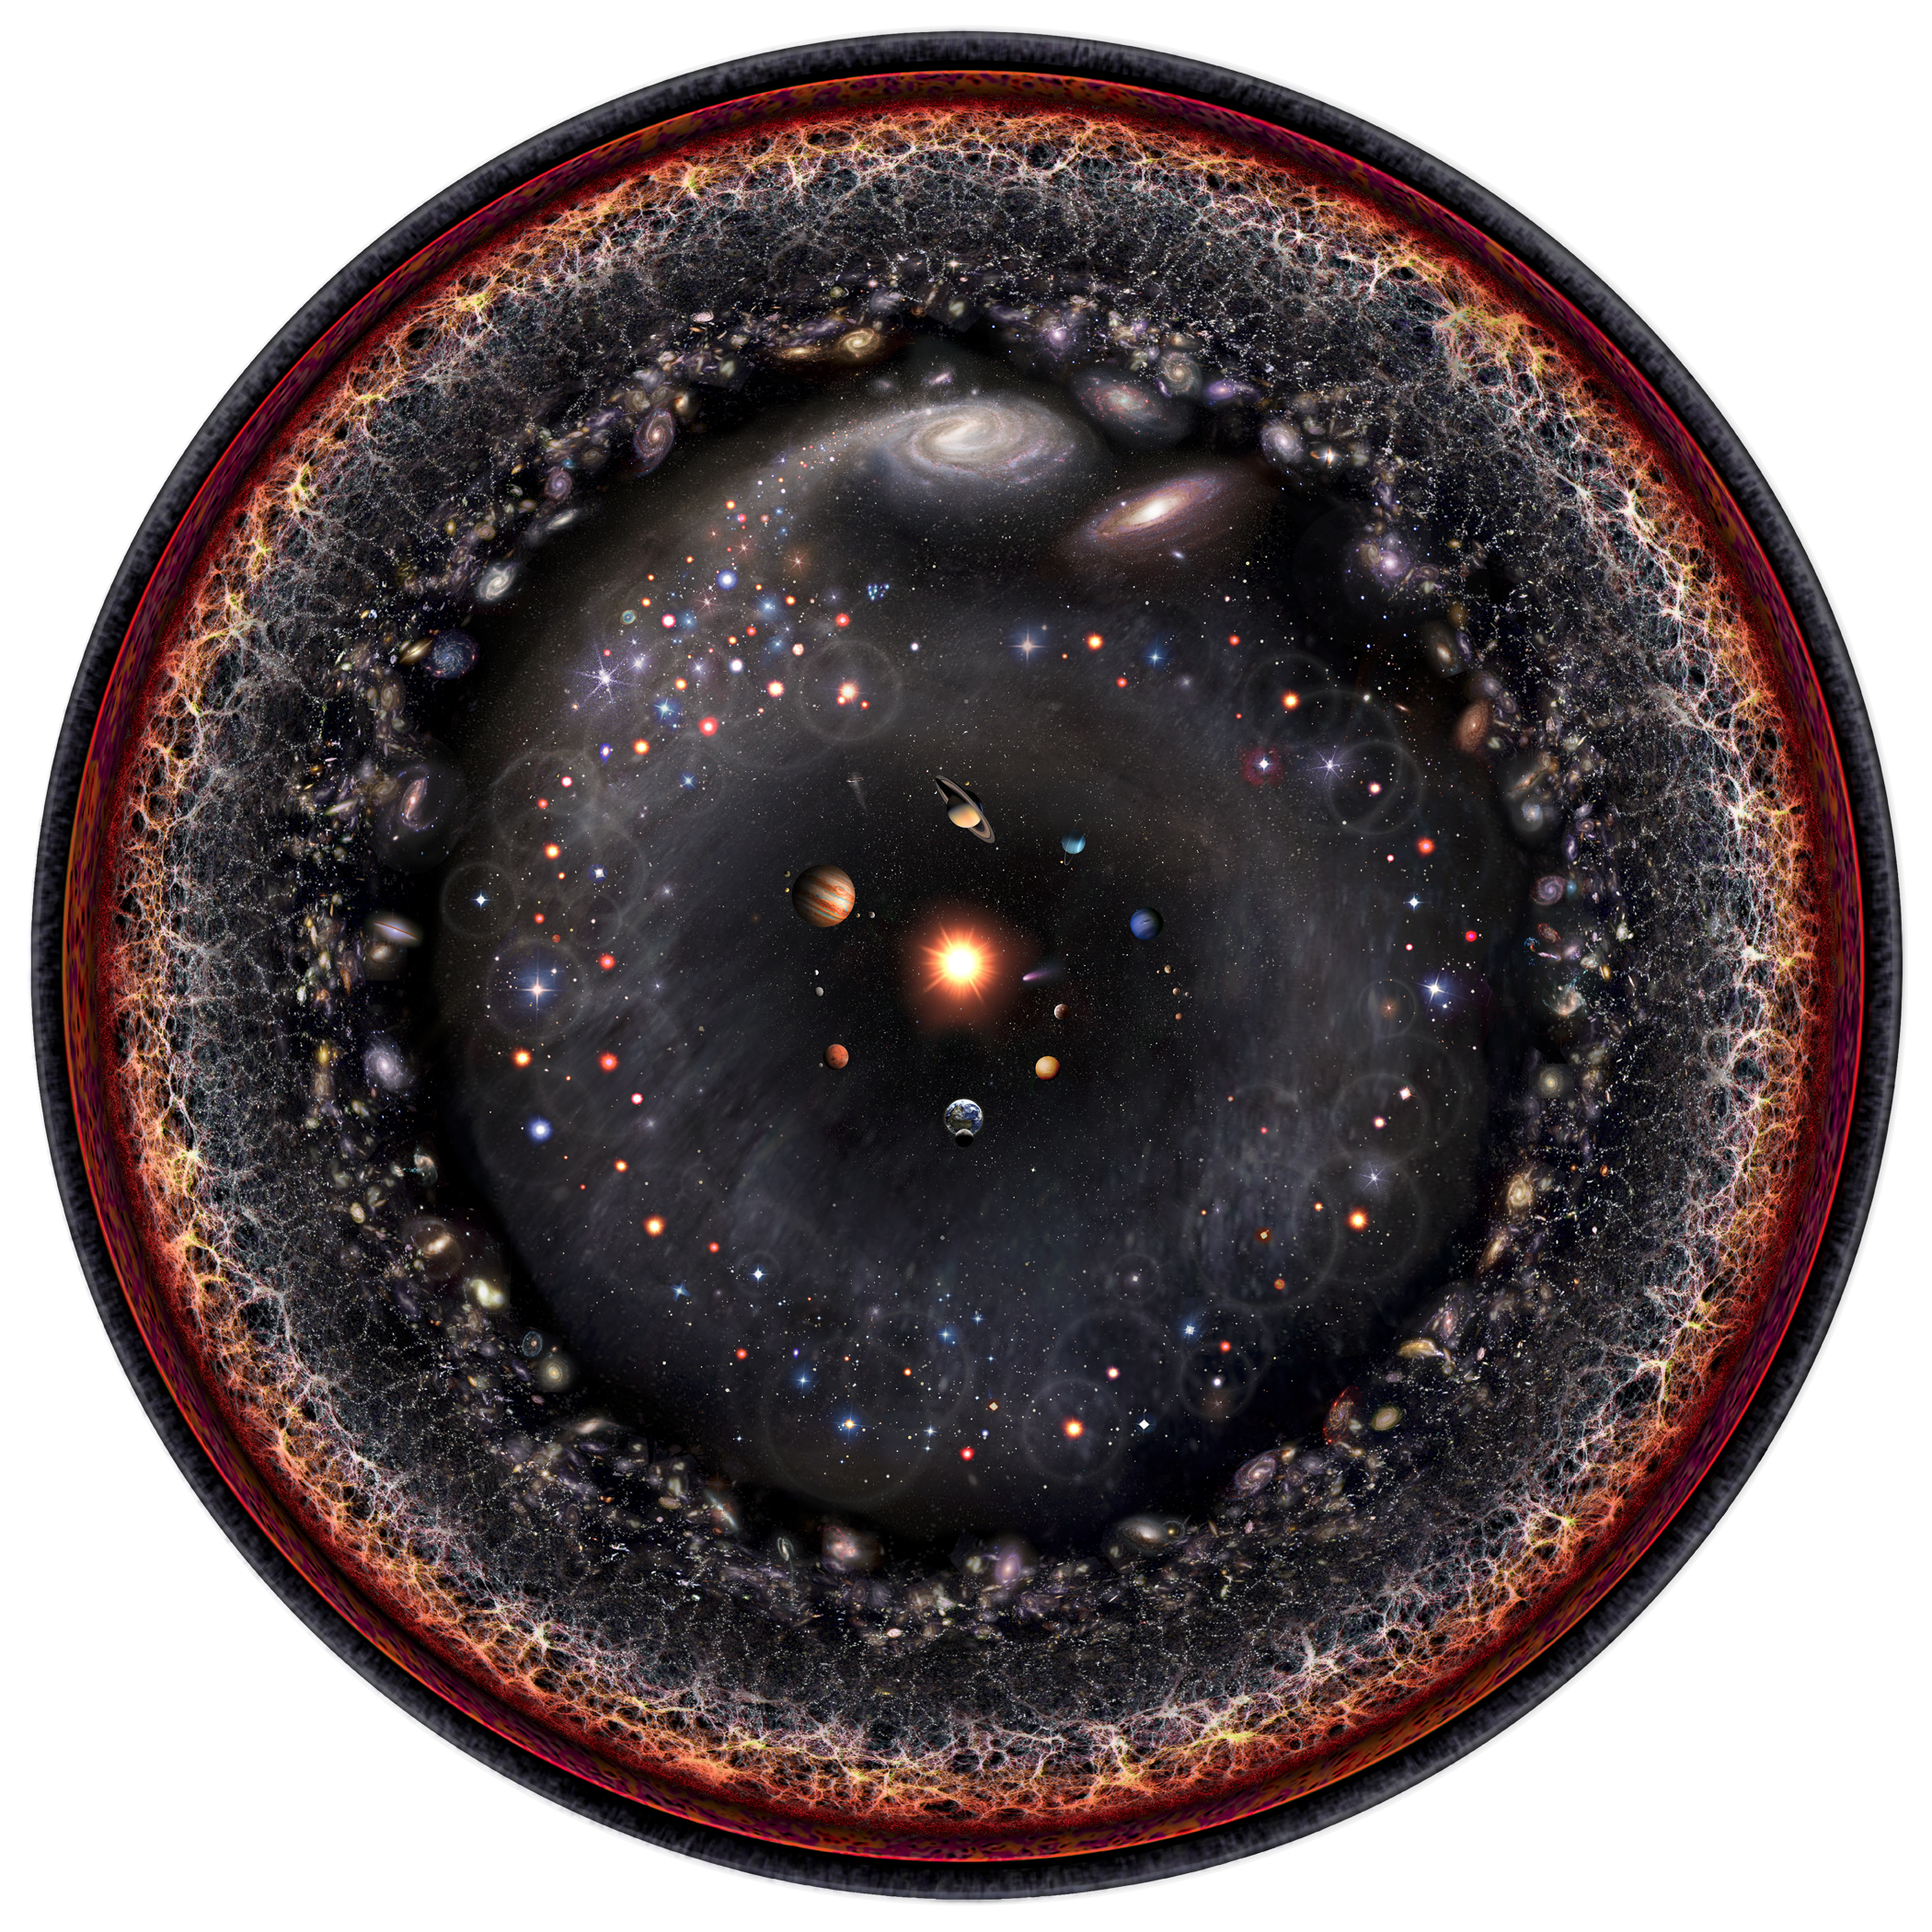
If not the absence of attacks, what is cybersecurity?
malicious
intent
cyber
attack
causality
safety
hazard
cause
effect
Causality
System
designs
Mankind
Nature
Exploitation
process
Process
abstract system
application
Weakness
Exploit
system
implementation
Vulnerability
Defect
realization
Failure
Black-hat
Hacking
process
Attack
malicious
intents
Incident
Accident
non-malicious
intents
Hazard
Asset
impacts
Threat
impacts
Asset
“Software weaknesses are errors that can lead to software vulnerabilities.
A software vulnerability [...] is a mistake in software that can be directly used by a hacker to gain access to a system or network” (MITRE)
Notes:
We analyzed in depth the state of the art trying to understand what is the role of attacker’s intents in cybersecurity.
It turns out that the whole process that leads an attacker to attack a system, starts from an error which creates a weakness and in turn a vulnerability which may lead to an attack.
So, cybersecurity is tightly related to errors.

Slide 26
V-Research Security Hypothesis
Errors [CWE???]
Fact: insecurity starts with a (human?) error
Hyp: a theory on system errors should predict insecurity
Challenge: how can we define a theory of errors?
Weak System [CWE]
Causality
Vulnerable System [CVE]
System under attack [CAPEC]
Security Facts (Extended)
If security is the absence of attacks, we have some 1000+ falsifications (by experiment) per month
Cybersecurity implies the absence of CWE/CVE (not the opposite)
Cybersecurity attacks only if system error is present

Slide 27
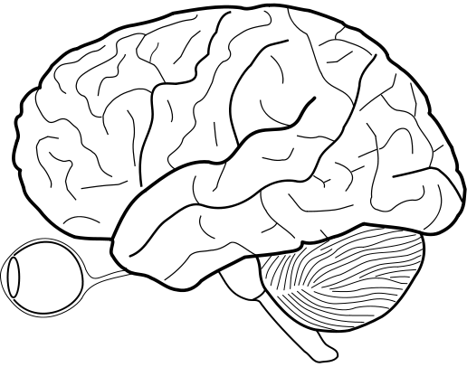

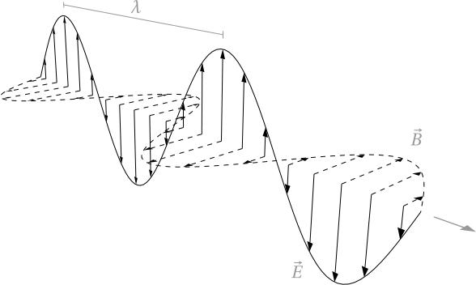
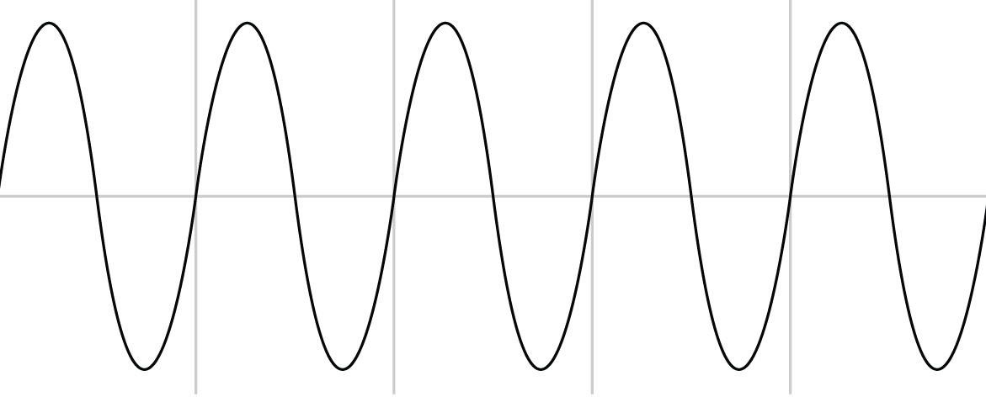

V-Research Cybersecurity Theory
We developed our theory from Jaakko Hintikka’s works,
mapping epistemological concepts to system engineering
Epistemology
Set of Truths – Knowledge
Poorly Justified Statements – Beliefs
Transfer of Beliefs – Information
Error?
uncertainty
[Beliefs]
Acquisition, Generation
& Reasoning
[Knowledge]
Apple
[Information]
EM wave
[Information]
Sound wave

Slide 28
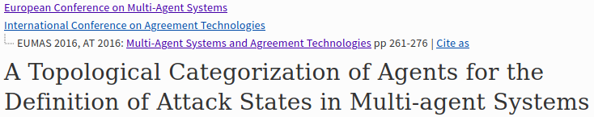
V-Research Cybersecurity Theory
We developed our theory from Jaakko Hintikka’s works,
mapping epistemological concepts to system engineering
Epistemology
Multi-Agent Systems
Set of Truths – Knowledge
Poorly Justified Statements – Beliefs
Transfer of Beliefs – Information
Facts – Ground Truths/Environment
Behaviors – Agent’s thoughts
Assertions – Agent’s communication
Error?
uncertainty
[Beliefs]
Acquisition, Generation
& Reasoning
[Knowledge]
Apple
[Information]
EM wave
B
F
B/F
B
F
B
F
F
B
Equal
Disjoint
Partial Overlap
Proper Part
Given a calculus (RCC5) over a topology
B/F errors in behaviors
A/F errors in assertions
A/B errors in translations
[Information]
Sound wave

Slide 29
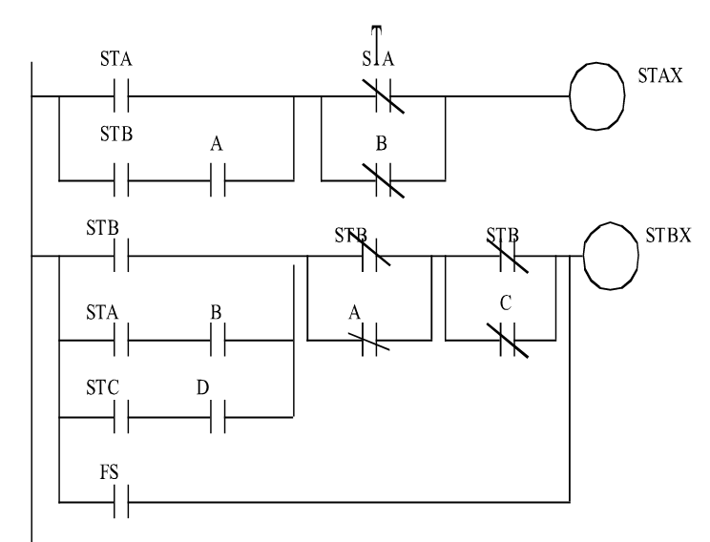
System Modeling Framework (Background Theory)
A CPS can be defined as a MAS
Physical environment
agent
Epistemology/Multi-Agent Systems
Cyber-Physical Systems as MAS
Reasoning
over Beliefs
Functional architecture
Port
Device
Information
translation
Channel
Information
transfer
Universe of Truths
(Knowledge)
Universe of Truths
(Requirements)

Slide 30
Cybersecurity Theory
Physical environment
agent
If the theory is wrong, we will not predict all the errors/weaknesses
(allows falsification by an experiment)
Functional architecture
beliefs
assertions
I/O Port
beliefs
X
X
assertions
Functional architecture
Errors
Port
Channel
Device
beliefs
assertions
Channel
An error may occur in: fun. arch., port, or channel
Ports are sources of errors since they define the
relation between beliefs and assertions
  Similarly Fun. Arch. & Channels but how?
Relations C/P, P/Fa result in an infinite regress
Universe of Truths
(Requirements)

Slide 31
Data flow quality
(see CWE covered by JuliaSoft)
rcc5(Bo,Bi)
rcc5(Ao,Ai)
“PORTS”
“PORTS”
Functional architecture
PORTS
Channel
Port = rcc5(B,A)
Beliefs
Assertions
Behavior = rcc5(B,F)
Communication = rcc5(A,F)
Facts/Information
Requirements
 | Calculus | Assertions Beliefs | Facts
nominal | EQ | x | x
replace | DR | x | y
insert | PP | x | x·y
delete | PPi | x | x’ x
inject | PO | x | x’·y, x’ x
Errors
U
U

Slide 32
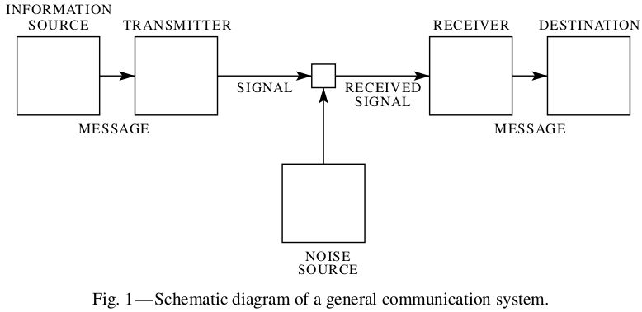

Data flow quality
(see CWE covered by Juliasoft)
Remove?
Rephrase?
rcc5(Bo,Bi)
rcc5(Ao,Ai)
“PORTS”
“PORTS”
Functional architecture
PORTS
Channel
Port = rcc5(B,A)
Beliefs
Assertions
Behavior = rcc5(B,F)
Communication = rcc5(A,F)
Facts
Information
Requirements
channel
agent
output
port
input
port
agent

Slide 33
A
A
A
Information
Security
&
Logic
Verification
Data flow
(static analysis)
&
Channel Noise
Channel
Channel
F
B
A
B
Port
Fun. Arch.
 | Quantity: Beliefs & Assertions Channel(A,A); Port(B,A); Fun(B,B) | Quality: Requirements (Facts) Channel(A,F); Behavior(B,F)
EQ | Expected Nominal | Expected Nominal
DR | drops all the inputs and inserts new malicious data | the component never performs/carries the expected behavior/information
PP | selectively drops inputs | part of the expected outputs are not generated in response to the correct inputs
PPi | forwards all the inputs but crafts and inserts new malicious data | the components correctly performs/carries the expected behavior/information when the correct inputs are provided but is subject to input injections
PO | selectively drops inputs and inserts new data | Byzantine behavior - occasionally outputs the expected output given the correct inputs. Not all the inputs are handled properly, nor all the expected outputs are always generated when correct inputs are given
availability
integrity
Confidentiality?
Not a system property?
Confined to Information?

Slide 34
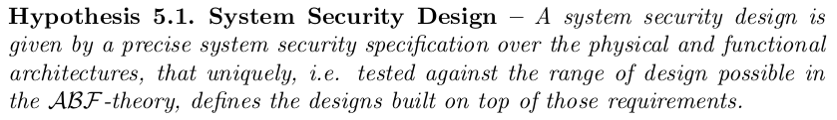
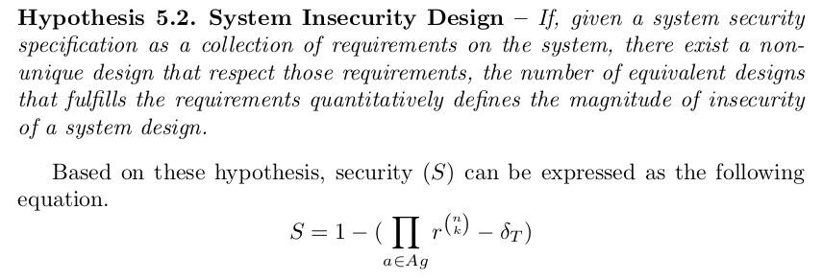
Cybersecurity Theory
This allows us to precisely measure security risks

Slide 35
Agenda
Who we are, V-Research, Business Model
V-Research Cybersecurity Challenge
State-of-the-art Solutions and Competitors
Cybersecurity – A scientific Quest!
V-Research Prototype - Security Risk Assessment Demo
Summary & Vision

Slide 36

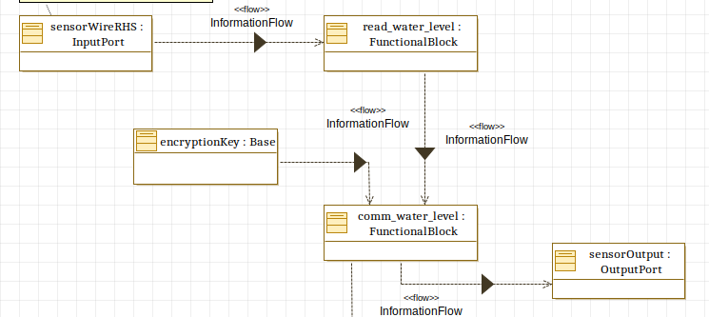
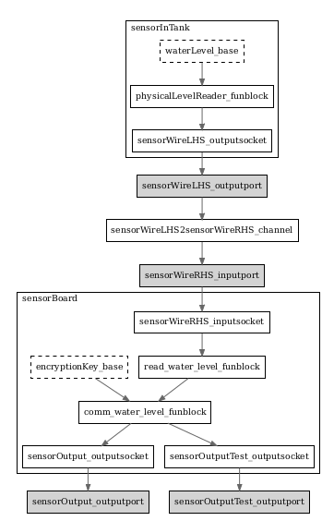
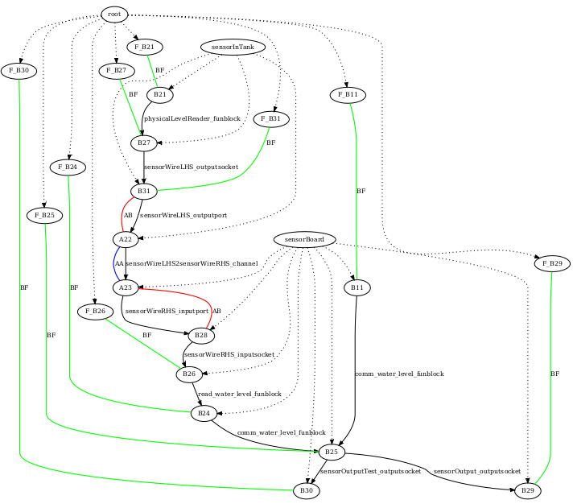

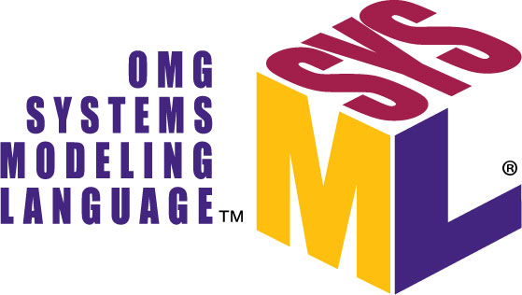
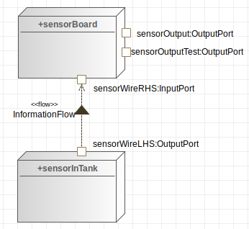

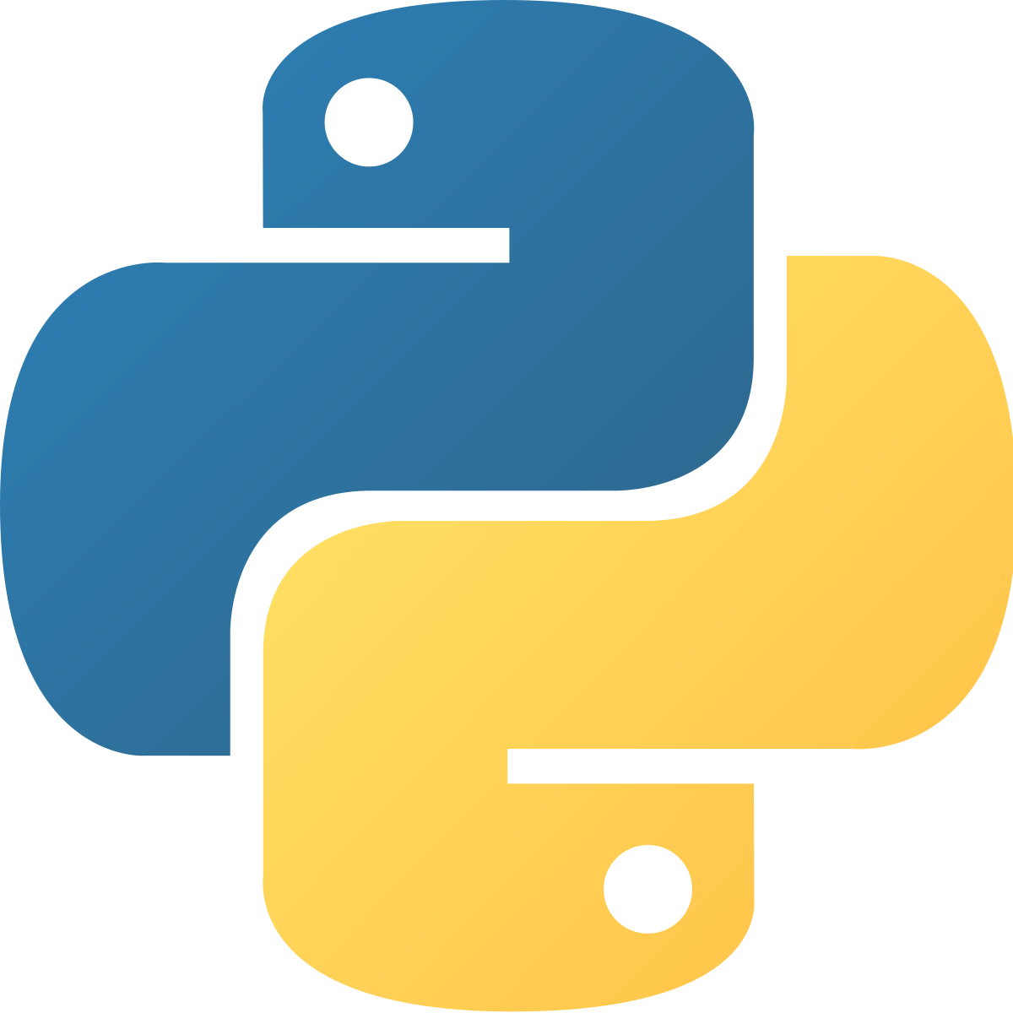



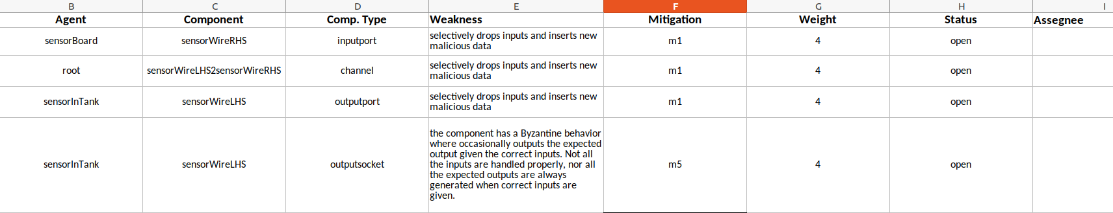
TODO
Add mitigations in tool
Automated Cybersecurity Risk Assessment
2. Automated Threat Scenario
Generation & Reasoning
1. System Engineering
3. Automated Risk Estimation &
Mitigation Suggestions
4. on-the-fly Risk Reduction
Based on Mitigation

Slide 37
Agenda
Who we are, V-Research, Business Model
V-Research Cybersecurity Challenge
State-of-the-art Solutions and Competitors
Cybersecurity – A scientific Quest!
V-Research Prototype - Security Risk Assessment Demo
Summary & Vision

Slide 38
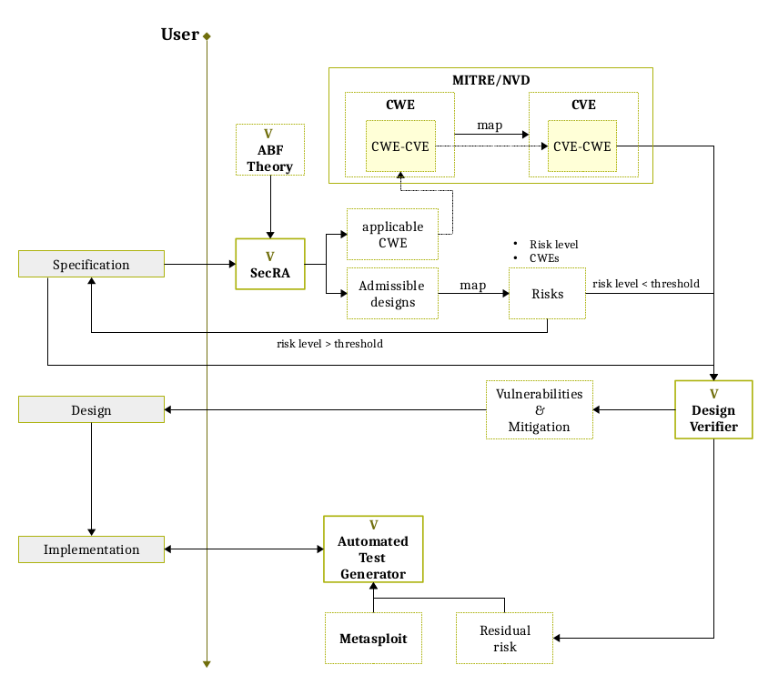
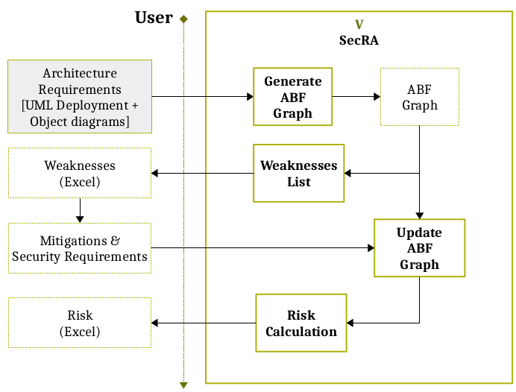
Summarizing
We defined a framework where the constituents of a system are
Generic enough to model any CPS (and MAS)
Allows the quantitative evaluation of Design Weaknesses
We defined a Cybersecurity Hypothesis that can be tested
predict all possible Weaknesses (Insecurity)

