Slide 1
V
-
R
e
s
e
r
c
h
v
Images for Experiment Alpha
Marco Rocchetto
Dissemination level: public
Confidentiality level: public
ECCN: NSR

Slide 2
v1.0
deprecated
Mankind
Nature
Malicious intents
Non-Malicious intents
Hazards
Dissemination level: public
Confidentiality level: public
ECCN: NSR

Slide 3
V1.1
deprecated
Mankind
Nature
Exploit
Vulnerability
Defect
Failure
Attack
Threat
Hazard
Accident
Malicious intents
Incident
Non-Malicious intents
Dissemination level: public
Confidentiality level: public
ECCN: NSR

Slide 4
V1.2
deprecated
Mankind
Nature
Exploit
Vulnerability
Defect
Failure
Attack
Incident
Hazard
Accident
Malicious intents
Threat
Non-Malicious intents
Dissemination level: public
Confidentiality level: public
ECCN: NSR

Slide 5
V1.3
outdated
Mankind
Nature
Exploit
Vulnerability
Defect
Failure
Attack
Incident
Accident
Hazard
Malicious intents
Threat
Non-Malicious intents
Dissemination level: public
Confidentiality level: public
ECCN: NSR

Slide 6
V1.4
outdated
Causality
Mankind
Nature
Exploit
Vulnerability
Defect
Failure
Attack
Incident
Accident
Hazard
Malicious intents
Threat
Non-Malicious intents
Dissemination level: public
Confidentiality level: public
ECCN: NSR

Slide 7
V1.4
outdated
Causality
Mankind
Nature
Exploit
implementation
Vulnerability
Defect
realization
Failure
Attack
malicious
intents
Incident
Accident
non-malicious
intents
Hazard
Asset
Threat
Asset
Dissemination level: public
Confidentiality level: public
ECCN: NSR

Slide 8
V1.5
latest
Causality
System
designs
Mankind
Nature
Exploitation
process
Risk
poses
Weakness
Errors
Black-hat
Hacking
process
Exploit
generates
Vulnerability
Defect
realization
Failure
Attack
malicious
intents
Incident
Accident
non-malicious
intents
Hazard
Asset
impacts
Threat
impacts
Asset
Dissemination level: public
Confidentiality level: public
ECCN: NSR

Slide 9
V1.0
latest
Server
Alice
Bob
I) Bob’s public key
II) Symmetric key generation
III) Symmetric key exchange
Dissemination level: public
Confidentiality level: public
ECCN: NSR

Slide 10
V1.0
deprecated
Propositional Language
Truths
Beliefs
poorly
justified
true beliefs
knowledge
Dissemination level: public
Confidentiality level: public
ECCN: NSR

Slide 11
V1.0
latest
Language
Truths
Beliefs
poorly
justified
true beliefs
knowledge
Dissemination level: public
Confidentiality level: public
ECCN: NSR

Slide 12


V1.1
latest
Security Specification
Security-aware System Specification
Causality
Structure
First Order Logic
System States
Risk
Assessment
Doxastic & Epistemic Logic
Devices and Connections
Modal Logic
System Evolution
Security Design
Security-aware System Design
Dissemination level: public
Confidentiality level: public
ECCN: NSR

Slide 13
V1.2
latest
System & Security Specification
Security Risk
Assessment
Physical Architecture
Functional Architecture
System & Security Design
Testing
Function Logic Security Verification
Functional Logic
Physical Logic
System & Security Implementation
Design Compliance
Verification
HW/SW Architecture
Implementation code
Dissemination level: public
Confidentiality level: public
ECCN: NSR

Slide 14
V1.0
latest
Philosophy
Science
Engineering
Hypothesis
Theory
Application
Ideas
Work
Reward
Dissemination level: public
Confidentiality level: public
ECCN: NSR

Slide 15
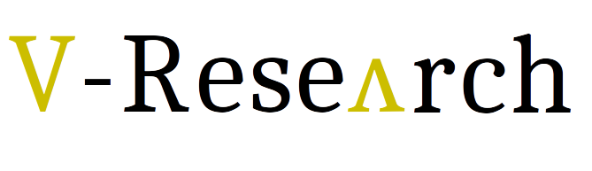
V1.1
latest
Philosophy
Science
Engineering
Sextus Empiricus
Karl
Popper
Edmund Husserl?
Hypothesis
Theory
Application
Methodology
Model
Process
Idea
Research
Reality
Dissemination level: public
Confidentiality level: public
ECCN: NSR

Slide 16
V1.0
latest
CVE-2008-3773
CVE-2008-4636
CVE-2008-3773
CVE-2008-4636
CWE-116
CWE-116
CVE-2008-5573
CVE-2008-0769
CVE-2008-5573
CVE-2008-0769
CVE-2008-0005
CVE-2008-0005
Dissemination level: public
Confidentiality level: public
ECCN: NSR

Slide 17
V1.0
latest
Causality
CVE-2008-4636
CVE-2008-3773
CVE-2008-4636
CWE-116
CWE-116
CVE-2008-5573
CVE-2008-0769
CVE-2008-0005
Dissemination level: public
Confidentiality level: public
ECCN: NSR

Slide 18
V1.0
latest
Causality
Mankind
Exploit
implementation
Vulnerability
Honest
malicious
intents
Honest
Attack
Incident
CWE-116
CWE-116
Asset
Threat
CVE-2008-0005
Attacker
Attacker
Dissemination level: public
Confidentiality level: public
ECCN: NSR

Slide 19
V1.0
latest
Weakness - dictionary
Vulnerability - dictionary
Mistake 1
Abstract
System 1
CWE – entry 1
System
Implementation 1
...
...
...
...
Abstract
System N
System
Implementation N
Mistake N
CWE – entry N
Instance
NIST - CVE
Instance
CVE-2008-4636
implementation
CWE - 116
CVE-2008-4636
...
MITRE - CWE
CVE-2008-0757
CWE-117
abstraction
MITRE - CAPEC
CWE-93
...
CAPEC-81
CAPEC-81
CWE-713
CAPEC-117
Dissemination level: public
Confidentiality level: public
ECCN: NSR
...
CAPEC-713
Attack Pattern - dictionary
CWE 1
Exploitation
Process
Instance
...
...
Abstract
System N
CWE N

Slide 20
Op-net
ABF
Git repo
Z3 Solver
ABF
encoding
Agent
Quantifiers
unfolding
System spec
Agent’s
Security
configurations
File
File
File
File
...
...
File
File
Weakness - dictionary
Agent
Term
Mistake 1
Abstract
System 1
...
...
Abstract
System N
Mistake N
translator
AI
Z3 Solver
Solver
semantic_search
dictionary.txt
File
read_terms_from_file
input.txt
File
read_input_text
String

Slide 21
V1.0
latest
System
Agent
Agent
I
I
O
I
O
O
Agent
Behavior
I
O

Slide 22
V1.0
latest
Specification
Other Designs
Excluded Designs
Cybersecurity Risk of an Agent

Slide 23
User
MITRE/NVD
CWE
CVE
V
ABF
Theory
CWE-CVE
map
CVE-CWE
applicable
CWE
V
SecRA
Risk level
CWEs
Specification
Admissible
designs
map
Risks
risk level < threshold
risk level > threshold
Vulnerabilities
&
Mitigation
V
Design
Verifier
Design
V
Automated
Test
Generator
Implementation
Metasploit
Residual
risk

Slide 24
User
V
SecRA
Architecture
Requirements
[UML Deployment +
Object diagrams]
Generate
ABF
Graph
ABF
Graph
Weaknesses
(Excel)
Weaknesses
List
Mitigations &
Security Requirements
Update
ABF
Graph
Risk
(Excel)
Risk
Calculation
MITRE/NVD
CWE
CVE
V
ABF
Theory
CWE-CVE
map
CVE-CWE
applicable
CWE
V
SecRA
Risk level
CWEs
Specification
Admissible
designs
map
Risks
risk level < threshold
risk level > threshold
Vulnerabilities
&
Mitigation
V
Design
Verifier
Design
V
Automated
Test
Generator
Implementation
Metasploit
Residual
risk

Slide 25
Implementation
Assertions & Beliefs
Design
abstraction
soundness
Specification
Facts

Slide 26
Agent
Input port
Output port
behavior
behavior
agent s
agent r
Input port
Input port
Mono-directional
channel
relations

Slide 27
agent server [s]
agent client [c]
resource_service
request_response

Slide 28
b1
sum
b3
b1

Slide 29
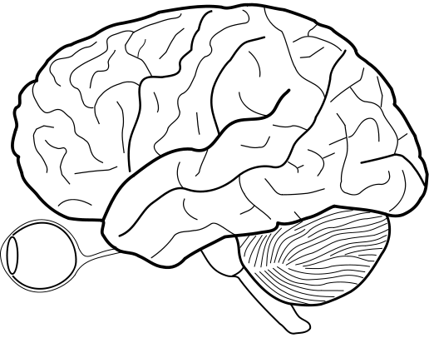
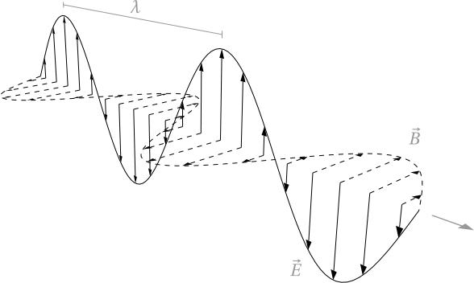
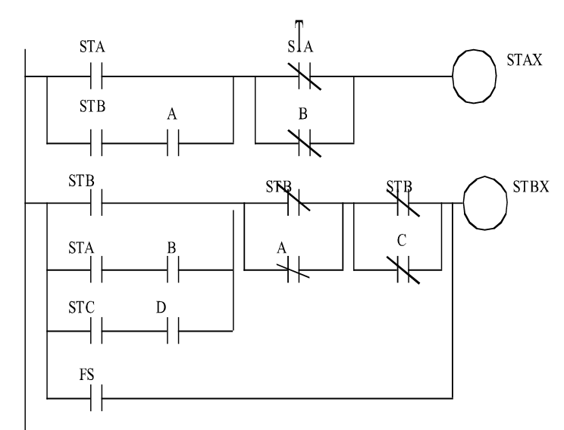
Errors
Weak System [CWE]
Causality
Vulnerable System [CVE]
System under attack [CAPEC]
Epistemology to MAS
MAS to CPS
Agent
Reasoning
over Beliefs
Requirements
(Universe of Truths)
Functional Architecture
Information
translation
into Beliefs
Information
transfer
Knowledge
(Universe of Truths)
Device
Channel
Port

Slide 30

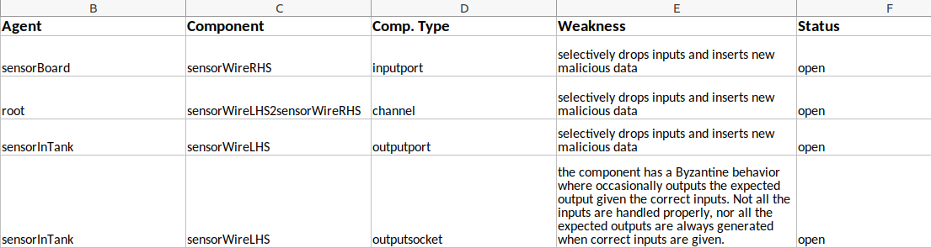
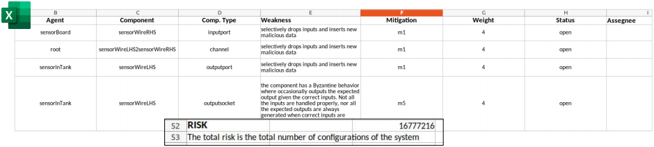

Slide 31
Text can be in black
Or THIS red
But V-Research is nice in gold :) and you can use our big V ->
You can write nerd style (e.g. code) like: 131.164.202.154
Title (somewhere)
Links are nicer small
Quotes are still nice in Caladea but authors are nices in Carlito
A theory which is not refutable by any conceivable event is non-scientific. Irrefutability is not a virtue of a theory (as people often think) but a vice.
K. Popper, Conjectures and Refutations
Dissemination level: public
Confidentiality level: public
ECCN: NSR

