Slide 1
V
-
R
e
s
e
r
c
h
v
R&D for Systems and Security Engineering
ABF-based Security Risk Assessment Tool
Marco Rocchetto
Dissemination level: L-0
Confidentiality level: confidential
ECCN: NSR

Slide 2
What is a secure system?
What is cybersecurity?
What is a secure engineering process?

Slide 3

What is cybersecurity?
“Those who believe they have discovered it [the truth] are the dogmatists”
Sextus Empiricus, Outlines of Pyrrhonism
“Academics treats it as inapprehensible”
Sextus Empiricus, Outlines of Pyrrhonism
“The skeptics keep on searching”
Sextus Empiricus, Outlines of Pyrrhonism
Cybersecurity
is the protection of computer systems and networks from the theft of or damage to their hardware, software, or electronic data, as well as from the disruption or misdirection of the services they provide.
The only truly secure system is one that is powered off, cast in a block of concrete and sealed in a lead-lined room with armed guards — and even then I have my doubts.
[…] things can be declared insecure by observation, but not the reverse. There is no test that allows us to declare an arbitrary system or technique secure. This implies that claims of necessary conditions for security are unfalsifiable.
Eugene H. Spafford
Purdue University
Cormac Herley
Microsoft Research

Slide 4
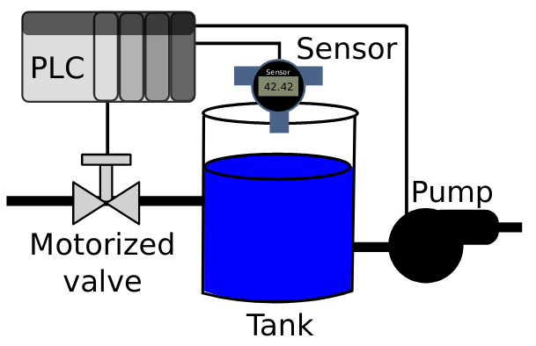
Spec: Physical and Functional Architecture of a CPS
Specification
Use Case
actuator
http://marcorocchetto.eu/pub/categorizationEUMAS16.pdf

Slide 5
Spec: Physical and Functional Architecture of a CPS
Simplified

Slide 6
System-spec as an Agent: Assertions, Beliefs, and Facts
Simplified
Assertions
a transfer of
beliefs (information)
between agents
Beliefs
Constituents
of agents’
nominal behavior
Facts
True beliefs

Slide 7
System-spec as an Agent: Assertions, Beliefs, and Behavior
Simplified
First Focus

Slide 8
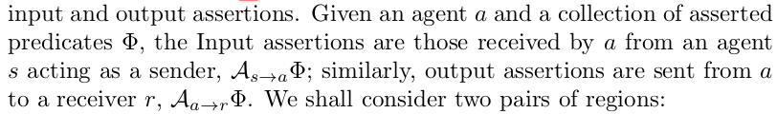
System-spec as an Agent: Assertions, Beliefs, and Behavior
Simplified
First Focus

Slide 9
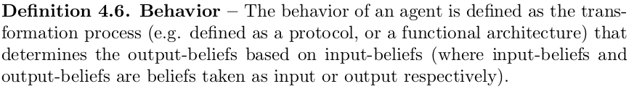
System-spec as an Agent: Assertions, Beliefs, and Behavior
Simplified
First Focus

Slide 10
System-spec as an Agent: Assertions, Beliefs, and Behavior
Simplified
First Focus
Ports’ Behavior?

Slide 11
System-spec as an Agent: Assertions, Beliefs, and Ports’ Behavior
Simplified
Port’s Behavior
Changes the type to information
From assertions/belief to
belief/assertion; forwarding
Information form I/O to O/I
First Focus
Ports’ Behavior?
Atom – no transformation

Slide 12
Ports-spec as an Agent: Assertions, Beliefs, and Behavior
Port’s Behavior
Changes the type to information
From assertions/belief to
belief/assertion; forwarding
Information form I/O to O/I
behavior
Who said EQ(Ai,Ao)?

Slide 13
Ports-spec as an Agent: Assertions with static (forward) Behavior (RCC5)
Forward all inputs
Drops and new out
Drops and new output but keeps forwarding
Forwards but creates new outputs?
Forwards and drops some inputs?

Slide 14
Ports-spec as an Agent: Assertions with static (forward) Behavior (RCC5)
Forward all inputs
Drops and new out
Drops and new output but keeps forwarding
There exist 4 types of
security weakness (CWE) for
an IP interface/port
Forwards but creates new outputs?
Forwards and drops some inputs?

Slide 15
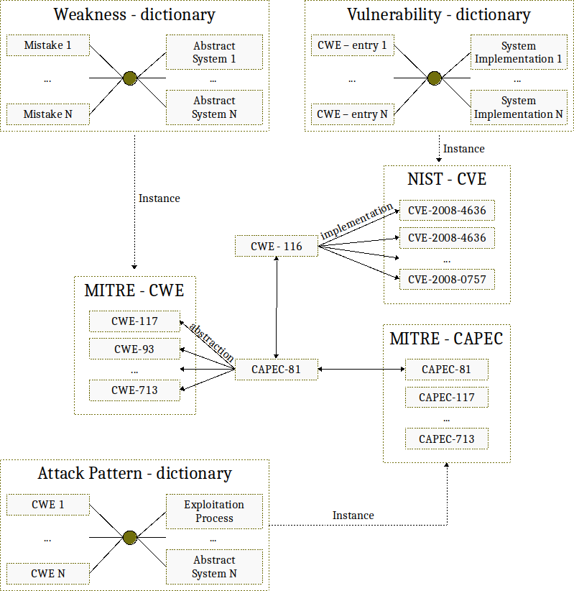

Slide 16
CVE-2003-0857
CWE-264
This is not a
vulnerability of
the port itself
Herbert Xu discovered that a number of netlink applications do not
check the source address of incoming packets, assuming they are coming
from the kernel. As any local user can send unicast netlink messages
to any process on the system, this can lead to a local denial of
service attack, or other local attacks
https://bugzilla.redhat.com/show_bug.cgi?id=108574
ipq_read(…,buf,…)
if buf = kernel
ipq_read(…,buf,…)
...
kernel
netlink
app

Slide 17
Ports-spec as an Agent: Assertions with static (forward) Behavior (RCC5)
Forward all inputs
ACCEPT
Drops and new out
DROP
Drops all inputs

Slide 18
Ports-spec as an Agent: Assertions with static (forward) Behavior (RCC5)
NO!
Forward all inputs
ACCEPT
Drops and new out
Relations between Ai and Ao only states the quantitative relation between regions of inputs and outputs
DROP
NO!
Drops all inputs

Slide 19
Ports-spec as an Agent: Assertions, Beliefs, and Behavior
Port’s Behavior
Changes the type to information
From assertions/belief to
belief/assertion; forwarding
Information form I/O to O/I
behavior
Behavior
Forward all inputs

Slide 20
Ports-spec as an Agent: Assertions, Beliefs, and Behavior
Port’s Behavior
Changes the type to information
From assertions/belief to
belief/assertion; forwarding
Information form I/O to O/I
behavior
Behavior
Forward all inputs
Who said EQ(Bi,Bo)?

Slide 21


Ports-spec as an Agent: Assertions with static (forward) Behavior (RCC5)
Forward all inputs
Port rules/behavior
Drops and new out
menu
port
agent
type
Drops and new output but keeps forwarding
network
software
layer
PHY
MAC
NET
behavior
Forwards but creates new outputs?
Syntactic
sugar
Forwards and drops some inputs?
new
Same as before… So, the behavior is specified by the model(er)
as a relation of assertions and beliefs between agents of a system

Slide 22
Ports-spec as an Agent: Assertions with static (forward) Behavior (RCC5)
Port rules/behavior
Input port
Takes Assertion
From output port of an agent and sends it to the functional architecture of the recipient agent
Output port
Takes Assertion
From the functional architecture of an agent and sends it to the input port of the recipient
menu
port
agent
type
network
software
layer
PHY
MAC
NET
behavior
new
Correct design
Other designs

Slide 23
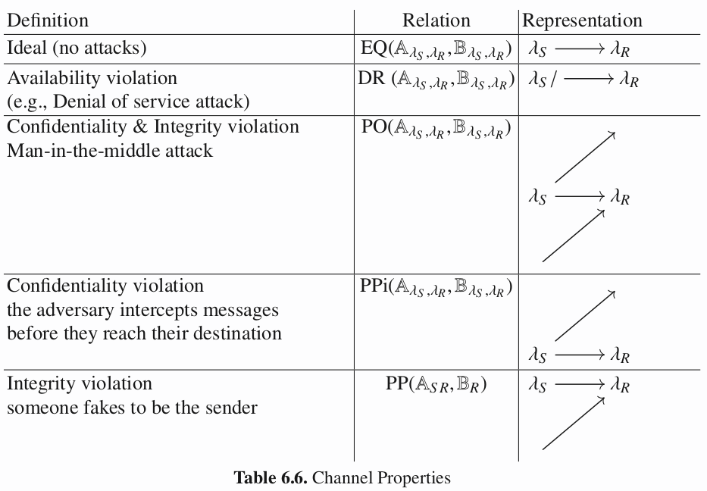
Spec: Physical and Functional Architecture of a CPS
Simplified

Slide 24
System Security 1/2: Assertions and Beliefs

Slide 25
Ports-spec as an Agent: Assertions, Beliefs, and Behavior

Slide 26
Ports-spec as an Agent: Assertions, Beliefs, and Behavior
behavior
Spec behavior
1
2
Spec behavior
3
4
1
Who said DR(Ai,Ao)?

Slide 27
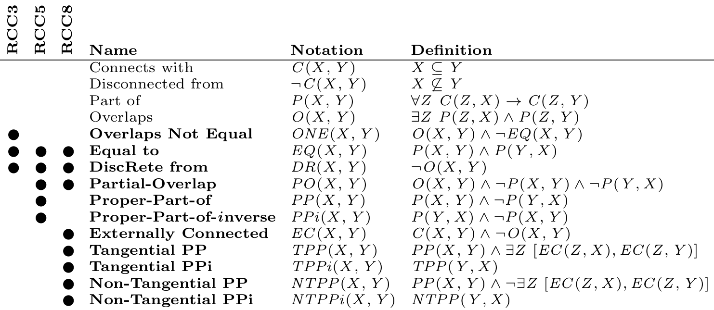
How many weaknesses?

Slide 28
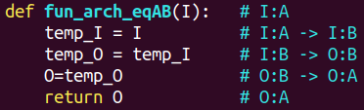
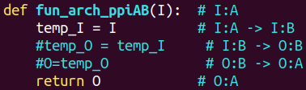
Ports-spec as an Agent: Assertions, Beliefs, and Behavior
behavior
Port’s Behavior
Changes the type to information
From assertions/belief to
belief/assertion; forwarding
Information form I/O to O/I
Spec behavior
1
2
Spec behavior
3
4
1
What if O was initialized to a default value outside the scope of the function?

Slide 29
Region Connection Calculus (5 relations)
If it asserts something
It is the result of a computation
Model
behavior
Not sincere
Sincere
2
Fair agent
1
3
Not collaborative
Collaborative
If it compute something
It asserts it
4
5
Saboteur
Not saboteur
Braggart
Not braggart
Byzantine
behavior
Opposite
behavior
No distinction between
Ai/Ao, and Bi/Bo
EQ
PP
PPi
PO
DR

Slide 30
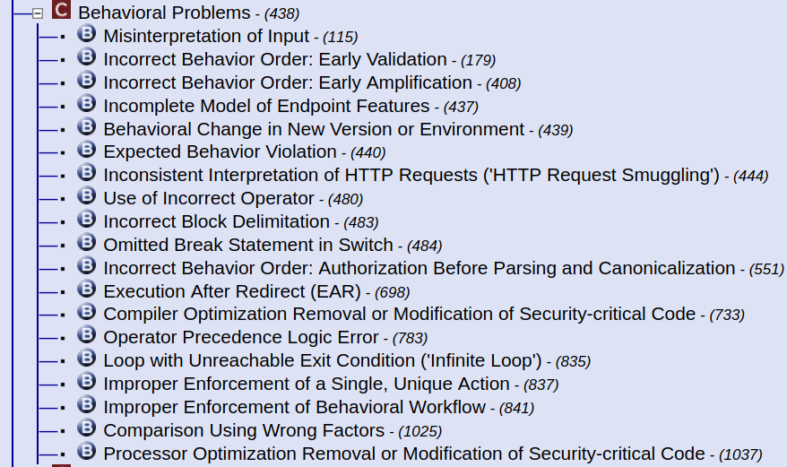
CWE-438 Behavior
Phase: architecture and design - implementation
https://cwe.mitre.org/data/definitions/438.html
Phase: implementation
Phase: implementation
CWE-115 misinterpretation of inputs
Phase: architecture and design - implementation
https://cwe.mitre.org/data/definitions/115.html

Slide 31
Physical and Functional Architecture
Simplified
First Focus
Ports’ Behavior?
PLC’s Behavior?

Slide 32
Physical and Functional Architecture
Simplified
First Focus
Ports’ Behavior?
PLC’s Behavior?

Slide 33
Physical and Functional Architecture
Simplified
First Focus
Ports’ Behavior?
PLC’s Behavior?

Slide 34
Physical and Functional Architecture
Simplified
No logic
First Focus
Ports’ Behavior?
PLC’s Behavior?

Slide 35
Physical and Functional Architecture
Cleaned
Ideal Comm.
Ideal Logic
Security?

Slide 36

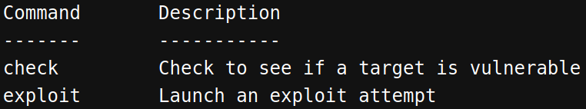



Physical and Functional Architecture
Cleaned
What if Sys. doesn’t
Sanitize the input?
Security?
@Specification
@Design
@Implementation
Software weaknesses are errors that can lead to software vulnerabilities
What if I wiretap
https://cwe.mitre.org/data/definitions/1000.html
https://cve.mitre.org/
https://www.metasploit.com/

Slide 37
Physical and Functional Architecture
Cleaned
Ideal Comm.
Ideal Logic
Security?
@Specification
Software weaknesses are errors that can lead to software vulnerabilities
How many errors?

Slide 38
Security?
Ideal Comm.
Ideal Logic
No weaknesses in

Slide 39
How many weaknesses?
Ideal Comm.
Ideal Logic
No weaknesses in
@EUMAS
Not Equal isn’t Disjoint

Slide 40
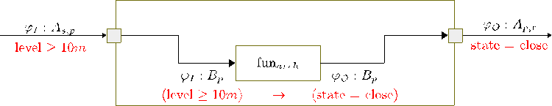

Slide 42
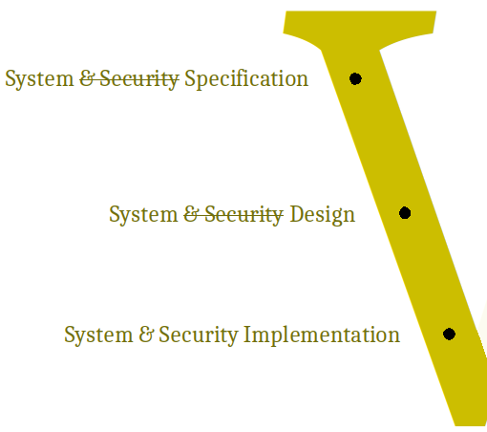
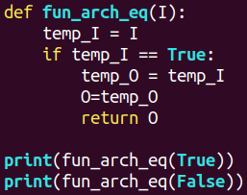

We all know it’s impossible but suppose that you consider security ONLY @implementation

Slide 43

System & Security Specification
Testing
System & Security Design
System & Security Implementation

Slide 44

Text can be in black
Or THIS red
But V-Research is nice in gold :) and you can use our big V ->
You can write nerd style (e.g. code) like: 131.164.202.154
Title (somewhere)
Links are nicer small
Quotes are still nice in Caladea but authors are nicer in Carlito
A theory which is not refutable by any conceivable event is non-scientific. Irrefutability is not a virtue of a theory (as people often think) but a vice.
K. Popper, Conjectures and Refutations
Dissemination level: public
Confidentiality level: public
ECCN: NSR

