Slide 1
V
-
R
e
s
e
r
c
h
v
Research & Development for Cybersecurity Engineering
Portfolio and Mission
Francesco Beltramini, Marco Rocchetto
francesco@v-research.it marco@v-research.it
Dissemination level: Public
Confidentiality level: unencrypted
ECCN: NSR

Slide 2

Agenda
Who we are and What V-Research is
Cybersecurity Challenge (problem statement)
State-of-the-art “Solutions” and Competitors
V-Research Prototype Solution

Slide 3
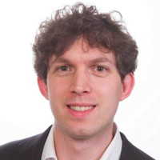
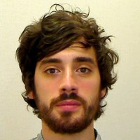
Who and History
Co-founder of V-Research
[Research & Development]
Co-founder of V-Research
[Business Development]
Head of SecOps Engineering - Inmarsat
Founded in 2020, Verona – IT
A private R&D center that bridges foundational challenges and engineering needs
Our mission is to develop a
  scientific theory of cybersecurity and
  a tool-chain for the secure engineering of cyber-physical systems
Combined 20+ years of experience in:
  formal methods for verification and testing
  system engineering for complex cyber (and cyber-physical) systems
  multi-year programs: both EU-funded (SPaCIoS, GOVSATCOM) and privately-funded (Global eXpress)
Notes:
We founded V-Research in February this year.
Our objective is to establish a private research center that bridges foundational challenges and engineering needs.
Our technical background is mainly on cybersecurity and ranges from formal methods for verification and testing to complex cyber-physical systems engineering
MR – technical role
Bachelor, Master and PhD in computer science – with B and M focusing on cybersecurity – and PhD
on the application of formal methods (logic-based approaches for the verification of security protocols).
Engineering state qualifying exam
Started as postdoc researcher University of Luxembourg, SUTD, Univr-ETHZ (with SIEMENS)
Researcher for the AVANTSSAR and SpaCIoS EU-funded projects (SAP, ETH, TUM, SIEMENS etc)
3 years as Senior Engineer in UTRC with leading role in several projects, two of them are:
– the Engineering of secure wireless elevator system (3 patents – Otis [elevator]) – up to tech transfer to Otis Engineers testing in Test tower
– Formal Risk Assessment (Otis [elevator], Rockwell Collins [aerospace])
Quit my position and opened V-Research
FB+

Slide 4
Business model

Slide 5
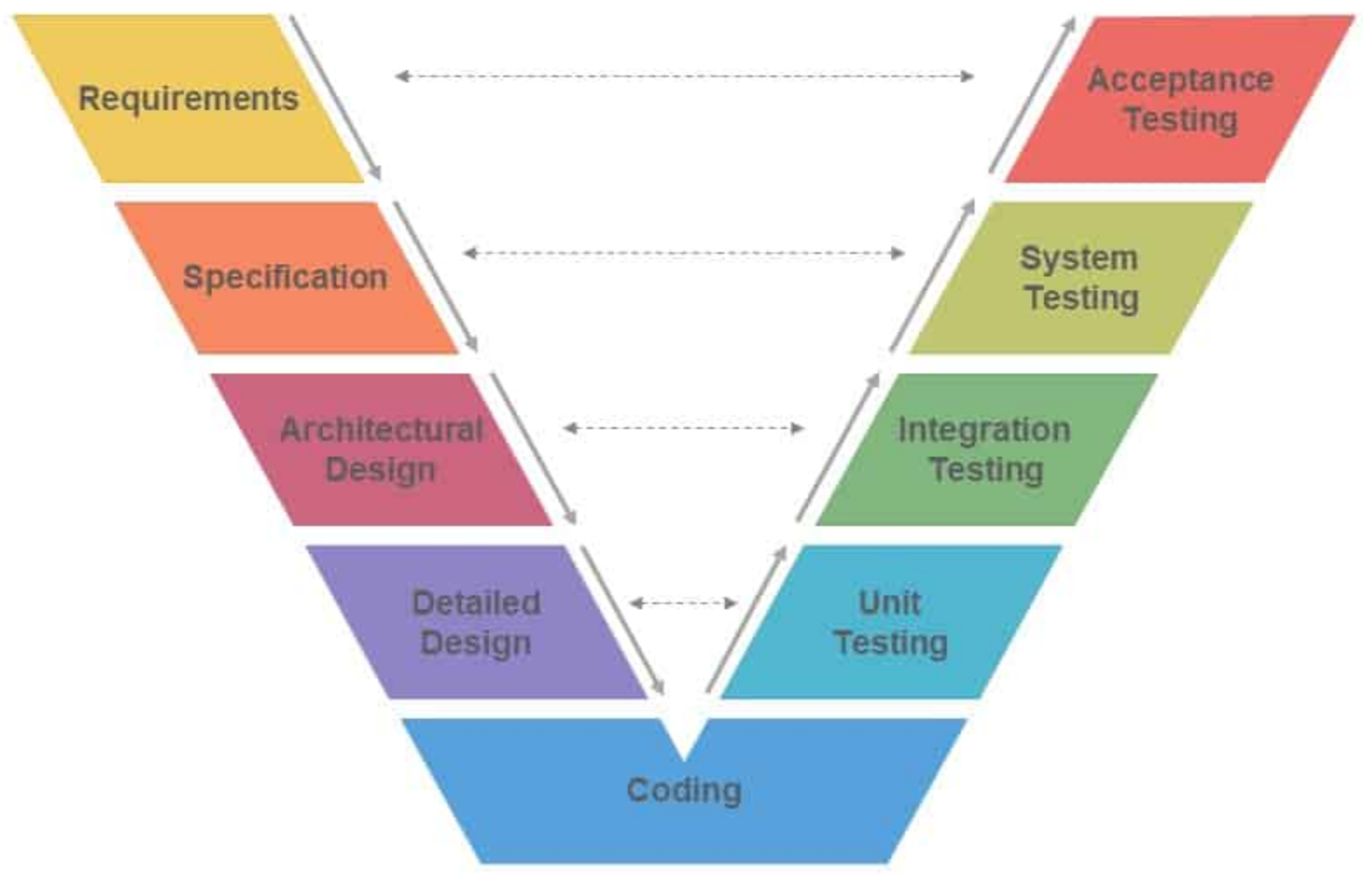
Current V-Research Offering (Consultancy)
Security Engineering
Requirements and Architecture
Design Specification
Implementation and Testing
Use cases definition
Assist in TRL maturation
Complement customers internal resources
Commercial Expertise
Platform Evaluation and Selection
RFP / Tender consultancy
Partnership and Security Assurance
Conformance / Compliance Testing

Slide 6
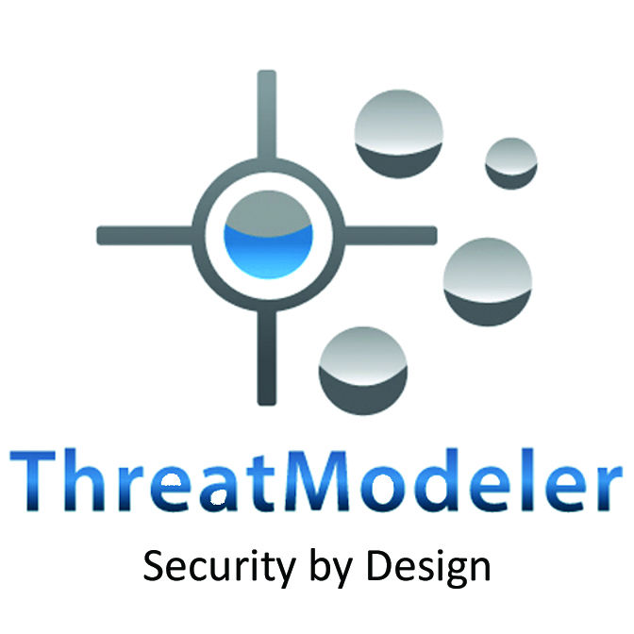

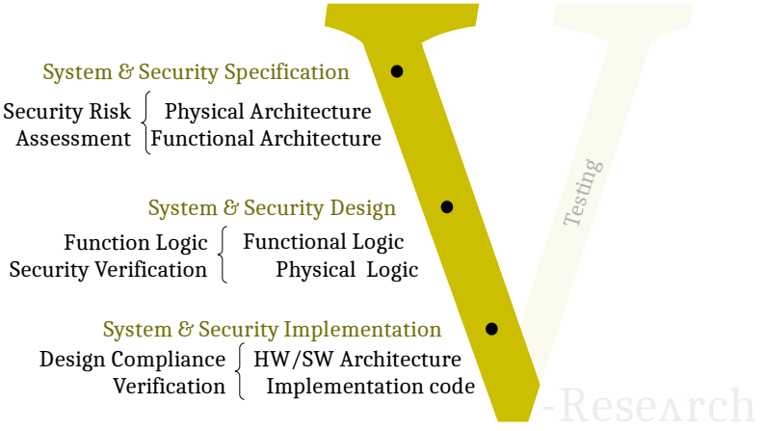
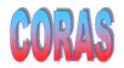
Current V-Research Investments (R&D – Products)
Security Challenges
Identify a scientific security theory
Build a security risk assessment (tool-assisted) process
Build a protocol (logic) design verifier
Build a security test-case generator
Again?
Yet another
security tool
MSAT
SecRAM
Another
Methodology?

Slide 7
Agenda
Who we are and What V-Research is
Cybersecurity Challenge (problem statement)
State-of-the-art “Solutions” and Competitors
V-Research Prototype Solution

Slide 8
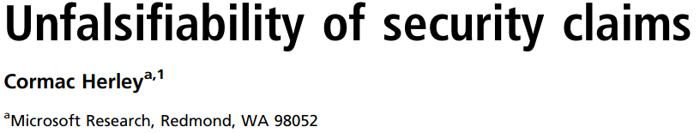
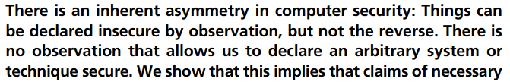
“We don’t have a test for security and
we don’t have a metric for security”
A theory which is not refutable by any conceivable event is non-scientific. Irrefutability is not a virtue of a theory (as people often think) but a vice.​ ​
K. Popper, Conjectures and Refutations​
https://www.usenix.org/conference/usenixsecurity16/technical-sessions/presentation/herley

Slide 9
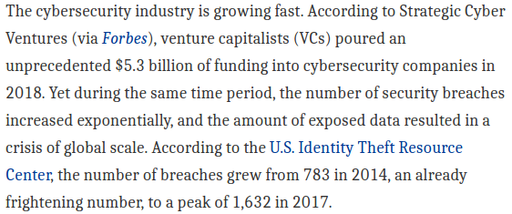

“We don’t have a test for security and
we don’t have a metric for security”
What are the consequences?
How do other researchers & companies handle this problem?
OT
Jacob Nielsen (usability expert)
Usability suffers if users only get a row of bullets when they type their password.
Password Masking doesn’t even increase security but cost you business due to login failures
Bruce Schneier (security expert)
[June 26, 2009] “I agree with this”
Epic flame-war
[July 3, 2009] “So was I wrong? Maybe. Okay, probably”
We don’t know what are the
necessary or sufficient conditions
nor we know how to distinguish between them

Slide 10
OT
“We don’t have a test for security and
we don’t have a metric for security”
What are the consequences?
How do other researchers & companies handle this problem?
systems engineering requires security standards
standards mandates
risk assessments
risk assessments requires a metric for security
DO-326A – “Airworthiness Security Process Specification” requires a cybersecurity risk assessment of the design and is the “the only Acceptable Means of Compliance by FAA & EASA for aviation cybersecurity airworthiness certification, as of 2019” [SAE]
[ISO 62443] [IEC 61508] [SAE J3061] [NIST 800-82] [etc]

Slide 11
“We don’t have a test for security and
we don’t have a metric for security”
What are the consequences?
How do other researchers & companies handle this problem?
If there really is no metric nor test for security
How come that companies sell risk assessment tools?
systems engineering requires security standards
standards mandates
risk assessments
risk assessments requires a metric for security
DO-326A – “Airworthiness Security Process Specification” requires a cybersecurity risk assessment of the design and is the “the only Acceptable Means of Compliance by FAA & EASA for aviation cybersecurity airworthiness certification, as of 2019” [SAE]
[ISO 62443] [IEC 61508] [SAE J3061] [NIST 800-82] [etc]

Slide 12
market
Risk Assessment
Standard process
CORAS
ThreatModeler

Slide 13
V-research
Security
theory
ABF secra
(comparison with sota)

Slide 14
Demo
secra

