Slide 1

Research & Development for Cybersecurity Engineering
The Etiology of Cybersecurity
The Science Club
knowledgezero@v-research.it
Dissemination level: Public
Confidentiality level: Public
ECCN: NSR
https://www.v-research.it

Slide 2
Agenda
The problem in the Method
Cybersecurity Hypothesis
Risk Assessment Prototype

Slide 3
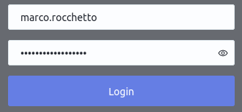

Necessary Cybersecurity Requirements
Jacob Nielsen (usability expert)
Usability suffers if users only get a row of bullets when they type their password.
Password Masking doesn’t even increase security but cost you business due to login failures
Bruce Schneier (security expert)
[June 26, 2009] “I agree with this”
Epic flame-war
[July 3, 2009] “So was I wrong? Maybe. Okay, probably”
So, is this secure? More secure?

Slide 4

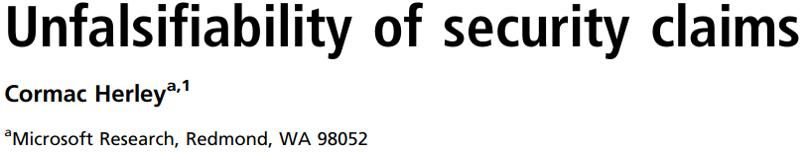
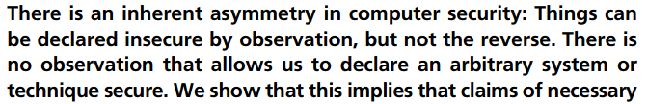
Necessary Cybersecurity Requirements
Jacob Nielsen (usability expert)
Usability suffers if users only get a row of bullets when they type their password.
Password Masking doesn’t even increase security but cost you business due to login failures
Bruce Schneier (security expert)
[June 26, 2009] “I agree with this”
Epic flame-war
[July 3, 2009] “So was I wrong? Maybe. Okay, probably”
So, is this secure? More secure?
Is there a propriety P of a system S such that S is a secure system?
What is P? Confidentiality?
Confidentiality=security?
(it’s tautological - it does what it does)
Security is something else

Slide 5
Theory
Reality
Weaknesses
Vulnerability
System
under
attack
Cybersecurity
Errors
Induction from Experience

Slide 6
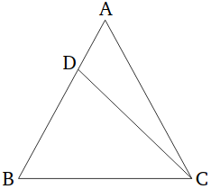
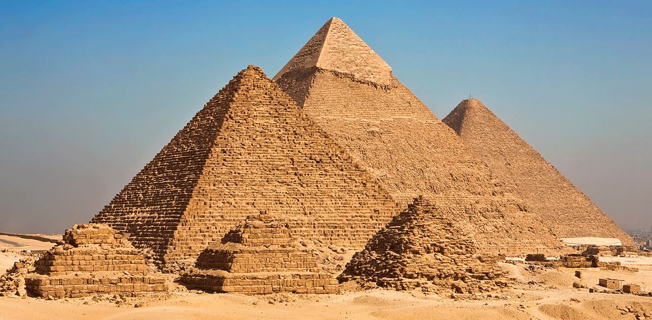
Theory
Reality
Weaknesses
Vulnerability
System
under
attack
Cybersecurity
Errors
Induction from Experience
Euclid & The scientific method
Deduction/Predictions
If a triangle has two angles equal to one another
the sides subtending the equal angles
will also be equal to one another.

Slide 7
We Are Aware of Cybersecurity Theories
Criticism
Crypto primitives are not perfect!
Computational Model where “messages are bitsrings, crypto primitives are functions from bitstrings to bitstrings, and the adversary is any probabilistic Turing Machine” [1]
Symbolic Model
“crypto primitives are considered as perfect black-boxed, modeled by function symbols in an algebra of terms, possibly with equations. Messages are terms on these primitives and the adversary can compute only using these primitives” [1]
OFMC, Tamarin, Schyter, CL-Atse, SpiM, ...
Blanchet
ProVerif [2]
Shoup
Sequences of
Games [6]
2001
Blanchet
Automated verification in computational model [3,7,8]
Diffie-Hellman
Related complexity theory to cryptography
Dolev-Yao
Proposed symbolic model
Ballare-Rogaway
Random Oracle Model [4]
Direct
approach
1976
1983
1993
2006
[1] Dolev, Yao. On the Security of Public Key Protocols. 1963
[2] Blanchet. Modeling and Verifying Security Protocols with the applied Pi Calculus and ProVerif. 2016
[3] Blanchet. An Efficient Cryptographic Verifier Based on Prolog Rules. 2001
[4] Ballare, Rogaway. Random Oracles are Practical: A Paradigm for Designing Efficient Protocols. 1995
[5] Abadi, Rogaway. Reconciling Two Views of Cryptography. 2002
[6] Shoup. Sequences of Games: a Tool for Taming Complexity in Security Proofs. 2004
[7] Blanchet. A Computationally Sound Mechanized Prover for Security Protocols. 2006
[8] Blanchet, Pointcheval. Automated Security Proofs with Sequences of Games. Advances in Cryptology. 2006
Abadi-Rogaway
Reconciling the two
models [5]
2002
Indirect
approach

Slide 8
Agenda
The problem in the Method
Cybersecurity Hypothesis
Risk Assessment Prototype

Slide 9
Cybersecurity Hypothesis
1. Claim: insecurity is generated by attacks
2. Claim: attacks are (caused) made possible by errors
3. Def: security is achieved when no attacks are possible
4. Hyp: a theory on system errors should predict insecurity
5. Challenge: how can we define a theory of errors?
6. First step: start from a theory of systems
Errors [CWE?]
Weak System [CWE]
Causality
Vulnerable System [CVE]
System under attack [CAPEC]

Slide 10
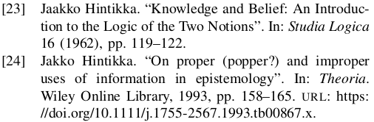
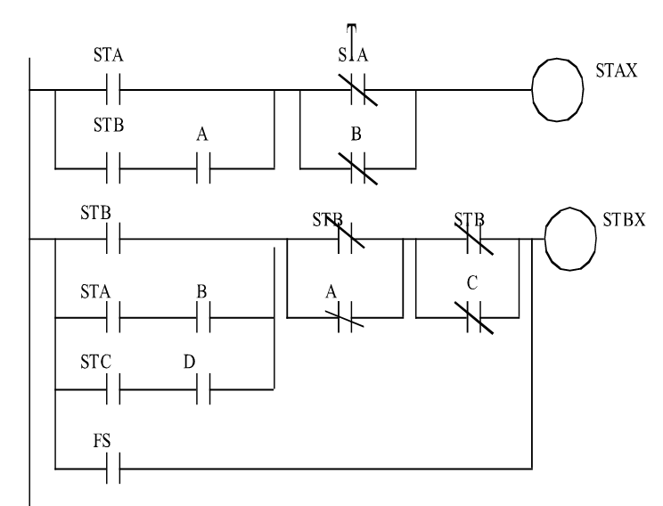
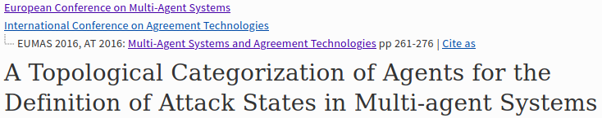
What is a system?
A belief revision system
Epistemology
Multi-Agent Systems
Cyber-Physical Systems
Knowledge
Fact
Fact
Architectural Requirements
Belief
Belief
Behavior
Functional Architecture
Information
Assertion
Assertion
Channels & Ports
On Etiology of Cybersecurity
Requirements
(Universe of Truths)
Functional Architecture
Channel
Port
Device

Slide 11
ABF-Framework for System Design
Cyber-Physical
Systems
Multi-Agent
Systems

Slide 12
Cybersecurity Weakness Prediction (RIDI-Hypothesis)
There exist 3 categories of weaknesses:
B/F errors in behaviors (functional architecture)
A/F errors in communications (channels)
A/B errors in translations (ports)
 | RCC Calculus | LHS | RHS
nominal | EQ | x
replace | DR | x
insert | PP | x
delete | PPi | x
inject | PO | x
B
A
A/B
A
B
A
B
A
B
Equal
EQ
Disjoint
DR
Partial Overlap
PO
Proper Part
PP/PPi
device
1011:A
1011:B
There are other (similar) weaknesses:
Selective drop
Selective drop+insert
port
LHS
RHS

Slide 13
From Errors to Architectural Weaknesses
 | RCC Calculus | R1 | R2
nominal | EQ | x
replace | DR | x
insert | PP | x
delete | PPi | x
inject | PO | x
 | Quantity: Data Flow between The input and output of: Channels(A,A); Ports(B,A); FunctionalBlocks(B,B) | Quality: Requirements (Facts) over Channel(A,F); Behavior(B,F)
EQ | Expected, Nominal | Expected, Nominal
DR | drops all the inputs and inserts new malicious data | the component never performs/carries the expected behavior/information
PP | selectively drops inputs | part of the expected outputs are not generated in response to the correct inputs
PPi | forwards all the inputs but crafts and inserts new malicious data | the components correctly performs/carries the expected behavior/information when the correct inputs are provided but is subject to input injections
PO | selectively drops inputs and inserts new data | Byzantine behavior - occasionally outputs the expected output given the correct inputs. Not all the inputs are handled properly, nor all the expected outputs are always generated when correct inputs are given

Slide 14
Cybersecurity Quantitative Evaluation
Cybersecurity = 1 – ( many - some)
Mathematically, not all the errors may occur simultaneously
The secure configuration where all the components of the system have no errors
=
A
transitivity
All the insecure configurations where an error occurs in (at least) one device
B
=
F
This allows us to precisely measure security risks
We have a metric for security

Slide 15
Cybersecurity Abstract Attacks – Not-so-easy Next Steps
 | Quantity: Data Flow between The input and output of: Channels(A,A); Ports(B,A); FunctionalBlocks(B,B) | Quality: Requirements (R) over Channel(A,R); Behavior(B,R)
EQ | Expected, Nominal | Expected, Nominal
DR | drops all the inputs and inserts new malicious data | the component never performs/carries the expected behavior/information
PP | selectively drops inputs | part of the expected outputs are not generated in response to the correct inputs
PPi | forwards all the inputs but crafts and inserts new malicious data | the components correctly performs/carries the expected behavior/information when the correct inputs are provided but is subject to input injections
PO | selectively drops inputs and inserts new data | Byzantine behavior - occasionally outputs the expected output given the correct inputs. Not all the inputs are handled properly, nor all the expected outputs are always generated when correct inputs are given
...
Engineering Process
System Architecture Requirements
Specification
System Logic Design
System Architecture Design
Communication
Logic
Design

Slide 16
Agenda
The problem in the Method
Cybersecurity Hypothesis
Risk Assessment Prototype

Slide 17

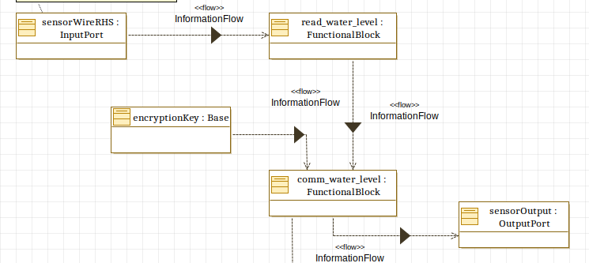
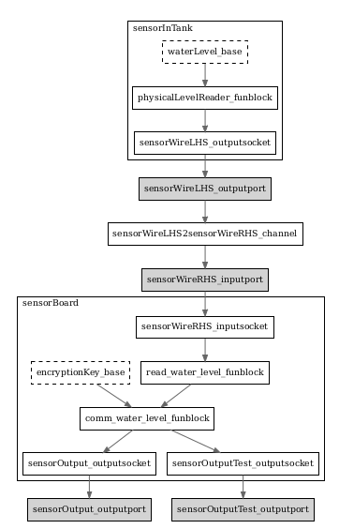
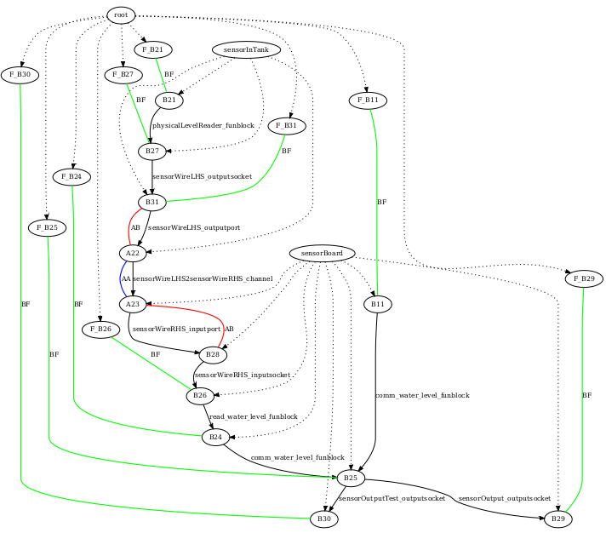

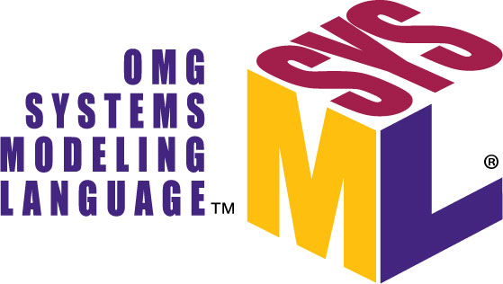
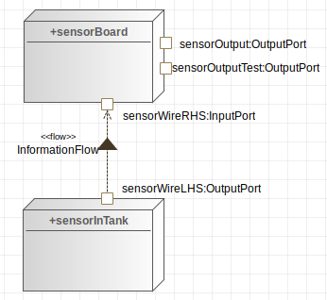




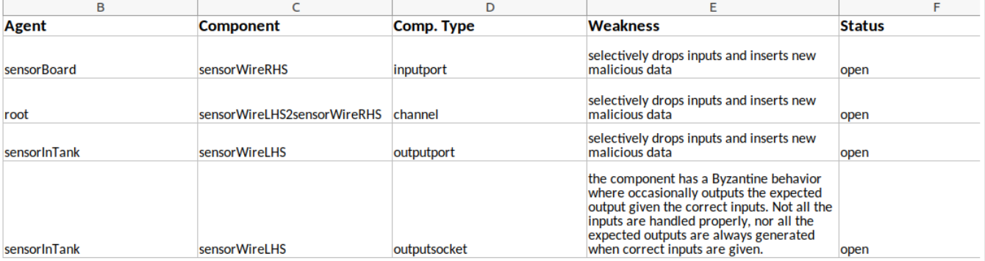
Automated Cybersecurity Risk Assessment
2. Automated Threat Scenario
Generation & Reasoning
1. System Engineering
3. Automated Risk Estimation &
Mitigation Suggestions
4. on-the-fly Risk Reduction
Based on Mitigation

Slide 18
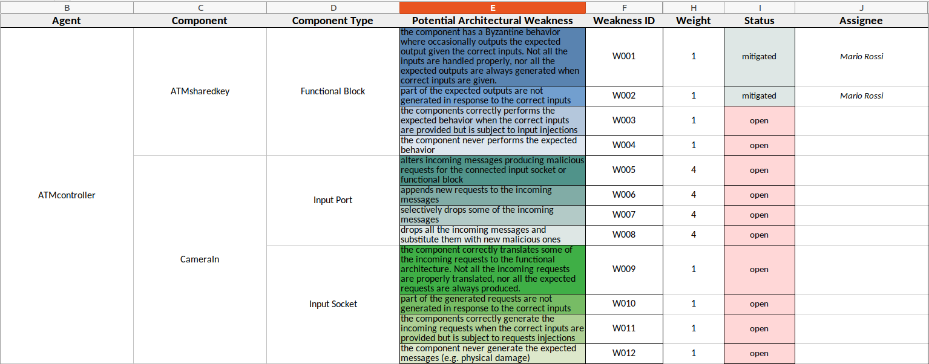
Risk Assessment Prototype
Complete Prediction of Cybersecurity Flaws
Without Databases of Known Attacks!

Slide 19
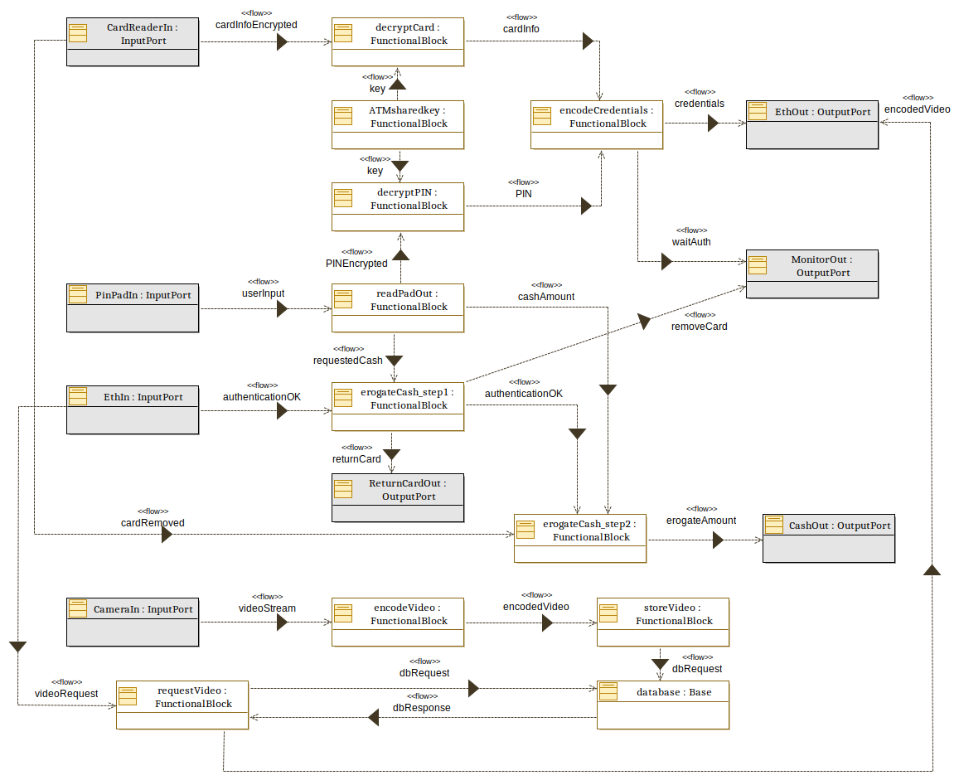
Security By Design
Architecture
Risk Assessment
Monitor
Real
cash
ATM
Card Reader
Cash
Handler
Virtual
cash
Inter-bank
Network
Controller
Physical
Architecture
Logic
(sub-systems)
Asset
(Bank)
System
(stakeholders)
Phase 1
Asset Diagram
Phase 2
Architecture
Phase 3
Automated Risk Assessment

Slide 20
v
Q&
TH NK YOU
v

