Slide 1
V
-
R
e
s
e
r
c
h
v
Images for Experiment Alpha
Marco Rocchetto
Dissemination level: public
Confidentiality level: public
ECCN: NSR

Slide 2
Cyber-Physical
Systems
Multi-Agent
Systems

Slide 3
Causality
System
designs
Mankind
Nature
Exploitation
process
Risk
poses
Weakness
Errors
Attack
process
Exploit
generates
Vulnerability
Defect
realization
Failure
Attack
malicious
intents
Incident
Accident
non-malicious
intents
Hazard
Asset
impacts
Threat
impacts
Asset
Dissemination level: public
Confidentiality level: public
ECCN: NSR

Slide 4
Server
Alice
Bob
I) Bob’s public key
II) Symmetric key generation
III) Symmetric key exchange
Dissemination level: public
Confidentiality level: public
ECCN: NSR

Slide 5


System & Security Specification
Security Risk
Assessment
Physical Architecture
Functional Architecture
System & Security Design
Testing
Function Logic Security Verification
Functional Logic
Physical Logic
System & Security Implementation
Design Compliance
Verification
HW/SW Architecture
Implementation code
Dissemination level: public
Confidentiality level: public
ECCN: NSR

Slide 6
System
Agent
Agent
I
I
O
I
O
O
Agent
Behavior
I
O

Slide 7
User
V
SecRA
Architecture
Requirements
[UML Deployment +
Object diagrams]
Generate
ABF
Graph
ABF
Graph
Weaknesses
(Excel)
Weaknesses
List
Mitigations &
Security Requirements
Update
ABF
Graph
Risk
(Excel)
Risk
Calculation

Slide 8
Specification
Other Designs
Excluded Designs
Cybersecurity Risk of an Agent
Specification
Other Designs
Excluded Designs
Agent Security Risk

Slide 9
Implementation
Assertions & Beliefs
Design
abstraction
soundness
and
Specification
Facts

Slide 10
Agent
Input port
Output port
behavior
behavior
agent s
agent r
Input port
Output port
Mono-directional
channel
relations

Slide 11
b1
sum
b3
b2

Slide 12
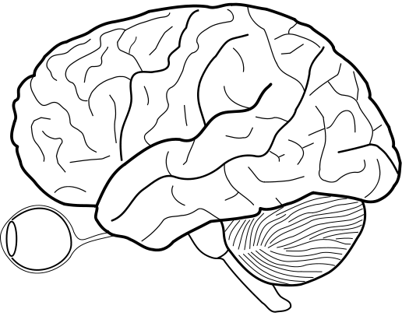
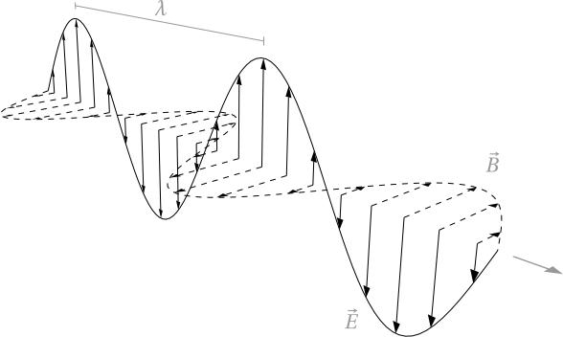
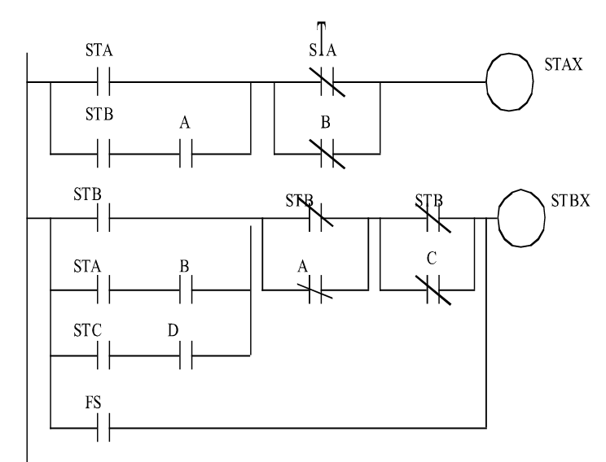
Errors
Weak System [CWE]
Causality
Vulnerable System [CVE]
System under attack [CAPEC]
Epistemology to MAS
MAS to CPS
Agent
Reasoning
over Beliefs
Requirements
(Universe of Truths)
Functional Architecture
Information
translation
into Beliefs
Information
transfer
Knowledge
(Universe of Truths)
Device
Channel
Port

Slide 13
