Slide 1
v
-
e
s
e
edu
V
R
r
c
h
Research & Development for Cybersecurity Engineering
Head count
Web Cybersecurity – L0
Marco Rocchetto Mattia Pacchin
marco@v-research.it mattia@v-research.it
https://v-research.github.io/edu/

Slide 2

Agenda
An introduction to Cybersecurity [theory 1h]
  #whoami & course overview
  Beliefs on Cybersecurity
  Infosec and the CIA-triad evolution (1970-today)
  Attacker vs Hacker, Blue and Red Teams, …
  Hacker Ethics and Laws against Attackers
  Cybersecurity Resources: CVE, CWE, CAPEC, WASC, NVD
  Cybersecurity Resources: OWASP, DEFCON, PHRAK, IEEE S&P
Brainstorming session - what is a cybersecure web app? [lab 1h]
  propose up to 10 keywords related to cybersecurity (using https://www.mentimeter.com/) [15m]
  Proposals Review & Open Discussion [30m]
Coffee break [10m]
Hacking the HTTP [theory 30m + lab 1h30m]
  The WebGoat platform [15m]
  The HTTP protocol and the Client-Server architecture [15m]
  Webgoat lesson (General->HTTPBasic) [1h30m]
    ZAP HUD Tutorial
edu

Slide 3

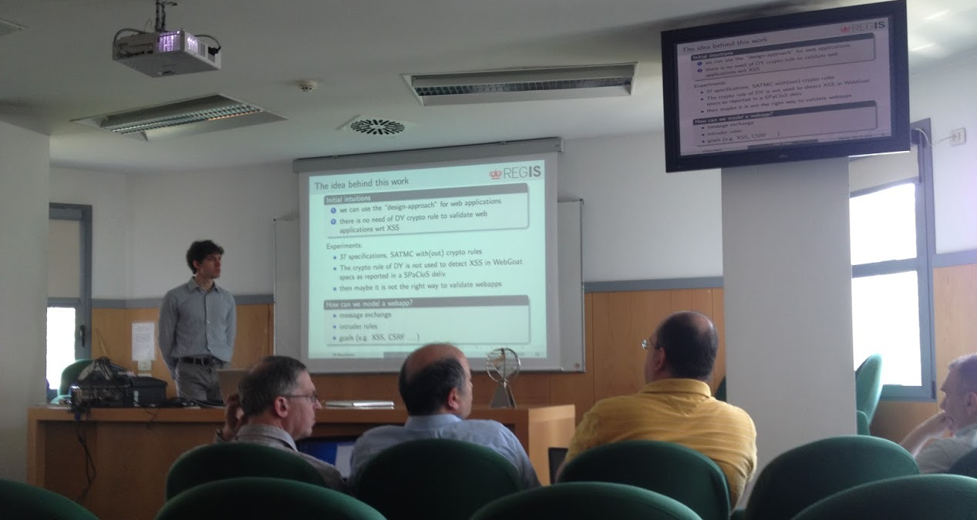
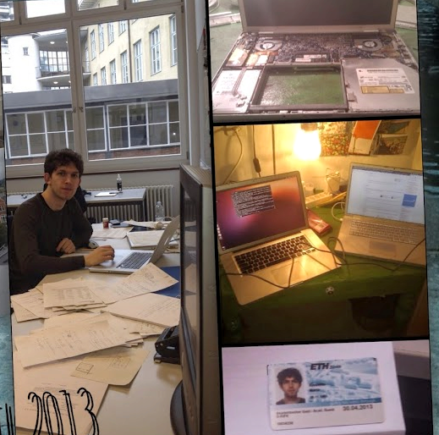
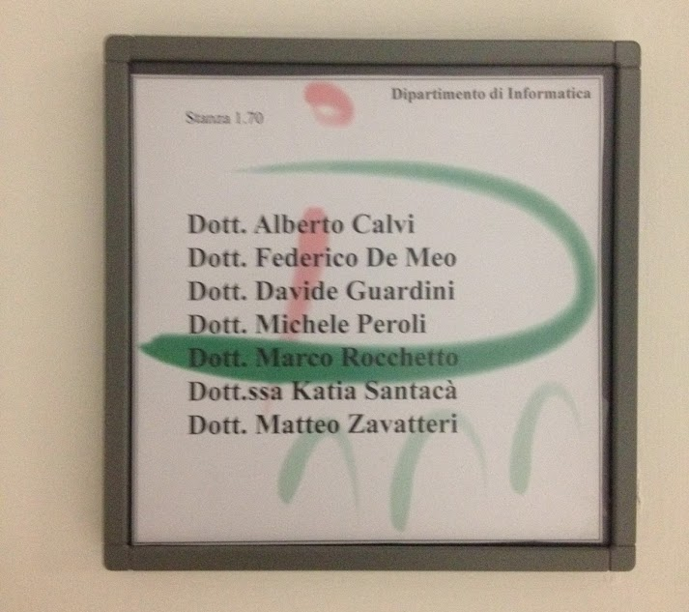
2015
2013
2012
edu

Slide 4

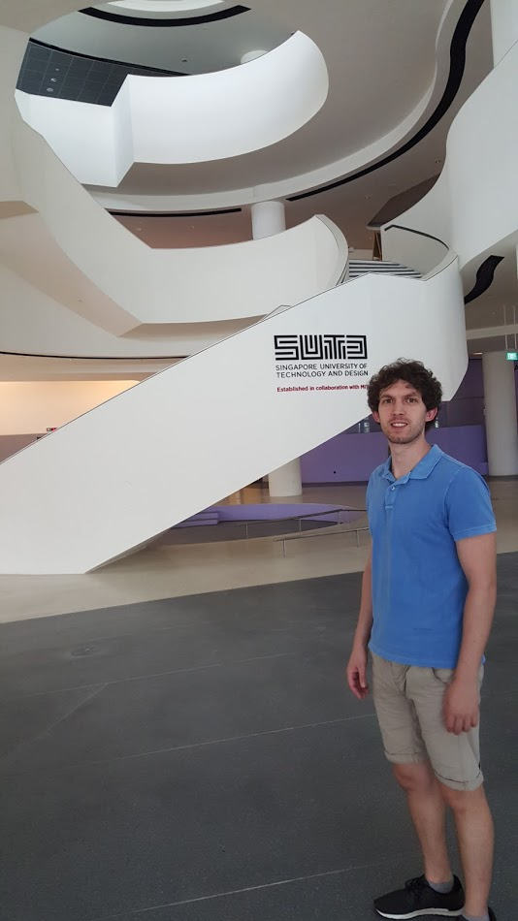
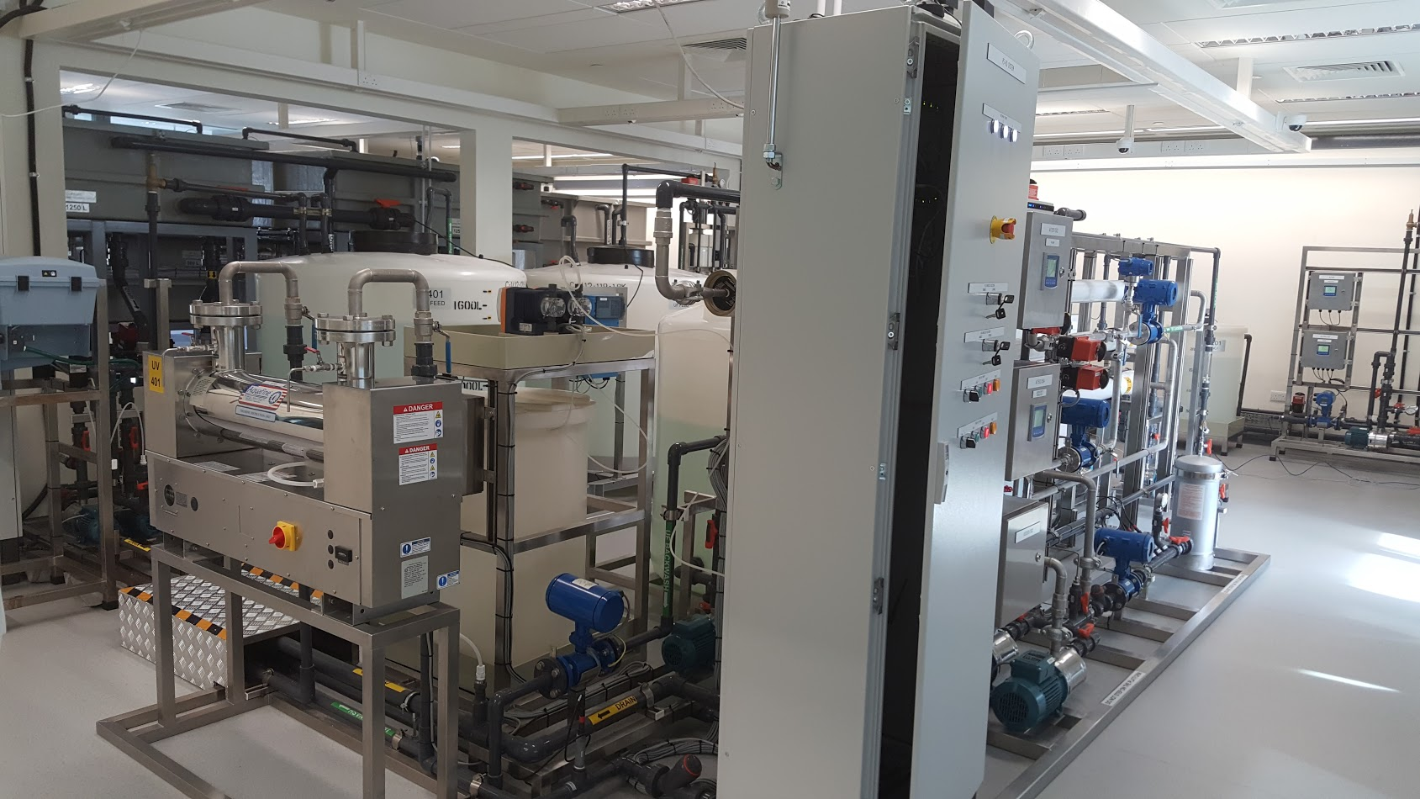
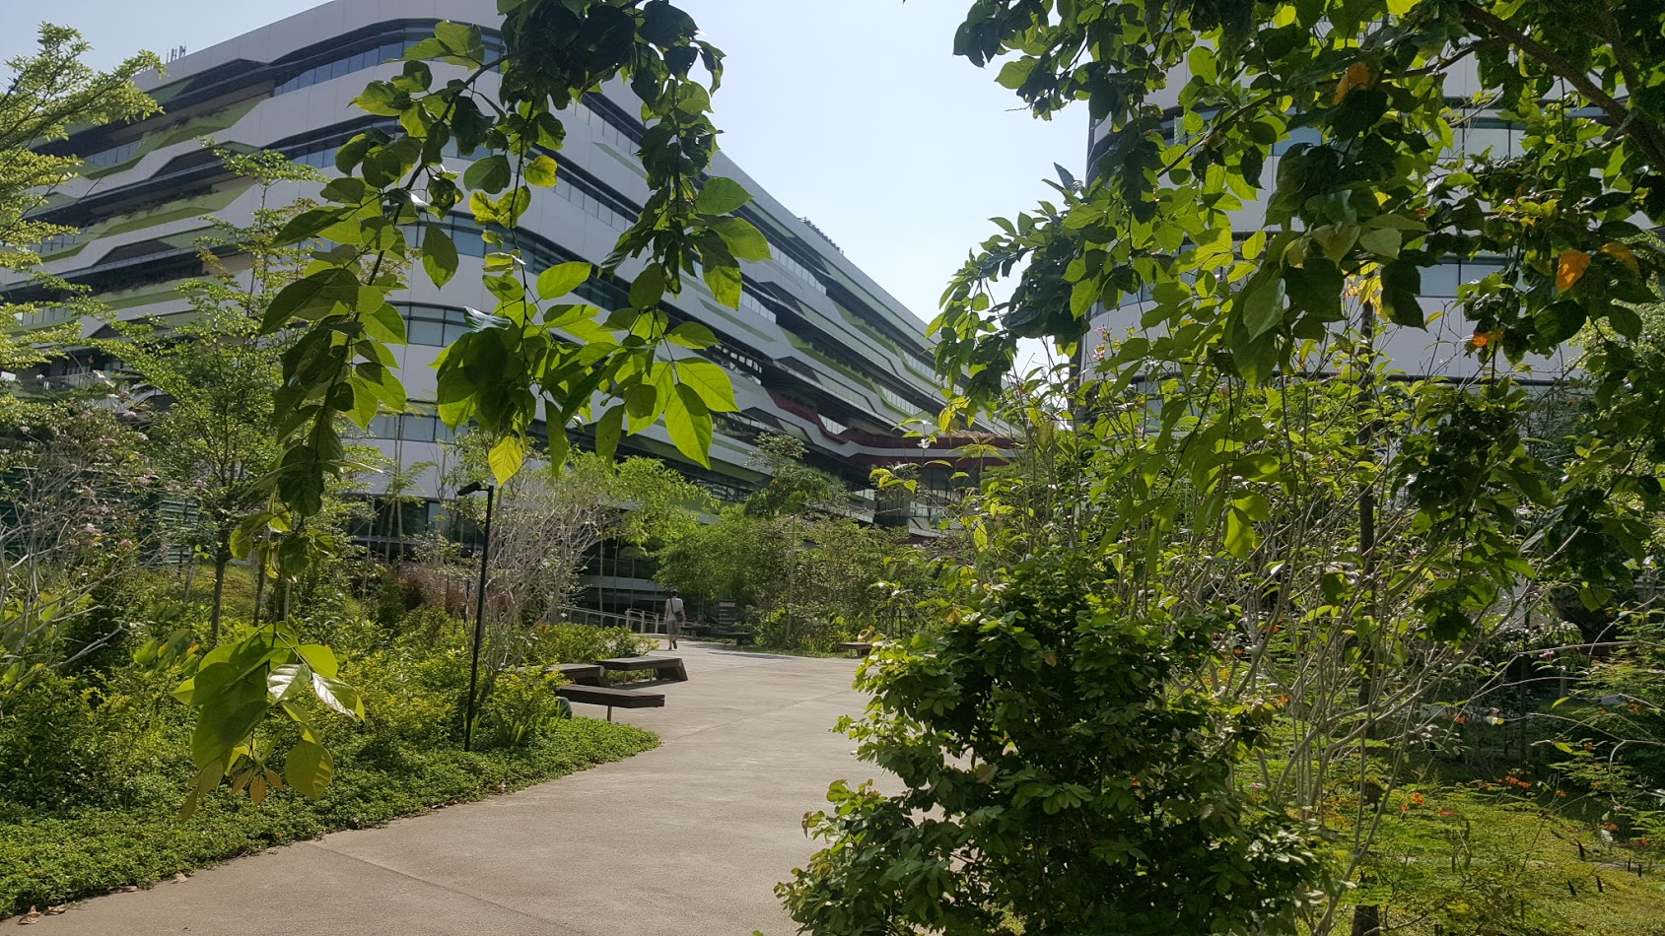

2015
SWaT
SUTD
edu

Slide 5

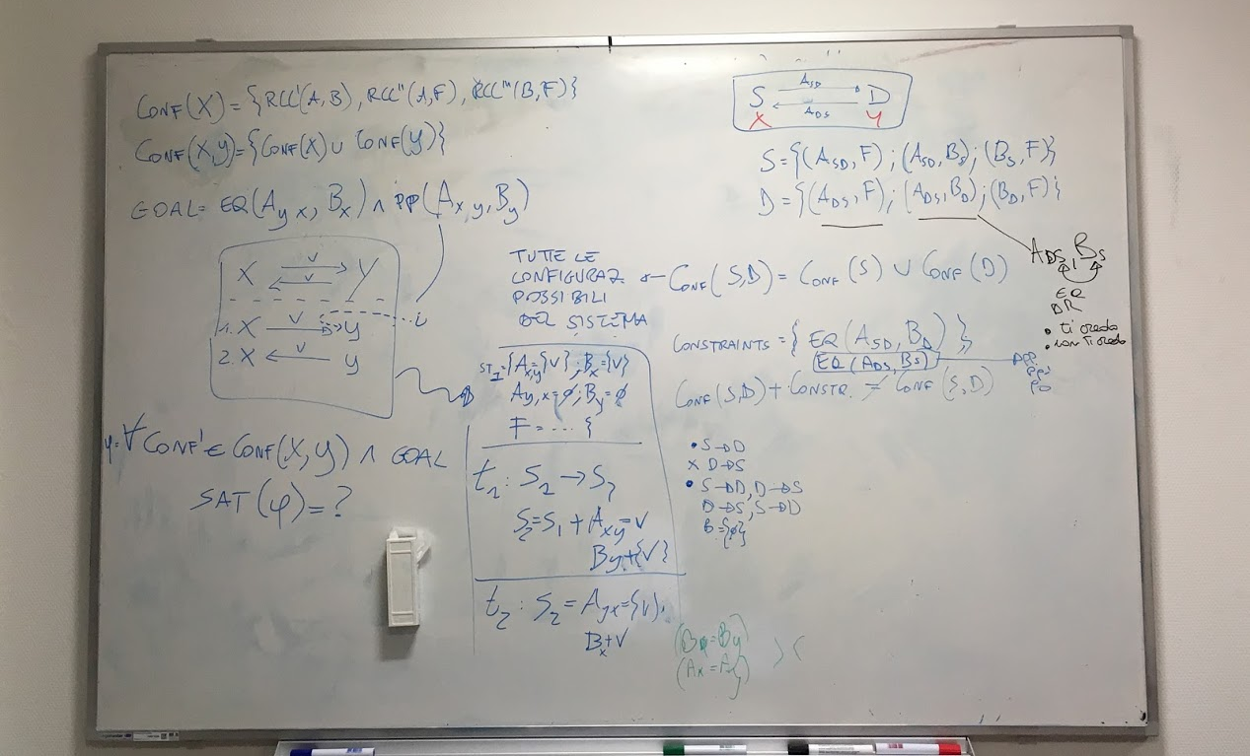
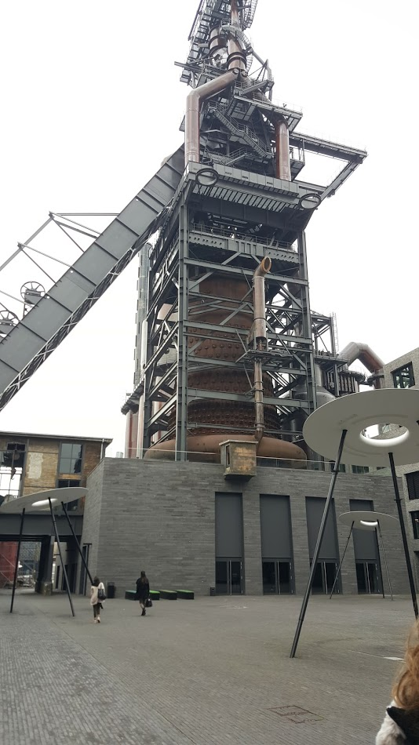
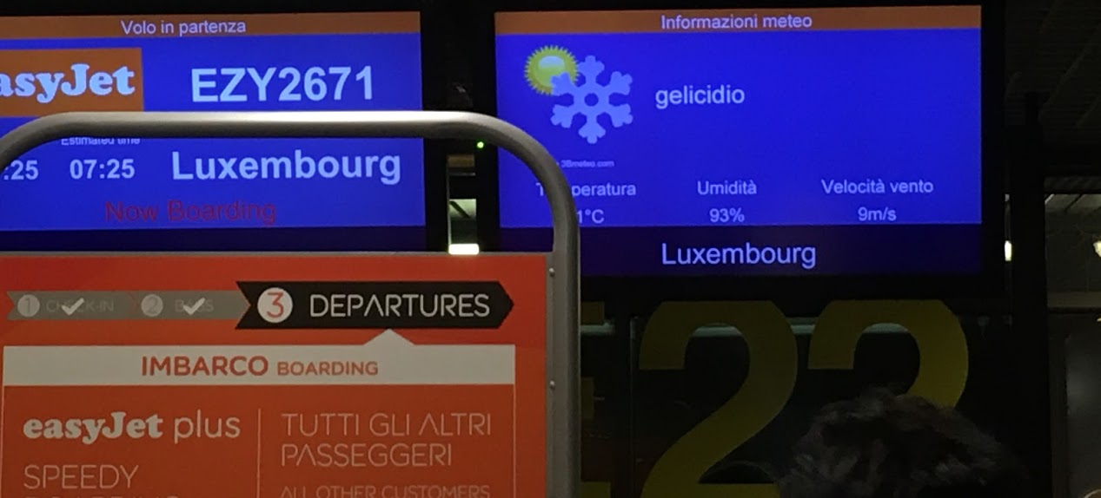
2016
2016
edu
2016

Slide 6


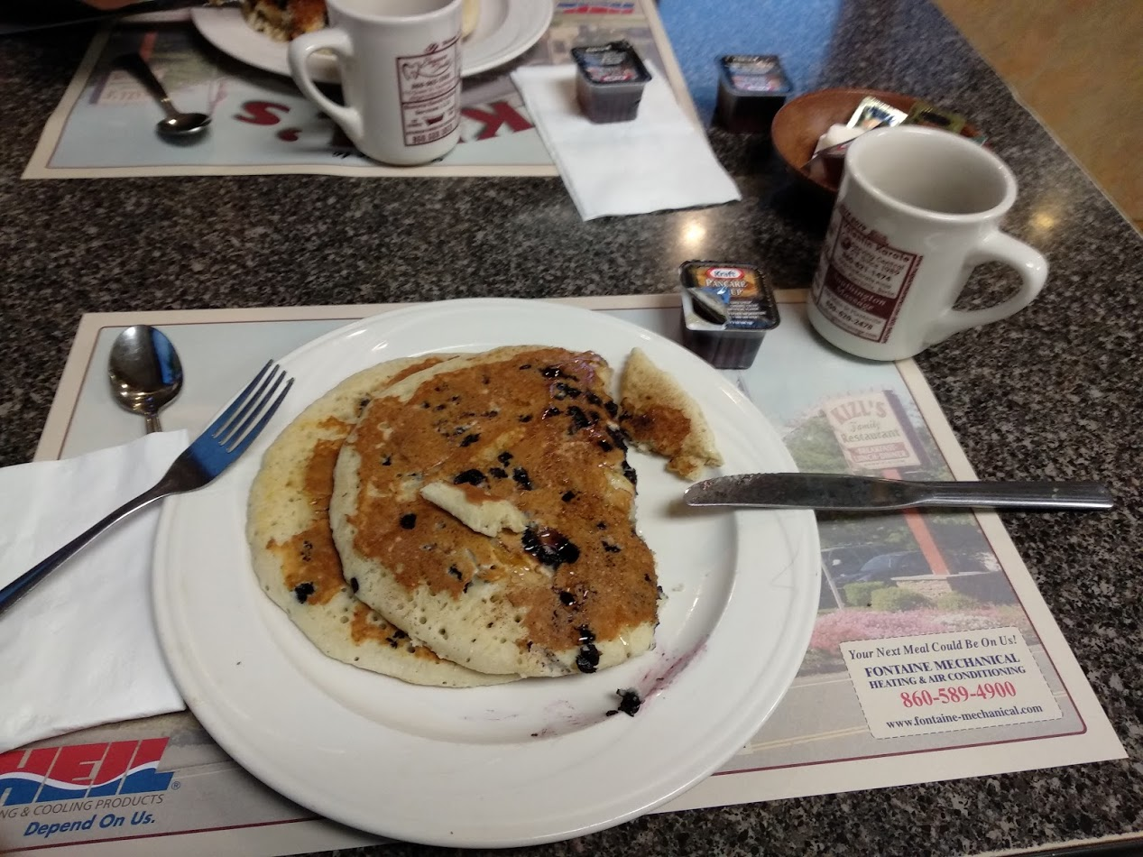
2018
2018
edu

Slide 7
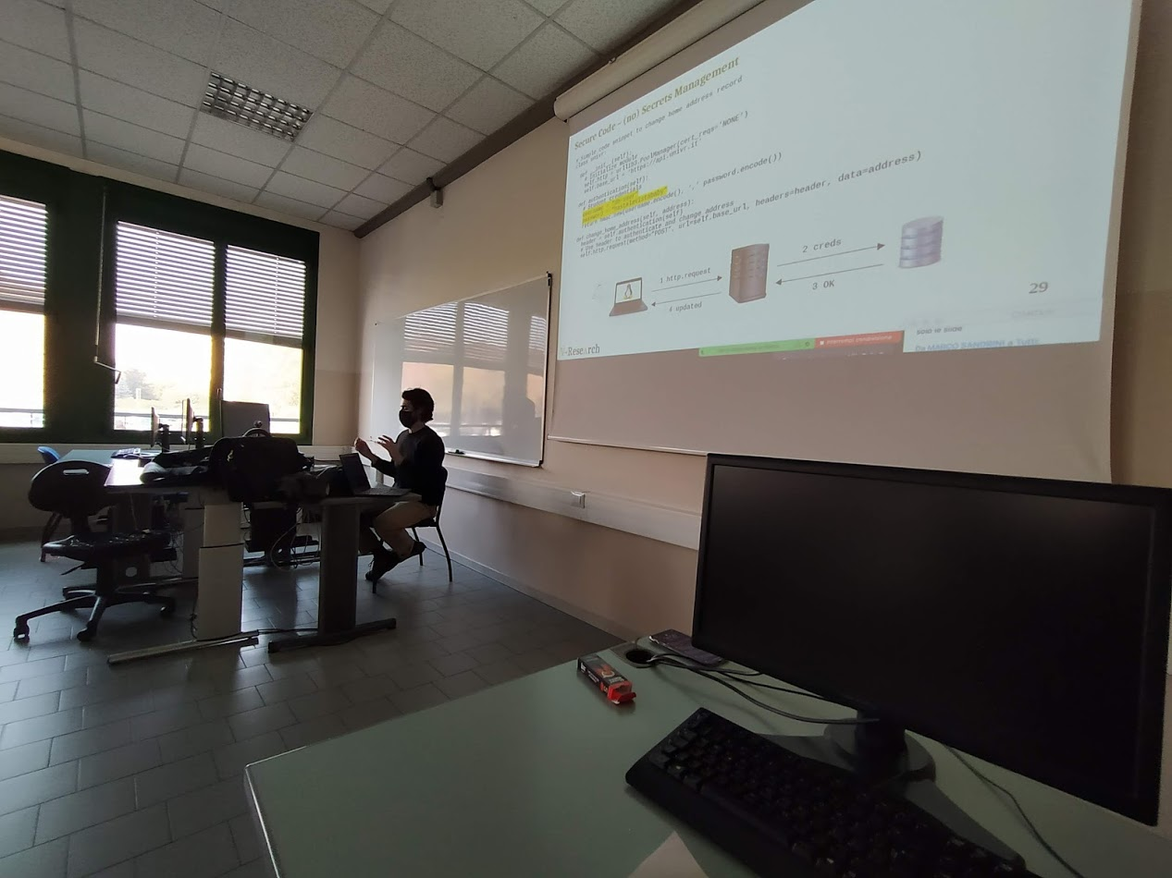
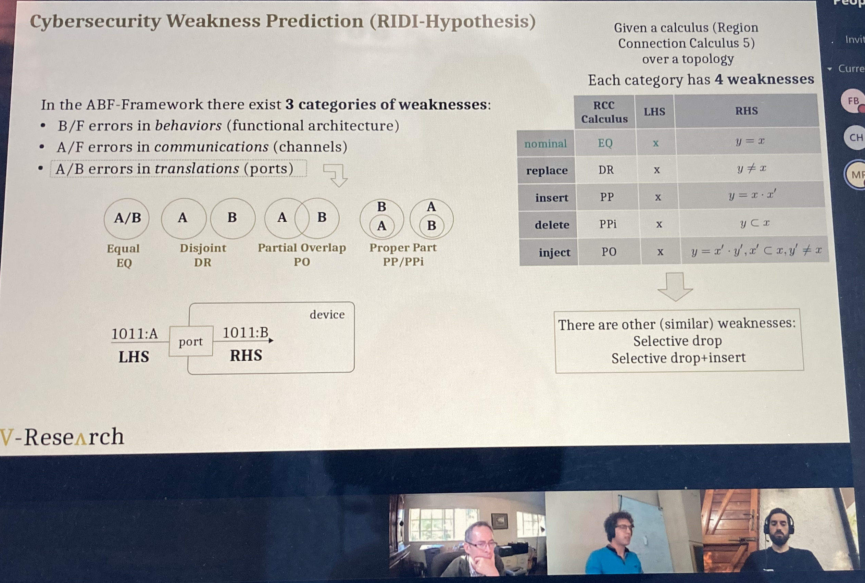
2020@V-Research
2020
2020
edu

Slide 8

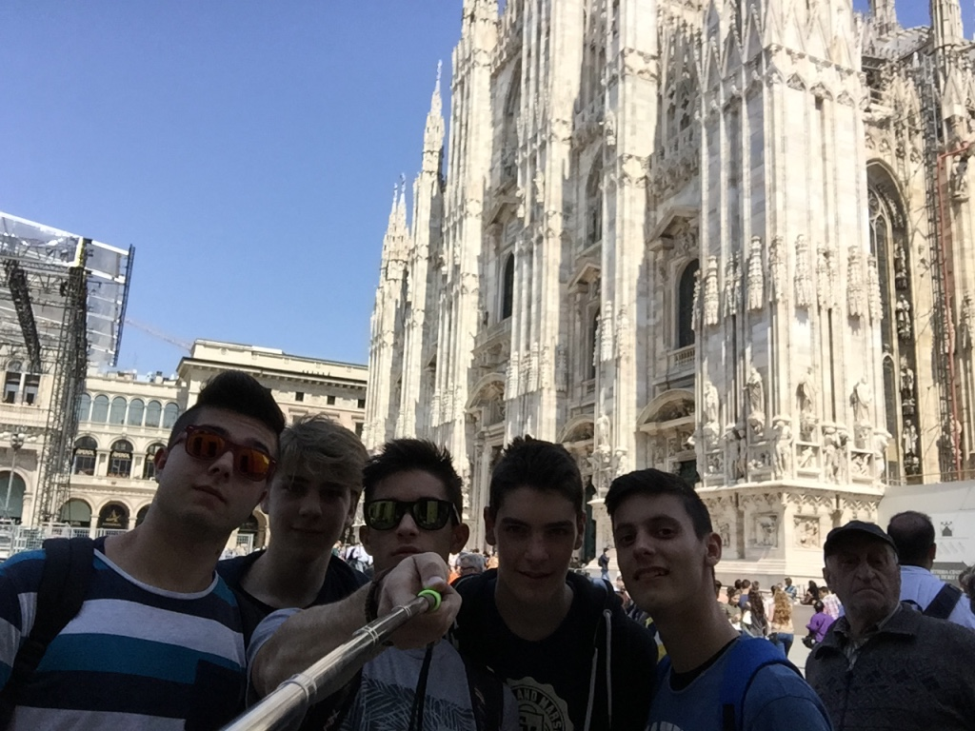
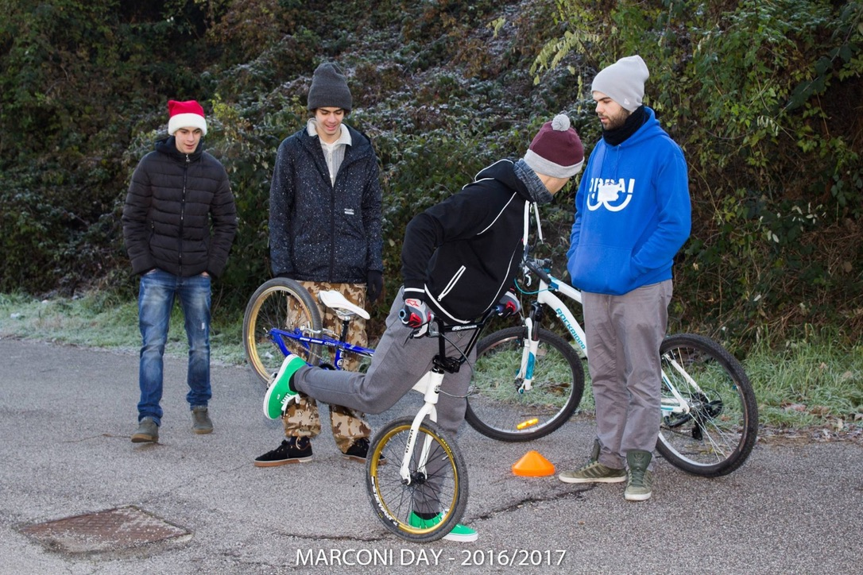
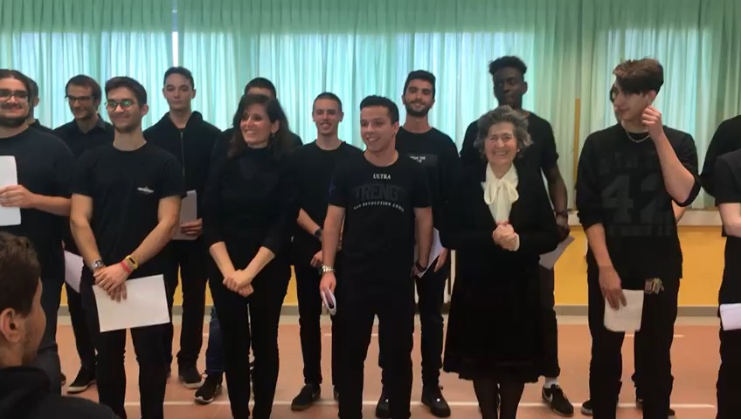
2014
2015
2016
2017
edu

Slide 9
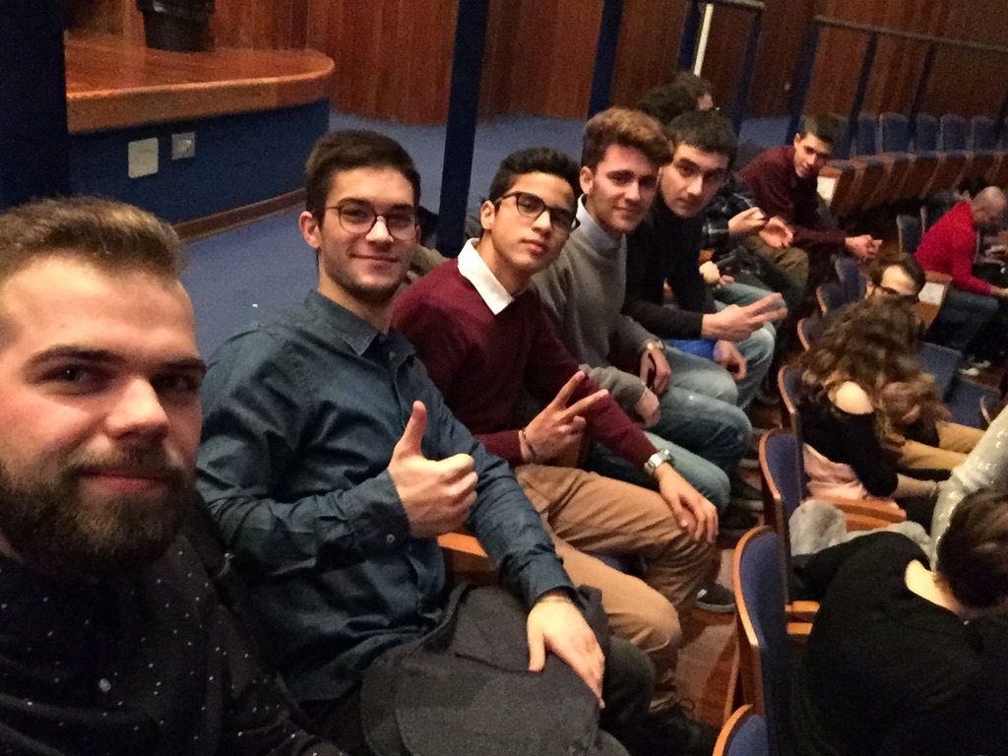
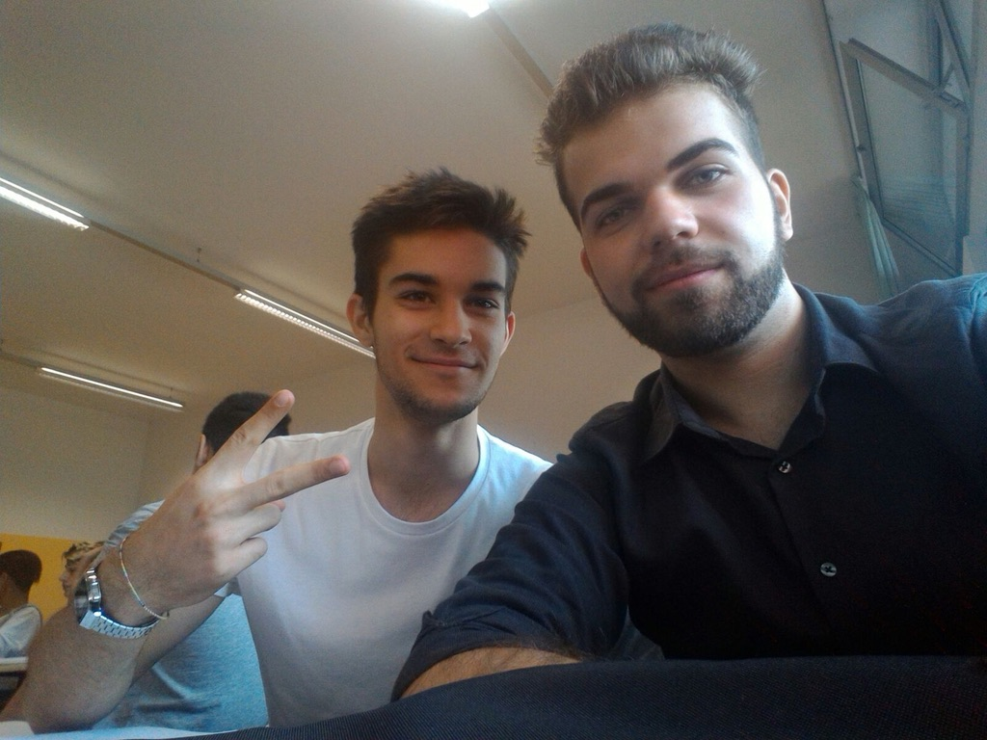
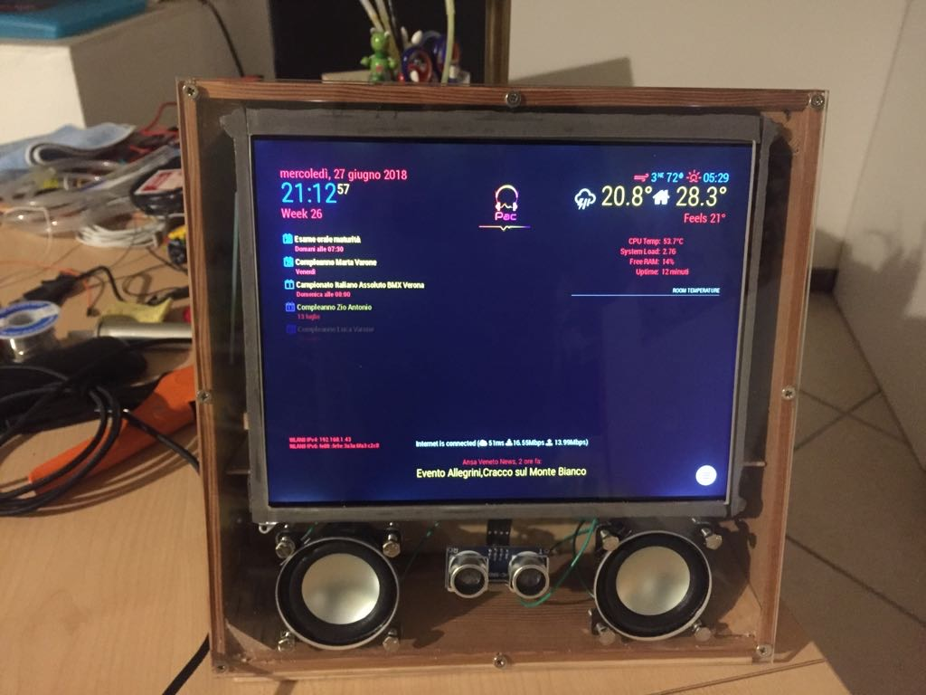

2018
2019
edu

Slide 10

What is Cybersecurity? Everybody knows vs Nobody knows
“Those who believe they have discovered it [the truth] are the dogmatists”
Sextus Empiricus, Outlines of Pyrrhonism
“Academics treats it as inapprehensible”
Sextus Empiricus, Outlines of Pyrrhonism
“The skeptics keep on searching”
Sextus Empiricus, Outlines of Pyrrhonism
Cybersecurity
is the protection of computer systems and networks from the theft of or damage to their hardware, software, or electronic data, as well as from the disruption or misdirection of the services they provide.
The only truly secure system is one that is powered off, cast in a block of concrete and sealed in a lead-lined room with armed guards — and even then I have my doubts.
[…] things can be declared insecure by observation, but not the reverse. There is no test that allows us to declare an arbitrary system or technique secure. This implies that claims of necessary conditions for security are unfalsifiable.
Eugene H. Spafford
Purdue University
Cormac Herley
Microsoft Research
edu

Slide 11
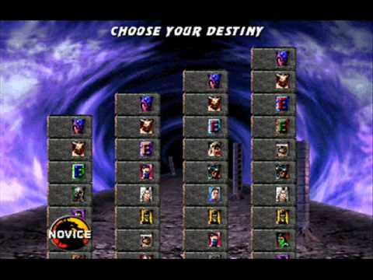
What is Cybersecurity? Everybody knows vs Nobody knows
Cybersecurity
is the protection of computer systems and networks from the theft of or damage to their hardware, software, or electronic data, as well as from the disruption or misdirection of the services they provide.
“Those who believe they have discovered it [the truth] are the dogmatists”
Sextus Empiricus, Outlines of Pyrrhonism
“Academics treats it as inapprehensible”
Sextus Empiricus, Outlines of Pyrrhonism
The only truly secure system is one that is powered off, cast in a block of concrete and sealed in a lead-lined room with armed guards — and even then I have my doubts.
Eugene H. Spafford
Purdue University
https://www.menti.com/
Code: 64 36 95
[…] things can be declared insecure by observation, but not the reverse. There is no test that allows us to declare an arbitrary system or technique secure. This implies that claims of necessary conditions for security are unfalsifiable.
“The skeptics keep on searching”
Sextus Empiricus, Outlines of Pyrrhonism
Cormac Herley
Microsoft Research
edu

Slide 12
The CIA-Triad
Let’s reason together
How can I use $RANDOM to choose one of you?
> echo $RANDOM
> 14003
Unauthorized information release (Confidentiality): an unauthorized person is able to read and take advantage of information stored in the computer. This category of concern sometimes extends to “traffic analysis,” in which the intruder only observes the patterns of information use. From those patterns, the intruder can infer some information content. This category also includes the unauthorized use of a proprietary program.
Unauthorized information modification (Integrity): an unauthorized person is able to make changes in stored information – a form of sabotage. It should be noted that in the case of this kind of violation, the intruder does not necessarily see the information he has changed.
Unauthorized denial of use (Availability): an intruder can prevent an authorized user from referring to, or from modifying information, even though the intruder may not be able to refer to, neither modify the information themselves.
edu

Slide 13

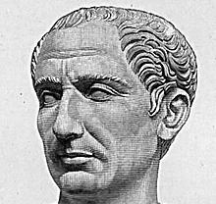
Confidentiality
More on this in L3
Plaintext: THE QUICK BROWN FOX JUMPS OVER THE LAZY DOG
Ciphertext: QEB NRFZH YOLTK CLU GRJMP LSBO QEB IXWV ALD
https://md5decrypt.net/en/Caesar/
edu

Slide 14
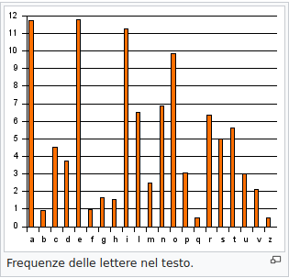
Confidentiality
More on this in L3
Plaintext: THE QUICK BROWN FOX JUMPS OVER THE LAZY DOG
Ciphertext: QEB NRFZH YOLTK CLU GRJMP LSBO QEB IXWV ALD
edu
https://md5decrypt.net/en/Caesar/

Slide 15
Integrity
More on this in L3
I love you Bob
I love you Bob
Alice
Internet
Bob
edu

Slide 16


Integrity
More on this in L3
I love you Bob
I love you Charlie
Alice
Internet
Bob
I love you Bob
I love you
Bob Charlie
Charlie
edu

Slide 17
Integrity
More on this in L3
I love you Bob
I love you Charlie
Alice
Internet
Bob
How can we solve this issue?
I love you Bob
I love you
Bob Charlie
https://www.menti.com/
Code: 32 32 397
Charlie
edu

Slide 18
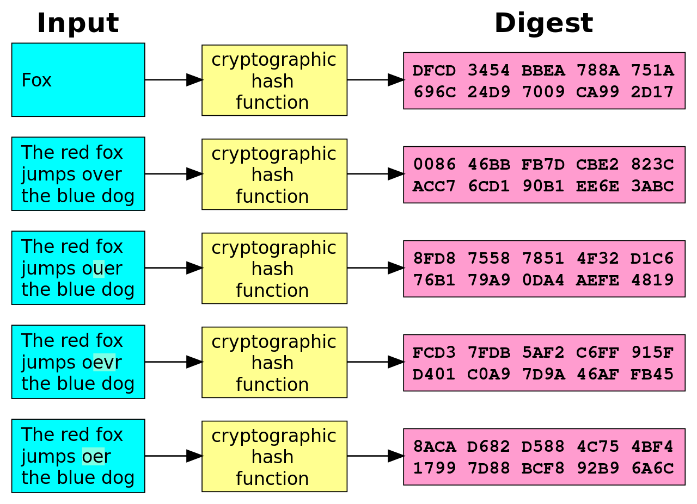
Integrity & Hashes
https://hashes.org/check.php
The ideal cryptographic hash function has the following main properties:
it is deterministic, meaning that the same message always results in the same hash
it is quick to compute the hash value for any given message
it is infeasible to generate a message that yields a given hash value (i.e. to reverse the process that generated the given hash value)
it is infeasible to find two different messages with the same hash value
a small change to a message should change the hash value so extensively that the new hash value appears uncorrelated with the old hash value (avalanche effect)[3]
edu

Slide 19
Availability

Slide 20
Beyond the CIA-Triad?
https://www.menti.com/
Code: 32 32 397
Unauthorized information release (Confidentiality): an unauthorized person is able to read and take advantage of information stored in the computer. This category of concern sometimes extends to “traffic analysis,” in which the intruder only observes the patterns of information use. From those patterns, the intruder can infer some information content. This category also includes the unauthorized use of a proprietary program.
Unauthorized information modification (Integrity): an unauthorized person is able to make changes in stored information – a form of sabotage. It should be noted that in the case of this kind of violation, the intruder does not necessarily see the information he has changed.
Unauthorized denial of use (Availability): an intruder can prevent an authorized user from referring to, or from modifying information, even though the intruder may not be able to refer to, neither modify the information themselves.
Have you ever heard of (or can you come up with)
any other cybersecurity property?
edu

Slide 21
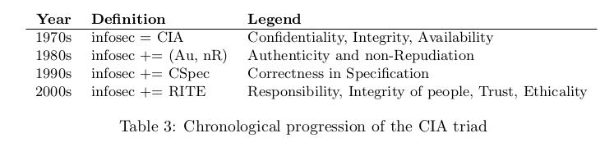
Evolution of Security Properties
Confidentiality: protects information from being accessed/understood by non-authorized parties
Integrity: makes it evident if information is modified by non-authorized parties
Availability: information is accessible to authorized parties
Authenticity: guarantees the identity of a party
Non-repudiation: guarantees that a party cannot dispute its authorship
Anonymity: hiding the (real) identity of a party
Trust? How do you know that my name is Marco? Do you trust Google? Myself? Someone who knows me?
edu

Slide 22
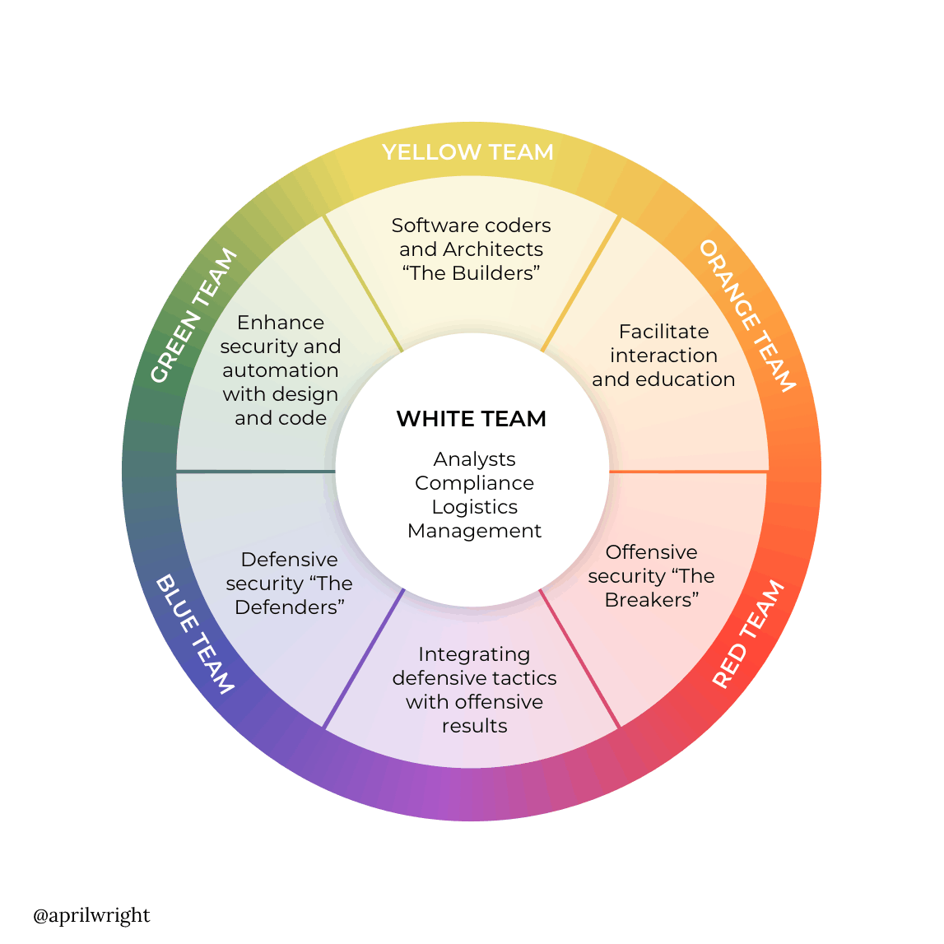


Hacker? Red Team? Blue Team?
The hacker culture is a subculture of individuals who enjoy the intellectual challenge of creatively overcoming limitations of software systems to achieve novel and clever outcomes
A security hacker is someone who explores methods for breaching defenses and exploiting weaknesses in a computer system or network
Defend to
Defend
Attack to
Defend
edu

Slide 23
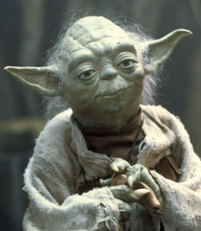
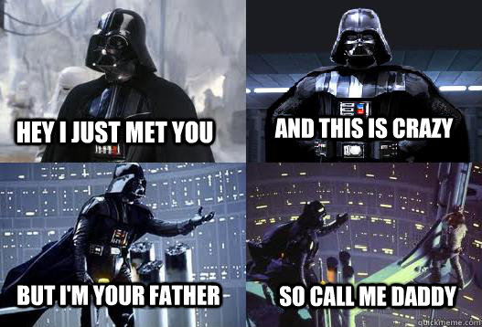
Choose the Dark Side Do Not
Be an Hacker!
The Red Team is not the Dark side
Joining the Dark side is much more difficult than you think
  Don’t be stupid, they’ll catch you
edu

Slide 24
Choose the Dark Side Do Not
Be an Hacker!
The Red Team is not the Dark side
Joining the Dark side is much more difficult than you think
  Don’t be stupid, they’ll catch you
  Don’t put your family at risk
edu

Slide 25

Choose the Dark Side Do Not
Be an Hacker!
The Red Team is not the Dark side
Joining the Dark side is much more difficult than you think
  Don’t be stupid, they’ll catch you
  Don’t put your family at risk
  Still want to join the dark side? Please don’t!
edu

Slide 26


Choose the Dark Side Do Not
Be an Hacker!
The Red Team is not the Dark side
Joining the Dark side is much more difficult than you think
  Don’t be stupid, they’ll catch you
  Don’t put your family at risk
  Still want to join the dark side? Please don’t!
Ok, let’s join the dark side and bypass the controls that limits our freedom to read PHRAK @311Verona
edu

Slide 27
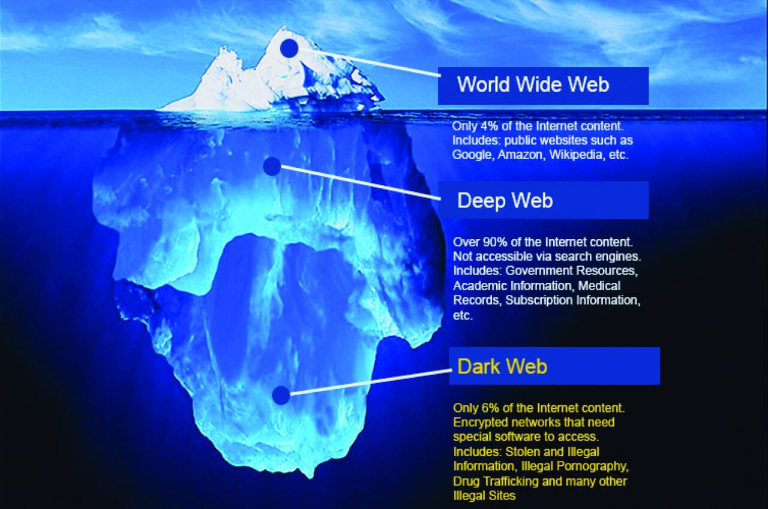
Just a step towards Anonymity
edu

Slide 28





Just a step towards Anonymity
What?! Phrack?!
Does he thinks I’m stupid?!?!
It’s a BAD website, full of
hacking content
http://phrack.org/
No way, you hacker!
Real picture of our network admin @311Verona
I’m going to miss
You Marco
The Internet
edu

Slide 29
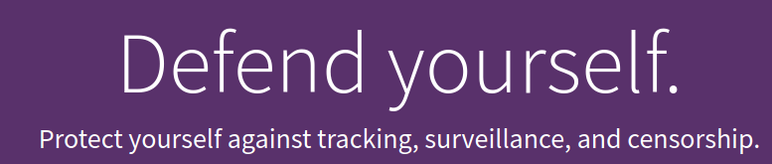

Just a step towards Anonymity
https://www.torproject.org/download/
http://phrack.org/
Sure!
Real picture of our network admin @311Verona
WHY?
Well, you must wait
Until L3 :)
edu

Slide 30



Online Resources (for the practical person)
517
839
500+
136312
144329
edu

Slide 31




Online Resources (for the practical person)
517
839
500+
136312
144329
Errors
Weak System [CWE]
why
Weak sanitization function
Authentication logic
Vulnerable System [CVE]
how
SQL-injection with payload ‘or 1=1’
System under attack [CAPEC]
what
Authentication bypass
Causality
Security=authentication
edu

Slide 32
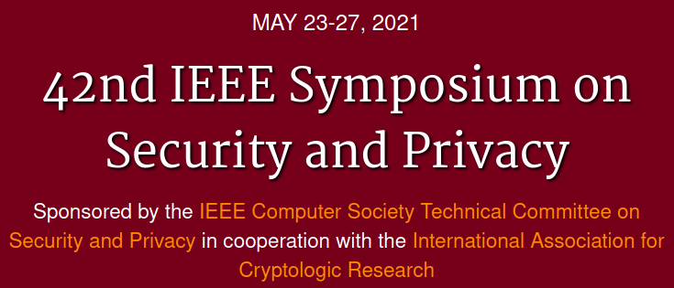
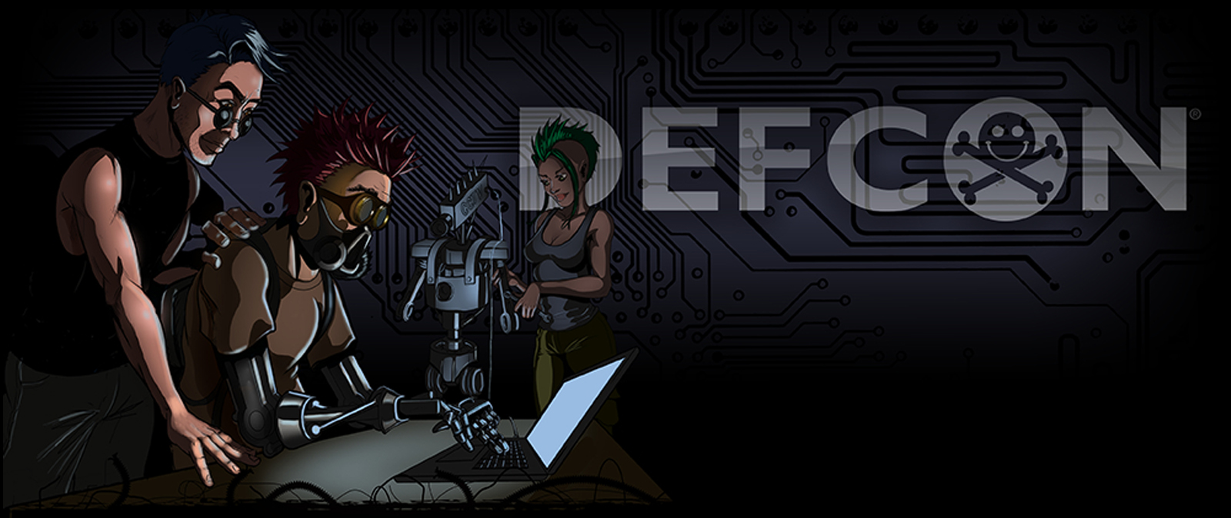

Online Resources (for the various hacker)
https://www.ieee-security.org/TC/SP2021/
http://phrack.org/
https://owasp.org/
https://defcon.org/
edu

Slide 33
Browse for 20 mins, then exam! :P
http://phrack.org/
capec.mitre.org/
https://www.ieee-security.org/TC/SP2021/
cwe.mitre.org/
https://attack.mitre.org/
https://owasp.org/
https://nvd.nist.gov/
https://defcon.org/
cve.mitre.org/
edu

Slide 34
Agenda
An introduction to Cybersecurity [theory 1h]
  #whoami & course overview
  Beliefs on Cybersecurity
  Infosec and the CIA-triad evolution (1970-today)
  Attacker vs Hacker, Blue and Red Teams, …
  Hacker Ethics and Laws against Attackers
  Cybersecurity Resources: CVE, CWE, CAPEC, WASC, NVD
  Cybersecurity Resources: OWASP, DEFCON, PHRAK, IEEE S&P
Brainstorming session - what is a cybersecure web app? [lab 1h]
  propose up to 10 keywords related to cybersecurity [30m]
  Proposals Review & Open Discussion [30m]
Coffee break [10m]
Hacking the HTTP [theory 30m + lab 1h30m]
  The WebGoat platform [15m]
  The HTTP protocol and the Client-Server architecture [15m]
  Webgoat lesson (General->HTTPBasic) [1h30m]
    ZAP HUD Tutorial
edu

Slide 35
Brainstorming Session – What is a Cybersecure web app?
https://www.menti.com/
Code: 64 36 95
Propose up to 10 keywords related to cybersecurity [30m]
Proposals Review & Open Discussion [30m]
edu

Slide 36
Agenda
An introduction to Cybersecurity [theory 1h]
  #whoami & course overview
  Beliefs on Cybersecurity
  Infosec and the CIA-triad evolution (1970-today)
  Attacker vs Hacker, Blue and Red Teams, …
  Hacker Ethics and Laws against Attackers
  Cybersecurity Resources: CVE, CWE, CAPEC, WASC, NVD
  Cybersecurity Resources: OWASP, DEFCON, PHRAK, IEEE S&P
Brainstorming session - what is a cybersecure web app? [lab 1h]
  propose up to 10 keywords related to cybersecurity [30m]
  Proposals Review & Open Discussion [30m]
Coffee break [10m for me, 15 mins for you]
Hacking the HTTP [theory 30m + lab 1h30m]
  The WebGoat platform [15m]
  The HTTP protocol and the Client-Server architecture [15m]
  Webgoat lesson (General->HTTPBasic) [1h30m]
    ZAP HUD Tutorial
edu

