Slide 1
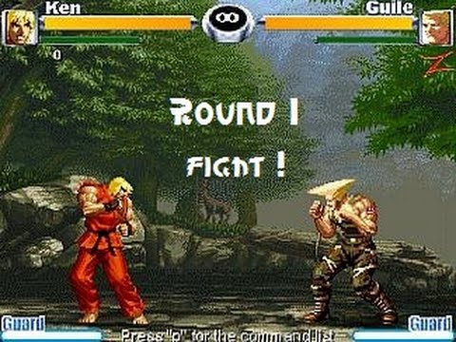
For the last time.
Do you agree that there
is no cybersecurity?
NEVER!
Let the CIA-triad
be with me!
[4 slides + 2 challenges]

Slide 2


What’s the truth on cybersecurity?
“Those who believe they have discovered it [the truth] are the dogmatists”
Sextus Empiricus, Outlines of Pyrrhonism
“Academics treats it as inapprehensible”
Sextus Empiricus, Outlines of Pyrrhonism
“The skeptics keep on searching”
Sextus Empiricus, Outlines of Pyrrhonism
Cybersecurity
is the protection of computer systems and networks from the theft of or damage to their hardware, software, or electronic data, as well as from the disruption or misdirection of the services they provide.
The only truly secure system is one that is powered off, cast in a block of concrete and sealed in a lead-lined room with armed guards — and even then I have my doubts.
[…] things can be declared insecure by observation, but not the reverse. There is no test that allows us to declare an arbitrary system or technique secure. This implies that claims of necessary conditions for security are unfalsifiable.
Eugene H. Spafford
Purdue University
Cormac Herley
Microsoft Research
edu

Slide 3
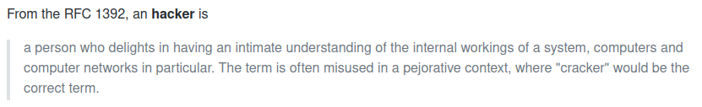
What’s the truth on cybersecurity?
“Those who believe they have discovered it [the truth] are the dogmatists”
Sextus Empiricus, Outlines of Pyrrhonism
“Academics treats it as inapprehensible”
Sextus Empiricus, Outlines of Pyrrhonism
“The skeptics keep on searching”
Sextus Empiricus, Outlines of Pyrrhonism
Cybersecurity
is the protection of computer systems and networks from the theft of or damage to their hardware, software, or electronic data, as well as from the disruption or misdirection of the services they provide.
The only truly secure system is one that is powered off, cast in a block of concrete and sealed in a lead-lined room with armed guards — and even then I have my doubts.
[…] things can be declared insecure by observation, but not the reverse. There is no test that allows us to declare an arbitrary system or technique secure. This implies that claims of necessary conditions for security are unfalsifiable.
Eugene H. Spafford
Purdue University
Cormac Herley
Microsoft Research
edu

Slide 4
The Attack Process
Attack (ISO/IEC 27000): an “attempt to destroy, expose, alter, disable, steal or gain unauthorized access to or make unauthorized use of an asset”
Vulnerability (cve.mitre.org) [2]: is a “weakness in an information system, system security procedures, internal controls, or implementation that could be exploited by a threat source”
Weakness (cwe.mitre.org) [1] “a type of mistake that, in proper conditions, could contribute to the introduction of vulnerabilities within that product. This term applies to mistakes regardless of whether they occur in implementation, design, or other phases of a product life-cycle.”
[1] FAQ – What is the difference between a software vulnerability and software weakness? Sept.17, 2019. URL: https://cwe.mitre.org/about/faq.html#A.2 (visited on 02/03/2020).
[2] Committee on National Security Systems (CNSS).“Glossary No 4009”. In:National Information Assur-ance (IA) Glossary(Apr. 6, 2015). URL: https://rmf.org/wp-content/uploads/2017/10/CNSSI-4009.pdf

Slide 5
The CIA-Triad
Unauthorized information release (Confidentiality): an unauthorized person is able to read and take advantage of information stored in the computer. This category of concern sometimes extends to “traffic analysis,” in which the intruder only observes the patterns of information use. From those patterns, the intruder can infer some information content. This category also includes the unauthorized use of a proprietary program.
Unauthorized information modification (Integrity): an unauthorized person is able to make changes in stored information [marco: and nobody notices it] – a form of sabotage. It should be noted that in the case of this kind of violation, the intruder does not necessarily see the information he has changed.
Unauthorized denial of use (Availability): an intruder can prevent an authorized user from referring to, or from modifying information, even though the intruder may not be able to refer to, neither modify the information themselves.
edu

Slide 6
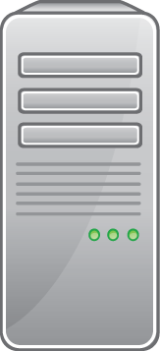

Information
CLIENT
SERVER
user_marco, psw_marco
[information in transit]
[Information at rest]
user_marco, psw_marco
user_test, psw_test
...
edu

Slide 7
C.1) Is the authentication process in your bookique secure?
What does it mean for an authentication process to be secure?
How do you show me that it is secure/insecure? Which tests are you going to do?
Confidentiality: protects information from being accessed/understood by non-authorized parties
Integrity: makes it evident if information is modified by non-authorized parties
Availability: information is accessible to authorized parties

Slide 8
C.2)Re-Design a secure bookique?
Focus on info at rest and in transit for user sign-in sign-up (auth)
What is a design and why is it important?
Should we “extend” the CIA-triad with authentication or trust?
“Test” insecurities
requirements
login_cred: confidential
...
login_credentials
[confidential]
edu

Slide 9
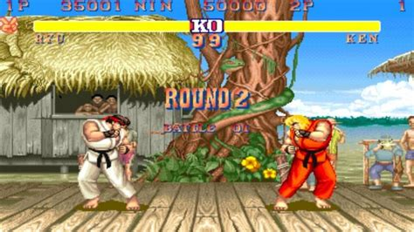
The CIA-triad
is just mumbo-jumbo.
Cybersecurity doesn’t
exist!
You’re wrong
97c131953908025bd7696acfe4171b587c1db519
[4 slides + 1 challenge]

Slide 10
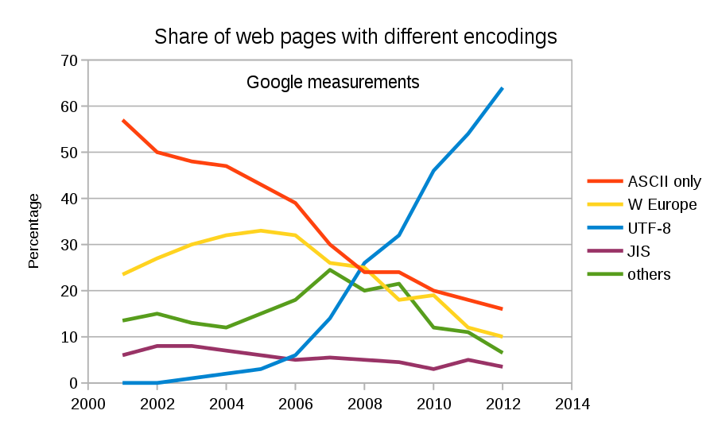
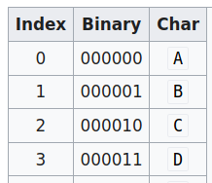
Encoding
input
ciao
output
Y2lhbwo=
PLAINTEXT
Base64 encoding
(software)
BASE64 (text-binary)
edu

Slide 11
Encoding
Is this secure?
CLIENT
SERVER
Y2lhbwo=
internet
input
ciao
output
Y2lhbwo=
Base64 encoding
(software)
BASE64 (text-binary)
edu

Slide 12
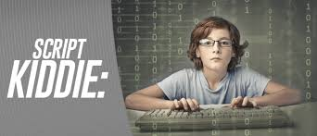

LIVE DEMO
http://localhost/tests/test.php
Base64 encoding
(software)
you
plaintext
ciao
encoded-text
Y2lhbwo=
script kiddie
edu

Slide 13
Hash functions
MD5 no-no
SHA1 maybe
SHA2 yes
SHA3 why not?
Hash function
(software)
Hash (SHA-512)
A0C299B71A9E59D5EBB07917E70601A3570AA103E99A7BB65A58E780EC9077B1902D1DEDB31B1457BEDA595FE4D71D779B6CA9CAD476266CC07590E31D84B206
plaintext
ciao
Hidden for
security
reasons
X
Do try this at home!
https://www.pelock.com/products/hash-calculator

Slide 14
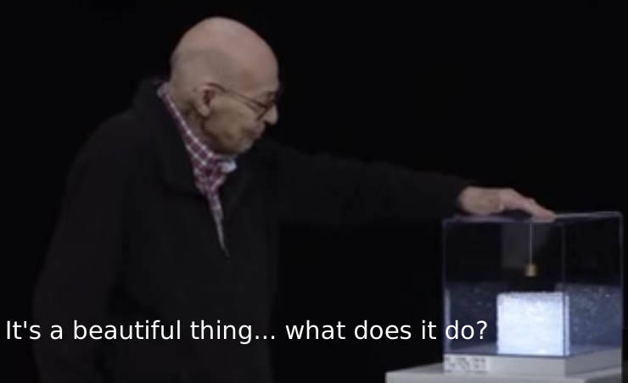
C.3) How do we use hash functions ?
Integrity? Confidentiality? Information at-rest/in-transit?
Database plain+hash? Website link+hash? Salt & pepper?
Attacks: brute-force attack & rainbow table
  Now crack my hash!
  https://en.wikipedia.org/wiki/John_the_Ripper
Hash function
(software)
Hash (SHA-512)
A0C299B71A9E59D5EBB07917E70601A3570AA103E99A7BB65A58E780EC9077B1902D1DEDB31B1457BEDA595FE4D71D779B6CA9CAD476266CC07590E31D84B206
you
plaintext
ciao
Hidden for
security
reasons
X
edu

Slide 15
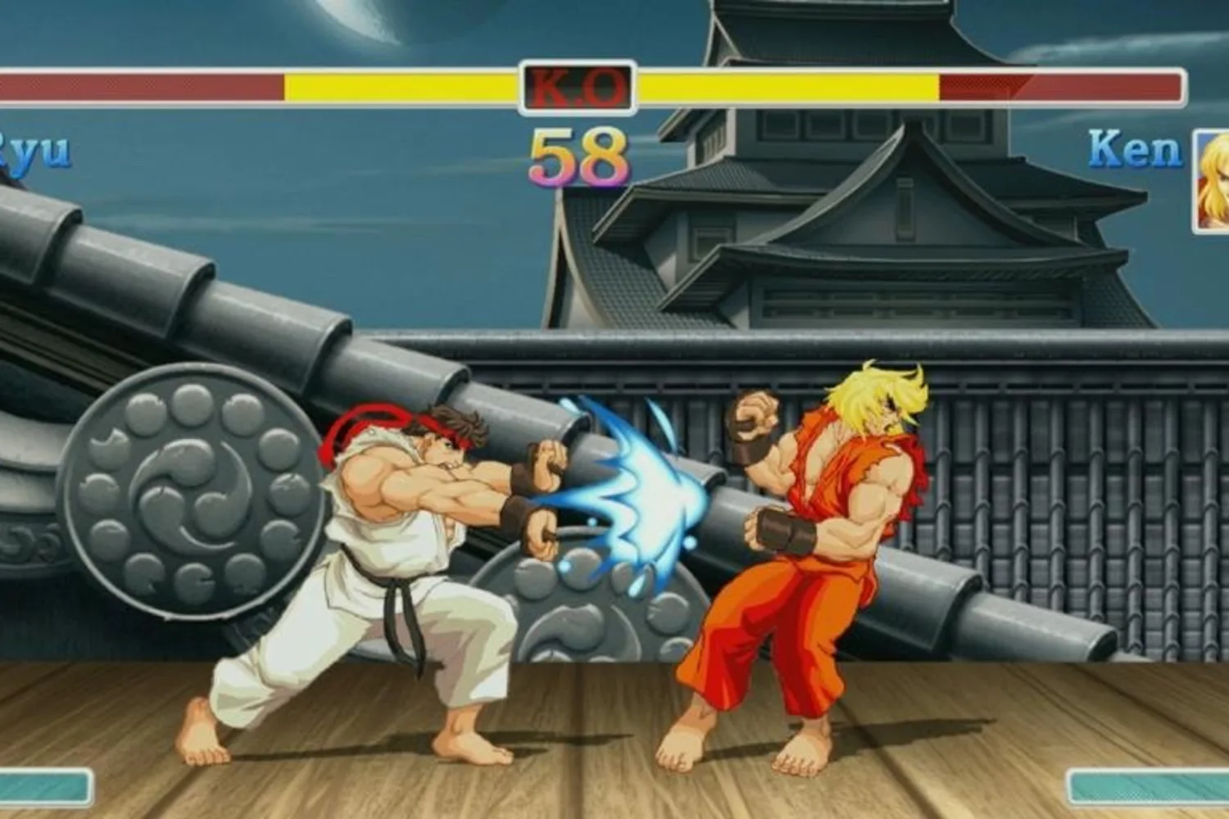
if you send your hash
nobody will undestand it
...
do you understand this?
[5 slides + 2 challenges]

Slide 16
Symmetric Encryption
CLIENT
SERVER
ciphertext
eqnvz
internet
plaintext
hello
Key
xmckl
ciphertext
eqnvz
Key
xmckl
ciphertext
eqnvz
plaintext
hello
encrypt
(software)
decrypt
(software)

Slide 17
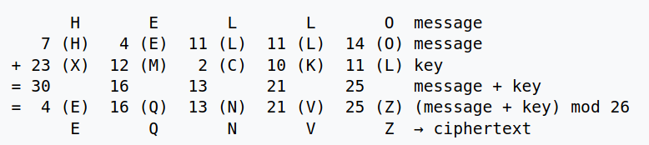
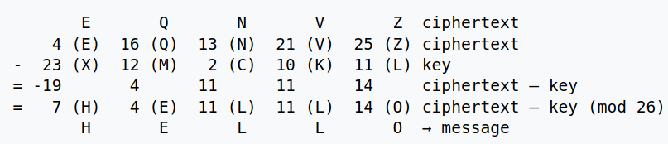
An example of Symmetric Encryption: One-Time Pad
encryption
decryption
edu

Slide 18
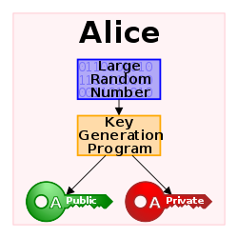
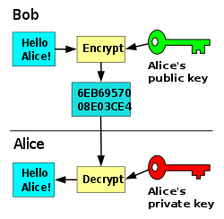
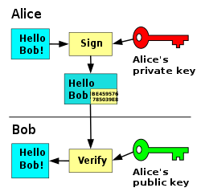
Public Key Encryption a.k.a. Asymmetric (key) Encryption
you can freely share your public key
edu

Slide 19


Symmetric Encryption
CLIENT
SERVER
ciphertext
internet
plaintext
hello
enc-Key
ciphertext
dec-Key
plaintext
hello
ciphertext
encrypt
(software)
decrypt
(software)

Slide 20
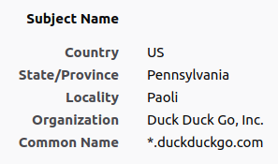
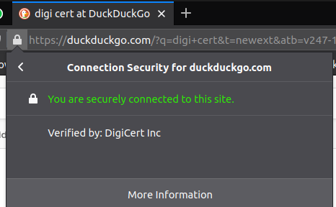
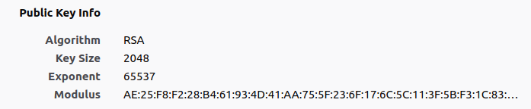
Public Key Infrastructures
Q) Is public key encryption the new 42?
A) Well… it’s slower than symmetric key encryption
Q) Why don’t we use asymmetric encryption to exchange symmetric keys?
A) What a great idea!
Public Key Infrastructure
(PKI)
edu

Slide 21
C.4) Propose techniques (security design) to preserve security properties
requirements
login_cred: hash?
...
login_credentials
[hash?sym-enc?]

Slide 22
C.5) How do we implement our security design ?
DO NOT WRITE YOUR OWN ENCRYPTION ALGORITHM
USE PHP-OPENSSL
PREFER SHA-*
PREFER AES for sym-enc
PREFER RSA/HTTPS for asym-enc
https://edu.v-research.it
marco@v-research.it
https://www.php.net/manual/en/book.openssl.php
Let’s have a look together

