Slide 1
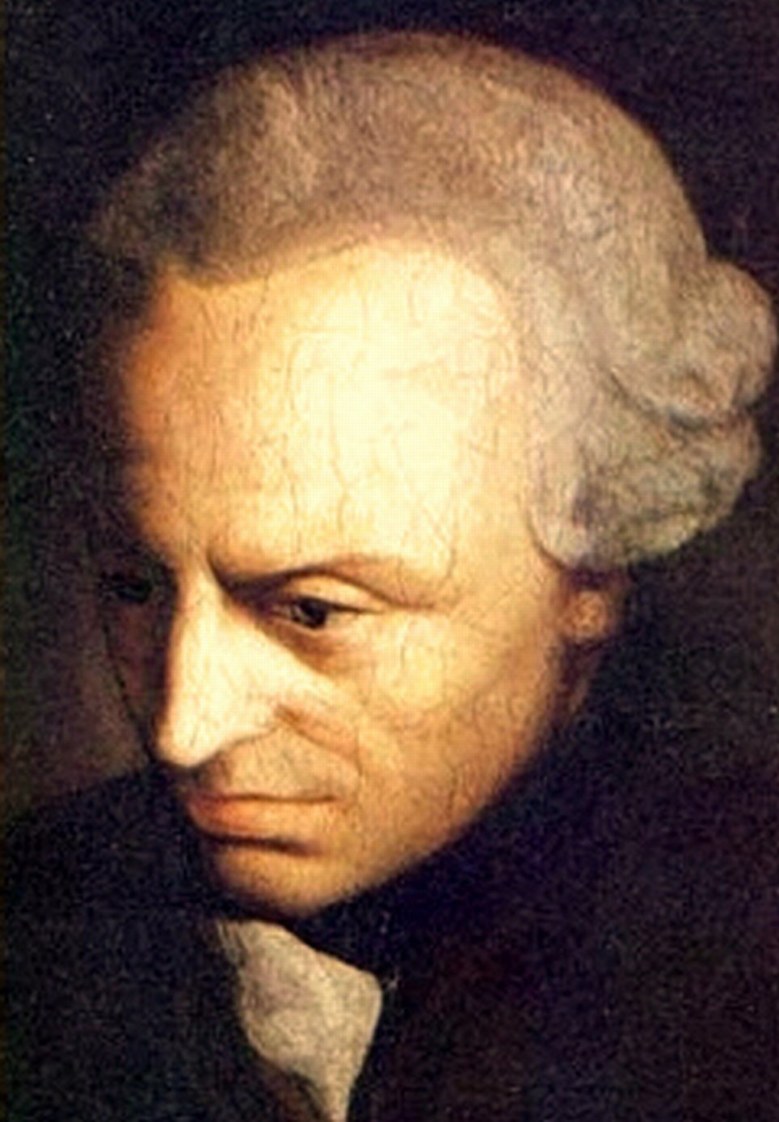
The observations and calculations of astronomers have taught us much that is wonderful;
but the most important is that they have revealed to us the abyss of our ignorance,
which otherwise human reason could never have conceived to be so great.
To meditate on this must produce a great change in the determination of the purposes
for which our reason should be used.
Immanuel Kant
Critique of Pure Reasoning (1781)
Web Cybersecurity – L3
Marco Rocchetto Mattia Pacchin
marco@v-research.it mattia@v-research.it
https://edu.v-research.it

Slide 2

Agenda
Crypto Overview [theory 1h30m]
Steganography, Encryption & Decryption
Symmetric and Asymmetric Encryption
Attacks on Protocol Logic (man-in-the-middle)
Coffee break [10m]
Cybersecurity Topic #4 - CSRF [lab 1h]
CSRF Intro (10m)
WebGoat lesson (A8:2013 Request Forgery) [1h]
Cybersecurity Topic #5 - Broken Authentication [1h]
WebGoat lesson (A2 – Secure Passwords) [1h]
edu

Slide 3


Steganography
Steganography is the practice of concealing information
Security by
obscurity
"System security should not depend on the secrecy of the implementation or its components."
edu

Slide 4

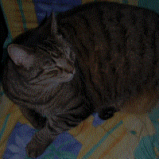
Steganography
Histiaeus sent a message to his vassal, Aristagoras, by shaving the head of his most trusted servant, "marking" the message onto his scalp, then sending him on his way once his hair had regrown
The hidden image is revealed by removing all but the two least significant bits of each color component and a subsequent normalization.
edu

Slide 5

Cryptography
is the practice and study of techniques for secure communication in the presence of third parties called adversaries
edu

Slide 6
Cryptography
is the practice and study of techniques for secure communication in the presence of third parties called adversaries
Confidentiality: protects information from being accessed/understood by non-authorized parties
Integrity: makes it evident if information is modified by non-authorized parties
Availability: information is accessible to authorized parties
Authenticity: guarantees the identity of a party
Non-repudiation: guarantees that a party cannot dispute its authorship
Anonymity: hiding the (real) identity of a party
edu

Slide 7
Cryptography
is the practice and study of techniques for secure communication in the presence of third parties called adversaries
Confidentiality: protects information from being accessed/understood by non-authorized parties
Integrity: makes it evident if information is modified by non-authorized parties
Availability: information is accessible to authorized parties
Authenticity: guarantees the identity of a party
Non-repudiation: guarantees that a party cannot dispute its authorship
Anonymity: hiding the (real) identity of a party
edu

Slide 8
NO security protocol
Attacker can read and modify your messages
Attacker
mex = 1
internet
mex = 0
Alice
Bob
edu

Slide 9

NO security protocol
Attacker can read and modify your messages
Attacker
mex = 1
internet
mex = 0
Alice
Bob
edu

Slide 10
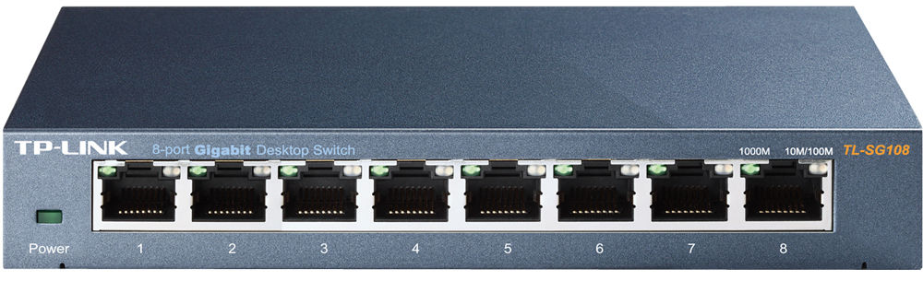
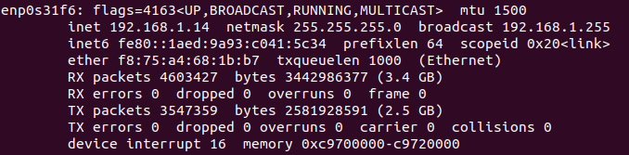
The ARP protocol and a “simple” MitM
Layer-2 switches don’t use IP but MAC & ports
MAC-Port
table
Alice
(device)
Bob
(device)
Devices use
IP addresses
IP-alice
MAC-alice
IP-Bob
MAC-Bob

Slide 11
The ARP protocol and a “simple” MitM
Layer-2 switches don’t use IP but MAC & ports
MAC-Port
table
1
1
1
1
1
1
1
1
Broadcast
ARP req
for IP-Bob
Bob
Alice
(device)
Empty
cache
Devices use
IP addresses
IP-alice
MAC-alice

Slide 12
The ARP protocol and a “simple” MitM
Layer-2 switches don’t use IP but MAC & ports
MAC-Port
table
1
1
1
1
1
1
1
1
Broadcast
ARP req
for IP-Bob
Bob
Alice
(device)
Empty
cache
Devices use
IP addresses
2
Unicast
IP-Bob
MAC-Bob
IP-alice
MAC-alice

Slide 13
The ARP protocol and a “simple” MitM
MAC-Port
table
Attacker
Unicast
IP-Bob
MAC-Attacker
Unicast
IP-Alice
MAC-Attacker
Alice
Bob
edu

Slide 14
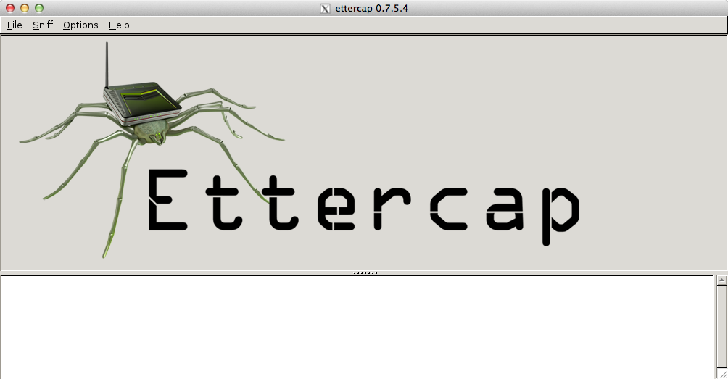
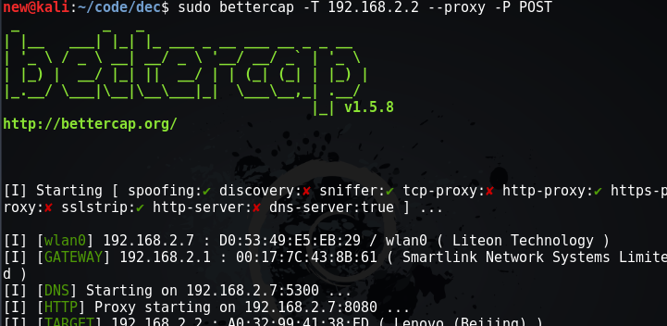
The ARP protocol and a “simple” MitM
MAC-Port
table
Attacker
Unicast
IP-Bob
MAC-Attacker
Unicast
IP-Alice
MAC-Attacker
Alice
Bob
edu

Slide 15
Back to our Example
NO security protocol
Cryptographic Algorithms makes the message confidential
Attacker
mex = Hi Bob
internet
mex = I hate you
Alice
Bob
edu

Slide 16
Using Cryptography - Confidentiality
Cryptographic Algorithms makes the message confidential
Attacker
????
mex = bae543
internet
mex = a235fe
Alice
Bob
mex = Hi Bob
mex = a235fe
Questions:
1. how do they compute
2. how do they share
mex = bae543
mex = Hx Bxx
Cryptographic algorithm
edu

Slide 17
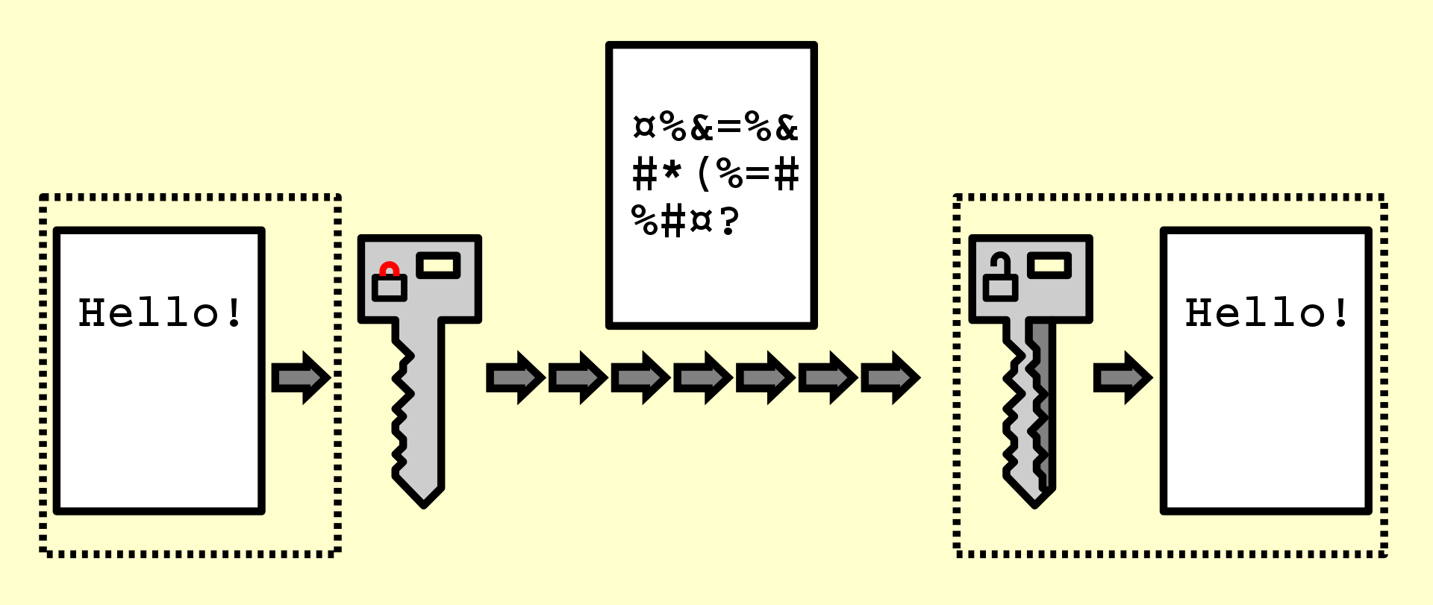
Encryption/Decryption
plaintext
encryption
ciphertext
key
decryption
plaintext
Same key (as in the Caesar cipher)
edu

Slide 18
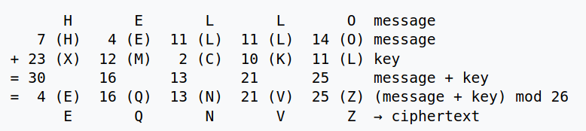
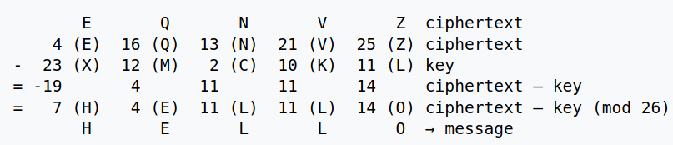
One-Time Pad
encryption
decryption
edu

Slide 19
One-Time Pad
encryption
decryption
Different operations but same key!
Symmetric (key) Encryption
edu

Slide 20
Shortcomings of Symmetric Encryption
Whoever has the key
can decrypt the messages
The KGB often issued its agents one-time pads printed on tiny sheets of flash paper, paper chemically converted to nitrocellulose, which burns almost instantly and leaves no ash
Still… if someone gets the key...
decryption
edu

Slide 21
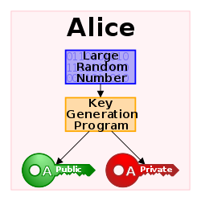
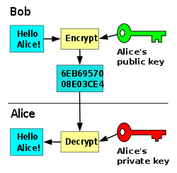
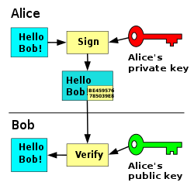
Public Key Encryption a.k.a. Asymmetric (key) Encryption
So, You can freely share your public key
edu

Slide 22
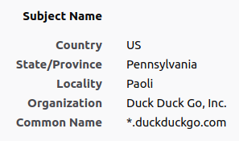
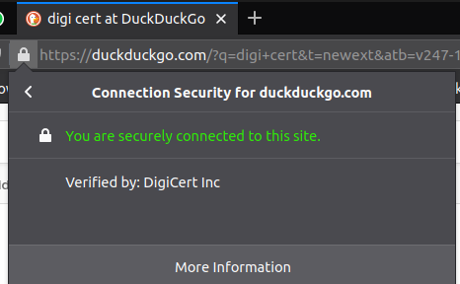
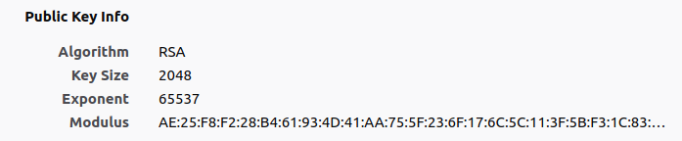
Public Key Infrastructures
Q) Is public key encryption the new 42?
A) Well… it’s slower than symmetric key encryption
Q) Why don’t we use asymmetric encryption to exchange symmetric keys?
A) What a great idea!
Public Key Infrastructure
(PKI)
edu

Slide 23
At least, read this definitions before the exam
Encryption: the process of converting a plaintext into the corresponding ciphertext in such a way that only authorized entities can obtain the plaintext from the ciphertext
Decryption: the process of converting a ciphertext into the corresponding plaintext
Steganography: the process of concealing information
  Security by obscurity: the belief that cybersecurity can be achieved by hiding sensitive information
Cryptography: the practice and study of techniques for secure communication in the presence of third parties called adversaries
Symmetric Encryption: use the same key to encrypt/decrypt.
Asymmetric Encryption: use a pair of public and private keys to encrypt decrypt resp.
Symmetric Enc. is relatively slower than Asymmetric
OTP: a symmetric key encryption scheme
edu

Slide 24
Agenda
Crypto Overview [theory 1h30m]
Steganography, Encryption & Decryption
Symmetric and Asymmetric Encryption
Attacks on Protocol Logic (man-in-the-middle)
Coffee break [10m]
Cybersecurity Topic #4 - CSRF [lab 1h]
CSRF Intro (10m)
WebGoat lesson (A8:2013 Request Forgery) [1h]
Cybersecurity Topic #5 - Broken Authentication [1h]
WebGoat lesson (A2 – Secure Passwords) [1h]
edu

Slide 25
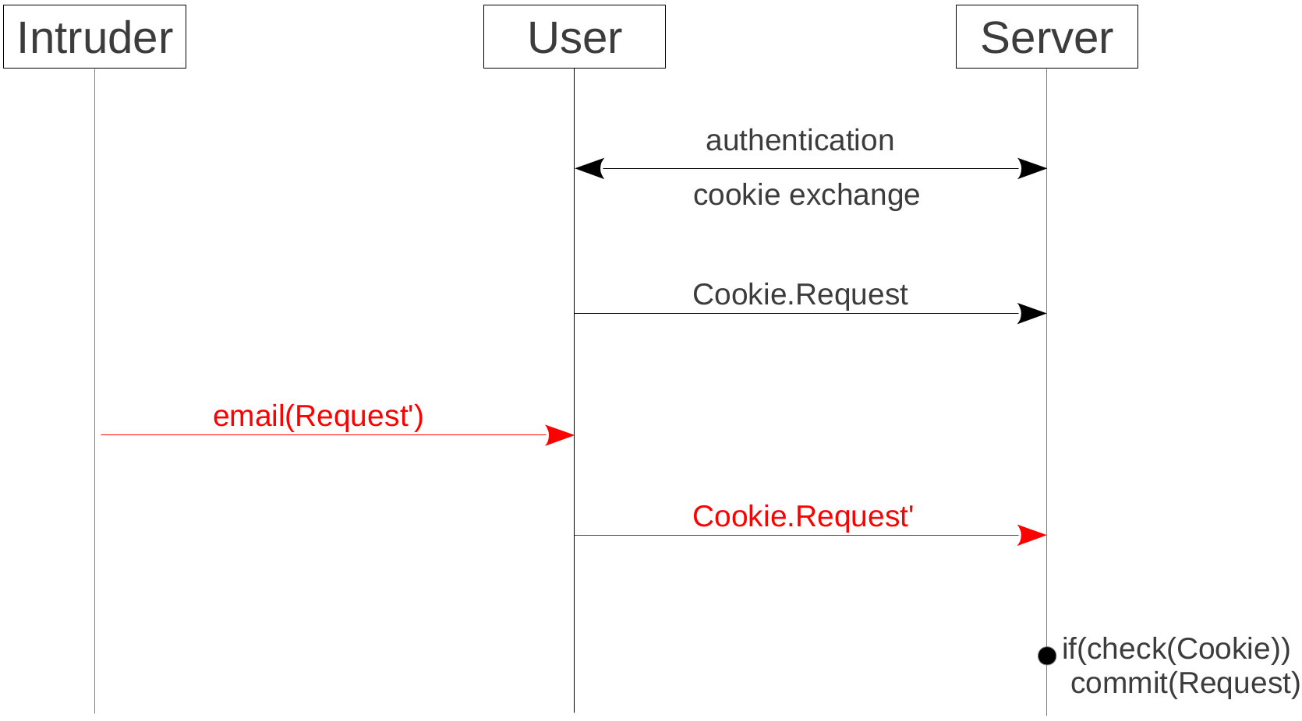
CSRF – Attack
We now know how to make it secure!
edu

Slide 26
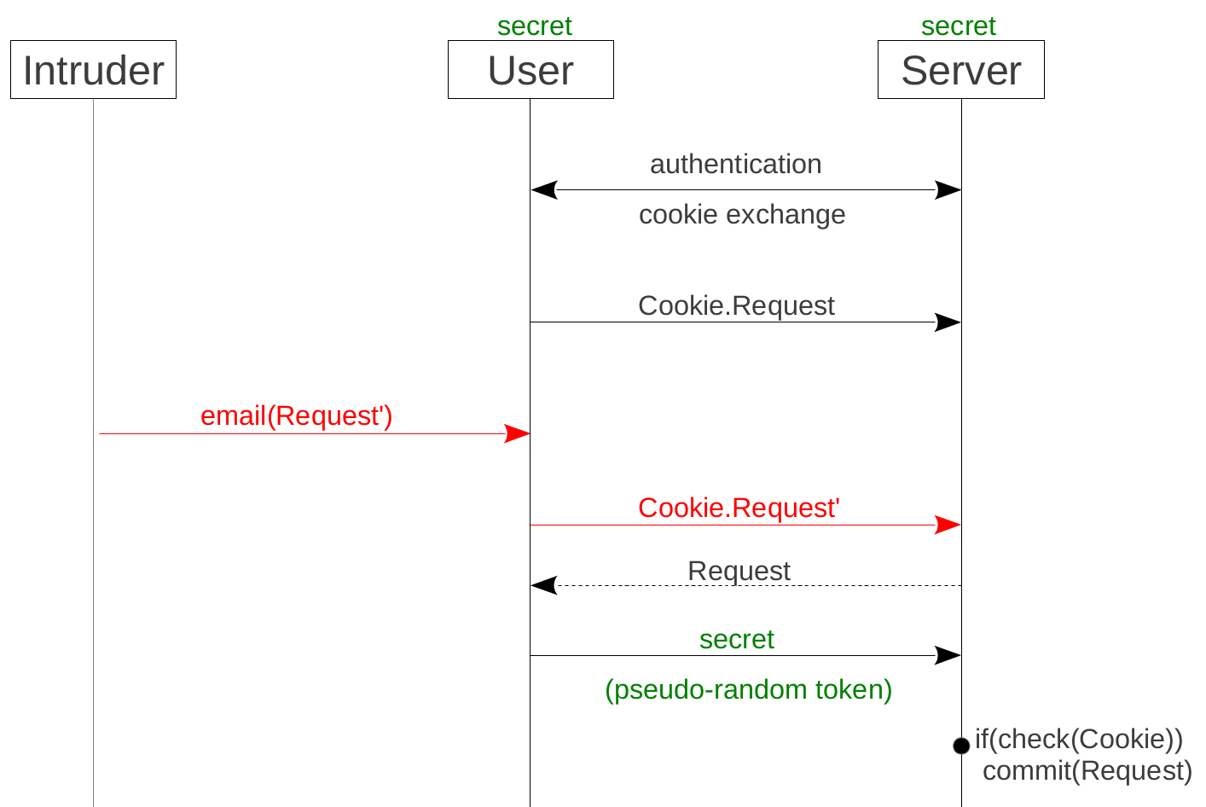
CSRF – Protection
edu

Slide 27
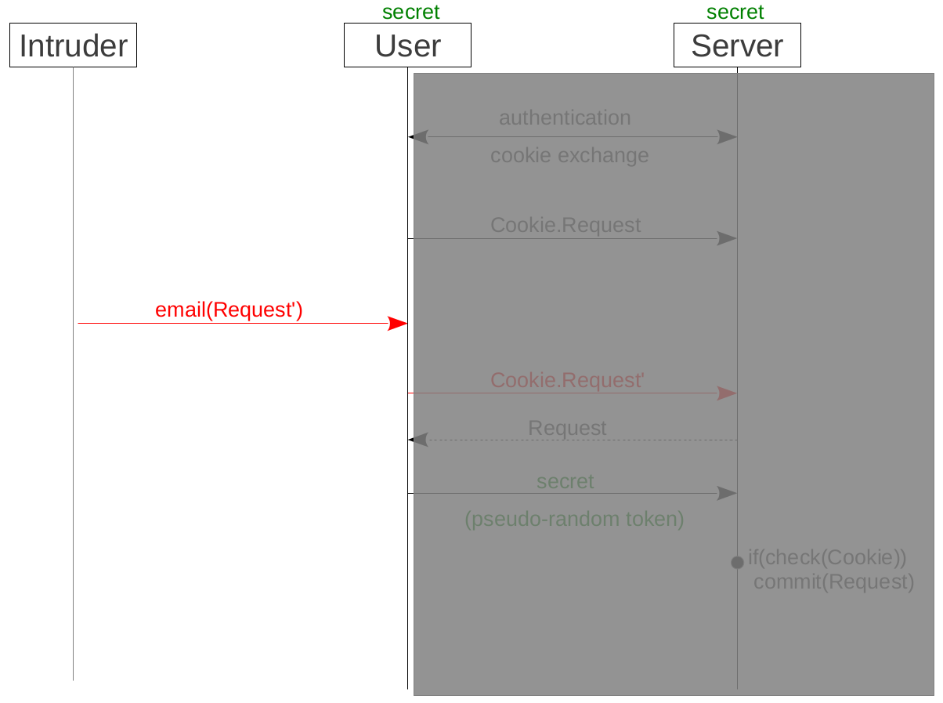
CSRF – User as an Oracle for the Intruder
edu

