Slide 1

All living is an obeying.
[…] The one who cannot obey himself is commanded.
[…] commanding is harder than obeying.
And not only that the commander bears the burden of all obeyers,
and that this burden easily crushed him:
In all commanding it seems to me there is an eperiment and a risk;
and always when it commands, the living risks itself in doing so.
Indeed, when it commands itself, even then it must pay for its commanding.
It must become the judge and avenger and victim of its own law.
Thus spoke Zarathustra (1885)
Friedrich Nietzsche
Web Cybersecurity – L1
Marco Rocchetto Mattia Pacchin
marco@v-research.it mattia@v-research.it
https://edu.v-research.it

Slide 2

Agenda
Summary of the previous lesson
Cybersecurity Topic #1 - SQL-injection [theory 30m + lab 2h]
Intro to Databases and DBMS [15m]
Introduction to SQLmap with examples [15m]
WebGoat lesson (A1 - Injection, path traversal excluded) [2h]
Coffee break [10m]
Open Discussion [30m]
Cybersecurity Topic #2 - Path Traversal [lab 30m]
WebGoat lesson (A1 - Injection -> Path Traversal) [30m]
edu

Slide 3
Summary of the Previous Lesson
The VERY IMPORTANT concepts in L0 are:
  CIA (Lesson 0)
  For the LAZY ones:
    Weakness [1] The definition given by the MITRE in of weakness is:
    “a type of mistake that, in proper conditions, could contribute to the introduction of vulnerabilitieswithin that product. This term applies to mistakes regardless of
    whether they occur in implementation, design, orother phases of a product lifecycle.”
    Vulnerability [2] as defined in [30], is a “weakness in an
    information system, system se-curity procedures, internal controls, or implementation
    that could be exploited by a threat source”.
    Attack: as defined by the International StandardISO/IEC 27000, is an “attempt to destroy,
    expose, alter, disable, steal or gain unauthorized access to or makeunauthorized use of an
    asset”
[1] FAQ – What is the difference between a software vulnerability and software weakness? Sept.17, 2019. URL: https://cwe.mitre.org/about/faq.html#A.2 (visited on 02/03/2020).
[2] Committee on National Security Systems (CNSS).“Glossary No 4009”. In:National Information Assur-ance (IA) Glossary(Apr. 6, 2015). URL: https://rmf.org/wp-content/uploads/2017/10/CNSSI-4009.pdf

Slide 4
DataBase
A database is an organized collection of structured data
A database is usually controlled by a database management system (DBMS)
Data within the most common types of databases in operation today is typically modeled in rows and columns in a series of tables to make processing and data querying efficient
edu

Slide 5
DBMS
A Database Management System (DBMS) is software designed to store, retrieve, define, and manage data in a database
DBMS software primarily functions as an interface between the end user and the database, simultaneously managing the data, the database engine, and the database schema in order to facilitate the organization and manipulation of data
edu

Slide 6
SQL
SQL (Structured Query Language) is a standard language for storing, manipulating and retrieving data in databases.
SQL can:
  execute queries against a database
  retrieve data
  insert, update and delete records
  create new databases, new tables, stored procedures and views
  set permissions on tables, procedures and views
edu

Slide 7
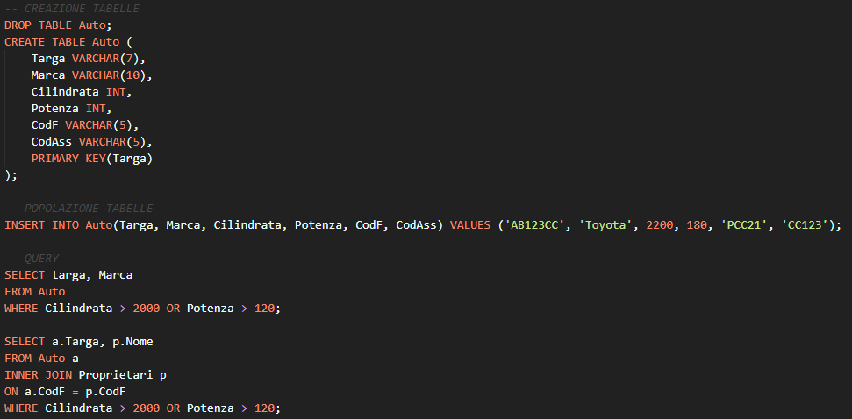
SQL
edu

Slide 8
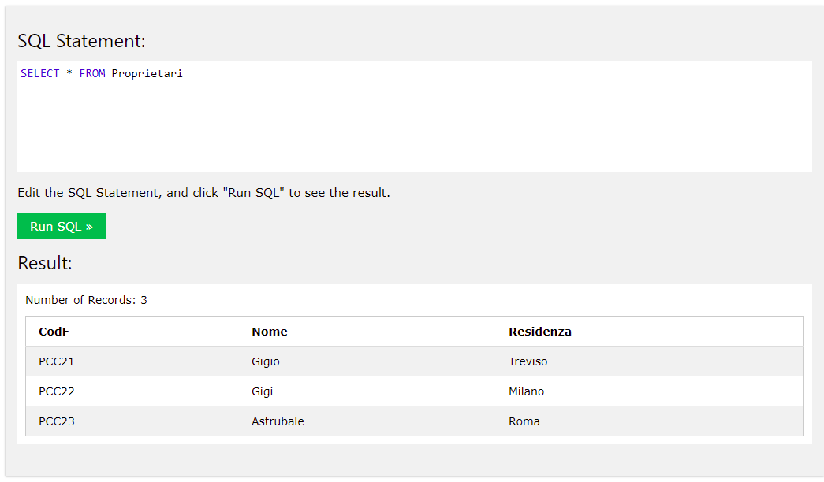
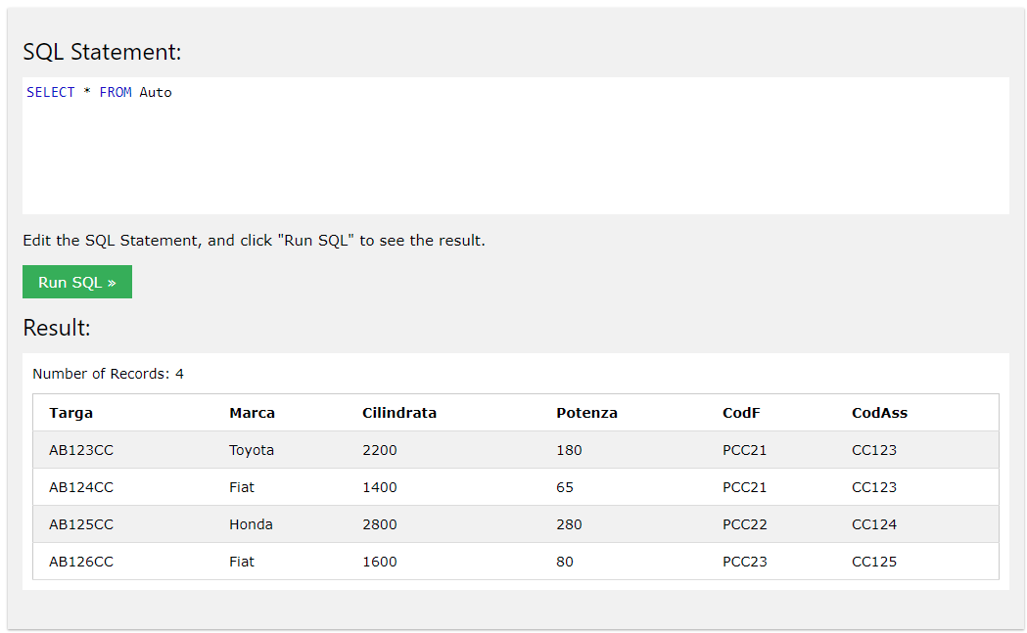
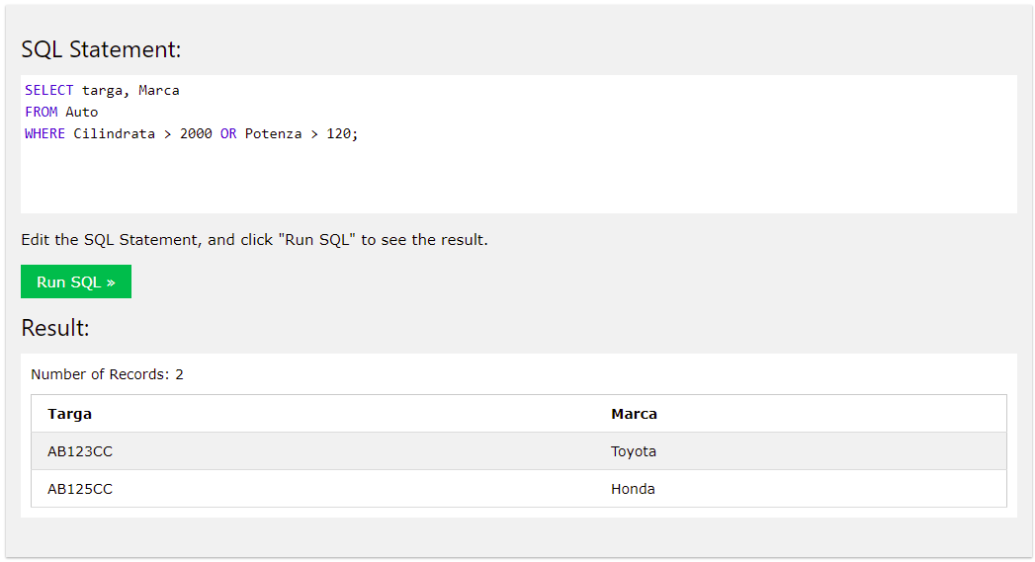
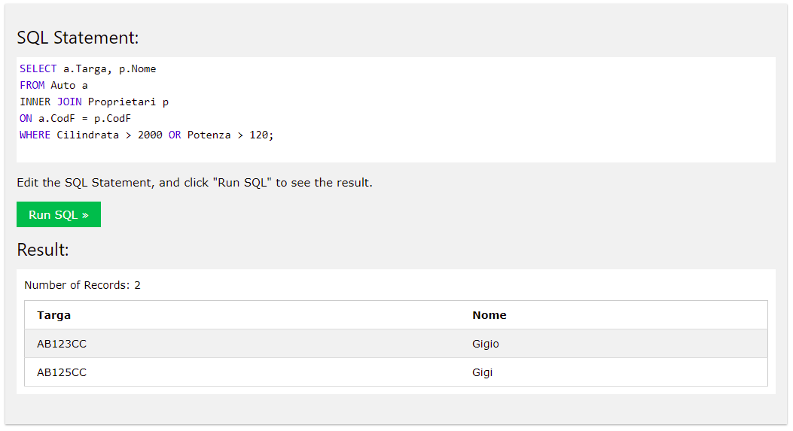
Detailed Examples

Slide 9




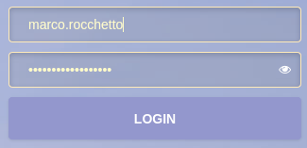
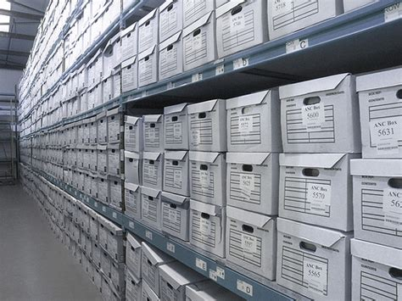
A DBMS from the point of view of a USER
3
1
2
4
User
Server
DBMS
Database
1
2
SELECT * FROM users
WHERE
user = marco AND
psw = sesquipedale
etc

Slide 10

A DBMS from the point of view of a USER
3
1
2
4
Hacker
Server
DBMS
Database
1
I Love you, DBMS
From the bottom of my heart!
?
3
Can you guess what the
DBMS would think?

Slide 11

A DBMS from the point of view of a USER
3
1
2
4
Hacker
Server
DBMS
Database
1
I Love you, DBMS
From the bottom of my heart!
?
3
The DBMS interprets
it literally!

Slide 12
A DBMS from the point of view of a USER
3
1
2
4
Hacker
Server
DBMS
Database
1
2
SELECT * FROM users
WHERE
user = marco
AND
psw = “ “
OR
1=1
yes...

Slide 13
A DBMS from the point of view of a HACKER
A = does it exists?
0 = no
1 = yes
A
1
1
0
0
AND
1
0
0
0
B
1
0
1
0
A
1
1
0
0
OR
1
1
1
0
B
1
0
1
0
SELECT * FROM users
WHERE
{user = marco
AND
psw = “ “}
OR
1=1
user = marco
1
AND
0
Psw = “ ”
0
OR
1
1=1
1

Slide 14
SQL-injections - Types
Authentication bypass attack: the intruder bypasses an authentication checkthat a web app performs by querying a database.
Data extraction attack: the intruder obtains data from the database that she should not be able to obtain.
In a Boolean-Based SQLi (BB), an intruder inserts into an HTTP parameter, which is used by a web app to write a SQL query, one or more valid SQL statements that make the WHERE clause of the SQL query evaluate to true or false. By interacting with the web app and comparing the responses, the intruder can understand whether or not the injection was successful. In this way, an intruder can perform both authentication bypass and data extraction attacks.
Time-Based SQLi (TB) is quite similar to BB: the only difference is that TB does not need the web app to have a Boolean behavior. The intruder appends a timing function to the validity value of a Boolean clause. Thus, after the submission of the query by the web app, the database waits for a predefined amount of time for a tuple as a response to the query; the intruder can then inferwhether the Boolean value of the query was true or false observing a delay in the response. In real case scenarios, a BB is preferable as it is faster than a TB
When error pages are exposed to the Internet, some error messages of thedatabase could be exposed, thus giving an intruder the possibility of exploiting an Error-Based SQLi (EB). In this type of injection, the intruder tricks the database into performing operations that result in an error and then he extracts information from the error messages produced by the database. EB is generallyused to perform a data extraction attack by inducing the generation of an error that contains some information stored in the database

Slide 15
SQL-injections - Types
A UNION Query-Based SQLi (UQ) is a technique in which an intruder injects a SQL UNION operator to join the original query with a malicious one.The aim is to overwrite the values of the original query and thus, in order to extract information, UQ requires the web app to print the result of the query within the returned HTML page. This behavior allows the intruder to actually extract information from the database by reading it within the web app itself.
Second-Order SQLi (SO) is an injection that has no direct effect when submitted but that is exploited in a second stage of the attack. In some cases, aweb app may correctly handle and store a SQL statement whose value depends onthe user input. Afterwards, another part of the web app that doesn’t implement a control against SQLi might use the previously stored SQL statement to executea different query and thus expose the web app to a SQLi. Automated scanners generally fail to detect this type of SQLi
With a Stacked Queries SQLi (SQ), an intruder can execute an arbitrary query different from the original one. The semicolon character “;” enables the intruder to concatenate a different SQL query to the original one. By doing so, the intruder can perform data extraction attacks as well as execute whatever operation is allowed by the database. With a SQ, an intruder can perform any of the SQLis described above. Thus, whenever we refer to all the SQLis in our categorization, we exclude SQ as it is already covered by the other ones.

Slide 16
SQL-injections - Protections
A sanitization function takes the input provided by the user and removes (i.e., escapes) all the special characters that could be used to perform a SQLi. Sanitization functions are not the best option when dealing with SQLi because they might not be properly implemented or do not consider some cases.
Prepared statements are the best option for preventing SQLis. They are mainly used to execute the same query repeatedly maintaining efficiency. However, due to their inner execution principle (if properly implemented) they are immune to SQLi attacks. The execution of a prepared statement consists mainly in two steps: preparation and execution. In the preparation step, the query is evaluated and compiled, waiting for the parameters for the instantiation. During the execution step, the parameters are submitted to the prepared statement and handled as data and thus they cannot be interpreted as SQL commands.

