Slide 1

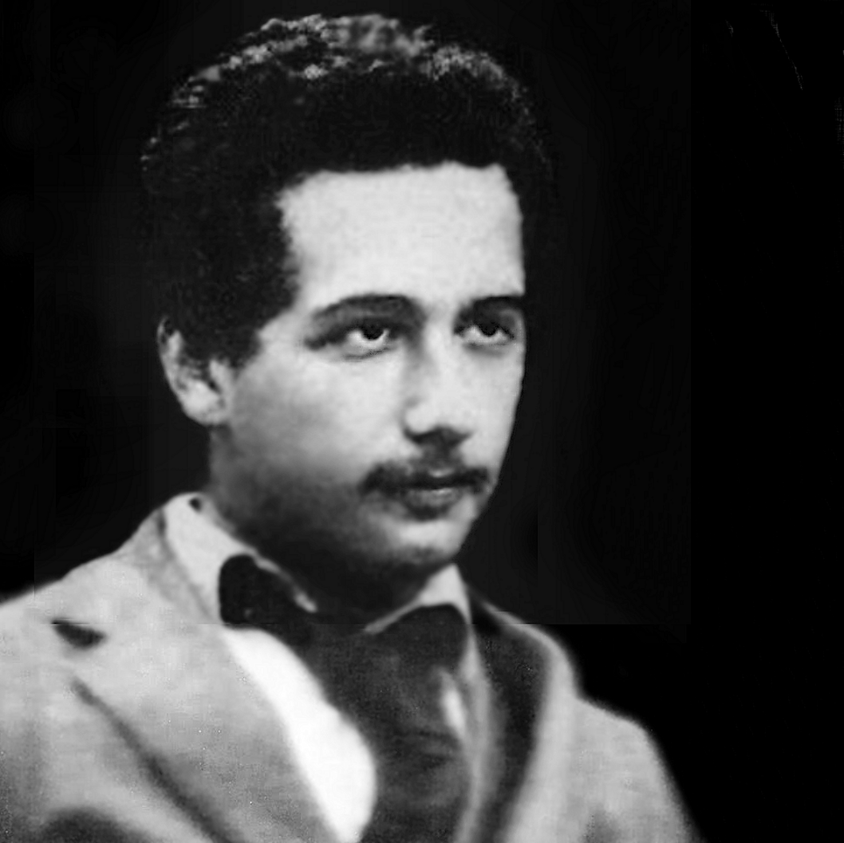
A theory which is not refutable by any conceivable event is non-scientific. Irrefutability is not a virtue of a theory (as people often think) but a vice.
Conjectures and Refutations (1963)
Karl Popper
In a letter from Albert Einstein to Karl Popper:
“[...] and I think (like you, by the way)that theory cannot be fabricated out of the results of observation, but that itcan only be invented.”
From “The Logic of Scientific Discovery” (1959)
Karl Popper
Web Cybersecurity – L2
Marco Rocchetto Mattia Pacchin
marco@v-research.it mattia@v-research.it
https://edu.v-research.it

Slide 2

Agenda
Intro to JavaScript & HTML [theory 30m]
Cybersecurity Topic #3 - XSS [theory 15m + lab 1h]
XSS short intro [15m]
WebGoat lesson (A7 – Cross-Site Scripting) [1h]
Coffee break [10m]
XSS Game (by Google: https://xss-game.appspot.com/) [1h30m]
“At Google, we know very well how important these bugs are. In fact, Google is so serious about finding and fixing XSS issues that we are paying mercenaries up to $7,500 for dangerous XSS bugs discovered in our most sensitive products.”
edu

Slide 3
The VERY IMPORTANT concepts so far
L0
  CIA-triad
  Weakness (CWE), Vulnerability (CVE), Attack (CAPEC)
  Hackers & Pentesting
L1
  What is a SQL injection in theory (definition)
  Which types of SQL injections (Boolean-based, Time-based, etc)
  Effects of a SQL injection (auth. Bypass, data extraction)
  Mitigations of a SQL injection (sanitization function, prepared statement)
  How to write and use SQL injection for both authentication bypass & data extraction
edu

Slide 4
HTML
HTML (Hyper Text Markup Language) is the standard markup language for Web pages
HTML elements are the building blocks of HTML pages
HTML elements are represented by <> tags
edu

Slide 5
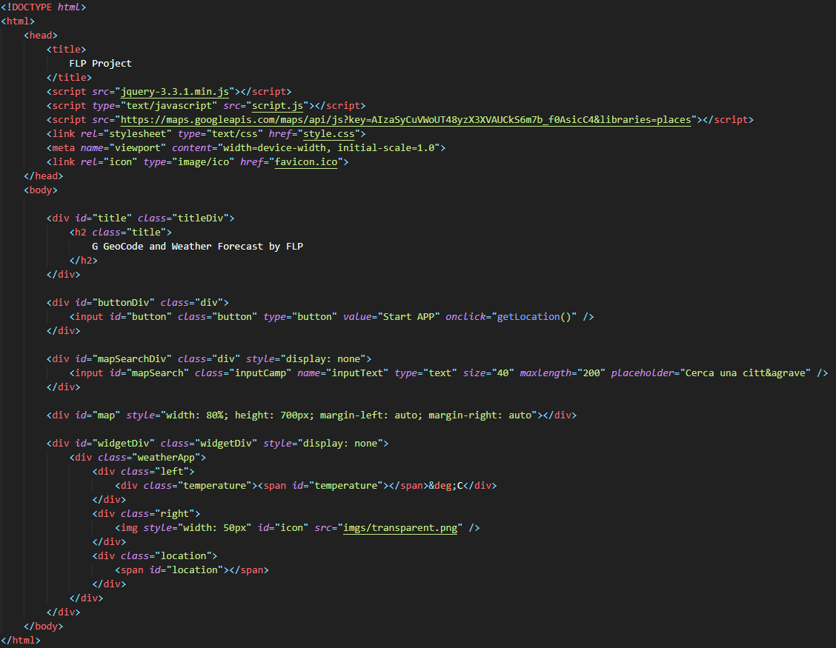
HTML example
<head> - here we call necessary external files and libraries
<body> - here we define all the contents of an HTML document
edu

Slide 6
HTML example
id – it is unique and it specifies a unique HTML element
class – it specifies a class (a group) of HTML elements
style – it defines CSS inline properties
edu

Slide 7
CSS
CSS (Cascading Style Sheets) describes how HTML elements are to be displayed on screen, paper, or in other media
CSS saves a lot of work. It can control the layout of multiple web pages all at once
External style sheets are stored in .css files
With an external style sheet file, you can change the look of an entire website by changing just one file!
edu

Slide 8
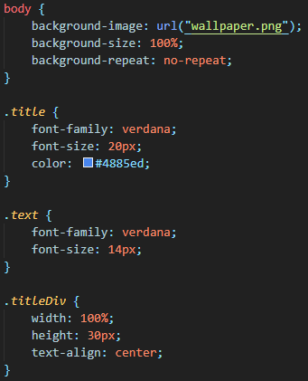
CSS example
Style valid for <body> element
Style valid for many classes of elements
* #id {} - style valid for the element with that id
edu

Slide 9
JavaScript
JavaScript is the programming language of the Web
JavaScript Can Change HTML Content, HTML Attribute Values, HTML Styles (CSS)
There are Functions and Events
For example, a function can be called when an event occurs, like when the user clicks a button (events)
edu

Slide 10
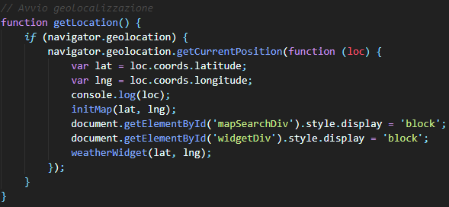
JavaScript example
Function name
Function variable
Modifying style of an element identified by id
Calling another function
edu

Slide 11
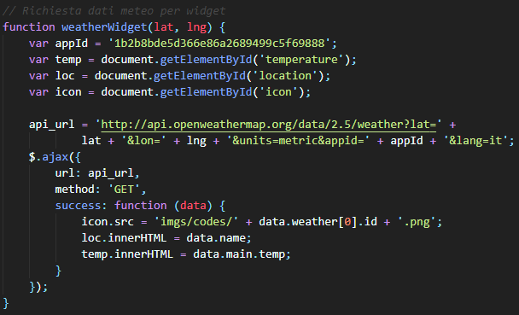
JavaScript example
ajax call
edu

Slide 12
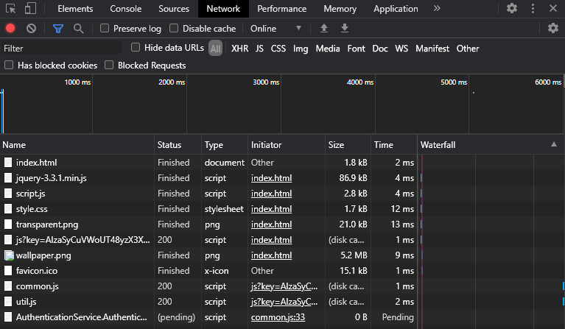
Element Inspector
In element inspector we can find everything about our html site
edu

Slide 13
JSON
JSON (JavaScript Object Notation) is a lightweight data-interchange format
It is easy for humans to read and write and it is easy for machines to parse and generate
JSON is built on two structures:
  A collection of name/value pairs named object. Ex:{“name”:“Mario”}
  An ordered list of values named array. Ex:[“languages”:“en”,“it”]
edu

Slide 14
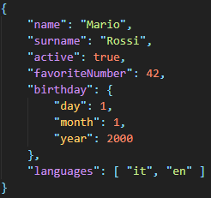
JSON
JSON body
JSON object
JSON array
edu

Slide 15

Agenda
You now also “magically” “know”
Intro to JavaScript & HTML [theory 30m]
Cybersecurity Topic #3 - XSS [theory 15m + lab 1h]
XSS short intro [15m]
WebGoat lesson (A7 – Cross-Site Scripting) [1h]
Coffee break [10m]
XSS Game (by Google: https://xss-game.appspot.com/) [1h30m]
“At Google, we know very well how important these bugs are. In fact, Google is so serious about finding and fixing XSS issues that we are paying mercenaries up to $7,500 for dangerous XSS bugs discovered in our most sensitive products.”
edu

Slide 16

XSS or Cross-site Scripting
XSS vulnerability enables attackers to
inject client-side scripts
into the web pages
(by taking advantage of another user’s session)
test
search
Please wait – we are searching for test
webpage
edu

Slide 17
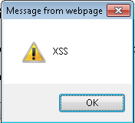
XSS or Cross-site Scripting
XSS vulnerability enables attackers to
inject client-side scripts
into the web pages
(by taking advantage of another user’s session)
<script> alert(‘XSS’)</script>
test
search
Please wait – we are searching for
webpage
edu

Slide 18
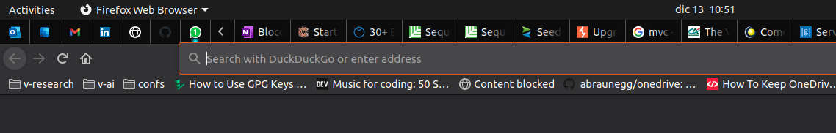
XSS or Cross-site Scripting
XSS vulnerability enables attackers to
inject client-side scripts
into the web pages
(by taking advantage of another user’s session)
Can I use this in a URL?
Can I use it
https://.../[HERE]
<script> alert(‘XSS’)</script>
edu

Slide 19
XSS or Cross-site Scripting
XSS vulnerability enables attackers to
inject client-side scripts
into the web pages
(by taking advantage of another user’s session)
Can I use this in a URL?
Can I use it
https://.../[HERE]
<script> alert(‘XSS’)</script>
%3Cscript%3Ealert%28%22XSS%22%29%3C%2Fscript%3E

Slide 20
XSS Types
Stored XSS (persistent), where the malicious client-side code that the attacker can execute is saved by the web site and subsequently retrieved, and executed by a user, every time a certain page is loaded.
Relfected XSS (non-persistent), We refer to Reflected XSS in all the cases where the malicious client-side code that the attacker can execute is not saved by the web site but is "reflected" within a web page, meaning that the web site takes an user-controllable input, includes it within a web page (hence the name "reflection") and serves it to the user within the response of a request.
DOM-Based XSS, the malicious code is never sent to the web server, meaning that there's no request begin sent and no response being received by the web browser. Both Reflected and Stored XSS requires at least one request being sent and one response being received. Such interaction is carried out by means of the HTTP protocol which involves sending and receiving HTTP requests and responses. DOM-Based XSS, on the other end, does not.
Self-XSS is a form of XSS vulnerability which relies on social engineering in order to trick the victim into executing malicious JavaScript code into their browser.
not a new type but an attack vector?

Slide 21
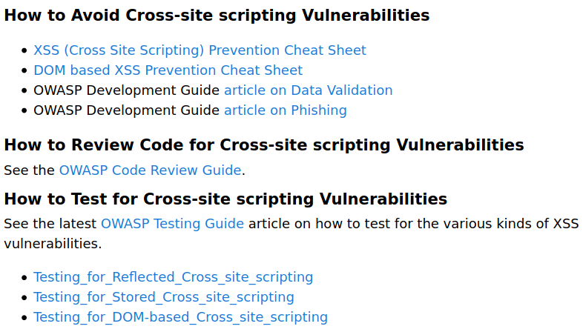
XSS Info & Mitigations
https://owasp.org/www-community/attacks/xss/
edu

Slide 22
XSS Info & Mitigations
https://owasp.org/www-community/attacks/xss/
Output Encoding/Escaping
Input (HTML) Sanitization
Cookies security
edu

Slide 23
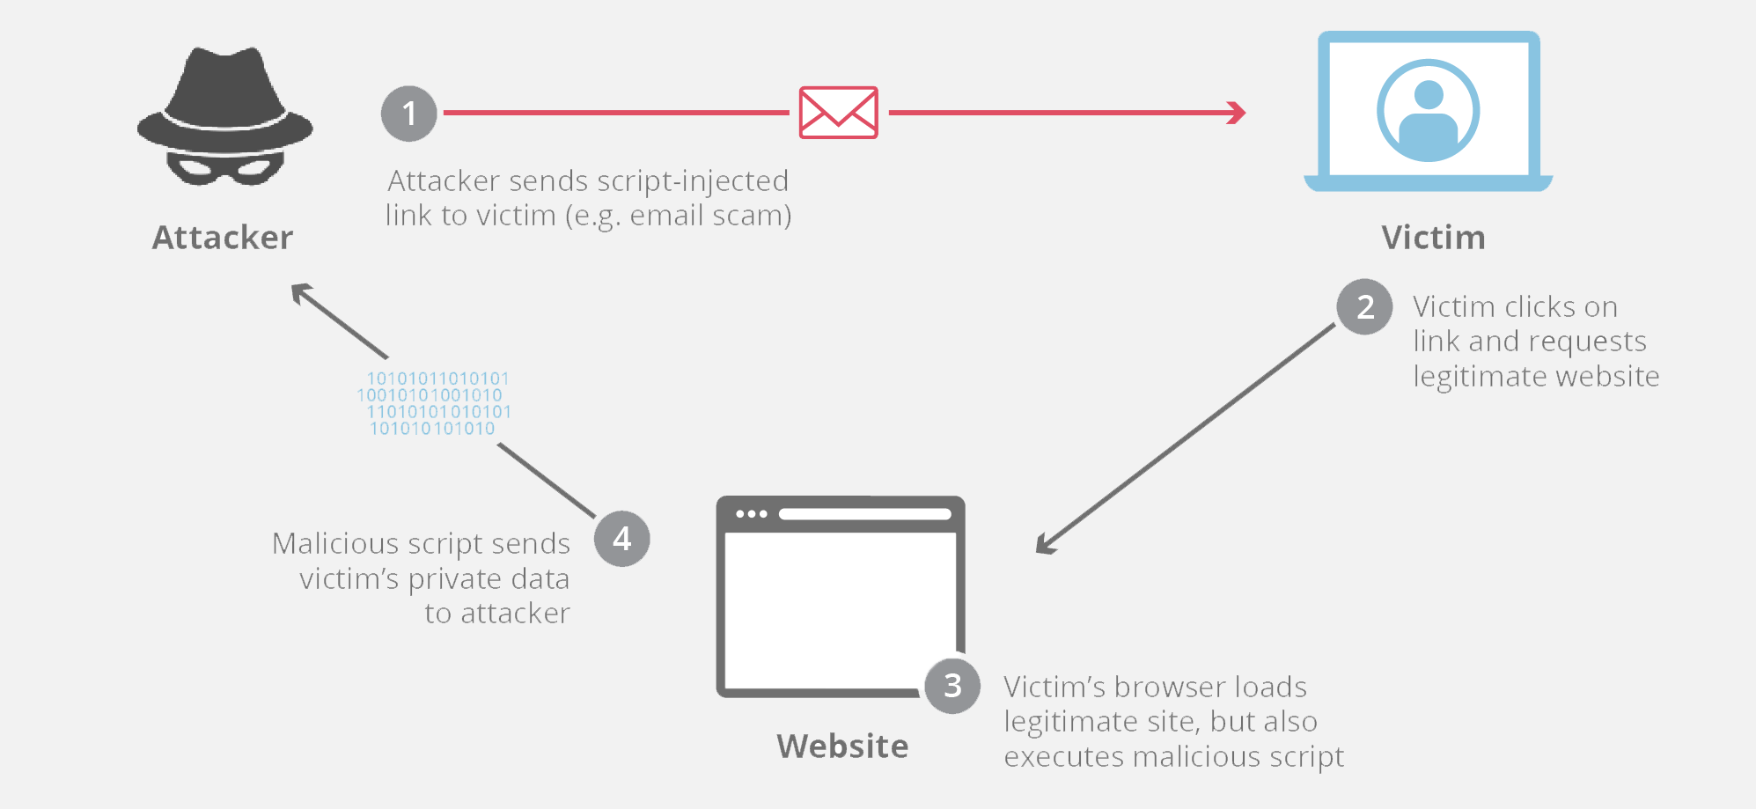
Attack Pattern – Example
edu

Slide 24
Attack Pattern – Example
Social engineering
[you]
[myself]
[link via meet]
[registro elettronico]
edu

Slide 25
Agenda
Intro to JavaScript & HTML [theory 30m]
Cybersecurity Topic #3 - XSS [theory 15m + lab 1h]
XSS short intro [15m]
WebGoat lesson (A7 – Cross-Site Scripting) [1h]
Coffee break [10m]
XSS Game (by Google: https://xss-game.appspot.com/) [1h30m]
“At Google, we know very well how important these bugs are. In fact, Google is so serious about finding and fixing XSS issues that we are paying mercenaries up to $7,500 for dangerous XSS bugs discovered in our most sensitive products.”
edu

Slide 26



Hacking Playground [1h30m]
1
X
A7 – Cross-Site Scripting
Follow WebGoat 1-9
2
Skip these!
3
https://xss-game.appspot.com/
edu

Slide 27
Hacking Playground [1h30m]
https://stackoverflow.com/questions/10323392/in-javascript-jquery-what-does-e-mean
1
For the courious ones:
* MVC pattern
* JS e as Event var
* %2F = /
X
A7 – Cross-Site Scripting
Follow WebGoat 1-9
2
Skip these!
3
https://xss-game.appspot.com/
edu

