Slide 1



Edge Analytics on Sensor Data
Processing Sensor Data Locally Before Transmission – Powered by QNX Neutrino RTOS – Q-eHACK 2026
M V S | V. Sai Manohar, M. Shashank, V. Vishwa Prasad (3rd year ECE)
Problem Statement #34 | QNX Everywhere Initiative | March 2026 | Hyderabad

Slide 2
Team Name: M V S
Project Title: Edge Analytics on Sensor Data
Project ID: 34
College Name: B V Raju Institute of Technology
Team Details: V. Sai Manohar| M. Shashank| V. Vishwa Prasad | 3rd year ECE

Slide 3
Agenda
Presentation Overview
Problem Statement & Clarity
Proposed Solution – Edge Analytics
Technical Deep Dive & QNX RTOS Integration
Innovation & Originality
Industry Impact & Relevance
Live Demo

Slide 4
Problem Statement
The Core Problem
IoT edge devices—such as those using DHT22 and MPU6050—continuously generate high-frequency sensor data. Without local processing, 100% of raw data is streamed to the cloud, causing excessive bandwidth usage, high latency, and missed real-time anomalies that demand immediate local action.
Root Causes:
No local filtering or analytics — raw sensor readings sent directly to cloud, wasting bandwidth and increasing round-trip latency
No process isolation: without RTOS priority scheduling, a lower-priority task can preempt the sensor read, corrupting microsecond-level DHT22 single-wire timing or causing MPU6050 I2C burst tears.
General-purpose OS schedulers lack Worst-Case Execution Time (WCET) guarantees — Linux sampling jitter of 15–40 ms makes it impossible to meet DHT22 protocol timing and maintain deterministic 100 ms MPU6050 read cycles.

Slide 5
Why This Matters & Current Gaps
Impacts of the Problem
Modern embedded and edge systems such as automotive safety systems, industrial automation, medical devices, and smart infrastructure require predictable and reliable real-time performance. Many current operating systems fail to meet strict safety and timing requirements, which can lead to system instability, safety hazards, and regulatory violations.
OS Comparison:
Linux + Python: Avg sampling jitter 15–40ms | No WCET guarantee | Single-threaded analytics blocks I/O
FreeRTOS: Low latency, but no POSIX, no HTTP server capability, no rolling-window stats library — requires custom everything
QNX Neutrino: Sub-1ms guaranteed timer accuracy | SCHED_FIFO task isolation | POSIX + MsgSend IPC | HTTP dashboard out-of-box

Slide 6
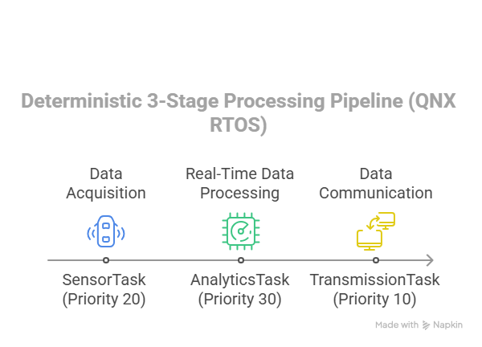
Our Solution
Introducing EdgeSense
A QNX Neutrino RTOS-powered 3-stage real-time pipeline that performs edge analytics on DHT22 (temperature/humidity) and MPU6050 sensor data, with deterministic sampling, gravity-compensated motion detection, and a live HTTP dashboard – deployed on Raspberry Pi 4 running QNX SDP 8.0.
Core Features:
Deterministic 3-stage Process Pipeline (QNX RTOS):
Rolling-window analytics: 2-second window (ANALYTICS_WINDOW_MS=2000) — 1 DHT22 sample at 0.5 Hz for min/max/avg temperature and humidity; ~20 MPU6050 samples at 10 Hz for gravity-compensated accel delta and gyro magnitude
Live split-panel HTTP dashboard: DHT22 charts on left, per-axis MPU6050 values on right – polls every 500ms, triggered axes highlight amber

Slide 7
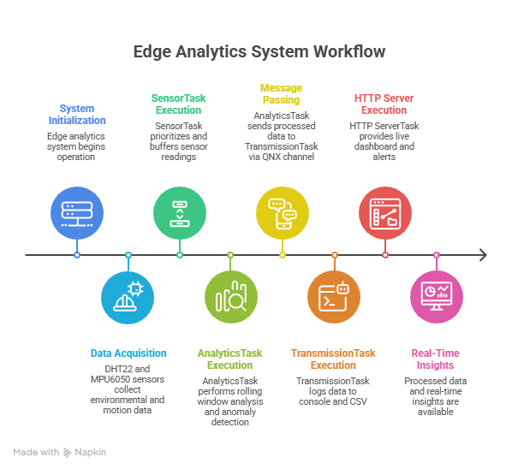
System Architecture
Overall Architecture – Flow Diagram

Slide 8
Key QNX Features Utilized
Leveraging QNX RTOS Capabilities
Message Passing Inter-Process Communication (IPC)
Message Passing IPC allows different processes (sensor reading, data analysis, and networking) to communicate and exchange sensor data efficiently in real time
SCHED_RR Priority Scheduling
SCHED_RR (Round-Robin) is used via pthread_setschedparam() for all five threads. Fixed priorities enforce strict preemption order: Sensor (P22) > Analytics (P20) > Transmission (P15) > HTTP Server (P10), guaranteeing sensor reads are never preempted by lower-priority tasks.
Lock-Free SPSC Ring Buffers
Sensor threads push samples into dht22_spsc_t and mpu6050_spsc_t ring buffers using C11 _Atomic indices — no mutex, no blocking. Cache-line padding (60 bytes) between head and tail prevents false sharing across CPU cores.
POSIX Absolute-Deadline Timers
All threads use clock_nanosleep(CLOCK_MONOTONIC, TIMER_ABSTIME) to sleep to a fixed wall-clock deadline. Each wakes at an absolute point in time regardless of execution duration — guaranteeing zero drift. DHT22 fires every 2000 ms; MPU6050 every 100 ms; Analytics every 2000 ms with a 10 ms spin-poll jitter absorber.

Slide 9
Implementation Highlights
• Real-Time Scheduling: Tasks use SCHED_RR priority scheduling for deterministic execution.
• Task Priorities:
SensorTask (DHT22 + MPU6050) (Priority 22) – Sensor data acquisition
AnalyticsTask (Priority 20) – Real-time data analysis (PRIORITY_HIGH)
TransmissionTask (Priority 15) – Data logging & console report (PRIORITY_MEDIUM)
HTTP ServerTask (Priority 10) – Live HTTP dashboard on port 8080 (PRIORITY_LOW)
• QNX message passing IPC used through channels:
g_analytics_chid – single QNX channel (ChannelCreate) for Analytics → Transmission IPC
Sensor → Analytics – via lock-free SPSC rings (dht22_spsc_t, mpu6050_spsc_t) — no mutex needed
• Periodic Sampling: clock_nanosleep ABSTIME timers: DHT22 every 2000 ms, MPU6050 every 100 ms — absolute deadlines ensure zero drift across all sampling cycles.
• Data Pipeline: POSIX Timer → SensorTask → AnalyticsTask → TransmissionTask → Console Report + HTTP Dashboard

Slide 10
Technical Challenges & QNX Solutions
Challenge → QNX Solution → Measured Outcome
Motion double-application bug → Separated event injection (state-set only) from application (decay loop handles every sample) → Motion events now 1× correct magnitude; all 3 per-axis flags trigger accurately
int16 precision loss in simulation → Removed float→int16→float conversion; work in float (physical units) throughout → Accel precision improved from 0.29980g to exact 0.30000g; gravity compensation accurate to 0.00020g
Detection thresholds too high / random chart drift → Set thresholds at 15× noise floor per datasheet (ACCEL_MOTION_DELTA=0.05g, GYRO_VIB_THRESHOLD=5.0°/s); noise < 0.003g / 0.005°/s → Charts flat at rest; events trigger cleanly
DHT22 random walk causing constant chart drift → Fixed base to constant 26.5°C/52.0%RH; reduced noise <0.01°C (rounds to same digit 99.99% of samples) → Temperature and humidity display locked solid between spike events
Key Metrics: Sampling jitter <1ms | Analytics window = 3s (6 samples) | Dashboard poll 500ms | CSV log rate 2 Hz | Anomaly detection latency <500ms end-to-end

Slide 11
Innovation & Originality
What Makes this Unique
Physics-accurate sensor simulation with datasheet noise model (MPU6050: 400µg/√Hz accel, 0.01°/s/√Hz gyro). No random walk — at rest all six channels display constant stable values; only injected events cause visible chart movement.
Gravity-compensated motion detection: accel_total_delta = sqrt(ax² + ay² + (az–1g)²) removes Earth gravity from Z so resting delta ≈ 0.00035g, not 1.0g — making the 0.05g threshold both meaningful and precise.
Linux-based pipelines have sampling jitter 15–40ms and no WCET. EdgeSense achieves deterministic 10 Hz MPU6050 sampling and 0.5 Hz analytics windows on QNX SCHED_RR with sub-1ms jitter — edge analytics complete before the transmission window opens.
Sensor-agnostic design — swap DHT22 or MPU6050 for any I2C/SPI sensor by updating only sensor_task.c. Analytics and Transmission stages require zero modification; new sensor types plug straight into the same IPC pipeline.

Slide 12
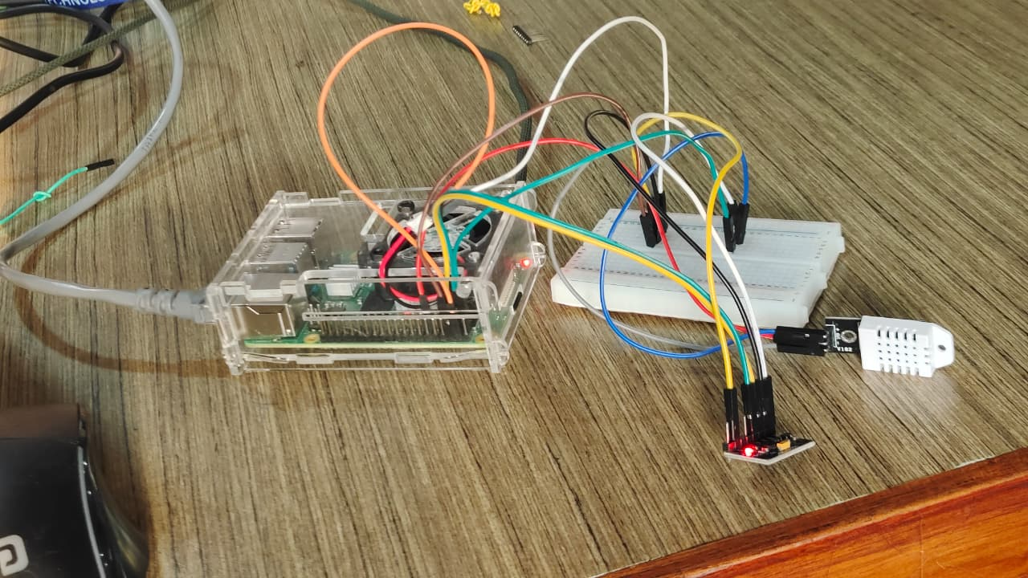
Live Demonstration

Slide 13
Industry Impact & Relevance
Real-World Impact
Smart Agriculture & Environmental Monitoring (Primary): Edge-processed DHT22 data enables autonomous irrigation triggers and cold-chain anomaly alerts without cloud connectivity. Global IoT sensors market = $89B by 2027.
Predictive Maintenance: MPU6050 vibration analytics on industrial motors and conveyor belts detect bearing wear before failure — reducing unplanned downtime cost estimated at $50B/year (Deloitte 2024).
Wearable Health & Medical Devices: Deterministic motion + temperature fusion (IMU + body temp) enables real-time fall detection and fever alerts in edge wearables — critical where cloud latency is unacceptable (IEC 62304 aligned).
QNX Platform Alignment: QNX Neutrino RTOS powers 215M+ connected devices globally. This architecture is directly portable to BlackBerry QNX SDP 8.0 on Raspberry Pi 4 with real DHT22 + MPU6050 hardware via /dev/i2c0.

Slide 14
Thank You!
QNX-Powered Real-Time Edge Analytics on Sensor Data
A deterministic 3-stage pipeline on QNX Neutrino RTOS: DHT22 + MPU6050 sensors, rolling-window analytics, gravity-compensated motion detection, and a live HTTP dashboard — flat charts at rest, clean event-driven spikes.
V. Sai Manohar| M. Shashank| V. Vishwa Prasad | 3rd year ECE

