Slide 1
Look at the assignment sheet, you will see there are 8 requirements listed. This template uses the same 8 numbers to show how you might present your work.
You might choose a different layout – that is fine. You may find you need more space in one section and less in another. This is just an example, you should choose your own layout, to suit your results. Obviously, you should remove these instructions!
CSCU9M5 Assignment 1. Student Number xxxxxx
2. Project Methodology List the steps you took to carry out the project Include train/validate/test split and model selection This list should cover ALL the steps in the process … … 4. Data Preparation Show two histograms here. One should show the distribution of one variable before it has been cleaned. The other should show the distribution of the same variable after cleaning. Choose a variable that needs to be cleaned!! | 3 Variables/ Data Understanding Say which variables you used in your model, and whether you treated then as numeric or categorical. Explain the impact your choices will have on the models you build. You can use a table:
5. Model Training and Hyper Parameters A table showing the different models and hyper parameters you trained, along with the correct metric for each; Add a sentence on how you chose the hyper parameter values. Make sure you name the metric correctly. | Model Hyper Parameters
6. Final Model and Results Say how you chose the final model to test, and how you trained that model. Put the confusion matrix here Explain what the confusion matrix tells us. | 7. Insight about data or models gained For example, did you learn anything about specific features that drive the model? Is the model biased towards particular groups in the data? Is the model you've chosen good for helping us to understand why particular predictions are made?
Variable | Type
Variable 1 | Numeric
Variable 2 | Categorical
Before Cleaning
After Cleaning
Model | Hyper Parameters | Validation Metric
Model 1 | Hyper parameter list | A%
Model 2 | Hyper parameter list | B%
Model 3 | Hyper parameter list | C%
Model 4 …. | Hyper parameter list | D%
Explain here how you chose the hyper parameter settings to explore and how you ran your experiments.
Actual / Predicted | Good | Bad
Good | 220 | 25
Bad | 32 | 195
8. References
[1] If you reference any papers or websites, list them here

Slide 2
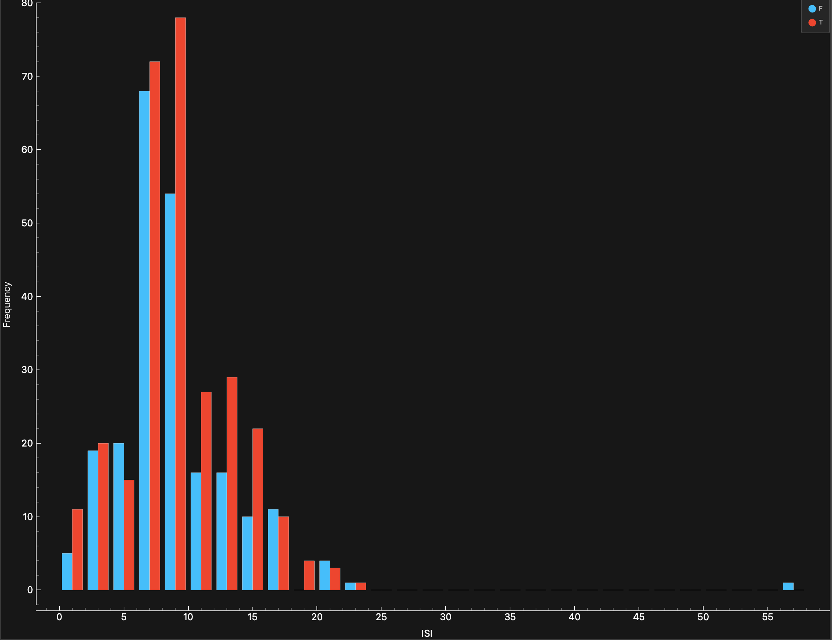
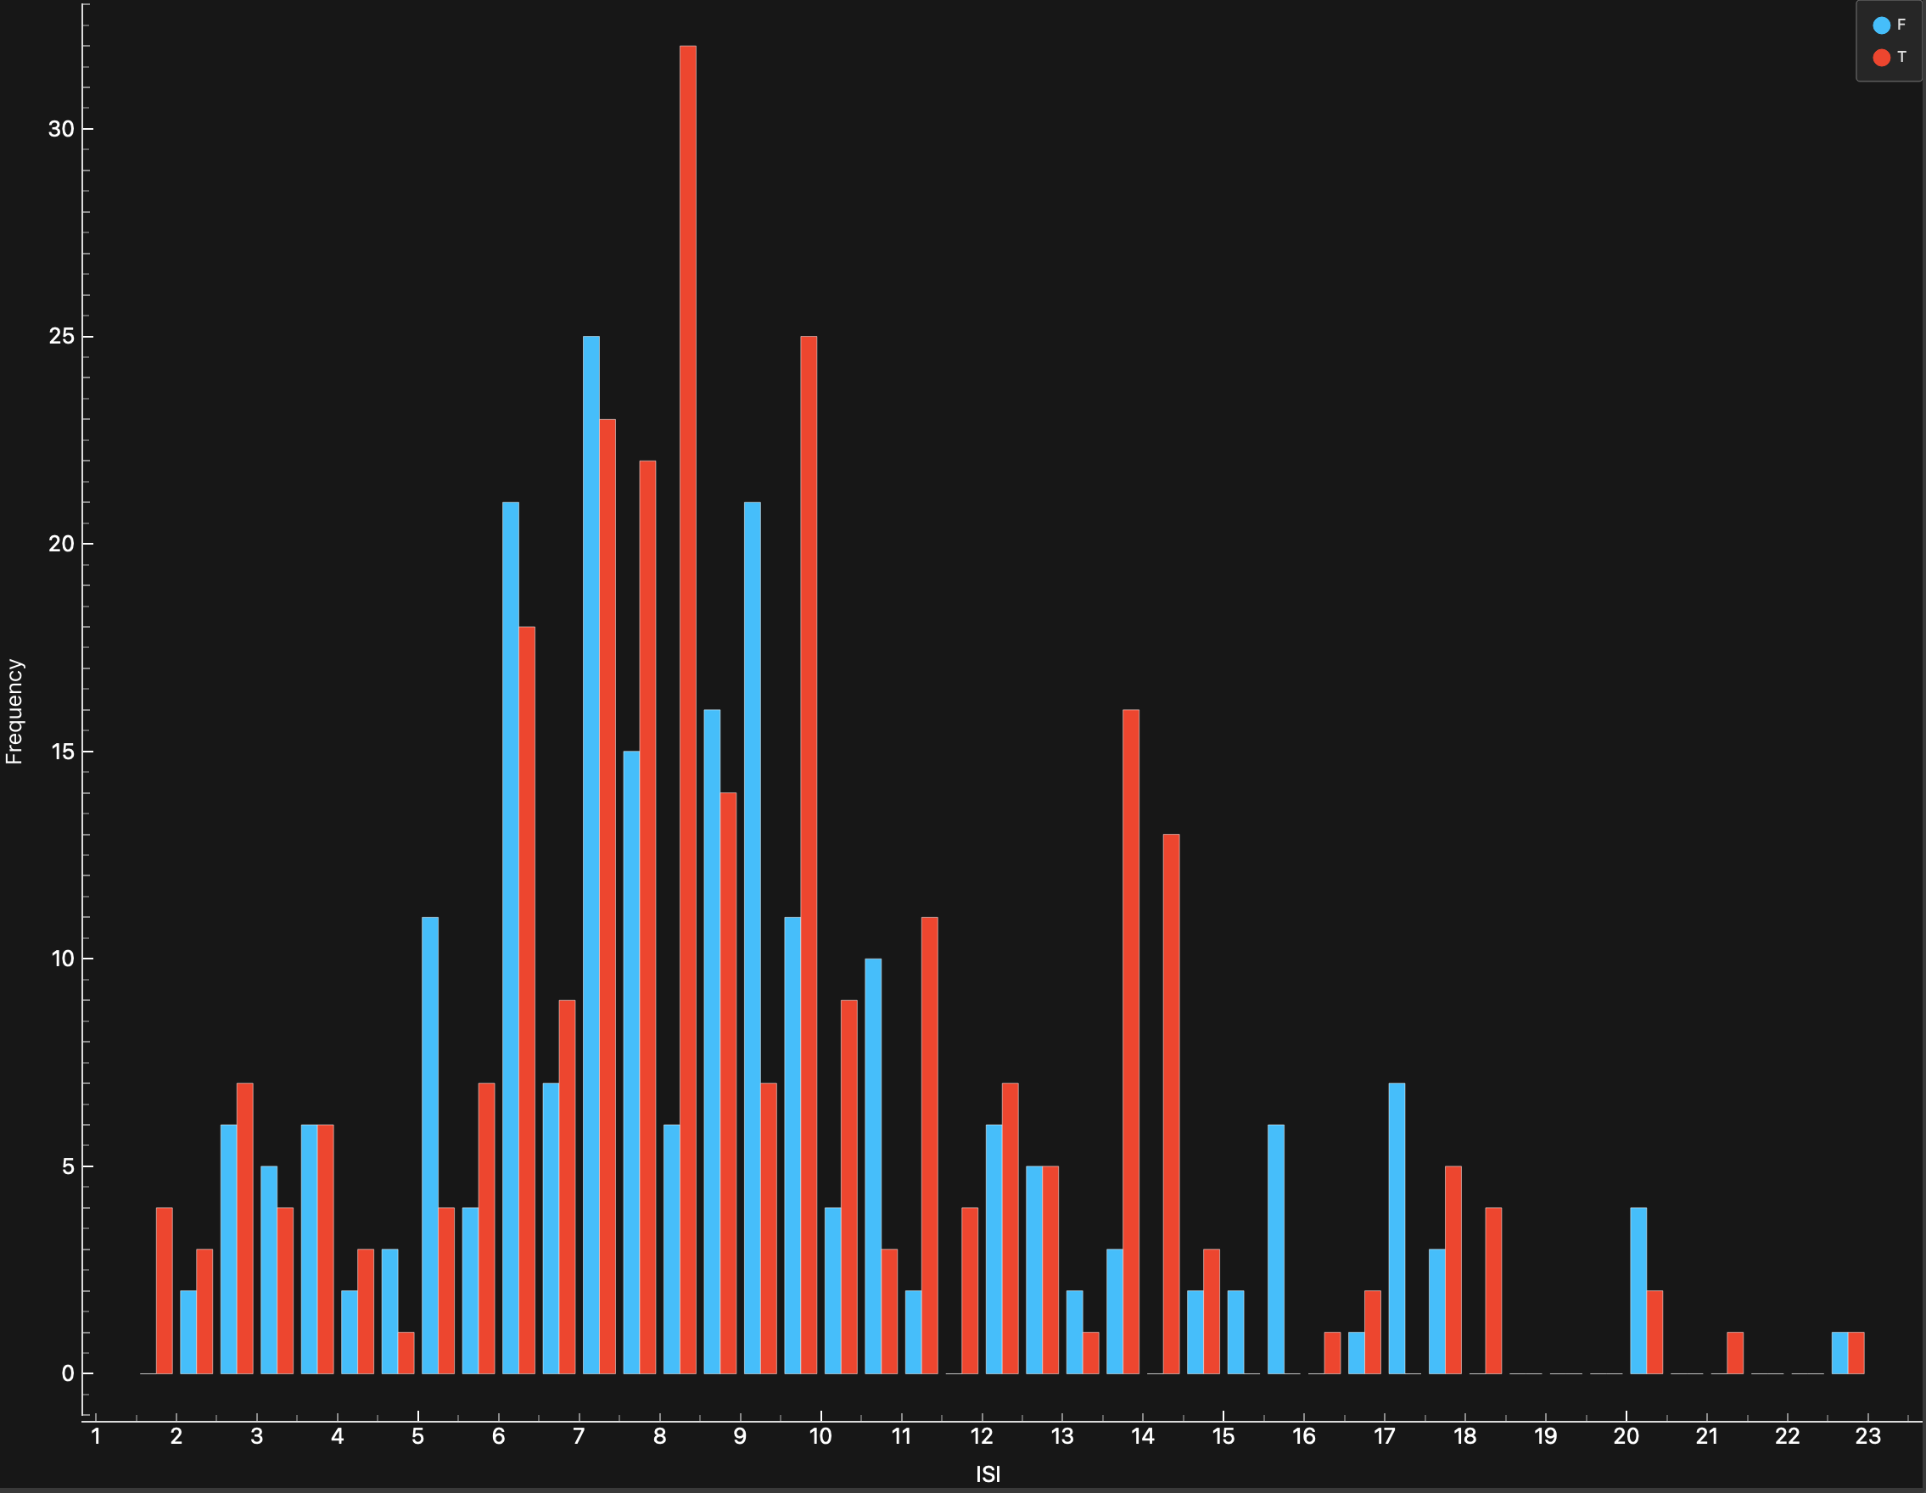
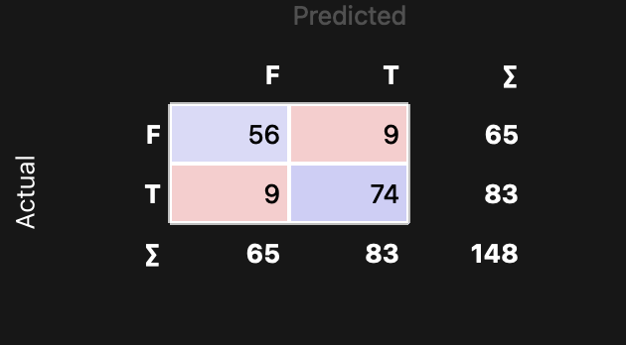
CSCU9M5 Assignment 1. Student Number xxxxxx
2. Project Methodology
List the steps you took to carry out the project
Include train/validate/test split and model selection
This list should cover ALL the steps in the process
…
…
3 Variables/ Data Understanding
The variables used are:
All the environmental variables are treated as continuous numeric variables. The month variable is treated as nominal categorical. The target area variable is treated as binary categorical which shows whether the burned area exceeds 4%. The X, Y variables are not used as they don’t really add a lot of information in the dataset. Most of the rain values are zero which is why it has been removed. The day variable don’t necessarily help the model as we don’t want to see weekly patterns which is why It has been removed as well.
Variables | type | Used in model
Month | Categorical (nominal) | Yes
FFMC, DMC, DC,ISI, TEMP, RH, WIND | Numeric (continuous) | Yes
area | Categorical (binary) | Yes (target)
4. Data Preparation
I decided to clean the ISI variable. It initially had a positively skewed graph with many outliers. The histogram on the left shows the variable before cleaning. It is wide and uneven. After removing several outliers the histogram on the right shows much smoother and even distribution. This is done so that the model receives a consistent data and improves the final prediction.
Before Cleaning
After Cleaning
Model | Hyper Parameters | Validation Metric (F1)
Logistic regression | C = 1; Regularisation type = L2 | 63.2 %
Neural network | Hidden layers = 100; Max iterations = 200 | 79.6 %
Gradient boosting | No of trees = 75; learning rate = 0.1 | 87.8 %
Random forest | No of trees = 100 | 85.8 %
kNN | No of neighbour= 10; Metric = Euclidean Weight =. uniform | 82.4 %
5. Model Training and Hyper Parameters
I trained five different models Logistic Reasoning, Neural Network, gradient boosting, Random Forest, kNN. All these models are trained using a 70/30 train-test split. I used F1 score as the validation metric as it balances both precision and recall making it useful when dealing with class imbalance. Gradient boosting was the best performing model. I tuned the hyper parameters for the best performing models to give a better score and ended up with the best performing model.
6. Final Model and Results
The final model was evaluated on the 30% test using confusion matrix. It correctly
predicted : 74 large fire cases (true positives) and 56 non-large fire cases (true negatives)
Which is around 88% correctly predicting the outcomes which matched with our F1
validation metric. The model made 9 false positives (predicting a fire when there is none)
and 9 false negatives (failed to predict a fire).
7. Insight about data or models gained
For example, did you learn anything about specific features that drive the model? Is the model biased towards particular groups in the data? Is the model you've chosen good for helping us to understand why particular predictions are made?
8. References
[1] If you reference any papers or websites, list them here

Slide 3
or each learner widget:
Open the widget.
Change one hyperparameter (e.g.:
kNN: change k = 3, 5, 7
Random Forest: number of trees = 10, 50, 100
Gradient Boosting: number of trees/iterations
After each change, check Test & Score and record the metric.

