Slide 1

Note: The data and information in this document is reflective of a hypothetical situation and client. This document is to be used for KPMG Virtual Internship purposes only.
Sprocket Central Pty Ltd
Data analytics approach
[Data Insights] - [Kathleen], [Vaishnavi Sonawane]

Slide 2
Note: The data and information in this document is reflective of a hypothetical situation and client. This document is to be used for KPMG Virtual Internship purposes only.
Agenda
Introduction
Data Exploration
Model Development
Interpretation

Slide 3
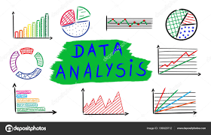
Note: The data and information in this document is reflective of a hypothetical situation and client. This document is to be used for KPMG Virtual Internship purposes only.
Introduction
How To Analyse The New 1000 Customer’s List?
For Retrieving Useful Customer Insights, Following are the categories on the basis of which the list should be analysed :
Sale in Past 3 years
Industry based Sale Distribution
Age based Sale Distribution
Gender based Sale Distribution
Wealth Segment based Sale Distribution

Slide 4
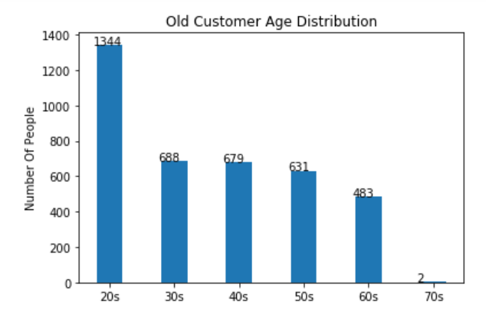
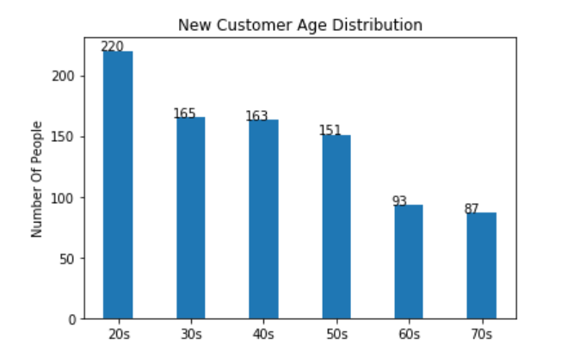
Note: The data and information in this document is reflective of a hypothetical situation and client. This document is to be used for KPMG Virtual Internship purposes only.
Data Exploration
1) Age Distribution Of Customers

Slide 5
Note: The data and information in this document is reflective of a hypothetical situation and client. This document is to be used for KPMG Virtual Internship purposes only.
Interpretation
Interpretation From Age Distribution Of Customers:
Following are the inferences from previous slide :
Most of the customers belong to age-group of 20-40 years. Hence, This age group should be kept in focus in training dataset for the model.
Very less number of customers belong to age-group of 70-80 years. Hence, to optimize the training process, records belonging to this age-group can be ignored.

Slide 6
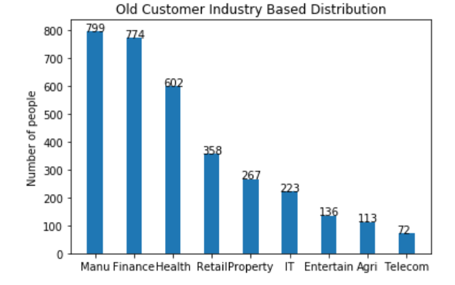
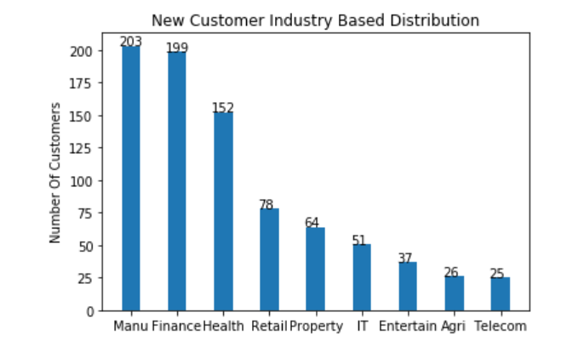
Note: The data and information in this document is reflective of a hypothetical situation and client. This document is to be used for KPMG Virtual Internship purposes only.
Data Exploration
2) Industry based Distribution of Customers

Slide 7
Note: The data and information in this document is reflective of a hypothetical situation and client. This document is to be used for KPMG Virtual Internship purposes only.
Interpretation
Interpretation From Industry Based Distribution Of Customers:
Following are the inferences from the previous slide:
Most of the customers belong to Manufacturing, Finance & Health Industry. Hence, again they shall be kept in focus while assessing new datasets if provided.
Also, the same industries shall be kept in consideration while creating training datasets for the model.
Very less number of customers belong to Telecom industry, which decreases the probability of of it as an output of our prediction model. Hence, it can be ignored to keep the optimisation consistent.

Slide 8
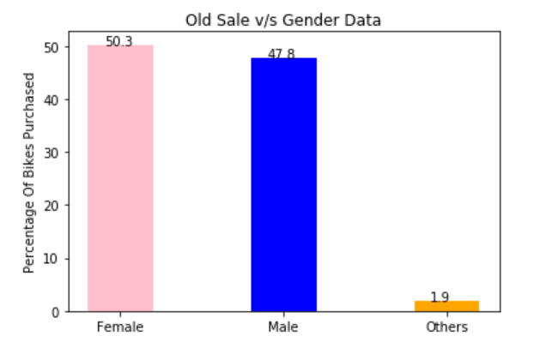
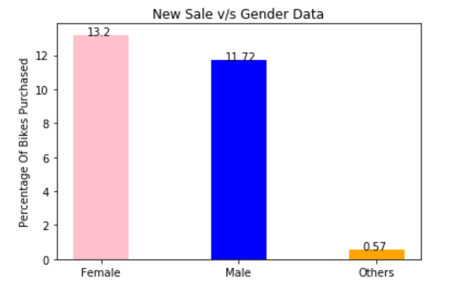
Note: The data and information in this document is reflective of a hypothetical situation and client. This document is to be used for KPMG Virtual Internship purposes only.
Data Exploration
3) Gender based Sale Distribution of Customers

Slide 9
Note: The data and information in this document is reflective of a hypothetical situation and client. This document is to be used for KPMG Virtual Internship purposes only.
Interpretation
Interpretation From Gender Based Sales Distribution:
Following are the inferences from the previous slide:
50.3% of the total customers are females.
47.8% are males.
Since in both the old and new data, genders other than male and female consist of less than 2%, they can be ignored in further processes to optimise them.
In the training dataset, both male and female customers shall be taken into consideration.

Slide 10
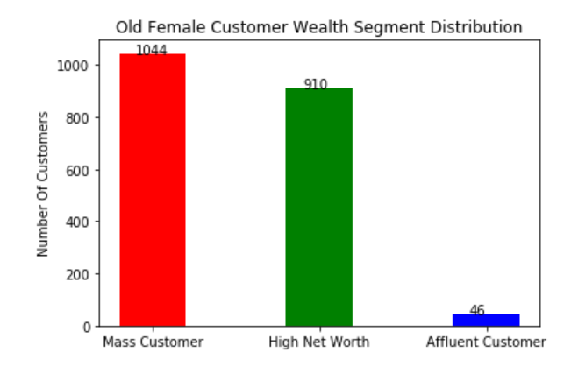
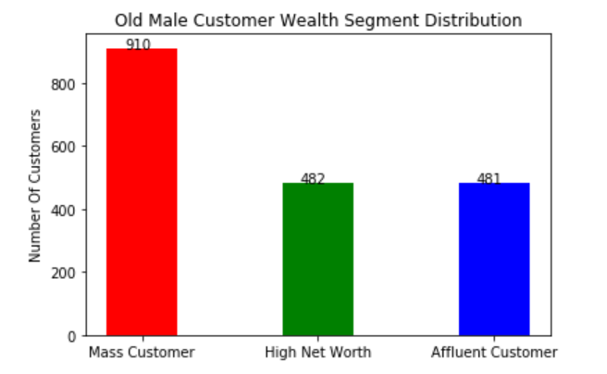
Note: The data and information in this document is reflective of a hypothetical situation and client. This document is to be used for KPMG Virtual Internship purposes only.
Data Exploration
4) Customer’s Gender v/s Wealth Segment Distribution
(OLD)

Slide 11
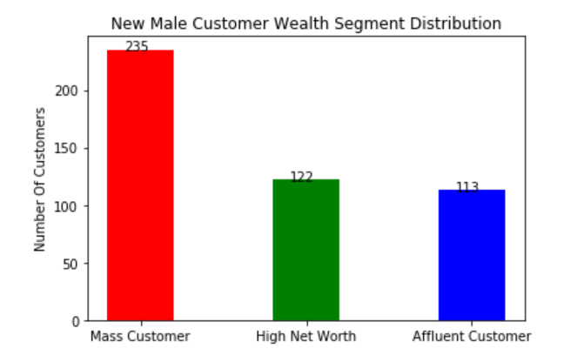
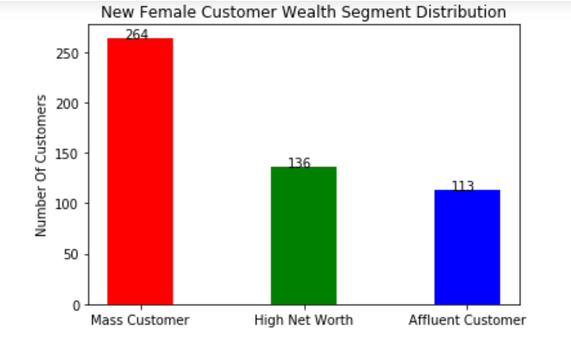
Note: The data and information in this document is reflective of a hypothetical situation and client. This document is to be used for KPMG Virtual Internship purposes only.
Data Exploration
4) Customer’s Gender v/s Wealth Segment Distribution
(NEW)

Slide 12
Note: The data and information in this document is reflective of a hypothetical situation and client. This document is to be used for KPMG Virtual Internship purposes only.
Interpretation
Interpretation From Gender v/s Wealth Segment Distribution of Customers:
Following are the inferences from the previous slides:
In the previous dataset, number of female customers are higher than number of male customers in category of “Mass Customer”.
Same are the circumstances for the category of “High Net Worth”.
Whereas, there are relatively less female customers in the category of “Affluent Customer”. Hence in the prediction model for this category , Number of male customers shall be kept in focus relatively more.

Slide 13
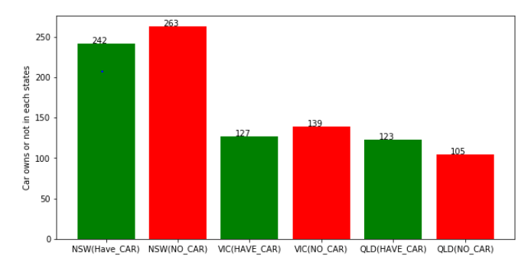
Note: The data and information in this document is reflective of a hypothetical situation and client. This document is to be used for KPMG Virtual Internship purposes only.
Data Exploration
5) Distribution Of New Customers acc. States & Ownership of Cars

Slide 14
Note: The data and information in this document is reflective of a hypothetical situation and client. This document is to be used for KPMG Virtual Internship purposes only.
Interpretation
Interpretation Based On New Customers’ States & Ownership Of Car
Following are the inferences from the previous slide:
Since New South Wales has most number of customers who don’t own a car, the company should beneficiate from this opportunity and focus on its business strategy in New South Wales.
Same is applicable for Victoria.

Slide 15
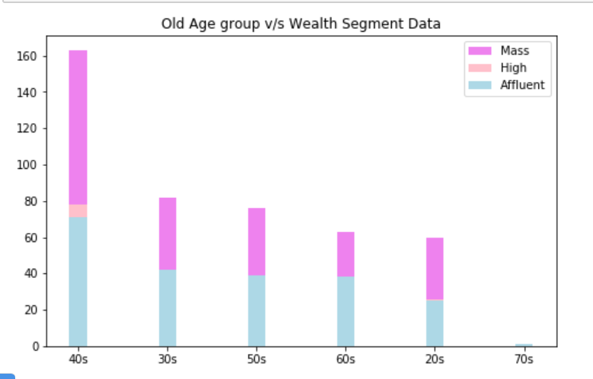
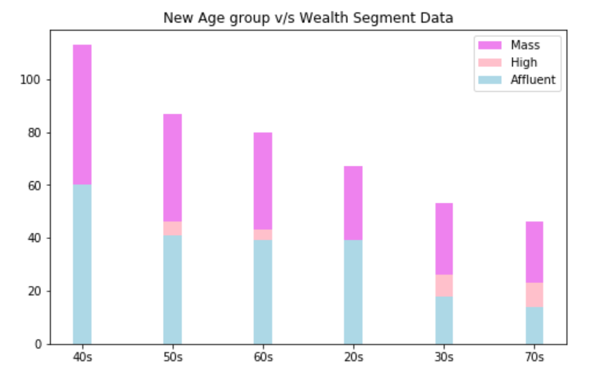
Note: The data and information in this document is reflective of a hypothetical situation and client. This document is to be used for KPMG Virtual Internship purposes only.
Data Exploration
6) Age Group v/s Wealth Segment

Slide 16
Note: The data and information in this document is reflective of a hypothetical situation and client. This document is to be used for KPMG Virtual Internship purposes only.
Interpretation
Interpretation Based On Distribution Of Customers acc. to Age-Group & Wealth Segment
Following are the inferences from the previous slide:
Most number of customers i.e 163 customers who belong to the age-group of 40-49 years fall in the category of “Mass Customers”.
Most number of customers i.e 78 customers whole belong to the age-group of 40-49 years fall in the category of “High Net Worth”.
Most number of customers i.e 71 customers who belong to the age-group of 40-49 years fall in the category of “Affluent Customer”.
Hence, Customers belonging to the age-group of 40 shall be kept in focus while creating the training dataset.
Negligible number of customers i.e 1 customer belonging to the age-group of 70-79 years fall in the category of “Affluent Customer”. Hence, this can be ignored.

