Slide 1
Lending Case Study
Vasileios Sotiriadis March 2026

Slide 2
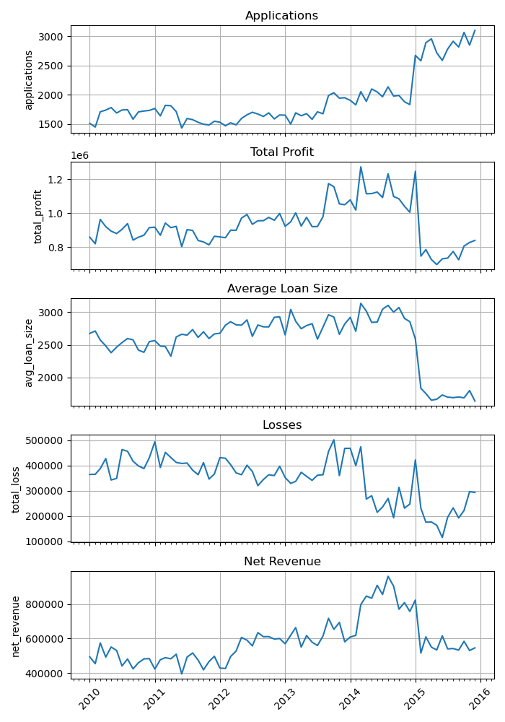
Loan Portfolio Evolution
2014 VS 2015 Structural break
Applications +43%
Total Profit −27%
Average Loan Size -39%
Total Losses -24%
Net Revenue -28%
Several strategic initiatives introduced in Q1 2015 changed the portfolio dynamics.
This motivates the deeper analysis of:
Second aggregator launch
Credit policy tightening

Slide 3
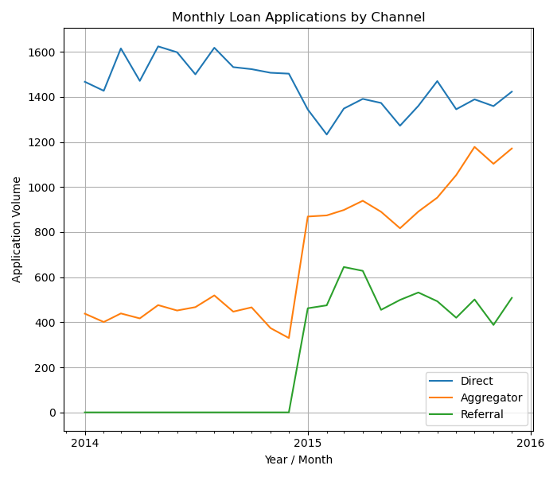
Second aggregator launch
Channel Mix Shift After Aggregator Launch
Aggregator applications: 2x
Aggregator portfolio share: 20%-40%
The new aggregator significantly increased loan acquisition through third-party platforms.
However, channel expansion can affect borrower quality and profitability.

Slide 4
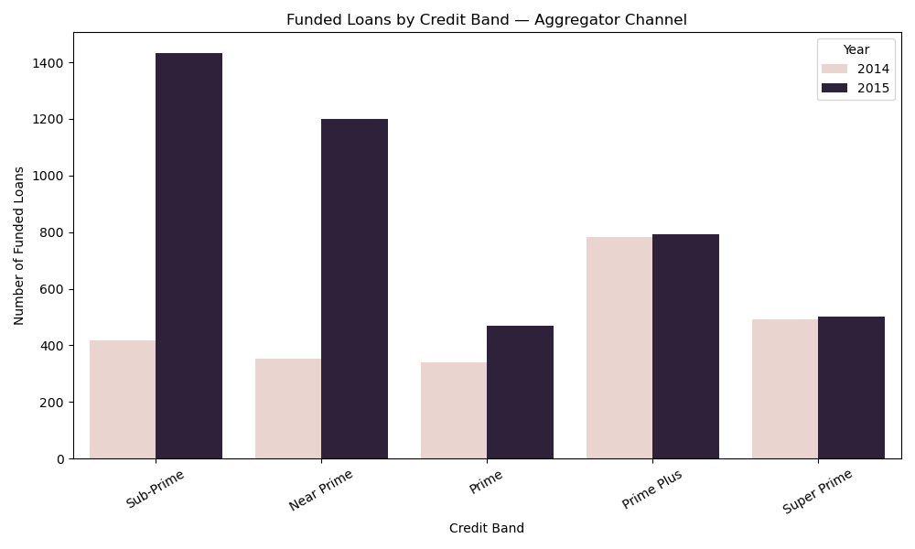
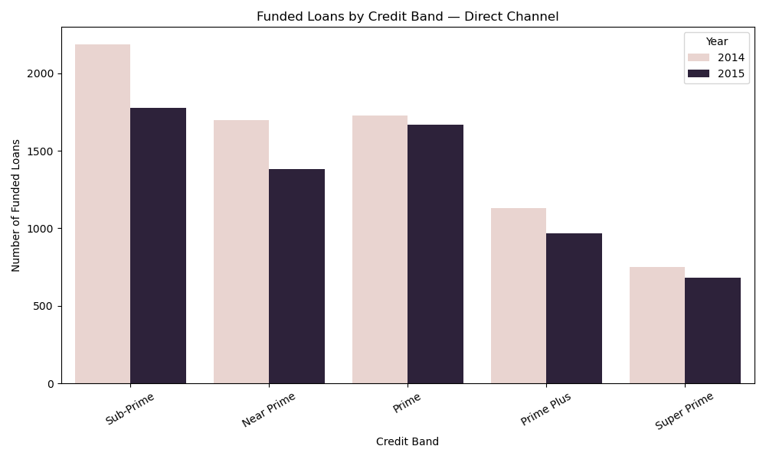
Aggregator Impact on Credit Risk Mix
Borrower Risk Profile by Channel
Aggregator channel shows:
Strong increase in Sub-Prime and Near-Prime borrowers
Direct channel remains more prime-heavy
The second aggregator attracted riskier borrowers, which contributed to:
Lower loan sizes
Higher credit risk
Lower profitability per loan

Slide 5
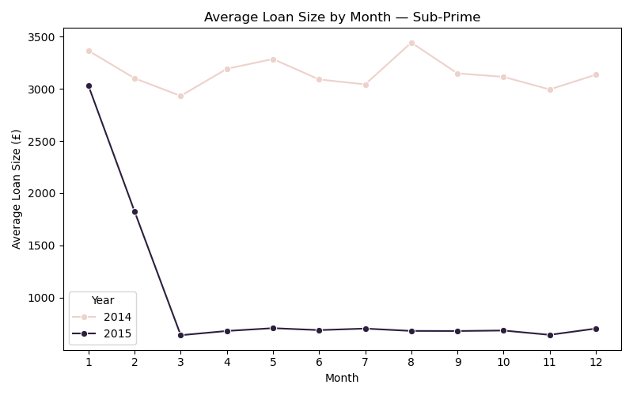
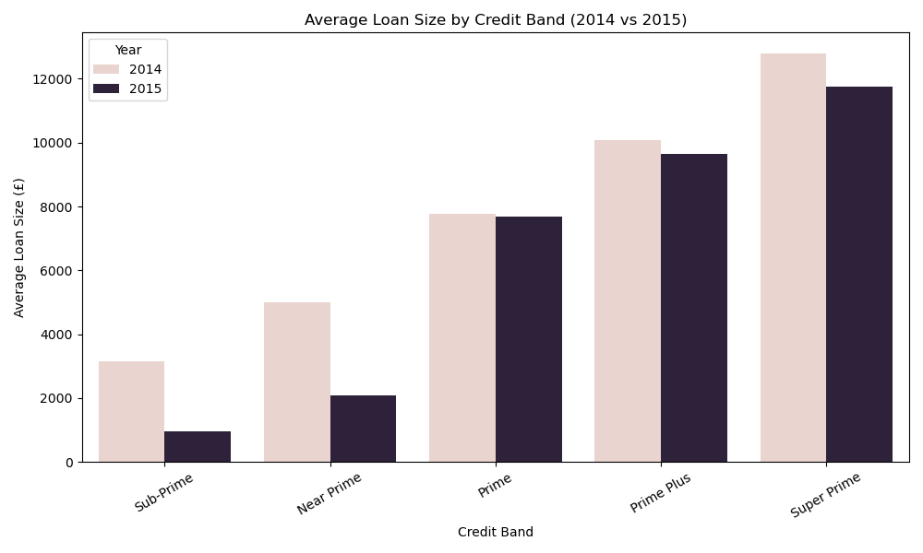
Credit Policy Tightening
Impact of Loan Size Caps on Risky Borrowers
Credit policy tightening measures rolled out in February and finalized in March 2015
Loan sizes decreased significantly for:
Sub-Prime
Near-Prime
Higher credit bands remained largely unchanged.

Slide 6
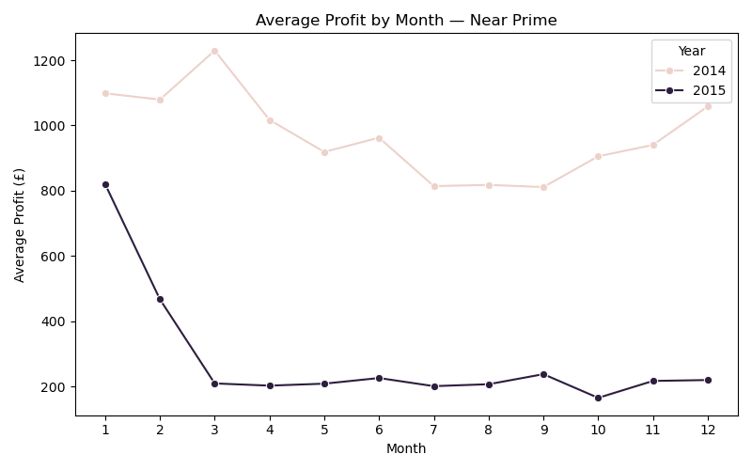
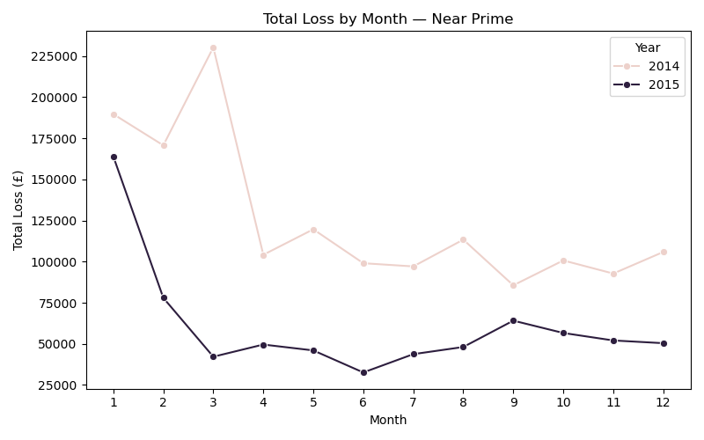
Risk and Profitability Impact
Credit Policy Reduced Loss Exposure
Loss rates declined for lower credit bands
Profit per loan stabilized despite smaller loan sizes
The credit tightening policy helped mitigate credit risk, partially offsetting the increased risk introduced by the aggregator channel.

