Slide 1


CITY ENGINEERING COLLEGE
Doddakallasandra, Off Kanakapura Main Road, Bangalore - 560 062
Department of Computer Science and Engineering
Presentation On
“Internship”
Student Name: V. Sudeep USN: 1CE22CS170
Company Name: Dyashin TechnoSoft Pvt LTD Duration:4 Months

Slide 2

Table of Content
Introduction
About the Organization
Internship Overview
Tasks Performed
Tools & Technologies Used
Key Learnings
Practical Experience
Challenges Faced
Solutions & Improvements
Skills Developed
Learning Outcomes
Conclusion

Slide 3
Introduction
Data analytics is the process of collecting, cleaning, analyzing and interpreting data to make better decisions.
It helps organizations understand trends, improve performance and solve problems using data.
Data analytics is widely used in business, healthcare, finance, and marketing to make data drive decisions.
It helps to improve efficiency, productivity, and overall outcomes effectively.
3

Slide 4

About the Organization: Dyashin TechnoSoft Pvt Ltd
Dyashin Technosoft Pvt Ltd is a technology company based in Bengaluru, India, founded in 2023. that provides innovative solutions in software development, data science, data analytics, artificial intelligence and web development.
The company focuses on building practical, data-driven applications that help businesses improve efficiency and make better decisions. It emphasizes modern technologies,quality solutions and innovation to support digital transformation.
4

Slide 5
Internship Overview
Company Name: Dyashin TechnoSoft Pvt Ltd
Internship Domain: Data Analytics
Duration: 4 Months
Project Title: E-Commerce Sales Performance Analysis
Tools Used: Power BI, Excel, Power Query, DAX
Objective: To analyze e-commerce sales data and generate meaningful business insights through interactive dashboards and visualizations.
Outcome: Developed practical skills in data cleaning, analysis, dashboard creation, and business reporting.
5

Slide 6
Task Performed
Collected and imported the e-commerce dataset.
Cleaned and preprocessed the data. Removed missing and duplicate values.
Performed data transformation and analysis.
Created KPIs and calculated measures.
Developed interactive Power BI dashboards.
Analyzed customer behavior and sales trends.
Generated business insights and reports.
6

Slide 7
Tools
Microsoft Power BI – Dashboard creation and data visualization
Microsoft Excel – Data storage and handling
Power Query Editor – Data cleaning and preprocessing
DAX – KPI and calculated measures creation
7

Slide 8
Key Learnings
Gained practical experience in data cleaning and preprocessing techniques.
Learned to create interactive dashboards using Power BI. Improved understanding of KPI creation and data visualization methods.
Developed knowledge of analyzing customer behavior and sales trends.
Learned how to transform raw data into meaningful business insights.
Enhanced analytical thinking and problem-solving skills.
8

Slide 9
Practical Experience
Worked with real-world datasets and industry-related problems.
Gained hands-on experience in data processing and analysis.
Applied theoretical knowledge to practical scenarios.
Improved understanding of project workflows and deadlines.
Experienced a professional work environment.
9

Slide 10
Challenges Faced
Handling missing and duplicate values in the dataset during data preprocessing.
Cleaning and transforming raw data into a structured format suitable for analysis.
Creating calculated measures and KPIs for meaningful insights.
Designing interactive and user-friendly Power BI dashboards.
Managing relationships between different data fields and tables.
10

Slide 11
Solutions & Improvements
Used online resources and documentation to solve errors.
Improved debugging skills through practice and analysis.
Broke down complex tasks into smaller steps for better understanding.
Managed time effectively by planning and prioritizing tasks.
Gained better understanding of data visualization techniques through practice.
11

Slide 12
Skills Developed
Technical Skills
Python programming
SQL querying
Data analysis basics
Power BI dashboards
Tableau basics
Soft Skills
Logical thinking
Problem solving
Self-learning
12

Slide 13
Learning Outcomes
Ability to analyze and interpret real-world data effectively.
Improved understanding of data analytics concepts and tools.
Gained hands-on experience with industry-level projects.
Enhanced problem-solving and analytical thinking skills.
Better preparedness for data-related roles in the future.

Slide 14
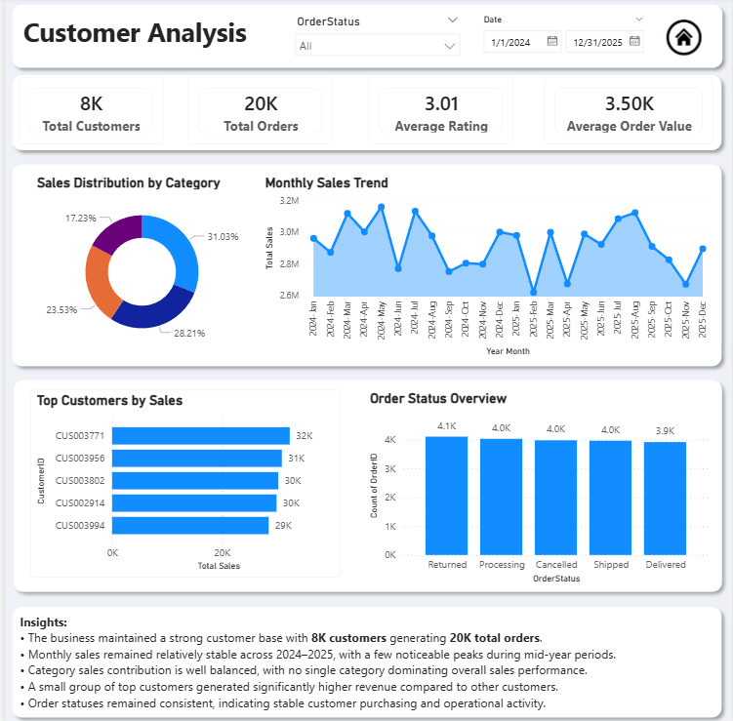
Customer Analysis Dashboard

Slide 15
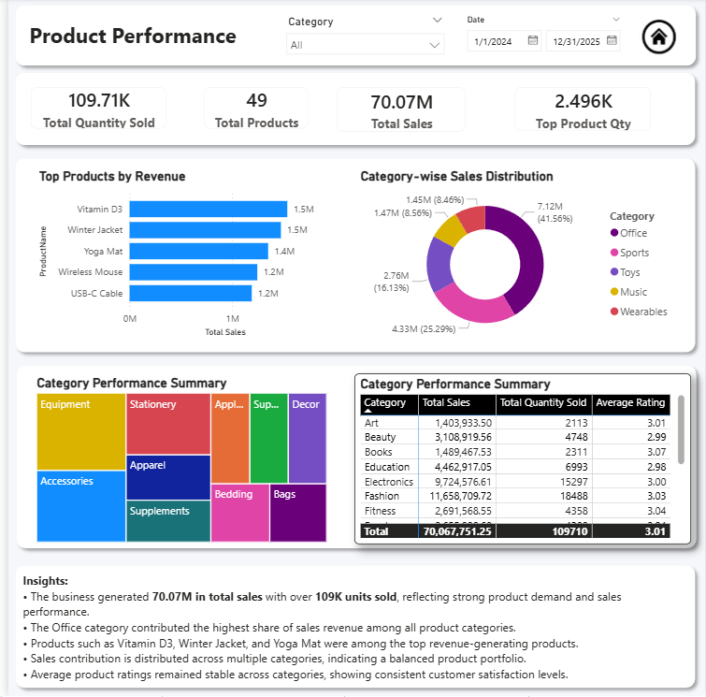
Product Performance Dashboard

Slide 16
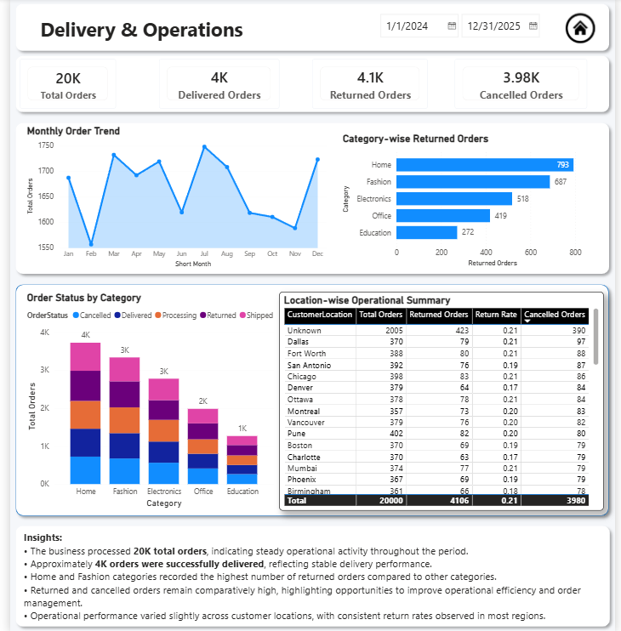
Delivery & Operations Dashboard

Slide 17
Business Insights and Interpretation
1 .What are the key business insights identified from the dashboard?
• The business generated over 70M in total sales with strong customer engagement across 20K total orders and 8K customers.
• The Office category emerged as the highest revenue contributor among all product categories.
• Monthly sales and order trends remained stable throughout 2024–2025, indicating consistent business performance.
• Top-performing products such as Vitamin D3, Winter Jacket, and Yoga Mat contributed significantly to revenue generation.
• Returned and cancelled orders remained comparatively high, highlighting operational improvement opportunities.
• Top customers generated higher sales contribution, emphasizing the importance of customer retention strategies.
2. What operational improvements can be recommended based on the analysis?
• Improve delivery efficiency to reduce returned and cancelled orders.
• Strengthen product quality checks, especially in high-return categories such as Home and Fashion.
• Optimize inventory planning for top-performing products and high-demand categories.
• Monitor operational performance by customer location to identify underperforming regions.
• Enhance customer support and faster issue resolution to improve customer satisfaction ratings.
• Implement regular KPI monitoring for returns, cancellations, and delivery performance.
3. What strategies can help improve sales and customer retention?
• Introduce loyalty and reward programs for repeat and high-value customers.
• Focus promotional campaigns on top-performing products and revenue-generating categories.
• Personalize offers based on customer purchasing behavior and order history.
• Increase marketing efforts during peak sales periods to maximize revenue opportunities.
• Improve customer experience through better delivery communication and post-purchase support.
• Encourage repeat purchases through targeted customer engagement strategies.
4. What are the major trends observed from the analysis?
• Revenue contribution is well distributed across multiple product categories.
• Certain products consistently generated higher sales and customer demand.
• Monthly order and sales trends remained relatively stable throughout the analysis period.
• Return and cancellation rates were higher in selected categories, impacting operational efficiency.
• Average customer ratings indicate moderate satisfaction levels with opportunities for improvement.
• Delivery operations remained stable across most customer locations and regions
.
5. Assumptions & Considerations
• Analysis is based on the available e-commerce sales and operational dataset.
• Customer ratings are assumed to reflect the overall customer purchase experience.
• Seasonal and external market factors were not considered in this analysis.
• Revenue, sales, and operational metrics are assumed to be accurately recorded in the dataset.

Slide 18
Conclusion
Data analytics plays a vital role in transforming raw data into meaningful insights that support informed decision-making.
It helps organizations identify patterns, improve efficiency, and gain a competitive advantage.
By combining technical skills with analytical thinking, professionals can solve real-world problems and drive business success.
17

Slide 19
Thank You!

