Slide 1





Administración de aplicaciones Corporativas (AAY5121)
Docente: Valentina Muñoz
Sección: 002V
Alumnos:
Christopher Cabrera
Luis Nahuelan
Kevin Aguirre

Slide 2



Conceptos básicos de Azure y la nube
PaaS
IaaS
SaaS
Infrastructura
como Servicio
Plataforma como Servicio
Software como Servicio
Hospeda
Construye
Consume
2
Notes:
[EDITOR] TWB_Trevor:
04 October 2013 What does “PDC08” refer to? Is it a reference to the Professional Developers Conference held in 2008?

Slide 3

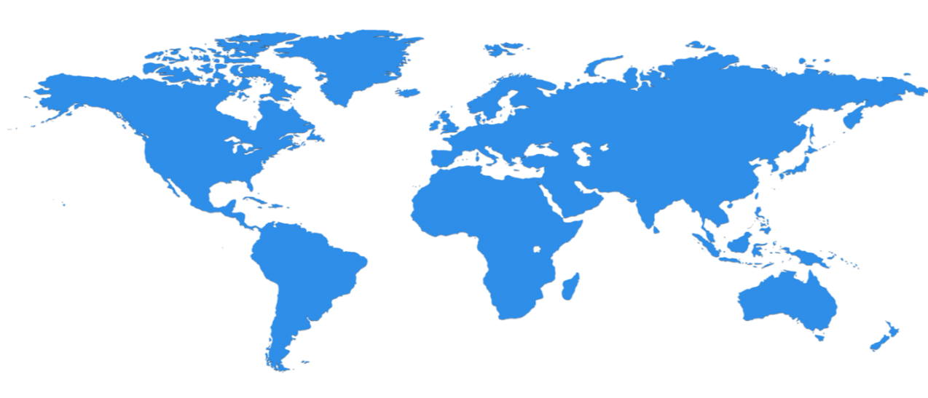

Infraestructura a escala es el motor
27 Regiones a nivel mundial, gran capacidad a escala mundial creciendo cada año.
North Central US
Illinois
United Kingdom
Regions
West Europe
Netherlands
Central US
Iowa
Canada Central
Toronto
Canada East
Quebec City
Germany North East
Magdeburg
China North *
Beijing
US Gov
Iowa
North Europe
Ireland
Germany Central
Frankfurt
China South *
Shanghai
Japan East
Tokyo, Saitama
West US
California
East US
Virginia
India Central
Pune
Japan West
Osaka
South Central US
Texas
East US 2
Virginia
US Gov
Virginia
India South
Chennai
India West
Mumbai
East Asia
Hong Kong
SE Asia
Singapore
Australia East
New South Wales
Brazil South
Sao Paulo State
Australia South East
Victoria
100+ datacenters
Top 3 networks in the world
2.5x AWS, 7x Google DC Regions
G Series – Largest VM in World, 32 cores, 448GB Ram, SSD…
Operativo
Anunciado/No Operativo
3

Slide 4
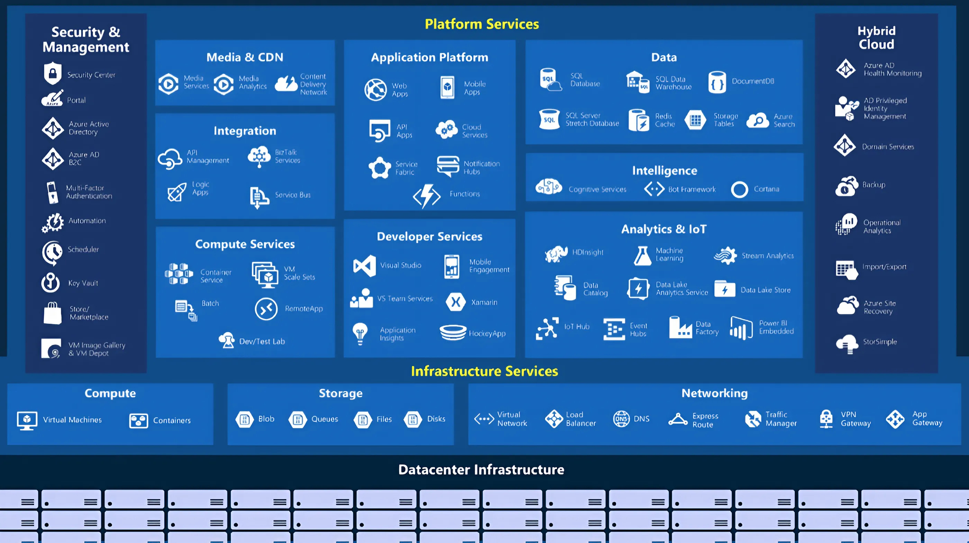

Slide 5













Azure portal
Redes
virtuales
Functions
Máquinas
virtuales
Grupos de
recursos
SQL
Databases
Cuentas de
almacenamiento
Máquinas virtuales y servicios web
Automatización mediante Azure CLI
Security Center, Governanza
MS Defender
For cloud
MFA
Tags
Calculadora de precios y TCO
Azure budgets
Cost
management
TCO
Notes:
[EDITOR] TWB_Trevor:
04 October 2013 Content seems to be missing from the bullet about .NET developers. Please update.
[EDITOR] TWB_Trevor:
04 October 2013 Kindly follow LCA guidelines on usage of the term “Free” and the claim made against third-party software.

Slide 6
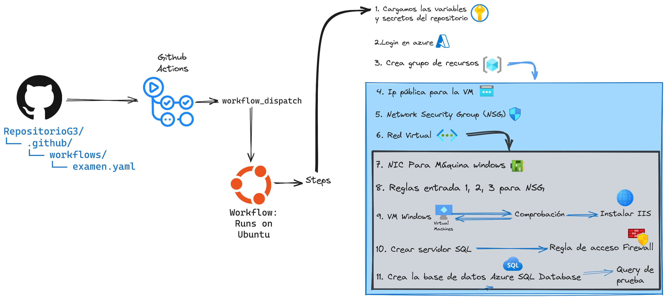
Demo
Notes:
[EDITOR] TWB_Trevor:
04 October 2013 Content seems to be missing from the bullet about .NET developers. Please update.
[EDITOR] TWB_Trevor:
04 October 2013 Kindly follow LCA guidelines on usage of the term “Free” and the claim made against third-party software.

