Slide 1
Getting started with contributing to open source
Vaishali Thakkar (@kernel_girl)
Linux Kernel Engineer (Oracle)
23rd April, 2016

Slide 2
Who Am I?
Linux kernel engineer at Oracle
Worked as a Linux kernel intern under the Outreachy program
Linux foundation training scholarship winner
Involved with open source internship programs [RGSoC, Learn IT, Girl, GCI, GSoC]
In short, an open source ethusiast who is getting paid for working on open source software

Slide 3
Agenda
What is open source?
Why contribute to open source?
Ways to getting involved in open source
How to get involved in open source
Git
Open source internship programs
Questions

Slide 4



What I am not going to do...

Slide 5

What is Open Source?
Open source is a methodology or philosophy that promotes free redistribution and access to a product's design or ideas and implimentation details
    Open as in free
    Open as in access
    Open as in any place and available for everyone
    Dozens of License types
    Modifiable and usuable for any purpose
    Often community developed

Slide 6

Why contribute to open source?
Give back to the community
People and collaboration
Education and learning
Interesting and challenging
Fun
Your portfolio = your CV

Slide 7



Ways to getting involved in Open Source
Bugs
    Finding bugs
    Reporting bugs
    Fixing bugs

Slide 8

Ways to getting involved in Open Source
Bugs
Testing
    Using tools
    Testing of new features
    Performance testing

Slide 9

Ways to getting involved in Open Source
Bugs
Testing
Documentation
  Contributing to the existing
  docs
  Writing blogs
  Adding new docs

Slide 10

Ways to getting involved in Open Source
Bugs
Testing
Documentation
Translation and localization

Slide 11

Ways to get involved in Open Source
Bugs
Testing
Documentation
Translation and localization
Community involvement
and helping others

Slide 12
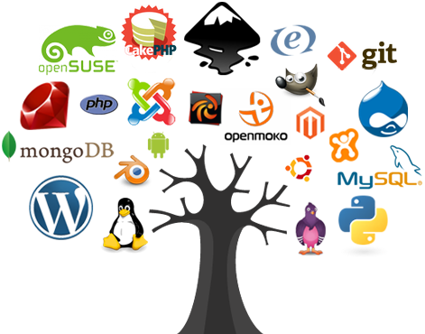

How to get involved in open source
Choose a project
        Skills Projects

Slide 13


How to get involved in open source
Choose a project
Mailing list and IRC

Slide 14
How to get involved in open source
Choose a project
Subscribe to Mailing lists and connect over IRC
Setting up an environment
    Installing the Linux distro [Ubuntu, Fedora, Debian]
    Getting the source code
    Version control systems [ex. Git]
    Setting up necessary tools

Slide 15
How to get involved in open source
Choose a project
Subscribe to Mailing lists and connect over IRC
Setting up an enviuronment
Read documentation and/or tutorials
    “Getting started with ...” docs/wikis
      ex. https://wiki.gnome.org/NewcomersTutorial
      http://www.mediawiki.org/wiki/Gerrit/Getting_started
      https://wiki.openstack.org/wiki/How_To_Contribute
      http://kernelnewbies.org/Outreachyfirstpatch
    Reading blog of developers and previous participants of
    open source internship programs
    Reading mailing list archieves and IRC logs

Slide 16
How to get involved in open source
Choose a project
Subscribe to Mailing lists and connect over IRC
Setting up an environment
Read documentation and/or tutorials
Bug trackers
    Software application that keeps track of reported software bugs in software development projects
    Common bug trackers : Bugzilla, Gerrit

Slide 17
How to get involved in open source
Choose a project
Subscribe to Mailing lists and connect over IRC
Setting up an environment
Read documentation and/or tutorials
Bug trackers
Understanding community best practices
    Project hosting site [ex. Github, GitLab]
    Mailing lists and IRC etiquetts

Slide 18
How to get involved in open source
Choose a project
Subscribe to Mailing lists and connect over IRC
Setting up an environment
Read documentation and/or tutorials
Bug trackers
Understanding community best practices
Coding -> Testing -> Discussing -> Repeat

Slide 19

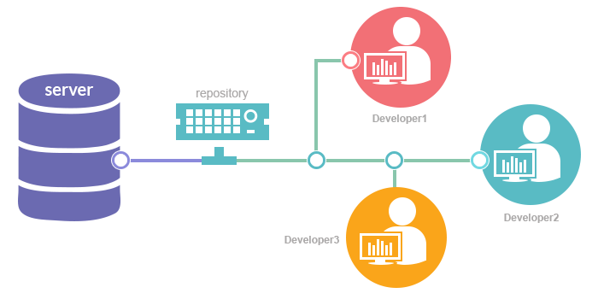
Git
Version control system
    A system that records changes to a file or set of files over time so that you can recall specific versions later

Slide 20
Git
Version control system
Developed by Linus Torvalds in 2005
    Speed
    Simple design
    Fully distributed
    Large projectr support

Slide 21
Git
Version control system
Developed by Linus Torvalds in 2005
Installation
    Debian based: “sudo apt-get install git-all”
    Yum based: “dnf install git-all” or
              “sudo yum install git-all”

Slide 22
Git
Version control system
Developed by Linus Torvalds in 2005
Installation
Setting up .gitconfig
    git config --global user.name "John Doe"
    git config --global user.email johndoe@example.com

Slide 23
Git
Version control system
Developed by Linus Torvalds in 2005
Installation
Setting up .gitconfig
Getting the source code
    Git clone <URL to git repository>

Slide 24
Git
Version control system
Developed by Linus Torvalds in 2005
Installation
Setting up .gitconfig
Getting the source code
Some common terminology and commands
    Intializing your project – git init
    What's up? - git status
    What is relevant – git add, git commit -s -v

Slide 25
Git patch
fcoe: Convert use of __constant_htons to htons
In little endian cases, the macro htons unfolds to __swab16 which provides special case for constants. In big endian cases, __constant_htons and htons expand directly to the same expression. So, replace __constant_htons with htons with the goal of getting rid of the definition of __constant_htons completely.
Signed-off-by: Vaishali Thakkar <vthakkar1994@gmail.com >
Signed-off-by: Mark Brown <broonie@kernel.org>
diff --git a/drivers/scsi/fcoe/fcoe.c b/drivers/scsi/fcoe/fcoe.c
index ec193a8..d3eb80c 100644
--- a/drivers/scsi/fcoe/fcoe.c
+++ b/drivers/scsi/fcoe/fcoe.c
@@ -364,7 +364,7 @@ static int fcoe_interface_setup(struct fcoe_interface *fcoe,
* on the ethertype for the given device
*/
fcoe->fcoe_packet_type.func = fcoe_rcv;
- fcoe->fcoe_packet_type.type = __constant_htons(ETH_P_FCOE);
+ fcoe->fcoe_packet_type.type = htons(ETH_P_FCOE);

Slide 26
Github based terminologies
Repository
Pull request
Fork
Issue
Commit
Star

Slide 27
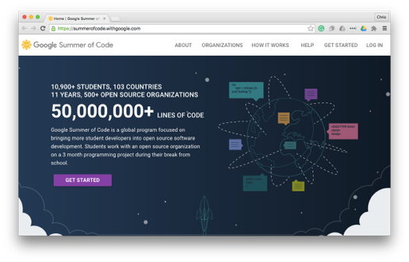
Open source internship programs
        GOOGLE SUMMER OF CODE
100+ participating organizations
Some big organizations
includes Mozilla, Wikipedia,
Linux Foundation, GNOME, KDE
Eligibility: 18+ student
5500$ stipend / 3 months, Goodies
Takes place once a year, summer only
Program site : https://summerofcode.withgoogle.com/

Slide 28
Open source internship programs
        STATICS OF GOOGLE SUMMER OF CODE
1051 total accepted students from 73 countries in 2015
India ranked first with the highest number of participants [335] in 2015
1307 total accepted students in 2014
India ranked first with highest number of participants [401]
IIIT-H was ranked first with highest number of selected students in 2015 [69] and in 2014 [62]

Slide 29
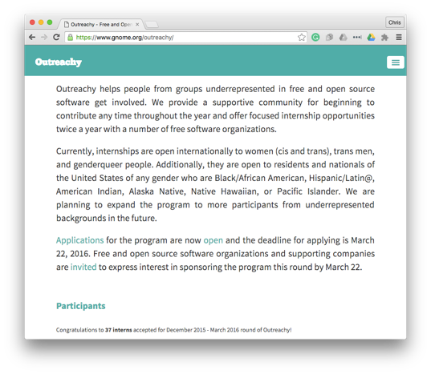
Open source internship programs
              OUTREACHY
15+ participating organizations
including Mozilla, Wikipedia,
Linux Kernel, GNOME, Openstack
Eligibility: People from
underrepresented group in
technology
5500$ stipend / 3 months, extra 500$ as a travel reimbursement
for conference
Takes place twice a year, summer and winter
Program site : https://www.gnome.org/outreachy/

Slide 30
Open source internship programs
            STATICS OF OUTREACHY
More than 280 participants participated till now
Around 45 had full session talks at FOSS conferences
Around 37 found full employment or contract positions with the
sponsoring organization
Around 30 continued to participate in GsoC either as a student or
mentor
Around 70 are working in the IT industry [half of them in the open source]
Interviews of many interns published in magazines like IT World, opensource.com, linux.com, SC magazine etc

Slide 31
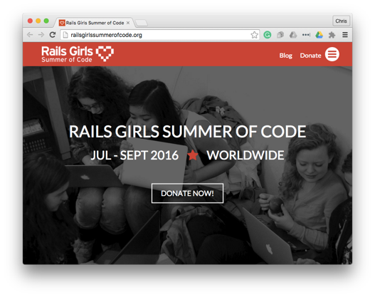
Open source internship programs
RAILS GIRLS SUMMER OF CODE
40+ participating organizations
including Apache, GitLab, Rails
etc
Aim: Getting more women in the
open source
Stipend varies based on the location, and it
mandatory to apply as a team
Takes place once a year, in a summer
Program site : http://railsgirlssummerofcode.org/

Slide 32
Open source internship programs
            STATICS OF RGSoC
Around 35 sponsored teams and 20 volunteer teams partcipated from 2013 to 1015
90% students are now working in tech, 8% students founded their startup, 55% students are still working on OSS
Teams participated from more than 23 countries
Around 86 sponsors sponsored teams [from 2013 to 2015]

Slide 33
Open source internship programs
            SOME MORE PROGRAMS
Season of KDE
Mozila winter of security
OWASP SoC
Open Daylight internship program
TOR Summer of Privacy

Slide 34
      QUESTIONS?
                Contact: http://vthakkar1994.github.io/
                @kernel_girl

Slide 35


WELCOME TO THE OPEN
SOURCE COMMUNITY

