Slide 1


Bhoj Reddy Engineering College for Women
(Sponsored by Sangam Laxmibai Vidyapeet, Accredited by NAAC with A grade approved by AICTE and affiliated to JNTUH) Vinaynagar, IS Sadan Crossroads, Saidabad, Hyderabad – 500 059, Telangana. www.brecw.ac.in
Department of Computer Science and Engineering
Mini Project Design Seminar on
AutoSeat: Smart Exam Seating System
Internal Guide: K.Shireesha Date : 11 April 2025
Associate Professor Batch No: 22MP41
CSE-B Coordinator: K.Shireesha
Associate Professor T.Ramyasree : 22321A0576
V.Ushakiran : 22321A05B7
P.Yamini : 22321A05C5
Dr B Raveendranadh Singh Dr J Madhavan
Professor & Head Professor & Principal

Slide 2
Introduction
The "Exam Seating Auto-Generation System" automates and optimizes exam seat allocation in educational institutions. It ensures fair student distribution, prevents cheating, accommodates special needs, and supports various hall layouts. Integrated with student databases, it resolves conflicts, provides smart reallocation, and offers reporting for data-driven decisions. With a user-friendly interface and strong security measures, it enhances efficiency, fairness, and compliance with regulations, making exam management seamless and scalable.

Slide 3
Scope
The Exam Seating Auto-Generation System Ensures fair student distribution, minimizes cheating, and accommodates special needs and preferences.Supports various hall layouts, integrates with student databases, and resolves seating conflicts.Provides an intuitive interface, ensures data privacy, and complies with regulations.Offers automated seat allocation, comprehensive reporting, and a structured development process for reliability.

Slide 4
Existing System
Current exam seating arrangements rely on manual methods or basic software, which are time-consuming, error-prone, and lack automation. These systems struggle with fair student distribution, cheating prevention, special needs accommodations, and conflict resolution. Limited integration with student databases and weak reporting further reduce efficiency. Overall, existing solutions are inflexible and inefficient, emphasizing the need for an advanced automated system.

Slide 5
Disadvantages of Existing System
Manual Processes: Time-consuming, error-prone, and lack automation for complex scenarios.
Limited Flexibility: Inability to support various hall layouts and configurations.
Integration Challenges: Difficulty syncing with student databases, leading to outdated information.
Conflict Resolution Issues: Weak mechanisms for handling overlapping schedules and seating preferences.
Security and Privacy Concerns: Insufficient measures to protect student data, increasing privacy risks.

Slide 6
Proposed System
The proposed system introduces automated exam seating system which will streamline seat allocation using advanced algorithms, ensuring fair distribution, reducing administrative workload, and minimizing cheating. It will support various hall layouts for flexible adjustments and integrate seamlessly with student databases to maintain accurate information and accommodate special needs. The system will detect and resolve conflicts like overlapping schedules and seating preferences through alerts and reallocation suggestions.

Slide 7
Advantages of Proposed System
Increased Efficiency: Automation reduces manual effort, minimizes errors, and speeds up seat allocation.
Fair Distribution: Ensures equitable student placement, reducing cheating opportunities.
Accurate Data Management: Integrates with student databases for up-to-date seating information.
Effective Conflict Resolution: Identifies and resolves scheduling and seating conflicts efficiently.
Enhanced Security: Protects student data with robust privacy measures.
Scalability: Adapts to different exam hall sizes and student numbers.

Slide 8
1. Admin:
Requirement Analysis
Functional Requirements:
Login
Manage Classes
Manage students
Manage Rooms
Manage Allotment
Logout
Login
View Allocation
2. Student:

Slide 9
Requirement Analysis
Non-Functional Requirements:
Security: Ensures secure access with role-based authentication, encryption, and compliance with privacy laws.
Scalability: Capable of handling a large number of students, exams, and halls without performance issues.
Reliability: Must function smoothly during peak exam periods without crashes or data loss.
Performance: Should be fast and responsive, enabling quick seat allocations, conflict detection, and report generation.
Data Integrity: Ensures accuracy of seating assignments and prevents unauthorized modifications.

Slide 10
Hardware Requirements:
Computational Resources
Software Requirements:
Operating System : Windows 11
Database : MySQL
Front-end : HTML , CSS
Back-end : PHP
Processor : Ryzen 7
Ram : 16.0 GB
Hard disk : 512 GB

Slide 11
Design
Design represents the number of components we are using as a part of the project and the flow of request processing i.e., what components in processing the request and in which order.An architecture description is a formal description and representation of a system organized in a way that supports reasoning about the structure of the system.

Slide 12
Software Architecture
Admin
Login
Manage classes
Manage Students
Manage Rooms
Manage Allotment
Logout
Database
Login
View Allotment
Student

Slide 13
Technical Architecture
HTML
CSS
PHP
MySQL

Slide 14
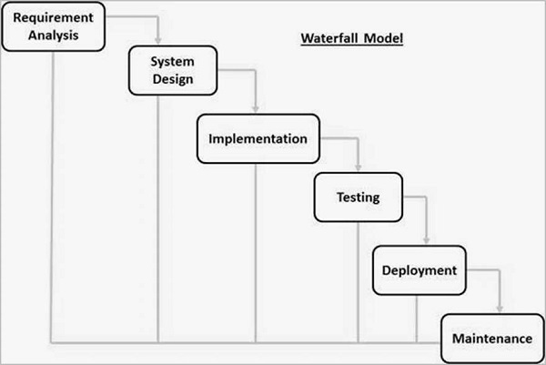
Software Process Model
Waterfall Model

Slide 15
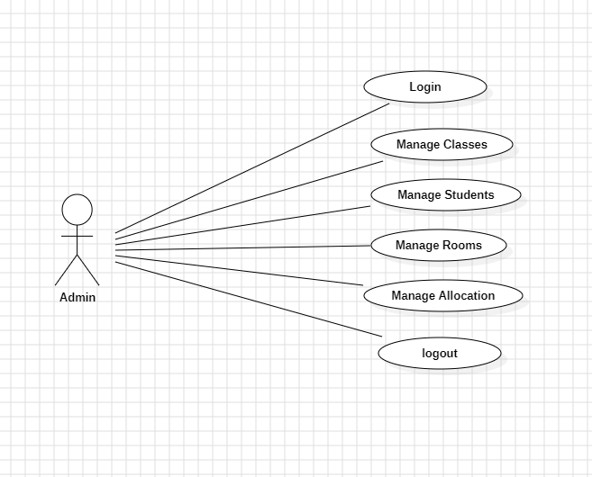
UML DIAGRAMS
USE CASE DIAGRAM:
Use Case diagram for Admin

Slide 16
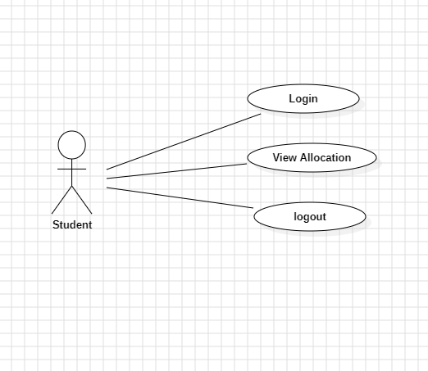
USE CASE DIAGRAM:
Use Case diagram for Student

Slide 17
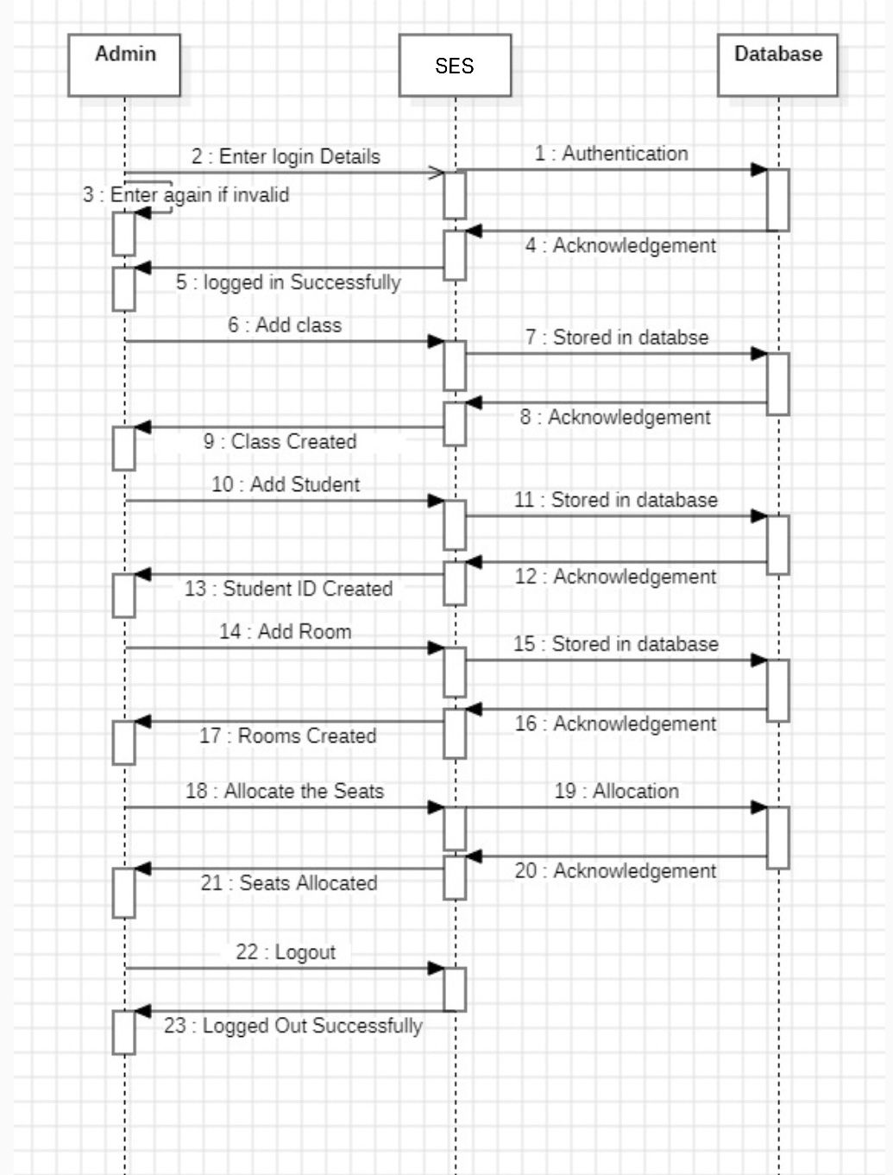
SEQUENCE DIAGRAM:
Sequence diagram for Admin

Slide 18
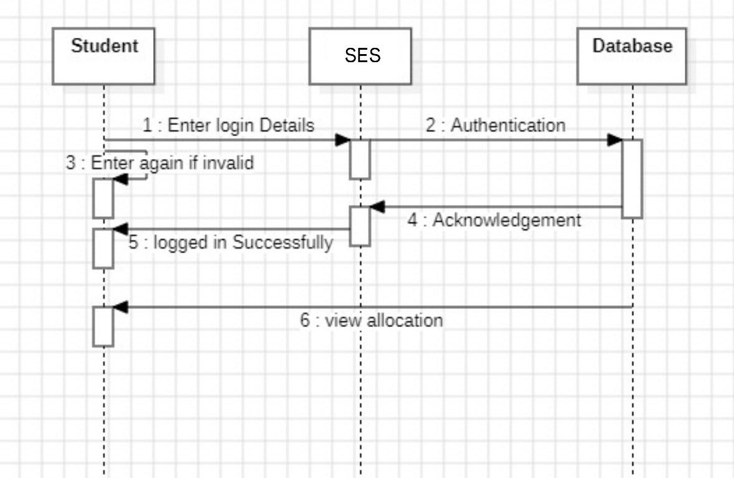
SEQUENCE DIAGRAM:
Sequence diagram for Student

Slide 19
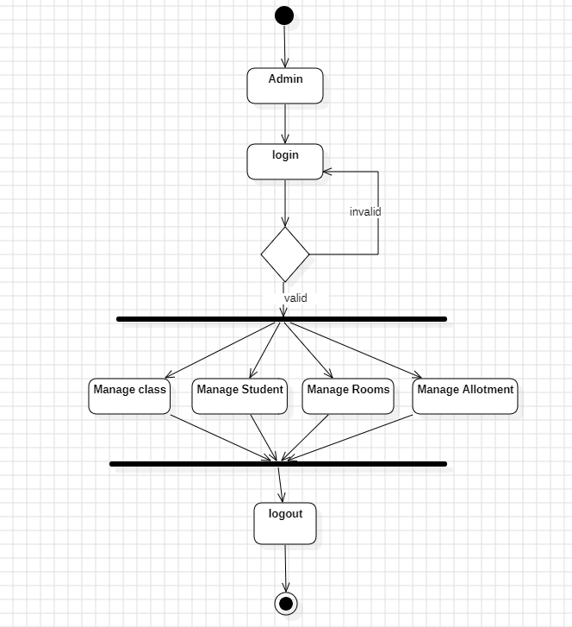
ACTIVITY DIAGRAM:
Activity Diagram for Admin

Slide 20
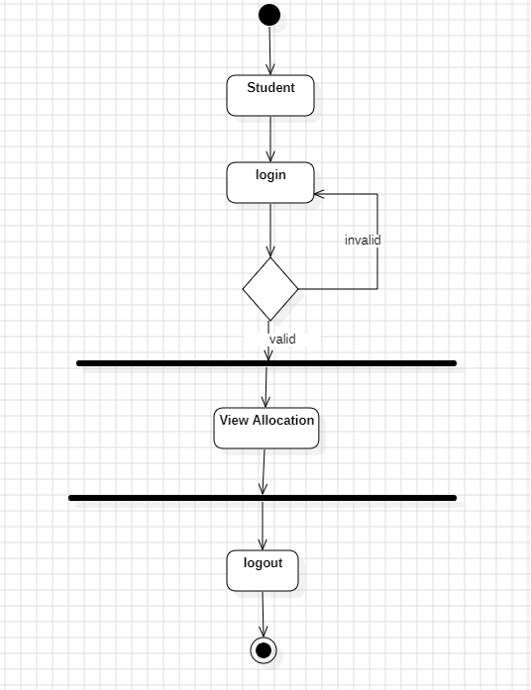
ACTIVITY DIAGRAM:
Activity Diagram for Student

Slide 21
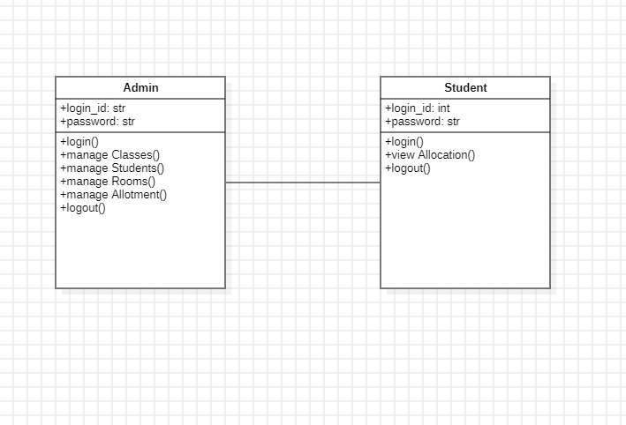
CLASS DIAGRAM:

Slide 22
Expected Output

Slide 23
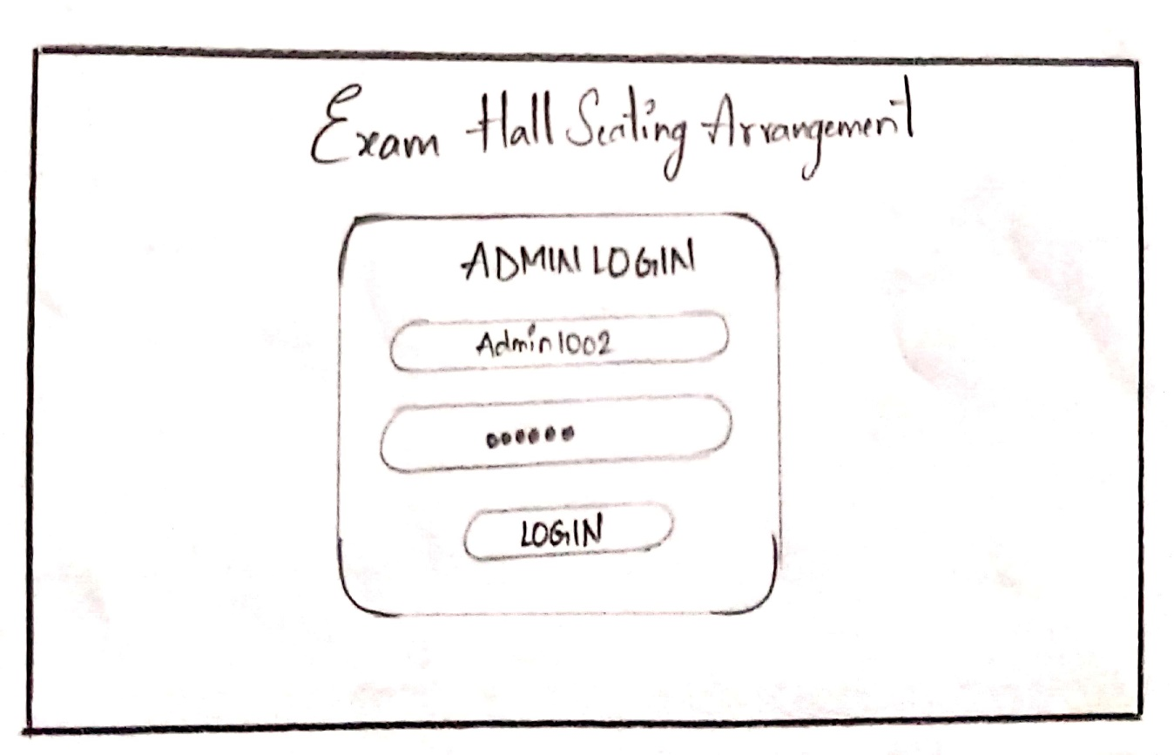
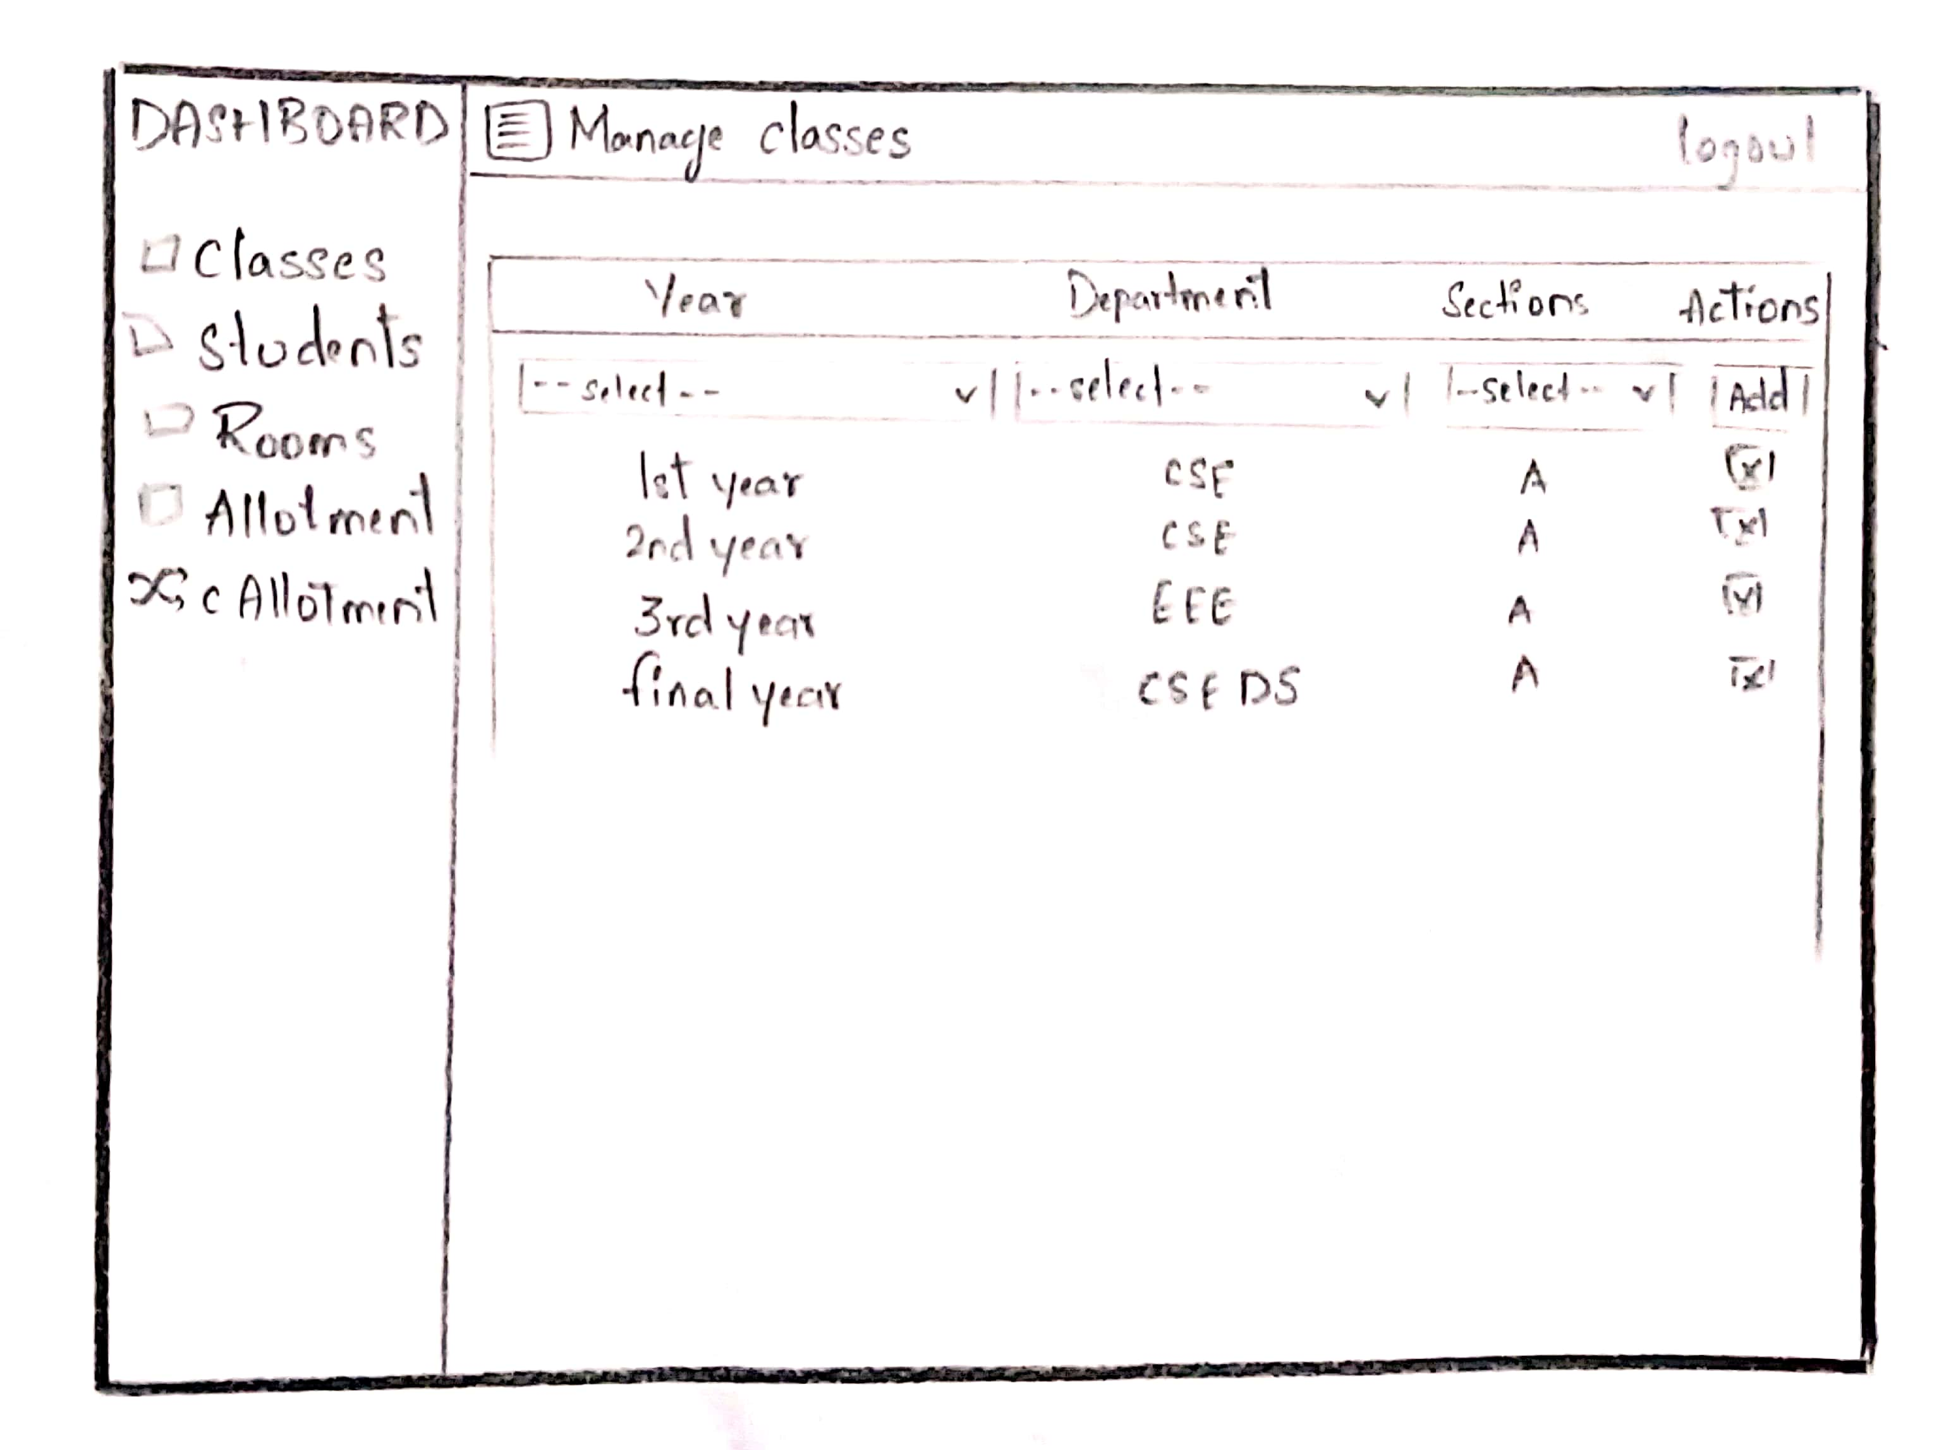
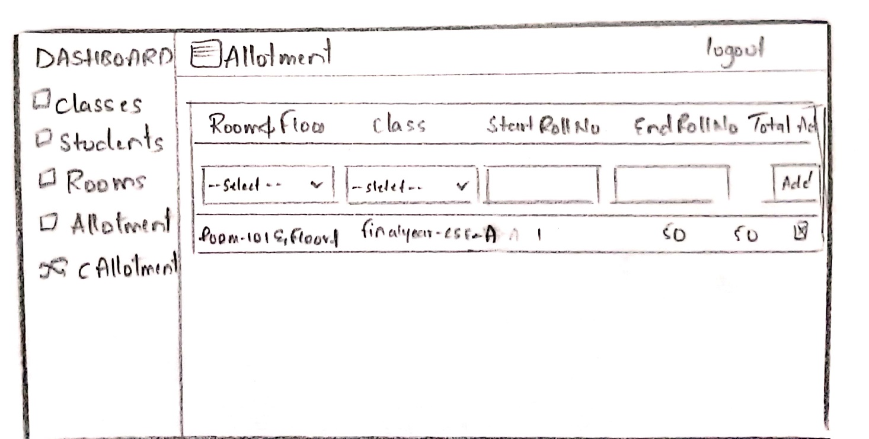
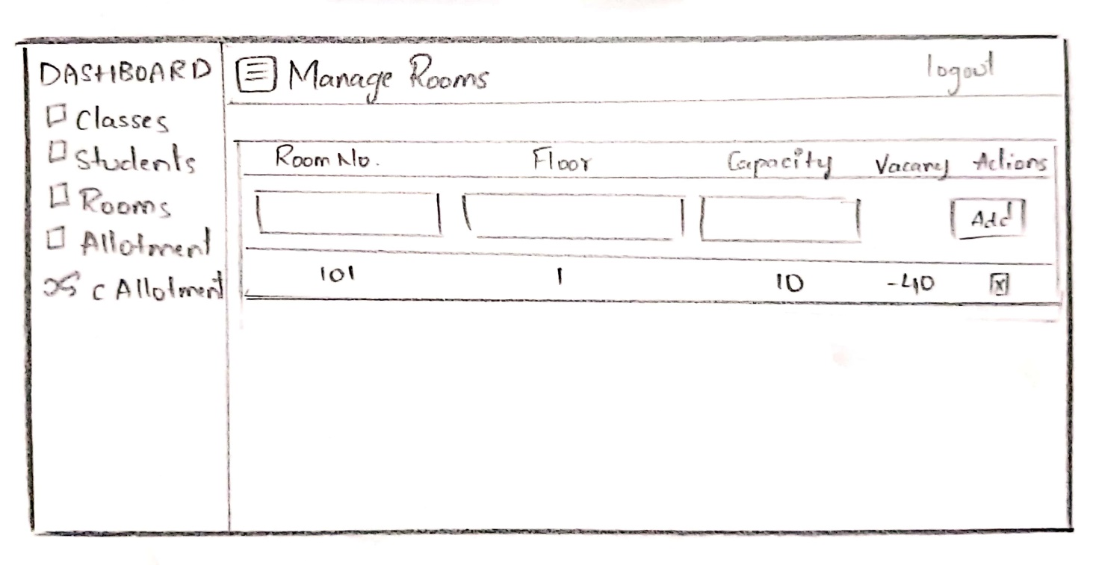

Slide 24
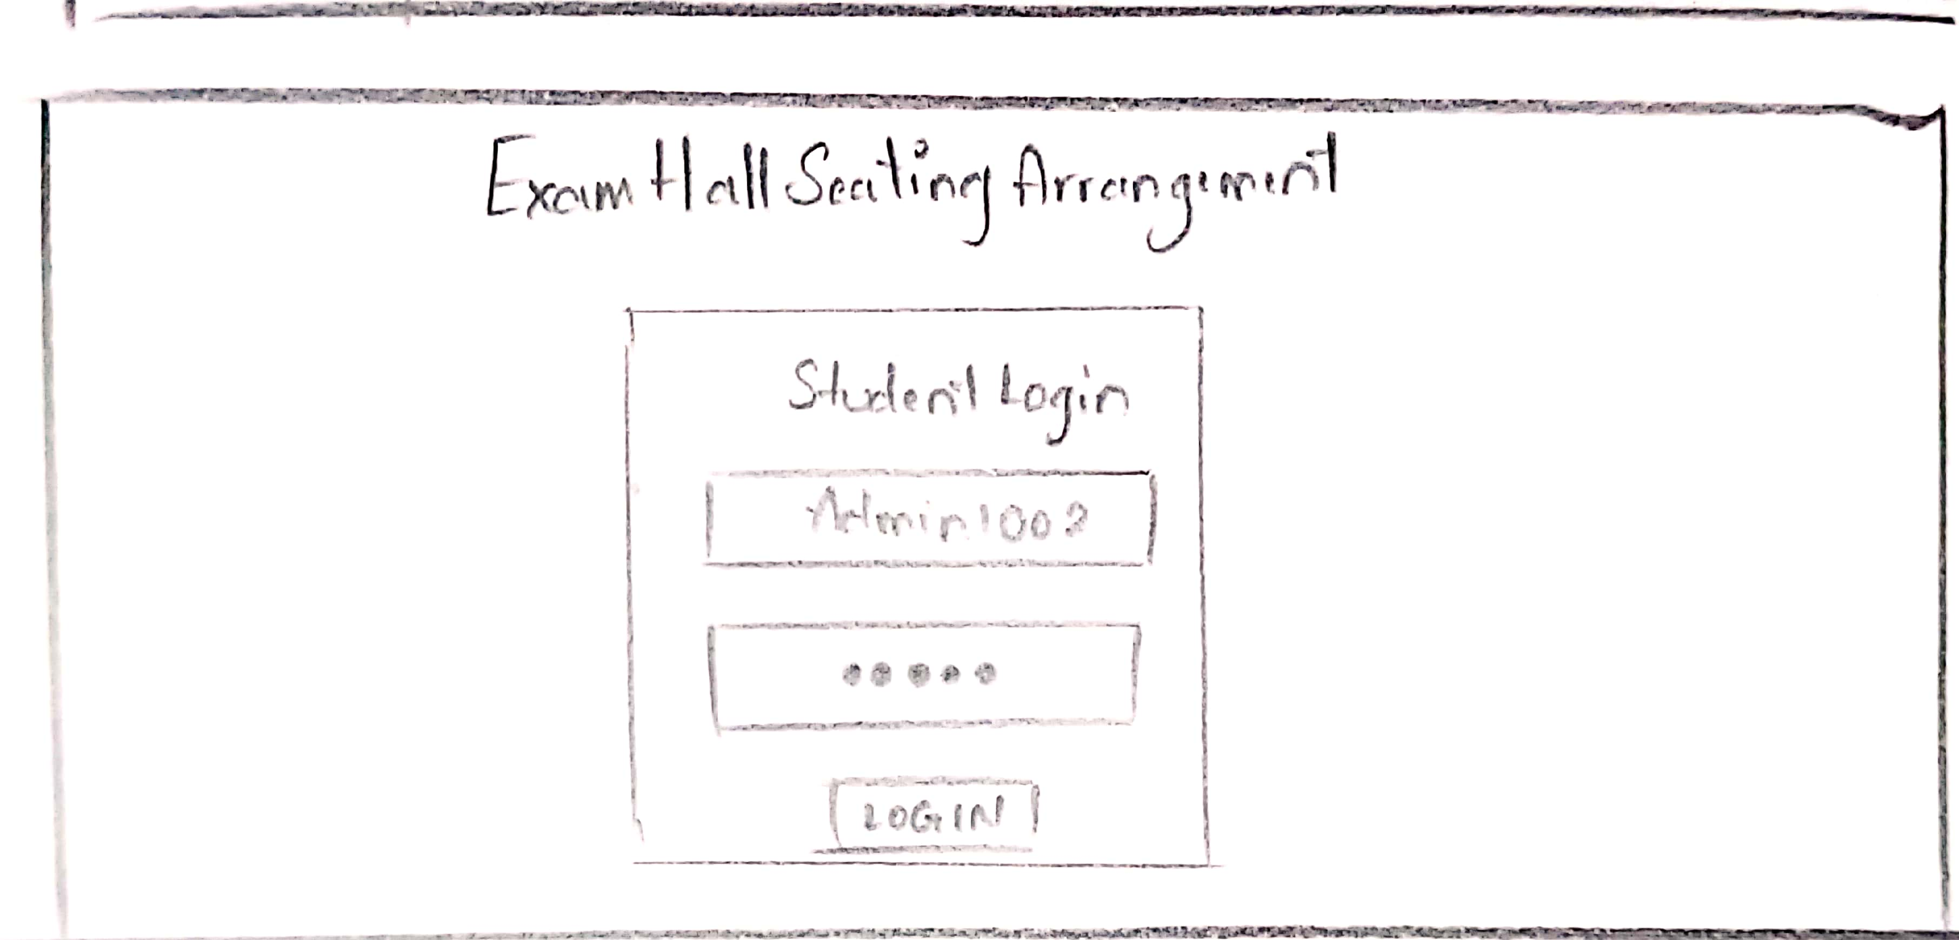
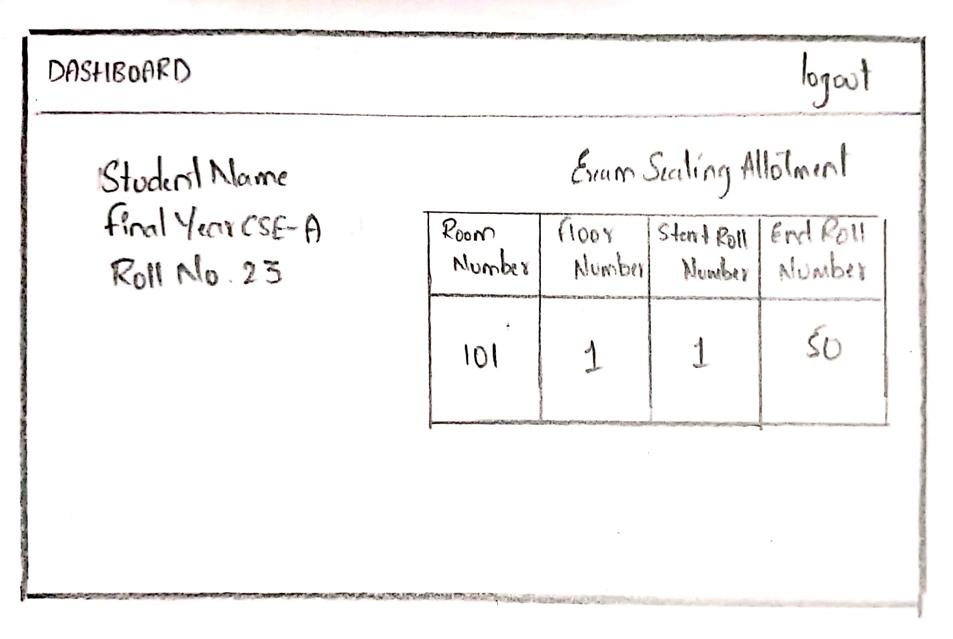

Slide 25
CONCLUSION
The "Exam Seating Allocation System" successfully addresses the challenges associated with manual exam seating arrangements by automating the process, thereby enhancing efficiency, accuracy, and ease of use. Also the system ensures reliable and secure performance. This project not only streamlines the allocation of seats based on predefined rules and constraints but also provides a user-friendly interface for both administrators and students. The comprehensive testing process has validated the system's robustness, usability, and compliance with specified requirements, making it a dependable tool for educational institutions.

Slide 26
References
Kishore, A. N. Sasireka, & Vijay. K (2021). Design and Development of Enhanced Exam Hall Seating Arrangement Automation System. International Journal of Innovative Technology and Exploring Engineering (IJITEE), DOI:10.17762/ITII.V9I2.418.
Vidyashree B. P., Azadar Hussain, Harsha Kumar Gowda D. K., Karthik S., & Kshithij Bharadwaj K. V. (2023). Automatic Exam Seating Arrangement System. International Journal of Engineering Research and Technology (IJERT), e-ISSN: 2582-5208.
Sankari, G. R., Jenisha, R., Mary, X., Haritha, K., & Pushparaj, D. J. (2020). Exam Seating Arrangement. International Journal of Advanced Research Trends in Engineering and Technology (IJARTET), Vol. 7, Issue 7.

Slide 27
THANK YOU !

