Slide 1
Microarchitectural Side-Channel Attacks Part 2
Yuval Yarom
The University of Adelaide and Data61

Slide 2
X86 L1 Cache
12 11
6 5
0
Tag
Set
Offset
Stores fixed-size (64B) lines
Arranged as multiple (64) sets, each consisting of multiple (8) ways.
Each memory line maps to a single cache set
Bits 6-11 select the set
Can be cached in any of the ways in the set
 |  |  | Tag, Data
Sets
Ways

Slide 3
X86 L1 Cache
Better visualised when the cache is rotated
Memory
Sets
Cache
Ways

Slide 4
Prime+Probe [OST05, Per05]
Attacker chooses a cache-sized memory buffer
Attacker accesses all the lines in the buffer, filling the cache with its data
Victim executes, evicting some of the attackers lines from the cache
Attacker measures the time to access the buffer
Accesses to cached lines is faster than to evicted lines
Memory
Cache

Slide 5
The gritty details
The observer effect
Our code uses the cache - want to minimise our footprint
The optimising compiler removes what it thinks is dead code
Not optimising increases the code's footprint
Solution:
Know your optimiser
Use assembly language

Slide 6
Thrashing
The cache uses a Pseudo-LRU replacement
Our probe + victim access can cause thrashing
Solution [TOS10]: Zig-zag on data
S₀
S₀
S₁
S₇
V₀
S₁
S₂
S₃
S₄
S₅
S₆
S₆
S₇

Slide 7
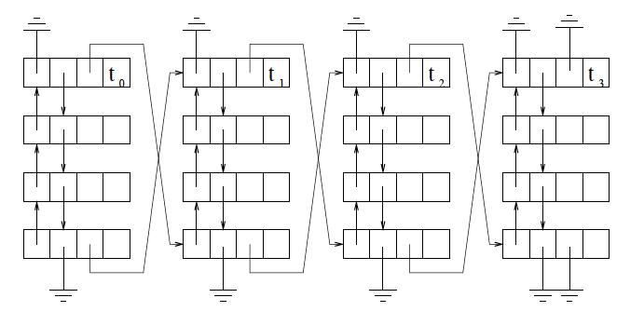
Hardware prefetcher
Aims to improve temporal locality
Brings data to the cache before it is required
We do not want that!!!
Solution [TOS10]: pointer chasing
[Per05] uses data dependency for achieving the same result

Slide 8
Data streams
The cache aims to predict regular access patterns with fixed strides
Linear access within a page may trigger the mechanism
Solution [OST10]: Randomise order of probed sets

Slide 9
Putting it all together
L1-capture
With L1-rattle
With rungnupg

Slide 10
Challenges to last-level cache attacks
Difficulty in finding memory lines that map to a given cache set
Virtual memory
LLC slices
Large cache size and longer cache access times mean LLC Prime+Probe is very slow
Visibility of the victim memory access at the LLC
Intel inclusive cache takes care of the issue

Slide 11
Virtual vs. Physical addresses
Phys. Memory
?
Virt. addresses
In L1, the cache stride is the same as the page size (4KiB)
The cache set is completely determined by the page offset
Cache

Slide 12
Addressing uncertainty
Phys. Memory
Virt. addresses
In larger caches, the stride is bigger. Pages only contain lines of some of the cache sets.
Parts of the mapping of memory to cache sets is masked by the virtual address.
Cache

Slide 13
Address fields
12 11
6 5
0
Tag
Set
Offset
L1 Cache
12 11
0
Page number
Page offset
Virtual address
17 16
6 5
0
Tag
Set
Offset
LLC SandyBridge
16 15
6 5
0
Tag
Set
Offset
LLC Skylake

Slide 14
Addressing uncertainty
Phys. Memory
Virt. addresses
Missed victim access
The attacker cannot guarantee an even cover of the cache.
Self-contention
Cache

Slide 15
Solution : Use large pages [LYG+15,IES15]
12 11
6 5
0
Tag
A feature of the MMU. Large pages (2MiB or bigger) reduce the overhead of address translation
Set
Offset
L1 Cache
12 11
0
Page number
Page offset
Virtual address
17 16
6 5
0
Tag
Set
Offset
LLC SandyBridge
16 15
6 5
0
Tag
Set
Offset
LLC Skylake
21 20
0
Large page number
Large page offset
Virtual address

Slide 16
Solution – large pages
Phys. Memory
Virt. addresses
Cache

Slide 17
Intel LLC Slices
17 16
6 5
0
Tag
Set
Offset
LLC SandyBridge
Hash
The last-level cache is divided into slices
One slice per core
Two in Skylake?
The slice for a memory line is chosen using an undisclosed hash function

Slide 18
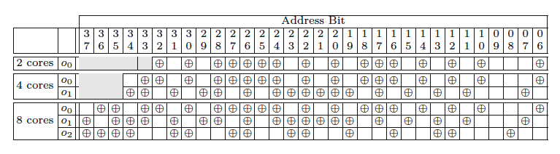
Reverse Engineering the Hash Function
[MLN+15] Use performance counters to RE linear hash functions (number of cores is a power of two)

Slide 19
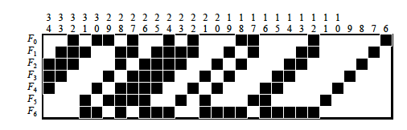
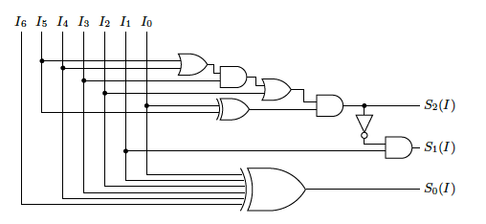
Reverse Engineering the Hash Function
[YGL+15] use timing to RE the function for 6 cores

Slide 20
Reverse Engineering the Hash Function
[MLN+15] Use performance counters to RE linear hash functions (number of cores is a power of two)
[YGL+15] use timing to RE the function for 6 cores
But – need physical addresses
Can be done on Linux < 4.0
Unless running in a VM

Slide 21
Probing the hash function
Start with a set of potentially conflicting memory lines
At least twice as many as the totalsize of the cache sets
Expand a subset until it conflicts on a single set in a single slice
Contract the subset until it contains only lines of the conflicted set
Collect all of the lines of the conflicting set from the original set
Repeat until the original set is (almost) empty

Slide 22
Expand
Start from an empty subset
Iteratively add lines to the subset as long as there is no self-eviction
Self-eviction is detected by priming a potential new member, accessing the current subset and timing another access to the potential new member
🙂
🙂
😈
🤔
😡
🙂
🙂
🙂

Slide 23
Contract
Iteratively remove lines from the subset checking for self-eviction
Only keep members if self-eviction disappears when removed
🙂
🙂
😈
🤔
🙂
🙂
🙂

Slide 24
Collect
Scan original set, looking for members that conflict with the contracted subset
😇
😇
😇
😇
😇
😇
🙂
🙂
🙂
🙂
🙂
🙂
🙂
🤕
🤕
🤕
🤕
🤕
😍
😍
😍
😍
😍
😍
😍
😍

Slide 25
Demo
L3-capture
L3-capturecount

Slide 26
Slow LLC Prime+Probe times
L1 (32KB) probe:
64 sets * 8 ways *4 cycles = 2,048 cycles
Small last-level cache (6MB):
8,192 sets * 12 ways * ~30 cycles = ~3,000,000 cycles
We cannot probe the entire LLC in a reasonable time, but probing one cache set is fast
Our solution:
Probe one or a few cache sets at a time
Look for temporal patterns rather than spatial footprints

Slide 27
Demo
L3-scan

Slide 28
Countermeasures
Hardware
System
Software

Slide 29
Hardware countermeasure
Don't share
Hardware cache partitioning [DJL+12]
Intel Cache Allocation Technology
Cache Randomisation [WL06]

Slide 30
System Countermeasures
Limited sharing
Don't share memory
Don’t share cores
Cache Colouring [BLRB94,SSCZ11]
STEALTHMEM [KPM12]
CATalyst [LGY+16]
CacheBar [ZRZ16]

Slide 31
Software Countermeasures
Constant-time programming
No variable-time instructions
No secret-dependent flow control
No secret-dependent memory access

Slide 32
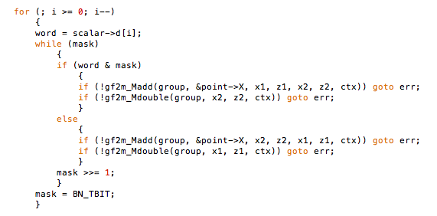
Non constant-time [YB14]

Slide 33
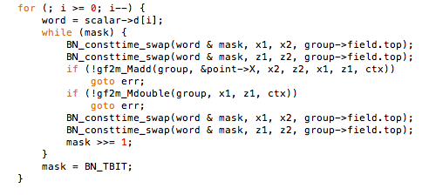
Constant-time

Slide 34
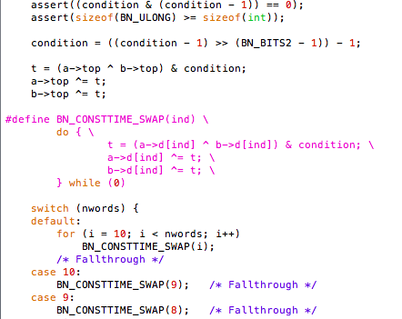
Constant-time

Slide 35
Bibliography
[ABF+15] T. Allan, B. B. Brumley, K. Falkner, J. van de Pol and Y. Yarom, "Amplifying Side Channels Through Performance Degradation", ePrint 2015/1141
[AK09] O. Acıiçmez, Ç. K. Koç, "Microarchitectural Attacks and Countermeasures," in Ç. K. Koç, ed. Cryptographic Engineering, Springer US, 2009
[AS07] O. Acıiçmez and J-P Seifert, "Cheap Hardware Parallelism Implies Cheap Security", FDTC 2007
[Ber05] D. J. Bernstein, "Cache-timing attacks on AES", http://cr.yp.to/antiforgery/cachetiming-20050414.pdf, 2005
[DJL+12] L. Domnister, A. Jaleel, J, Loew, N. Abu-Ghazaleh and D. Ponomarev, "Non-Monopolizable Caches: Low-Complexity Mitigation of Cache Side Channel Attacks", TACO 8(4), 2012
[GBK11] D. Gullasch, E. Bangerter and S. Krenn, "Cache Games -- Bringing Access-Based Cache Attacks on {AES} to Practice", IEEE S&P 2011
[GYCH16] Q. Ge, Y. Yarom, D. Cock and G. Heiser, "A Survey of Microarchitectural Timing Attacks and Countermeasures on Contemporary Hardware", ePrint 2016/613
[GMWM16] D. Gruss, C. Maurice, K. Wagner and S. Mangard, "Flush+Flush: A Fast and Stealthy Cache Attack", DIMVA 2016
[GSM15] D. Gruss , R. Spreitzer and S. Mangard, "Cache Template Attacks: Automating Attacks on Inclusive Last-Level Caches", USENIX Security 2015
[IES15] G. Irazoqui, T. Eisenbarth and B. Sunar, "S$A: A Shared Cache Attack that Works Across Cores and Defies VM Sandboxing – and its Application to AES", IEEE S&P 2015.
[IES16] G. Irazoqui, T. Eisenbarth and B. Sunar, "Cross processor cache attacks", AsiaCCS 2016
[IIES14] G. Irazoqui, M. S. Inci, T. Eisenberth and B. Sunar, "Wait a minute! A fast, Cross-VM Attack on AES", RAID 2014
[Lam73] B. W. Lampson, "A Note on the Confinement Problem", CACM 16(10), 1973
[LYG+15] F. Liu, Y. Yarom, Q. Ge, G. Heiser and R. B. Lee, "Last-Level Cache Side-Channel Attacks are Practical", , IEEE S&P 2015
[MLN+15] C. Maurice, N. Le Scourance, C. Neumann, O. Heen and A. Francillon, "Reverse Engineering Intel Last-Level Cache Complex Addressing Using Performance Counters", RAID 2015
[NS16] M. Neve and J-P Seifert, "Advances on access-driven cache attacks on AES," 13th SAC, 2006

Slide 36
Bibliography
[OST06] D. A. Osvik, A. Shamir and E. Tromer, "Cache Attacks and Countermeasures: The Case of AES", CT-RSA 2006
[pag02] D. Page, "Theoretical Use of Cache Memory as a Cryptanalytic Side-Channel," ePrint 2002/169
[Pag03] D. Page, "Defending against cache-based side-channel attacks," Information Security Technical Report, 8(1), 2003
[Per05] C. Percival, "Cache Missing for Fun and Profit", BSDCan, 2005
[PGM+16] P. Pessl, D. Gruss, C. Maurice, M. Schwarz and S. Mangard, "DRAMA: Exploiting DRAM Addressing for Cross-CPU Attacks", USENIX Security 2016
[TOS10] E. Trome, D. A. Osvik, A. Shamir, "Efficient Cache Attacks on AES, and Countermeasures", JoC 23(1), 2010
[TTMM02] Y. Tsunoo, E. Tsujihara, K. Minematsu and H. Miyauchi, "Cryptanalysis of Block Ciphers Implemented on Computers with Cache", International Symposium on Information Theory and Its Applications, Oct. 2002.
[WL06] Z. Wang and R. B. Lee, "Covert and Side Channels Due to Processor Architecture", ACSAC 2006
[WS12] Y. Wang and G. E. Suh, "Efficient timing channel protection for on-chip networks", NoCS 2012.
[WXW12] Z. Wu, Z. Xu and H. Wang, "Whispers in the Hyper-space: High-speed Covert Channel Attacks in the Cloud", USENIX Security 2012
[YB14] Y. Yarom and N. Benger, "Recovering OpenSSL ECDSA Nonces Using the FLUSH+RELOAD Cache Side-channel Attack", ePrint 2014/140
[YF14] Y. Yarom and K. Falkner, "FLUSH+RELOAD: a High Resolution, Low Noise, L3 Cache Side-Channel Attack", USENIX Security 2014
[YGH16] Y. Yarom, D. Genkin and N. Heninger, "CacheBleed: A Timing Attack on OpenSSL Constant Time RSA", CHES 2016
[YGL+15] Y. Yarom, Q. Ge, F. Liu, R.B. Lee and G. Heiser, "Mapping the Intel Last-Level Cache", ePrint 2015/905
[ZXZ16] X. Zhang, Y. Xiao and Y. Zhang "Return-Oriented Flush-Reload Side Channels on ARM and Their Implications for Android Devices", CCS 2016

