Slide 1
Bankers team (Receipt bank problem)
Valentin Zmiycharov (valentin.zmiycharov@gmail.com)
Plamen Hristov (hristov.reading@gmail.com)
Pavel Nikolov (pavelnnikolov@gmail.com)
Nikolay Marinov (nikolay.marinov@sciant.com)

Slide 2
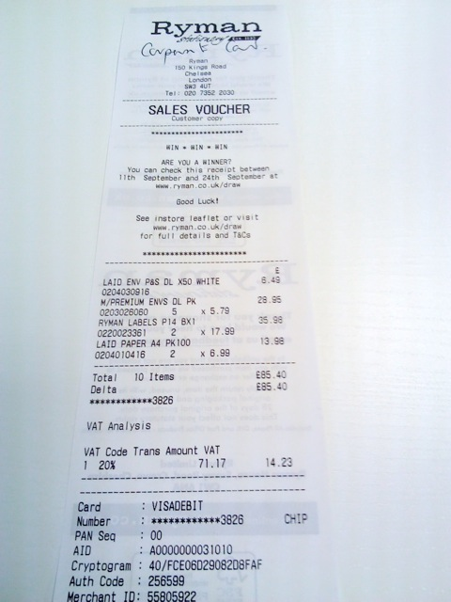
The tasks
What is the currency?
What is the total price?
Who is the supplier?

Slide 3
Total amount approach
Extract all the prices in each receipt
Extract some features for each price
TF-IDF on surrounding text
Count of digits on the price line
Order by occurance in the receipt
Order by value in the receipt
Can be sum of other prices
Train binary classifier -> Is total price or not?
Calculate probability for each price in the receipt
Select the one with the highest probability

Slide 4
Achieved results for total price
TOP 1 Accuracy: 0.544
TOP 2 Accuracy: 0.607

Slide 6
Thank you!
Q&A

